Slide 1
MEDICAL ROBOTICS — MASTER'S PROJECT
Multi-RCM Kinematic Control for a ROSA-like Surgical Robot
A Unity simulation of double Remote-Center-of-Motion control
Samuele Civale · Medical Robotics, 2026
Notes:
Good morning. Today I'll present a Unity-based simulation of a ROSA-like surgical robot implementing double Remote-Center-of-Motion control, inspired by Aghakhani et al., ICRA 2013. I'll walk through the clinical motivation, the controller, the simulation, and the validation evidence -- all from data I logged and analyzed myself.

Slide 2
01 — MOTIVATION
One Entry Point. Zero Lateral Force.
Stereotactic neurosurgery inserts a rigid tool through a single skull opening toward a deep target.
Entry
Any sideways force at that opening risks tissue damage.
Target
MOTIVATION
02 / 17
Notes:
In minimally invasive neurosurgery -- biopsy, electrode placement -- the surgeon plans one entry point and one deep target from imaging. The instrument must pass through that entry point without levering against the skull. This single constraint is the whole motivation for what follows.

Slide 3
02 — CONCEPT
A Pivot Point That Isn't Physically There
λ-point (RCM)
p_RCM(q, λ) = p_base(q) + λ · L · z(q)
λ slides the RCM point along the tool shaft as insertion depth changes.
CONCEPT
03 / 17
Notes:
An RCM is a virtual pivot -- the tool axis always passes through it, even though no mechanical hinge exists there. Here it's realized purely through control: lambda is a scalar that slides a point along the needle shaft, and the controller forces that point to coincide with the entry marker.

Slide 4
03 — WHY IT MATTERS
Constraining the Pivot Changes Everything
✕
✓
Without RCM
With RCM
Shaft levers against the entry point as the arm reconfigures → lateral tissue load at the skull surface.
Tip reaches the target while the shaft pivots cleanly through the entry point, simultaneously.
WHY IT MATTERS
04 / 17
Notes:
Without an RCM constraint, nothing stops the shaft from pushing sideways against the skull as the arm reconfigures. With the RCM formulated as an extra task stacked alongside the tip task, the robot reaches the target and keeps the pivot locked at the entry simultaneously -- this project adds a twist: in some modes the effective RCM is relocated to the target itself, the double-RCM idea in the title.

Slide 5
04 — OVERVIEW
Project at a Glance
6
4
1
9 / 9
DOF procedural arm
Task modes
Controller, built from scratch
Validation checks passed
OVERVIEW
05 / 17
Notes:
Before going into detail, here's the project in four numbers: a procedural six-degree-of-freedom ROSA-like arm, four selectable task modes, one hand-written damped-least-squares controller -- no external IK library -- and nine out of nine automatic validation checks passed on the logged session, which I'll detail later.

Slide 6
05 — TASKS
Four Tasks, One Controller
●
Task 1
◆
Task 2
Entry-RCM + Tip Target
Target-RCM + Entry-Side Cone
▣
Task 3
◐
Task 4
Insertion Sequence (main task)
Entry-RCM + Tip Cone Around Target
TASKS
06 / 17
Notes:
All four modes are implemented in the current controller -- I verified this directly in the code, not just in old plots. Task 1 and Task 3 both anchor the RCM at the entry; Task 2 and Task 4 explore a cone of motion around a pivot, with the pivot location swapped between the two. Task 3 is the realistic surgical sequence and the one I'll detail next.

Slide 7
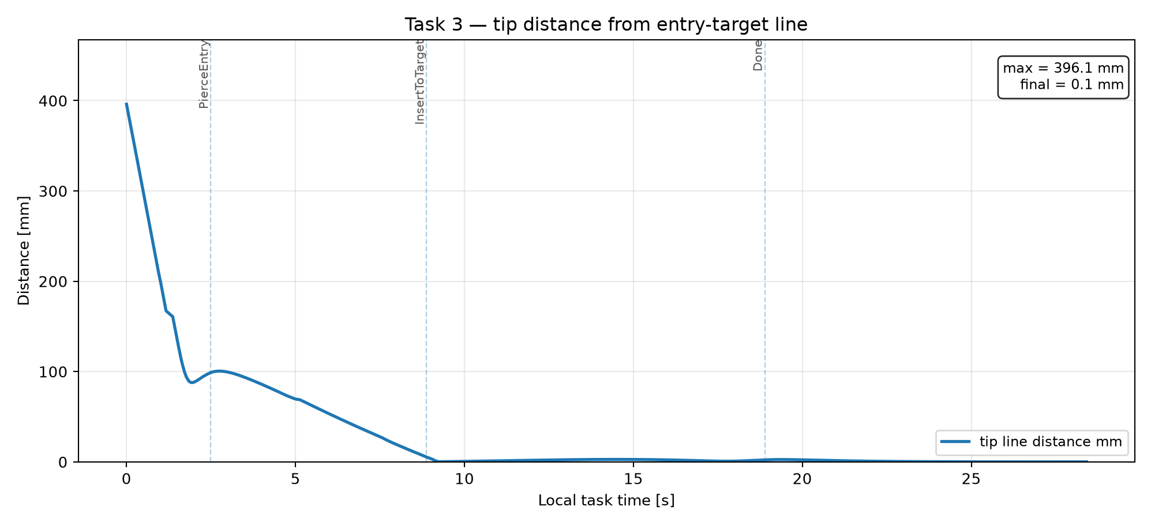
06 — MAIN TASK
Inside Task 3: The Insertion Sequence
ApproachEntry
PierceEntry
InsertToTarget
Align needle axis, approach outside the trocar
Tip travels to the entry point (RCM not yet active)
RCM locked at entry — tip advances to target
Tip-to-corridor distance collapses to ~0 mm once insertion begins.
MAIN TASK
07 / 17
Notes:
Task 3 is a three-phase state machine mirroring the clinical sequence: align and approach, pierce the trocar, then insert with the RCM constraint active. The plot underneath shows the tip's distance from the planned straight entry-target line: it starts near 400 mm while the arm is still approaching, then collapses to essentially zero once the tip reaches the trocar -- meaning the needle travels along the planned corridor, not an arbitrary path.

Slide 8
07 — CONTROLLER
Controller Architecture
Stacked Tasks
Damped Least Squares
Null-space Correction
Velocity Output
Tip / cone / RCM tasks stacked into one Jacobian
Custom Gauss–Jordan solve
Joint limits, λ target, secondary objectives
Saturated joint + λ̇ velocities, integrated
Jacobians computed by numerical finite differencing.
CONTROLLER
08 / 17
Notes:
Every control step stacks the active point-tasks -- tip, cone, RCM -- into one Jacobian and solves it with a damped least-squares pseudoinverse implemented from scratch with a Gauss-Jordan solver. A null-space term is projected into the task Jacobian's kernel to bias the solution toward keeping joints centered and lambda near its target, without disturbing the primary tasks. Jacobians themselves are computed numerically, a deliberate simplicity trade-off that keeps the DH table easily replaceable.

Slide 9
08 — CONTROLLER (MATH)
The Control Law, in Full
Stacked task Jacobian
Per-task error → velocity
[ ẋ_task ] [ J_task 0 ] [ q̇ ]
[ ẋ_RCM ] = [ J_RCM ] [ λ̇ ]
ẏ_i = K_i · (x_des,i − x_i), saturated
Damped least-squares solve
Null-space secondary objective
[ q̇ ; λ̇ ] = Jᵗ (J Jᵗ + μ²I)⁻¹ y
+ (I − J⁺J) · w
w: joint limits, λ target
Integration (saturated): q_{k+1} = clamp(q_k + q̇·Δt) · λ_{k+1} = clamp(λ_k + λ̇·Δt, 0.02, 0.995)
CONTROLLER (MATH)
09 / 17
Notes:
Here is the control law in full. The active point tasks -- tip, cone, RCM -- are stacked into one Jacobian, each weighted by a gain and clamped error. The stacked system is solved with a damped least-squares pseudoinverse: q-dot and lambda-dot equal J-transpose times the inverse of J J-transpose plus mu-squared identity, times the desired task velocity y. A null-space term is then projected into the kernel of J and added on top to bias the solution toward keeping joints centered and lambda near a target value, without disturbing the primary tasks. Finally, both joint and lambda velocities are saturated before being integrated forward in time. Every piece of this is implemented from scratch in C#, with no external IK or optimization library.

Slide 10
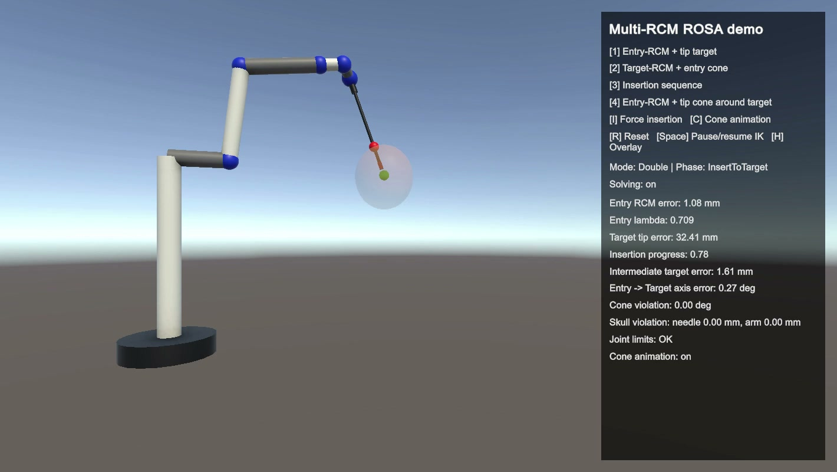
09 — IMPLEMENTATION
Built in Unity — Three Scripts
▣
Project4SceneBuilder.cs — builds the scene procedurally
▣
ROSADoubleRCMController.cs — kinematics, control law, logging
▣
FreeFlyCameraKeyboard.cs — keyboard fly-camera
Simulation view: procedural arm, needle, target marker, live HUD. (Captured from an earlier development build.)
IMPLEMENTATION
10 / 17
Notes:
The entire scene is generated at runtime from a single script, rather than hand-built in the editor, which keeps the project self-contained. The controller script does everything robot-related: kinematics, the control law, the insertion state machine, the on-screen overlay, and CSV logging. A separate, independent script provides a keyboard fly-camera for free inspection during recording. The screenshot is from an earlier development build, but the robot, needle, and marker visualization are representative of the current scene too.

Slide 11
10 — METHODOLOGY
From Simulation to Evidence
Unity Controller
Python Analyzer
Plots + Tables
Live CSV log ~20 Hz, every relevant variable
analyze_rcm_logs_clean.py one metric per plot
Thresholded plots + pass_fail_checks.csv
METHODOLOGY
11 / 17
Notes:
Validation here is data-driven. The controller logs every relevant quantity to CSV at about 20 hertz while running. A Python pipeline -- the clean analyzer, written specifically to replace an earlier version that crammed every error into one unreadable chart -- turns that log into one focused, thresholded plot per metric, plus summary tables. The plots in this deck are reused directly from that pipeline's output, not redrawn.

Slide 12
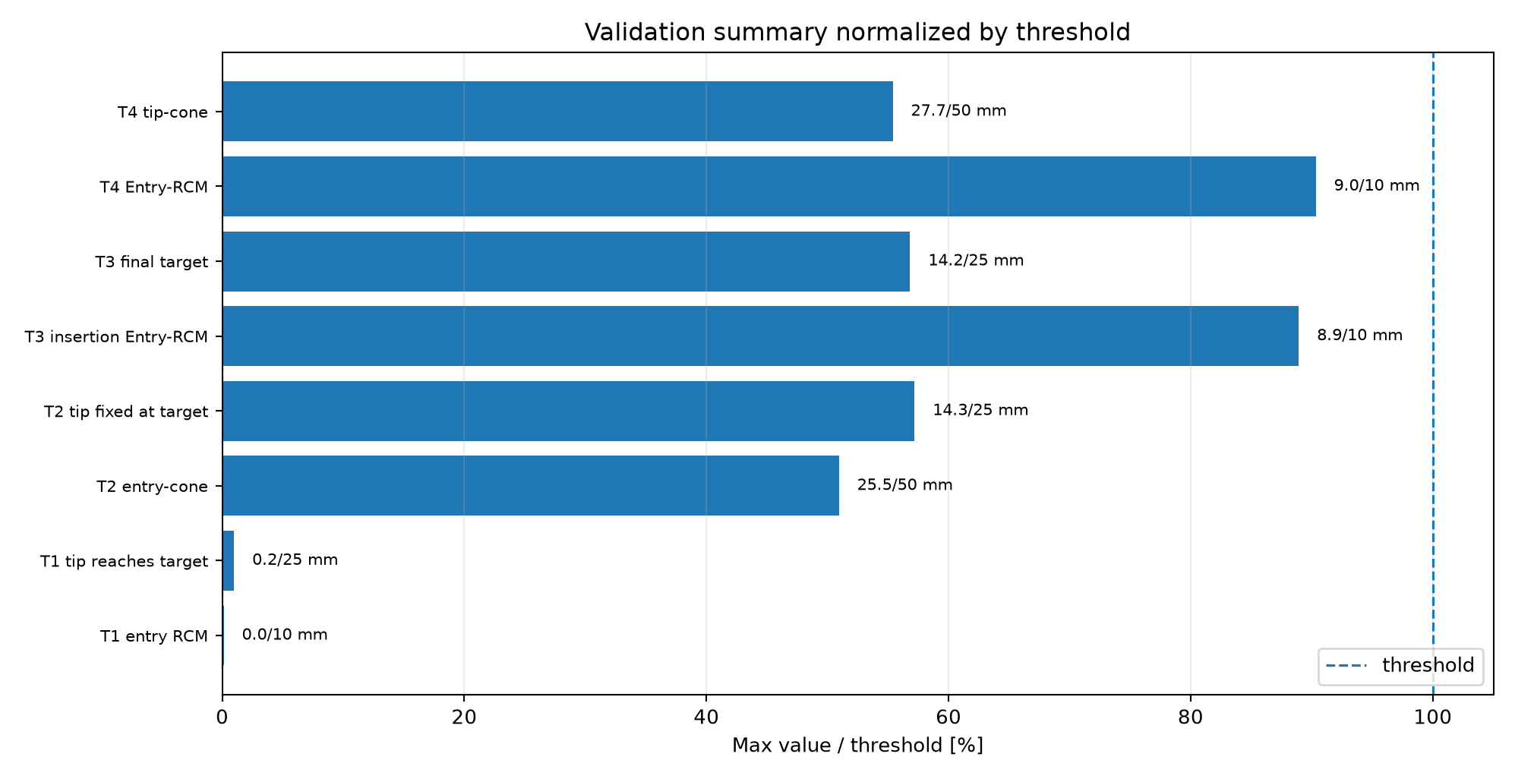
11 — RESULTS
Results: Everything Passes
9 / 9
validation checks passed
Tightest margin: entry-RCM error during insertion, ~90% of threshold.
RESULTS
12 / 17
Notes:
This bar chart normalizes every automatic check against its own threshold. All nine pass. The tightest margins are the entry-RCM constraints during Task 3 insertion and Task 4 -- both around ninety percent of their ten-millimetre allowance, worth noting as a margin rather than a failure. Task 1 is essentially perfect, under two percent of its threshold.

Slide 13
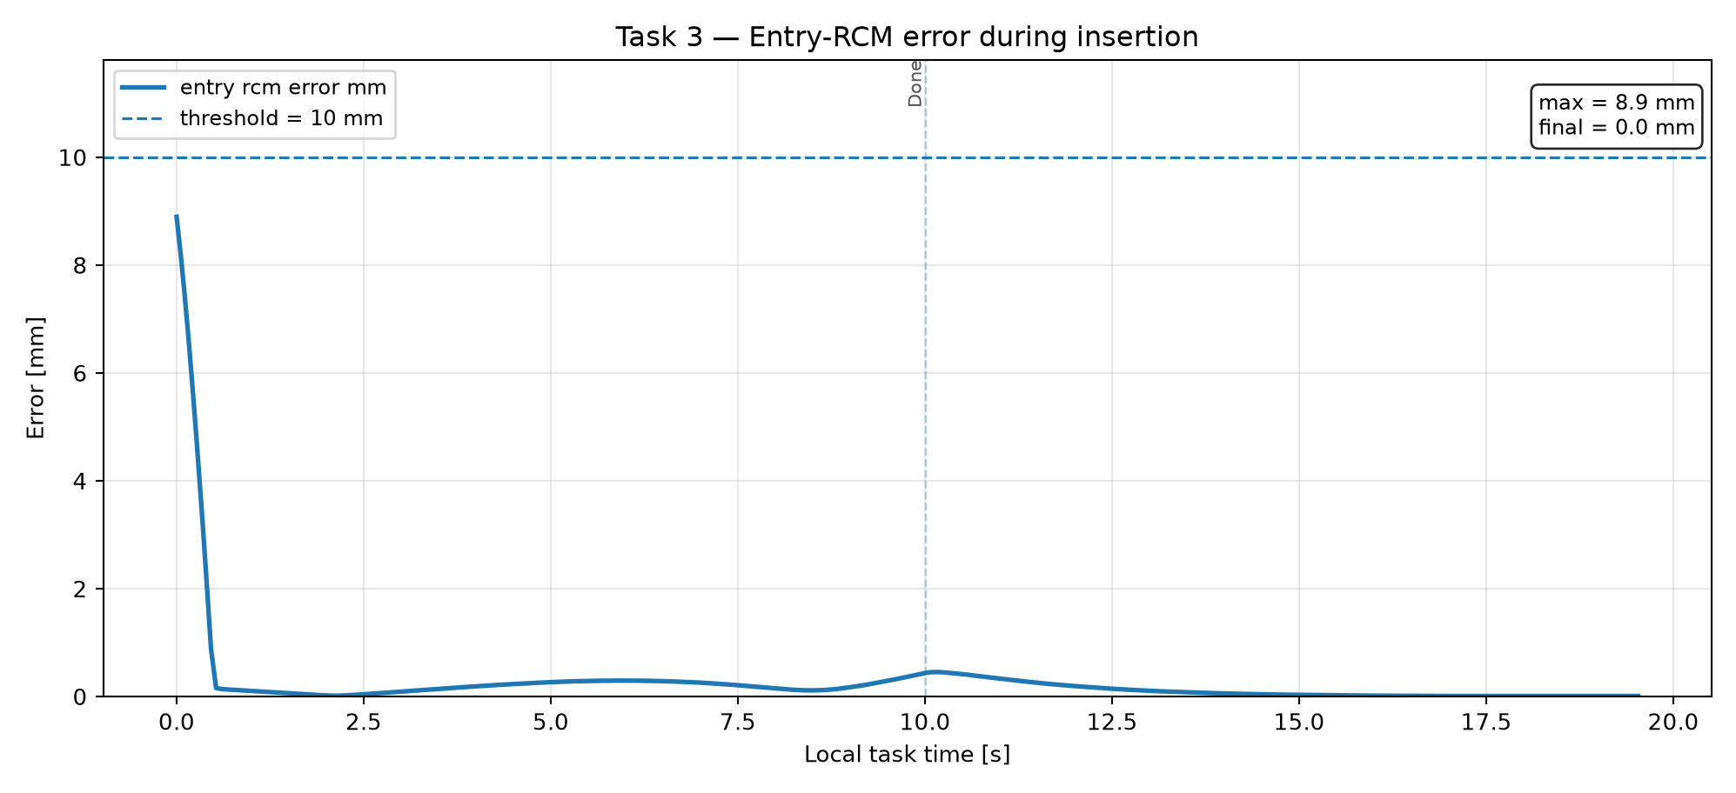
12 — RESULTS
Results: Safe Insertion (Task 3)
Entry-RCM error → ~0 mm once insertion starts
Tip stays on the planned entry–target line
RESULTS
13 / 17
Notes:
These two plots validate the core neurosurgical claim for the main task. The entry-RCM error is not enforced before the tip reaches the trocar -- by design -- then converges to essentially zero once true insertion begins. The tip-to-line-distance plot is the most intuitive for a clinical audience: after the approach phase, the needle tip travels almost exactly along the planned straight corridor from entry to target.

Slide 14
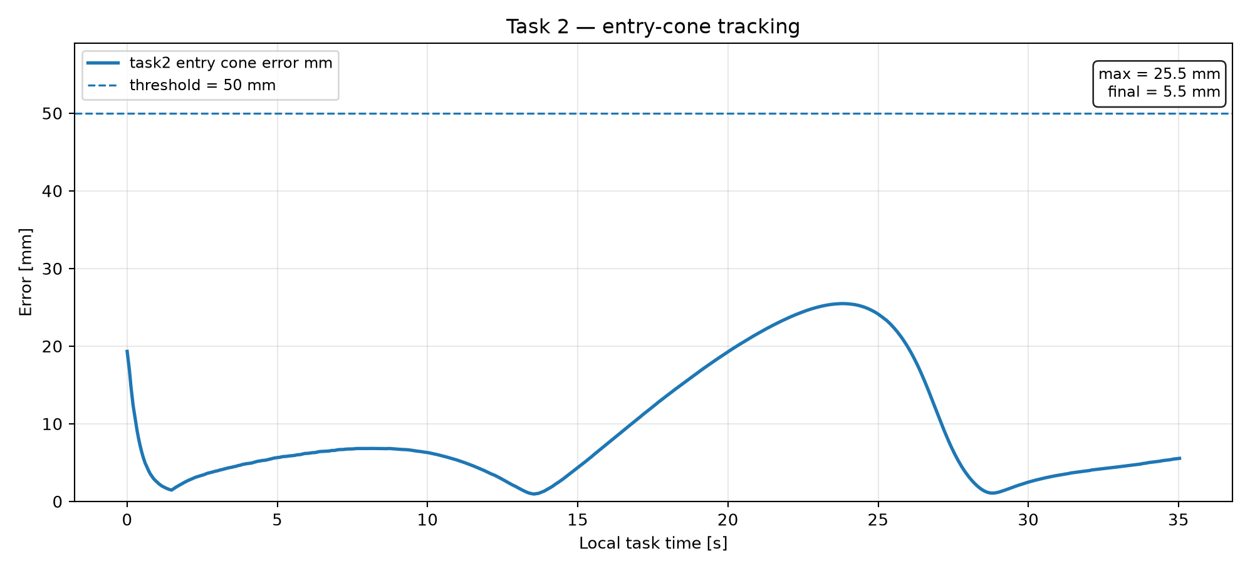
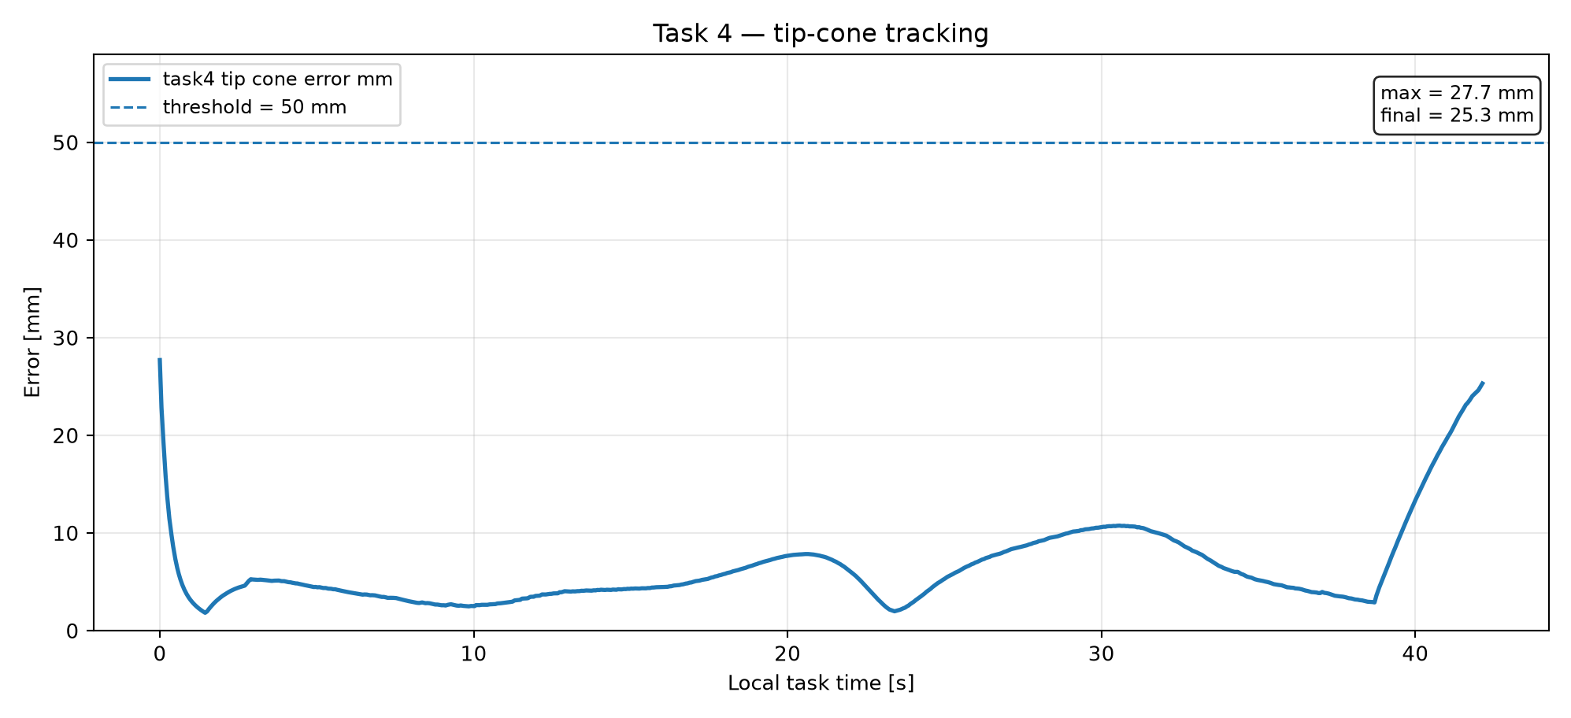
13 — RESULTS
Tracking Moving Targets (Tasks 2 & 4)
Bounded, oscillating tracking error — expected for a continuously rotating target, both well under threshold.
RESULTS
14 / 17
Notes:
For the cone tasks, zero steady-state error isn't the right expectation, since the desired point is continuously rotating. What matters is that tracking stays bounded and below threshold throughout, which both plots confirm -- with visibly less margin than the static Task 1/3 targets, consistent with tracking a moving point under a simultaneous RCM constraint being intrinsically harder.

Slide 15
14 — SCOPE
Limitations
◐
ROSA-like, not an official CAD model — plausible DH, not measured
◐
Needle = rigid cylinder, no tissue interaction
◐
No anatomical collision avoidance in the final build
◐
Purely kinematic — no dynamics, no force control
◐
Jacobians computed numerically, not symbolically
SCOPE
15 / 17
Notes:
It's important to state plainly what this project doesn't claim. The geometry is plausible, not an official ROSA model. There's no tissue interaction, no force control, and no active obstacle avoidance in the final build. The controller is purely kinematic, and Jacobians are numerical rather than closed-form. None of this invalidates the kinematic result -- it bounds what can be claimed from it.

Slide 16
15 — OUTLOOK
What's Next
1
2
3
4
Analytic Jacobian (replace finite differences)
Re-introduce anatomy as a separate validation layer
Real ROSA DH parameters, if available
Randomized multi-trial validation
OUTLOOK
16 / 17
Notes:
The most natural next step is an analytic Jacobian, for speed and numerical robustness. Re-introducing anatomy should happen as an explicitly separate validation layer, not mixed back into the core RCM logic, exactly as the project's own documentation argues. Beyond that: real ROSA kinematic parameters if they become accessible, and validating over many randomized entry/target configurations instead of a single logged run, to get statistical rather than anecdotal evidence.

Slide 17
CONCLUSION
A Validated Double-RCM Controller, Honestly Scoped
Four tasks. One controller built from scratch. Nine of nine checks passed. Anatomy deliberately left out to keep the focus on the RCM formulation.
Thank you — questions welcome.
CONCLUSION
17 / 17
Notes:
To close: this project turns the double-RCM formulation from Aghakhani et al. into a working, validated Unity simulation -- four task modes, a from-scratch damped least-squares controller, and a full logging-and-validation pipeline. The evidence shows the RCM constraint held within the defined thresholds across every tested task. The scope was kept deliberately narrow -- kinematics, not anatomy or dynamics -- and stated as such throughout. Thank you, I'm happy to take questions.

