Slide 1
Joint Detection of AI-Generated Images
and Post-Processing Alterations
Computer Vision Project — A.A. 2025–2026
Samuele Civale · Alexandru Vivian Pita
Real or AI?
Which alteration?
Two forensic questions, one multi-task model
1/12

Slide 2
Outline
1
Problem and motivation
2
State of the art and gap
3
Dataset and label space
4
Proposed multi-task method
5
Experimental setup
6
Results and error analysis
7
Conclusions and future work
2/12

Slide 3
Problem Statement
Real-world images are rarely clean generator outputs
Forensic Question 1
Is the image real or AI-generated?
Image
Platform transfer
Re-digitalization
Forensic Question 2
Post-processing can hide, distort, or introduce forensic traces. A robust detector should reason about both authenticity and alteration.
Which post-processing condition was applied?
3/12

Slide 4
State of the Art and Project Gap
From clean binary detection to real-world robustness
Typical setup
Main limitation
This project
Binary detector trained and tested on clean images directly sourced from generators.
Images online undergo transfer, compression, resizing, or re-capture artifacts.
A unified model predicts authenticity and the post-processing condition jointly.
Novelty in the implementation
Loss-weight ablation, per-transformation breakdown, cross-class analysis, and an optional artifact-aware residual branch.
4/12

Slide 5
Dataset and Label Space
RRDataset subset balanced by transformation and authenticity
Transformation
Real
AI
Total
6,000
2
3
original
1000
1000
2000
balanced images
authenticity classes
alteration settings
transfer
1000
1000
2000
redigital
1000
1000
2000
Two outputs per input image
Total
3000
3000
6000
real / AI
original / transfer / redigital
Split
Images
Per transformation
Train
4800
1600
Validation
1200
400
5/12

Slide 6
Proposed Method
Shared EfficientNet-B0 backbone with two classification heads
Real/Fake head
2 classes
EfficientNet-B0
feature extractor
Input image
Transformation head
3 classes
α
Effect
Training objective
0.2
more transformation weight
L = α CE(real/fake) + (1 − α) CE(transformation)
0.5
balanced objective
0.8
more real/fake weight
Optional variant: an artifact-aware branch processes high-frequency residuals before feature fusion.
6/12

Slide 7
Experimental Setup
Colab/PyTorch pipeline with deterministic validation
Component
Configuration
Validation transform is deterministic
Framework
PyTorch + torchvision
Training uses augmentation: horizontal flip, rotation, brightness/contrast jitter. Validation uses only resize, tensor conversion, and ImageNet normalization.
Backbone
EfficientNet-B0, ImageNet weights
Image size
224 × 224
Optimizer
Adam, lr = 5e-4, weight decay = 1e-4
This prevents validation metrics from depending on random augmentations and makes alpha comparisons meaningful.
Training
10 epochs per run, batch size 32
Device
CUDA, mixed precision enabled
7/12

Slide 8
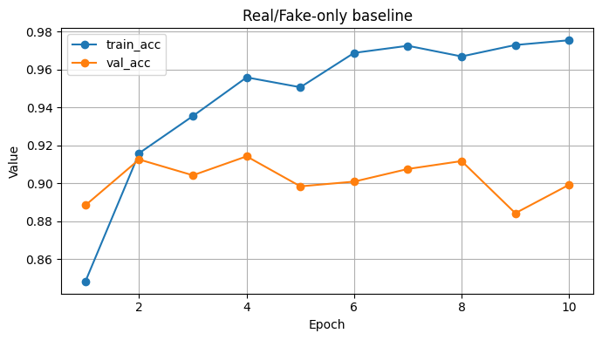
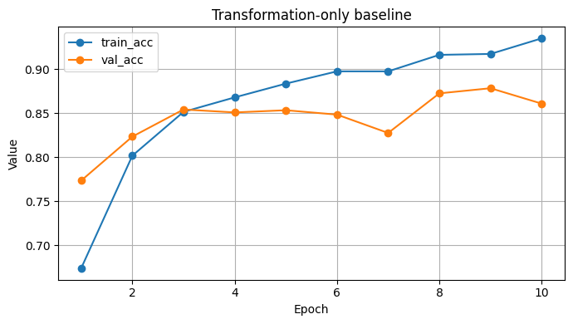
Baseline Performance
Single-task models establish reference points
89.92%
86.08%
Training curves show strong learning, but validation accuracy saturates and oscillates: the task is not solved by clean single-task training alone.
final RF-only accuracy
final transformation-only accuracy
8/12

Slide 9
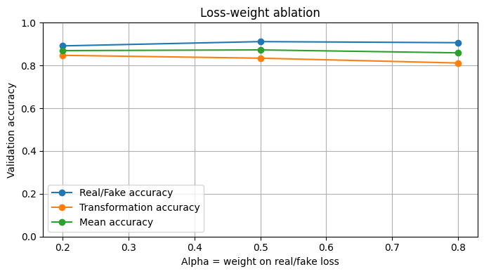
Loss-Weight Ablation
Balanced alpha gives the best final mean accuracy
α
RF acc.
Trans acc.
Mean acc.
0.2
89.17%
84.75%
86.96%
0.5
91.17%
83.42%
87.29%
0.8
90.67%
81.17%
85.92%
α = 0.5
Higher α protects real/fake accuracy but hurts transformation recognition. Lower α has the opposite effect.
selected model
9/12

Slide 10
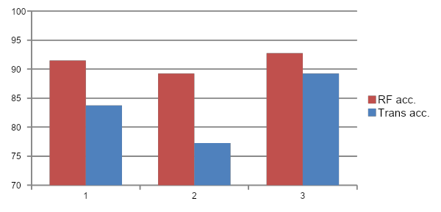
Selected Multi-Task Model
Detailed breakdown for alpha = 0.5
91.17%
83.42%
87.29%
real/fake accuracy
transformation accuracy
mean accuracy
Condition
RF acc.
Trans acc.
original
91.50%
83.75%
redigital
89.25%
77.25%
transfer
92.75%
89.25%
Redigital is the most harmful condition, especially for recognizing the transformation.
10/12

Slide 11
Error Analysis and Artifact-Aware Variant
Main failure mode: redigital is confused with original
RF confusion
pred real
pred AI
Transformation
pred original
pred transfer
pred redigital
true real
550
50
true original
335
59
6
true AI
56
544
true transfer
40
357
3
true redigital
76
15
309
The binary classifier is balanced: 50 real→AI and 56 AI→real errors.
Transformation errors are asymmetric: 76 redigital images are predicted as original.
Model
RF acc.
Trans acc.
Mean
Standard α=.5
91.17%
83.42%
87.29%
Artifact-aware
90.08%
84.17%
87.13%
Artifact-aware improves transformation accuracy slightly, but does not outperform the standard model overall.
11/12

Slide 12
Conclusions, Limitations and Future Work
The joint formulation is useful, but task competition remains
Key findings
Limitations and Future work
• Best trade-off: standard multi-task model with α = 0.5
• Real/fake detection benefits from the auxiliary transformation task
• Transformation classification is still stronger when trained alone
• Redigital is the most difficult condition
• Add macro-F1, ROC-AUC, and confidence calibration
• Evaluate on a larger RRDataset subset
• Test stronger backbones and augmentation policies
• Make artifact-aware training fully reproducible
12/12

