Slide 1
Project 6 – Scrum 4
Asmita, Rocco, Samuele
The AQTIVATE project receives funding from the European Union’s HORIZON MSCA Doctoral Networks programme, under Grant Agreement No. 101072344.

Slide 2
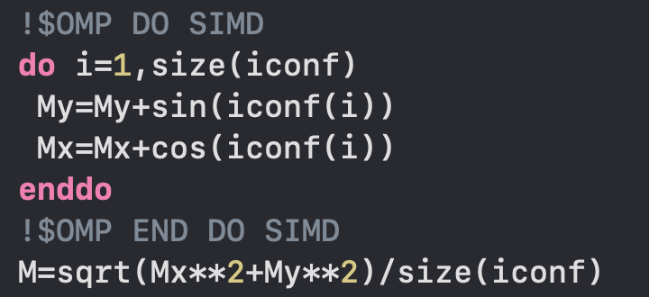
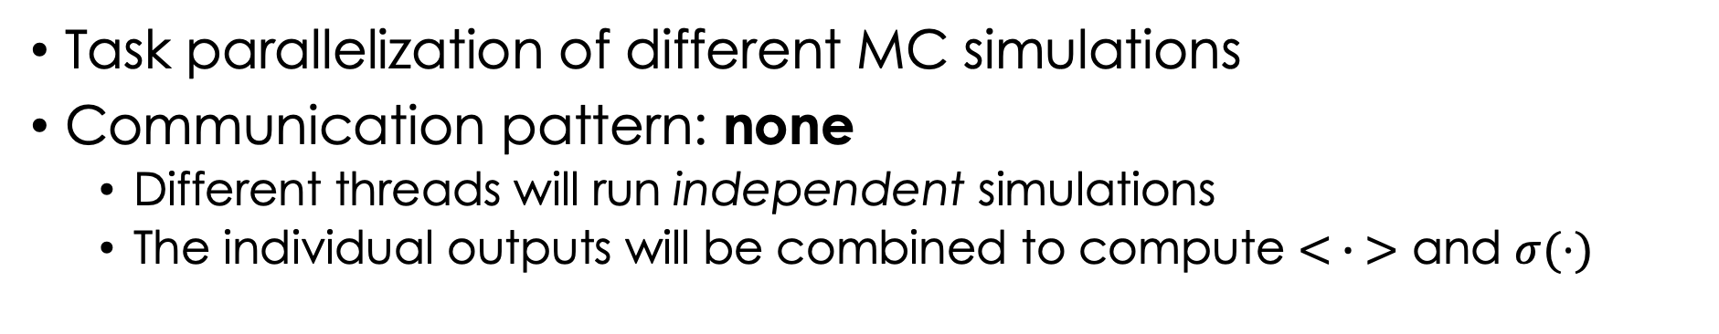
Application parallelization
SIMD parallelization of Magnetization with OpenMP
Task parallelization of different MC simulations
Communication pattern: none
Different threads will run independent simulations
The individual outputs will be combined to compute $< ∙ >$ and $σ(⋅)$

Slide 3
Wrap up
Results
Successful implementation of the Wolff (cluster) algorithm for the 2D XY model in a lower-level language (f90)
Problem solved: critical slowing down
Task parallelization of different simulations
Problem solved: computationally expensive simulations
Data parallelization of observable computation (M)
Problem solved: optimization of the code making use of computer architecture
Speedup & performance study
Project presentation
Samuele (10m) - Wolff algorithm & critical slowing down
Asmita (10m) - Parallelization
Rocco (10m) – Speedup & performance study

Slide 4
Thank you

