Slide 1
Project 6 – Scrum 5
Asmita, Rocco, Samuele
The AQTIVATE project receives funding from the European Union’s HORIZON MSCA Doctoral Networks programme, under Grant Agreement No. 101072344.

Slide 2


Today’s work
Implementation of task parallelization via OpenMP
…
Study of speedup & efficiency computing wall time via

Slide 3
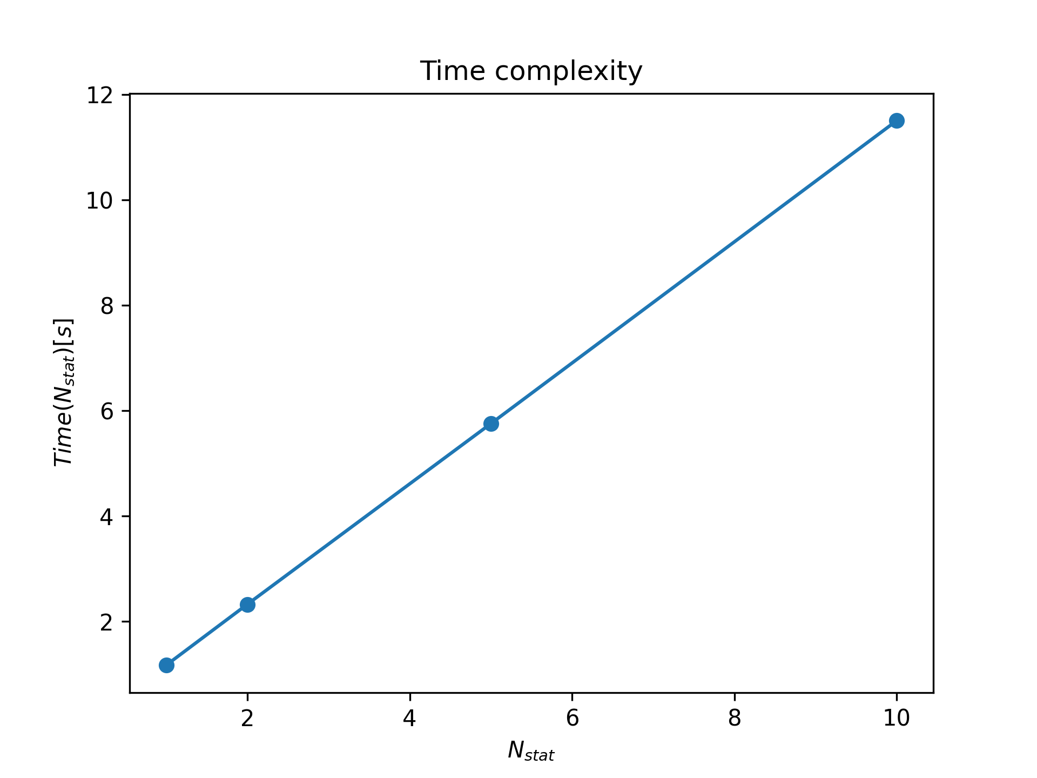
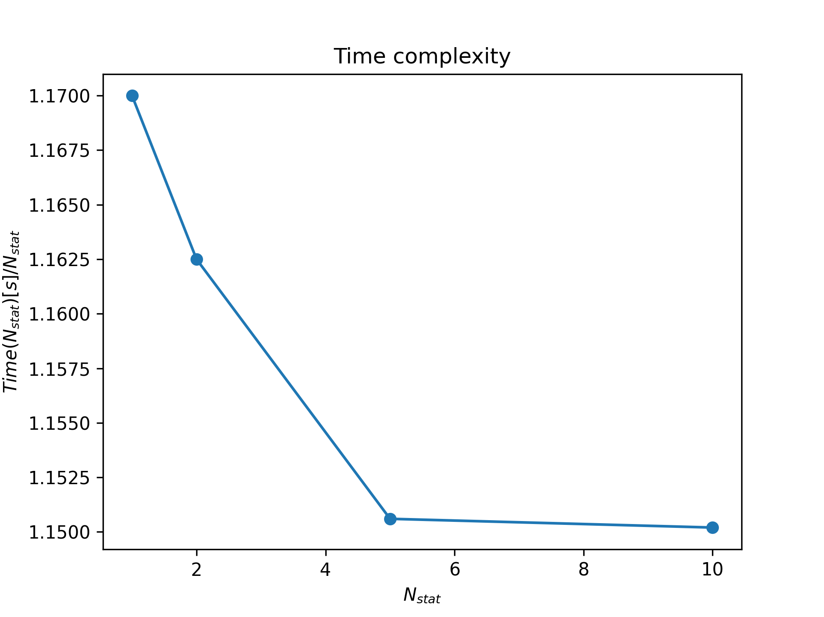
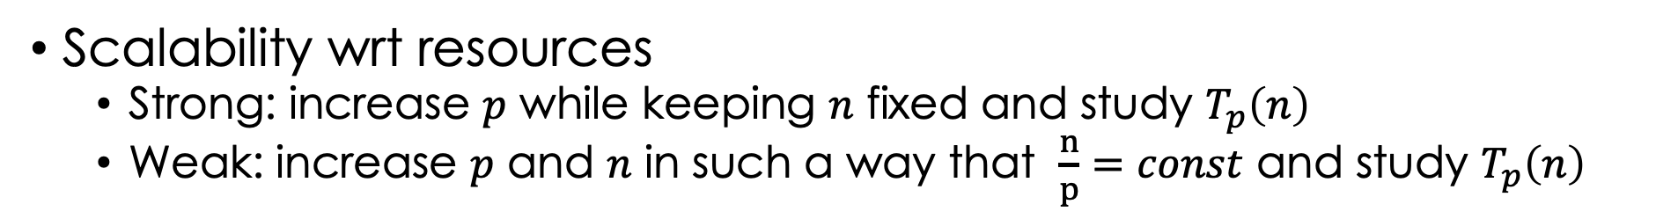
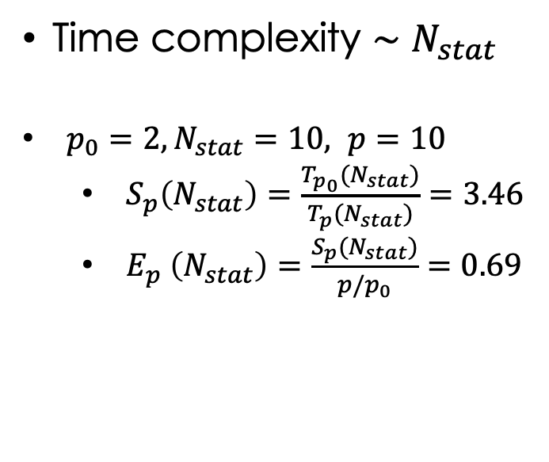
Speedup & Efficiency
Time complexity $\sim$ $N_{stat}$
$p_{0}=2, N_{stat}=10, p=10$
$S_{p}\left(N_{stat}\right)=\frac{T_{p_{0}}(N_{stat})}{T_{p}(N_{stat})}=3.46$
$E_{p} \left(N_{stat}\right)=\frac{S_{p}(N_{stat})}{p/p_{0}}=0.69$
Scalability wrt resources
Strong: increase $p$ while keeping $n$ fixed and study $T_{p}\left(n\right)$
Weak: increase $p$ and $n$ in such a way that $\frac{n}{p}=const$ and study $T_{p}\left(n\right)$

Slide 4
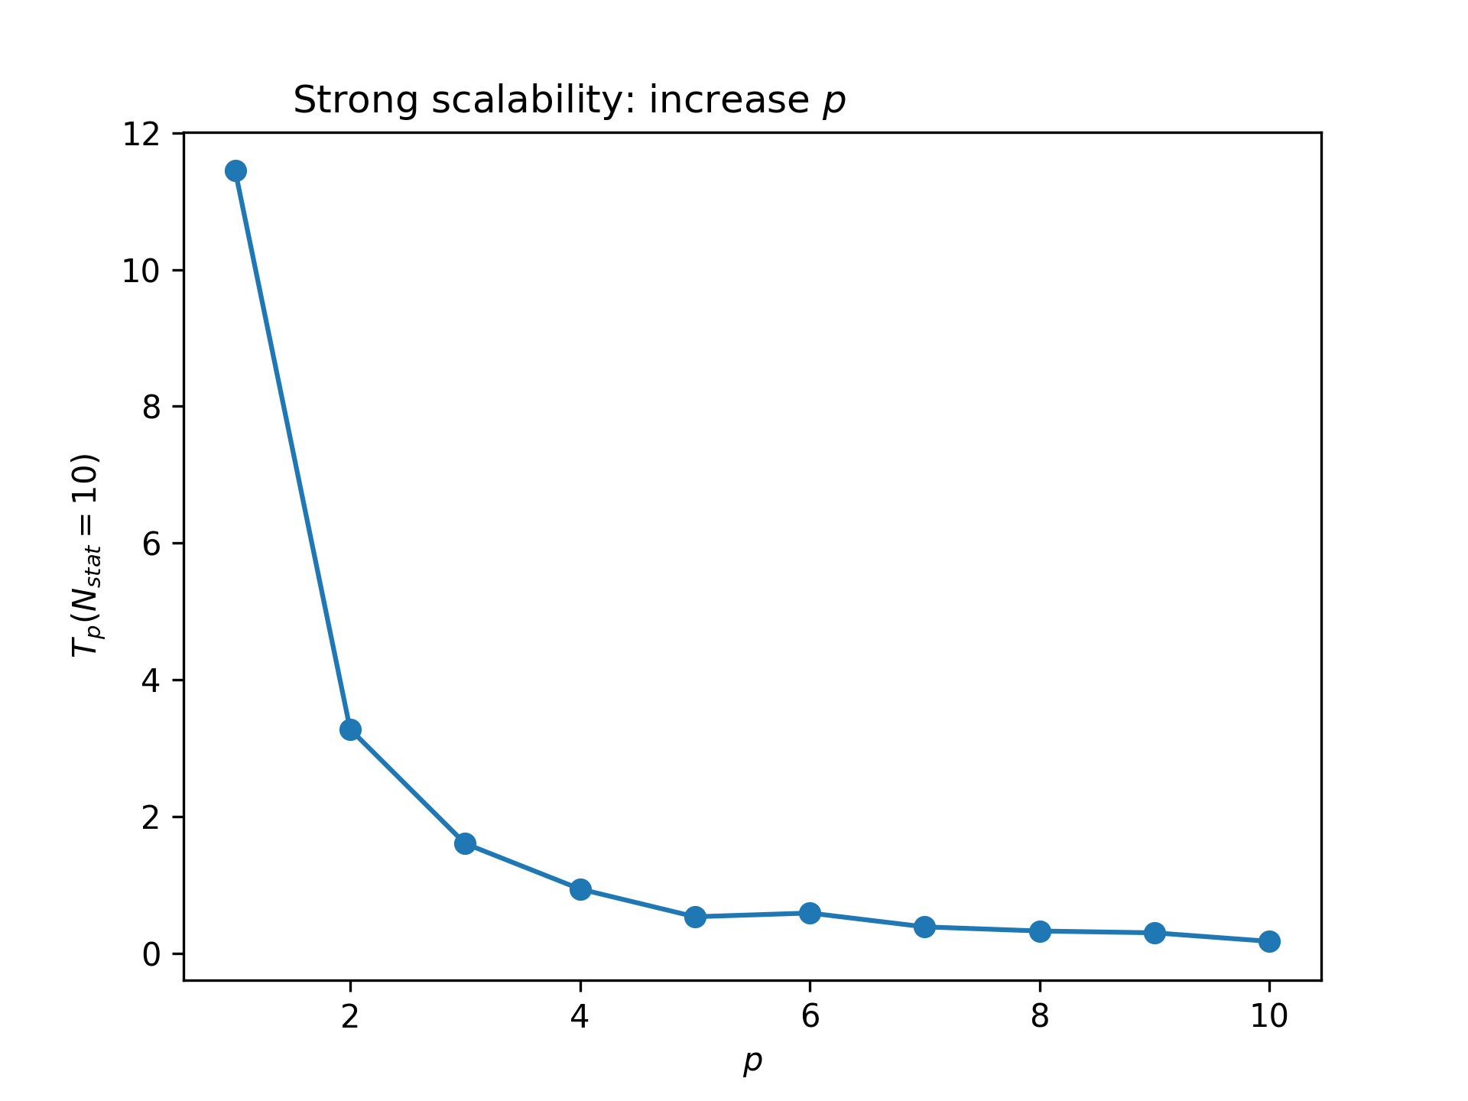
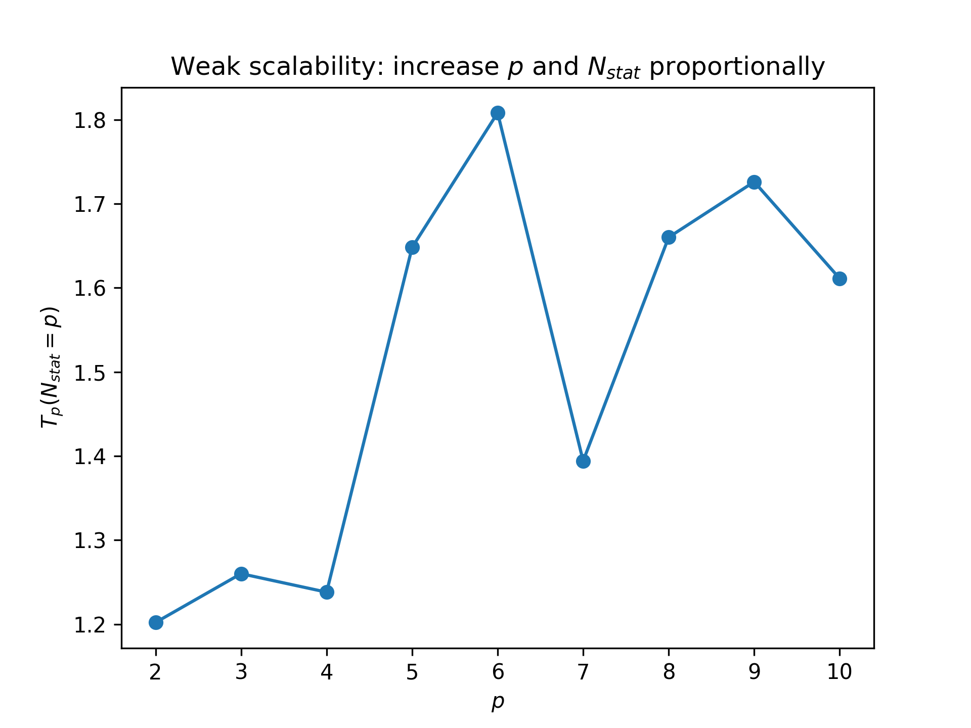
First results on scalability & Leftover issues
Strong scalability
Weak scalability
Leftover issues
Refine results on scalability
Performance analysis

Slide 5
Thank you

