Slide 1



Python Data Analysis
2026 – 2027
General informations
Louie Corpe
louie.corpe@cern.ch
Romain Madar
romain.madar@cern.ch
Adrien Auriol
adrien.auriol@cern.ch

Slide 2
Material for the lecture
1. On moodle platform (ENT, UCA accout required):
https://moodle2026.uca.fr/course/view.php?id=17249
2. On github platform (free access):
https://github.com/rmadar/lecture-python
(those have the same exact same content)

Slide 3
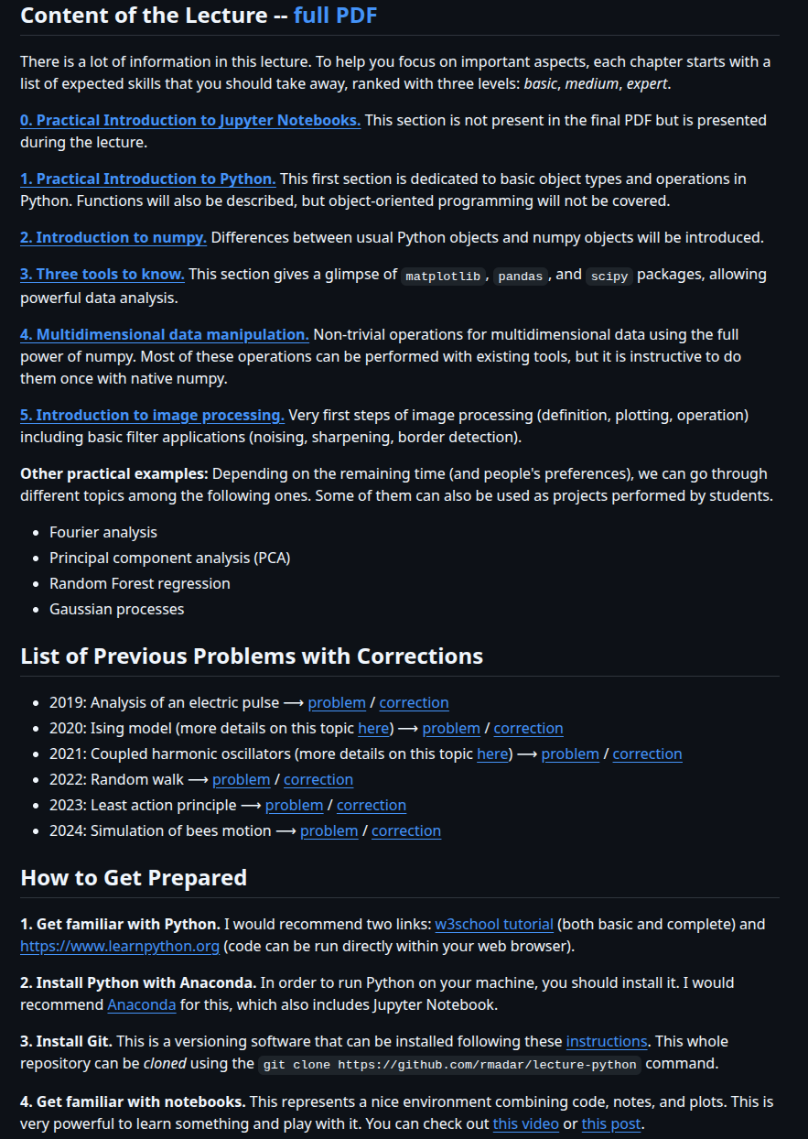
Material for the lecture
1. On moodle platform (ENT, UCA accout required):
https://moodle2026.uca.fr/course/view.php?id=17249
2. On github platform (free access):
https://github.com/rmadar/lecture-python

Slide 4
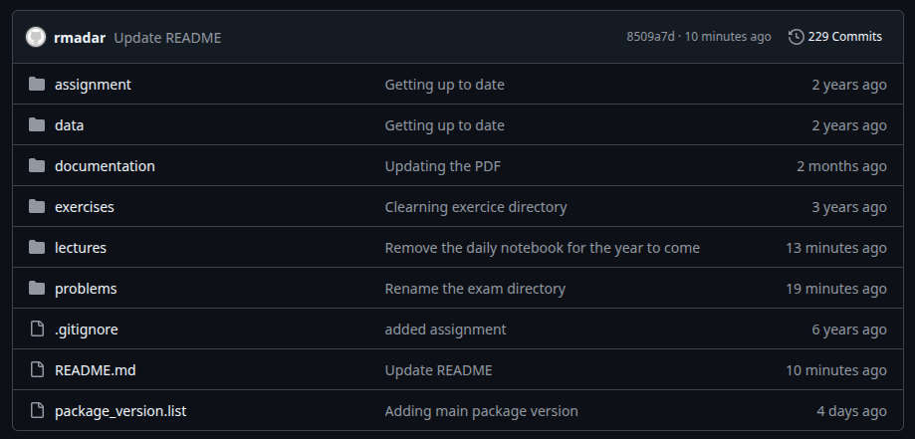
Material for the lecture
1. On moodle platform (ENT, UCA accout require):
https://moodle2026.uca.fr/course/view.php?id=17249
2. On github platform (free access):
https://github.com/rmadar/lecture-python

Slide 5
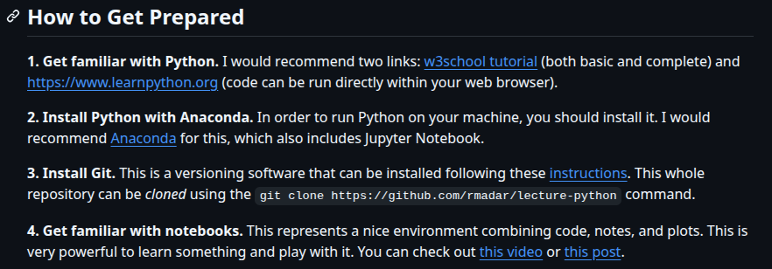
Lecture structure & technicals
A typical day:
→ presentation of a new chapter, with some little exercises for you to practice
→ practical sessions with larger exercises
You need to have a running notebook with a proper python environment
(2 options : UCA computer, your laptop)

Slide 6
Skills you’re expected to learn
They are listed on top of each chapter, sorted into 3 categories : basic, medium, expert.

Slide 7
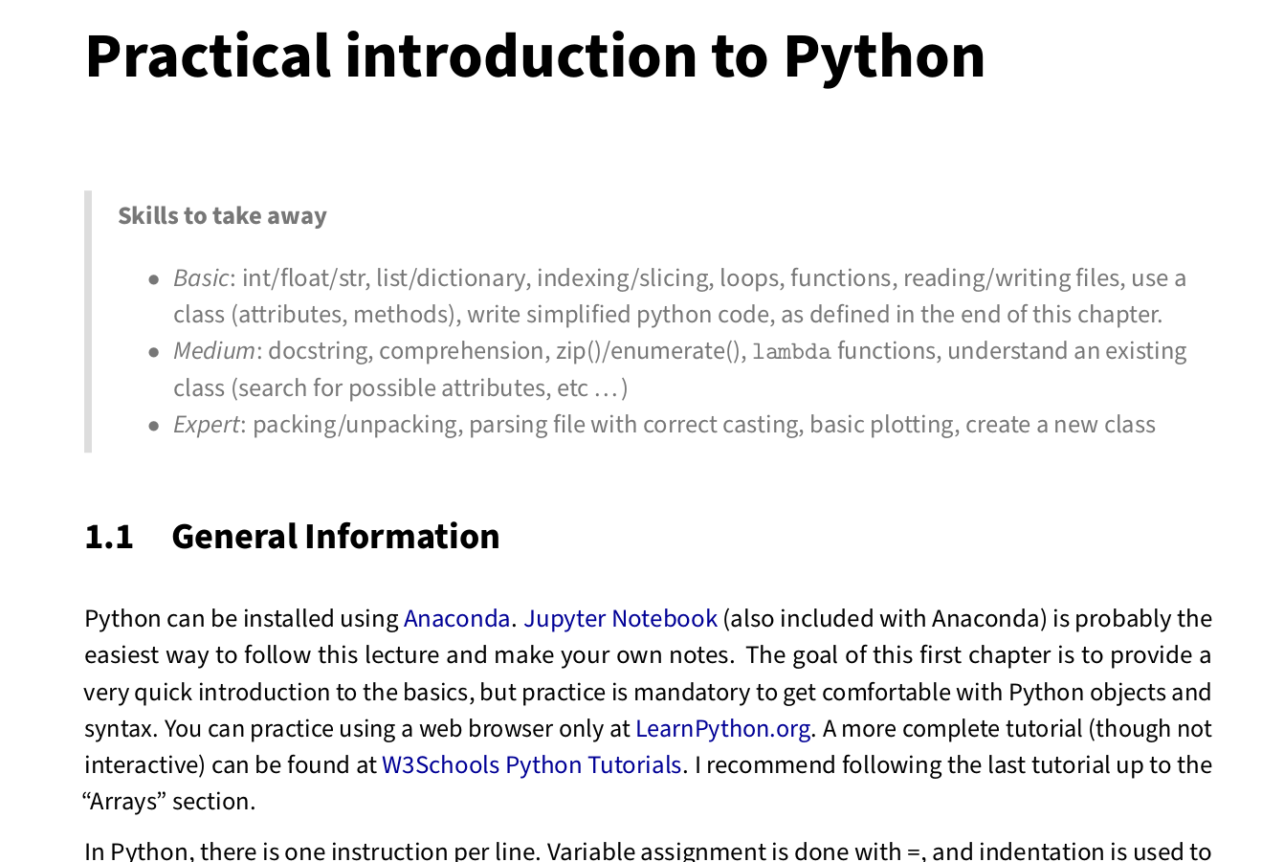
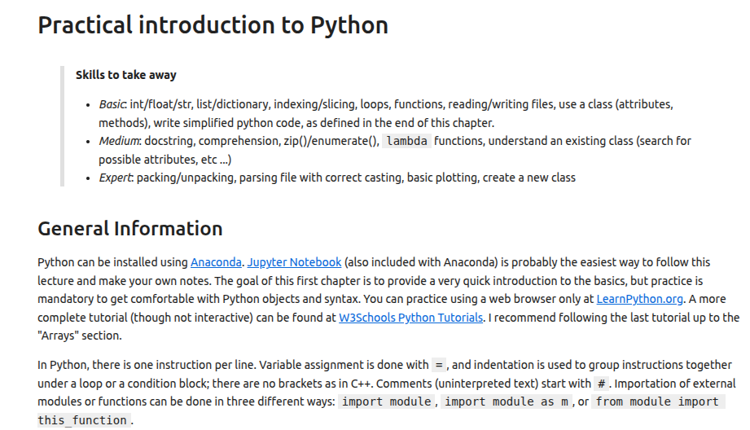
Skills you’re expected to learn
They are listed on top of each chapter, sorted into 3 categories : basic, medium, expert.
[lecture pdf]
[lecture notebook]

Slide 8
Evaluation
Evaluation : ~1h30 pen & paper exam in classroom (beginning of november – to be confirmed).
Exam goal: make sure you got
    broad (and useful!) numerical python knowledge
    good coding practices
Exam typical content:
    Lecture questions (concepts, definitions, typical use cases, etc ...)
    Simplified code writing (to be described in the lecture)
    Error findings, code output prediction, etc ...
Allowed material :
  paper and pen only
  no documentations, no chatGPT
  In particular, lecture material not allowed
Caution: in case of doubt about your answers, you might be interviewed to explain what you wrote and why (it happened in the past that some people might have used unauthorized ressources).

Slide 9
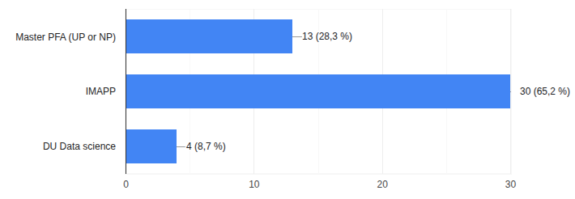
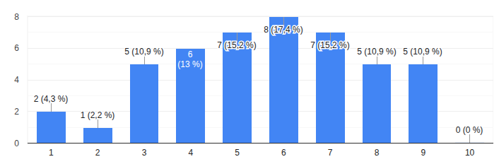
The group
Composition
Auto-evaluation of python skills

Slide 10
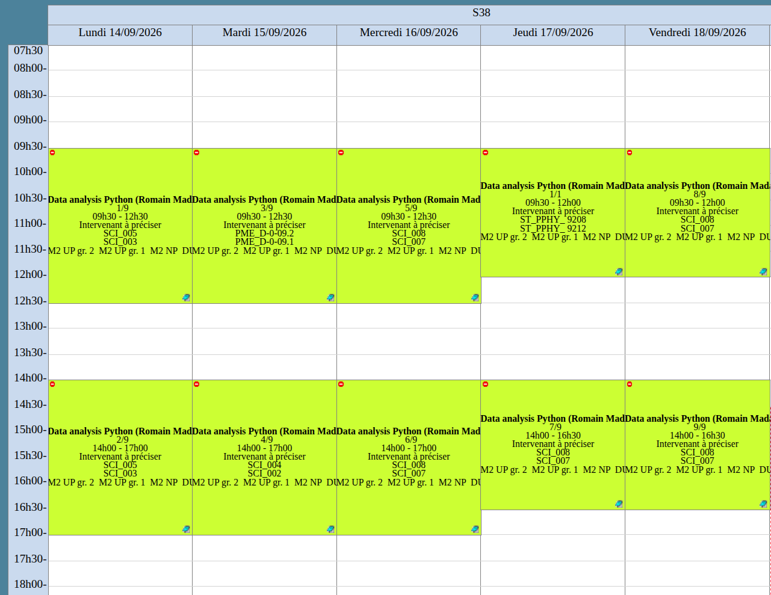
Caution: no computers in that room
Afternoon “support” for you to work on the lecture with our help

Slide 11
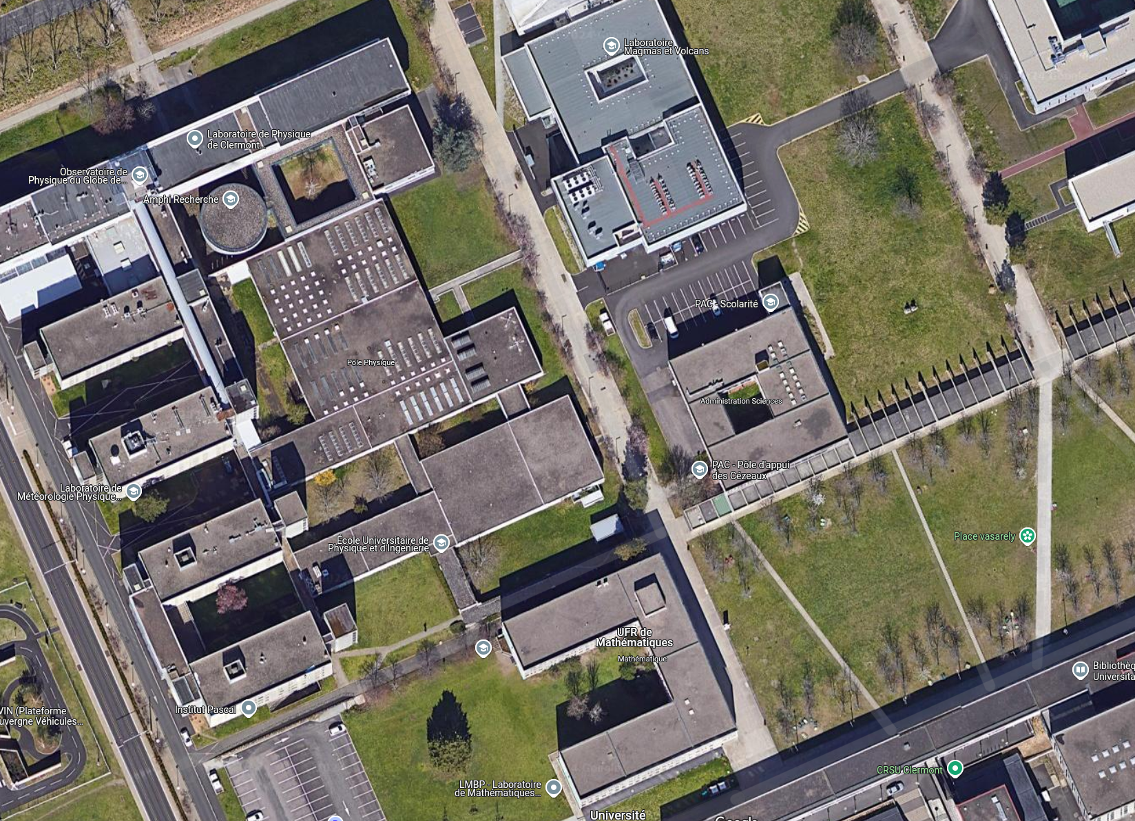
Physics department
Lecture place

Slide 12
Side comment : ChatGPT
Is it needed to learn programing language today, when tools like ChatGPT exist ?
Let’s try something!

Slide 13
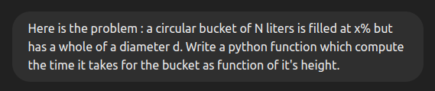
Side comment : ChatGPT
Is it needed to learn programing language today, when tools like ChatGPT exist ?
Let’s try something!

Slide 14
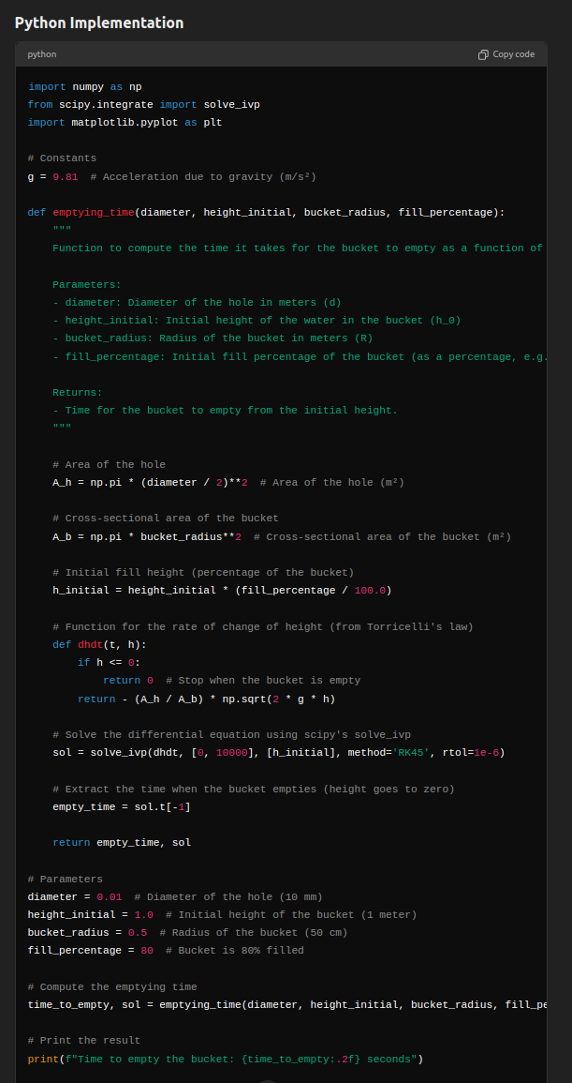
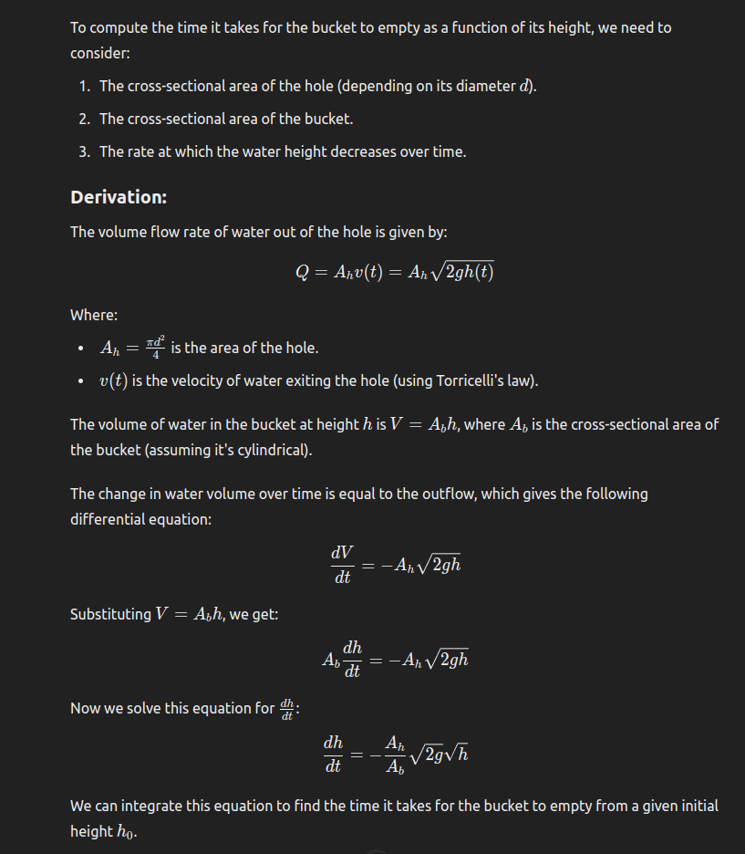
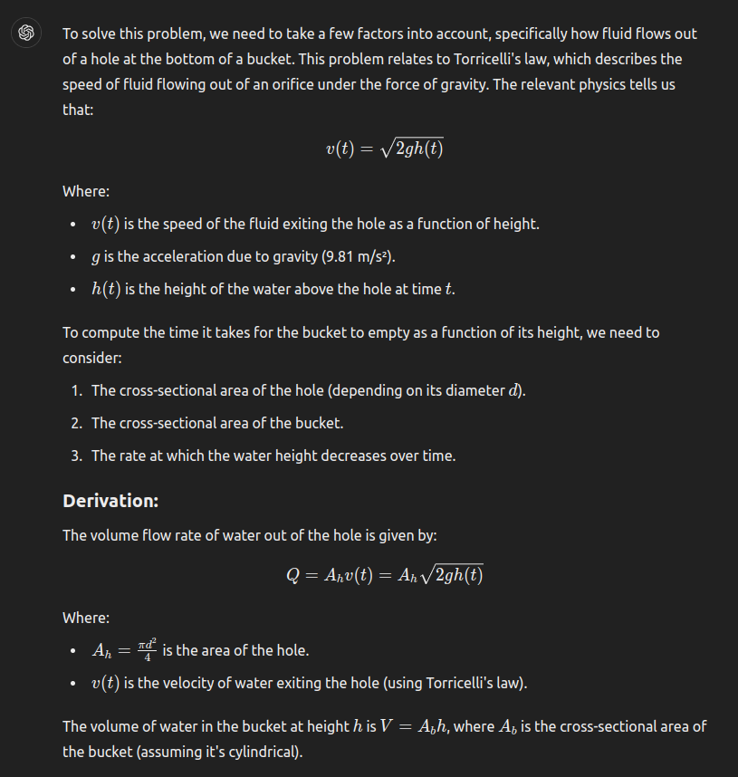
Side comment : ChatGPT
Is it needed to learn programing language today, when tools like ChatGPT exist ?
Let’s try something!

Slide 15
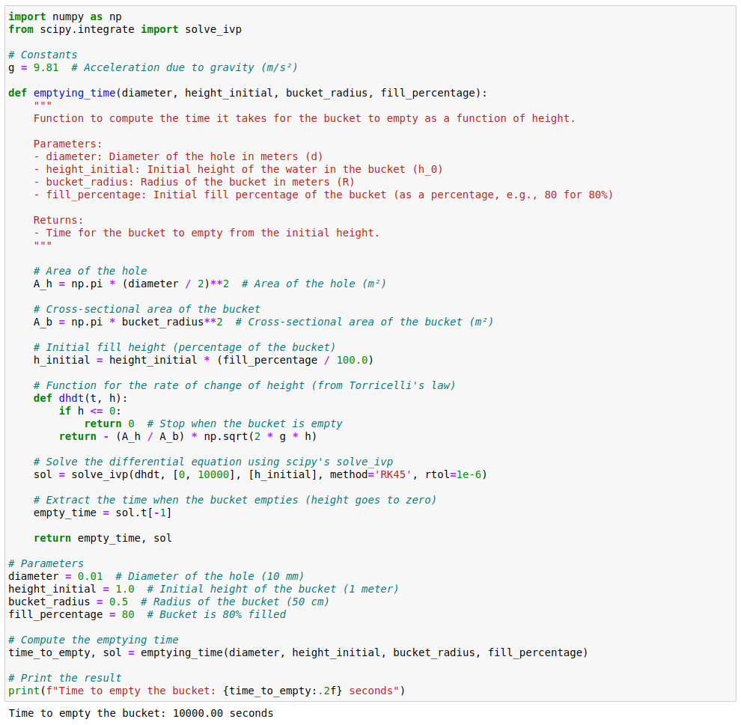
Side comment : ChatGPT
Is the result correct ?

Slide 16
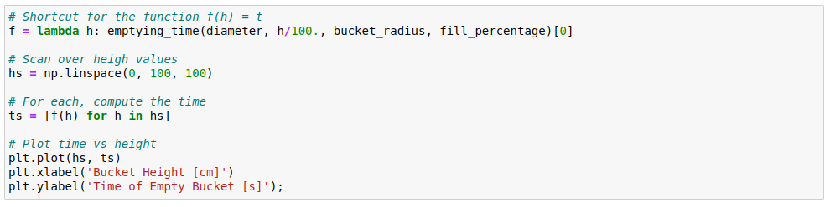
Side comment : ChatGPT
Is the result correct ?

Slide 17
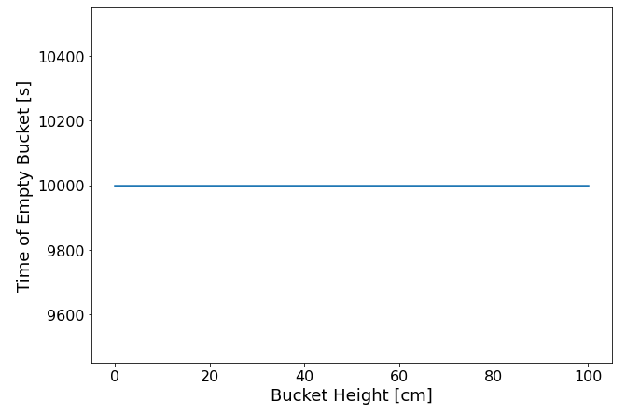
Side comment : ChatGPT
According to chatGPT, a bucket of 1cm or 1m will empty in 1000s ...
Is the result correct ? NO

Slide 18
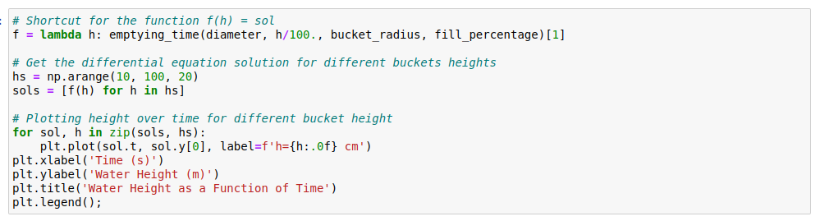
Side comment : ChatGPT
Let’s investigate h(t) for different bucket heights
Is the result correct ? NO

Slide 19
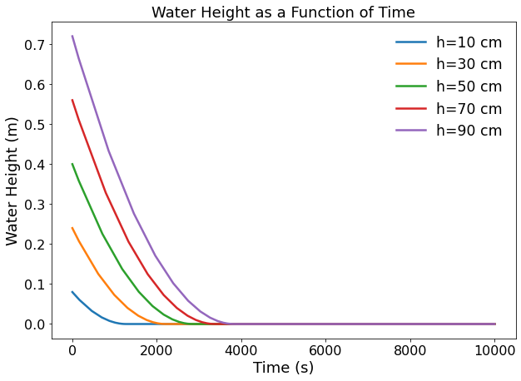
Side comment : ChatGPT
Let’s investigate h(t) for different bucket heights
Seems ok !
Is the result correct ? NO

Slide 20
Side comment : ChatGPT
Let’s investigate h(t) for different bucket heights
Seems ok !
But ChatGPT gives the last value, instead of the first one equal to (sufficiently close to) zero ...
Is the result correct ? NO

Slide 21
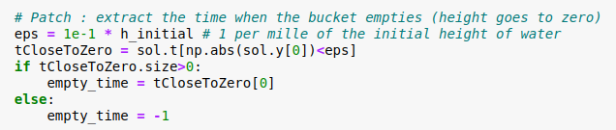
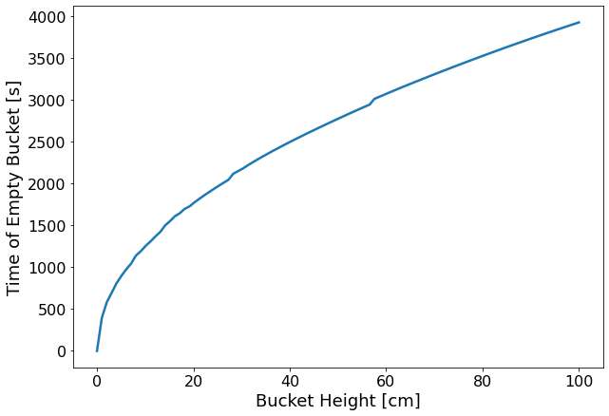
Side comment : ChatGPT
Patch to get the correct time
Is the result correct ? Now, yes.

Slide 22
Side comment : ChatGPT
Is it needed to learn programing language today, when tools like ChatGPT exist ?
Well … Yes, it is.
ChatGPT w/o human brain
ChatGPT w/ human brain

