Slide 1
Image noise decreases accuracy but increases confidence of neural networks
Samuel Goldstein & Dobromir Rahnev
School of Psychology, Georgia Tech

Slide 2
Background
Confidence is often mis-calibrated in neural networks (when confidence is provided using softmax)
However, beyond general miscalibration, little is known about how various manipulations affect confidence
Here we test various types of image degradation and discover a novel phenomenon where large image degradation decreases accuracy but paradoxically increases confidence of NNs

Slide 3
General methods
See noise_confidence_reversal.ipynb
We trained small (2- or 3-layer) NNs on relatively simple image classification (e.g., MNIST and Fashion MNIST)
  We think that larger networks and more complex classification tasks will show the same behaviors but haven’t yet tested that
We then tested the NNs using images with the following corrupting influences:
  Gaussian noise (random noise added to each pixel)
  Luminance (increase or decrease from original)
  Contrast (increase or decrease from the original of 1)
  White/gray/black dropout (a random selection of pixels replaced with white/gray/black pixels)

Slide 4
Results 1
For Gaussian noise, luminance, white dropout, and gray dropout:
  A small amount of distortion leads to accuracy and confidence decrease
  However, larger amounts of distortion continue to lower accuracy but confidence starts to dramatically increase

Slide 5
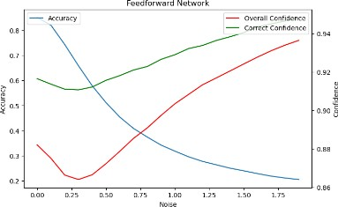
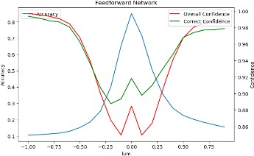
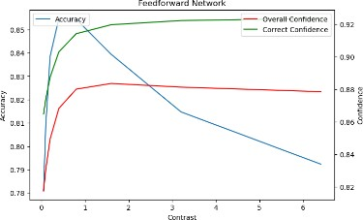
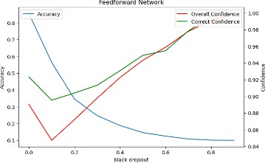
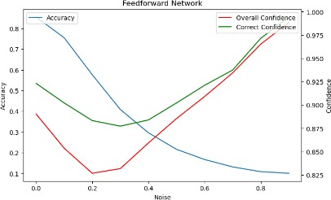
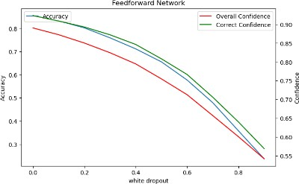
Results 1
See noise_confidence_reversal.ipynb
Gaussian noise
Luminance
Contrast
White dropout
Gray dropout
Black dropout

Slide 6
Results 2
noise_confidence_reversal_unseen.ipynb
We tested what would happen if one category was completely left out of training
We found that confidence for that category (we call it “Alien confidence”) is sensible for low levels of noise but becomes indistinguishable from confidence for trained categories for high levels of noise

Slide 7
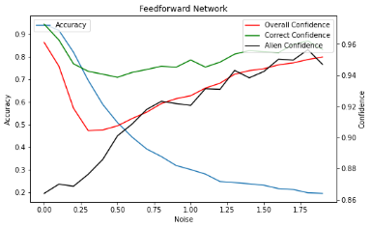
Results 2
noise_confidence_reversal_unseen.ipynb
Gaussian noise

Slide 8
Results 3
noise_confidence_reversal_noise_train.ipynb
We inserted noise into the training set to test whether this would lead to more meaningful confidence
We found that this significantly improved the range in which confidence decreases (i.e., goes together with accuracy)
Importantly, training using one type of noise (e.g., Gaussian noise) also increased the range in which confidence follows accuracy for another type of noise (e.g., Gray dropout)
  However, when the noise in the testing set increases beyond what is exposed in the training set, confidence again starts to increase despite a continuous decrease in accuracy

Slide 9
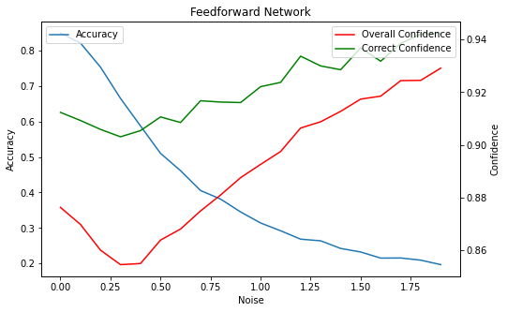
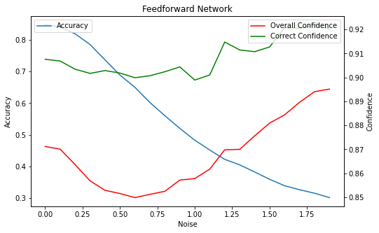
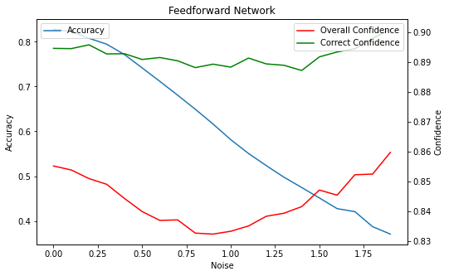
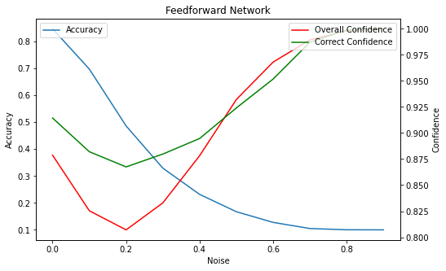
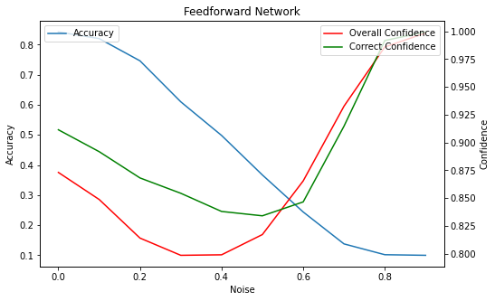
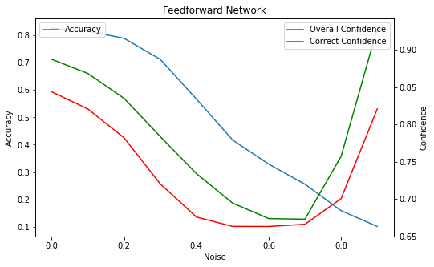
Results 3: Train using various levels of Gaussian noise
noise_confidence_reversal_noise_train.ipynb
Noise level in training | No noise | Noise between 0 and 0.3 | Noise between 0 and 0.8
Gaussian Noise
Grey Dropout

Slide 10
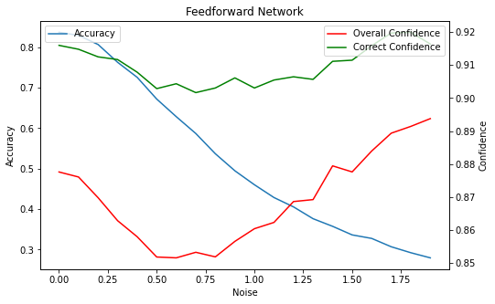
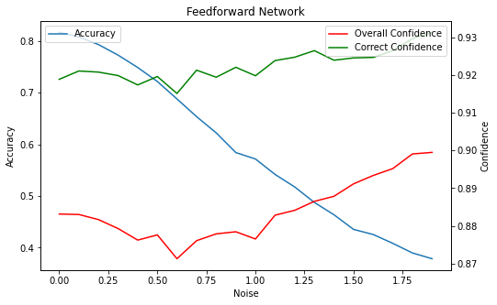
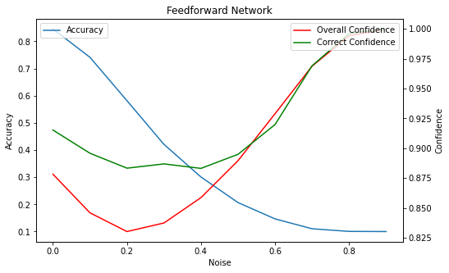
Results 3: Train using various levels of Gray dropout
noise_confidence_reversal_noise_train.ipynb
Dropout level in training | No Dropout | Dropout between 0 and 0.3 | Dropout between 0 and 0.8
Gaussian Noise
Grey Dropout

Slide 11
Results 4
noise_confidence_reversal.ipynb
We tested several methods proposed in the literature for calibrating NNs
  Training a Bayesian Neural Network (BNN)
  Ensemble testing (i.e., training and testing multiple instantiations of a model)
    noise_confidence_reversal_multi_train.ipynb
  Mix up (data augmentation technique that involves a data set with linear combinations between different samples; this allows the network to learn blurry labels that have a mix of 2 classes)
Results: BNNs and ensemble testing didn’t help at all; Mix up had no effect on Gaussian noise and contrast but did well with Gray dropout

Slide 12
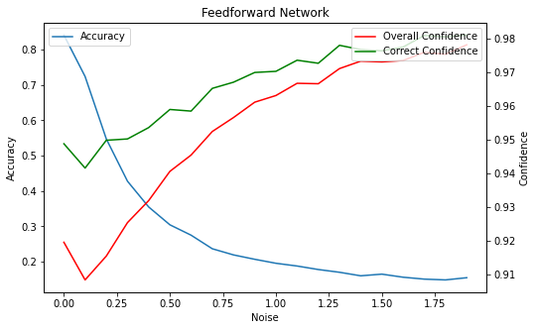
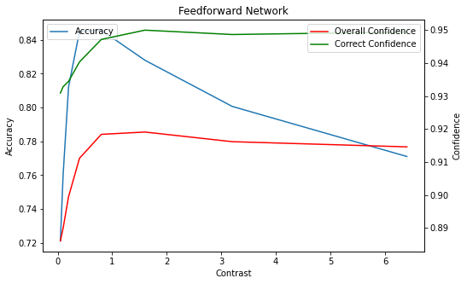
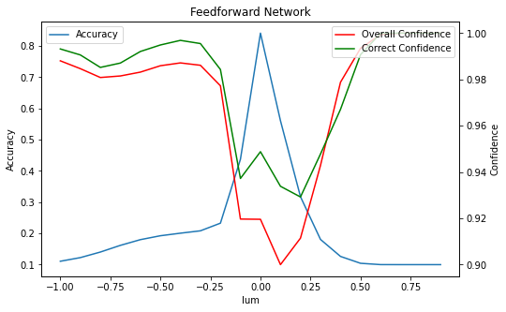
Results 4: BNN
noise_confidence_reversal.ipynb
Gaussian noise
Contrast
Luminance

Slide 13
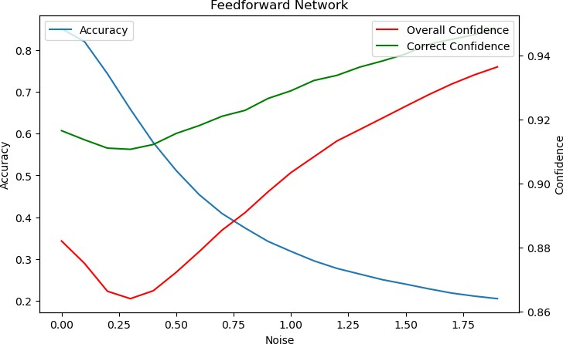

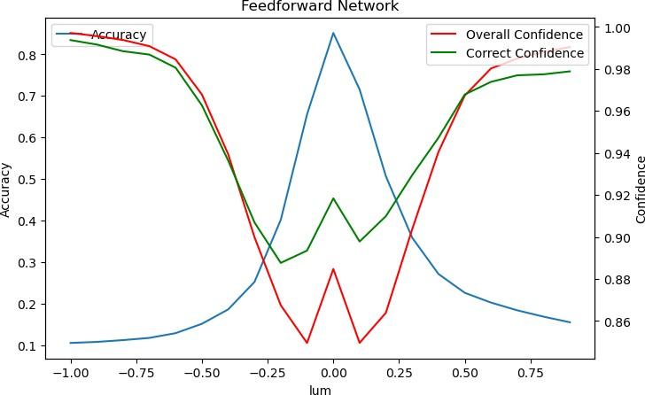
Results 4: Ensemble testing
    noise_confidence_reversal_multi_train.ipynb
Gaussian noise
Contrast
Luminance

Slide 14
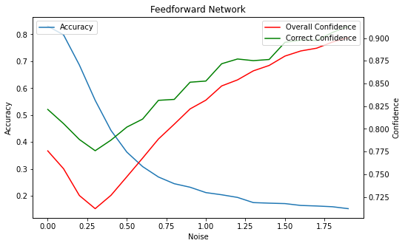
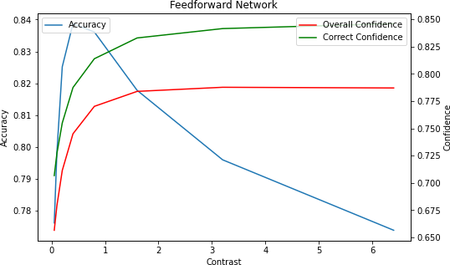
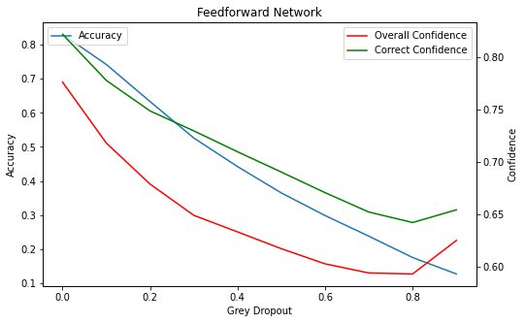
Results 4: Mix up
noise_confidence_reversal.ipynb
Gaussian noise
Contrast
Gray dropout

Slide 15
Results 5
noise_confidence_reversal_activation_histogram.ipynb
We analyzed histograms of binned activation levels for different stages of neural network
We found that larger noise levels lead to larger spread in the activations in both the hidden and output (but pre-softmax) layers. Since softmax leads to more extreme values for multiplicative transformations of its input, this higher variability likely accounts for the observed effects on confidence.

Slide 16
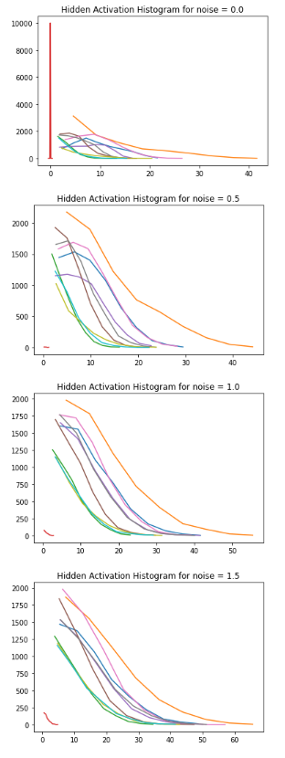
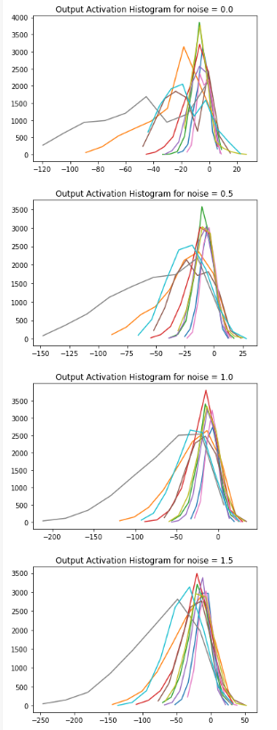
Results 5
noise_confidence_reversal_activation_histogram.ipynb
Activations in output layer (but before softmax)
Activations in hidden layer

Slide 17
Overall summary
In neural networks, when noise is present in the testing set that was not in the training, confidence disassociation occurs where confidence increases with increased noise
Existing methods for improving confidence calibration don’t deal with this issue well
Training on data with a range of noise levels alleviates this problem (within the trained range) and may improve confidence across a range of manipulations

Slide 18
Questions
What part of this project would be most interesting to the ML community?
What additional analyses should we run?
How should we frame the paper?
What journals/conferences should we target?

