Slide 1
Which car should you get?
Dispatch rules for destination-controlled elevators, measured
elevator-dispatch-sim · one engineer, one AI assistant, one brief
Elevator dispatch, measured
01 / 16
Notes:
Good afternoon. This is a walkthrough of the elevator-dispatch simulator: what the question was, what I built, what the measurements say, and how the work was done. Fifteen minutes, then questions; halfway through I will switch to the live simulator for a couple of minutes. The problem first; then what was built, how, and how it was checked; then the live simulator; then the answer, the findings, and what to do with them.

Slide 2
The problem in plain language
Destination dispatch
What good means
Why it is not obvious
You enter your destination before you board. The controller picks one car, at that moment, and the choice is final.
Short wait — request to boarding. Short total time — request to arrival. And fairness : no one waits far longer than everyone else.
The controller cannot see the future. And the goals pull apart: the best average bundles people onto a busy car, which is efficient on the whole and hard on whoever keeps being passed over.
Elevator dispatch, measured
02 / 16
Notes:
In a destination-controlled building you type your floor before you board and a display says: car C. That assignment is final. Good means three things at once: short waits, short total journeys, and nobody left standing for a very long time. It is not obvious because the controller cannot see the future, and because the fastest average tends to bundle people onto a car already going their way — efficient in aggregate, occasionally cruel to the individual who keeps being passed over.

Slide 3
What was built
Tick loop
Feed
LOOK movement · capacity · dwell
Outputs
Requests
positions.csv trace.json summary
Evidence
CSV · validate
→
releases a request only when its time has come
→
→
→
compare table · charts · browser simulator
Smart dispatch
Nearest car
Take turns
3
7
192
0
rules behind one interface
seeded traffic patterns · 20 fresh seeds each
tests, six levels
runtime dependencies
Elevator dispatch, measured
03 / 16
Notes:
One picture. Requests come in as a CSV, are validated, and a feed releases each one to the controller exactly at its time — never earlier. The tick loop asks a scheduler which car; three rules answer behind one interface. The loop moves the cars and writes the positions log, a trace and statistics. Around that: a seeded generator for seven traffic patterns — each re-drawn with twenty fresh seeds in the robustness study — a compare command, charts, a browser simulator that runs a JavaScript port of the same engine, and 192 tests.

Slide 4
How the work was done
seven phases over two days
01
02
03
04
05
06
07
Frame
Plan
Research
Build & test
Measure
Validate
Document
The brief read closely, four questions answered.
Eleven ambiguities pinned; working rules; checkpoints.
How real controllers assign; traffic patterns from the literature.
Engine, three rules, seeded scenarios, 192 tests.
Comparison, charts, car usage, the browser simulator.
Adversarial review; twenty fresh seeds per pattern.
Whitepaper, assumptions, design notes, this deck.
owner
owner + assistant
assistant, autonomous
assistant
assistant
owner + assistant
assistant
OWNER
ASSISTANT
Intent, scope and quality bar. Every judgement call. Review at each checkpoint before anything was committed.
Drafted, researched, built, tested, challenged. Executed the plan autonomously, committing as it went.
Time: two sessions on consecutive days — one to two hours of my attention on the first, two to three on the second; about six hours of wall-clock in the history, the assistant doing the rest.
Elevator dispatch, measured
04 / 16
Notes:
The method is the point, not the tool. Seven phases. I framed the problem from the brief and answered the assistant’s four questions; together we fixed a plan that pinned every ambiguity and set working rules. Then research into how real controllers assign cars and what traffic looks like, the build with tests at every level, the measurement — comparison, charts, car usage, the browser simulator — an adversarial review including a twenty-seed robustness study, and the documentation and this deck. My part throughout: intent, scope, quality bar, every judgement call, review at each checkpoint. The assistant drafted, researched, built, tested and challenged, executing the plan autonomously. Time, honestly: two sessions on consecutive days, one to two hours of my attention on the first and two to three on the second, about six hours of wall-clock with the assistant doing the rest.

Slide 5
How the model works
for the engineers · skippable
ONE TICK, IN FIXED ORDER
ENFORCED BY STRUCTURE, PINNED BY TESTS
1
Release and assign — requests due now reach the scheduler; it returns a car index.
No peek-ahead. The feed releases a request only when time ≤ now; a spy scheduler proves it.
2
Unload, then load — at the current floor, in request order, while capacity allows, only in the departure direction.
Assignment is final , as in real destination systems — so capacity is the scheduler’s problem.
LOOK movement. Keep direction while a stop lies ahead; never carry anyone away from their destination.
3
Log — one row of positions per tick, from tick 0.
4
Advance — each car moves one floor toward its next stop, dwells, or stays idle.
A stop costs one tick. The brief’s literal model is recovered with --dwell 0.
Elevator dispatch, measured
05 / 16
Notes:
For the engineers — I will skip this if we are short on time. Time is discrete: one tick is one floor of travel, and a stop costs one tick; without a stop cost, fewer stops would have no effect and all three rules would look the same. Inside a tick the order is fixed: release and assign, unload then load, log, advance. Three things are enforced by structure rather than promised: the feed cannot release a future request, assignment is immutable, and cars follow LOOK.

Slide 6
The three dispatch rules
Smart dispatch
Nearest car
Take turns
ETD · estimated time to destination
baseline · distance
baseline · round robin
Picks the car that delays everyone the least: the newcomer’s projected time to destination plus the delay added to passengers already assigned.
Sends the closest car going the right way; a large penalty if the car is moving away or in the wrong direction.
Cars take requests in strict rotation, wherever they are. It uses no information at all.
Trade-off: ignores how many stops the car already has — so it degrades as load rises.
Trade-off: nobody is singled out for a long wait; everybody waits longer.
Trade-off: optimises the aggregate; without a fairness weight it can leave one person waiting a long time.
Three policies sit on top of any rule: a fairness weight that makes long waits progressively more expensive to extend, parking idle cars at a chosen floor, and zoning cars to a range of floors.
Elevator dispatch, measured
06 / 16
Notes:
Three rules, one interface. Smart dispatch projects each candidate car’s route with and without the new passenger, using the simulation’s own movement code, and charges the passenger’s own time to destination plus the delay inflicted on everyone already assigned — the estimated-time-to-destination method Peters Research describes and commercial controllers use. Nearest car sends the closest car going the right way and ignores how many stops that car already has. Take turns uses no information at all — the floor for the comparison, and by accident the most even-handed rule.

Slide 7
How the numbers were assured
192
50/50
41
tests, six levels
scenario × rule combinations
findings, adversarial review
1
Unit — every observable assumption
The browser engine is a JavaScript port. Positions per tick, the full event list and every passenger’s lifecycle are asserted identical to Python’s.
0
blockers · 8 major
2
Structural — no peek-ahead
16
changed code or tests
3
Property-based invariants, random buildings
21
changed documents
4
resolved otherwise
4
Golden statistics — every committed result
20
fresh seeds per pattern — the headline held
5
Scenario and CLI, end to end
6
JS / Python conformance — incl. per-car usage
Elevator dispatch, measured
07 / 16
Notes:
Before the demo and the numbers: why you should believe them. 192 tests at six levels — unit tests for every observable assumption, a structural no-peek-ahead test, property-based invariants over random buildings, golden statistics that now pin every committed result so a behaviour change forces a documentation change, end-to-end CLI checks, and a conformance matrix that runs the JavaScript port on all fifty scenario-by-variant combinations and asserts identical positions, events and car usage. Then an adversarial review of the whole repository: forty-one findings, no blockers, eight major; sixteen changed code or tests, twenty-one changed documents, four resolved otherwise. The review also re-drew every pattern with twenty fresh seeds — the headline held, two secondary claims did not. Sceptic’s question: two engines agreeing only proves they share the same bugs. Correct — conformance proves equality, not correctness; correctness comes from the unit and property tests and from a 400-seed fuzz, which broke no invariant.

Slide 8
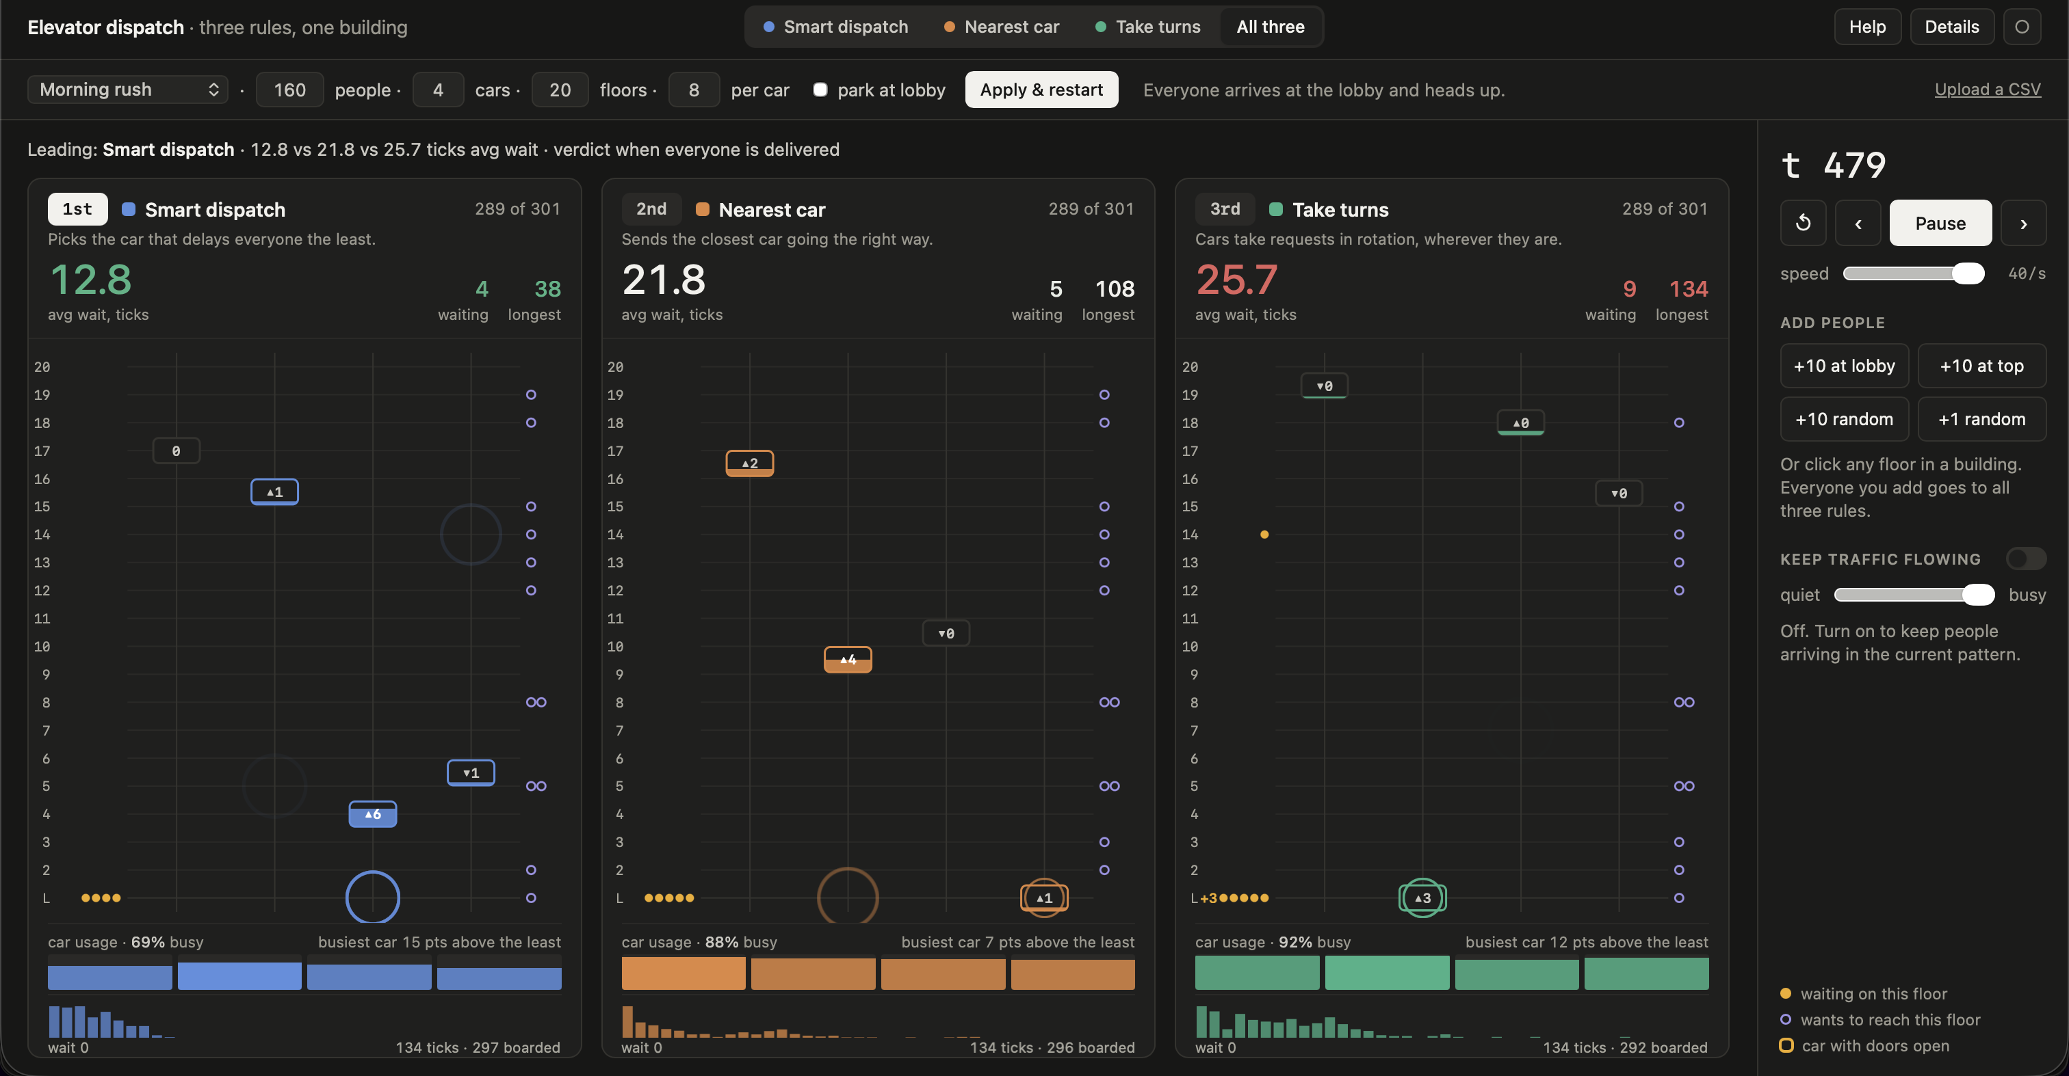
SWITCHING TO THE BROWSER
The live simulator
samuelgregorovic.github.io/elevator-dispatch-sim/docs/viewer/
WHAT TO WATCH FOR
·
Three rules, one building, the same 160 people — the ranking updates live.
·
Amber dots are people waiting. Watch where they pile up under each rule.
·
The usage strip under each building: one bar per car, filled by busy share — see which cars sit out.
·
Click a floor to add a passenger; tick park at lobby and restart.
Elevator dispatch, measured
08 / 16
Notes:
Now the live simulator — the same engine, ported to JavaScript and verified identical to Python on all fifty scenario-by-rule combinations. I will run the morning rush: 160 people, 4 cars, 20 floors, 8 per car. Watch the ranking at the top of each building change as people are delivered; watch nearest car pile passengers onto whichever car is closest to the lobby while take turns sends a far car; watch the usage strip under each building — one bar per car — to see smart dispatch leave cars idle while take turns keeps all of them busy; then I will tick park at lobby and click a floor to add a passenger — everyone I add goes to all three rules.

Slide 9
THE QUESTION
How should a bank of elevators decide which car takes which passenger — and how much does the choice matter?
THE ANSWER, MEASURED
1.2–2.6×
2–3×
shorter average wait with smart dispatch than nearest car , across twenty fresh seeds per pattern — 3.7× on the committed tower draw
shorter than take turns — lowest average wait in 119 of 120 runs across the six realistic patterns
Elevator dispatch, measured
09 / 16
Notes:
Back from the demo — now the question, and the short answer. The question is simple to state: a bank of cars, passengers who tell the system where they are going, a controller that must pick a car for each one — how much does the rule matter? The answer, measured on identical traffic and then re-drawn twenty times per pattern, is a lot. Smart dispatch waits are 1.2 to 2.6 times shorter than nearest car across seeds — 3.7 on the committed tower draw, which was a high one — and 2 to 3 times shorter than taking turns. It had the lowest average wait in 119 of 120 runs on the six realistic patterns; on the saturated lobby burst the rules are within noise of each other.

Slide 10
Average wait per rule, per pattern
ticks · lowest in bold
Scenario
Smart
Nearest
Turns
TWO CASES THAT GO THE OTHER WAY
Morning up-peak · 20 floors, 4 cars
7.1
12.0
16.5
Lobby burst: within noise
Lunch two-way · 20 floors, 4 cars
4.0
6.9
13.2
60.3 against 60.1 on the committed draw; across twenty seeds 55 ± 21, 61 ± 20 and 59 ± 19 — within noise, smart dispatch lowest in 12 of 20. Every request has the same origin and the system is saturated; the rule does not matter here.
Evening down-peak · 20 floors, 4 cars
7.6
10.8
17.9
Quiet interfloor · 20 floors, 4 cars
3.9
4.5
8.1
Tower · 51 floors, 6 cars
18.3
67.1
51.4
The brief’s sample: nearest car wins
Lobby burst · 20 floors, 2 cars × 6
60.3
76.2
60.1
6.3 against 15.0 on three passengers. Smart dispatch splits two lobby passengers across both cars to save a stop, leaving no idle car for the third request. A greedy rule with no view of the future can lose on tiny inputs — which is why the scenarios, not the sample, are the basis for judgement.
Elevator dispatch, measured
10 / 16
Notes:
The headline numbers, average wait in ticks, on the committed draw of each pattern. Smart dispatch wins the four office patterns and the tower. Two cases go the other way and I would rather show them than hide them. Under the lobby burst — 76 people, one origin, two small cars — the three rules are within noise of each other: 60.3 against 60.1 here, and across twenty seeds 55, 61 and 59 with a standard deviation of about 20; when the system is saturated the rule does not matter. And on the brief’s own three-passenger sample nearest car wins: smart dispatch splits two lobby passengers across both cars to save a stop, so no car is idle when the third request comes. Sceptic’s question: why not tune the sample away? Because a greedy per-request rule can lose on tiny inputs, and the fix — batch re-optimisation — is a real change, first on the future-work list, not a parameter tweak.

Slide 11
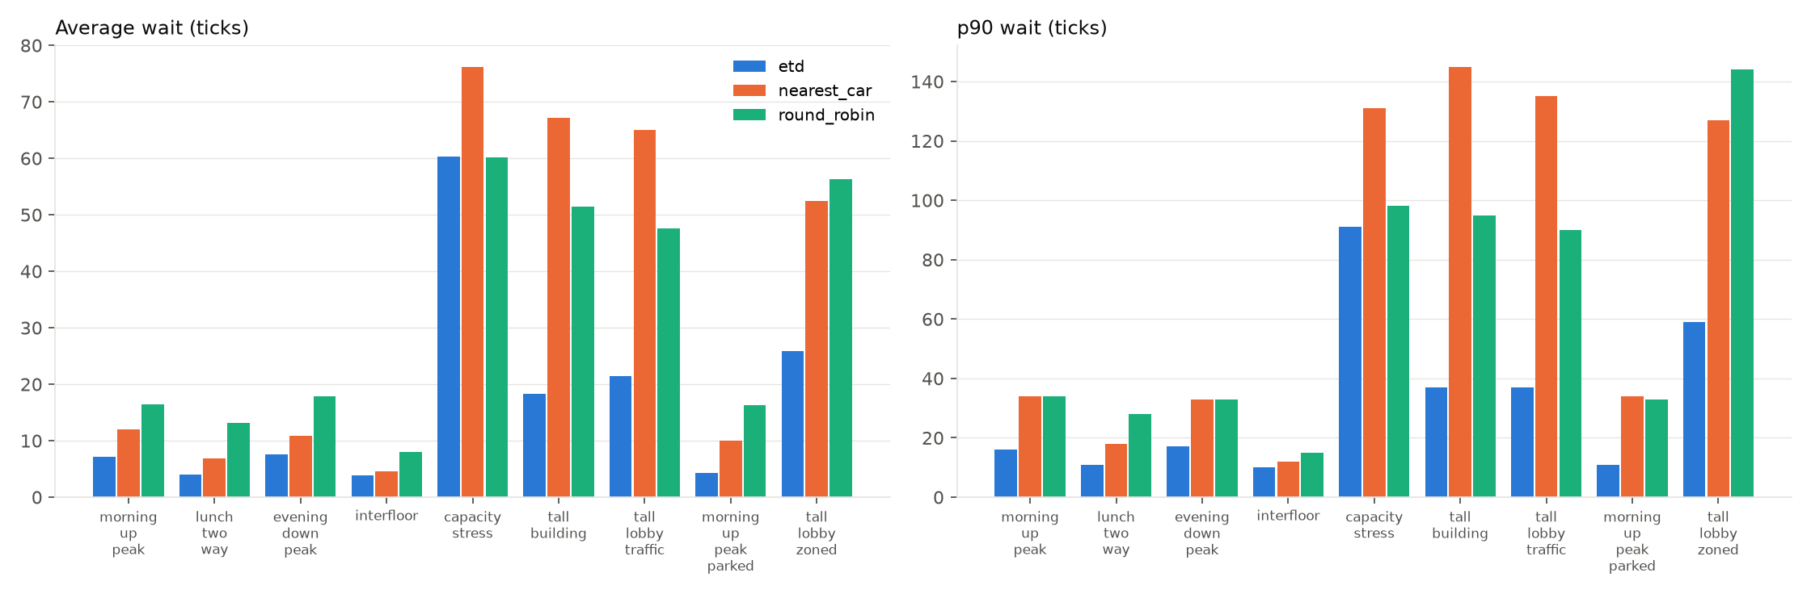
Waiting time by scenario
ticks · identical traffic per rule
Smart dispatch
Nearest car
Take turns
Lowest on every realistic pattern; the margin grows with height and load.
Elevator dispatch, measured
11 / 16
Notes:
This is the committed chart: average wait on the left, 90th percentile on the right, every scenario, all three rules on identical traffic. Blue is lowest on every realistic pattern, and the gap grows as the building gets taller and busier: small on quiet interfloor traffic, very large on the 51-floor tower. Sceptic’s question: every scenario is one seed — how do you know? The final review re-drew every pattern with twenty fresh seeds. The direction is robust: smart dispatch had the lowest average wait in 119 of 120 runs on the six realistic patterns. The size is not: the tower ratio is 2.6 ± 0.8 across seeds and the committed 3.7 was a high draw. Two secondary claims did not reproduce, and they are on the use-case slide after the demo, labelled as such.

Slide 12
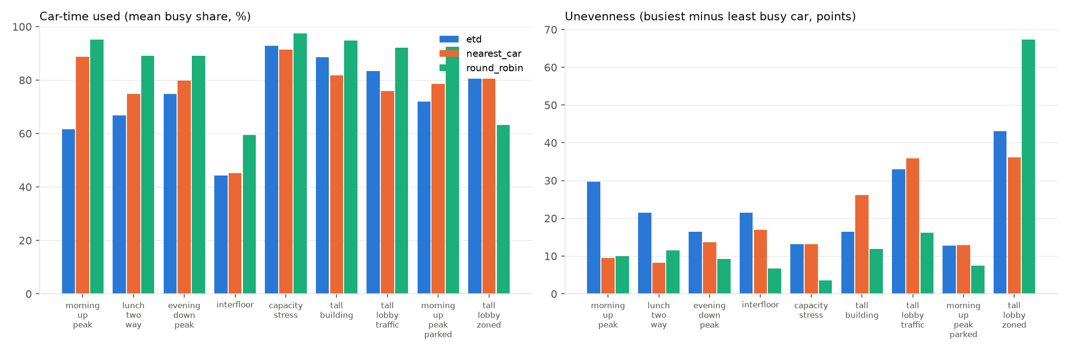
How the cars are used
busy = aboard or assigned · spread = busiest − least busy car
62%
89%
95%
36% fair share 25%
30 → 18 · 21 → 5 · 33 → 10
vs
vs
Least car-time for the same job. Cars busy in the morning peak; fewer stops per trip is less travel per passenger.
But the work is shared least evenly. One car in four carries 36% of the morning passengers.
The fairness weight evens the cars as a side effect. Spread in points, committed draws; narrower in 11–15 of 20 fresh seeds. One knob, two effects.
Elevator dispatch, measured
12 / 16
Notes:
Waiting time says how the passengers fared; this says how the cars were used. A car is busy when it has someone aboard or someone assigned and still waiting. Three points. Smart dispatch does the same job with the least car-time — 62% busy in the morning peak against 89% and 95% — because fewer stops per trip is less travel per passenger; take turns keeps its cars busiest everywhere, which is waste, not throughput. But smart dispatch shares the work least evenly: one car in four carries 36% of the morning passengers where a fair share is 25%. And the fairness weight evens the cars as a side effect — 30 to 18 points in the morning, 21 to 5 at lunch, 33 to 10 on the tall lobby on the committed draws, and narrower in 11 to 15 of 20 fresh seeds on every pattern. One knob, two effects — it also raises the average wait in most seeds. Sceptic’s question: busy for a car that is travelling to a pickup — is that use or waste? It is work caused by the assignment, so it counts; that is the definition in A20, and a car driving to its parking floor is excluded.

Slide 13
Which rule, which policy, for which building
average wait, ticks
Building and traffic
Choose
Evidence
Ordinary office, moderate traffic · ≤20 floors
Smart dispatch. 1.5–2× shorter average wait than nearest car on the three peaks across seeds; 29–42% on the committed draws.
Strong · 20 of 20 seeds on each peak
Quiet, interfloor traffic
Smart dispatch , but by 1.2× — a nearest-car controller is within 15% here.
19 of 20 seeds
Tall building · ~50 floors
Smart dispatch — 2.6× across seeds (3.7× committed draw); nearest car’s maximum 250 ± 85 against 65 ± 13.
Strong · 20 of 20 seeds
Where the tail matters · hospitals, hotels
The fairness weight works reliably only under saturation: burst max lower in 14 of 20. The tower’s 108 → 56 was one draw — max lower in 4 of 20, average up in 18.
Robust on the burst · not reproduced on the tower
Morning up-peak, known lobby
Park idle cars at the lobby. 7.1 → 4.3 average on the committed draw; −38.6 ± 11.6% across seeds. Should follow time of day.
20 of 20 seeds
Even wear across cars · per-car maintenance
Add the fairness weight — it narrows the spread between cars. Do not switch to take-turns: it evens cars by working all of them more.
Majority of seeds · 11–15 of 20 · wear not modelled
Saturation · more people than cars can move
No rule fixes a capacity problem — the three rules are within noise. The levers are cars and capacity.
20 seeds · same answer: the rule does not matter
Zoning and express cars
A null result at moderate load: 24.4 vs 24.8 across seeds, worse in 11 of 20. The committed 21.4 → 25.8 was one draw.
Null result, 20 seeds · positive case untested
Elevator dispatch, measured
13 / 16
Notes:
The practical output, with the evidence strength after the final review re-drew every pattern twenty times. Ordinary offices: smart dispatch, 20 of 20 seeds on each peak. Tall buildings: this is where the rule matters most — 2.6 times across seeds, 3.7 on the committed draw, and nearest car’s worst wait around 250 ticks against 65. Two rows changed. The fairness weight only reliably shortens the tail under saturation: on the tower the 108 to 56 was one draw — it lowered the maximum in 4 of 20 seeds and raised the average in 18. And zoning is a null result: 24.4 against 24.8 across seeds, not the harm first reported. Parking held on every seed, about 39% off the up-peak average. Where even wear matters, add the fairness weight rather than switching to take turns. Sceptic’s question: ticks are not seconds, so what do the absolutes mean? Nothing directly: a tick is one floor of travel and one stop; trust the ratios and the direction, not the absolute figures.

Slide 14
Limits of the model
NOT MODELLED
WHAT WOULD SHARPEN THE CONCLUSIONS
Door and acceleration physics — a stop is one tick, whoever boards
Reassignment after dispatch, as hybrid systems allow
Sky-lobby transfers across zones
Passenger no-shows and group entries
Energy
A sweep of arrival rate — where each rule breaks down
A sweep of car count — the price of capacity
Fairness weight swept on more than two scenarios
The saturated counterpart to the zoning experiment
Batch re-optimisation in place of greedy per-request choice
The headline survived twenty fresh re-draws of every pattern. Measuring seed variance changed two secondary claims — the fairness weight on the tower, and zoning — which is what the remaining sweeps would do to the rest.
Elevator dispatch, measured
14 / 16
Notes:
What the model does not do. No door or acceleration physics — a stop is one tick regardless of who boards. No reassignment after dispatch, no sky-lobby transfers, no no-shows or groups, no energy. One traffic level per pattern; the zoning experiment lacks its saturated counterpart. Seed variance is the one item on this list that has since been measured: twenty fresh draws of every pattern. The headline survived; two secondary claims did not — the fairness weight on the tower and the harm from zoning — and that is the honest reason the remaining sweeps matter.

Slide 15
What I would do next
BUILD, IN THIS ORDER
QUESTIONS FOR A REAL CUSTOMER FIRST
1
Reassignment window — move a passenger until their car starts slowing, as hybrid systems do.
What does your traffic look like — arrival rate and mix, by hour?
Which complaint are we fixing: the average wait, or the worst one?
Is a zoned or sky-lobby bank on the table, or one free group?
May the display change a passenger’s car after it is shown?
Do people travel in groups, and how often do they not show up?
2
Batch re-optimisation — revisit outstanding assignments every few ticks.
3
Time-of-day policies — parking floor and fairness weight follow the traffic profile.
Elevator dispatch, measured
15 / 16
Notes:
Next, in order of expected effect: a reassignment window, which is what hybrid systems do and the change most likely to help under bursty load; batch re-optimisation every few ticks, which addresses the greedy loss on the sample; and policies that follow the time of day. Before building any of it I would ask a customer five things — because the answers decide which of these matters, and whether a tick-based model is even the right tool for their building.

Slide 16
A rule that accounts for queued stops and the delay it inflicts on others beats rules that do not — increasingly so as buildings get taller and busier.
REPOSITORY
LIVE SIMULATOR
github.com/samuelgregorovic/elevator-dispatch-sim
samuelgregorovic.github.io/elevator-dispatch-sim/docs/viewer/
Elevator dispatch, measured
16 / 16
Notes:
Everything I have shown is in the repository — every number regenerates from the commands in the README, and the simulator runs the same engine in your browser. One line to take away: a rule that accounts for queued stops and the delay it inflicts on others beats rules that do not, increasingly so as buildings get taller and busier. Questions.

