Slide 1
Recent Developments in
Mantid Indirect

Slide 2
Script Generation
Where we are:
Mechanism works for the majority of cases.
Distinction between algorithms and work-flow algorithms
Able to track the history of algorithms and their parameters.
Able to produce executable scripts from the history.
Works for energy transfer & diffraction reduction
Other routines will need more work.

Slide 3
Demo

Slide 4
Script Generation: Improvements
Better structure in Indirect
For this we'll need to convert the scripts underneath Indirect to use work-flow algorithms
More intelligent formatting
Condense large properties
Use variables for workspace names

Slide 5
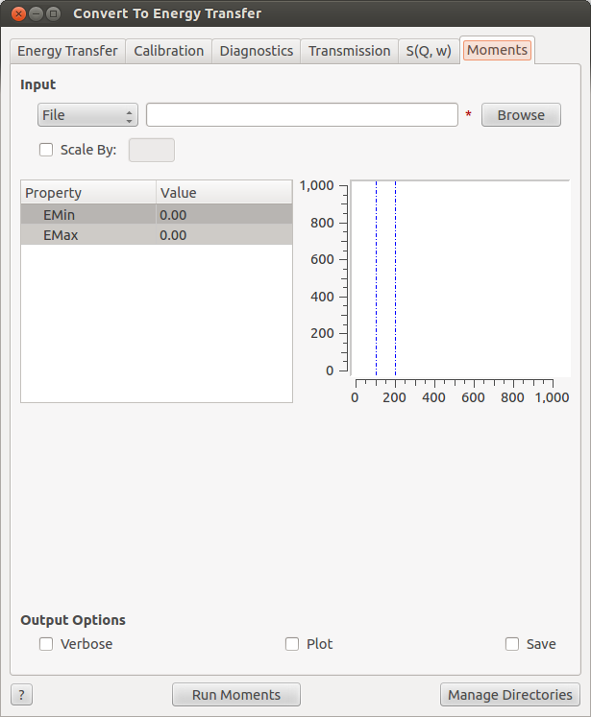
Convert To Energy
New tab: Moments
Calculates the moments of a SofQW workspace
Just another algorithm
SofQWMoments
Additional output options for IRIS/OSIRIS
.aclimax format
cm^-1

Slide 6
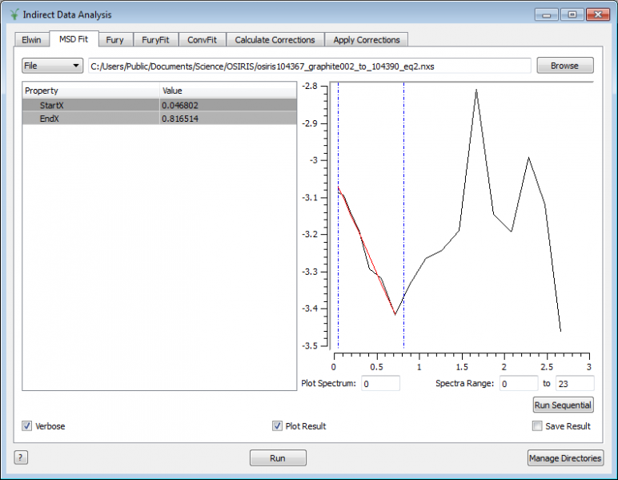
MSDFit
Restructured to work more consistently with ConvFit and FuryFit.
Plot spectrum selects which spectrum show in plot
Single fit with run button.
Sequential fit with
sequential fit button.

Slide 7
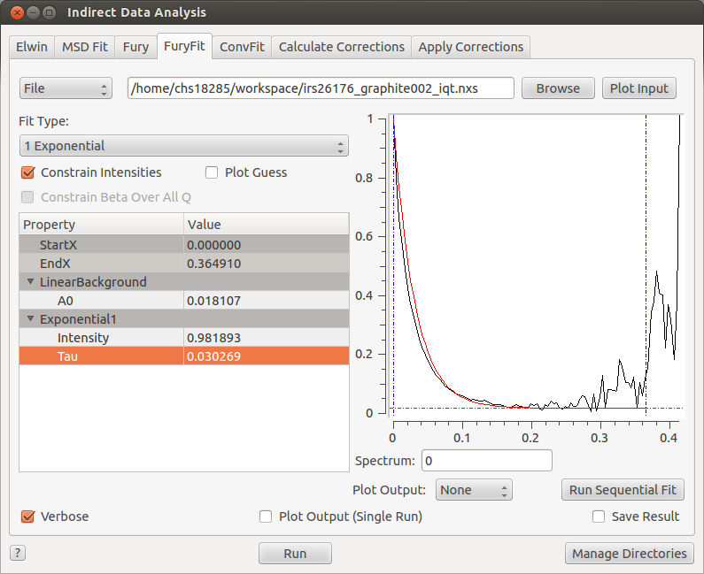
FuryFit
Improved starting parameters calculated from the data.
Fixing parameters over a sequential fit now works.
Using right-click menu,
same as ConvFit

Slide 8
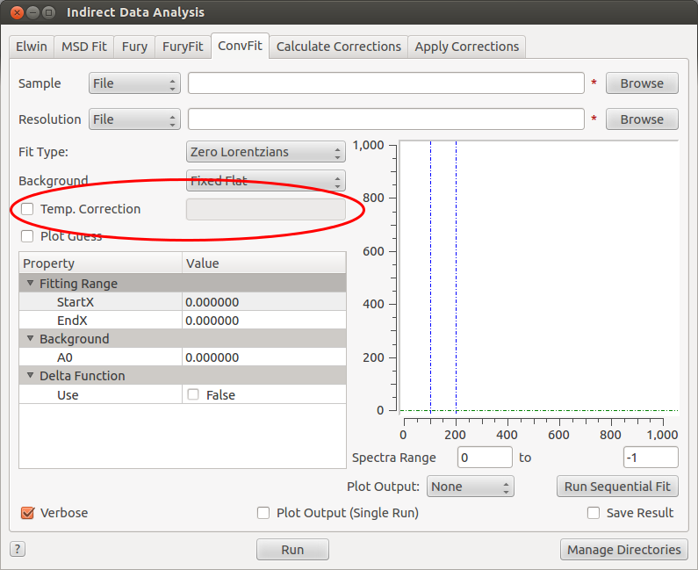
ConvFit
Additional temperature correction parameter can be added to the convolution.

Slide 9
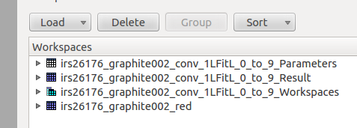
Fit Routines: A Note On Terminology
Wanted to make the output naming more consistent with Fit and PlotPeakByLogValue.
What you need to know:
Fit workspaces appear in *_Workspaces group
Fitted parameters appear in *_Result workspace

Slide 10
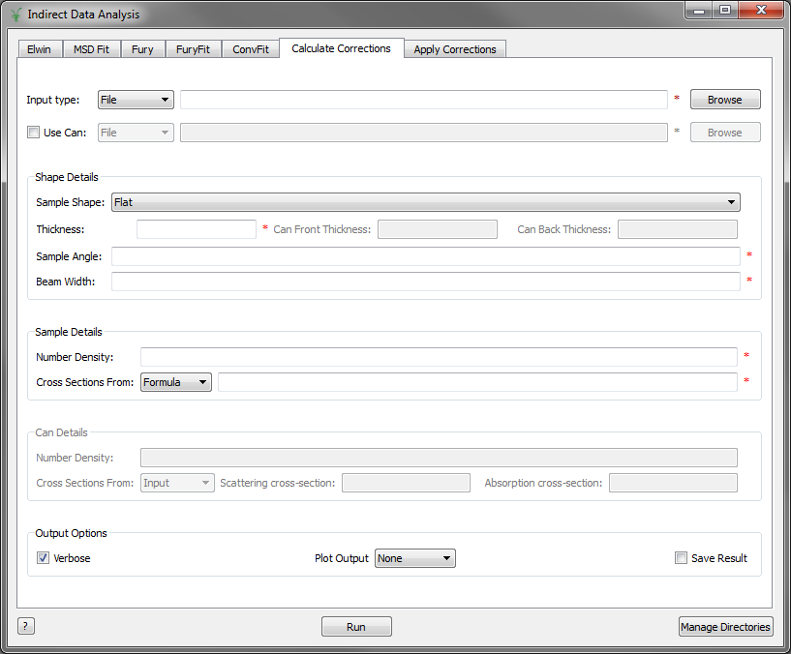
Calculate Corrections
Can now enter values for cross sections as chemical formulas.

Slide 11
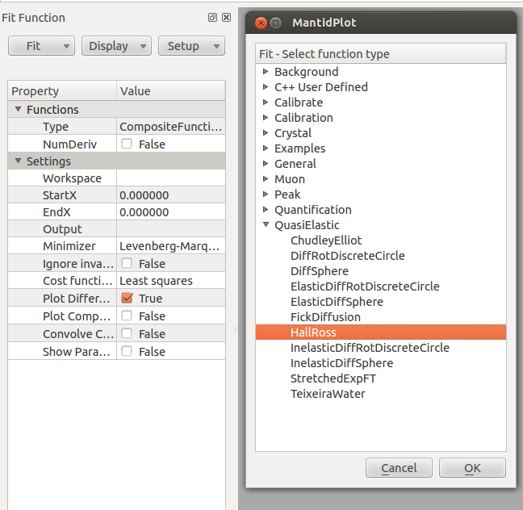
Fit Functions
New Function:
DSFInterp1DFit
Sigwi-Sjolander renamed to Hall-Ross

Slide 12
Simulation
nMOLDYN used to be in Indirect Load ASCII
Moved to Indirect Simulation
We want to add more nMOLDYN support
Sassena integration to come. (Jose)
DensityOfStates

Slide 13
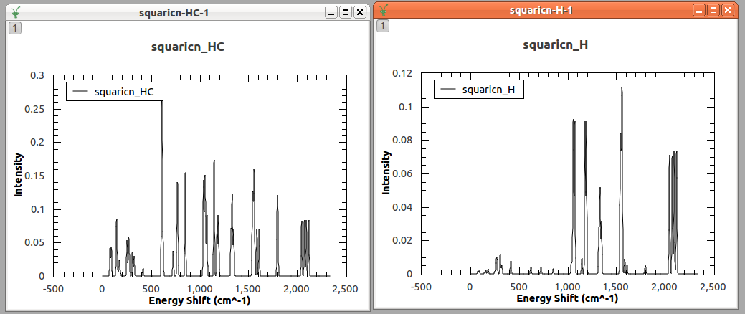
Density Of States
Algorithm now calculates the partial density of states from .phonon files.
Output as summed or individual workspaces

Slide 14
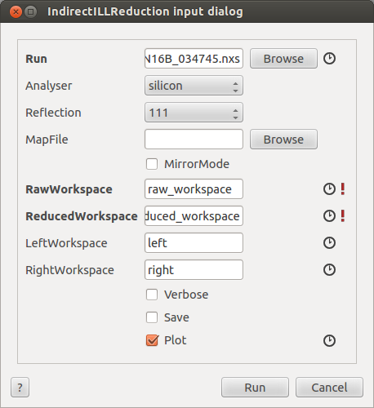
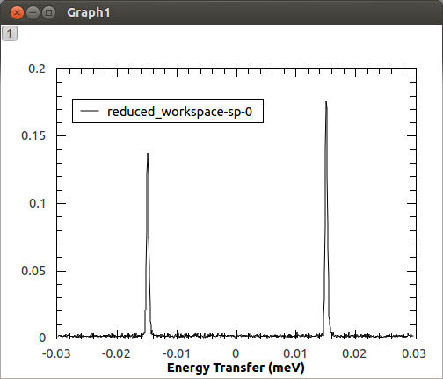
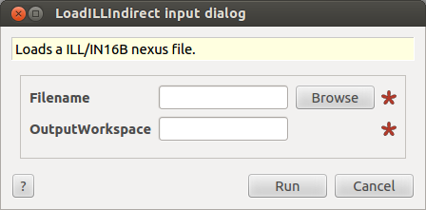
ILL Support
Some new algorithms to note:
LoadILL
LoadILLIndirect
LoadILLASCII
IndirectILLReduction (for IN16B)

Slide 15
Notable Bug Fixes
Indirect Diffraction now works again
TOSCA multi-run energy reduction fixed
And grouping issues resolved.
Can file scaling in Apply Corrections
Calibration file averaging with masked spectra

Slide 16
Next Release
Focus on Vesuvio
Parting of Direct and Indirect Interfaces
History/Scripting improvements
TFXA and TOSCA-1 support
Any other requests?

Slide 17
Thank You
Any Questions?

