Slide 1
Recent Developments in
Mantid Indirect

Slide 2
Script Generation
Where we are:
  Mechanism works for the majority of cases.
  Able to track the history of algorithms and their parameters.
  Able to produce executable scripts from the history.
  Works for energy transfer & diffraction reduction
  Other routines will need more work.

Slide 3
Demo

Slide 4
Script Generation: Improvements
Better structure in Indirect
  For this we'll need to convert the scripts underneath Indirect to work-flow algorithms
More intelligent formatting
  Condense large properties
  Use variables for workspace names

Slide 5
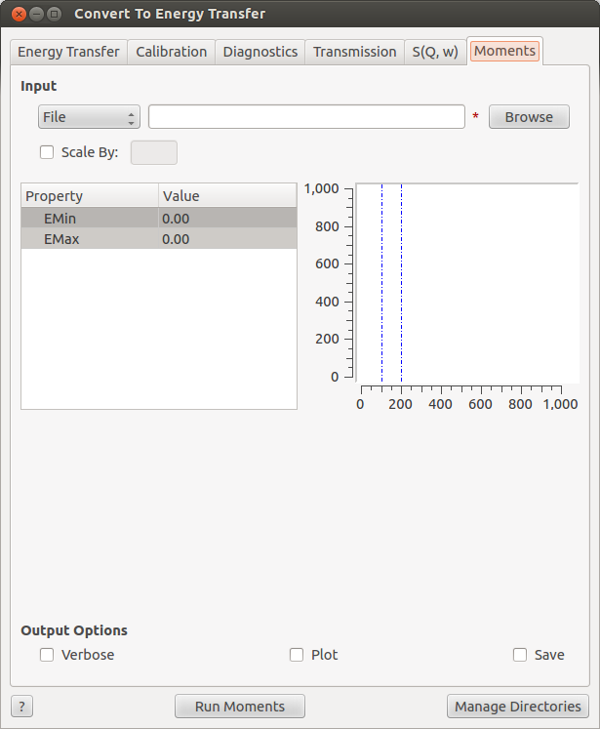
Convert To Energy
Additional output options for saving in the .aclimax format and cm^-1 for IRIS/OSIRIS
New tab: Moments
  Calculates the moments of
  an SofQW workspace
  Just another algorithm
    SofQWMoments

Slide 6
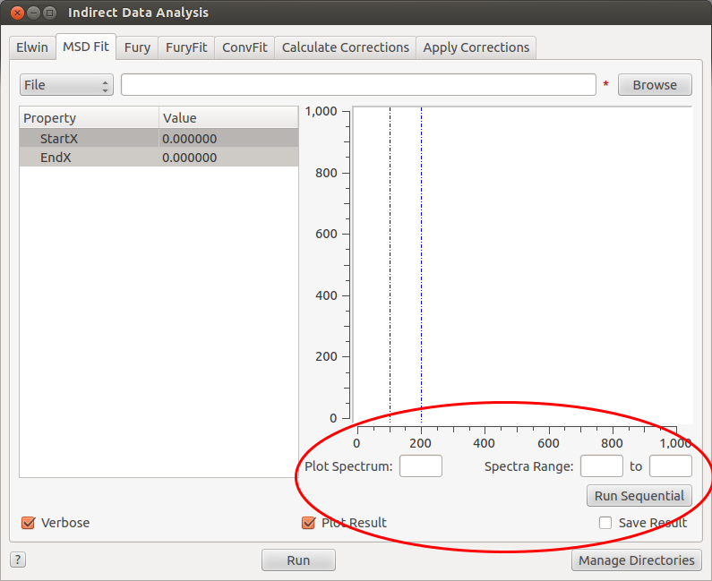
MSDFit
Restructured to work more consistently with ConvFit and FuryFit.
  Plot spectrum selects which spectrum show in plot
  Single fit with
  run button.
  Sequential fit with
  sequential fit button.

Slide 7
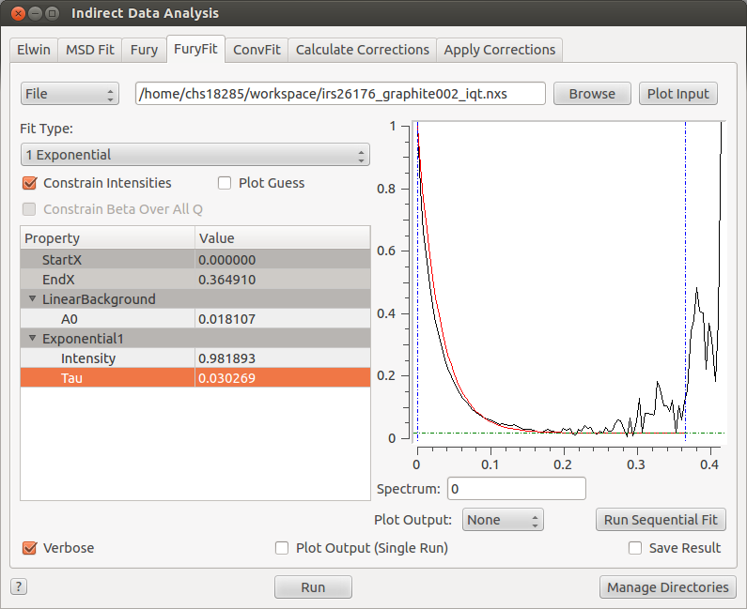
FuryFit
Improved starting parameters calculated from the data.
Fixing parameters over a sequential fit now works.
  Using right-click menu,
  same as ConvFit

Slide 8
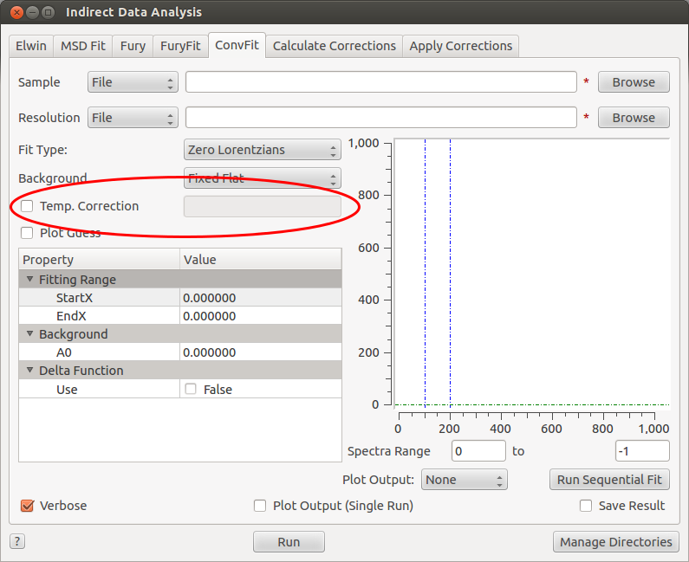
ConvFit
Additional temperature correction parameter can be added to the convolution.

Slide 9
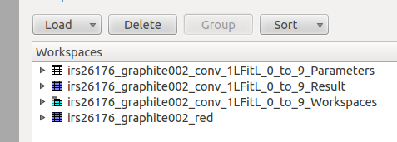
Fit Routines: A Note On Terminology
Wanted to make the output naming more consistent with Fit and PlotPeakByLogValue.
What you need to know:
  Fit workspaces appear in *_Workspaces group
  Fitted parameters appear in *_Result workspace

Slide 10
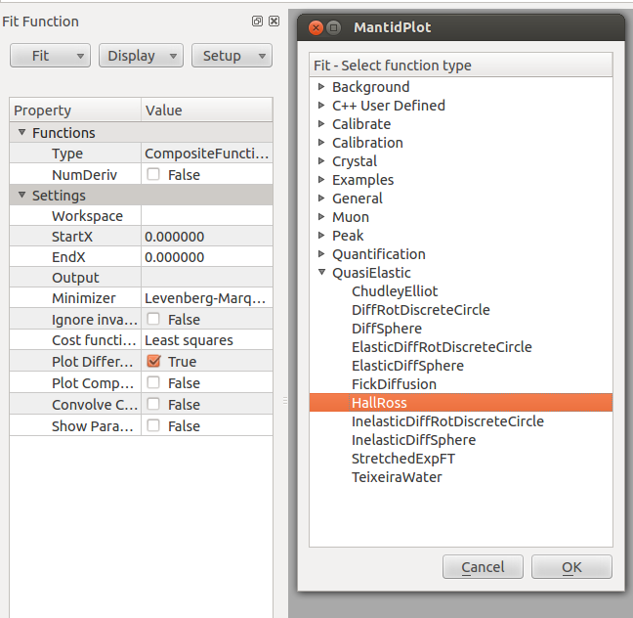
JumpFit
Two new diffusion models:
  Fick diffusion and Teixeria Water
  These are now just fit functions!
    Can use them in the fit wizard
Sigwi-Sjolander renamed
to Hall-Ross

Slide 11
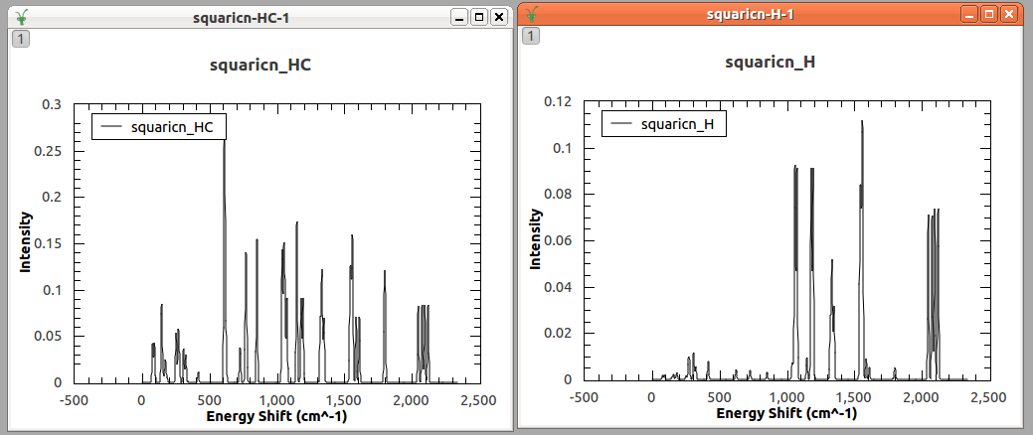
Density Of States
Algorithm now calculates the partial density of states from .phonon files.
  Output as summed or individual workspaces

Slide 12
nMOLDYN
Used to be in Indirect Load ASCII
Moved to Indirect Simulation
  We want to add more nMOLDYN support
  Sassena integration to come.
  DensityOfStates

Slide 13
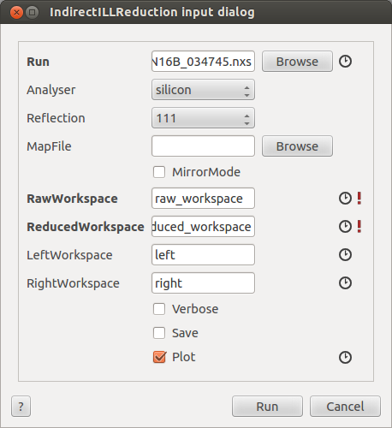
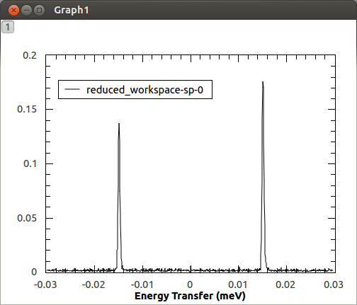
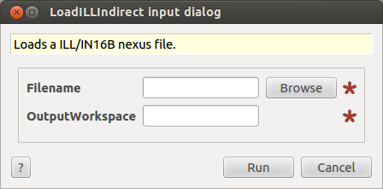
ILL Support
Some new algorithms to note:
  LoadILL
  LoadILLIndirect
  LoadILLASCII
  IndirectILLReduction (for IN16B)

Slide 14
Notable Bug Fixes
Indirect Diffraction now works again
TOSCA multiple run energy reduction fixed
Can file scaling in Apply Corrections
Calibration file averaging with masked spectra

Slide 15
Thank You
And Any Questions?

