Slide 1
A Review on Automatic Image Annotation Techniques
Samuel Jackson (slj11)

Slide 2
What is AIA?
In a nut shell: labelling images correctly!
More formally: Trying to find images that are semantically similar to our input query.
The key challenges: automation, higher level meaning.

Slide 3


What Do I Need to Do AIA?
Raw Images
Feature extraction
Segmentation
Global vs. Local
Colour, Texture, Shape based…
Semantic learning technique
Single label
Multi-Labelling
Metadata
Annotated Images
Feature
Extraction
User
Query
Image
Features
Similar Images
Semantic Learning

Slide 4
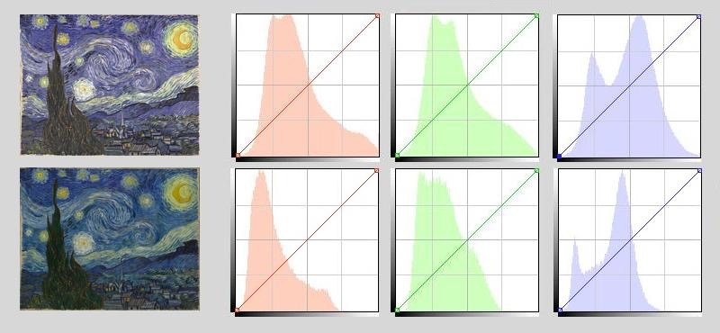
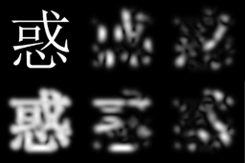
Feature Extraction
Low level representation of what characterises the image
Just a few different approaches:
Colour: Moments, Histogram, Correlogram
Texture: Texton, GLCM, Gabor
Shape: Area, Moments, Circularity
Global vs. Local?
Colour Histogram of van Gogh’s Starry Night
Gabor filtered Chinese text
Shape features from mammogram

Slide 5
Semantic Learning
Once we’ve acquired low level features we can use these to represent the image (assumption!)
Features used as input to a machine learning algorithm.

Slide 6
Single Label Annotation
Attempt to assign an image to a single concept/class
Often uses pretty simple/well known machine learning methods.

Slide 7
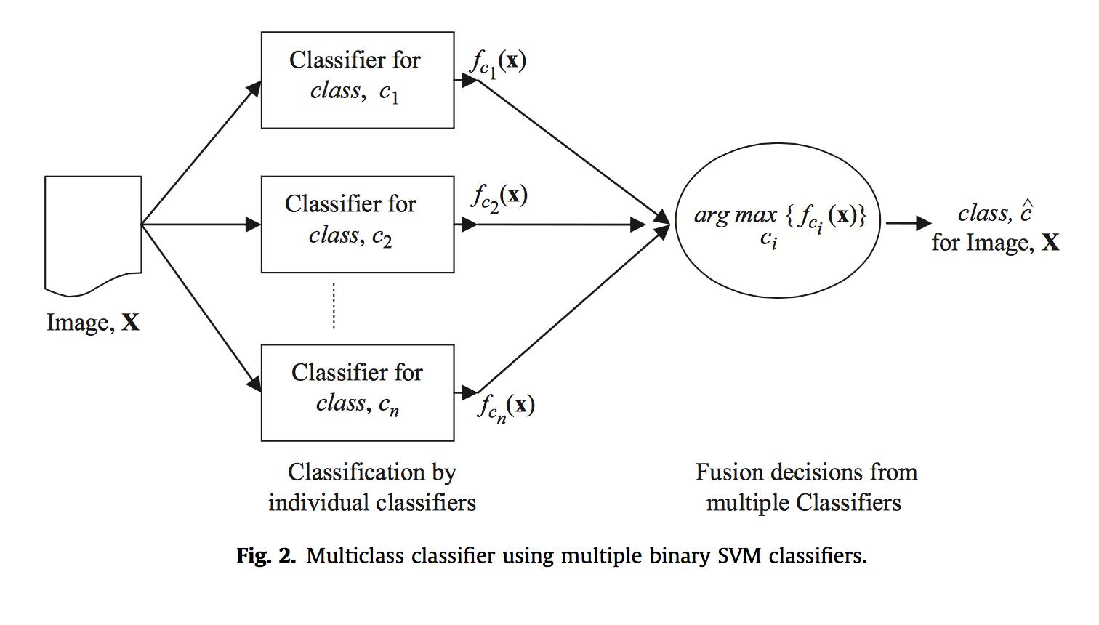
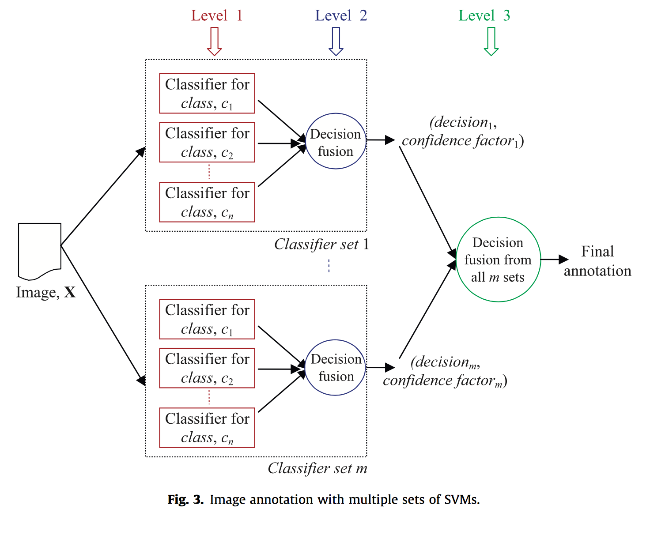
Support Vector Machines
Finds optimal class boundary
Train separate SVM for each class.
Can use multiple groups of classifiers + confidence factor
Cons: Class imbalance issues, prone to overfitting

Slide 8
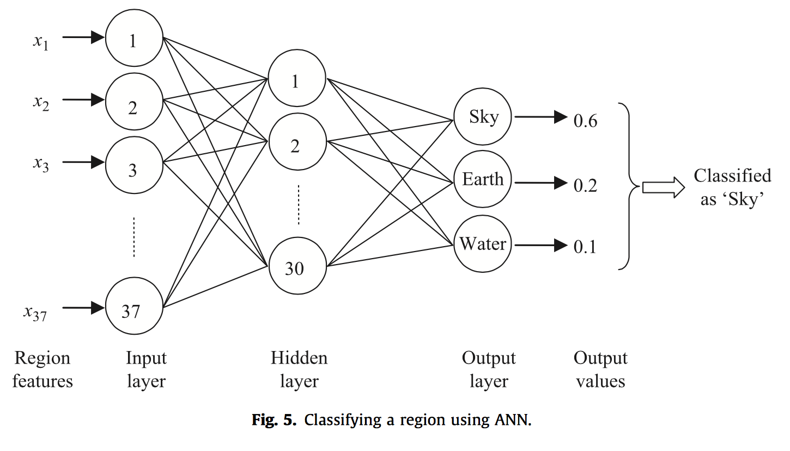
Neural Networks
Features form input layer
Output gives probabilistic estimate of class.
Cons: Black box, Number of layers?

Slide 9
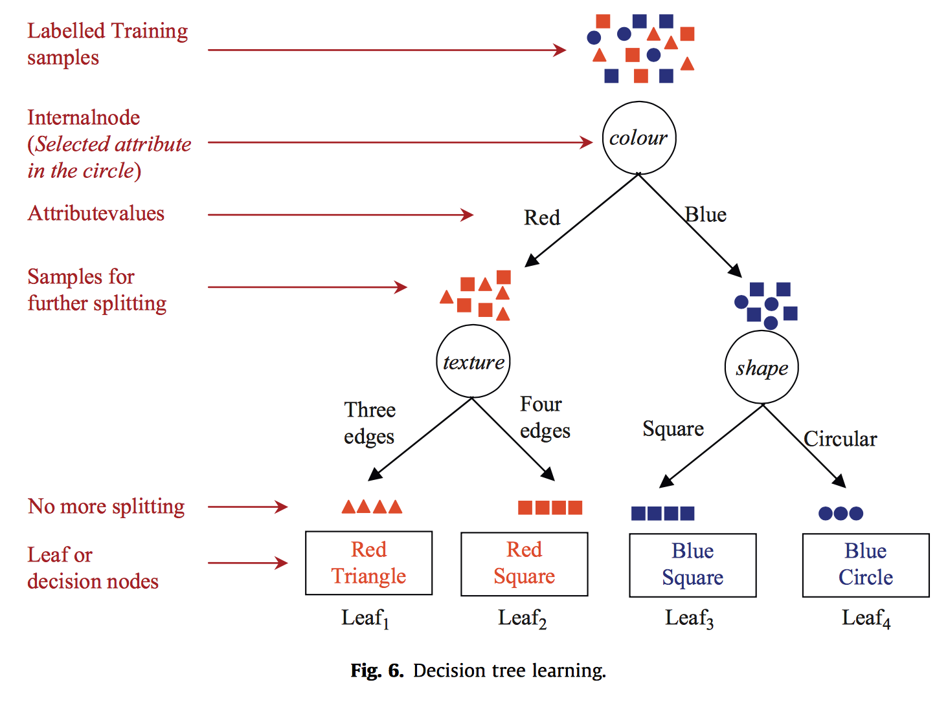
Decision Trees
Grow tree which splits training data by features
Easy to interpret the decision
Cons: Discretisation is an issue, Need to prune

Slide 10
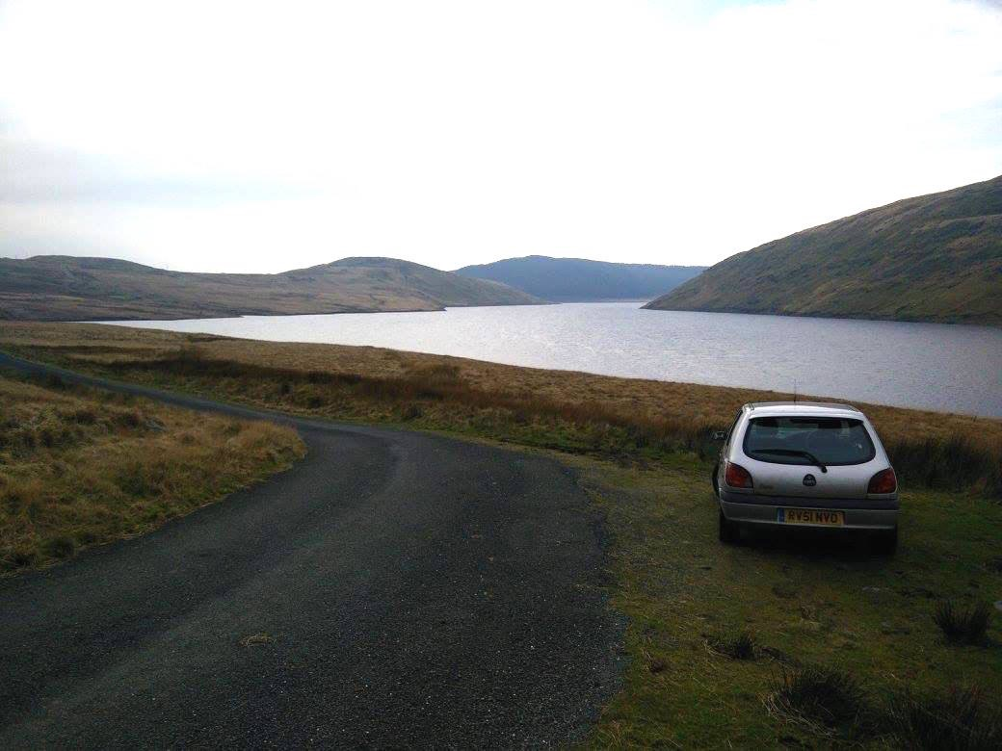
Interlude: What Should We Label This?
Car, Lake, Road, Grass, Hills, Sky, Wales, Landscape?
Google Photos says: Mountains and Car

Slide 11
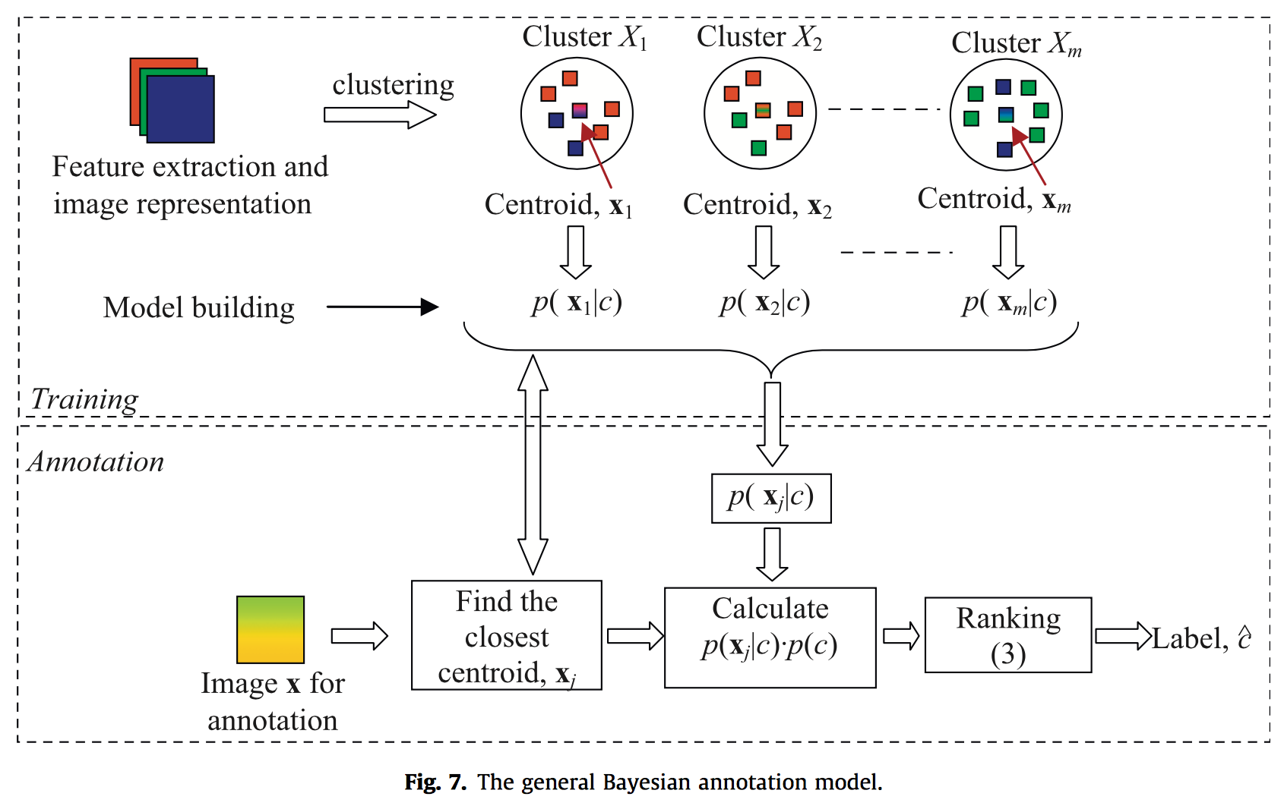
Multi-Labelling
Label images with multiple semantic concepts.
Typically formulated as a probabilistic Bayesian learning problem
Two major types:
Non-Parametric
Parametric

Slide 12
Parametric vs. Non-Parametric
Conditional probabilities are calculated without prior assumption
Pros:
Model free
Quick to train
Cons:
Lots of Parameters
Sensitive to noise
Features space assumed to follow a known distribution (often Gaussian)
Pros:
Good approximation of unknown distribution
Small samples
Cons:
Predefined distribution
Expensive training

Slide 13
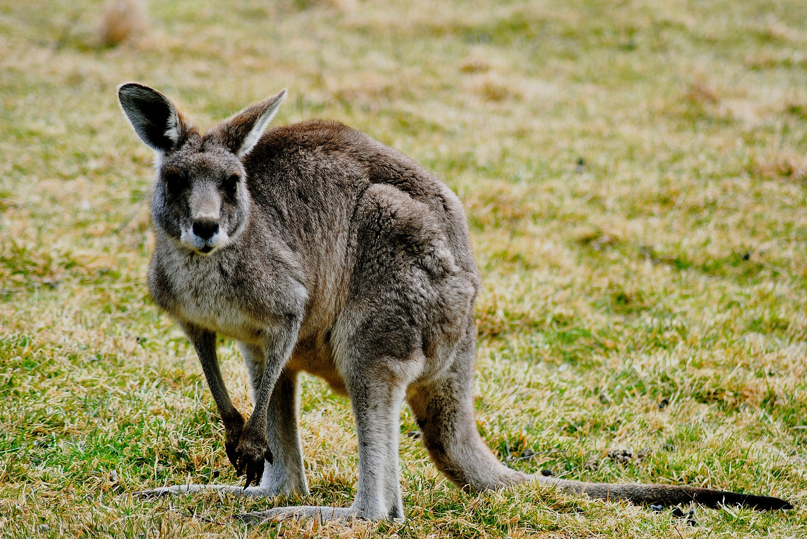
Metadata
But isn’t all this image processing is computationally expensive?
Use content from HTML, URLs, text etc.
Can use hybrid approach
Issues:
Often noisy/unreliable content
The “semantic gap”
Lexicon size
Mapping to visual features
Kangaroo or Australia?
Image source: Sinead Friel http://www.flickr.com/people/53005672@N04

Slide 14
Final Thoughts
Generally a well written & interesting paper
Covers an awful lot of content (perhaps too much?)
Gives the reader a good flavour of the methods
Perhaps out of date? Are Deep NNs used more now?

Slide 15
Thank You
Any Questions?

