Slide 1


“Doing the dirty work”: An investigation on the relationship between occupation and covid 19 Samuel Ofosuaah

Slide 2
Objectives
Research question: Do areas with a higher proportion of skilled employees have lower rates of deaths caused by covid 19? If so, is this due to potentially different vaccinations rates by occupation?
Hypothesis: Region with the lowest skilled workers will have the highest rate of covid deaths because they are less likely to get vaccinated.
Objectives:
Group occupations by the 4 skill levels defined by the ONS SOC2020 (ONS, 2020).
Compare covid deaths by occupation skill level.
Compare occupations by skill level and the proportion of non vaccinations from each skill level to the proportion of Covid-19 deaths
Compare differences in the most common occupation type and number of covid deaths by region.

Slide 3
Skill level
Definitions of the different skill levels directly lifted from ons.gov.uk (2020)
Skill levels: measured by the length of time deemed necessary for a person to become fully competent in the performance of the tasks associated with a job. This, in turn, is a function of the time taken to gain necessary formal qualifications or the required amount of work-based training.
Skill level 1: general education, achieved upon completion of compulsory education, signalled via a satisfactory set of school-leaving examination grades. Approx. GCSE level
Skill level 2: requires knowledge provided via a good general education like level 1, but with more training and work experience.
Skill level 3: requires a body of knowledge associated higher education, however not necessarily to degree level, but a significant period of work experience is typical.
Skill level 4: professional occupations and high-level managerial positions in corporations, national or local government. Occupations at this level normally requires a degree

Slide 4
Justification of data compilation
Data taken from covid datasets all available from Gov.uk and the Office of national statistics (ONS). Used: vaccination rates by occupation, deaths involving Covid-19 in England and Wales, and occupation statistics these datasets were chosen because they could all be connected by two variables, occupation name and the region which enables good information to be extracted from the data
Variables to be used to help answer the question are: Deaths, covid death rates, region, occupation which is grouped in order to gain insight of the relationship between the two to answer the questions

Slide 5

Data Statistics

Slide 6
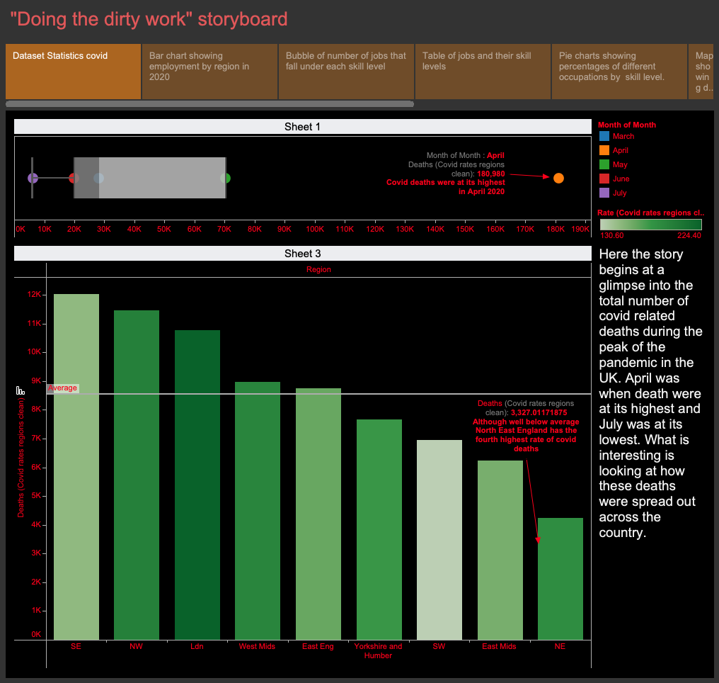

Slide 7

“Doing the dirty work”: story

Slide 8
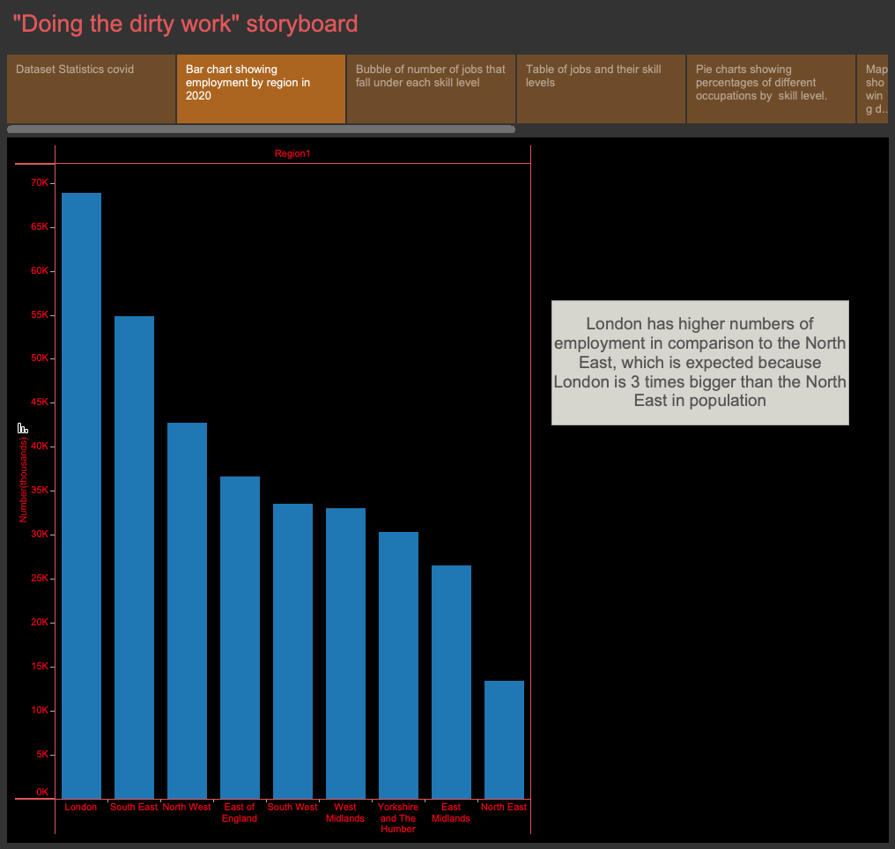

Slide 9
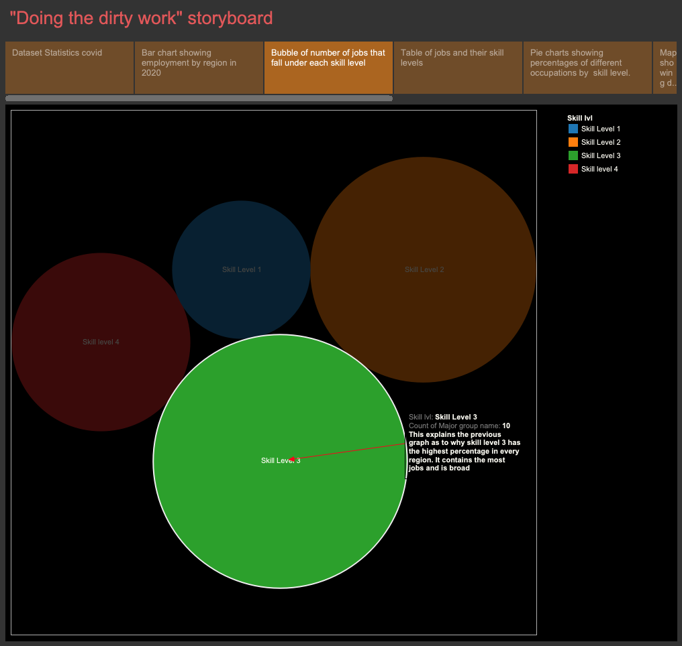

Slide 10
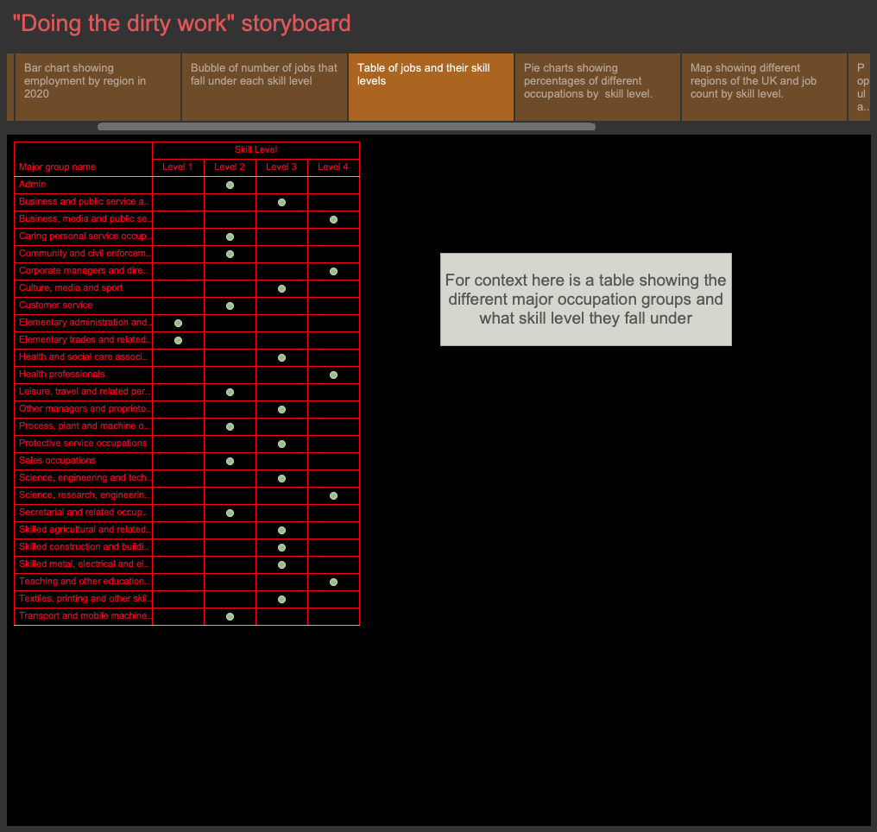

Slide 11
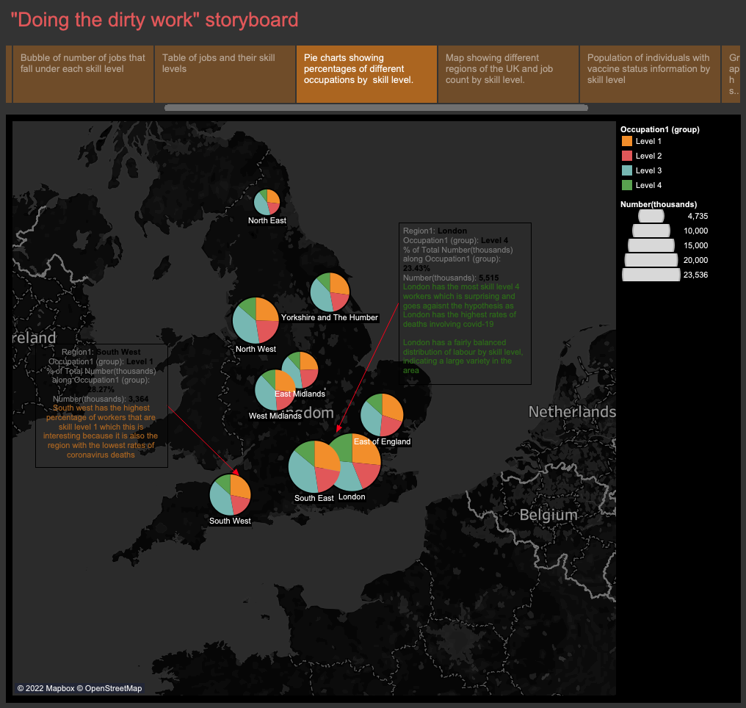

Slide 12
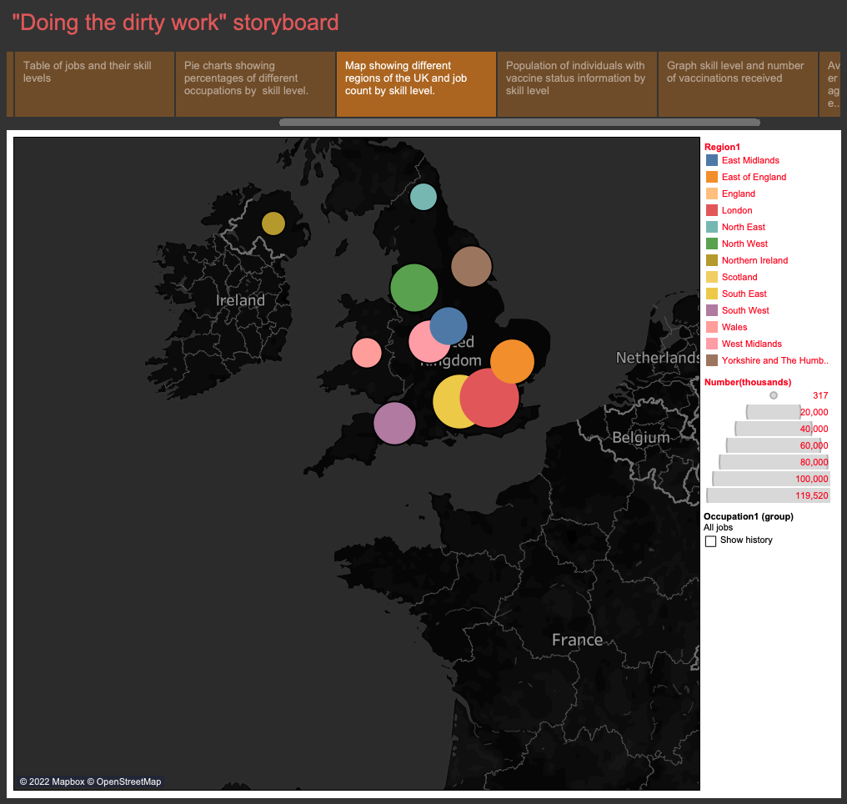
Notes:
There may potentially be a bias towards London as it has the most employment as a whole region

Slide 13
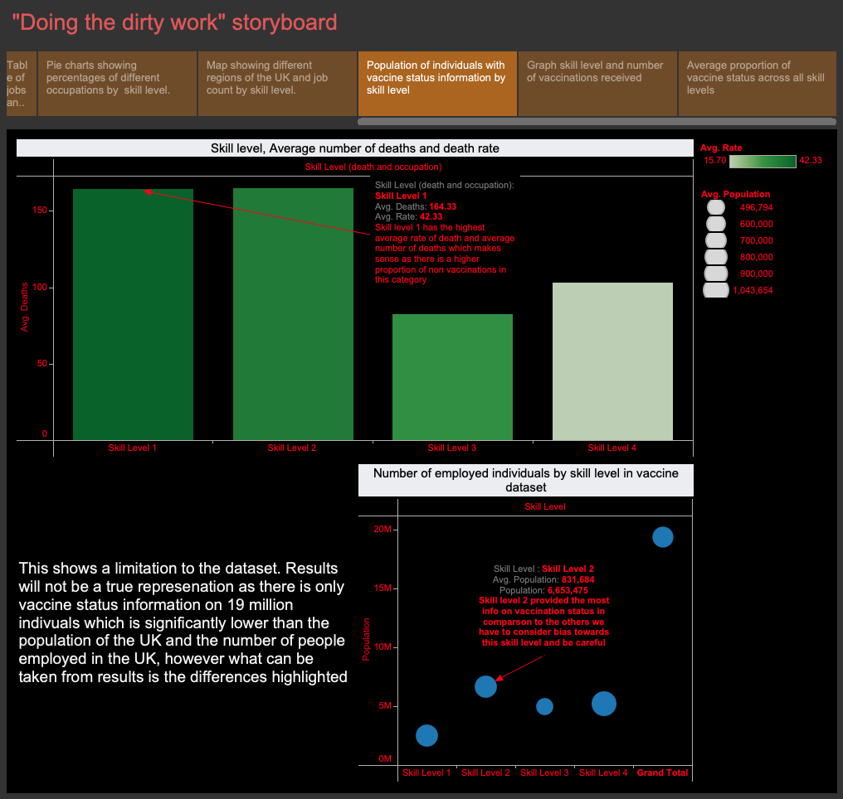

Slide 14
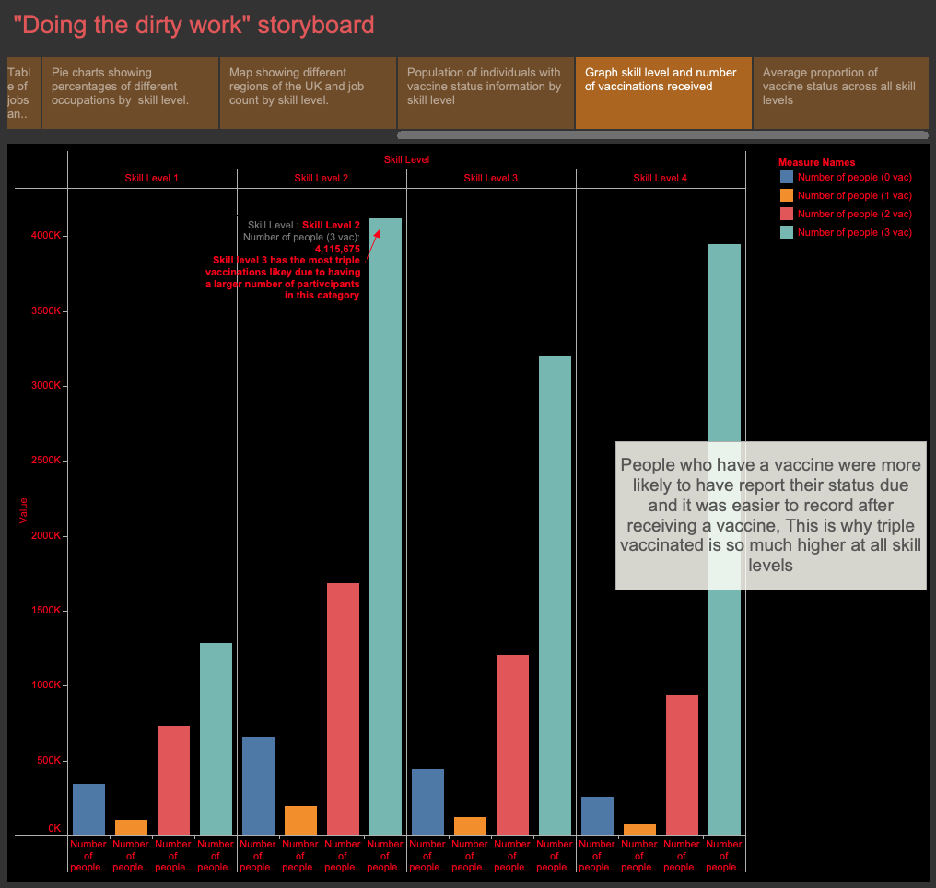

Slide 15
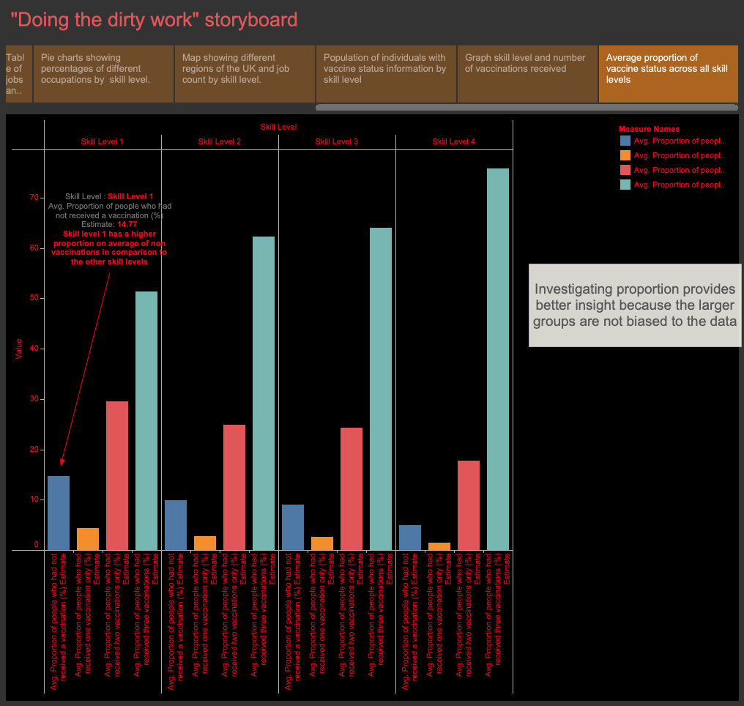

Slide 16
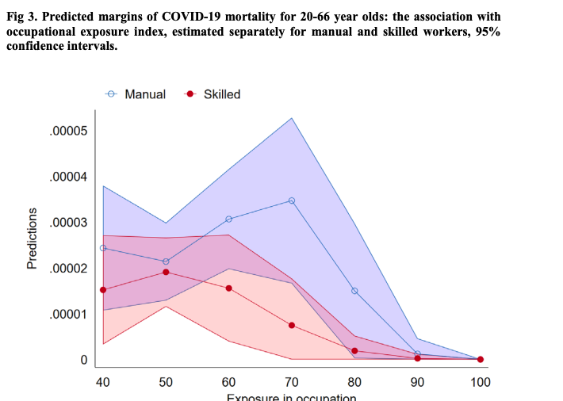
Media and research
Similar research has been made in Sweden on this topic, looking at different occupations, finding that taxi drivers and bus drivers were more likely to die from Covid in comparison to other groups. However, being a frontline worker did not significantly increase your chances of dying from covid
Transport is under skill level 2 which covers roles such as bus drivers and taxi drivers and the table shown the slide 21 partly supports Billingsley et al.’s (2020) findings as skill level 2 had a higher mortality rate than level 3 and 4.
Fig 4. Shows the graph used with predicted mortalities between manual and skilled workers based on their exposure to others (Billingsley et al., 2020). The researchers take a different approach from this project and created an area graph

Slide 17
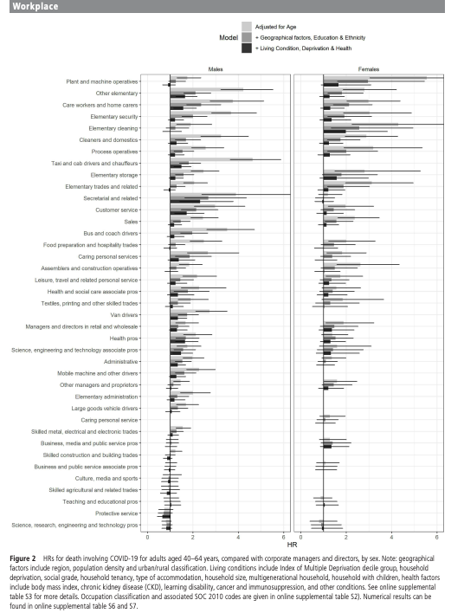
Media and research
Nafilyan et al. (2021) conducted a study high in similarity to this report as it investigates if there are any differences in covid mortality rates between ethnicity education, and occupation. The limitation to this study however is that it examines a limited number of individuals from a specific age range of 40-64, whereas this project has a wider range of 20–64-year-olds. Like Billingsley et al., this study discovered that taxi drivers had the highest risk of dying from Covid-19. This project also supports these findings because as shown in slide 21, drivers are under skill level 2 which had the joint highest number of average deaths, the differences between this project and Nafilyan et al. is that the results used here age standardized, while this project’s results were not age standardised. Figure 2 shows a plot with different groups of occupations

Slide 18
Conclusions
Overall, the research question was answered but the hypothesis was rejected
While the hypothesis was part true in terms of the lowest skilled occupation having the highest proportion of non vaccinations (see slide 23), this was not strong enough to explain the disparity between region, occupation and covid-19 mortality.

Slide 19
The South West had the highest percentage of people with skill level 1 occupations yet it also has the lowest covid-19 mortality rate. This caveat has shown the flaws in the project as there are issues with the dataset in terms of bias in size and an issue with representation. A lot of non-vaccinated individuals will not report that they have not been vaccinated due to fear of social stigma. There is also a bias towards more crowded places such as London where things are less spaced out and people are more likely to be in contact with each other in comparison to other regions of the country.

Slide 20
This makes any correlation between the skill level of workers and covid rates weaker in validity.
However, the research question was answered, and the objectives were met. Occupations were successfully grouped (see slide 17 and slide 18). Covid mortality was compared by the different skill levels. Also found that the South West region has the highest percentage of level 1 workers while London has the highest percentage of level 4 workers which is interesting because despite the South West has the lowest covid mortality rate while London has the highest (see slide 14).
The research question of whether areas of higher skilled workers have lower rates of death involving covid-19 is no based on the evidence provided. London has the highest percentage of level 4 workers (see slide 19) and a high number of level 4 workers are triple vaccinated (see slide 22) this should mean that an area with a high number of level 4 workers should be triple vaccinated making them more immune to covid and less susceptible to dying from covid meaning that London should have lower rates of deaths from covid yet referring to slide 14, that is not necessarily the case.

Slide 21
To conclude, for the future, a narrowed-down investigation is a better idea. Looking at occupation groups and regions is not a good idea in the case of examining covid-19 relationship with external factors because of the differences in population density in addition to the fact that a region contains a lot of different towns and cities makes it difficult to make definitive conclusions on a plethora of them at once. Next time this project should be done on a city scale to properly understand the relationship between vaccination, occupation and Covid-19 deaths.

Slide 22
References
Billingsley, S., Brandén, M., Aradhya, S., Drefahl, S., Andersson, G. and Mussino, E. (2020) Deaths in the frontline: occupation-specific COVID-19 mortality risks in Sweden.
Nafilyan, V., Pawelek, P., Ayoubkhani, D.,Rhodes, S., Pembrey, L., Matz, M., Coleman, M., Allemani, C., Windsor-Shellard, B., van Tongeren, M. and Pearce, N. (2021) Occupation and COVID-19 mortality in England: a national linked data study of 14.3 million adults. Occupational and environmental medicine
ONS (2020) SOC 2020 Volume 1: structure and descriptions of unit groups. Available from: https://www.ons.gov.uk/methodology/classificationsandstandards/standardoccupationalclassificationsoc/soc2020/soc2020volume1structureanddescriptionsofunitgroups [Accessed 26th May 2022]
ONS datasets links:
https://www.ons.gov.uk/peoplepopulationandcommunity/healthandsocialcare/healthinequalities/datasets/coronavirusandvaccinationratesinpeopleaged18to64yearsbyoccupationengland
https://www.ons.gov.uk/employmentandlabourmarket/peopleinwork/employmentandemployeetypes/datasets/employmentbyindustryemp13
https://www.ons.gov.uk/employmentandlabourmarket/peopleinwork/employmentandemployeetypes/datasets/workforcejobsbyregionandindustryjobs05
https://www.ons.gov.uk/peoplepopulationandcommunity/healthandsocialcare/causesofdeath/datasets/coronaviruscovid19relateddeathsbyoccupationenglandandwales
https://www.ons.gov.uk/peoplepopulationandcommunity/healthandsocialcare/healthinequalities/datasets/coronavirusandvaccinationratesinpeopleaged18to64yearsbyoccupationengland

