Slide 1

Rockbuster Strategy 2020 – Data-Driven Expansion Plan

Slide 2
Title: Rockbuster Strategy 2020 Subtitle: Data Insights to Guide Global Expansion Presented by: Samuel Lal Link :- https://public.tableau.com/app/profile/samuel.lal7799/viz/RockbusterStrategy2020/Dashboard1

Slide 3

Agenda Business Objective Key Insights Revenue Analysis by Geography Genre Investment Strategy Customer Behavior & Revenue Patterns Strategic Recommendations

Slide 4
Business Objective
Goal
High-performing regions
Profitable customer segments
Genres to invest in
Customer spending behavior

Slide 5

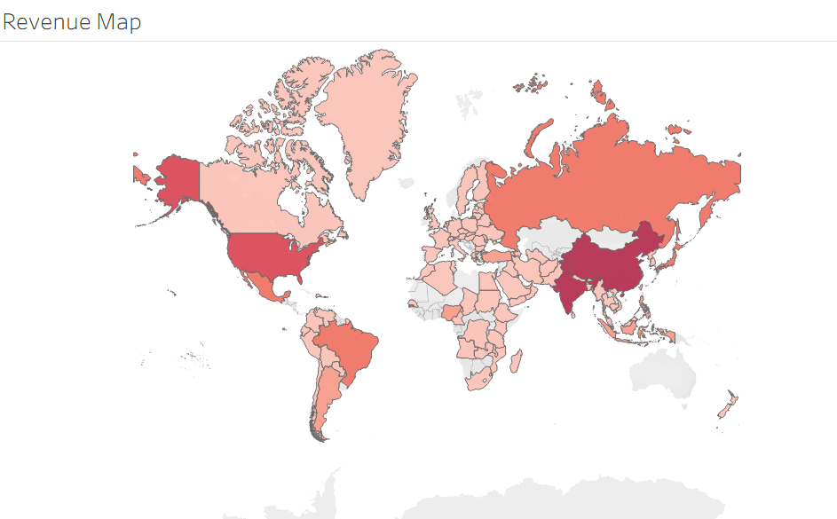
Global Revenue Overview
Highest revenues are generated from China, the US, and parts of Europe.
Emerging markets like India and South America show moderate activity.
Some regions (gray areas) lack sufficient data and may need further analysis.

Slide 6
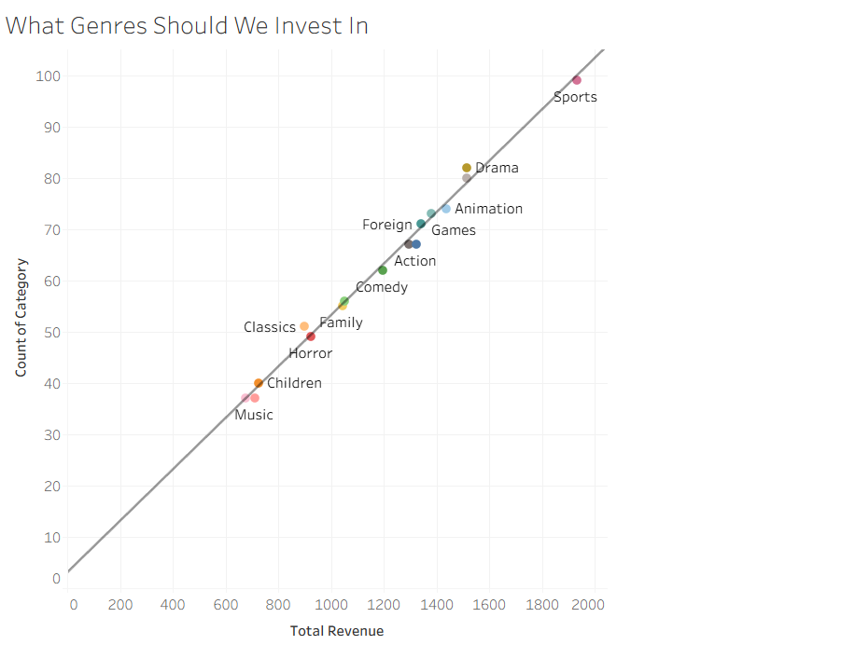
Top Genres to Invest In
Insights:
Sports, Drama, and Animation are the top revenue-generating genres.
Comedy and Documentary perform well with high volume.
Music, Children, and Classics underperform less ROI per category.

Slide 7
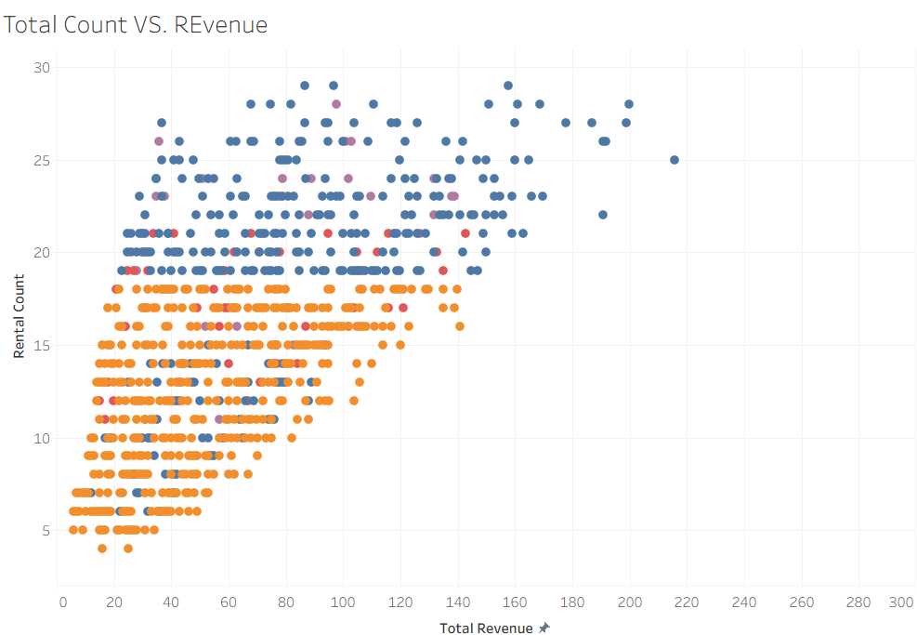
Rental Behavior vs. Revenue
Insights:
Clusters reveal that many movies generate decent rental counts but low revenue.
Some titles show high revenue despite fewer rentals these may have premium pricing or strong niche demand.
Opportunity to bundle or price-discriminate effectively.

Slide 8

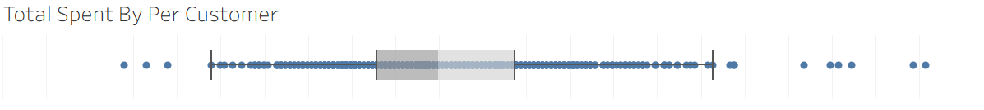
Customer Spending Distribution
Insights:
Most customers spend within a tight mid-range.
A few high-value outliers exist (power users).
Retention and loyalty campaigns should target mid-to-high spenders.

Slide 9
Strategic Recommendations
Focus on Sports, Drama, and Animation genres for marketing and acquisitions.
Prioritize expansion in regions showing high revenue potential (e.g., China, US, Europe).
Create premium bundles around niche content with high revenue per rental.
Identify and nurture loyal customers with tailored offers.

Slide 10
Next Steps
Conduct deeper analysis on gray/unclassified regions
Segment customers based on Customer Lifetime Value (CLV) and preferences
Implement A/B testing on genre-specific promotions
Review pricing models for low-rental/high-revenue titles

Slide 11

THANK YOU

