Slide 1
ECMAScript 6
aka ES 6 Features

Slide 2
Why Study JavaScript
JavaScript is one of the 3 languages all web developers must learn:
HTML to define the content of web pages
CSS to specify the layout of web pages
JavaScript to program the behaviour of web pages
JavaScript works with both HTML and CSS. JavaScript was invented by Brendan Eich in 1995, and became an ECMA standard in 1997. ECMAScript is official name of the language.

Slide 3
Introduction
The ECMAScript specification is a standardized specifications of a scripting language developed by Brendan Eich of Netscape.
Initially the scripting language was named as Mocha, later LiveScript, and finally JavaScript.
The main objective of the JavaScript language was to be used as the client-side scripting language (aka a program that runs only in the browser).
JavaScript is used in conjunction with HTML to develop responsive and dynamic webpages.

Slide 4
ECMA Script 6
Support for constants
Block Scope
Arrow Functions
Extended Parameter Handling
Template Literals
Extended Literals
Enhanced Object Properties
De-structuring Assignment
Modules
Classes
Iterators
Generators
Collections
New built in methods for various classes
Promises

Slide 5
Babel
Babel allows to create applications using ECMAScript 6 or ES6
Babel is a JavaScript transpiler that converts edge JavaScript into plain old ES5 JavaScript that can run in any browser.
Babel is more of a polyfill to allow for the usage of the ES6/Harmony/next features in current tech architecture until more support is added in browsers.
Babel is not adding any "syntactic sugar" on top of JavaScript.
Babel is simply bridging the gap between ES5 and ES6.

Slide 6
JavaScript

Slide 7
JavaScript Primer - Objectives
By end of chapter, everybody should know
Include a JavaScript on web page
Statements
Types and variables
Operators
Control structures
Functions, Parameters and Return Values
Objects, Properties and Methods
Arrays and JSON
Callbacks

Slide 8
Include JavaScript
There are two ways to include a JavaScript on web page
Referencing an External Script It is better to keep the scripts in a separate file and create a reference to the file in the web page. This way, the scripts can be reused. To do this use the script tag The src attribute points to the location of a JavaScript file. Example <script src="scripts/myScript.js"></script>

Slide 9
Include JavaScript
There are two ways to include a JavaScript on web page
Using an Inline Script This method is used when the reuse of script is not necessary. Simply for convenience Example <script> document.write(“Hello”); </script> Scripts can be placed in the <body>, or in the <head> section of an HTML page, or in both.

Slide 10
Output
JavaScript can "display" data in different ways:
Writing into an HTML element, using innerHTML. <p id="demo"></p> <script> document.getElementById("demo").innerHTML = "Hello world"; </script>
Writing into the HTML output using document.write(). <script>document.write("Hello world");</script>
Writing into an alert box, using window.alert(). <button onclick="window.alert('Hello world')">Try it</button>
Writing into the browser console, using console.log().

Slide 11
Environment Setup

Slide 12
Node.js
Node technology has two components, such as
Node.js is an open source, cross-platform runtime environment for server-side JavaScript and a platform for building fast and scalable server applications using JavaScript. Node.js is to run JavaScript without a browser. It uses Google V8 JavaScript engine to execute code.
NPM is the Node Package Manager. NPM is a command line utility which interacts with an online repository that hosts open source Node.js projects and aids in package installation, version management and dependency management.

Slide 13
Node.js - Installation
Node is available here − https://nodejs.org/en/download
NPM node package manager, is distributed with Node.js, which means that when you install Node.js, automatically npm also get installed. Download the LTS (Long term support) version.
Installation on Windows
Download and run the .msi installer for Node.
To verify if the installation of node was successful, enter the command node --v in the terminal window.
To verify if the installation of npm was successful, enter the command npm --v in the terminal window.

Slide 14
NodeJS Installation
Verify installation: Executing a File
Open the notepad
Create a .js (JavaScript) file named main.js and type the following inside the main.js file console.log("Hello, World!")
Let us execute the main.js file using the following command node main.js
This should produce the following result in the command windows Hello, World!

Slide 15
Visual Studio Code - Installation
Visual Studio Code is a lightweight but powerful and FREE source code editor by Microsoft for web developers. Visual Studio Code
runs on desktop
is available for Windows, macOS and Linux
Visual Studio Code editor comes with built-in support for
JavaScript
TypeScript
Node.js

Slide 16
Node.js in Visual Studio Code
In command window create a folder to keep all our JavaScript code
mkdir JavaScript-Tutorial
cd JavaScript-Tutorial
code .
The period '.' refers to current folder. So Visual Studio Code will start and open JavaScript-Tutorial folder. Do the following steps
Create app.js file
Type JavaScript code and confirm IntelliSense is working
Run the JavaScript in Integrated Terminal
Debug the JavaScript code

Slide 17
Environment Setup
Create a Folder named as "HelloWorld". F:\Lab\REACT>mkdir HelloWorld
Create empty package.json by running npm init F:\Lab\REACT\HelloWorld>npm init
Install the babel Packages by running the npm install command F:\Lab\REACT\HelloWorld>npm install -g babel-cli F:\Lab\REACT\HelloWorld>npm install babel-core --save F:\Lab\REACT\HelloWorld>npm install babel-preset-es2015 --save F:\Lab\REACT\HelloWorld>npm install http-server --save

Slide 18
Environment Setup
Open package.json "scripts": { "babel": "babel --presets es2015 js/main.js -o build/main.bundle.js", "start": "http-server" },
npm run babel
Open index.html <script src="build/main.bundle.js"></script>
npm start

Slide 19
ES6 - Syntax

Slide 20
Statements
JavaScript program is essentially a collection of instructions to be executed. These instructions are called statements. JavaScript statements are
executed line by the browser
executed one after the other
exist on its own line
ends with semicolon
multiple statements can be in one line separated with semicolon
Example
console.log("I am a statement");
console.log("I am also a statement");

Slide 21
Statements
JavaScript ignores multiple spaces in a statement. var person = "Hege"; is same as var person="Hege";
For readability, avoid statements longer than 80 characters. The best place to break it, is after an operator such as “=“ document.getElementById("demo").innerHTML = "Hello Dolly!";
JavaScript statements can be grouped together in code blocks, inside curly brackets {...} such as if, for, do, while, function function myFunction() { document.getElementById("demo1").innerHTML = "Hello Dolly!"; document.getElementById("demo2").innerHTML = "How are you?"; }

Slide 22
Comments
Ideally, comments are used to say something useful about the purpose and context of code. The comments will help to understand why that code is there. There are two ways to comment code and they are
Single line comments are useful for short comments
Multiline comments are useful for multiline comments
Example
// The following lines are used to get user input
/* The following lines are used to validate
User IC and Passport
Email address */

Slide 23
Values
JavaScript syntax is the set of rules, how JavaScript programs are constructed. The JavaScript syntax defines two types of values and they are
Fixed values are called literals. Example: 3, 2.5, “Hello World”
Variable values are called variables. Example: _price, _discount, total_amount
The JavaScript Expressions are composed of variables, operators and literals.

Slide 24
Variables & Identifiers
Variables are
the containers that hold the data.
named areas of computer memory in which values can be stored and retrieved.
declared using the keyword “var” or “Let”
Multiple variables can be declared on a single line separated using “comma”
Values are assigned to a variable using the “equal” symbol

Slide 25
Variables & Identifiers
JavaScript variables must be identified with unique names called identifiers.
Identifiers can be short names or more descriptive names
Identifiers can contain letters, digits, underscores, and dollar signs
Identifiers must begin with a letter or $ or _
Identifiers are case sensitive (y and Y are different variables)
var color = "red";
var color, size, shape;
var color,
size,
shape;
color = "blue";

Slide 26
The Concept of Data Types
In programming, data types is an important concept.
To be able to operate on variables, it is important to know something about the variable data type. Without data types, a computer cannot safely solve the expression like
var x = 16 + "Volvo";
In JavaScript variables are dynamic data types. This means that the same variable can be used to hold different data types:
var x; // Now x is undefined var x = 5; // Now x is a Number var x = "John"; // Now x is a String

Slide 27
The Concept of Data Types
The undefined and null are 2 data types that cannot contain values
There are 5 different data types that can contain values:
number
string
boolean
object
function
There are 3 types of objects:
Object
Date
Array

Slide 28
Undefined and Null
The variable is not assigned with any value var myName; console.log(myName); The result: undefined
The variable is assigned with null value var myName = null; console.log(myName); The result: null

Slide 29
Arithmetic Operators
Operator | Description
+ | Addition
- | Subtraction
* | Multiplication
/ | Division
% | Modulus
++ | Increment
-- | Decrement
+ | String concatenation

Slide 30
Assignment Operators
Operator | Description
= | Assignment
+= | Addition Assignment
-= | Subtraction Assignment
*= | Multiplication Assignment
/= | Division Assignment
%= | Modulus Assignment

Slide 31
Comparison Operators
Operator | Description
== | Equal to
=== | Equal value and equal type
!= | Not Equal
!== | Not Equal value or not equal type
> | Greater than
< | Less than
>= | Greater than or equal to
<= | Less than or equal to
? | Ternary operator

Slide 32
Other Operators
Operator | Description
&& | Logical and
|| | Logical or
! | Logical not
typeof | Returns the type of a variable
Instanceof | Returns true if an object is an instance of an object type
& | Bitwise AND
| | Bitwise OR
~ | Bitwise NOT
^ | Bitwise XOR

Slide 33
Primitive Types - Numbers
JavaScript does not define different types of numbers, like integers, short, long, floating-point etc. JavaScript numbers are always stored as double precision floating point numbers.
var val1 = 22;
var val2 = .5;
var val3= 22.5;
Can perform arithmetic operation on variables
console.log(val1 + val2);
console.log(val2 + val3);

Slide 34
Primitive Types - Numbers
Precision - Integers are considered accurate up to 15 digits. Floating point arithmetic is not always 100% accurate.
Hexadecimal - JavaScript interprets numeric constants as hexadecimal if they are preceded by 0x.
Infinity - Infinity (or -Infinity) is the value JavaScript will return if you calculate a number outside the largest possible number.
NaN - Not a Number - NaN is a JavaScript reserved word indicating that a number is not a legal number.
Numbers Can be Objects - Numbers can also be defined as objects with the keyword new: var y = new Number(123)

Slide 35
Numbers Properties
Number properties belongs to the JavaScript's number object wrapper called Number. Number properties can only be accessed as Number.MAX_VALUE.
MAX_VALUE - Returns the largest number possible in JavaScript
MIN_VALUE - Returns the smallest number possible in JavaScript
NaN - Represents a "Not-a-Number" value
NEGATIVE_INFINITY - Represents negative infinity (returned on overflow)
POSITIVE_INFINITY - Represents infinity (returned on overflow)

Slide 36
Numbers Methods
Usually, primitive values cannot have properties and methods. But in JavaScript, primitive values are treated as objects. Example 9.656
toString() - returns a number as a string
toExponential()
toFixed() - a specified number of decimals [toFixed(2) => 9.66]
toPrecision() - a specified length [toPrecision(2) => 9.7]
valueOf()
Number() - returns a number
parseInt() - returns an integer
parseFloat() - returns a floating point number

Slide 37
Math Object
Method | Description
abs(x) | Returns the absolute value of x
acos(x) | Returns the arccosine of x, in radians
asin(x) | Returns the arcsine of x, in radians
atan(x) | Returns the arctangent of x, in radians
atan2(y, x) | Returns the arctangent of the quotient of its arguments
ceil(x) | Returns the value of x rounded up to its nearest integer
cos(x) | Returns the cosine of x (x is in radians)
exp(x) | Returns the value of E^{x}
floor(x) | Returns value of x rounded down to its nearest integer

Slide 38
Math Object
Method | Description
log(x) | Returns the natural logarithm (base E) of x
max(x, y, z, ..., n) | Returns the number with the highest value
min(x, y, z, ..., n) | Returns the number with the lowest value
pow(x, y) | Returns the value of x to the power of y
random() | Returns a random number between 0 and 1
round(x) | Returns the value of x rounded to its nearest integer
sin(x) | Returns the sine of x (x is in radians)
sqrt(x) | Returns the square root of x
tan(x) | Returns the tangent of an angle

Slide 39
Primitive Types - Strings
Use either single quotation or double quotation.
var firstName = "Jane";
Using one within the other
var opinion = "It's alright";
var sentence = 'Billy said, "How are you today?", and smiled.';
Using backslash
var sentence = "Billy said, \"How are you today?\", and smiled.";
var opinion = 'It\'s alright';

Slide 40
Strings Methods
String methods help to work with strings.
length
indexOf()
lastIndexOf()
search()
slice()
substring()
substr()
replace()
toUpperCase()
toLowerCase()
concat()
charAt()
charCodeAt()

Slide 41
Primitive Types - Booleans
A Boolean variable can have either true or false. Boolean() function can be used to find out if an expression (or a variable) is true or false.
var isLoggedIn = true;
var isMember = false;
True conditions
var isMember = "false";
var isMember = 1;
var isMember = "Hello";

Slide 42
Primitive Types - Booleans
Comparing to other programming language the false value of a Boolean variable are quiet confusing.
False conditions
var isMember = "";
var isMember = 0;
var isMember = -0;
var isMember;
var isMember = null;
var isMember = 10 / “H”;

Slide 43
Date
Displaying Date Date();
Creating Date Objects new Date() new Date(milliseconds) new Date(dateString) new Date(year, month, day, hours, minutes, seconds, milliseconds)
Methods toString(); toDateString();

Slide 44
Date Methods
Method | Description
getDate() | Get the day as a number (1-31)
getDay() | Get the weekday as a number (0-6)
getFullYear() | Get the four digit year (yyyy)
getHours() | Get the hour (0-23)
getMilliseconds() | Get the milliseconds (0-999)
getMinutes() | Get the minutes (0-59)
getMonth() | Get the month (0-11)
getSeconds() | Get the seconds (0-59)
getTime() | Get the time (milliseconds since January 1, 1970)

Slide 45
Array
An array is a special variable, which can hold more than one value at a time. Storing multiple car names in single variable
var car1 = "Saab"; var car2 = "Volvo"; var car3 = "BMW";
This is where the Array comes in.
Using an array literal is the easiest way to create a JavaScript Array.
var cars = ["Saab", "Volvo", "BMW"];
Another way to create array is using the Array keyword.
var cars = new Array("Saab", "Volvo", "BMW");

Slide 46
Array
Accessing the Array Elements
var cars = new Array("Saab", "Volvo", "BMW");
An array element can be accessed by referring to the index number.
var name = cars[0];
cars[0] = "Opel";
Array indexes start with 0.
[0] is the first element in an array.
[1] is the second element.
The full array can be accessed by referring to the array name:
console.log(cars);

Slide 47
Array Properties and Methods
Array methods help to work with Arrays.
length
isArray()
instanceof
typeof
join()
pop()
push()
shift()
unshift()
delete
splice()
concat()
toString()

Slide 48
Array Properties and Methods
Array methods help to work with Arrays.
reverse()
sort()
By default, the sort() function sorts values as strings. Because of this, sort() method will produce incorrect result when sorting numbers. This can be fixed by passing a compare function.
Math.max.apply to find the highest number in an array
Math.min.apply to find the lowest number in an array

Slide 49
Decision making

Slide 50
Conditional Statements
if statement to specify a block of JavaScript code to be executed if a condition is true. if (condition) { block of code to be executed if the condition is true }
else to specify a block of code to be executed, if the same condition is false
else if to specify a new condition to test, if the first condition is false

Slide 51
Conditional Statements
Switch statement to select one of many blocks of code to be executed
switch(expression) { case n: javascript code block break; case n: javascript code block break; default: javascript code block }
Switch expression is evaluated only once and value of the expression is compared with the values of each case.

Slide 52
Looping

Slide 53
Looping - FOR
Loops can execute a block of code a number of times.
for (statement 1; statement 2; statement 3) {
code block to be executed }
Statement 1 is executed before the code block starts.
Statement 2 defines the condition for running the code block.
Statement 3 is executed each time after the code block has been executed.
for (i = 0; i < 5; i++) { text += "The number is " + i + "<br>"; }

Slide 54
Looping - FOR
Statement 1 is used to initialize the variable used in the loop. Statement 1 is optional, it can be omitted. Many variables can be initialized in statement 1.
Statement 2 is used to evaluate the condition of the initial variable. Statement 2 is also optional. If statement 2 returns true, the loop will start over again, if it returns false, the loop will end. If statement 2 is omitted, must provide a break inside the loop.
Statement 3 increments the value of the initial variable. Statement 3 is also optional. Statement 3 can do anything like negative increment (i--), positive increment (i = i + 15), or anything else. If statement 3 is omitted code inside the loop must increment the variable.

Slide 55
Looping - While
The while loop loops through a block of code as long as condition is true.
while (condition) { code block to be executed }
Example
while (i < 10) { text += "The number is " + i; i++; }
Don’t forget to increase the variable used in the condition, otherwise the loop will never end. This will crash your browser.

Slide 56
Looping – Do / While
Do / while loop execute code block once, before checking the condition is true, then it will repeat the loop as long as the condition is true.
do { code block to be executed } while (condition)
Example
do { text += "The number is " + i; i++; } while (I < 10)

Slide 57
Looping – Break / Continue
The Break Statement breaks the loop and continues executing the code after the loop
The break statement "jumps out" of a loop.
The break statement used switch() statement to "jump out".
The break statement can also be used to jump out of a loop.
The Continue Statement
The continue statement "jumps over" one iteration in loop.
The continue statement breaks one iteration (in the loop), if a specified condition occurs, and continues with the next iteration in the loop.

Slide 58
Functions

Slide 59
Functions
In JavaScript functions are defined using the keyword function
function functionName(parameters) { code to be executed;
return value; }
Declared functions are not executed immediately.
Functions are executed only when they are invoked (called upon).
Semicolons are used to separate executable JavaScript statements.
Since a function declaration is not an executable statement, it is not common to end it with a semicolon.

Slide 60
Function - Invoking
Code inside a function is not executed when function is defined.
Code inside a function is only executed when the function is invoked. The () operator invokes the function.
function functionName (param1, param2) {
javascript code; return value; } var result = functionName (value1, value2);
Developers to define code once and use it many times.
Developers can invoke the same code many times with different arguments, to produce different results.

Slide 61
Function Expressions
In JavaScript functions are called first class functions, because the functions are treated as an expression. Function expression can be stored in a variable. var func_variable = function (param1, param2) {
return param1 * param2;
}; var square_result = func_variable(3, 2);
Functions stored in variables do not need function names.
Functions are also called “anonymous function”, since there is no name given to the function.
These functions are always invoked using the variable name.

Slide 62
Self-Invoking Functions
Function expressions can be made "self-invoking".
A self-invoking function expression is invoked (started) automatically, without being called. (function () { alert (“Hello World”); })();
The above Function expression is executed automatically since it is followed by ().
Parentheses is added around the function to indicate that it is a function expression

Slide 63
Function Parameters & Arguments
Function parameters are the names listed in function definition.
Function arguments are real values passed to and received by.
Parameter Rules
Function definitions do not specify data types for parameters.
Functions do not perform type checking on passed arguments.
Functions do not check the number of arguments received.
If a function is called with missing arguments (less than declared), the missing values are set to: undefined
If a function is called with too many arguments (more than declared), these arguments can be reached using arguments object.

Slide 64
Function Parameters & Arguments
The Arguments Object
JavaScript functions have a built-in object called arguments object.
The argument object contains an array of the arguments used when the function was called (invoked).
Arguments are Passed by Value
The parameters, in a function call, are the function's arguments.
The function only gets to know values, not argument's locations.
Objects are Passed by Reference
In JavaScript, objects will behave like they are passed by reference.
If a function changes an object property, it changes original value.

Slide 65
Objects

Slide 66
Classes
ES5 JavaScript is class free.
Objects inherit directly from other objects, so any object can be the parent (superclass) of any other object.
Any function can be a constructor function, and calling it with the new keyword will yield a new object.
ES6 introduces the class keyword. This lets us define functions which can only be used as constructors.
A class, can only be used to define other objects. This is a special case of prototypical inheritence.

Slide 67
Objects - Introduction
In JavaScript, objects are king. In JavaScript, almost "everything" is an object.
Booleans can be objects (if defined with the new keyword)
Numbers can be objects (if defined with the new keyword)
Strings can be objects (if defined with the new keyword)
Dates are always objects
Maths are always objects
Regular expressions are always objects
Arrays are always objects
Functions are always objects
Objects are always objects

Slide 68
Objects - Creation
Objects are variables containing variables. Variables can contain single value. Objects can contain many values. In object values are written as key : value pairs, where key and value are separated by colon.
var person = {firstName:"John", lastName:"Doe", age:50, eyeColor:"blue"};
In the above example the person object contain multiple values such as firstName, lastName, age and eyeColor.
Objects are created in three different ways and they are
Object literal way
Using the keyword new
Function Constructor

Slide 69
Objects - Creation
Object Literal Way
var person = {
firstName: “John”,
lastName: “Doe”,
age: 50,
eyeColor: “blue” ,
fullName: function() {
return this.firstName + " " + this.lastName;
}
};
Object is collection of named values, called properties and methods.

Slide 70
Objects - Creation
Using the keyword new
var person = new Object();
person.firstName = "John";
person.lastName = "Doe";
person.age = 50;
person.eyeColor = "blue";
person.fullName = function() {
return this.firstName + " " + this.lastName + this.age;
};

Slide 71
Objects - Creation
Object Constructor
JavaScript allows to create "object type" that can be used to create many objects of one type. To create "object type" use object constructor function.
function Person(first, last, age, eye) { this.firstName = first; this.lastName = last; this.age = age; this.eyeColor = eye; } var myFather = new person("John", "Doe", 50, "blue"); Constructor function creates the prototype for Person object.

Slide 72
Objects - Property
Syntax for accessing the property of an object is: objectName.property // person.age objectName["property"] // person["age"] objectName[expression] // x = "age"; person[x]
New properties can be added to an existing object by giving it a value. object.property = "English";
The delete keyword deletes a property from an object: delete object.property;

Slide 73
Objects - Method
Methods are actions that can be performed on objects. A JavaScript method is a property containing a function definition.
Syntax of an object method
methodName : function() {
code lines
} An object method can be accessed with the following syntax:
objectName.methodName()

Slide 74
Objects - Adding
Add new properties/methods to an existing object. myFather.nationality = "English"; myFather.name = function () { return this.firstName + " " + this.lastName; };
Add new properties/methods using prototype keyword. Person.prototype.nationality = "English"; Person.prototype.name = function() { return this.firstName + " " + this.lastName; };

Slide 75
Objects – Indexed Properties
JavaScript supports objects with indexed properties. An Indexed property
is a property with an index number instead of a property name.
can not be accessed with the dot (.) operator.
can be accessed with the associate array operator (['index']).
can also be accessed with the array operator ([index]).
can be assigned with a function to become an indexed method.

Slide 76
Objects – Indexed Properties
var myBook = {
author: "Herong Yang",
title: "JavaScript Tutorials",
3: 2008,
price: "Free",
4: myToString
};
myBook[9] = "Programming";
document.writeln("myBook['author']: " + myBook['author']);
document.writeln("myBook[3]: " + myBook[3]);
document.writeln("myBook['3']: " + myBook['3']);
document.writeln("myBook[4]: " + myBook[4]);
document.writeln("myBook[9]: " + myBook[9]);

Slide 77
Looping – FOR / IN
JavaScript for/in loops through properties of an object.
Block of code inside loop will be executed once for each property. var person = {fname:"John", lname:"Doe", age:25}; var text = ""; var x; for (x in person) { text += person[x]; } console.log(text);
Do not use for/in statement to loop through arrays where index order is important. Use the for statement instead.

Slide 78
Call or Apply Method
The call() or apply() methods are used to invoke a function with an owner object as first argument. This code calls fullName function of person object by sending the myObject as parameter.
var person = { firstName:"John", fullName: function() { return this.firstName; } } var myObject = { firstName:"Mary", } person.fullName.call(myObject); // Will return "Mary"

Slide 79
typeof Operator
typeof "John" // Returns "string"
typeof 3.14 // Returns "number"
typeof NaN // Returns "number"
typeof false // Returns "boolean"
typeof [1,2,3,4] // Returns "object"
typeof {name:'John', age:34} // Returns "object"
typeof new Date() // Returns "object"
typeof function () {} // Returns "function"
typeof myCar // Returns "undefined" *
typeof null // Returns "object"

Slide 80
Constructor Property
"John".constructor // Returns function String()
(3.14).constructor // Returns function Number()
false.constructor // Returns function Boolean()
[1,2,3,4].constructor // Returns function Array()
{name:'John',age:34}.constructor // Returns function Object()
new Date().constructor // Returns function Date()
function () {}.constructor // Returns function

Slide 81
Scope
Local Variables
Variables declared within a JavaScript function, become LOCAL to the function.
Local variables have local scope meaning they can only be accessed within the function.
Global Variables
A variable declared outside a function, becomes GLOBAL.
A global variable has global scope meaning all scripts and functions on a web page / java script file can access it.

Slide 82
Closures
Closure has 3 scope chains and they are
it can access to its own scope
it can access to outer function’s variables
it can access to global variables
function showName (firstName, lastName) {
​var nameIntro = "Your name is ";
​function makeFullName () { // access local & outer variable including parameters
​return nameIntro + firstName + " " + lastName;
} ​
​return makeFullName ();
}
showName ("Michael", "Jackson");

Slide 83
React
A JavaScript library for building user interfaces

Slide 84
Introduction
ReactJS is a declarative, efficient, and flexible JavaScript front-end library for building user interfaces.
ReactJS is developed by Facebook.
ReactJS is used for handling view layer for web and mobile apps.
ReactJS is the "V" in MVC
ReactJS allows to create Reusable User Interface (UI) components.
React implements Unidirectional data flow.
ReactJS is currently one of the most popular JavaScript libraries.
ReactJS has a strong foundation and large community.

Slide 85
Imperative vs Declarative
Imperative code exactly says "how to get what you want". For example, the following loop adds GST 6% to every price of an array
var prices = [100, 50, 300, 150, 200, 1000]
for (let i = 0; i < prices.length; i++) {
prices[i] = prices[i] + (prices[i] * 0.06)
}
set an initial value for the iterator - (let i = 0)
tell the for loop when it needs to stop - (i < prices.length)
get the price at the current position and add GST
store the data in the I th position
increment the i variable by one - (i++)

Slide 86
Imperative vs Declarative
Declarative code exactly says "What you want". Let us see how to code in Declarative, adding GST 6% to every price of an array
var prices = [100, 50, 300, 150, 200, 1000]
prices = prices.map (price => price + (price * 0.06)
In this code
We haven't created an iterator object
We haven't told the code when it should stop running
We haven't used the iterator to access a specific item in price array
All steps are taken care of by JavaScript's .map() Array method.

Slide 87
Why UI Library
In reactive programming the systems should be event-driven and responsive to state changes.
DOM’s user interface components have internal state and updating DOM is complicated whenever changes occurs. For example, in Gmail if browser refreshed in order to display a new message, wiping out the email being composed it will be annoying.
UI libraries watch for changes in data model and update the DOM. It also watch for changes in DOM and update the data model.
This type of watching and updating is called two-way binding.

Slide 88
React and Virtual DOM
Like the actual DOM, the Virtual DOM is a node tree that lists elements and their attributes and content as objects and properties.
Developers write pure JavaScript code that updates React components and React updates the DOM.
React uses one-way data binding to make things simpler. So the data binding is not intertwined with the application.
Every time user type in an input field in a React UI it does not directly change the state of the component.
Instead, it updates the data model, which causes the UI to be updated and the text you typed into the field appears in the field.

Slide 89
React and Virtual DOM
When ever the underlying data changes the new Virtual DOM representation of the user interface is created. React updates the browser’s DOM is a three-step process.
Whenever anything changes the entire UI will be re-rendered in a Virtual DOM representation.
Difference between the previous Virtual DOM representation and the new one will be calculated.
The real DOM will be updated with what has actually changed. This is very much like applying a patch.

Slide 90
Features
Components − React is all about components. You need to think of everything as a component. This will help you maintain the code when working on larger scale projects.
JSX − JSX is JavaScript syntax extension. It isn't necessary to use JSX in React development, but it is recommended.
Unidirectional data flow and Flux − React implements one-way data flow which makes it easy to reason about your app. Flux is a pattern that helps keeping the data unidirectional.
License − React is licensed under the Facebook Inc. Documentation is licensed under CC BY 4.0.

Slide 91
Advantages / Limitations
Advantages
React uses a virtual DOM which is a JavaScript object. The JavaScript virtual DOM is faster than the regular DOM.
React is used on client and server side as well as with other frameworks.
Component and data patterns improve the readability of the code which helps to maintain larger apps.
Limitations
React covers only view layer, hence developers still need to choose other technologies to get a complete tooling set for development.
Uses inline Templating and JSX not preferred by developers.

Slide 92
Environment Setup

Slide 93
NodeJS Installation
Let us set up an environment for React development.
There are many steps involved but this will help to speed up the development process later.
To do the procedure let us intall NodeJS.
Software & Description
NodeJS and NPM NodeJS is the platform needed for the ReactJS development. Download the MSI from NodeJS

Slide 94
NodeJS Installation
Installation on Windows
Double click the MSI file and install the Node.js.
The installer installs Node.js in C:\Program Files\nodejs.
Installer set "C:\Program Files\nodejs\bin directory" in PATH variable.
Restart any open command prompts for the change to take effect.
Verify installation: Executing a File
Create a js file named main.js on the machine with the code console.log("Hello, World!")
Execute main.js file using the command >> node main.js
This should produce the following result: Hello, World!

Slide 95
Environment Setup
Best way to create a React App is using the "create-react-app" cli.
The "create-react-app" method sets up the development environment so that developer can use the latest JavaScript features, provides a nice developer experience, and optimizes the app for production.
To install the cli "create-react-app" must have Node >= 6.
Let us install create-react-app cli using the following command npm install –g create-react-app
Let us create a React Application using the following command create-react-app customer

Slide 96
Environment Setup
"Create React App" uses build tools like Babel and webpack under the hood, but works with zero configuration. To run the application use the following code
cd customer
npm start
Once the application is ready to deploy for production, run the following command
npm run build
This will create an optimized build of the app in the build folder.

Slide 97
Explore the Boilerplate
Move into the project folder using the following command cd customer
Let us open the folder using the software visual studio code.
The customer folder has the following 3 folders
node_modules => Dependency libraries
public => This folder has the index.html file
src => This folder contains all JavaScript files related to the project. It contains the components and jsx files.
Note: Delete all the files in the src folder. Add two new files index.js and index.css

Slide 98
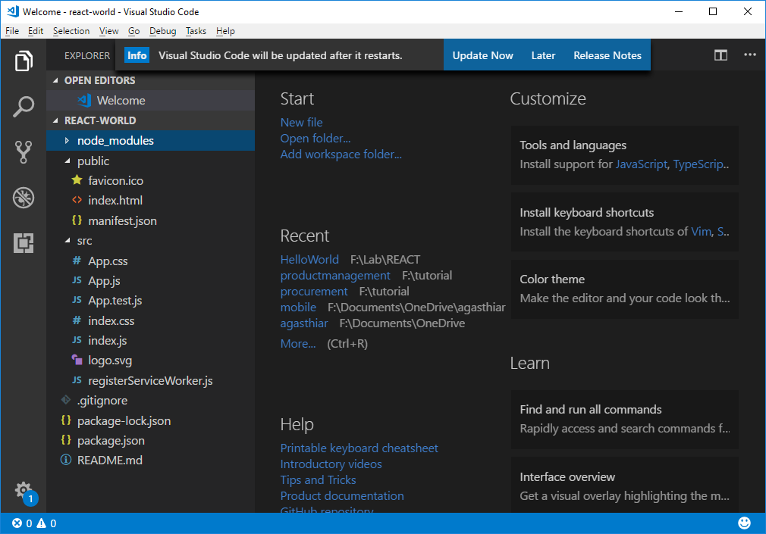
Explore the Boilerplate

Slide 99
Coding Explained
index.html
<!DOCTYPE html>
<html lang = "en">
<head>
<title>React App</title>
</head>
<body>
<div id = "app"></div>
</body>
</html>
Note: The "index.js" is not included in the index.html. But it is
configured in "paths.js" [node_modules/react-scripts/config/]
appHtml: resolveApp('public/index.html'),
appIndexJs: resolveApp('src/index.js'),
Setting div id = "app" as a root element

Slide 100
Coding Explained
Index.js
import React from 'react';
import ReactDOM from 'react-dom';
import './index.css';
class CustomerManager extends React.Component {
render() {
return (
<div><h1>Hello World !!!</h1></div>
);
}
}
ReactDOM.render(<CustomerManager />,
document.getElementById('root'));
The component CustomerManager is rendered at root App element using ReactDOM Object

Slide 101
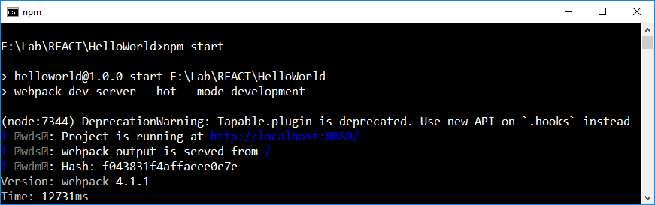
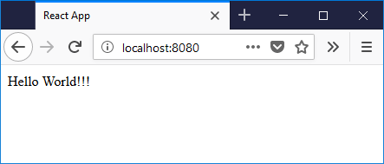
Running the Server
Setup is complete. Start the server by running "npm start"
Open the browser and access the website by http://localhost:8080/

Slide 102
Component

Slide 103
Component
React is all about components. React codebase is basically just one large pile of big components that contains smaller components.
A React component is a single object that not only outputs HTML like a traditional template would, but also includes all the code needed to control that output.
In React a component can be created using ES6. It is essentially a mix of HTML and JavaScript.
React Component is a class that consists of a render method that returns HTML.

Slide 104
Component
Example
class MyComponent extends React.Component {
constructor() {
// define application state here
}
doSomething() {
//write a function to perform an action
}
render() {
return <p>Hello World!<p>;
}
}

Slide 105
Stateless Component
Let us create our first component called CustomerManager. The CustomerManager component will be the owner of Header, Footer and Content components.
Create Header Component in the header.jsx
Create the Footer Component in the general.jsx
Create the CustomerManager Component in the customer.jsx
Add the header and footer components inside the render method of CustomerManager component.
Only the CustomerManager component is rendered using the ReactDom.render method.

Slide 106
Stateless Component
header.jsx
import React from 'react';
class Header extends React.Component {
render() {
return ( <div>
<h1>Customer Management</h1>
<hr />
</div> );
}
}
export default Header

Slide 107
Stateless Component
footer.jsx
import React from 'react';
class Footer extends React.Component {
render() {
return ( <div>
<hr />
<p>To manage the customer </p>
</div> );
}
}
export default Footer

Slide 108
Stateless Component
index.js
import React from 'react';
import ReactDOM from 'react-dom';
import './index.css';
import Header from './header.jsx';
import Footer from './footer.jsx';
class CustomerManager extends React.Component {
render() {
return (
<div><div><Header/></div>
<h1>Hello World !!!</h1>
<div><Footer/></div></div>
);
}
}
ReactDOM.render(<CustomerManager />, document.getElementById('root'));

Slide 109
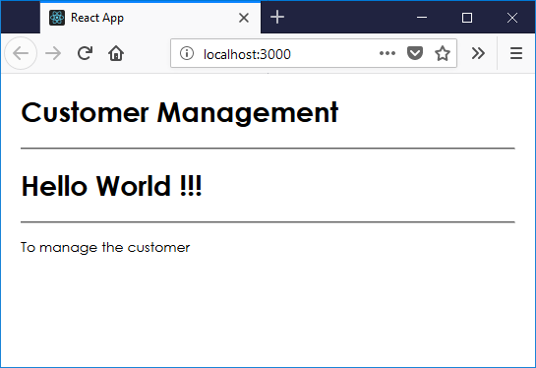
Stateless Component
output

Slide 110
Stateful Component
Let us set the state for CustomerManager component.
Create the constructor for the CustomerManager component.
In the constructor call the super constructor.
Create an array of customer objects with three fields such as id, name and age { "id" : 1, "name" : "Jegan", "age" : "45" }
Assign the customer objects array to data property of the state attribute [ { "id" : 1, "name" : "Jegan", "age" : "45" } { "id" : 1, "name" : "Aida", "age" : “32" } ]

Slide 111
Stateful Component
class CustomerManager extends React.Component {
constructor() {
super();
this.state = {
data: [
{ "id":1, "name":"Jegan", "age":“45" },
{ "id":2, "name":"Aida", "age":"32" },
{ "id":3, "name":"Daivd", "age":"40" }
]
}
}
render() {
}
}
index.js

Slide 112
Stateful Component
Let us set the state for CustomerManager component.
In the render method replace the <h1>Hello World !!!</h1> with table and tbody elements
Dynamically insert TableRow for every object from the data array using the map method and the arrow syntax (⇒) as { this.state.data.map((person, i) => <TableRow key={i} data={person} />) }

Slide 113
Stateful Component
class App extends React.Component {
constructor() { }
render() {
return ( <div>
<div><Header/></div>
<table><tbody>
{
this.state.data.map((person, i) =>
<TableRow key={i} data={person}/>)
}
</tbody></table>
<div><Footer/></div>
</div> );
}
}
index.js

Slide 114
Stateful Component
index.js
class TableRow extends React.Component {
render() {
return (
<tr>
<td>{ this.props.data.id }</td>
<td>{ this.props.data.name }</td>
<td>{ this.props.data.age }</td>
</tr>
);
}
}

Slide 115
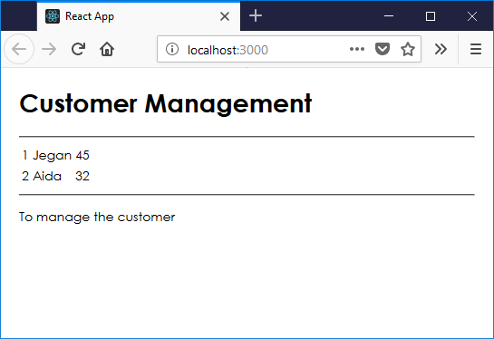
Stateful Component
Note − Since we are using key = {i} inside map() function. React will update only necessary elements instead of rendering entire list. It is a performance boost for larger number of dynamically created elements.
index.js

Slide 116
Babel
Babel is a transpiler for JavaScript which turn the ES6 code into ES5 code that runs in any browser. For example the following code:
const input = [1, 2, 3];
console.log(input.map(item => item + 1));
This is compiled by Babel to:
var input = [1, 2, 3];
console.log(input.map(function (item) {
return item + 1;
}));

Slide 117
JSX Templating

Slide 118
Introduction
JSX is a pre-processor step that adds XML syntax to JavaScript.
Just like XML, JSX tags have a tag name, attributes, and children. <div className="red">Children Text</div>
If an attribute value is enclosed in quotes, the value is a string. <div className="red">Children Text</div>
Value inside curly braces are JavaScript expression. <MyCounter count={3 + 5} />
Attribute is "className"
instead of "class" because
class is a keyword in JavaScript
tag name
attribute name
children
Value is string
Value is Expression

Slide 119
JSX Code vs REACT Code
The JSX code <div className="red">Children Text</div> <MyCounter count={3 + 5} />
The equivalent REACT code React.createElement("div", { className: "red" }, "Children Text"); React.createElement(MyCounter, { count: 3 + 5 });
The JSX syntax is more readable than the REACT code.

Slide 120
JSX – Naming Convention
HTML tags always use lowercase tag names, while React components start with Uppercase.
Note − You should use className and htmlFor as XML attribute names instead of class and for.
According to React official pages JSX is JavaScript, identifiers such as class and for are discouraged as XML attribute names.
Instead, React DOM components expect DOM property names such as className and htmlFor, respectively.

Slide 121
Why JSX
React uses JSX for Templating instead of regular JavaScript. JSX is a syntax extension to JavaScript. It is not necessary to use it, however, following are some pros that come with it.
JSX is faster because it performs optimization while compiling code to JavaScript.
JSX is also type-safe and most of the errors can be caught during compilation.
JSX makes it easier and faster to write templates, if you are familiar with HTML.

Slide 122
JSX Code
JSX looks like a regular HTML in most cases. The code App.jsx returns the div tag.
import React from 'react';
class App extends React.Component {
render() {
return ( <div> Hello World!!! </div> );
}
}
export default App;
The value in the return is similar to HTML code.
index.js

Slide 123
JSX Code
When ever JSX returns more nested HTML elements must wrap them with one container element. In most cases div tag is used as a wrapper tag for h1, h2 and p tags.
import React from 'react';
class App extends React.Component {
render() {
return ( <div><h1>Header</h1>
<h2>Content</h2><p>
This is the content!!!</p></div> );
}
}
export default App;
index.js
<div> tag is used as a container
tag for h1, h2 and p tags

Slide 124
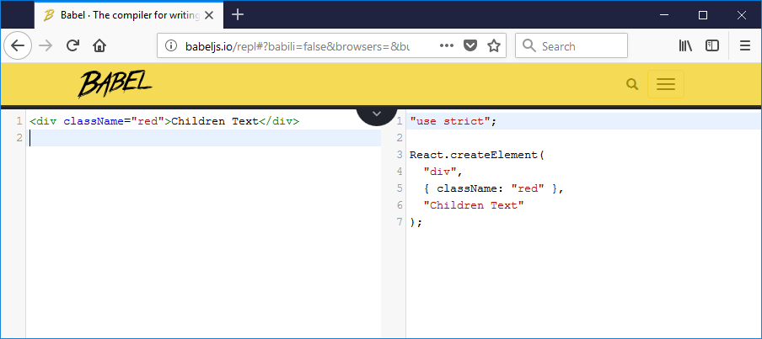
Babel Repl
Babel REPL is an online tool that converts JSX code to REACT code.
To access Babel Repl go to http://babeljs.io/repl

Slide 125
Babel Repl
In JSX if a value is enclosed with "" (double quote) it is always string.
In the following screen the string value red is enclosed ""

Slide 126
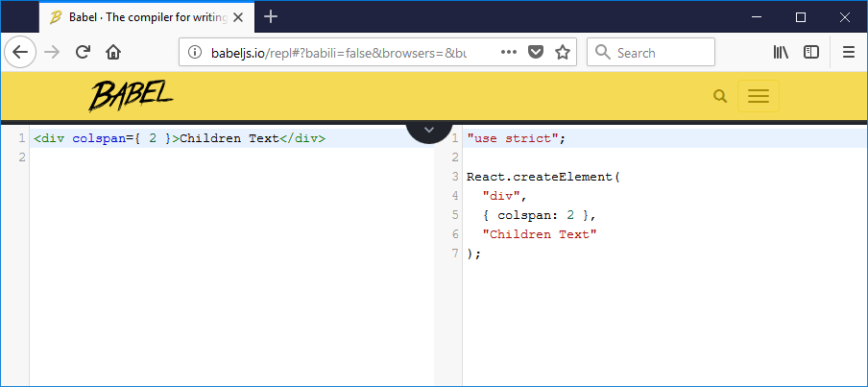
Babel Repl
In JSX the other type of values are enclosed with { }. In the following screen the integer value 2 is enclosed with {2}

Slide 127
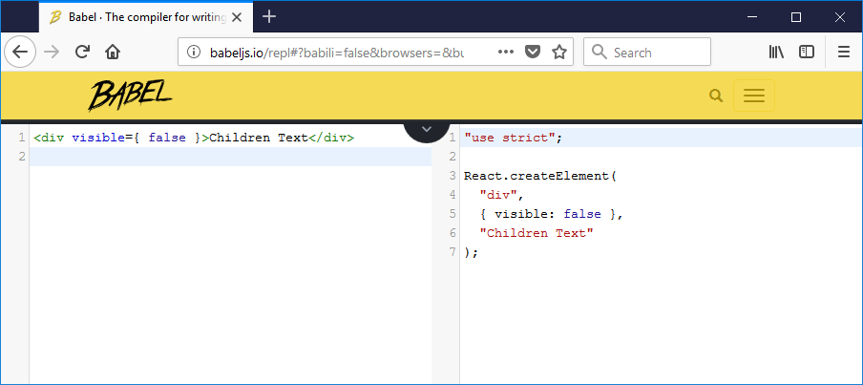
Babel Repl
In JSX the other type of values are enclosed with { }. In the following screen the boolean value false is enclosed with { false }

Slide 128
Attributes
In addition to regular HTML properties and attributes custom attributes can be declared and used. To add custom attributes, those attributes must be prefixed with "data-".
import React from 'react';
class App extends React.Component {
render() {
return ( <div> <h1>Header</h1>
<h2>Content</h2>
<p data-myattribute = "somevalue">
This is the content!!!</p> </div> );
}
}
export default App;
index.js

Slide 129
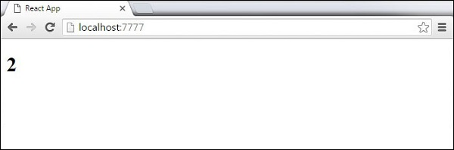
JSX - Expression
JavaScript expressions can be used inside JSX. JavaScript expressions will be wrap in curly brackets {}. The following example will render 2.
import React from 'react';
class App extends React.Component {
render() {
return ( <div> <h1>{1+1}</h1> </div> );
}
}
export default App;
index.js

Slide 130
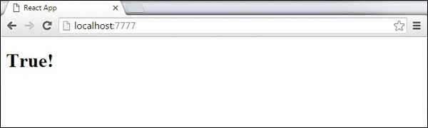
JSX – Decision Making
JavaScript if else statements cannot be used inside JSX.
The conditional (ternary) expressions can be used inside JSX.
The variable i equals to 1 so the browser will render true.
import React from 'react';
class App extends React.Component {
render() {
var i = 1;
return ( <div><h1>{i == 1 ? 'True!' : 'False'}</h1></div> );
}
}
export default App;

Slide 131
JSX - Styling
React recommends using inline styles.
When we want to set inline styles, we need to use camelCase syntax.
React will also automatically append px after the number value on specific elements.
The following example shows how to add myStyle inline to h1 element.

Slide 132
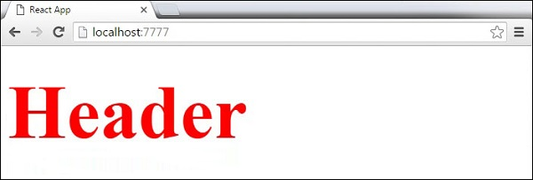
JSX - Styling
index.js
import React from 'react';
class CustomerManager extends React.Component {
render() {
var myStyle = { fontSize: 100, color: '#FF0000' }
return ( <div>
<h1 style = {myStyle}>Header</h1>
</div> );
}
}
export default CustomerManager;

Slide 133
JSX - Comments
index.js
When writing comments, we need to put curly brackets {}.
import React from 'react';
class CustomerManager extends React.Component {
render() {
return ( <div> <h1>Header</h1>
{ // End of the line Comment... }
{ /*Multi line comment...*/ }
</div> );
}
}
export default CustomerManager;
Comments – Single Line
Comments – Multi Line

Slide 134
JSX - Attributes
index.js
<div>
<Header data-myattribute={ this.state.data.header } />
</div>
<table><tbody>
{
this.state.data.map((person, i) =>
<TableRow key={i} data={person} />)
}
</tbody></table>
<div>
<Footer data-myattribute={ this.state.data.footer } />
</div>

Slide 135
State and Props

Slide 136
State
The State is the place where the data comes from.
Keep the state as simple as possible and minimize the number of stateful components.
In a project there may be ten components need data from state, create one container component that keeps state for all of them. this.state = { data: [ { "id" : 1, "name" : "Jegan", "age" : "45" }, { "id" : 2, "name" : "Aida", "age" : "32" } ], header: "Customer Management", footer: "To manage the Customers" }

Slide 137
Using Props
index.js
<div><Header headertext={ this.state.header } /></div>
<table>
<tbody>
{
this.state.data.map((person, i) =>
<TableRow key={i} data={person} />)
}
</tbody>
</table>
<div><Footer footertext={ this.state.footer } /></div>

Slide 138
Using Props
import React from 'react';
class Header extends React.Component {
render() {
return ( <div>
<h1>{ this.props.headertext }</h1>
<hr />
</div> );
}
}
export default Header
header.jsx

Slide 139
Using Props
footer.jsx
import React from 'react';
class Footer extends React.Component {
render() {
return ( <div>
<hr />
<p>{ this.props.footertext }</p>
</div> );
}
}
export default Footer

Slide 140
Props
Main difference between state and props is that props are immutable.
The container component should define the state that can be updated and changed.
For the child components should only pass data from the state using props. <Header headertext={ this.state.header } /> { this.props.headertext }

Slide 141

Props
index.js
This will produce the following result.

Slide 142
Default Props
index.js
Declare the default props
CustomerManager.defaultProps = {
title:"Customer List"
}
Render in the component as
<table>
<thead>
<tr><td colspan={ 3 }>{this.props.title}</td></tr>
</thead>
<tbody>
</tbody>
</table>

Slide 143
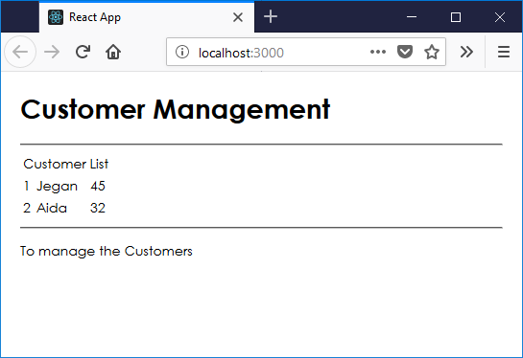
Default Props
Index.js
The output is as follows

Slide 144
Props Validation
Properties validation is to force the correct usage of the components. When the app grows properties validation assist in avoiding future bugs and problems. It also makes the code more readable.
Validating Props
Create a component with all the props that we need.
The App.propTypes is used for props validation.
If some of the props aren't using the correct type that are assigned, the warning appears in the console.
After specifying validation patterns, let us set App.defaultProps.

Slide 145
Props Validation
index.js
CustomerManager.propTypes = {
title:PropTypes.string,
citizen:PropTypes.array.isRequired,
goodPayMaster:PropTypes.bool.isRequired,
getCitizen:PropTypes.func,
totalCustomer:PropTypes.number
};
CustomerManager.defaultProps = {
title:"Customer List",
citizen:["Malaysian", "Foreigner"],
goodPayMaster:true,
getCode:function(code) { return "Customer Code : " + code },
totalCustomer:2
}

Slide 146
Props Validation
index.js
import PropTypes from 'prop-types';
render() {
return (
<thead>
<tr><td colspan={ 3 }>{this.props.title}</td></tr>
<tr><td colspan={ 3 }><select>
<option>{this.props.citizen[0]}</option>
<option>{this.props.citizen[1]}</option>
</select></td></tr>
<tr><td colspan={ 3 }>
{ (this.props.goodPayMaster) ? "Good Pay Master" : "Nope" }
</td> </tr>
<tr><td colspan={3}>Code: {this.props.getCode(1)}</td></tr>
</thead>
);
}

Slide 147
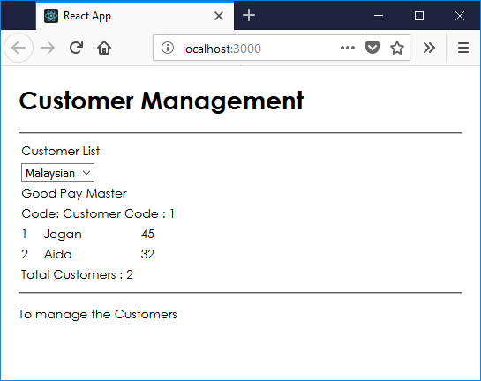
Props Validation
index.js
The output of the screen looks as follows

Slide 148
Props Validation
The code use isRequired when validating propArray and propBool.
This produces an error, if one of those two don't exist.
When propArray: [1,2,3,4,5] array is deleted from the App.defaultProps object, the console will log a warning.
When the code set the value of propArray: 1, React will warn that the propType validation has failed, since we need an array and we got a number.

Slide 149
Component API and Life cycle

Slide 150
Component API
There are three methods:
setState()
forceUpdate
ReactDOM.findDOMNode().
In new ES6 classes, this binding is done manually using the syntax
this.method.bind(this).

Slide 151
Component API – setState
index.js
The setState() method is used to update the state of component.
This method will add changes to the original state.
constructor() {
super();
this.state = {
data: [ { "id" : 1, "name" : "Jegan", "age" : "45" },
{ "id" : 2, "name" : "Aida", "age" : "32" } ],
header: "Customer Management",
footer: "To manage the Customers"
}
this.setStateHandler = this.setStateHandler.bind(this);
};

Slide 152
Component API – setState
index.js
setStateHandler() {
var item = { "id" : 3, "name" : "Khairi", "age" : "42" };
var myArray = this.state.data.slice();
myArray.push(item);
this.setState({data: myArray})
};
render() {
return (
<button onClick = {this.setStateHandler}>
SET STATE</button>
);
};

Slide 153
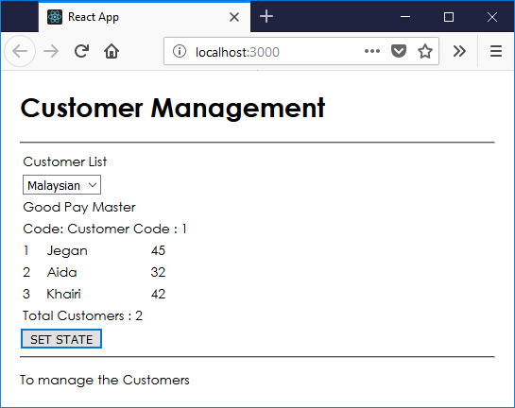
Component API – setState
index.js
Every time we click the button, the state will be updated.

Slide 154
Component API - forceUpdate
index.js
To update the component manually use the forceUpdate() method.
constructor() {
super();
this.forceUpdateHandler = this.forceUpdateHandler.bind(this);
};
forceUpdateHandler() {
this.forceUpdate();
};
render() {
return ( <div>
<button onClick = {this.forceUpdateHandler}>
FORCE UPDATE</button>
<h4>Random number: {Math.random()}</h4> </div>
);
}

Slide 155
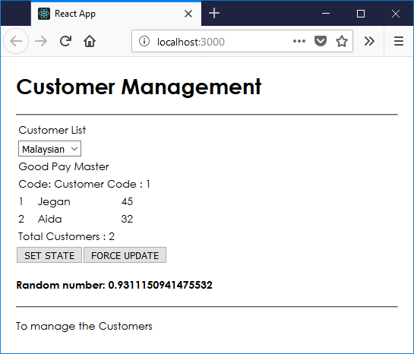
Component API
The code is setting a random number that will be updated every time the button is clicked.
index.js

Slide 156
Component API
index.js
For DOM manipulation, use ReactDOM.findDOMNode() method.
constructor() {
super();
this.findDomNodeHandler = this.findDomNodeHandler.bind(this);
};
findDomNodeHandler() {
var myDiv = document.getElementById('myDiv'); ReactDOM.findDOMNode(myDiv).style.color = 'green';
}
render() {
return ( <div>
<button onClick = {this.findDomNodeHandler}>
FIND DOME NODE</button>
<div id = "myDiv">NODE</div> </div> );
}

Slide 157
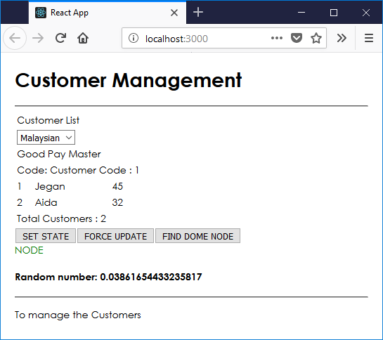
Component API
index.js
The myDiv element changes to green, once button is clicked.

Slide 158
Component Life Cycle
componentWillMount is executed before rendering, on both the server and the client side.
componentDidMount is executed after the first render only on the client side. This is where AJAX requests and DOM or state updates should occur. This method is also used for integration with other JavaScript frameworks and any functions with delayed execution such as setTimeout or setInterval. We are using it to update the state so we can trigger the other lifecycle methods.
componentWillReceiveProps is invoked as soon as the props are updated before another render is called. We triggered it from setNewNumber when we updated the state.

Slide 159
Component Life Cycle
shouldComponentUpdate should return true or false value. This will determine if the component will be updated or not. This is set to true by default. If you are sure that the component doesn't need to render after state or props are updated, you can return false value.
componentWillUpdate is called just before rendering.
componentDidUpdate is called just after rendering.
componentWillUnmount is called after the component is unmounted from the dom. We are unmounting our component in main.js.

Slide 160
Component Life Cycle
index.js
Set the initial state in constructor.
constructor(props) {
super(props);
this.state = { data: 0 }
this.setNewNumber = this.setNewNumber.bind(this)
};
setNewNumber() {
this.setState({data: this.state.data + 1})
}
render() {
return ( <div> <button onClick = {this.setNewNumber}>
INCREMENT</button>
<Content myNumber = {this.state.data}></Content> </div> );
}

Slide 161
Component Life Cycle
index.js
class Content extends React.Component {
componentWillMount() {
console.log('Component WILL MOUNT!')
}
componentDidMount() {
console.log('Component DID MOUNT!')
}
componentWillReceiveProps(newProps) {
console.log('Component WILL RECIEVE PROPS!')
}
shouldComponentUpdate(newProps, newState) {
return true;
}

Slide 162
Component Life Cycle
index.js
componentWillUpdate(nextProps, nextState) {
console.log('Component WILL UPDATE!');
}
componentDidUpdate(prevProps, prevState) {
console.log('Component DID UPDATE!')
}
componentWillUnmount() {
console.log('Component WILL UNMOUNT!')
}
render() {
return ( <div> <h3>{this.props.myNumber}</h3> </div> );
}
}
export default App;

Slide 163
Component Life Cycle
index.js
import React from 'react';
import ReactDOM from 'react-dom';
ReactDOM.render(
<App/>, document.getElementById('app'));
setTimeout(() => {
ReactDOM.unmountComponentAtNode(
document.getElementById('app'));
}, 10000);
After the initial render, the component display all the messages.

Slide 164
Component Life Cycle
Only componentWillMount and componentDidMount will be logged in the console, since we didn't update anything yet.
When we click the INCREMENT button, the update will occur and other lifecycle methods will be triggered.
After ten seconds, the component will unmount and the last event will be logged in the console.
Note − Lifecycle methods will always be invoked in the same order so it is a good practice to write it in the correct order as shown in the example.

Slide 165
Forms and events

Slide 166
Forms
Let us create an input form with value = {this.state.data}.
This allows to update the state whenever the input value changes.
Let us use the onChange event that will watch the input changes and update the state accordingly.

Slide 167
Forms
index.js
constructor(props) {
super(props);
this.state = { customerName: 'Initial data...' }
this.updateState = this.updateState.bind(this);
};
updateState(e) {
this.setState({customerName: e.target.value});
}
render() {
return ( <div>
<input type="text" value={this.state.customerName}
onChange = {this.updateState} />
<h4>{this.state. customerName}</h4> </div> );
}

Slide 168
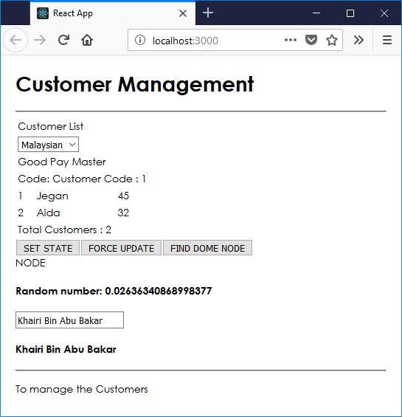
Forms
index.js
When the input text value changes, the state will be updated.

Slide 169
Forms
customerform.js
Let us create a component CustomerForm
import PropTypes from 'prop-types';
import React from 'react';
class CustomerForm extends React.Component {
render() {
return ( <div><hr /><div>
<input type = "text" value = {this.props.customerName}
onChange = {this.props.updateStateProp} /></div>
<h3>{this.props.customerName}</h3></div> );
}
}
export default CustomerForm

Slide 170
Forms
index.js
Include the form in the main component
<div>
<CustomerForm customerName={this.state.customerName}
updateStateProp = {this.updateState} />
</div>
Add the binding in the constructor
this.updateState = this.updateState.bind(this);
Add the new method
updateState(e) {
this.setState({customerName: e.target.value});
}

Slide 171
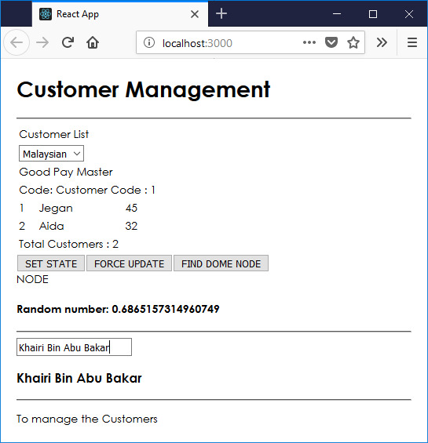
Forms
index.js
This will produce the following result.

Slide 172
Events, Refs and keys

Slide 173
Refs
The ref is used to return a reference to the element.
The Refs are useful when we need DOM measurements or to add methods to the components.
Let us see how to use refs to clear the input field. ClearInput function searches for element with ref = "myInput" value, resets the state,
Let us add focus to it after the button is clicked.

Slide 174
Refs
index.js
In the constructor
constructor(props) {
super(props);
this.state = { age: 0 }
this.updateState = this.updateState.bind(this);
this.clearInput = this.clearInput.bind(this);
};
Add a new Method
clearInput() {
this.setState({data: ''}); ReactDOM.findDOMNode(this.refs.myInput).focus();
}

Slide 175
Refs
index.js
In the render method
<input value = {this.state.age}
onChange = {this.updateState}
ref = "myInput">
</input>
<button onClick = {this.clearInput}>
CLEAR
</button>
<h4>{this.state.age}</h4>

Slide 176
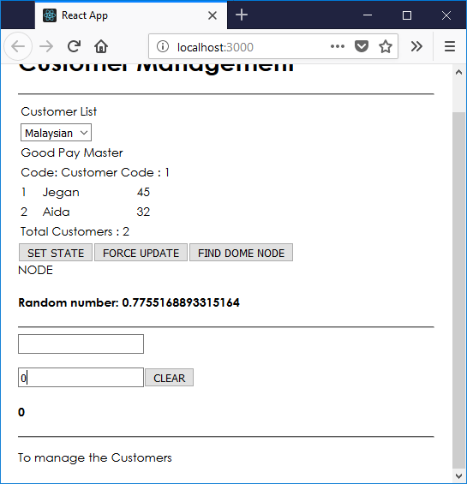
Refs
index.js
Once the button is clicked, the input will be cleared and focused.

Slide 177
Keys
React keys are useful when working with dynamically created components or when your lists are altered by the users. Setting the key value will keep your components uniquely identified after the change.
Using Keys
Let's dynamically create Content elements with unique index (i). The map function will create three elements from our data array. Since the key value needs to be unique for every element, we will assign i as a key for each created element.

Slide 178
Keys
App.jsx
import React from 'react'; class App extends React.Component { constructor() { super(); this.state = { data:[ { component: 'First...', id: 1 }, { component: 'Second...', id: 2 }, { component: 'Third...', id: 3 } ] } } render() { return ( <div> <div> {this.state.data.map((dynamicComponent, i) => <Content key = {i} componentData = {dynamicComponent}/>)} </div> </div> ); } }

Slide 179
Keys
class Content extends React.Component { render() { return ( <div> <div>{this.props.componentData.component}</div> <div>{this.props.componentData.id}</div> </div> ); } } export default App;

Slide 180
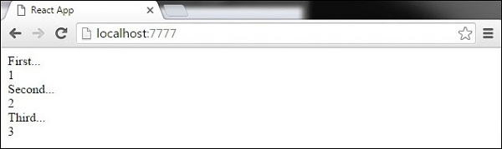
Keys
main.js
import React from 'react'; import ReactDOM from 'react-dom'; import App from './App.jsx'; ReactDOM.render(<App/>, document.getElementById('app')); We will get the following result for the Key values of each element.
If we add or remove some elements in the future or change the order of the dynamically created elements, React will use the key values to keep track of each element.

Slide 181
Router

Slide 182
Router
Install a React Router Module
To install the react-router run the following code
F:\Lab\REACT\vendor>npm install react-router
F:\Lab\REACT\vendor>npm install react-router-dom
Import the necessary libraries
import { BrowserRouter } from 'react-router-dom';
import { Route } from 'react-router-dom';

Slide 183
Router
index.html
Content of the index.html
<!DOCTYPE html>
<html lang = "en">
<head>
<meta charset = "UTF-8">
<title>React Router Tutorial</title>
</head>
<body>
<div id = "root"></div>
</body>
</html>

Slide 184
Router
index.js
Import React and Router Libraries
import React from 'react';
import ReactDOM from 'react-dom';
import './index.css';
import { BrowserRouter, Route } from 'react-router-dom';
Import all the components that are linked with menu import Menu from './component/menu';
import Footer from './component/footer';
import Dashboard from './component/dashboard';
import Vendors from './component/vendors';
import Products from './component/products';

Slide 185
Router
index.js
class Routes extends React.Component {
render () {
return (
<BrowserRouter><div className="primary-layout">
<Menu />
<div className="container">
<Route path="/" exact component={Dashboard} />
<Route path="/vendors" exact component={Vendors} />
<Route path="/products" component={Products} />
</div>
<Footer />
</div></BrowserRouter>
)
}
} ReactDOM.render(<Routes />, document.getElementById('root'));

Slide 186
Router
dashboard.js
import React from 'react';
class Dashboard extends React.Component {
render () {
return (
<div>
<div className="jumbotron">
<h1>Dashboard</h1>
<p>This system is used by IT Administrators. It is a
backend portal that allows the Administrators to
manage the Products and Vendors.</p>
</div>
</div>
)
}
}
export default Dashboard

Slide 187
Router
footer.js
import React from 'react';
class Menu extends React.Component {
render () {
return (
<div>
<hr />
<p className="textCenter">
While using this site, you agree to have read
and accepted our terms of use, cookie and
privacy policy. Copyright 2017-2018 by Data.
All Rights Reserved. Powered by
My Company Sdn. Bhd.</p>
</div>
)
}
}
export default Menu

Slide 188
Router
Menu.js
class Menu extends React.Component {
render () {
return (
<div>
<nav className="navbar navbar-default">
<div className="container-fluid">
<div className="navbar-header">
<span className="navbar-brand">My Company Sdn. Bhd.</span>
</div>
<ul className="nav navbar-nav">
<li className="active"><a href="/">Home</a></li>
<li><a href="/vendors">Vendors</a></li>
<li><a href="/products">Products</a></li>
</ul>
</div>
</nav>
</div>
)
}
}
export default Menu

Slide 189
Flux

Slide 190
Introduction
React really doesn't give us a way to manage data.
React simple accepts data through props or state.
That’s the reason React is called just a view layer.
There are many ways to handle the data by writing the custom code. There is no proper method in React.
Flux is a great, proven pattern for building apps with React.

Slide 191
Flux Concept
Flux is a programming concept, where the data is uni-directional. This data enters the app and flows through it in one direction until it is rendered on the screen.
Flux Elements Following is a simple explanation of the flux concept. In the next chapter, we will learn how to implement this into the app.
Actions The Actions are sent to the dispatcher to trigger the data flow.

Slide 192
Flux Concept
Dispatcher − This is a central hub of the app. All the data is dispatched and sent to the stores.
Store − Store is the place where the application state and logic are held. Every store is maintaining a particular state and it will update when needed.
View − The view will receive data from the store and re-render the app.

Slide 193
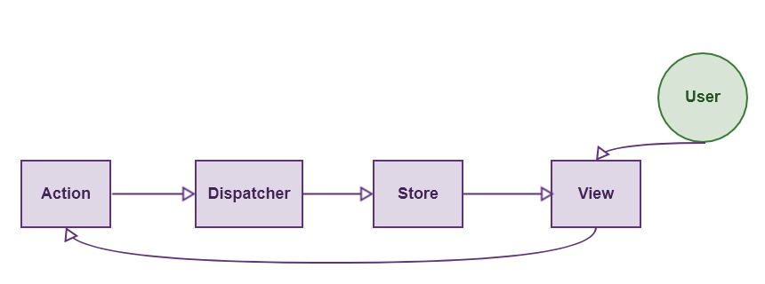
Flux Concept
The data flow is depicted in the following image.
Flux Pros
Single directional data flow is easy to understand.
The app is easier to maintain.
The app parts are decoupled.

Slide 194
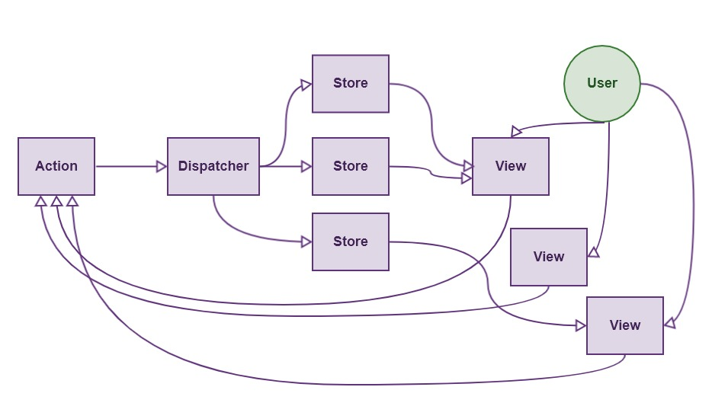
Flux Concept
The user interacts with the view and view triggers an action.
Action dispatch the corresponding function and then that function change the store.
When store updates its data, the subscriber views are automatically updated.
When have multiple stores, the application looks like this.
But the data flow is Unidirectional.

Slide 195
Flux Concept
Let us implement the Flux Concept
Actions
Dispatcher
Stores
Components

Slide 196
Components
vendors.js
Create a vendors Component
constructor() {
super();
this.state = {
vendors: [
{ "id" : "001", "name" : "Jegan", "age" : "45" },
{ "id" : "002", "name" : "Aida", "age" : "32" }
],
}
};

Slide 197
Components
vendors.js
render() {
return (
<div>
<table width={ "100%" }><thead>
<tr><td colspan={ 3 }><h4>Vendors List</h4></td></tr>
</thead><tbody> {
this.state.vendors.map((vendor, i) =>
<TableRow key={vendor.id} vendor={vendor} />) }
</tbody></table>
</div>
);
}

Slide 198
Store
vendorsstore.js
Let us create a "vendorsstore" file under the store folder.
Based on Flux concept the store must emit events and the components subscript to it.
import { EventEmitter } from 'events';
class VendorsStore extends EventEmitter {
constructor() {
super();
}
}
const vendorsStore = new VendorsStore;
export default vendorsStore

Slide 199
Store
vendorsstore.js
Let us move the data from vendors.js to vendorsstore.js
constructor() {
super();
this.vendors = [
{ "id" : "001", "name" : "Jegan", "age" : "45" },
{ "id" : "002", "name" : "Aida", "age" : "32" }
]
}
getAllVendors() {
return this.vendors;
}

Slide 200
Store
vendorsstore.js
Let us move the data from vendors.js to vendorsstore.js
constructor() {
super();
this.vendors = [
{ "id" : "001", "name" : "Jegan", "age" : "45" },
{ "id" : "002", "name" : "Aida", "age" : "32" }
]
}
getAllVendors() {
return this.vendors;
}

Slide 201
Components
vendors.js
Let us remove the date and fix the constructor of the vendors Component
import VendorsStore from '../store/vendorsstore'
constructor() {
super();
this.state = {
vendors: VendorsStore.getAllVendors();
}
};
Everything works same as before

Slide 202
Events
Now the data is already moved to the store. Based on the Flex concept, whenever the store changes it must automatically trigger an event to update the view. Add a createNewVendor method in the vendorsstore.
createNewVendor(name, age) {
let id = Date.now();
this.vendors.vendors.push(
{id, name, age}
);
this.emit("change");
}
vendorsstore.js

Slide 203
Events
vendors.js
Let us subscribe this event in the vendors
componentWillMount() {
VendorsStore.on("change", ()=> {
this.setState({
vendor: VendorsStore.getAllVendors()
})
})
}

Slide 204
Events
vendors.js
Let us test the CreateNewVendor Event
Add a Button
<button onClick = {this.addVendor}>Add</button>
Add an Event
addVendor() {
VendorsStore.createNewVendor("Khairi", 52);
};
Bind the Event
this.addVendor = this.addVendor.bind(this);

Slide 205
Dispatcher
dispatcher.js
Dispatcher is inside the library flux.
Let us install flux using the following command
npm install flux
Cretae a dispatcher.js file
In the file import dispatcher library and export the Dispatcher
import { Dispatcher } from "flux";
export default new Dispatcher

Slide 206
Dispatcher
Import the dispatcher
Create a handleActions method to handle all the relevant actions comes to the store.
import dispatcher from '../dispatcher'
handleActions(action) {
switch (action.type) {
case "CREATE_TODO": {
this.createNewVendor(action.name, action.age)
}
}
}
const vendorsStore = new VendorsStore()
dispatcher.register(vendorsStore.handleActions.bind(vendorsStore));
vendorstore.js

Slide 207
Dispatcher
Import the dispatcher
import dispatcher from '../dispatcher'
Modify an Event
Remove the VendorsStore.createNewVendor("Khairi", 52);
Add the dispatcher.dispatch method
addVendor() {
dispatcher.dispatch(
{type: "CREATE_TODO", name:"Khairi", age:52})
};
vendors.js

Slide 208
Actions
vendorsactions.js
Create an Actions Folder
Create a VendorsActions.js file
import dispatcher from '../dispatcher';
export function createVendor(name, age) {
dispatcher.dispatch({
type:"CREATE_TODO",
name:name,
age:age
})
}

Slide 209
Actions
Import the actions
import * as VendorsActions from '../actions/vendorsactions'
Modify an Event
Remove the dispatcher.dispatch({type: "CREATE_TODO", ……
Add the VendorsActions method
addVendor() {
VendorsActions.createVendor("Khairi", 52)
};
Note: Start adding textboxes now.
vendors.js

Slide 210
Redux

Slide 211
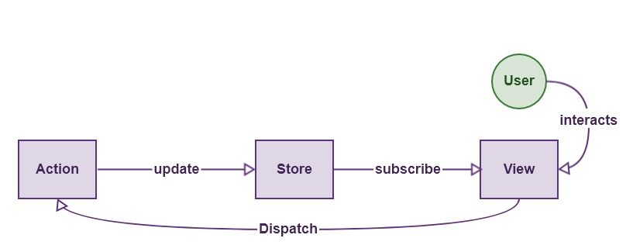
Using Redux
Redux is the predictable state container for JavaScript applications. Redux is also following the Unidirectional flow, but it is entirely different from Flux. Flux has multiple stores. Redux has a Single Store.
Redux can not have multiple stores. The store is divided into various state objects.

Slide 212
Redux Principles
Three Principles Of Redux
Single source of truth.
The state is read-only.
Changes are made with pure functions.
It is the state of our whole application is stored in an object within a single store.
There is an only way to change the state is to emit an action, an object describing what happened.
Reducers are to specify how actions transform the state.

Slide 213
Using Redux
Install Redux using the following command npm install redux
Create a project and delete all files except index.html and index.js
Open the index.js and import createStore import {createStore} from 'redux';
To start up the Redux Store you must create a reducer const reducer = function() { }
Create store by passing the reducer and initial state const store = createStore(reducer, 0)
Index.js

Slide 214
Using Redux
Let us subscript to the store store.subscribe(() => { console.log("Store changed", store.getState()) })
Throw an Event Store.dispatch({type: "INC", payload: 1})
Output: In the console "Store changed" message appear.
Since reducer is not returning anything we don’t see anything else
Index.js

Slide 215
Using Redux
Index.js
Let us modify the reducer
const reducer = function (state, action) {
if (action.type === "INC") {
state = state + 1;
}
if (action.type === "DEC") {
state = state - 1;
}
}

Slide 216
Using Redux
Index.js
Let us see how to pass value to Reducer store.dispatch({type: "INC", payload: 1) store.dispatch({type: "INC", payload: 2) store.dispatch({type: "INC", payload: 15)
The reducer can get the values from action as follows const reducer = function (state, action) { if (action.type === "INC") { state = state + action.payload; } }

Slide 217
Using Redux
Let us develop a simple example using Redux and let us see how it can be integrated with React.
Step 1 - Install Redux
Install Redux using the command npm install --save react-redux
Step 2 - Create Files and Folders
Create folders and files for actions
Create folders and files for reducers
Create folders and files for components

Slide 218
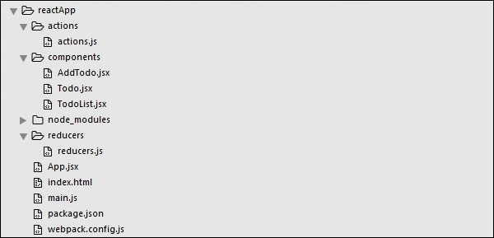
Using Redux

Slide 219
Using Redux
Actions are JavaScript objects that use type property to inform about the data that should be sent to the store. Let us define ADD_TODO action that will be used for adding new item to our list. The addTodo function is an action creator that returns our action and sets an id for every created item.
Open actions/actions.js
export const ADD_TODO = 'ADD_TODO'
let nextTodoId = 0;
export function addTodo(text) {
return {
type: ADD_TODO,
id: nextTodoId++, text
};
}

Slide 220
Using Redux
Step 4 - Reducers
While actions only trigger changes in the app, the reducers specify those changes. We are using switch statement to search for a ADD_TODO action. The reducer is a function that takes two parameters (state and action) to calculate and return an updated state.
The first function will be used to create a new item, while the second one will push that item to the list. Towards the end, we are using combineReducers helper function where we can add any new reducers we might use in the future.

Slide 221
Using Redux
reducers/reducers.js
import { combineReducers } from 'redux' import { ADD_TODO } from '../actions/actions' function todo(state, action) { switch (action.type) { case ADD_TODO: return { id: action.id, text: action.text, } default: return state } } function todos(state = [], action) { switch (action.type) { case ADD_TODO: return [ ...state, todo(undefined, action) ] default: return state } } const todoApp = combineReducers({ todos }) export default todoApp

Slide 222
Using Redux
Step 5 - Store
The store is a place that holds the app's state. It is very easy to create a store once you have reducers. We are passing store property to the provider element, which wraps our route component.
main.js
import React from 'react' import { render } from 'react-dom' import { createStore } from 'redux' import { Provider } from 'react-redux' import App from './App.jsx' import todoApp from './reducers/reducers' let store = createStore(todoApp) let rootElement = document.getElementById('app') render( <Provider store = {store}> <App /> </Provider>, rootElement )

Slide 223
Using Redux
Step 6 - Root Component
The App component is the root component of the app. Only the root component should be aware of a redux. The important part to notice is the connect function which is used for connecting our root component App to the store.
This function takes select function as an argument. Select function takes the state from the store and returns the props (visibleTodos) that we can use in our components.

Slide 224
Using Redux
App.js
import React, { Component } from 'react' import { connect } from 'react-redux' import { addTodo } from './actions/actions' import AddTodo from './components/AddTodo.js' import TodoList from './components/TodoList.js' class App extends Component { render() { const { dispatch, visibleTodos } = this.props return ( <div> <AddTodo onAddClick = {text ⇒dispatch(addTodo(text))} /> <TodoList todos = {visibleTodos}/> </div> ) } } function select(state) { return { visibleTodos: state.todos } } export default connect(select)(App);

Slide 225
Using Flux
Step 7 - Other Components
These components shouldn't be aware of redux.
components/AddTodo.js
import React, { Component, PropTypes } from 'react' export default class AddTodo extends Component { render() { return ( <div> <input type = 'text' ref = 'input' /> <button onClick = {(e) ⇒ this.handleClick(e)}> Add </button> </div> ) } handleClick(e) { const node = this.refs.input const text = node.value.trim() this.props.onAddClick(text) node.value = '' } }

Slide 226
Using Redux
components/Todo.js
import React, { Component, PropTypes } from 'react' export default class Todo extends Component { render() { return ( <li> {this.props.text} </li> ) } }
components/TodoList.js
import React, { Component, PropTypes } from 'react' import Todo from './Todo.js' export default class TodoList extends Component { render() { return ( <ul> {this.props.todos.map(todo ⇒ <Todo key = {todo.id} {...todo} /> )} </ul> ) } }

Slide 227
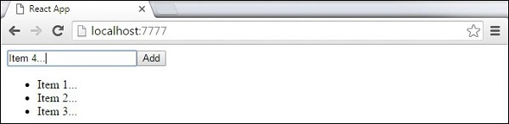
Using Redux
When we start the app, we will be able to add items to our list.

Slide 228
Animations

Slide 229
Animations
Step 1 - Install React CSS Transitions Group
This is React add-on used for creating basic CSS transitions and animations. We will install it from the command prompt window −
C:\Users\username\Desktop\reactApp>npm install react-addons-css-transition-group Step 2 - Add a CSS file
Let's create a new folder css and file style.css inside. To be able to use it in the app, we need to link it to the head element in index.html.
<link rel = "stylesheet" type = "text/css" href = "css/style.css"> Step 3 - Appear Animation
We will create a basic React component. The ReactCSSTransitionGroup element will be used as a wrapper of the component we want to animate. It will use transitionAppear and transitionAppearTimeout, while transitionEnter and transitionLeave are false.

Slide 230
Animations
App.jsx
import React from 'react'; var ReactCSSTransitionGroup = require('react-addons-css-transition-group'); class App extends React.Component { render() { return ( <div> <ReactCSSTransitionGroup transitionName = "example" transitionAppear = {true} transitionAppearTimeout = {500} transitionEnter = {false} transitionLeave = {false}> <h1>My Element...</h1> </ReactCSSTransitionGroup> </div> ); } } export default App;

Slide 231
Animations
main.js
import React from 'react' import ReactDOM from 'react-dom'; import App from './App.jsx'; ReactDOM.render(<App />, document.getElementById('app')); The CSS animation is very simple.
css/style.css
.example-appear { opacity: 0.01; } .example-appear.example-appear-active { opacity: 1; transition: opacity 500ms ease-in; }

Slide 232
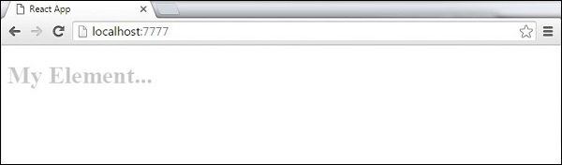
Animations
Once we start the app, the element will fade in.

Slide 233
Animations
Step 4 - Enter and Leave Animations are used to add or remove elements.
import React from 'react';
var ReactCSSTransitionGroup = require('react-addons-css-transition-group');
class App extends React.Component {
constructor(props) {
super(props);
this.state = { items: ['Item 1...', 'Item 2...', 'Item 3...', 'Item 4...'] }
this.handleAdd = this.handleAdd.bind(this);
};
handleAdd() {
var newItems = this.state.items.concat([prompt('Create New Item')]);
this.setState({items: newItems});
}
handleRemove(i) {
var newItems = this.state.items.slice(); newItems.splice(i, 1); this.setState({items: newItems});
}

Slide 234
Animations
render() {
var items = this.state.items.map(
function(item, i) {
return ( <div key = {item}
onClick = {this.handleRemove.bind(this, i)}>
{item} </div> );
}.bind(this));
return ( <div> <button onClick = {this.handleAdd}>
Add Item</button>
<ReactCSSTransitionGroup transitionName = "example" transitionEnterTimeout = {500} transitionLeaveTimeout = {500}>
{items} </ReactCSSTransitionGroup> </div> );
}
}
export default App;

Slide 235
Animations
import React from 'react'
import ReactDOM from 'react-dom';
import App from './App.jsx';
ReactDOM.render(<App />, document.getElementById('app'));
.example-enter { opacity: 0.01; }
.example-enter.example-enter-active {
opacity: 1; transition: opacity 500ms ease-in;
}
.example-leave { opacity: 1; }
.example-leave.example-leave-active {
opacity: 0.01; transition: opacity 500ms ease-in;
}

Slide 236
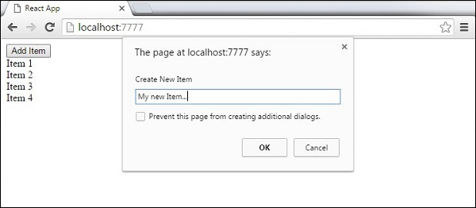
Animations
When we start the app and click the Add Item button, the prompt will appear.

Slide 237
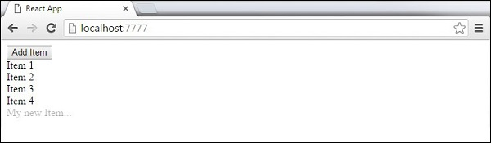
Animations
Once the name enter and press OK, the new element will fade in.

Slide 238
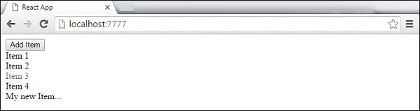
Animations
Now we can delete some of the items (Item 3...) by clicking it. This item will fade out from the list.

Slide 239
Higher Order Components
Higher order components are JavaScript functions used for adding additional functionalities to the existing component.
These functions are pure, which means they are receiving data and returning values according to that data.
If the data changes, higher order functions are re-run with different data input.
If we want to update our returning component, we don't have to change the HOC.
All we need to do is change the data that our function is using.

Slide 240
Higher Order Components
Higher Order Component (HOC) is wrapping around "normal" component and provide additional data input. It is actually a function that takes one component and returns another component that wraps the original one. Let us take a look at a simple example to easily understand how this concept works.
The MyHOC is a higher order function that is used only to pass data to MyComponent.
This function takes MyComponent, enhances it with newData and returns the enhanced component that will be rendered on the screen.

Slide 241
Higher Order Components
import React from 'react';
var newData = { data: 'Data from HOC...', }
var MyHOC = ComposedComponent ⇒ class extends React.Component {
componentDidMount() {
this.setState({ data: newData.data });
}
render() {
return <ComposedComponent {...this.props} {...this.state} />; }
};
class MyComponent extends React.Component {
render() {
return ( <div> <h1>{this.props.data}</h1> </div> )
}
}
export default MyHOC(MyComponent);

Slide 242
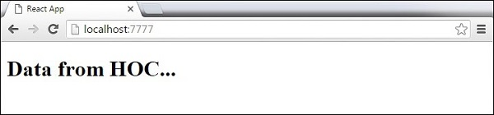
Higher Order Components
If we run the app, we will see that data is passed to MyComponent.
Note − Higher order components can be used for different functionalities. These pure functions are the essence of functional programming. Once you are used to it, you will notice how your app is becoming easier to maintain or to upgrade.

Slide 243
Best Practices
React best practices, methods, and techniques that will help to stay consistent during the app development.
State − The state should be avoided as much as possible. It is a good practice to centralize state and pass it down the component tree as props. Whenever there is group of components that need the same data, set a container element around them to hold state. Flux pattern is a nice way of handling the state in React apps.
PropTypes − PropTypes should always be defined to track all props in the app.

Slide 244
Best Practices
Render − Most of the app's logic should be moved inside the render method. We should try to minimize logic in component lifecycle methods and move that logic in the render method. The less state and props we use, the cleaner the code will be. We should always make the state as simple as possible. If we need to calculate something from the state or props, we can do it inside the render method.

Slide 245
Best Practices
Composition − React team suggests to use a single responsibility principle. This means that one component should only be responsible for one functionality. If some of the components have more than one functionality, we should refactor and create a new component for every functionality.
Higher Order Components (HOC) − Former React versions offered mixins for handling reusable functionalities. Since mixins are now deprecated, one of the solutions is to use HOC.

