Slide 1

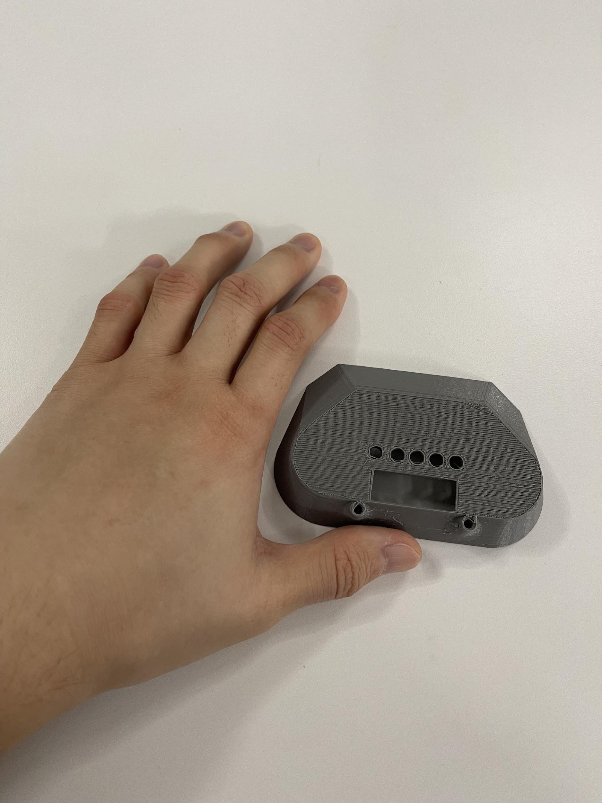
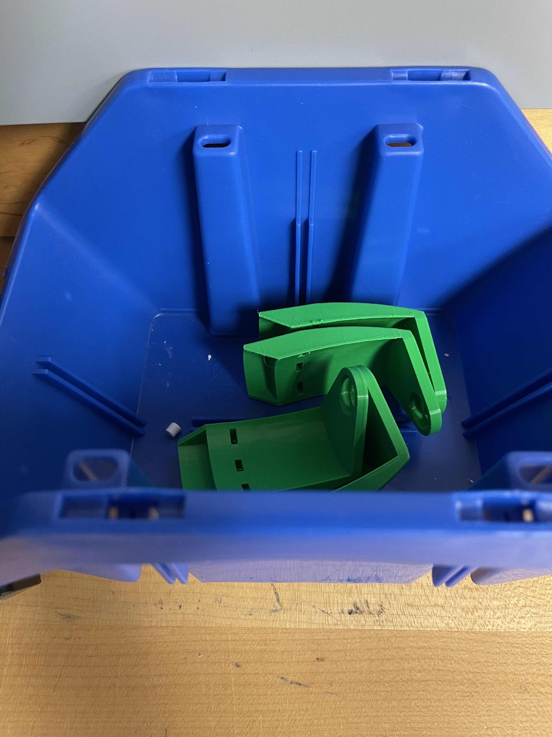
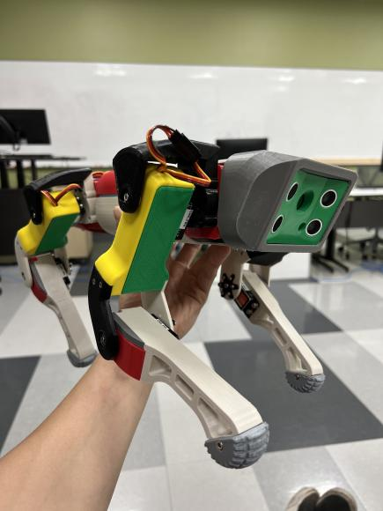
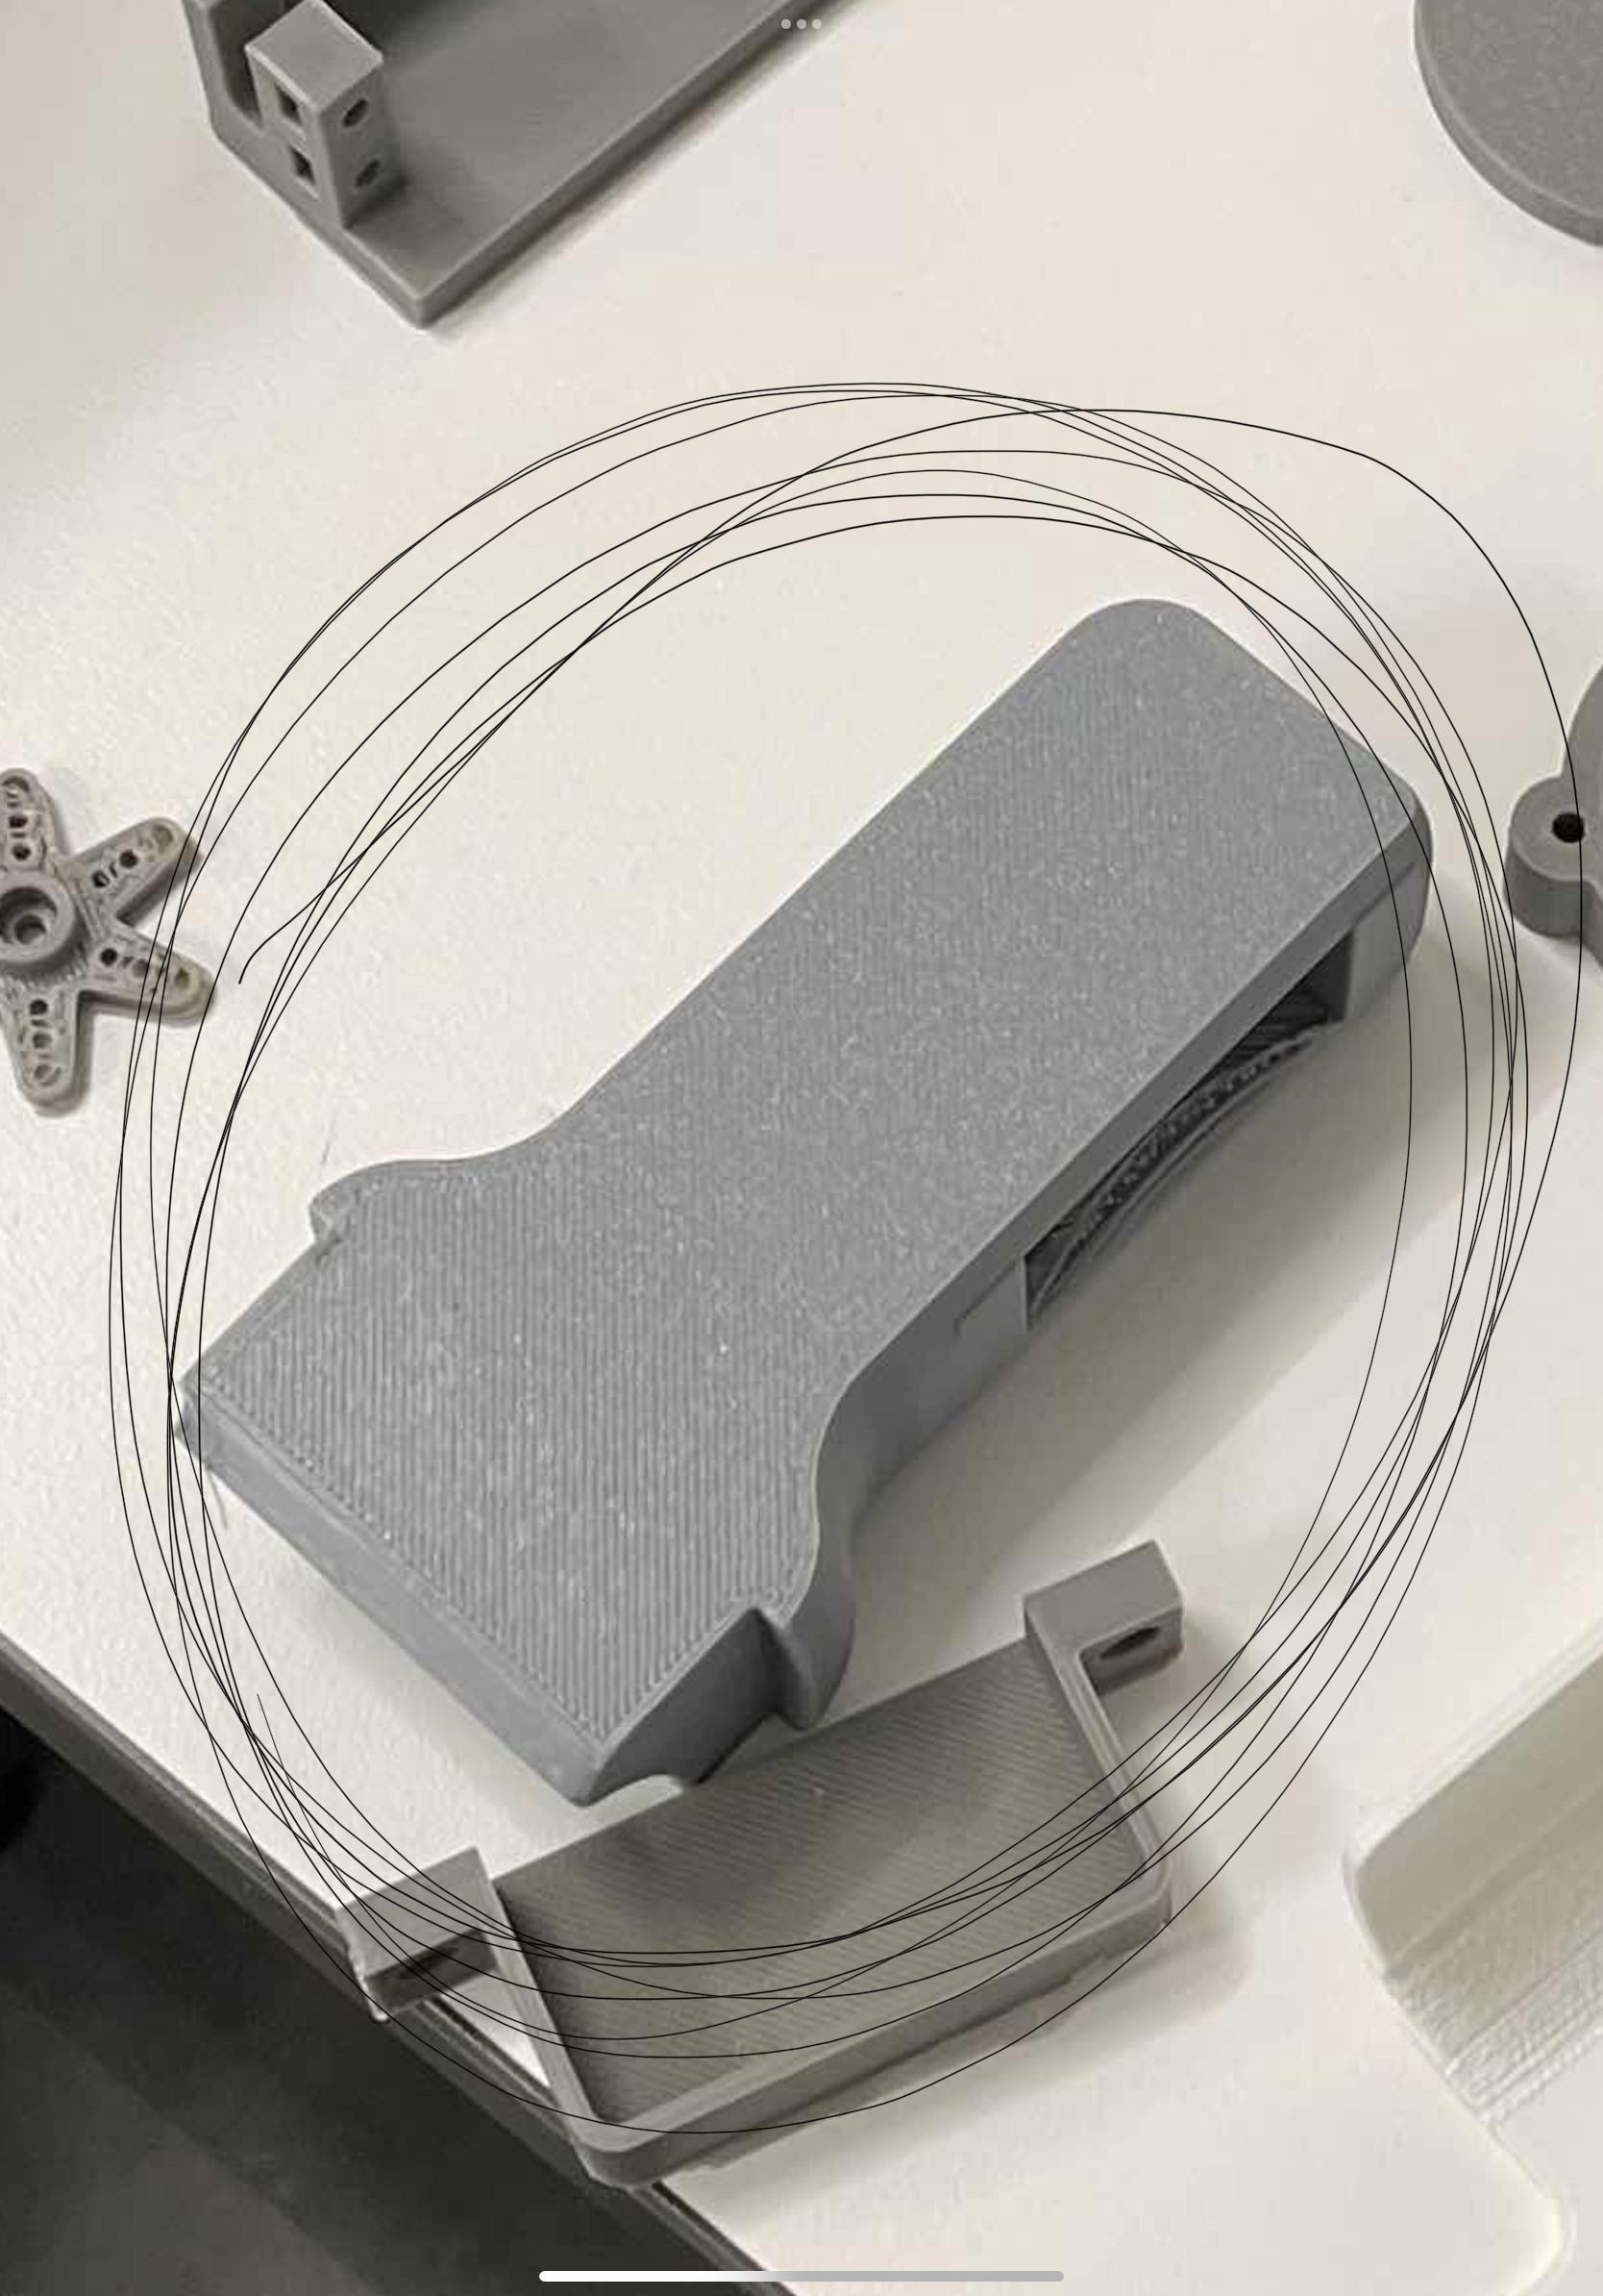
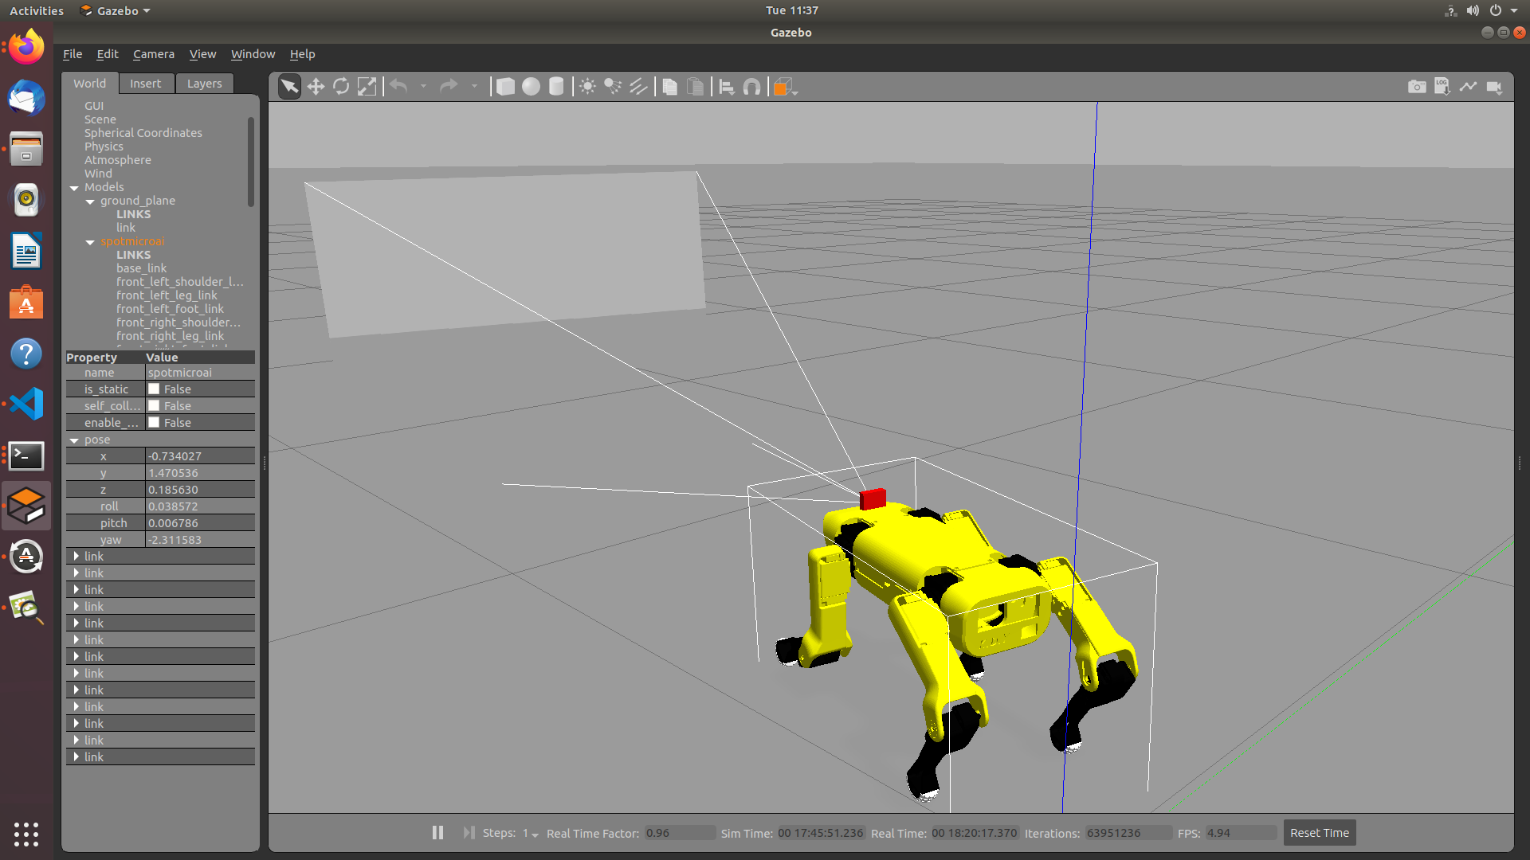

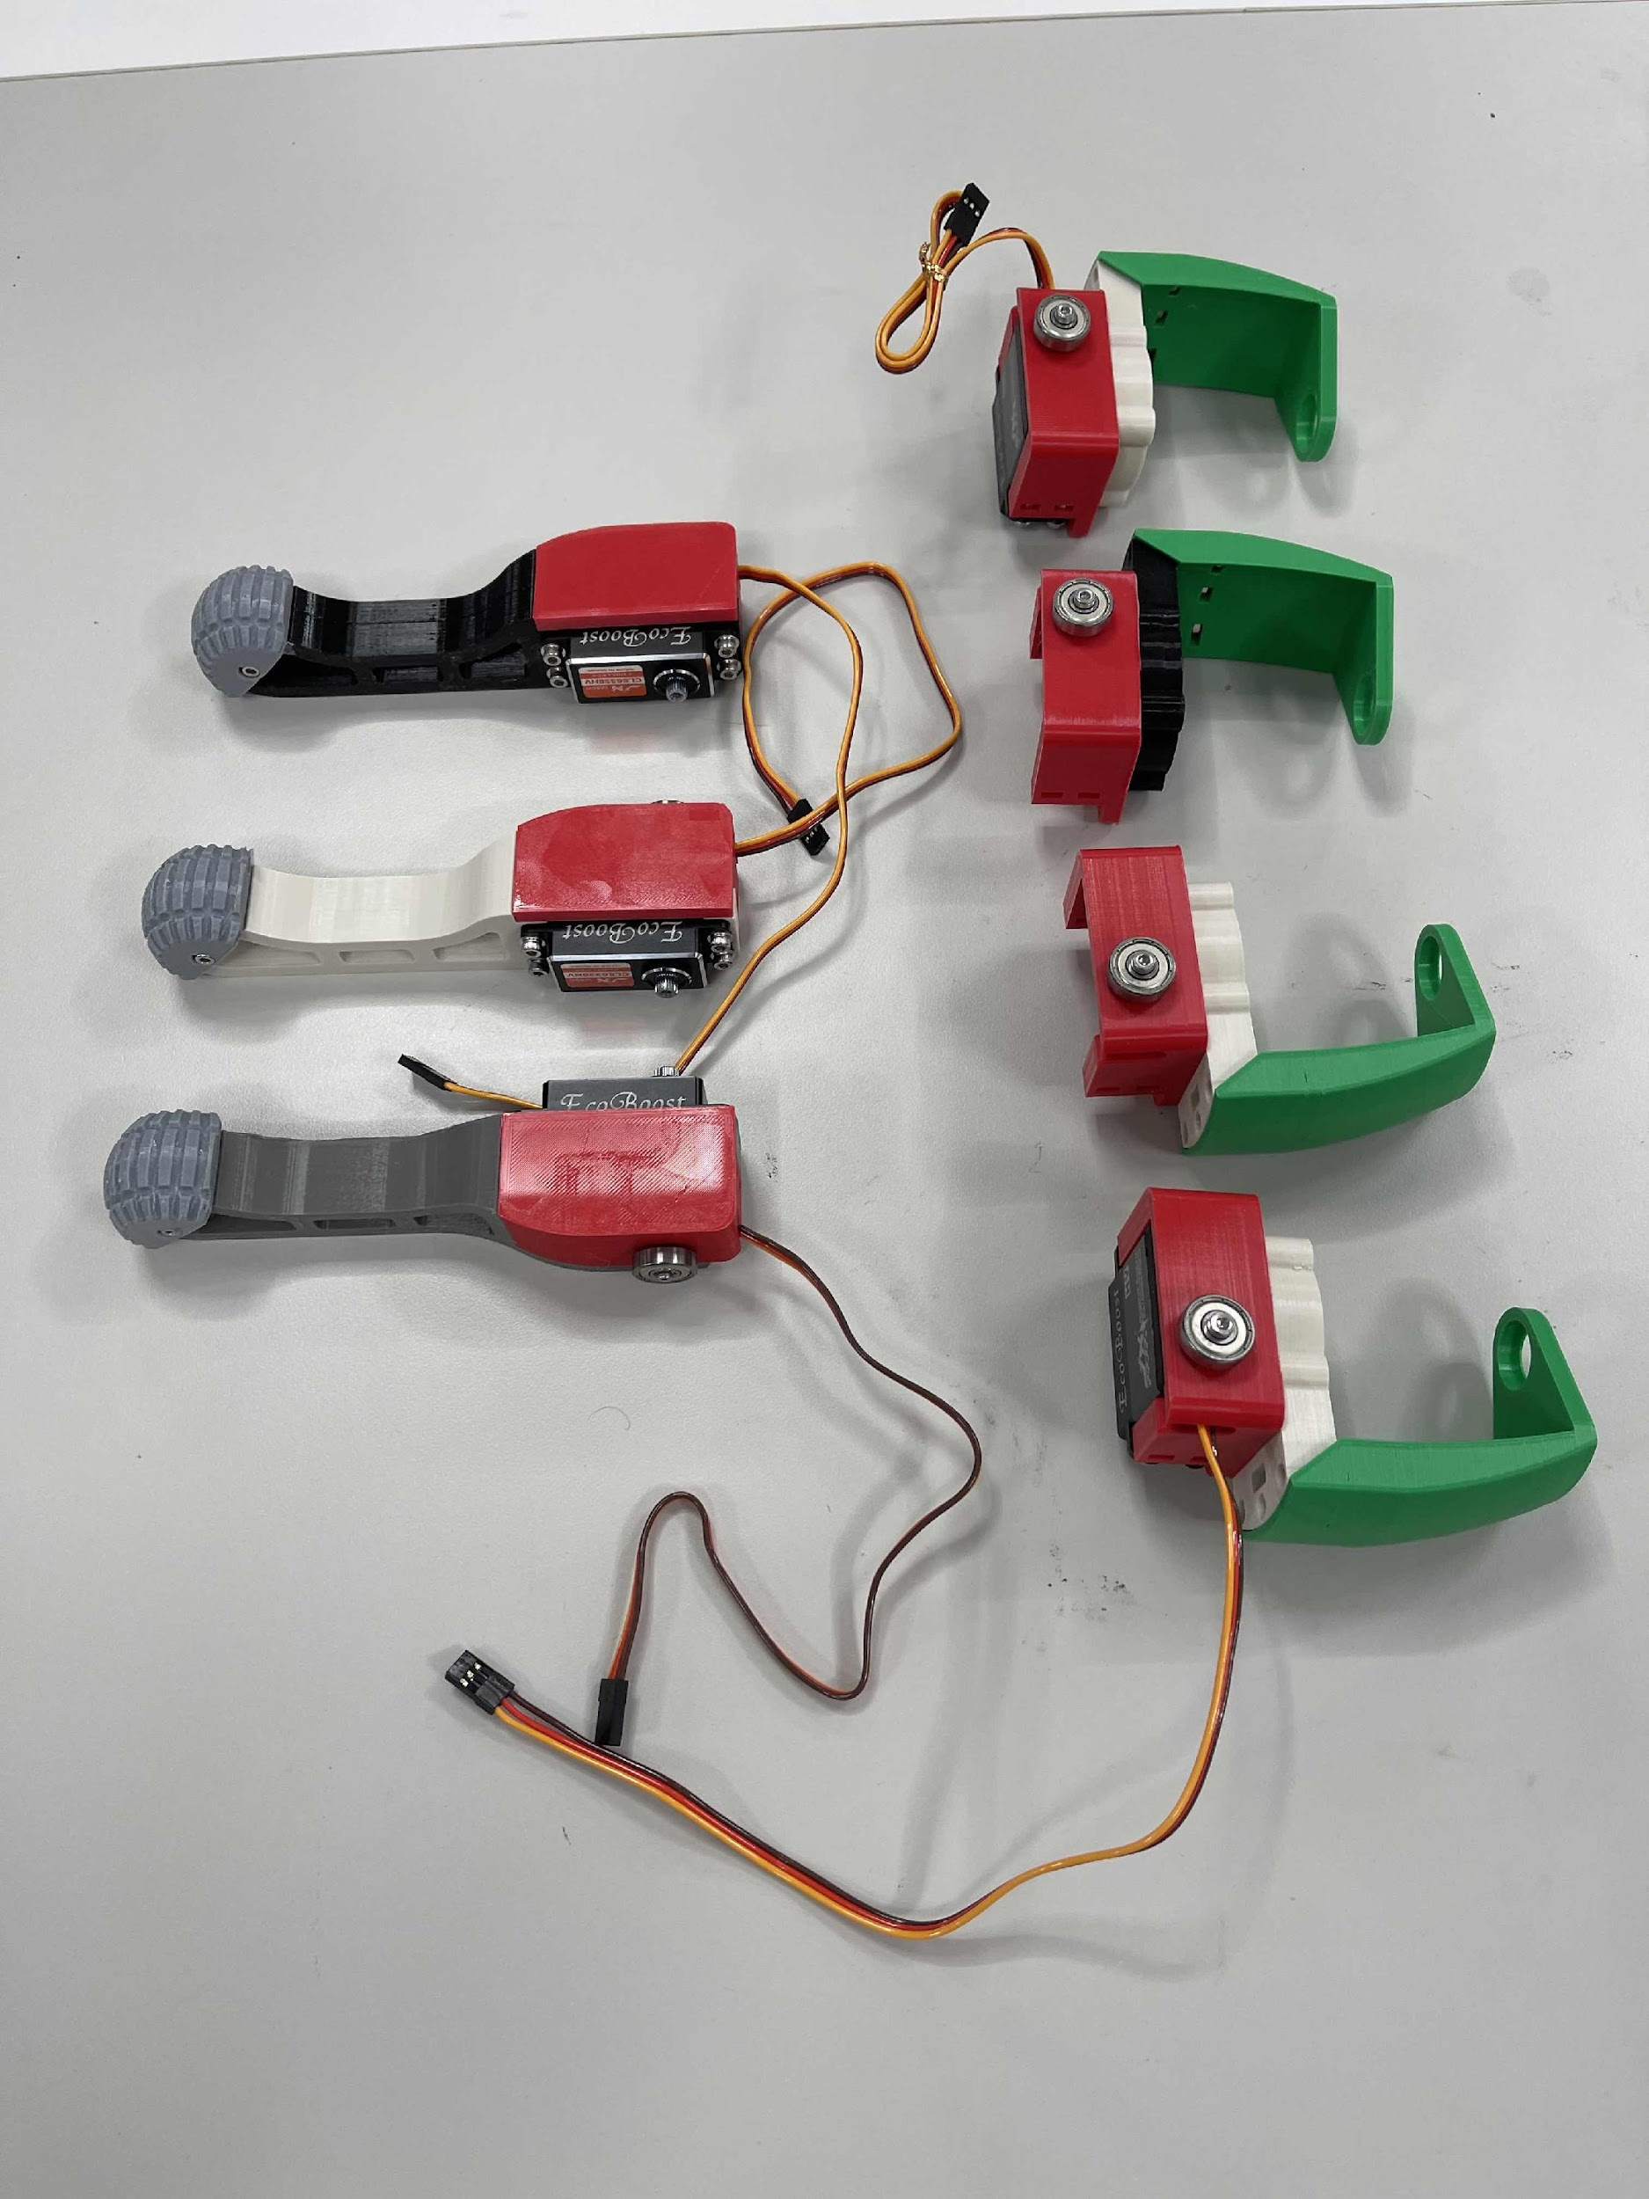
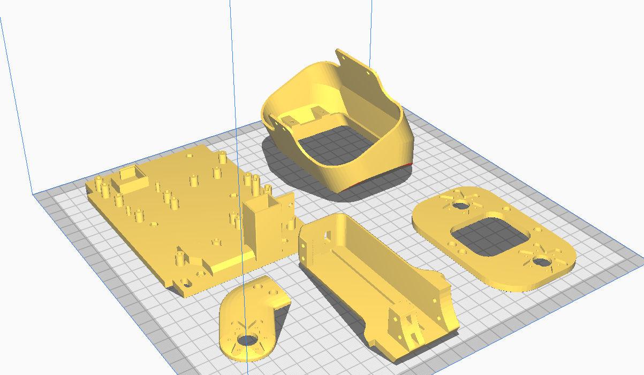

Obstacle Avoidance With a Quadrupedal Robot
Ryunghoon Ahn, Samuel Lee, Christopher Valdes, Dr. Dongchul Kim Department of Computer Science, College of Engineering and Computer Science
INTRODUCTION
Abstract
This project revolves around a quadrupedal robot that does usage of a JetsonNano to implement neural network computations for the robot so that it can perform actions autonomously.
Introduction
There are three main components for this project. First is the creation of the real robot, second is the simulation of the robot, and third is Sim2Real which refers to the transferring of the simulation gathered information to the physical robot.
Components for the physical robot are the Jetson Nano, 12 35.6kg 7.4~8.4 Servos, PCA9685 Servo Driver, MPU6050 Gyro, and HC-SR04 Ultrasonic Sensor. The main body of the robot is composed of 3d printed parts.
Choosing the ideal software to perform our simulation was important as a lot of these simulation environments are not supported by the Jetson Nano. After some research we decided on using ROS(Robot Operating System)/Gazebo which is known for smoothing out the transfer of simulations to real robots. For the reinforcement learning aspect we intend to employ tensorflow into the simulation.
For the senior project deadline, we wish to have the physical robot move in a straight line not with a controller, but with our program.
METHOD, PLAN or APPROACH
Details, Details
Initially, we had a way smaller robot we were going to use.
Here’s a picture of the back plate of the previous robot:
3D printed parts were printed in the Makerspace at the engineering building lab. Circuitry/servos were purchased online. Assembly was done in the research lab.
The software aspect of the project had many unexpected roadblocks. Initially, we had established that we would use Isaac Gym as our simulation environment but realized the Jetson Nano would not be able to handle it.
After some research, we settled with ROS/Gazebo which the Jetson Nano can handle. Started by importing the robot and spawning it to the Gazebo environment, then learning all about ROS and how to take control of the robot’s movement. Our two language options to write our scripts for the robot on ROS/Gazebo were Python and C++ and we stuck with Python. Writing our Python scripts we can control ROS/Gazebo.
RESULTS or PROGRESS
We’ve accomplished quite a lot already.
Here is a quick rundown:
ROS/Gazebo/Tensorflow installation in Ubuntu.
Procurement of circuitry, sensors, motors.
3d printed close to 100 parts (not all of which were used).
Comfortable with Robot movement in ROS/Gazebo.
Constructed a plastic/metal robot.
Optimized parts, for example the feet of the robot are in a more flexible material (TPU). Some parts needed infill increased as well.
Calibrated all servos to not go past allowed degrees
Calibrated Ultrasonic Sensor
These are examples of parts we don’t use anymore:
DISCUSSION
About Printing
The Makerspace was essential for this project. Thanks to the help of the engineering building/department and more specifically Dr. Noe Vargas, we were able to print the 3d printed parts necessary for this project.
Thank you Dr. Vargas!
About The Robot
We are able to move all servos and gather data from sensor on the robot such as the camera. We are also at the stage where our main focus is no longer on robot construction/assembly but on the the elaboration of our NN model and the transferring of it to the physical robot.
Once we have created a learning model that we are satisfied with in the simulation, we will have to employ it to the physical robot which is where ROS comes into play. ROS has embedded libraries that aid with the transfer of information from a simulation to actual circuitry and sensors of a robot.
CONCLUSIONS
We’ve made good progress, but we are not content with what we’ve done so far so now our next immediate goal is getting the physical dog walking with a learning model which can be daunting but we believe is possible.
Next steps:
Continue programming, robot should be able to walk in a straight line through model.
Robot does not fall over in either the simulator or in physical trials.
Extra parts/materials in case a part is damaged.
GOALS
Our immediate goal was creating a working robot that moved with circuitry, 3d printed parts, and attached devices like a front facing camera. We also aimed to have at least some simulations of the robot learning to walk. Throughout the project, we wanted to gain industry knowledge.
Assembly of a working, functioning quadruped.
Gain experience with robotics and robot simulators.
Hands on learning approach, physical end product.
Completed robot construction using 3d printed parts.
Not enough infill
Gazebo simulator. Notice the addition of a front-facing camera.
ACKNOWLEDGEMENTS
Thank you again Dr. Vargas for the aid in 3d printing, and the Teaching Assistants in the Makerspace. Thank you Dr. Kim for the advice and opportunity to do this in the first place. Thank you to the research lab members who helped us with this project as well.
Ultimaker Cura Slicer
Gazebo/ROS
Wrong material (TPU)
Lots of circuitry involved.

