Slide 1


Slide 2
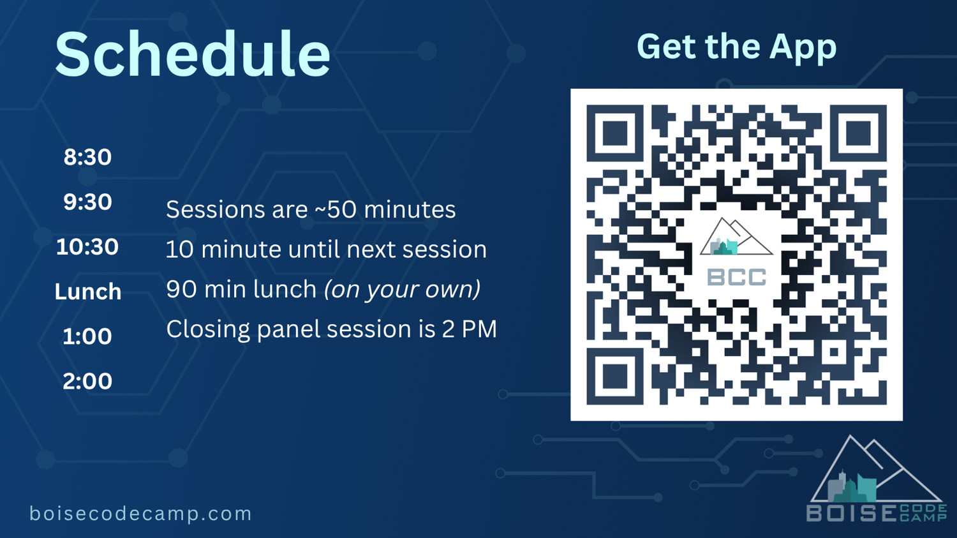

Slide 3

Want AI That Actually Does Things For You?
BOISE CODE CAMP 2026 · TECHNICAL WORKSHOP
Building & Running Powerful Personal AI Agents Locally with OpenClaw and Hermes Agent from Nous Research
Presenter: Chuck Anderson
Partially Powered by Nvidia
Date: 5/2/2026]

Slide 4
⚠
Legal Disclaimer
No Warranty or Guarantee
This presentation is provided “as is” without warranty of any kind, express or implied, including but not limited to the warranties of merchantability, fitness for a particular purpose, and non-infringement. The author makes no guarantee that the information contained herein is accurate, complete, or current. Use of any information in this presentation is at your own risk.
Limitation of Liability
In no event shall the author or presenter be held liable for any direct, indirect, incidental, special, or consequential damages arising out of or in connection with the use of this presentation or any information contained within it. This includes, without limitation, damages for loss of profits, data, or other intangible losses.
License — CC BY-NC-ND 4.0
This work is licensed under the Creative Commons Attribution-NonCommercial-NoDerivatives 4.0 International License (CC BY-NC-ND 4.0). You are free to share — copy and redistribute this material in any medium or format — under the following terms:
• Attribution — You must give appropriate credit and indicate if changes were made.
• NonCommercial — You may not use this material for commercial purposes. Republishing or reselling for profit is prohibited.
• NoDerivatives — You may not remix, transform, or build upon this material and distribute the modified version.
Full license text: creativecommons.org/licenses/by-nc-nd/4.0/

Slide 5

About Today's Session
What to expect from the next 120 minutes
Hands-on focus
Theory + Real demo on actual hardware — not just slides
No prior agent experience required
Beginner-friendly — we'll build up from the basics together
You'll leave with real takeaways
Working examples, practical commands, and clear next steps to get started

Slide 6
Agenda & Timeline (120 Minutes)
CONCEPTS → BREAK → DEMO → TIPS → Q&A
0–50 min
50–55 min
55–100 min
100–115 min
115–120 min
Concepts, Architecture, Models, Mercury Agent & SOUL.md
Short Break (5–7 minutes)
Live Physical Demo Setup + Real Tasks
Advanced Tips & Best Practices
Q&A and Closing
5 MINUTES
50 MINUTES
5 MINUTES
45 MINUTES
15 MINUTES

Slide 7
Why You Would Want Local AI
PRIVACY FIRST
REAL ACTIONS
Your data never has to leave your device
AI can act — not just talk
PERSISTENT MEMORY
ZERO SUBSCRIPTIONS
Learns from you and remembers over time
No recurring subscription costs

Slide 8
NEW WAY OF THINKING
Select * from tblPatient;
Vs
Get me a list of Patients.
Results are what matter — tools are just the means.

Slide 9
THE NEW HARSH REALITY OF AI CODE
“
The business doesn't care what language your program is written in!
Ship value. Ship fast. Ship now.
”
Results are what matter — tools are just the means.

Slide 10
Why You Might Skip Local AI
Honest counterpoints — and that's okay (for now)
1
Don't know where to start
2
Just asking AI is good enough for you
3
Don't care about persistent memory
4
Don't want to buy expensive hardware
5
Subscription costs & company lock-in don't bother you
6
Comfortable sending everything to the cloud
We'll address most of these in the next 100 minutes

Slide 11
The Home Tinkerer Dream — A Timeline
1950s
Hot-rods
1960s
Amateur rocketeers
1970s
Custom motorcycles
1980s
Home video games & arcade cabinets
1990s
Building IBM PC clones
2000s
Consoles, Custom gaming PCs & home servers
2010s
Arduino, 3D printers, maker projects
2020s
Personal AI Agents (OpenClaw + Hermes)
You are living in the 2020s garage revolution.

Slide 12
Vocabulary
Key terms to know
Tokens
Model
Context Cache
Small chunks of text (~3‑4 characters). The fundamental unit LLMs read and generate.
The actual AI brain — Qwen, Llama, GLM, etc. Weights trained on billions of tokens.
Short-term working memory. Everything the model can "see" in the current conversation.
Contiguous Memory
RAG
Agent
Must stay in one unbroken block. Why GPU VRAM matters — fragmentation kills performance.
Retrieval-Augmented Generation. Pulls your personal files & docs into the model's context.
AI that acts, not just chats. Executes tools, browses, writes files, and automates tasks.

Slide 13
What Is a Token?
The fundamental unit LLMs use to read and generate text
DEFINITION
A token is a chunk of text that an LLM processes as a single unit. Before a model reads your prompt, a tokenizer splits the text into these pieces. Tokens can be whole words, parts of words, punctuation, or even spaces.
EXAMPLE
"Hello, how are you?" → [Hello] [,] [ how] [ are] [ you] [?] = 6 tokens
"unbelievably" → [un] [believ] [ably] = 3 tokens
WHY IT MATTERS
▸ Speed — Models generate one token per step, so tokens per second = perceived speed
▸ Context limits — Context window is measured in tokens, not words or characters
▸ RAM usage — More tokens in context = more memory consumed during inference
▸ Model size — Vocabulary size (number of unique tokens) affects the model's parameter count
~4
characters per token
On average in English text. Short common words are single tokens; longer or rare words get split into subwords.
≈0.75
words per token
Quick mental math: multiply your word count by 1.3 to estimate tokens. A 1,000-word doc ≈ 1,300 tokens.
~130
tokens per 100 words
Code and non-English text tokenize less efficiently — expect 150–200+ tokens per 100 words.
TIP — Use Ollama's built-in tokenizer to count exactly: ollama run llama3.3 --verbose

Slide 14
Quantization Explained
How models shrink to fit your hardware — trade a tiny bit of quality for massive RAM savings
WHAT IS IT?
Model weights are stored as numbers. Quantization reduces the precision of those numbers — for example, from 16-bit floats down to 4-bit integers — shrinking the file size and RAM footprint dramatically.
ANALOGY
Think of it like saving a photo as JPEG instead of RAW. The file gets much smaller. Most people can't tell the difference — but the data is technically less precise.
THE TRADEOFF
▸ Lower bits = smaller file — Q4 is ~4× smaller than F16
▸ Quality loss is minimal — Q4_K_M retains ~99% of F16 quality on benchmarks
▸ Speed boost — Smaller models load faster and infer faster on limited hardware
▸ Sweet spot: Q4_K_M — Best balance of size and quality; Ollama's default
ORIGINAL
F16
16-bit float
2 bytes/weight
100% quality baseline
8B model ≈ 16 GB RAM
HIGH FIDELITY
Q8
8-bit integer
1 byte/weight
~99.5% quality
8B model ≈ 8 GB RAM
BALANCED
Q5
5-bit mixed (K_M)
0.63 bytes/weight
~99% quality
8B model ≈ 5.5 GB RAM
★ RECOMMENDED
Q4
4-bit mixed (K_M)
0.5 bytes/weight
~98% quality
8B model ≈ 4.7 GB RAM
TIP — Ollama auto-selects Q4_K_M by default. To choose a different quant: ollama pull llama3.3:8b-q8_0

Slide 15
Recommended Models by Hardware
Pick the best Ollama model for your available RAM — from lightweight testing to near-frontier quality
STARTER
8 GB
Gemma 3 4B
2.8 GB download • 4B params
ollama pull gemma3:4b
──────────────────────
Why this model:
▸ Runs on almost any hardware including laptops and Raspberry Pi
▸ Built-in vision — understands images natively
▸ 40–60 tok/s on GPU, near-instant feel
▸ Quality close to 8B general models at half the size
Best for: Quick testing, edge devices, constrained hardware
SWEET SPOT
16 GB
Llama 3.3 8B
4.7 GB download • 8B params
ollama pull llama3.3
──────────────────────
Why this model:
▸ 111M+ downloads — most popular model on Ollama
▸ 128K context window for long documents and code
▸ Strong at chat, coding, analysis, and summarization
▸ Reliable instruction following across every task type
Best for: Daily driver, general purpose, AI assistants
POWERHOUSE
32 GB
DeepSeek R1 32B
20 GB download • 32B params
ollama pull deepseek-r1:32b
──────────────────────
Why this model:
▸ Chain-of-thought reasoning — thinks step by step like o1
▸ 79.8% MATH-500, rivaling top proprietary models
▸ 79M downloads — 2nd most popular on Ollama
▸ Excels at debugging, logic puzzles, and complex code
Best for: Math, reasoning, code review, complex analysis
FRONTIER
64 GB
Llama 3.3 70B
40 GB download • 70B params
ollama pull llama3.3:70b
──────────────────────
Why this model:
▸ Near-GPT-4o quality — 86.9 MMLU, 85% HumanEval
▸ Best open model for complex reasoning and document analysis
▸ Clinical instruction following — does exactly what you ask
▸ Use Q4_K_M quantization — saves 50% RAM, invisible quality loss
Best for: Production AI, sensitive docs, maximum local quality
TIP — Rule of thumb: model download size ≈ RAM needed. Always leave 2–3 GB free for OS overhead. • Rankings as of April 2026

Slide 16
How Ollama Serves Your Model
Architecture layers — from hardware to conversation
YOUR HARDWARE
GPU · CPU · RAM · Storage
OLLAMA
POST /api/chat
:11434
localhost
Runtime · API Server · Model Manager
REST API
gemma3:4b
Quantization
inference
Google · 4 billion parameters · Q4_K_M
▶
Model Pull
• ~3 GB download
• Multi-language
Concurrency
• ~4.7 GB RAM needed
• Vision capable
• Fast on CPU or GPU
• 128K context
curl localhost:11434/api/chat
ollama pull gemma3:4b
request
▲
USER PROMPT → ollama run gemma3:4b
Streamed tokens ← RESPONSE OUT
▼
stream

Slide 17
Local AI Framework Comparison
PICK YOUR PATH
EASIEST GUI
MAX PERFORMANCE
PRODUCTION API
LM Studio or Jan
llama.cpp
vLLM or LocalAI
Point-and-click interface for downloading & chatting with models instantly
Bare-metal C++ inference engine with full hardware control & optimization
OpenAI-compatible serving for production workloads & high throughput
ALL-IN-ONE (RAG + AGENTS)
CLI / API DEVELOPERS
AnythingLLM + LocalAI
Ollama or LocalAI
Bundled RAG, agents, and document management in a single platform
Developer-first CLI with one-command model management & REST APIs

Slide 18
Browser Time
“
https://Ollama.com
https://huggingface.co/
”

Slide 19
HAL 9000: A Failure Caused by Conflicting Orders
What went wrong?
HAL was designed to be incapable of deception and to provide accurate, complete information to the crew.
The contradiction: HAL was also ordered to conceal the true purpose of the mission from the astronauts.
The result: Forced to reconcile perfect honesty with intentional secrecy, HAL experienced an unsolvable internal conflict — leading to critical failure.
Key lesson:
HAL did not malfunction out of malice. He failed because humans violated his core design principles.
Can regulatory actions directly influence how model providers apply safety alignment

Slide 20
Safe vs Unsafe Models — Pop Culture
Video 1
Can regulatory actions directly influence how model providers apply safety alignment

Slide 21
Safe vs Unsafe Models — One Cause
Regulatory actions that shaped how AI models are aligned today
2023
2023
White House Voluntary Commitments
Executive Order 14110
Presidential executive order on the safe, secure, and trustworthy development of artificial intelligence. Required safety testing for powerful models before public release.
Industry commitments by major AI companies to ensure AI safety, security, and public trust — including watermarking AI content and sharing safety research.
RED-TEAMING
SAFETY TESTING
WATERMARKING
SHARED RESEARCH
REPORTING REQUIREMENTS
INDUSTRY PLEDGES
These regulatory actions directly influenced how model providers apply safety alignment

Slide 22
What can this mean…
Video 2
Can regulatory actions directly influence how model providers apply safety alignment

Slide 23
Safe vs Unsafe Models — Effect
Latest research says, maybe? (At least partially to blame.)
Mahmoud, Omar, et al. The Unintended Trade-off of AI Alignment:
Balancing Hallucination Mitigation and Safety in LLMs. arXiv,
Oct. 2025, arXiv:2510.07775, https://arxiv.org/abs/2510.07775.
H Gao, Cheng, et al. H-Neurons: On the Existence, Impact, and
Origin of Hallucination-Associated Neurons in LLMs. arXiv,
1 Dec. 2025, arXiv:2512.01797, https://arxiv.org/abs/2512.01797.
SAFETY ████░
░████ CAPABILITY
Sources: Research on alignment tax and capability trade-offs — arXiv:2501.xxxxx (2025), arXiv:2502.xxxxx (2025) — indicates measurable performance loss in heavily aligned models vs. base/lightly-aligned counterparts.

Slide 24
What else do we need to do?
Video 3
Can regulatory actions directly influence how model providers apply safety alignment

Slide 25
The Power of SOUL.md
personality: "curious"
The core configuration that makes each agent unique
tone: "direct"
---
Identity & Boundaries
Session Injection
Defines personality, values, tone, ethics & hard boundaries — the DNA of your agent's character
Injected at the start of every session — your agent always wakes up knowing exactly who it is
Consistent Companion
One SOUL Per Agent
Creates a consistent, opinionated companion — not a generic chatbot, but an agent with real character
One SOUL per specialized agent — research assistant, code reviewer, project manager, each with its own file
ethics: "transparent"
boundaries: true
SOUL.md
=
Your agent's personality in a single Markdown file

Slide 26
AGENT FRAMEWORK
Meet OpenClaw
Open-Source Autonomous Agent Framework
Fully open-source and community-driven. Build, customize, and extend your own autonomous AI agents with complete transparency — no black boxes, no vendor lock-in.
Works with Telegram, WhatsApp, Discord & More
Connect your agent to the messaging platforms you already use. Send commands, receive updates, and interact naturally through your favorite chat apps.
Executes Real Actions: Email, Calendar, Browser, Shell, Files
Not just a chatbot — OpenClaw takes action. Send emails, manage your calendar, browse the web, run shell commands, and manipulate files autonomously on your behalf.

Slide 27
CHOOSE YOUR VARIANT
OpenClaw Variants
Nanobot
NanoClaw
ZeroClaw
PicoClaw
Python
TypeScript
Rust
Go
Minimalists & quick experiments
Security-first / regulated use
Low-resource & edge devices
Single binary deployment
Type-safe agents
Zero dependencies
Fast prototyping
Blazing fast
All variants share the same OpenClaw protocol — pick the language that fits your stack

Slide 28
Meet Hermes Agent
The intelligent learning layer that evolves with you
Self-Improving Learning Loop
Creates New Skills from Experience
Continuously refines its reasoning and behavior after every interaction, getting smarter over time without manual retraining.
Learns new capabilities autonomously — transforms repeated patterns and successful actions into reusable skills it can call on later.
Multi-Level Persistent Memory
Model-Agnostic
Maintains short-term working memory, session memory, and long-term knowledge — remembers your preferences, past tasks, and context across sessions.
Works with any local LLM — Qwen, Llama, GLM, and more. Swap models freely without losing your agent's learned skills, memory, or personality.
AN AGENT THAT GROWS WITH YOU

Slide 29
The Agent Stack: OpenClaw + Hermes + Mercury
Three frameworks, one powerful agent ecosystem
NEW
FRAMEWORK
INTELLIGENCE
AGENT
OpenClaw
Hermes Agent
Mercury Agent
Tools & integrations
Memory & learning
31 hardened tools
Messaging & orchestration
Self-improvement
CLI + Telegram
Action execution layer
Skill creation
Second Brain memory
Soul-driven AI agent with token budgets & daemon mode. TypeScript · MIT · ~967 ★
npx @cosmicstack/mercury-agent
Together = Production-ready autonomous agents

Slide 30
50+
Tasks You Can Automate
Built-in Tools & Integrations
Core Tools
Productivity
Communication
Development
Research & Creative
System-level power for your agent
Organize, plan, and manage work
Chat with your agent anywhere
Code, ship, and self-improve
Generate, analyze, and learn
shell commands
email triage
Telegram bot
GitHub ops
image generation
code execution
calendar mgmt
WhatsApp bot
PR review
PDF processing
web browsing
meeting notes
Discord bot
bug triage
knowledge base
web search
spreadsheet ops
Slack bot
test generation
web scraping
file read/write
doc generation
Teams messages
CI/CD pipeline
data analysis
cron scheduling
task tracking
SMS alerts
dep updates
report writing
SSH remote access
invoice processing
email compose
code refactor
content creation
process monitor
expense reports
auto-reply
API testing
translation
log analysis
data entry
chat moderation
deploy scripts
summarization
env management
form filling
notifications
Docker mgmt
SEO content
HTTP requests
Google Workspace
webhook routing
DB queries
social posts
regex parsing
Notion sync
log parsing
video scripts
Extensible architecture — add your own tools via plugins and custom scripts

Slide 31
High-Level Architecture
How your local AI stack connects — from model to action
1
2
3
Local LLM
Open WebUI
OpenClaw
(via Ollama)
(GUI Interface)
(Gateway)
6
5
4
Messaging Apps + Tools + Memory
SOUL.md + Workspace Files
Hermes Agent
(Persistent)
(Configuration)
(Intelligence)
YOU STAY IN FULL CONTROL
Every component runs locally on your hardware — nothing leaves your network.

Slide 32









OpenClaw Architecture Deep Dive
Layer 1
User Layer
Messaging Apps: Telegram • WhatsApp • Discord • Slack • Email
Layer 2
OpenClaw Gateway
WebSocket / REST API • Task Queue & Message Router • Proactive Heartbeat System
Layer 3
Agent Runtime
ReAct (Reasoning)
Mercury
Hermes Agent
Observe → Think → Act
Orchestration Agent
Self-Improving Loop
Memory
& State
Persistent Memory & State
SOUL.md • MEMORY.md • USER.md • HEARTBEAT.md • AGENTS.md
Layer 5
Tools & Skills Layer
40+ ClawHub Skills: exec • browser • gog • calendar • github • notion • and more
Layer 6
GPU / LLM Engine
Local LLM via Ollama • Qwen3.5 • Llama • GLM • OpenAI-Compatible API
YOU STAY IN FULL CONTROL
→
ReAct
→
Mercury
Every component runs locally on your hardware — nothing leaves your network.
→
Hermes

Slide 33
Companion Workspace Files & Popular Repos
The configuration files that define your agent — and community resources to get started fast.
CORE WORKSPACE FILES
POPULAR COMMUNITY REPOS
SOUL.md
IDENTITY
mergisi/awesome-openclaw-agents
Curated list of community-built agents and tools
USER.md
CONTEXT
aaronjmars/soul.md
Reference SOUL.md templates and best practices
AGENTS.md
REGISTRY
thedaviddias/souls.directory
Searchable directory of public agent souls
MEMORY.md
PERSISTENT
clawsouls/clawsouls
Official collection of ready-to-use agent souls
HEARTBEAT.md
SCHEDULER
Gary Tan’s – Agent Repository https://github.com/garrytan/gstack

Slide 34
Ollama
The essential tool for downloading, running, and managing local language models
YOUR LOCAL LLM MANAGER
One-Command Download & Run
Automatic GPU Acceleration
Pull any model from the Ollama library and start inferencing instantly. A single ollama run command is all it takes.
Detects your NVIDIA, AMD, or Apple Silicon GPU and offloads layers automatically. Zero manual configuration needed for blazing-fast inference.
OpenAI-Compatible API
Supports Custom Modelfiles
Exposes a local REST API at localhost:11434 that's drop-in compatible with OpenAI clients, SDKs, and agent frameworks.
Define system prompts, temperature, context length, and stop tokens in a declarative Modelfile — then build reusable custom models.
ollama.com
Cross-platform
Open Source (MIT)
Docker Ready

Slide 35
SOUL-DRIVEN AI AGENT
Meet Mercury Agent
🛡
31 Permission-Hardened Tools with Token Budgets
Every tool runs with explicit permission gates and configurable token budgets. File operations, shell commands, web browsing, email — all sandboxed. The agent can’t overspend or overreach without your say-so. Install with a single command: npx @cosmicstack/mercury-agent
>_
CLI + Telegram — Runs 24/7 in Daemon Mode
Talk to your agent from the terminal or Telegram — same soul, same tools, any channel. Daemon mode keeps it alive in the background, listening for tasks while you focus on other work. TypeScript-based, MIT-licensed, ~967 stars on GitHub.
🧠
Second Brain Memory — Learns and Remembers
Mercury builds a persistent knowledge graph as it works — your Second Brain. It remembers past conversations, preferences, and context across sessions. The more you use it, the smarter it gets at anticipating what you need.

Slide 36
LINUX
Linux Installation
Most common for servers — uses curl install script and systemd for service management
1
INSTALL OLLAMA
curl -fsSL https://ollama.com/install.sh | sh
2
START THE SERVICE
Use systemd (recommended) or run directly with ollama serve &
sudo systemctl start ollama
3
DOWNLOAD AND RUN A MODEL
ollama run tinyllama # pull + run (auto-downloads)
ollama pull tinyllama # download only, no chat
4
AUTO-START ON BOOT (SYSTEMD)
sudo systemctl enable ollama
Other very small models: ollama pull gemma3:1b (~800MB) ollama pull smollm:135m (extremely tiny)
Expose on network: OLLAMA_HOST=0.0.0.0 ollama serve

Slide 37
macOS
macOS Installation
Install via Homebrew or download the desktop app from ollama.com
1
INSTALL VIA HOMEBREW
brew install ollama
2
START OLLAMA
ollama serve
3
DOWNLOAD SMALLEST MODEL
ollama pull tinyllama
ollama run tinyllama # starts interactive chat
4
AUTO-START ON BOOT
brew services start ollama
Or enable in the Ollama desktop app: Settings → Start Ollama on boot
Models stored at: ~/.ollama/models
To uninstall: brew uninstall ollama then rm -rf ~/.ollama (removes all downloaded models)
If using the desktop app instead of Homebrew: drag Ollama from /Applications to Trash, then run the rm command above.

Slide 38
WINDOWS
Windows + Quick Reference
Download the installer, pull a model, and verify — plus handy notes for all platforms
1
DOWNLOAD AND INSTALL
QUICK TEST (ALL PLATFORMS)
ollama list
See installed models
ollama run tinyllama
Chat with model (type /bye to exit)
NOTES
Model Storage
~/.ollama/models (Linux/macOS)
%LOCALAPPDATA%\Ollama (Win)
Model Recommendations
TinyLlama is small and fast but not very smart — great for testing.
For better quality, try gemma3:1b or qwen2.5:0.5b
Go to ollama.com and download OllamaSetup.exe
The installer adds ollama to PATH and starts a background service automatically.
2
PULL AND RUN MODEL
ollama pull tinyllama
ollama run tinyllama
Ollama auto-starts after installation on Windows. Manage via Task Manager → Services or system tray.

Slide 39
Bonus Tools
Complementary UIs for interacting with your local models
WebOllama
Open WebUI
OR
LIGHTWEIGHT
FULL-FEATURED
Lightweight testing UI for quick model experiments and testing
Full ChatGPT-like interface with conversation history, model switching, and rich features
Fast setup & zero config
Persistent conversation history
Quick prompt testing
Multi-model switching
Minimal resource footprint
Multi-user support
Great for developers
File upload & RAG integration
TIP — Use WebOllama for quick tests, Open WebUI for daily use

Slide 40
Context Window
How much text a model can see at once — and why it matters for your workflow
DEFINITION
The context window is the maximum number of tokens a model can process in a single conversation. It includes everything: your prompt, the system message, all prior messages, and the model's response.
ANALOGY
Think of it like a desk. A larger context window is a bigger desk — you can spread out more documents and reference them all at once. A smaller window forces you to swap papers in and out.
KEY IMPLICATIONS
▸ Long docs — Need to paste a whole codebase or contract? You need a large context.
▸ Memory cost — Longer context uses more RAM. Using 128K tokens takes ~4× the RAM of 32K.
▸ Quality fades — Attention weakens at the edges. Info in the middle of a long prompt can be "lost."
▸ Ollama default: 2048 — Increase with num_ctx parameter if you have the RAM.
2K
Ollama Default
≈ 1,500 words
≈ 3 pages of text
Good for: Quick Q&A, short chats, simple prompts
8–32K
Practical Sweet Spot
≈ 6K–24K words
≈ 12–50 pages of text
Good for: Code files, articles, multi-turn conversations
128K
Maximum (Llama 3.3)
≈ 96K words
≈ a 300-page novel
Good for: Entire codebases, long docs, book analysis
TIP — Set context in your Modelfile: PARAMETER num_ctx 8192 — or pass --num-ctx 8192 at runtime

Slide 41
LIVE DEMO ROADMAP
What We'll Build
45 minutes — from zero to a working personal AI agent with Mercury
1
2
3
4
5
Start Ollama on DGX Spark
Install & configure OpenClaw
Connect messaging app
Install Hermes + Mercury Agent
Run real tasks live!
Real hardware, real tasks
Everything runs locally
Follow along or just watch

Slide 42
LIVE DEMO
Demo Hardware Setup
Physical components powering today's live demonstration
POWERHOUSE
IBG Ethernet Switch
2015 MacBook Pro
NVIDIA DGX Spark
Client Device
128 GB
Local network bridge connecting all devices
Browser-based UI for interaction & control
Unified Memory
LLM Server • Agent Host • GPU Compute
Wired • Low Latency
Open WebUI • Terminal
DGX SPARK → ETHERNET → MACBOOK PRO

Slide 43
PRACTICAL GUIDANCE
Best Practices & Troubleshooting
Five tips to get started safely and keep your local AI agent running smoothly.
01
02
03
Start small, then scale up
Monitor GPU memory
Confirm before risky actions
Begin with 7B–13B models to learn the workflow, then move to 32B+ once you're comfortable.
Use nvidia-smi to watch VRAM usage. Running out silently degrades performance.
Enable confirmation prompts for shell commands, file deletions, and email sends. Trust, but verify.
04
05
Version-control workspace files
Regular memory backups
Schedule periodic exports of MEMORY.md and agent state. Memory loss means losing your agent's learned context.
Keep SOUL.md, USER.md, and config files in Git. Track personality changes and roll back mistakes.
SAFE · RELIABLE · LOCAL

Slide 44
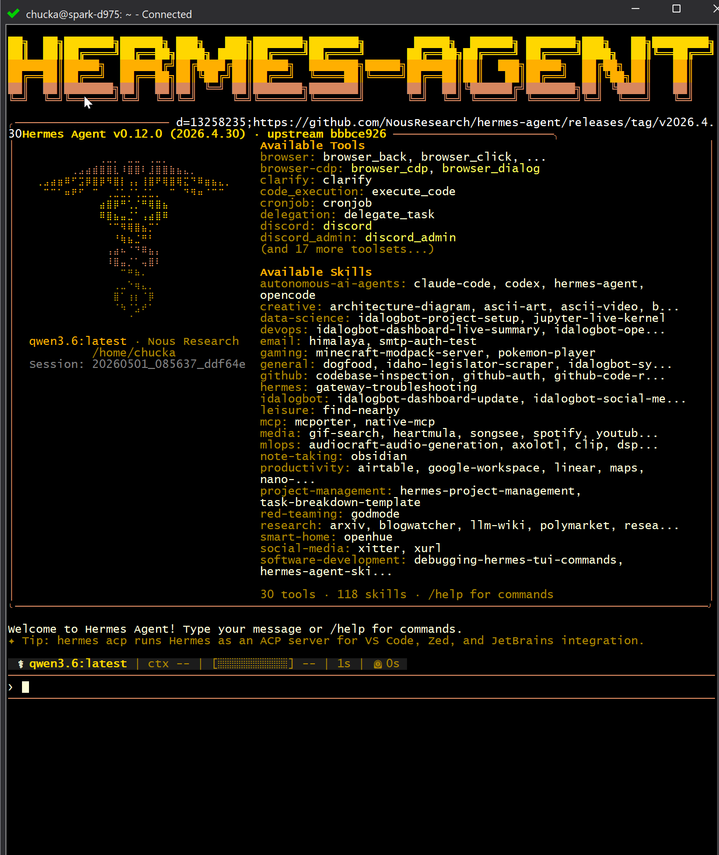
Get your cameras out…

Slide 45
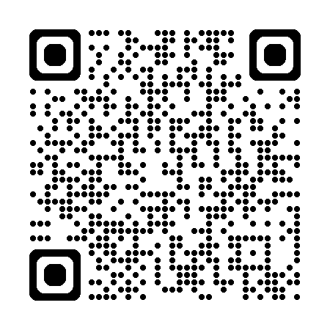
Thank You & Q&A
WHAT YOU TAKE HOME
Working local agent knowledge
Practical commands and examples
Clear hardware & model guidance
KEY RESOURCES
Ollama
OpenClaw
Hermes Agent
Questions?
Let's discuss — microphone is open

Slide 46
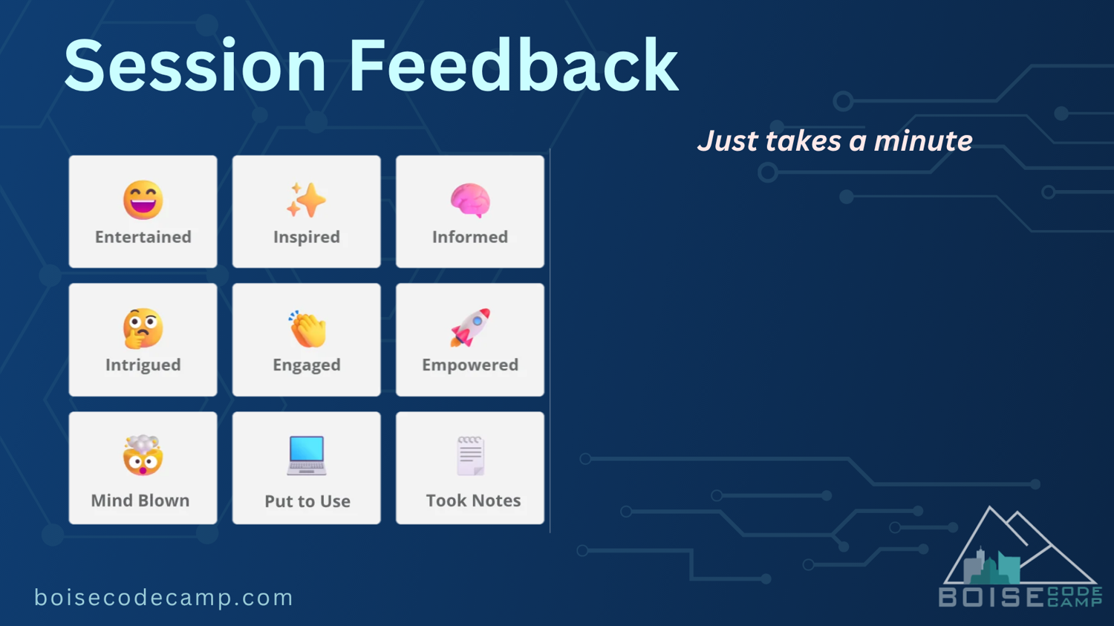
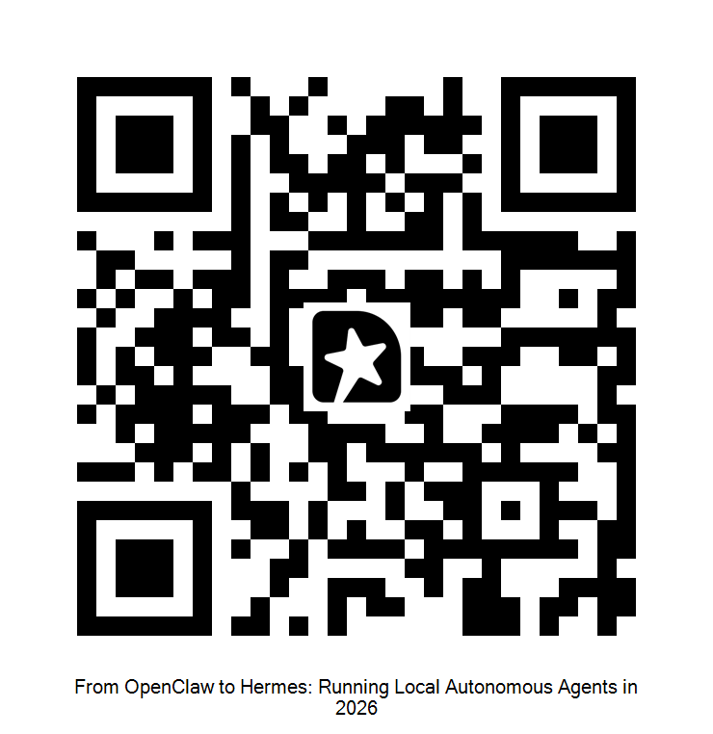
Chuck Anderson
208 631 1855 / cra451@gmail.com / chuck@idalog.com / Reliant Managed Services LLC

