Slide 1
EECS 598: Systems for AI
Mosharaf Chowdhury

Slide 2
Today’s Agenda
Administrivia
Topics
Projects

Slide 3
About the Instructor
Mosharaf Chowdhury
Morris Wellman Assistant Professor of CSE
Ph.D. from UC Berkeley in 2015
http://www.mosharaf.com/
Research interests span
Networked systems and networking in the context of big data applications, cloud computing infrastructure, and systems for AI
The core tenet being “application-infrastructure symbiosis”
Office hours:
Appointment-only

Slide 4

About Sanjay Singam (GSI)
Office hours from next week
11AM-Noon Thursdays
No office hours this week
singam@umich.edu

Slide 5
Status
As of today: ~50 registered or w/ override
If you are not planning to take the class, drop ASAP
Existing overrides that have not converted will be dropped at midnight today

Slide 6
Course Schedule
Webpage: https://github.com/mosharaf/eecs598
Meetings
1:30 PM – 3PM (Mon/Wed for lectures and discussions)
2PM – 3PM (Fri for makeups and projects)
Pay attention to the online announcements and schedule
On average, two meetings per week
Friday makeups will be added on a need-to-add basis

Slide 7
Prerequisites
EECS 482 / 484 / 489 / 491
Equivalent courses are acceptable as well
Good programming skills
Build substantial systems for course project

Slide 8
Course Requirements
Paper Summary | 20%
Paper Presentation | 20%
Participation | 10%
Assignment | 10%
Research Project | 40%

Slide 9
Group-Based Work
ALL activities will be done in groups except for participation
Paper presentation
Paper summary
Research projects

Slide 10
Form Groups ASAP
Submit at https://forms.gle/aTPa6DQKWb2mtpA47
By February 1 the latest, but much earlier if possible
Use piazza to find group members
Group size should be 3
May allow a few smaller groups if/when students drop off

Slide 11
Readings
36 papers/articles across
Systems venues like SOSP, OSDI, NSDI, EuroSys, and MLSys
Related venues like SIGCOMM, SIGMOD, and VLDB
Traditional AI/ML venues

Slide 12
Paper Summaries
This is a paper-reading course
Paper summaries account for 20% of the total grade
Roughly 1-2 summary per-group (assigned)
Each summary must follow the template and address the following
What is the problem and why is it important?
What is the hypothesis of the work?
What is the proposed solution, and what key insight guides their solution?
What is one (or more) drawback or limitation of the proposal, and how will you improve it?
Summary must include the gist of class discussion

Slide 13
Paper Summaries
Reviews must be emailed to eecs598-bigdata-staff@umich.edu within 24 hours of class presentation
Delayed submission will receive NO CREDIT
There will be NO extensions
Read (if you haven’t already!)
How to Read a Paper by S. Keshav
Writing Reviews for Systems Conferences by Timothy Roscoe

Slide 14
Paper Presentation
This is a seminar-style course
Each group must present at least one day (both the papers)
Paper presentation account for 20% of the total grade
The entire class will be dedicated to the assigned paper(s)
Aim for 45-minute presentation without interruption
But there will be intermittent discussions
Lead the discussion
Go through the paper in details, along with its strengths and weaknesses
Include companion papers and other related papers
The rest of the class
PARTICIPATE

Slide 15
Paper Presentation
Email your slides to eecs598-bigdata-staff@umich.edu 24 hours before the class
Use the template on the course website
Prepare early
Practice a lot
Also, read
How to Give a Bad Talk, by David A. Patterson

Slide 16
Participation
Attend all lectures
Can miss at most two with legitimate reasons
Read all the papers and participate
Ask questions!
Piazza participation
Ask questions about the
Rest: participate!

Slide 17
In general,
No extensions
Slides will be posted after the class
Everyone must come to class after reading the mandatory papers of the day

Slide 18
Topics
Background (8) – Mosharaf
Frameworks (4)
Distributed and Federated Learning (6)
Runtime and Compiler Optimizations (4)
Serving Systems and Inference (4)
Hyperparameter Tuning (4)
Scheduling and Resource Management (4)
Emerging Hardware (2)

Slide 19
An Assignment on Projects
10% of the grades
Get familiar with cluster environment
Run distributed training for simple models on small datasets
For some, the only systems part of “Systems for AI”

Slide 20
Projects
This is a research-oriented course!
The final project accounts for 40% of total grades
What can and cannot be a project?
Just surveys are not allowed
Measurements of new environments or of existing solutions on new environments are acceptable
Reproducing results from existing solutions is also acceptable
An ideal project should answer the questions you asked during paper reviews and points you cared about for presentations

Slide 21
How to Approach it?
Find a problem and motivate why this is worth solving
Survey background and related work to get a sense of your (friendly!) competition
Might require you to go back to the first step
Form/update your hypothesis
Test your hypothesis
Go back to 3 until you are happy
Present your findings on poster and in writing
Discuss known limitations

Slide 22
Milestones
Date | Milestone | Details
02/01/21 | Form Group | Find 3 like-minded students
02/10/21 | Draft Proposal | Send your proposal by email
02/17/21 | Finalize Proposal | After a back-and-forth discussions with the instructor
03/08/21 03/10/21 | Mid-Semester Checkpoint | Define and motivate a problem, survey related work, and form initial hypothesis and idea
04/19/21 04/21/21 | In-Class or Poster Presentations | Present your findings
04/27/21 | Research paper | Submit a report like the papers you read

Slide 23
Draft Proposal (Feb 10)
Two pages including references that ideally includes
What is the problem?
Why is it important to solve?
Any initial thoughts on what you want to do?
How would you evaluate your solution?
Include team members
Meaning, form a group ASAP
Instructions on meeting to discuss the proposal will be provided soon
First couple weeks of February

Slide 24
Finalized Proposal (Feb 17)
Two pages including references that must include
What is the problem?
Why is it important to solve?
Any initial thoughts on what you want to do?
How would you evaluate your solution?
Approved by the instructor and agreed upon by you
Forms the basis of expectation

Slide 25
Mid-Semester Checkpoint (Mar 8,10)
In-class short presentation over two days
This is to make sure you are making progress
Must include
What is the problem?
Why is it important?
What are the most related work?
What’s your hypothesis so far?
How are/will you evaluate it?

Slide 26
Final Presentation and Paper (Apr 19, 21, 27)
Research paper
The key part
Should be written like the papers you’ve read
As if you’d submit it to a workshop with ~3 more months of work or to a conference after ~6 more months of work
How to Write a Great Research Paper by Simon Peyton Jones
Extended from the mid-semester checkpoint writeup

Slide 27
Break!

Slide 28
What Do We Talk About When We Talk About “Systems for AI”

Slide 29
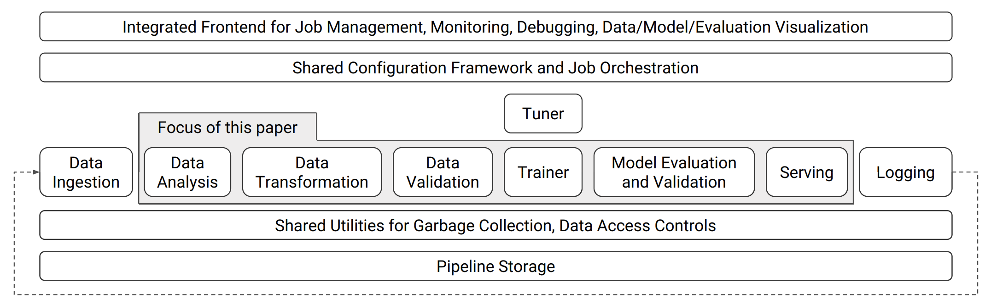
Google Pipeline
Notes:
In isolation, these components implement high-level functionality that is typical in machine-learning platforms.
However, it is worth pointing out two differentiations.
First, we built these components to adhere to the aforementioned principles, which introduced several technical difficulties.
Second, the integration of these components in a single platform, with shared configuration and utilities, enabled key improvements over existing alternatives.
To give an example, transformations applied in the trainer and at serving time may need statistics generated by the data analysis component.
Integrating these components ensures consistency across the pipeline and guarantees that the same transformations are applied at training and serving, which in turn prevents one form of training-serving skew (a common production headache in machine learning).
Although almost all of the components can be considered optional, TFX users find it beneficial to adopt the full stack in order to achieve more robust and reliable production systems and take advantage of all management and visualization tools in the integrated frontend.

Slide 30
Data Analysis
Processes each dataset fed to the system and generates a set of descriptive statistics on the included features
For example, distribution of the number of values per example
Gathers statistics over feature values
Continuous features: the statistics include quantiles, equi-width histograms etc.
Discrete features: the top-K values by frequency, etc.
Notes:
In a continuous training and serving environment, the above statistics must be computed efficiently at scale.
Unavailable feature statistics may result in missed opportunities to correct data anomalies, while outdated feature-to-integer mappings and feature value distributions may result in a drop in model quality.
On large training data, some of these statistics become difficult to compute exactly, and the component resorts to distributed streaming algorithms that give approximate results

Slide 31
Data Transformation
Feature wrangling for model training and serving
For example, the generation of feature-to-integer mappings, also known as vocabularies

Slide 32
Data Validation
A schema that provides a versioned, succinct description of the expected properties of the data
Features present in the data; the expected type of each feature, etc.
Flag any deviations from the schema as potential anomalies
Provide actionable suggestions to fix the anomaly
Notes:
• The expected presence of each feature, in terms of a minimum count and fraction of examples that must contain the feature.
• The expected valency of the feature in each example, i.e., minimum and maximum number of values.
• The expected domain of a feature, i.e., the small universe of values for a string feature, or range for an integer feature

Slide 33
Model Training
Continuously training and exporting machine learning models is a common production use case
Both time and resource intensive to retrain these models

Slide 34
Model Evaluation
Machine-learned models are often parts of complex systems comprising many data sources and interacting components
Deploy only “good” models
Safe to serve
Prediction quality is high

Slide 35
Validation
Once a model is launched to production and is continuously being updated, automated validation is used to ensure that the updated models are good
Evaluate prediction quality by comparing the model quality against a fixed threshold as well as against a baseline model

Slide 36
Model Serving
Serving systems for production environments require low latency, high efficiency, horizontal scalability, reliability and robustness
The following slides elaborates on two specific system challenges: low latency and high efficiency

Slide 37
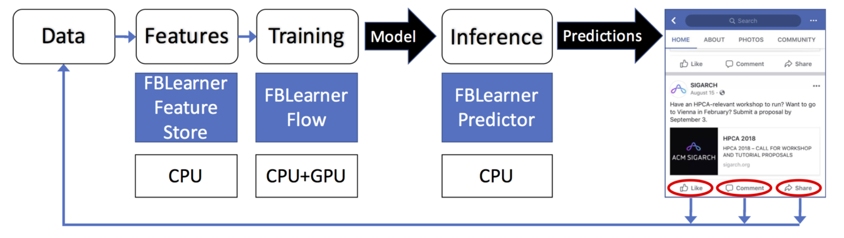
Facebook Pipeline

Slide 38
Resource Implication of ML
Heterogeneous Hardware Resources
Resource Implications of Offline Training
Resource Implications of Online Inference

Slide 39
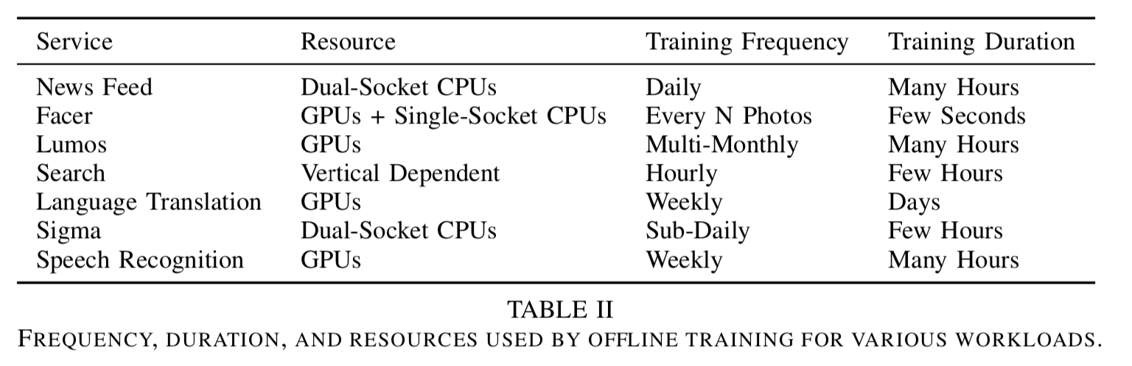
Resource Implications of Offline Training

Slide 40
Resource Implications of Offline Training
Memory, Storage, and Network
Locality of data
Scaling Considerations
Distributed training via Data parallelism

Slide 41
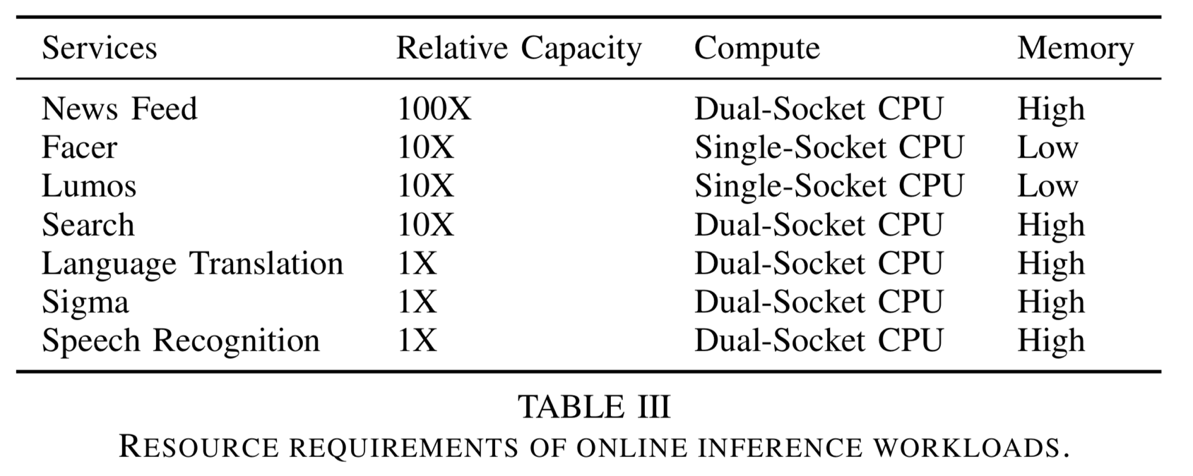
Resource Implications of Online Inference

Slide 42
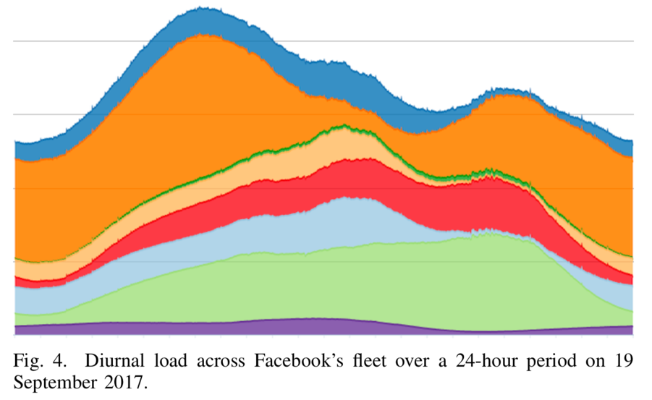
Leveraging Scale
Many idle compute resources
Heterogeneous hardware
co-design between network topology and scheduler

Slide 43
Microsoft Philly
Workloads
Supervised machine learning (TensorFlow, CNTK, Caffe, PyTorch)
Jobs rely on iterative optimization methods such as SGD
For large datasets, use distributed training with data parallelism
Cluster Architecture
100-Gbps RDMA (InfiniBand) network; cross-rack traffic uses Ethernet
Clusters use HDFS as distributed storage
Resource manager based off Apache YARN
Notes:
Remote direct memory access
Apache YARN split functionalities of resource management and job scheduling into separate daemons. Global resource manager and per-application application master

Slide 44
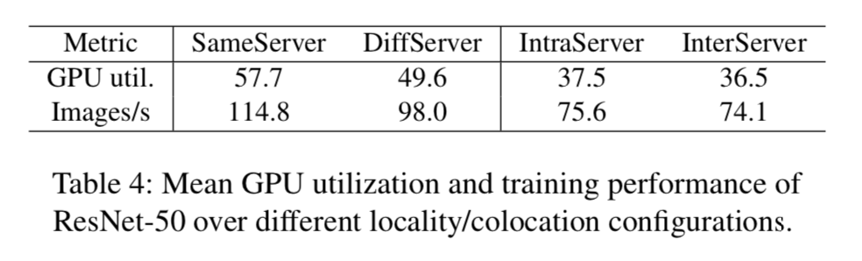
Impact of Distributed Learning
Test relationship between distribution and efficiency of GPUs using ResNet-50
SameServer: job placed in single server
DiffServer: job placed in two servers connected with RDMA network
IntraServer: two SameServer jobs, one on each server as interference
InterServer: two DiffServer jobs
Notes:
2 GPU r50
Each server has four NVIDIA Tesla P100 GPUs 16 gb attached to a CPU socket. The table reports GPU utilization when processing a batch size of 32 images during training. First we observe that the training does not fully utilize GPUs even for single machine execution. In particular, SameServer achieves utilization of 57.7% for GPUs in use. It increases to 71.1% for twice the batch size but only increases marginally for larger batches.
To show this we set DiffServer as our baseline and measure changes in the efficiency while populating additional ResNet-50 jobs in the same servers. First, we measure GPU utilization when the colocated jobs do not use RDMA network at all: we place two SameServer jobs, one on each server in the same CPU socket as the job under Figure 6: GPU utilization when running 8 and 16 GPU jobs on dedicated servers. study. Thus, these jobs interfere with the job under study in the use of PCIe buses while reading training inputs, aggregating model updates, and so on. The observed efficiency is shown as IntraServer in Table 4, and we see that having such intra-server interference lowers the utilization by as much as 12.1%. We also study if such interference matters for the RDMA network in InterServer. For this setup we use two DiffServer jobs instead of two SameServer jobs as background traffic, so that all the jobs are distributed across two servers and share the RDMA network. In this case, we see a 13.1% decrease in utilization compared to the baseline.

Slide 45
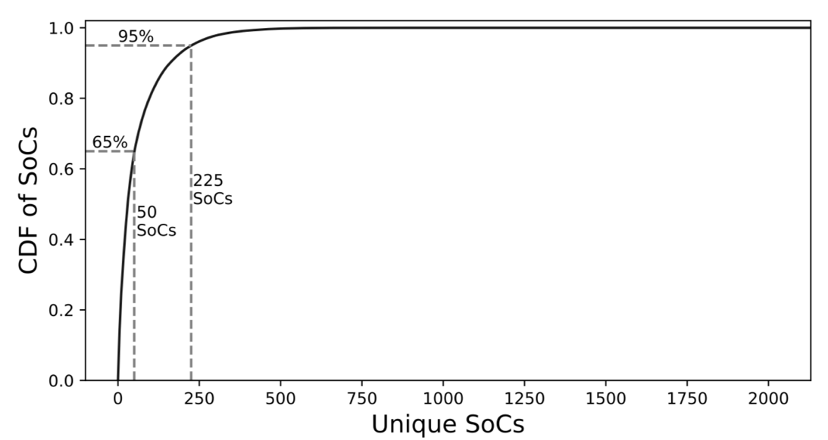
Survey of Mobile Devices: Mobile Chipset
No standard mobile chipsets to optimize for
The top 50 SoCs(System on a Chip) => only 65% of the market

Slide 46
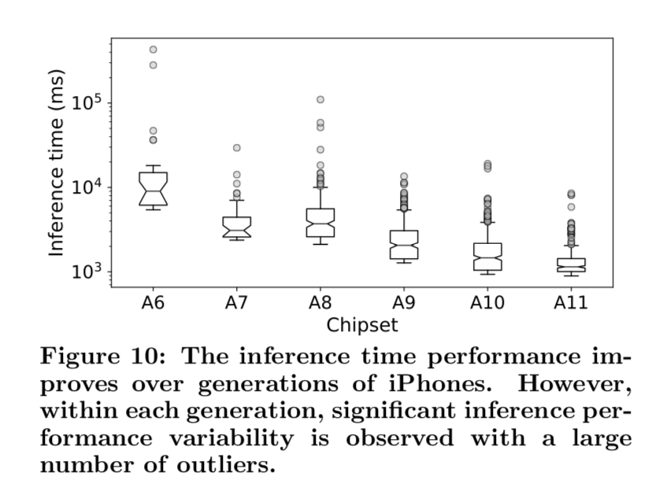
Inference in the Wild: Performance variability
Inference performance varies even across the same device
Background activities
Smartphone surface temperature
Battery aging

Slide 47
Next Class…
Read the assigned papers
Including today’s short reads mentioned in this presentation
Form groups of 3 and fill out https://forms.gle/aTPa6DQKWb2mtpA47 by Feb 1
This includes paper preference (dates) for your group
Try to decide if you’ll drop, before you fill it

Slide 49
Rough Outline
Abstract
Introduction (Highlight the importance and give intuition of solution)
Motivation (Use data and simple examples)
Overview (Summarize your overall solution so that readers can follow later)
Core Idea (Main contribution w/ challenges and how you address them)
Implementation (Discuss non-obvious parts of your implementation)
Evaluation (Convince readers that it works and when it fails)
Related Work (Let readers know that you know your competition!)
Discussion (Know your limitations and possible workarounds)
Conclusion (Summarize and point out future work)

