Slide 1
Compute and Storage
Mosharaf Chowdhury

Slide 2
Resilient Distributed Datasets (aka the Spark paper)
NSDI’12

Slide 3
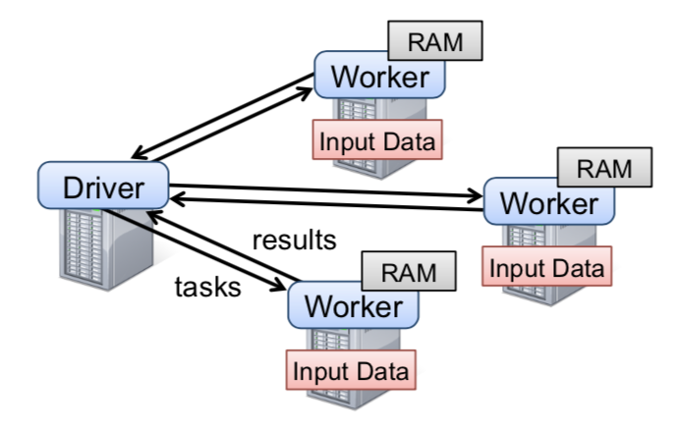
Motivation & Background
Frameworks back then: MapReduce, Dryad
Pros:
Allowed parallel computation without worrying low level details (e.g., work distribution, fault tolerance)
Provided a set of high-level operations (map, reduce)
Cons:
Little to no support for leveraging cluster memory
Large overhead for reusing data in iterative or interactive tasks (I/O, replication, serialization)

Slide 4
Resilient Distributed Datasets (RDDs)
Utilize Distributed Memory while providing efficient fault tolerance
By logging transformations (lineage)
Limit operations to coarse-grained transformations (e.g., map, filter)
Allow user control of data persistence and partitioning

Slide 5
RDDs
Read-only, partitioned collection of records
Created from either data in stable storage or other RDDs
Transformations define RDD:
Map, filter, flatmap, sample, groupbykey, reducebykey, join, union
Actions return value or export data to storage system
count, collect, save, reduce, lookup

Slide 6
Example: Console Log Mining
lines = spark.textFile("hdfs://...")
errors = lines.filter(_.startsWith("ERROR"))
errors.count()
HDFS File
definition
Base RDD: lines
Transformation: filter
Transformed RDD: errors
Action: count
Number of lines with ERROR

Slide 7
RDDs: Fault Tolerance
Limit operations to coarse-grained transformations and only log the transformations instead of replicating data for recovering
Lineage: transformations used to build a dataset
Recover lost partition by applying lineage from corresponding data partition in stable storage

Slide 8



Example
RDD 0
p1
p2
p3
Worker 3
Coordinator
RDD 1a
RDD 1b
p1
p2
p3
p1
p2
p3
Worker 1
Worker 2
RDD 2
p1
p2
p3
RDD 3
p1
p2
p3
Notes:
RDD 0: initialization (reading from an input file)
RDD 1a/b: some mapping or filtering
RDD 2: some joining
RDD 3: some filtering
What happens when Worker 3 goes down?
All partitions on worker 3 disappear.So we have to rebuild Worker 3’s partitions.
So we have to go back up the lineage and rebuild each partition from each ancestor.

Slide 9
Example
RDD 0
p1
p2
p3
Worker 3
Coordinator
RDD 1a
RDD 1b
p1
p2
p3
p1
p2
p3
Worker 1
Worker 2
RDD 2
p1
p2
p3
RDD 3
p1
p2
p3
Notes:
RDD 0: initialization (reading from an input file)
RDD 1a/b: some mapping or filtering
RDD 2: some joining
RDD 3: some filtering
What happens when Worker 3 goes down?
All partitions on worker 3 disappear.So we have to rebuild Worker 3’s partitions.
So we have to go back up the lineage and rebuild each partition from each ancestor.

Slide 10
Example
RDD 0
p1
p2
p3
Worker 3
Coordinator
RDD 1a
RDD 1b
p1
p2
p3
p1
p2
p3
Worker 1
Worker 2
RDD 2
p1
p2
p3
RDD 3
p1
p2
p3
Notes:
RDD 0: initialization (reading from an input file)
RDD 1a/b: some mapping or filtering
RDD 2: some joining
RDD 3: some filtering
What happens when Worker 3 goes down?
All partitions on worker 3 disappear.So we have to rebuild Worker 3’s partitions.
So we have to go back up the lineage and rebuild each partition from each ancestor.

Slide 11
Example
RDD 0
p1
p2
p3
Worker 3
Coordinator
RDD 1a
RDD 1b
p1
p2
p3
p1
p2
p3
Worker 1
Worker 2
RDD 2
p1
p2
p3
RDD 3
p1
p2
p3
Notes:
RDD 0: initialization (reading from an input file)
RDD 1a/b: some mapping or filtering
RDD 2: some joining
RDD 3: some filtering
What happens when Worker 3 goes down?
All partitions on worker 3 disappear.So we have to rebuild Worker 3’s partitions.
So we have to go back up the lineage and rebuild each partition from each ancestor.

Slide 12
Example
RDD 0
p1
p2
p3
Worker 3
Coordinator
RDD 1a
RDD 1b
p1
p2
p3
p1
p2
p3
Worker 1
Worker 2
RDD 2
p1
p2
p3
RDD 3
p1
p2
p3
Notes:
RDD 0: initialization (reading from an input file)
RDD 1a/b: some mapping or filtering
RDD 2: some joining
RDD 3: some filtering
What happens when Worker 3 goes down?
All partitions on worker 3 disappear.So we have to rebuild Worker 3’s partitions.
So we have to go back up the lineage and rebuild each partition from each ancestor.

Slide 13
Example
RDD 0
p1
p2
p3
Worker 3
Coordinator
RDD 1a
RDD 1b
p1
p2
p3
p1
p2
p3
Worker 1
Worker 2
RDD 2
p1
p2
p3
RDD 3
p1
p2
p3
Notes:
RDD 0: initialization (reading from an input file)
RDD 1a/b: some mapping or filtering
RDD 2: some joining
RDD 3: some filtering
What happens when Worker 3 goes down?
All partitions on worker 3 disappear.So we have to rebuild Worker 3’s partitions.
So we have to go back up the lineage and rebuild each partition from each ancestor.

Slide 14
RDDs
User can control
Persistence: indicate storage strategy (e.g. in-memory)
Partitioning: placement optimization (e.g. hash partitioning)
EECS 598 – W19

Slide 15
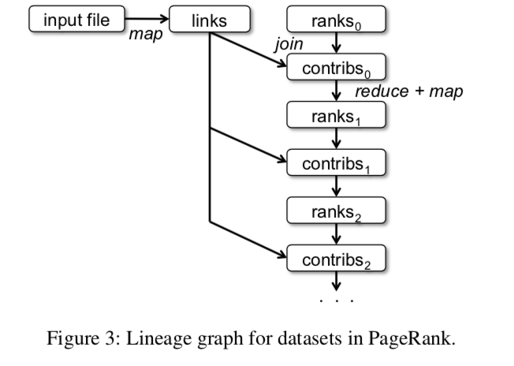
Example : PageRank
val links = spark.textFile(...).map(...).persist()
Partition rank and corresponding links on the same machine to eliminate communication
EECS 598 – W19
Notes:
locality

Slide 16
Example : PageRank
facebook.com
google.com
umich.edu
facebook.com
google.com
umich.edu
facebook.com
google.com
umich.edu
facebook.com
google.com
umich.edu
facebook.com
google.com
umich.edu
PageRank with hash partitioning
PageRank without partitioning
EECS 598 – W19

Slide 17
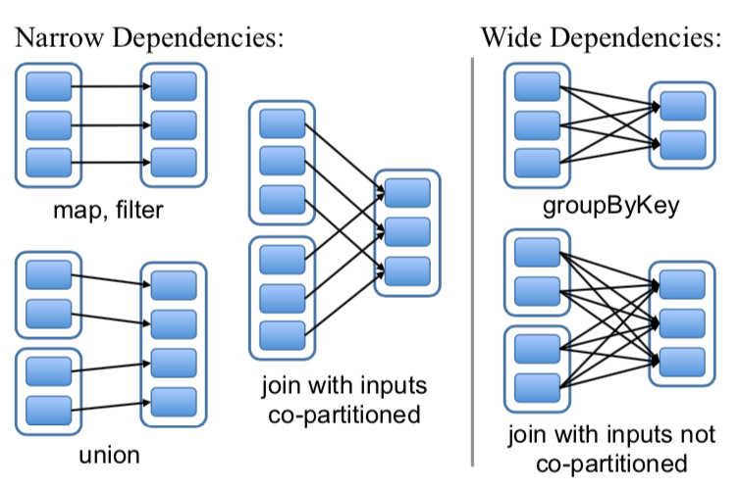
RDD Representation
Partitions: atomic pieces of the RDD
Dependencies: relations with parent RDDs
Narrow Dependencies: A parent RDD partition is used by at most one child partition (e.g. map, filter)
Wide Dependencies: A parent RDD partition is used by multiple child partitions (e.g. join, groupByKey)
EECS 598 – W19
Notes:
narrow dependencies: each partition of the parent RDD is used by at most one partition of the child RDD,
wide dependencies: multiple child partitions may depend on one parent RDD.
Narrow: pipelined execution on one node, efficient, as only the lost parent partitions need to be recomputed in parallel on different nodes.
Wide: need internode communication

Slide 18
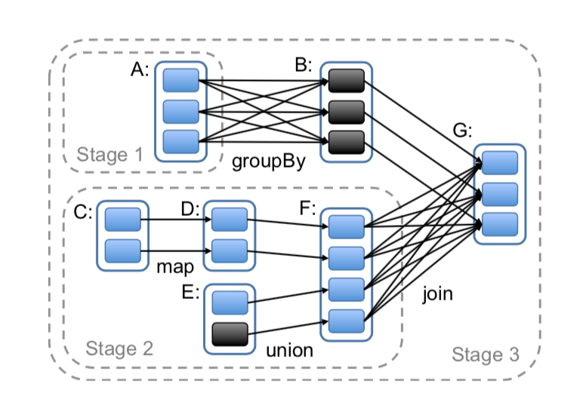
Job Scheduling
Build DAG of stages to execute
Each stage contains as much as possible pipelined transformations with narrow dependencies
Stages are linked by wide dependencies
Assign tasks based on data locality
EECS 598 – W19
Notes:
2 co-locate data and computation
Group narrow dependencies into a stage, which can be pipelined on 1 node.

Slide 19
Fault Tolerance
Task failures
Stage’s parents available: rerun on another node
Some stages unavailable: resubmit tasks to compute missing partitions in parallel
Does not tolerate scheduler failures
Solution: Lineage graph replication
EECS 598 – W19
19

Slide 20
Memory Management
Three storage strategy: In-memory storage as deserialized Java objects, in-memory storage as serialized data, and on-disk storage
LRU policy for eviction at RDD level when there is no enough RAM
Or, use user-specified “persistence priority” for eviction
EECS 598 – W19
Notes:
The first option provides the fastest performance, because the JVM can access each RDD element natively. The second option lets users choose a more memory-efficient representation than Java object graphs when space is limited, at the cost of lower performance. The third option is useful for RDDs that are too large to keep in RAM but costly to recompute on each use.

Slide 21
Checkpointing
What if there is a long lineage chain with wide dependencies, which would be too costly to derive lost data from beginning?
Spark streaming
Use checkpoints for RDDs
EECS 598 – W19

Slide 22
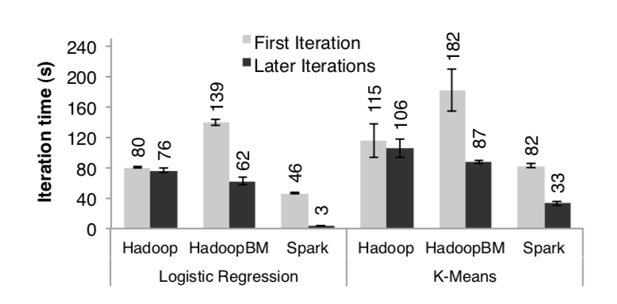
Performance: Iterative Machine Learning
K-Means and Logistic Regression
Experiment Setup:
10 iterations
10GB datasets
25-100 machines
EECS 598 – W19

Slide 23
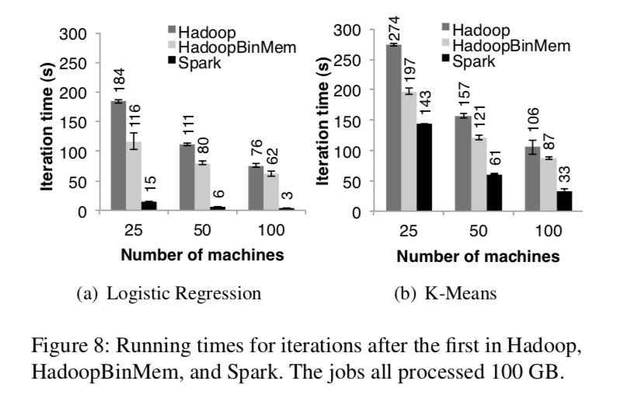
Performance: Iterative Machine Learning
EECS 598 – W19
Notes:
Outperforms HadoopBinMemory
1. Minimum overhead of the Hadoop software stack
2. Overhead of HDFS while serving data
3. Deserialization cost to convert binary records to us- able in-memory Java objects.

Slide 24
Takeaways
It maybe better to spend computation cycles than going to the disk
Especially when failures are not too common

Slide 25
Discussion
Are RDDs still a good choice when we go to modern deep learning architectures? (if one would run them on CPU)—Artem
When bandwidth is not a problem anymore (because of CLOS), we can return to centralized model of storage without worrying about data locality? Is it the central idea of the paper?—Artem

Slide 26
Discussion
With network speeds increasing is there a time in the foreseeable future where RDD will see diminishing performance benefits over prior distributed shared memory?—Jonah
It is then mentioned that this is not always done in the case of a long lineage chain so is it really fair to say that RDD generally has low overhead for fault recovery when in cases of many data transformations it relies on the same technique as distributed shared memory?—Jonah

Slide 27
Break!

Slide 28
Flat Datacenter Storage
OSDI’10

Slide 29
Disk Locality
Assumption: Network is bottlenecked
Move compute to data
Programming models like MapReduce and Spark
Good
Decrease bandwidth usage → faster task completions
Bad
Constraints on where a task can run → resource underutilization

Slide 30
Full Bisection Bandwidth Networks
Remember Jupiter?
From any machine to any other machine we have the same bandwidth
With balanced placement, there is no difference where something is located
As long as we are reading from the disk (why?)
FDS relies on a full bisection bandwidth network (VL2—sort of Microsoft’s Jupiter) to flatten the data placement problem
FDS read/write performance exceeds 2 GB/s, can recover 92GB of lost data in 6.2 seconds, and broke a world record in sorting in 2012.

Slide 31
FDS Design: Blobs and Tracts
Data is stored in logical blobs
Sequence of bytes with a unique GUID
Divided into constant sized (8MB) tracts
Both blobs and tracts are mutable
Each disk is managed by a tractserver process
Tracts are written directly to disk instead of going through a file system
All tract meta-data are kept in memory

Slide 32
API
Reads and writes not guaranteed to appear in the order they are issued
Read and writes are atomic
Happens completely or doesn’t happen
API is non-blocking (why?)
Applications have to register a call-back function to be notified
Performance improves: many requests can be issued in parallel, and FDS can pipeline disk reads with network reads

Slide 33
Deterministic Tract Placement
Tractservers can be found deterministically using a Tract Locator Table (TLT)
TLT is distributed to clients using a centralized metadata server
TLT is constructed by concatenating m random permutations of the tract- server list
Find tract i in blob with GUID g at
Tract_Locator = (SHA-1(g) + i) mod TLT_Length
Deterministic function
Hashing the GUID randomizes the first tracts placement

Slide 34
Replication
Each TLT entry is k-way (k > 2)
Writes go to all k replicas; reads pick a random entry
Metadata updates are serialized by a primary replica
Then shared with secondaries using a two-phase commit protocol

Slide 35
Per-Blob Metadata
FDS stores a blob’s metadata in each blob’s special metadata tract (“tract −1”)
Blobs are extended using API calls, all of which must access the metadata tract

Slide 36
Dynamic Work Allocation
Instead of scheduling task to process on a specific piece of data, work can be assigned to already running workers in FDS (why?)
Data is always equidistant
Whichever worker is done can start doing more work
Fine-grained work distribution

Slide 37
Failure Recovery
TLT carries a version number for each row
Upon failure
Metadata server detects failure by heartbeat
Current TLT is invalidated by incrementing version
Random tractservers are picked to fill gaps in TLT after failure
tractservers ACK new assignment, replicate data
Clients with stale TLTs request new ones from metadata server

Slide 38
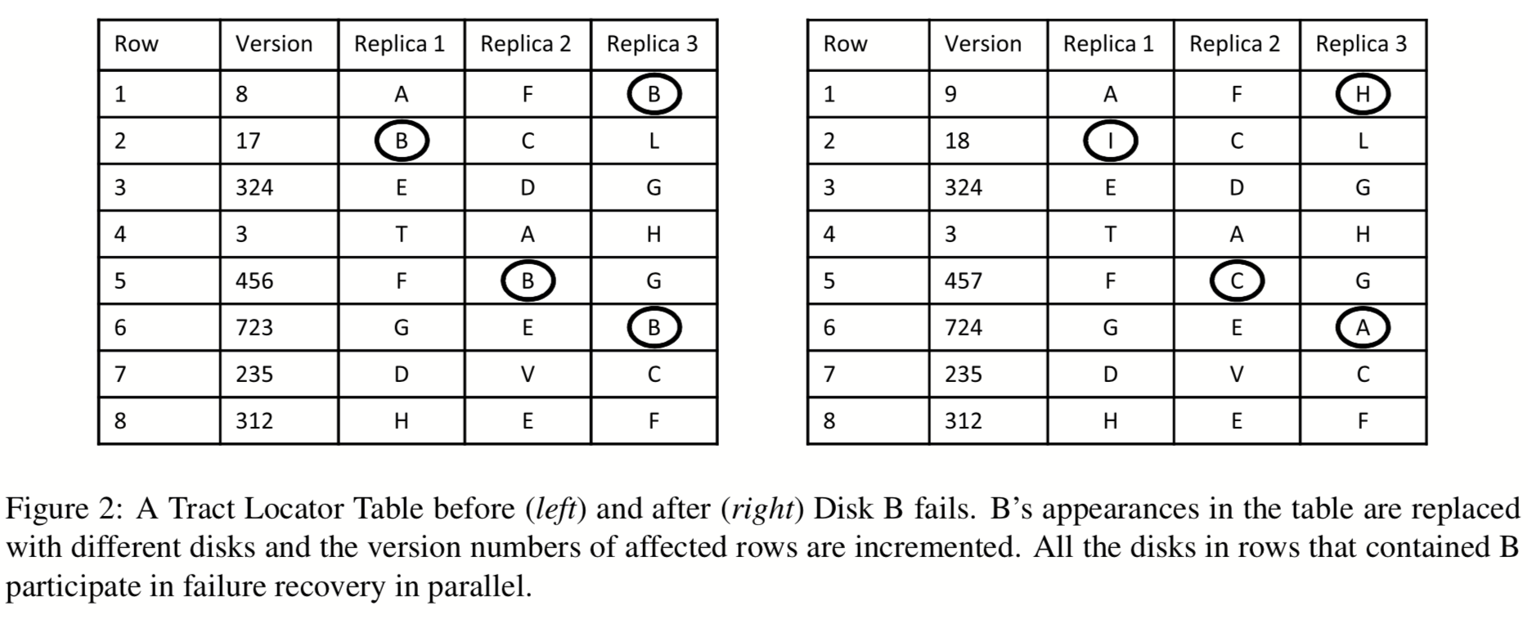
Failure Recovery

Slide 39
Fault Recovery Guarantees
Weak Consistency
trackservers may be inconsistent during failure, or if client fails after a write to a subset of replicas
Availability
Clients will block until TLT is updated

Slide 40
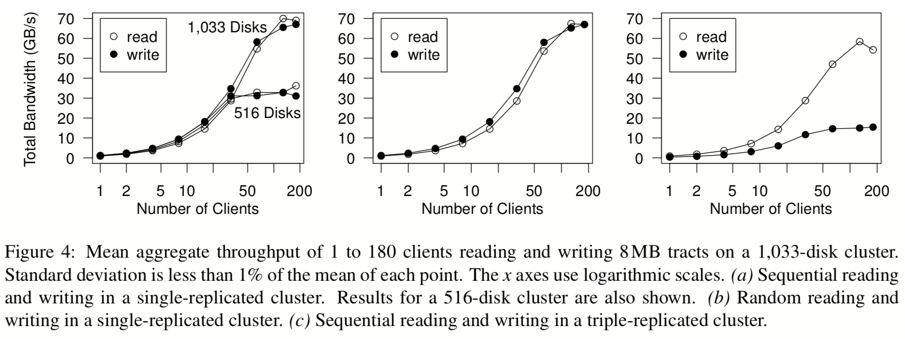
Read & Write Performance
Sequential
Replication=1
Random
Replication=1
Sequential
Replication=3

Slide 41
Takeaways
If network is not the bottleneck, then disk locality is irrelevant
Do we ignore locality completely?
Memory locality
Memory disaggregation

