Slide 1
Accelerators: TPU & FPGA

Slide 2
In-Datacenter Performance Analysis of a Tensor Processing Unit

Slide 3
Training vs. Inference
Typically, floating point is used for model training
GPUs are popular for floating point matrix operations
Throughput is the primary requirement
Inference often takes place on quantized models
Transform floating points to integer
Energy- and space-efficient from a hardware design perspective
User-facing; hence, latency is king
GPUs are inefficient for many Google workloads

Slide 4
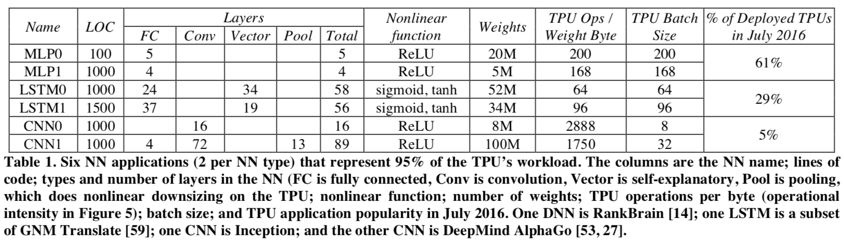
Google NN Workloads

Slide 5
High-Level Idea
TPU is single threaded and minimalistic compared to CPUs and GPUs
It has no caches, branch prediction, out of order execution, multiprocessing etc.
More deterministic execution
It leverages minimalism of domain-specific architecture to meet stringent application latency requirements
Maximize throughput per host interaction

Slide 6
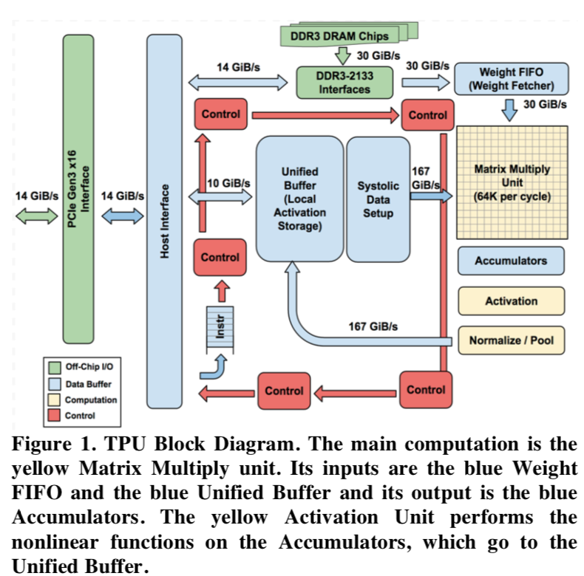
Architecture
To reduce the delay of deployment, the TPU was designed to be a coprocessor on the PCIe I/O bus
The TPU instructions are sent from the host over the PCIe Gen3 x16 bus into an instruction buffer
Internal blocks are connected together by 256-byte-wide paths

Slide 7
Compute: Matrix Multiply Unit(MMU)
Contains 256x256 MACs (Multiply Accumulate Unit)
Performing 8-bit multiply and adds on signed or unsigned integers
Output is 16-bit data
The matrix unit produces one 256-element partial sum per clock cycle
Can work when using a mix of 8-bit weights and 16-bit activations (or vice versa)
Half and quarter speeds respectively

Slide 8
IO Bandwidth
External
14 GiB/s to PCIe interface
30GiB/s to DDR3 interface
Internal
10 GiB/s for control plane
167 GiB/s for data plane

Slide 9
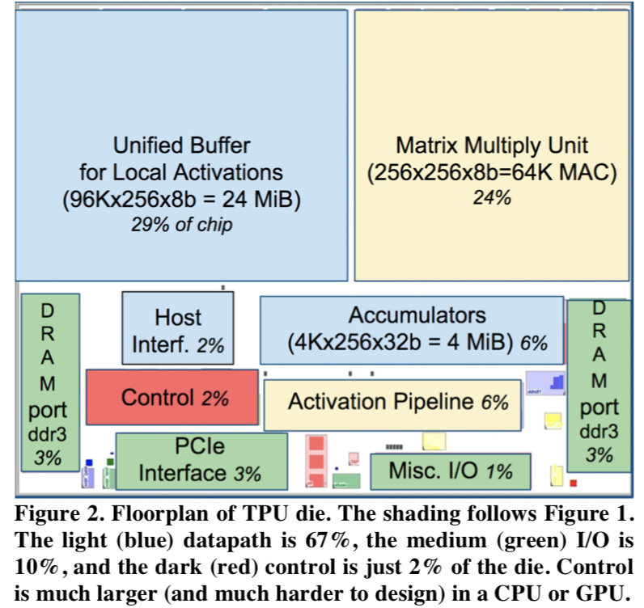
Space Management
Unified Buffer is almost a third (29%) of the die
MMU is a quarter (24%)
Interfaces take up about 10%

Slide 10
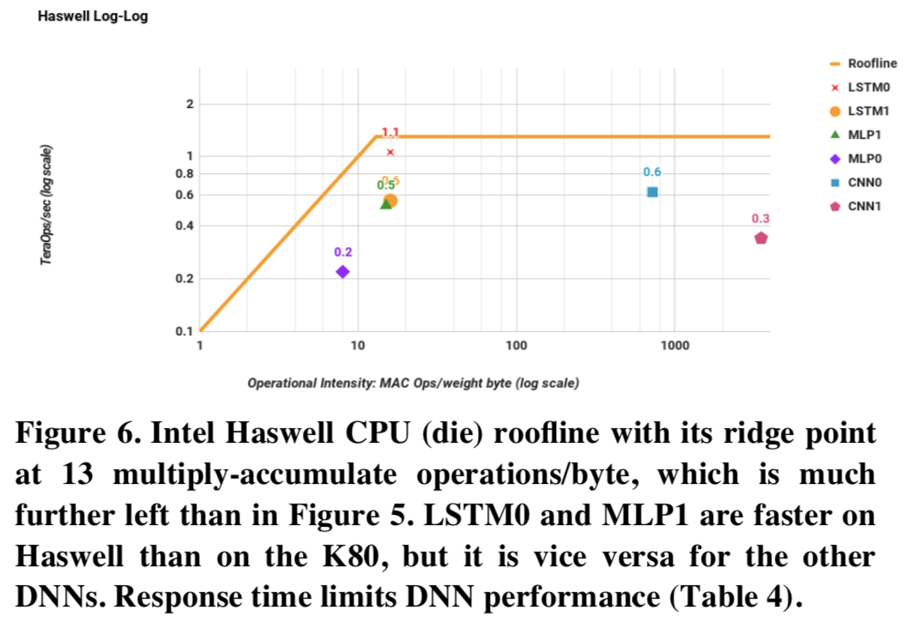
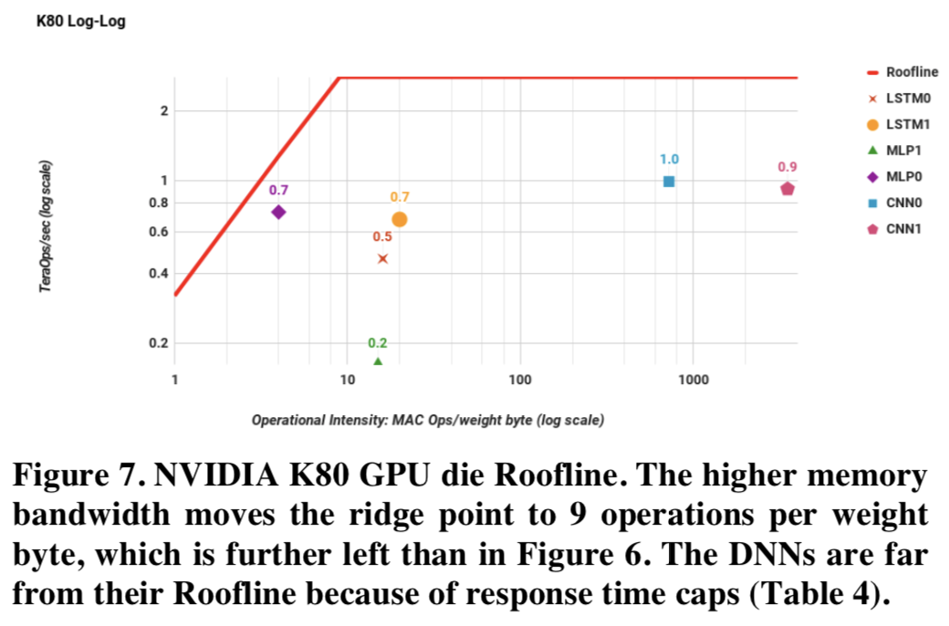
Performance
Intel Haswell
NVIDIA K80

Slide 11
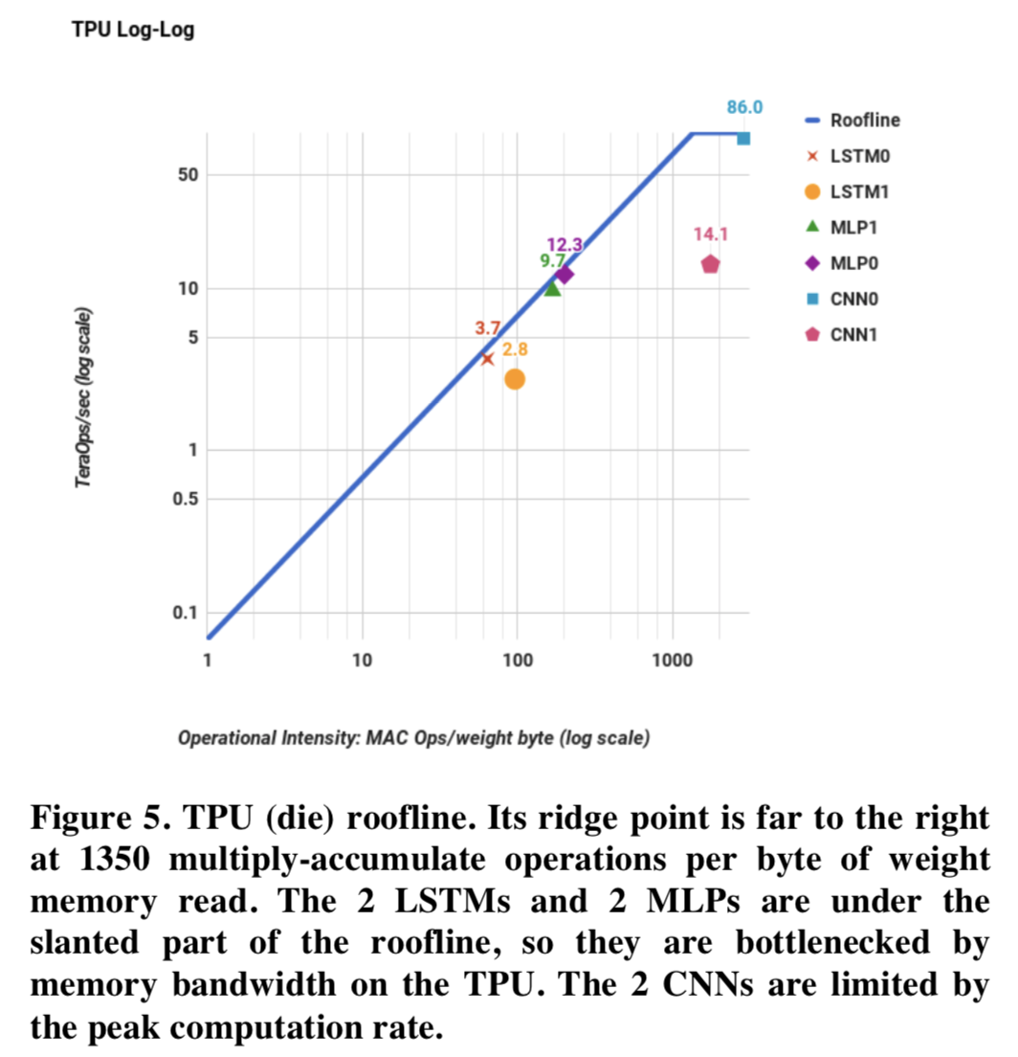
Performance: TPU
Performance is limited by memory bandwidth rather than by peak compute for most

Slide 12
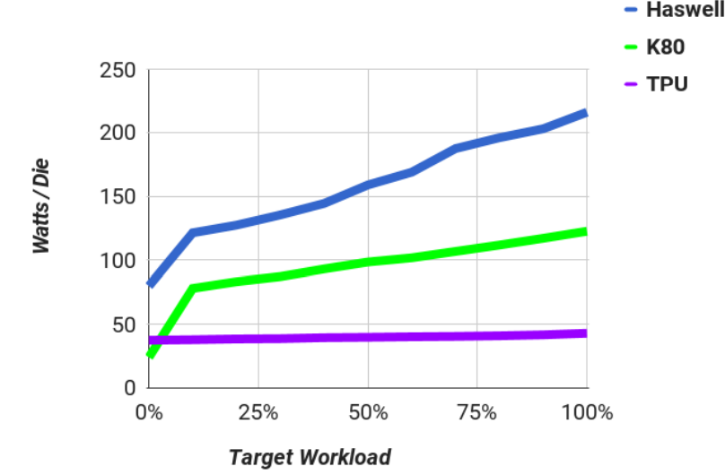
Energy proportionality under load
TPU has minimal optimizations for saving cost energy savings

Slide 13
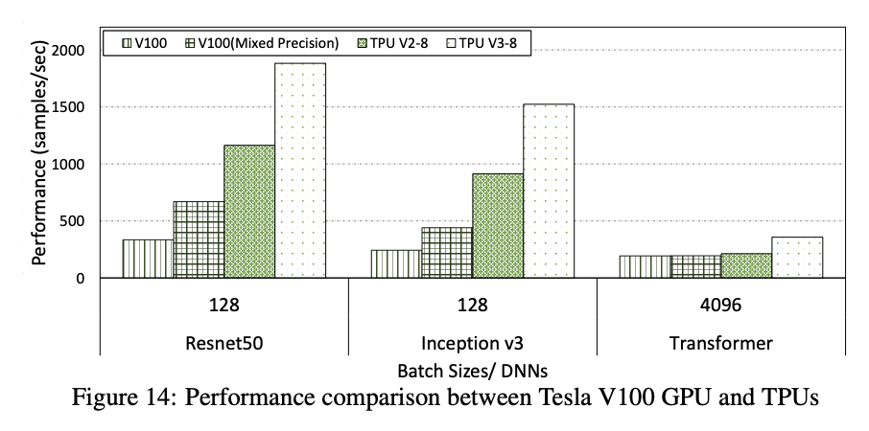
What’s Going on Today?
“Performance and Power Evaluation of AI Accelerators for Training Deep Learning Models” – arXiv’19

Slide 14
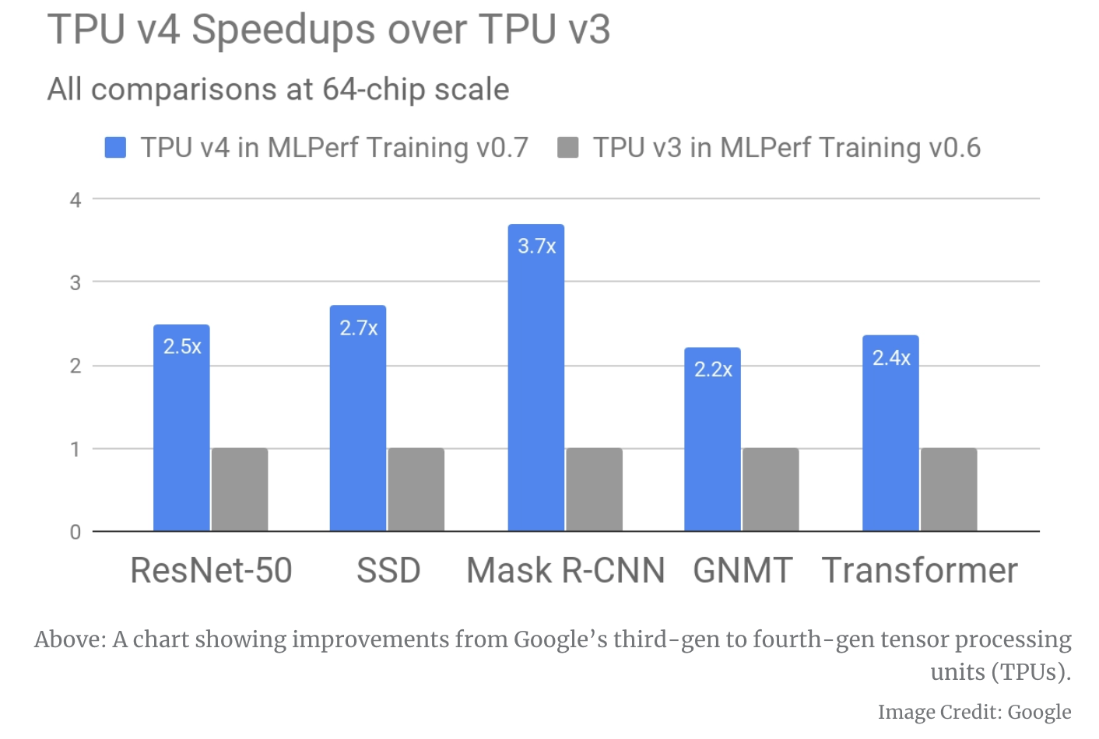
What’s Going on Today?

Slide 15
Discussion
How to design an ASIC?
What’s the most important resource?
How to measure performance?
ASIC vs. FPGA?

Slide 17
Serving DNNs in Real Time at Datacenter Scale with Project Brainwave

Slide 18
Motivation
Cloud service providers deploy DNN-infused applications that ingest live data streams such as search queries and videos
Computational demands of DNNs are outpacing performance growth of traditional CPUS
Specific example: Bing’s intelligent search feature
There is a clear need for low latency and high throughput
Specialized hardware can improve efficiency and performance

Slide 19
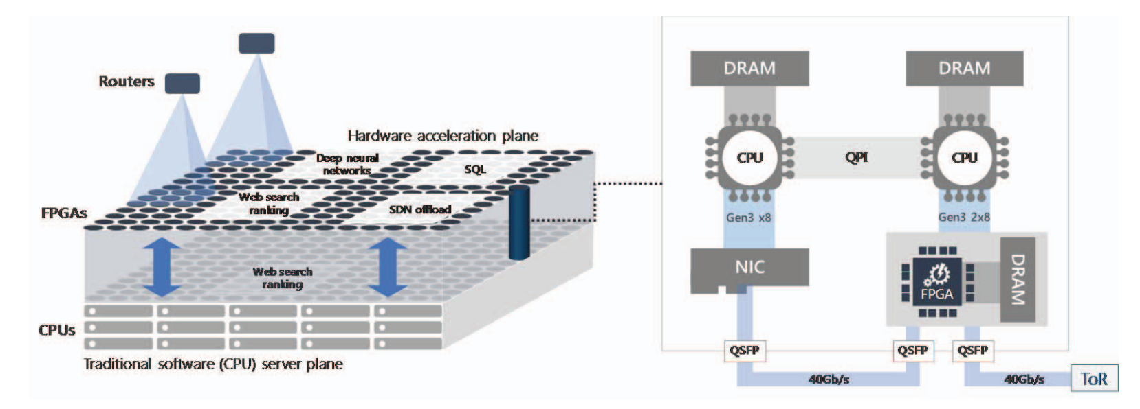
FPGAs
FPGA – field-programmable gate array
Parallelism targeted for a specific algorithm
Reprogrammable
Multiple can be allocated as a shared hardware microservice

Slide 20
Brainwave Architecture Overview
Model parallelism and on-chip pinning
Splits DNN models into sub graphs and pins to FPGAs
This is why the hardware microservice & cloud elasticity is important

Slide 21
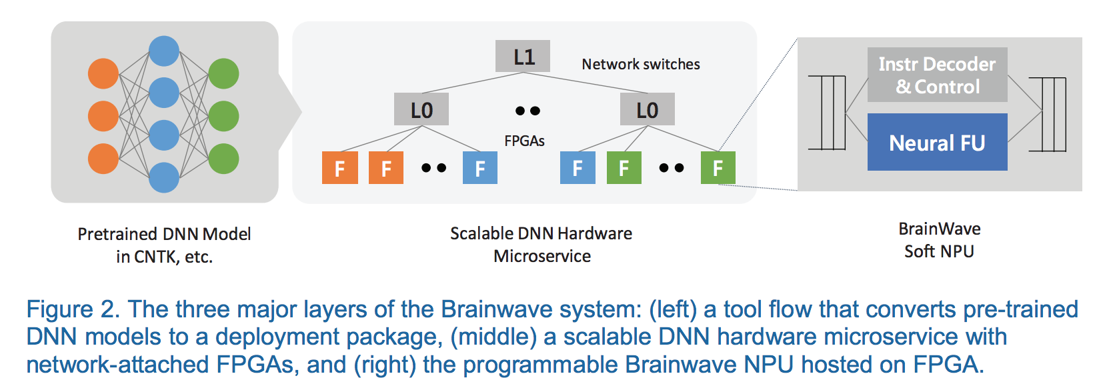
Brainwave Stack Overview

Slide 22
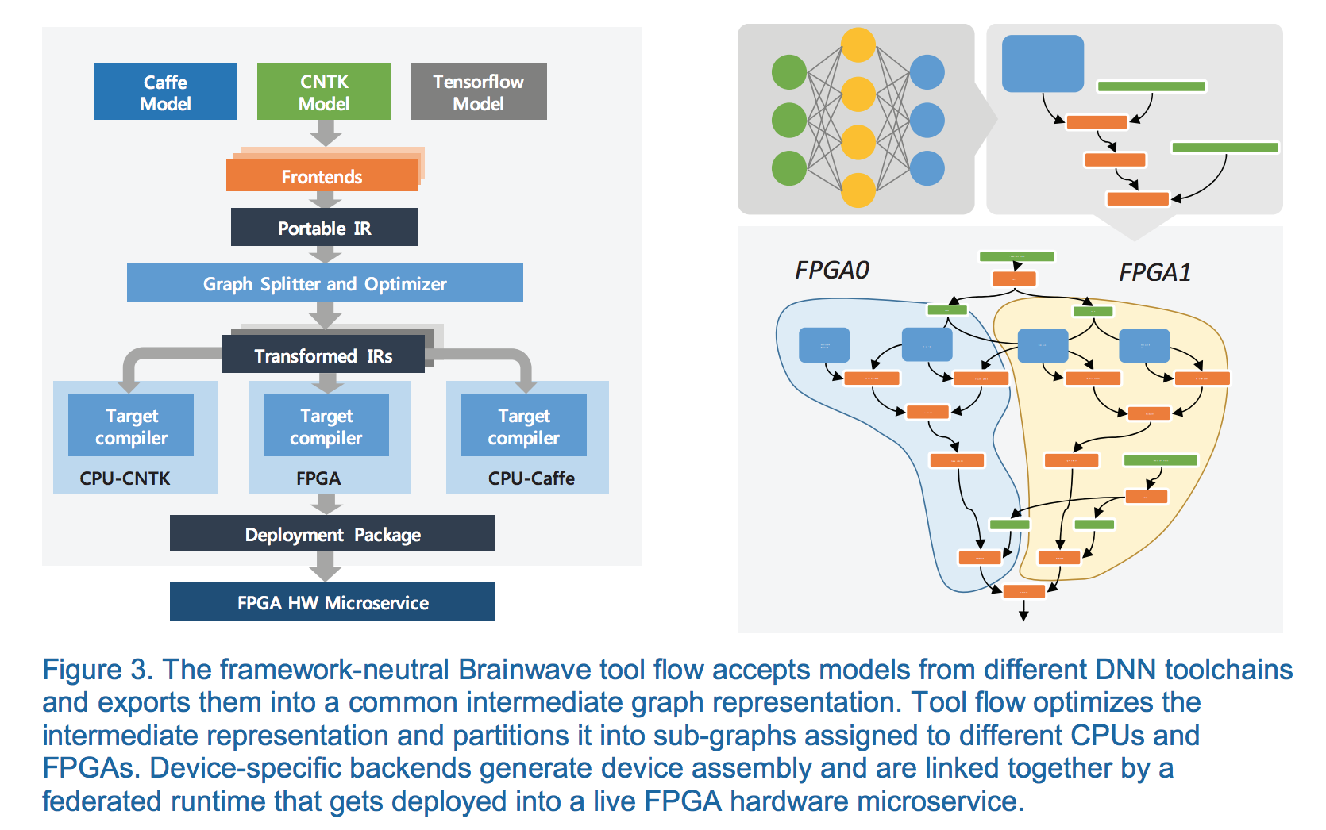
Tool Flow
CNNs high intensity mapped to single FGPA
Weights of bandwidth-limited RNNs pinned greedily
Unsupported or not profitable operators assigned to CPUs

Slide 23
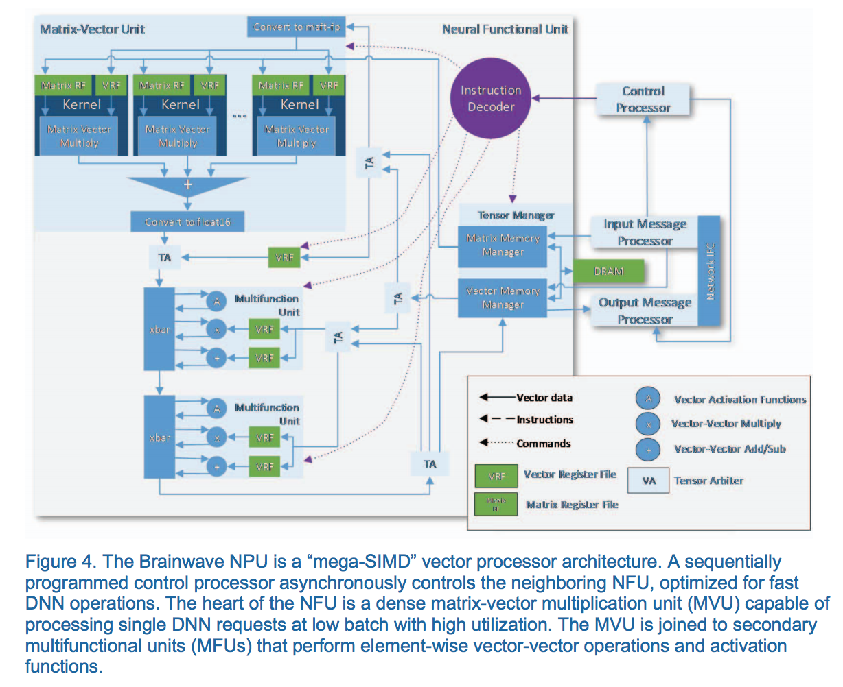
Brainwave NPU
Compile-time narrow precision data types
Simple, single-threaded programming model with an extensible ISA
Scalable microarchitecture that maximizes hardware efficiency at low batch sizes

Slide 24
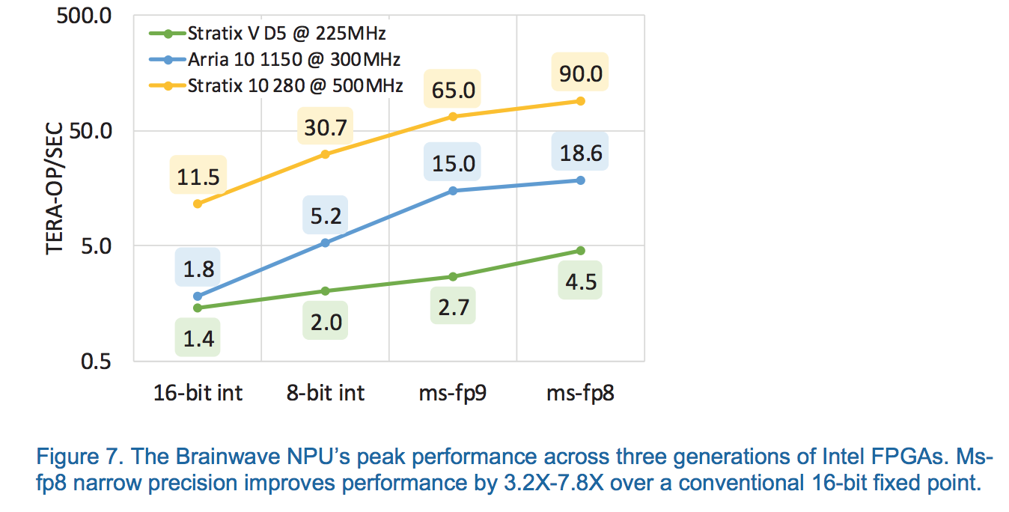
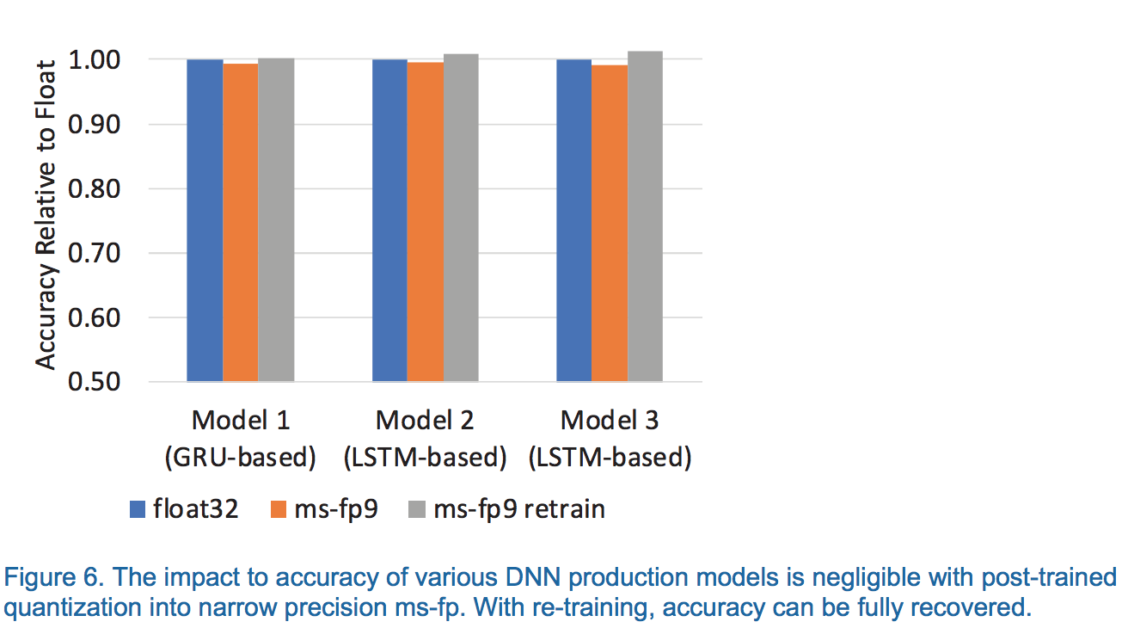
Narrow Precision
Proprietary ‘neural’-optimized data formats
ms-fp8 and ms-fp9
Mantissa trimmed to 2 or 3 bits

Slide 25
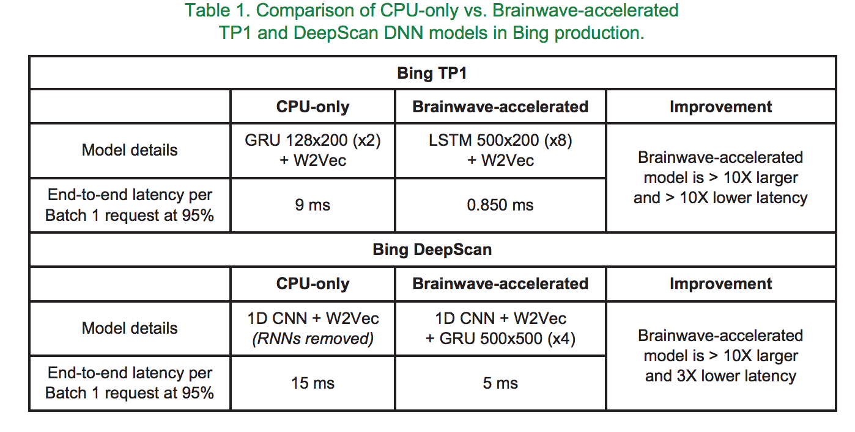
Results

Slide 26
Results
Brainwave NPU scaled up to run on a pre-production Intel Stratix 10 280 FPGA
This engine can serve a Batch-1 high-dimensional 3,200x2,400 GRU with 480 timesteps in under 1 ms
5X that of ResNet-50 and about 25X that of AlexNet

Slide 27
Conclusion
Key takeaway: Using configurable hardware at scale, a system can be designed without an adversarial tradeoff between latency and throughput (batching)
In Brainwave, the system and the soft NPU are co-architected in mind for each other, exploiting datacenter-scale pinning of models in on-chip memories that scale elastically beyond single-chip solutions
Narrow precision quantization is a viable approach for production DNN models. This is a large part of what allows Brainwave to compete in performance and energy efficiency without trading accuracy

