Slide 1

attachifykenya
Presented by: Maina Samuel Mbae
Date: 10th July 2026

Slide 2
INTRODUCTION
Finding industrial attachment opportunities shouldn't be harder than the attachment itself.
AttachifyKenya is a web-based platform developed to connect university and college students with attachment opportunities across Kenya. The platform also provides organizations with a convenient way to reach students and advertise available attachment positions.
Many students spend significant time searching across different websites, social media platforms, and personal networks to find attachment opportunities. This process is often time-consuming, frustrating, and inefficient due to the lack of a centralized platform.
AttachifyKenya addresses this challenge by bringing attachment opportunities from multiple industries into one easy-to-use website, making the search process simpler, faster, and more accessible for both students and employers.

Slide 3
Overview
Browse attachment opportunities by industry (Technology, Medicine, and Architecture).
Student and company login portals.
Student profile registration.
Company registration.
About and Contact pages for user support.
Simple, user-friendly interface with intuitive navigation.

Slide 4
WHY CHOOSE ATTACHIFYKENYA?
Value of the Application
Reduces the time students spend searching for attachment opportunities.
Provides a single platform for opportunities across multiple industries.
Connects students with companies more efficiently.
Creates a foundation for a future system with job applications, dashboards, and database integration.

Slide 5
UI & UX
The application features a clean and modern interface designed with simplicity and consistency in mind. A burgundy and cream color scheme was chosen to create a professional appearance, while clear typography and intuitive layouts make the platform easy to navigate.
The website was designed to provide a smooth and user-friendly experience by:
Maintaining a consistent layout across all pages.
Providing simple navigation through the navigation bar.
Organizing opportunities into industry-specific pages.
Using clear buttons, forms, and interactive elements.
Ensuring users can easily locate important information.

Slide 6
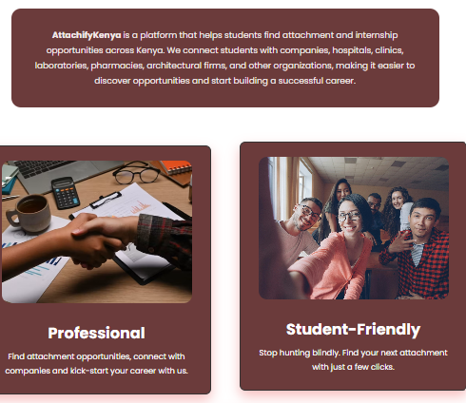
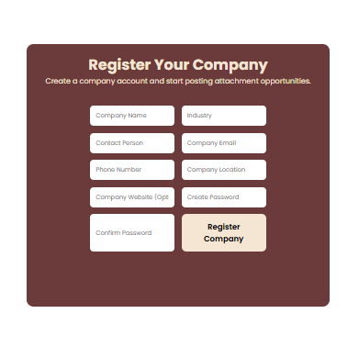

Website overview.

Slide 7
CORE FEATURES
Homepage
Welcomes users to the platform.
Provides an overview of Attachify Kenya.
Includes quick navigation to all sections of the website.
Benefit: Gives users an easy starting point.
2. Industry Categories
Opportunities are organised into:
Technology
Medicine
Architecture
Each category has its own dedicated page.
Benefit: Makes it easier for students to find opportunities relevant to their field..

Slide 8
CORE FEATURES
3. Student Registration
Students can create a profile by entering their personal and academic details.
Benefit: Prepares students for future attachment applications
4. Company Registration
Companies can register to become part of the platform.
Benefit: Enables organizations to connect with students and advertise opportunities.

Slide 9
CORE FEATURES
5. Login System
Separate login options for students and companies.
Benefit: Provides a more organized and user-friendly experience for different types of users.
6. Contact & About Pages
About page explains the purpose of the platform.
Contact page allows users to get in touch with the platform administrators.
Benefit: Builds trust and provides support for users.

Slide 10
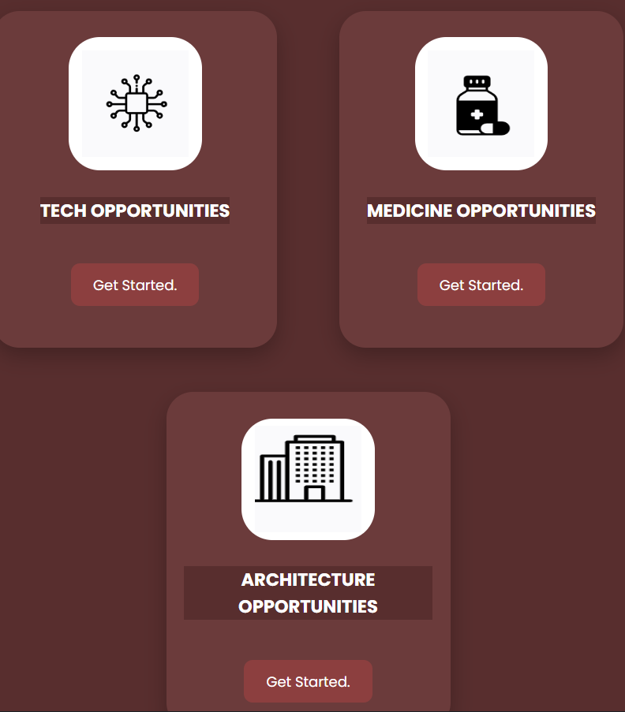
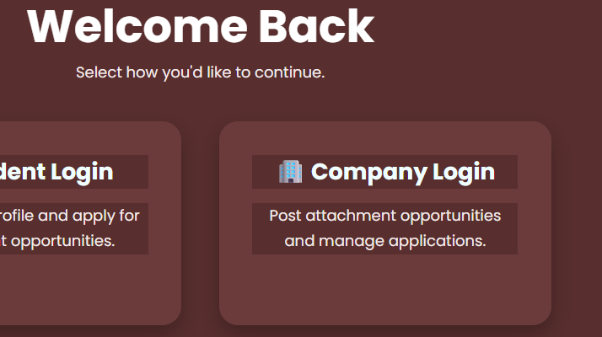
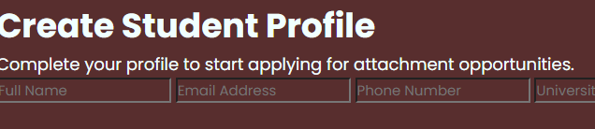
SNIPPETS OF THE WEBSITE

Slide 11
TECHNOLOGY STACK
Technologies Used
HTML5 – Structured the web pages.
CSS3 – Styled the website and created responsive layouts.
Figma – Designed the user interface.
Git & GitHub – Managed version control and project hosting.
Key Technologies
Flexbox & CSS Grid for responsive layouts.
Google Fonts (Poppins) for modern typography.
Contribution
Created a clean, responsive, and user-friendly website.
Improved code organization and maintainability.
Enabled efficient development and version tracking.

Slide 12
DEVELOPMENT PROCESS
Methodology
Agile approach
Developed and tested one feature at a time
Key Milestones
Designed the UI in Figma
Built the homepage and navigation
Created category pages
Added login, registration, About, and Contact pages
Tested and refined the website
Challenges
Managing file paths
Maintaining a consistent design
Creating responsive layouts
Solutions
Organized files into folders
Reused CSS styles
Tested links and layouts regularly

Slide 13
MARKET ANALYSIS AND COMPETITOR LANDSCAPE
Target Market
University and college students seeking attachment opportunities.
Companies offering industrial attachments and internships.
Competitors
LinkedIn
BrighterMonday Kenya
MyJobMag Kenya
What Makes Attachify Kenya Different?
Focuses specifically on student attachments.
Simple and easy-to-use interface.
Organizes opportunities by industry.
Tailored to the Kenyan market.
Market Opportunity
Thousands of students require attachments each year.
Growing demand for a centralized platform connecting students with employers.

Slide 14
MARKETING STRATEGY AND REVENUE STRATEGY
Marketing Strategy
Social media promotion.
Partnerships with universities and colleges.
Collaborations with companies.
Revenue Strategy
Company registration fees.
Premium job posting packages.
Website advertising.
Future Growth
Expand to more industries.
Partner with more organizations across Kenya.
Launch a mobile application.

Slide 15
ROADMAP AND FUTURE ENHANCEMENTS
Upcoming Features
Database integration.
Student and company dashboards.
Online attachment applications.
CV upload and profile management.
Advanced search and filtering.
Long-Term Vision
Become Kenya's leading attachment and internship platform.
Expand services to East Africa.

Slide 16
CONCLUSION
AttachifyKenya simplifies the search for attachment opportunities.
It connects students and employers through one centralized platform.
The project provides a strong foundation for future development.
Thank You!

Slide 17
Q&A
Feel free to ask any questions with regards to attachifykenya.

