Slide 1
Project:
AUTOMOBILE INSURANCE COMPLAINTS RANKINGS
DataMites Client Project — CDACL-001
Complaint Analysis, Company Performance & Premium Trends
Tools Used: SQL | Power Query | Power BI
Presented By: Pinipe Samuel Manoj

Slide 2
Project Objective
The main aim of this project is to understand automobile insurance complaint patterns, compare different insurance companies, and identify areas where customer service could improve.
What I Analyzed
Yearly insurance complaint trends.
Different complaint outcomes and their distribution.
Performance comparison of five insurance companies.
Complaint history and premium trends of Allstate Insurance Company.
Tools Used
SQL / phpMyAdmin: Database exploration and analysis.
Power Query: Data preparation.
Power BI: Dashboard creation and visualization.

Slide 3
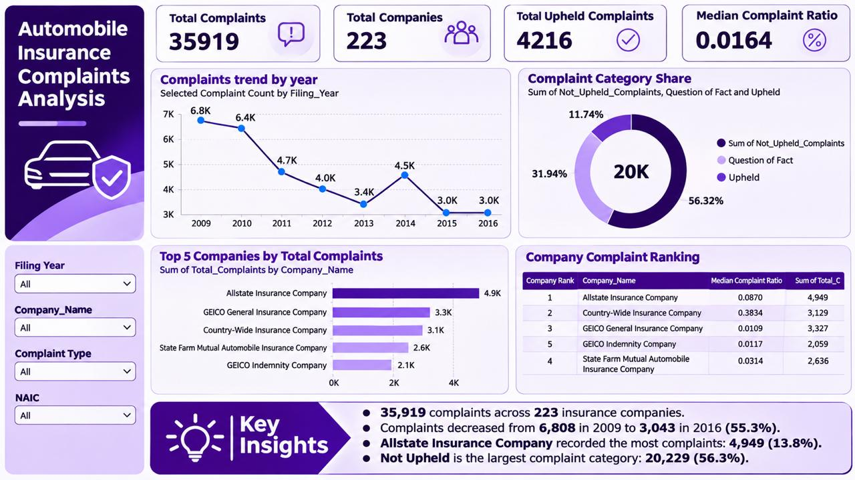
Overall Insurance Complaints Dashboard
Key Results
35,919 total complaints.
223 insurance companies analyzed.
4,216 upheld complaints.
0.0164 median complaint ratio.
Main Observations
The overall number of complaints declined between 2009 and 2016, with some fluctuations.
The dashboard shows the distribution of Upheld, Not Upheld, and Question of Fact complaints.
The company comparison highlights differences in complaint volumes across insurers.

Slide 4
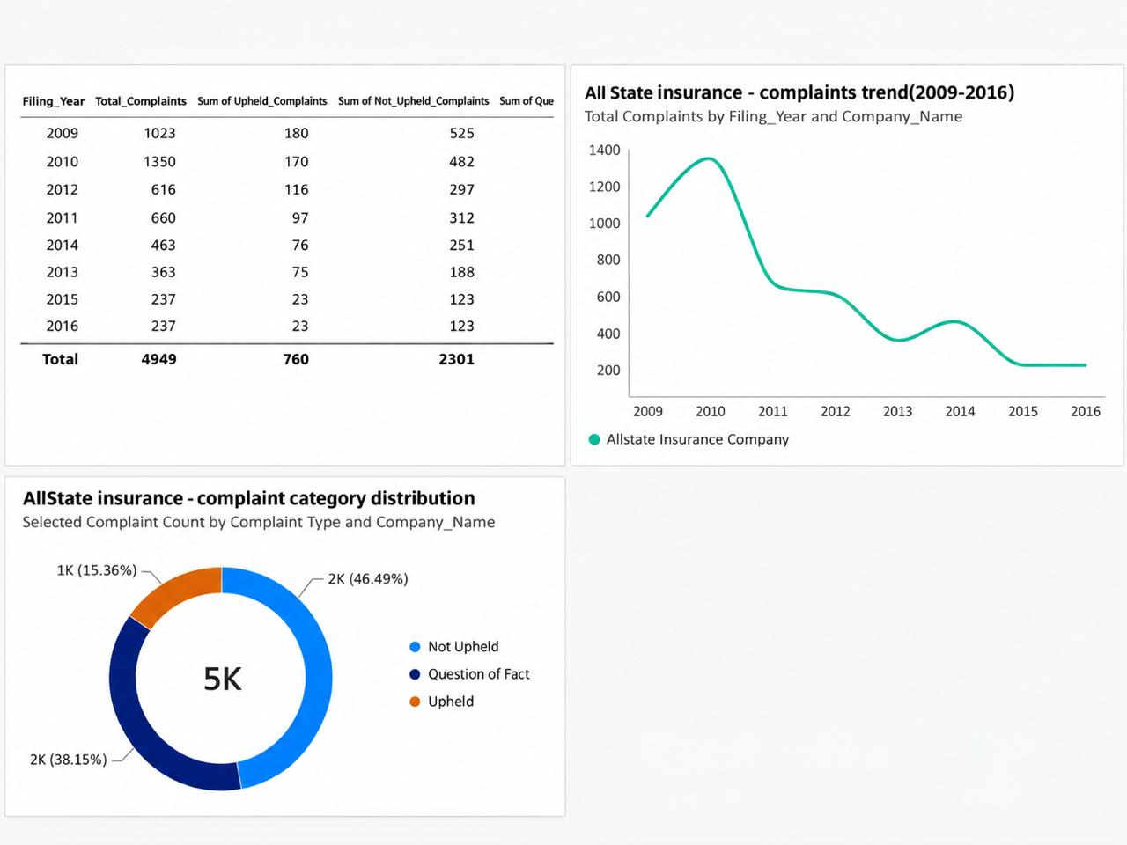
Allstate Insurance Company: Complaint Analysis
Not Upheld complaints formed the largest category, at approximately 46.5%.
The highest yearly complaint count was 1,350 in 2010.
Complaints decreased to 237 by 2016.
The decline is encouraging, although complaint volume alone does not confirm an improvement in customer satisfaction.
Category | Complaints
Upheld | 760
Not Upheld | 2,301
Question of Fact | 1,888
Total | 4,949

Slide 5
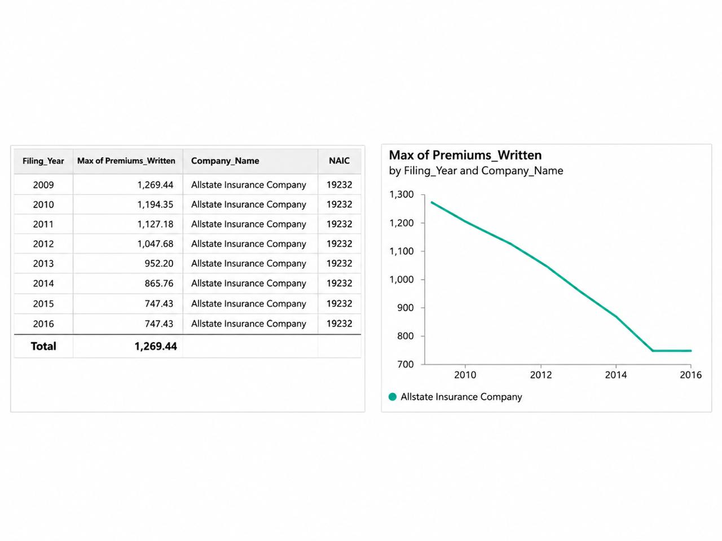
Premium Trend Analysis
Selected Company: Allstate Insurance Company
The premium analysis examines the company's reported premiums from 2009 to 2016.
Key Results
2009: Approximately $1,269.44 million.
2016: Approximately $747.43 million.
Overall change: Approximately 41.1% decrease.
Possible Reasons
Changes in insurance policy volume.
Market competition and pricing decisions.
Economic conditions and regulatory changes.
Future Outlook
The historical decline suggests that premium performance needs closer monitoring. Future results could improve or decline depending on business and market conditions.
These possible reasons are not confirmed causes; the available dataset alone cannot establish why premiums changed.

Slide 6
Comparison of Five Insurance Companies
The dashboard compares five companies based on their total complaint counts.
Companies Compared
Allstate Insurance Company
GEICO General Insurance Company
Country-Wide Insurance Company
State Farm Mutual Automobile Insurance Company
GEICO Indemnity Company
Key Observations
Allstate recorded the highest total complaints among these five companies.
GEICO General and Country-Wide followed in complaint volume.
Comparing complaint totals helps identify companies that may need closer review.
Complaint ratios and business size should also be considered before judging a company's performance.

Slide 7

Key Findings, Recommendations & Conclusion
Allstate recorded 4,949 complaints, with Not Upheld being the largest category.
Allstate's reported premium values also declined between 2009 and 2016.
Recommendations
Review recurring customer complaints to identify service issues.
Improve communication and updates during the complaint resolution process.
Monitor complaint ratios alongside business performance and premium trends
.
Conclusion
This project helped turn insurance complaint records into meaningful insights using SQL and Power BI. The analysis highlights how dashboards can support company comparisons, identify trends, and help businesses make better decisions.

Slide 8
Thank You
Pinipe Samuel Manoj
Certified Data Analyst – CDA
DataMites Client Project — CDACL-001
Automobile Insurance Complaints Rankings

