Slide 1
Econ 270 Lecture 1
Sam Gifford

Slide 2
iClicker Test Pop Quiz
Immediately after a basketball leaves a player’s hand after taking a 3 point shot, the force on the ball is
A Upwards and constant
B Upwards and decreasing
C Downwards and constant
D Downwards and decreasing
E Tangent to the path of the ball

Slide 3
Why this course is useful
Data is being used in increasing rates in every job field
Routine tasks are being automated by AI or offshored
Employers are reluctant to hire gen Z workers
High bar for interviews at good companies
Most interviews have an analytic component!

Slide 4
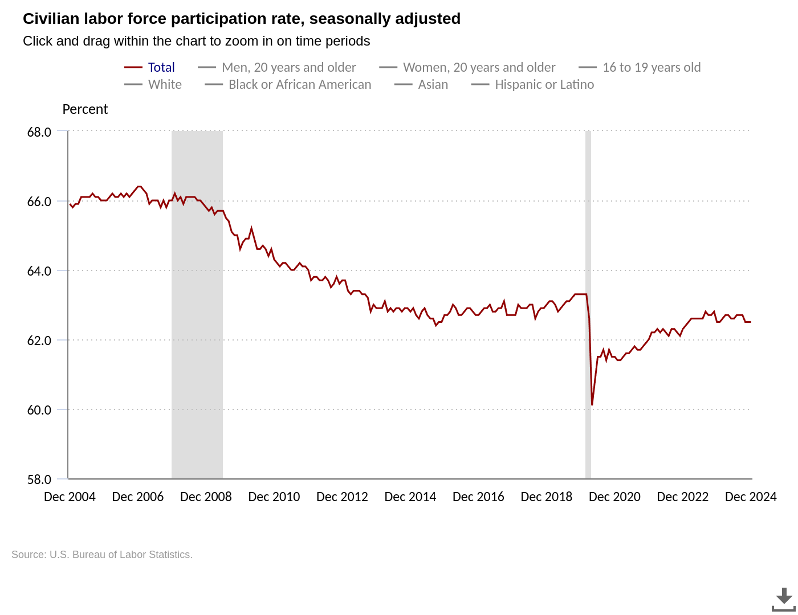
Labor Force Participation Rate

Slide 5
New College Graduate Success
over half of hiring managers believe new college graduates are unprepared for the workforce (intelligent.com survey)
New graduates are being fired at higher rates than in the past
At least partly due to dilution of the education system, including college

Slide 6
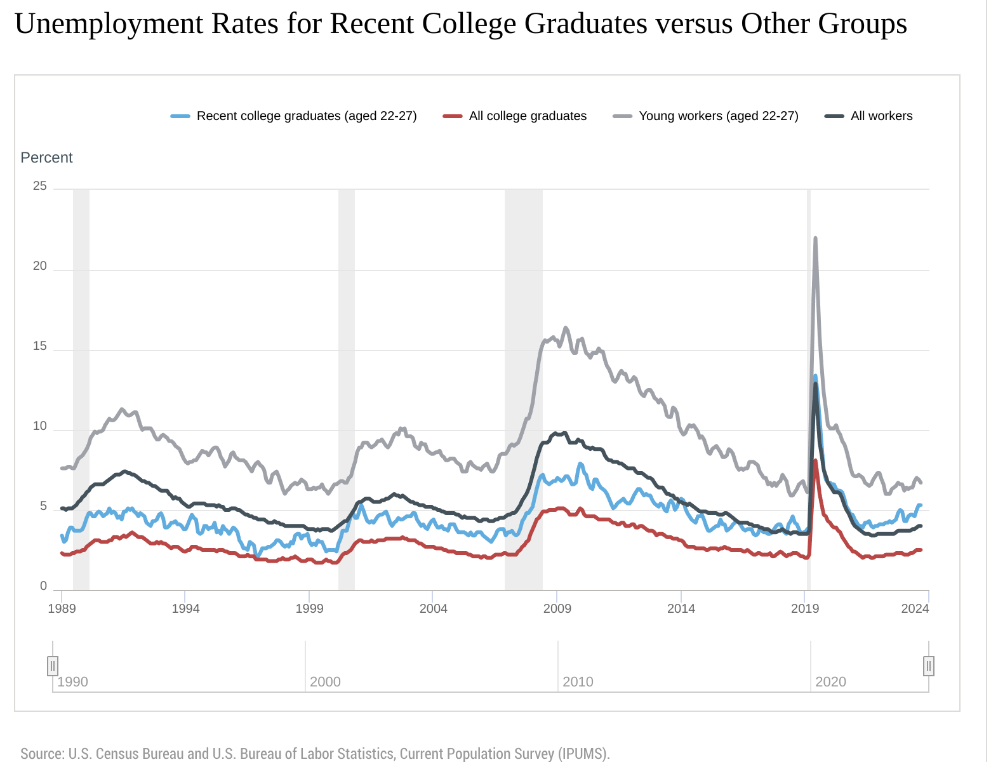
Unemployment rates

Slide 7

Bunny Intermission

Slide 8
How to Get Ahead
Need to signal quality to interviewers to get interviews
Improve technical skills to pass interviews
Developing statistical knowledge and working on projects is the best way
College is still a good return on investment

Slide 9
An example of statistical analysis
Should I make attendance mandatory?
How would I go about answering this question?

Slide 10
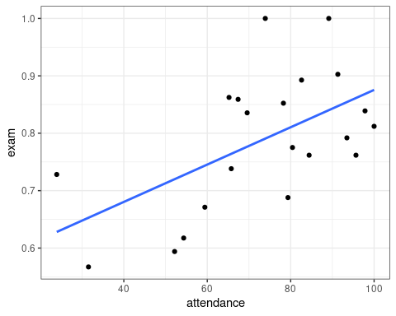
Data Simulated From Class Data

Slide 11

Is This Strong Evidence?

Slide 12
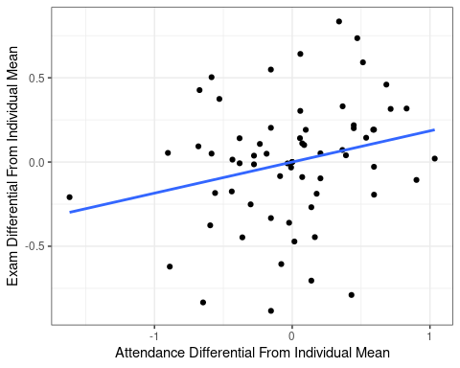
Attendance Fluctuations

Slide 13
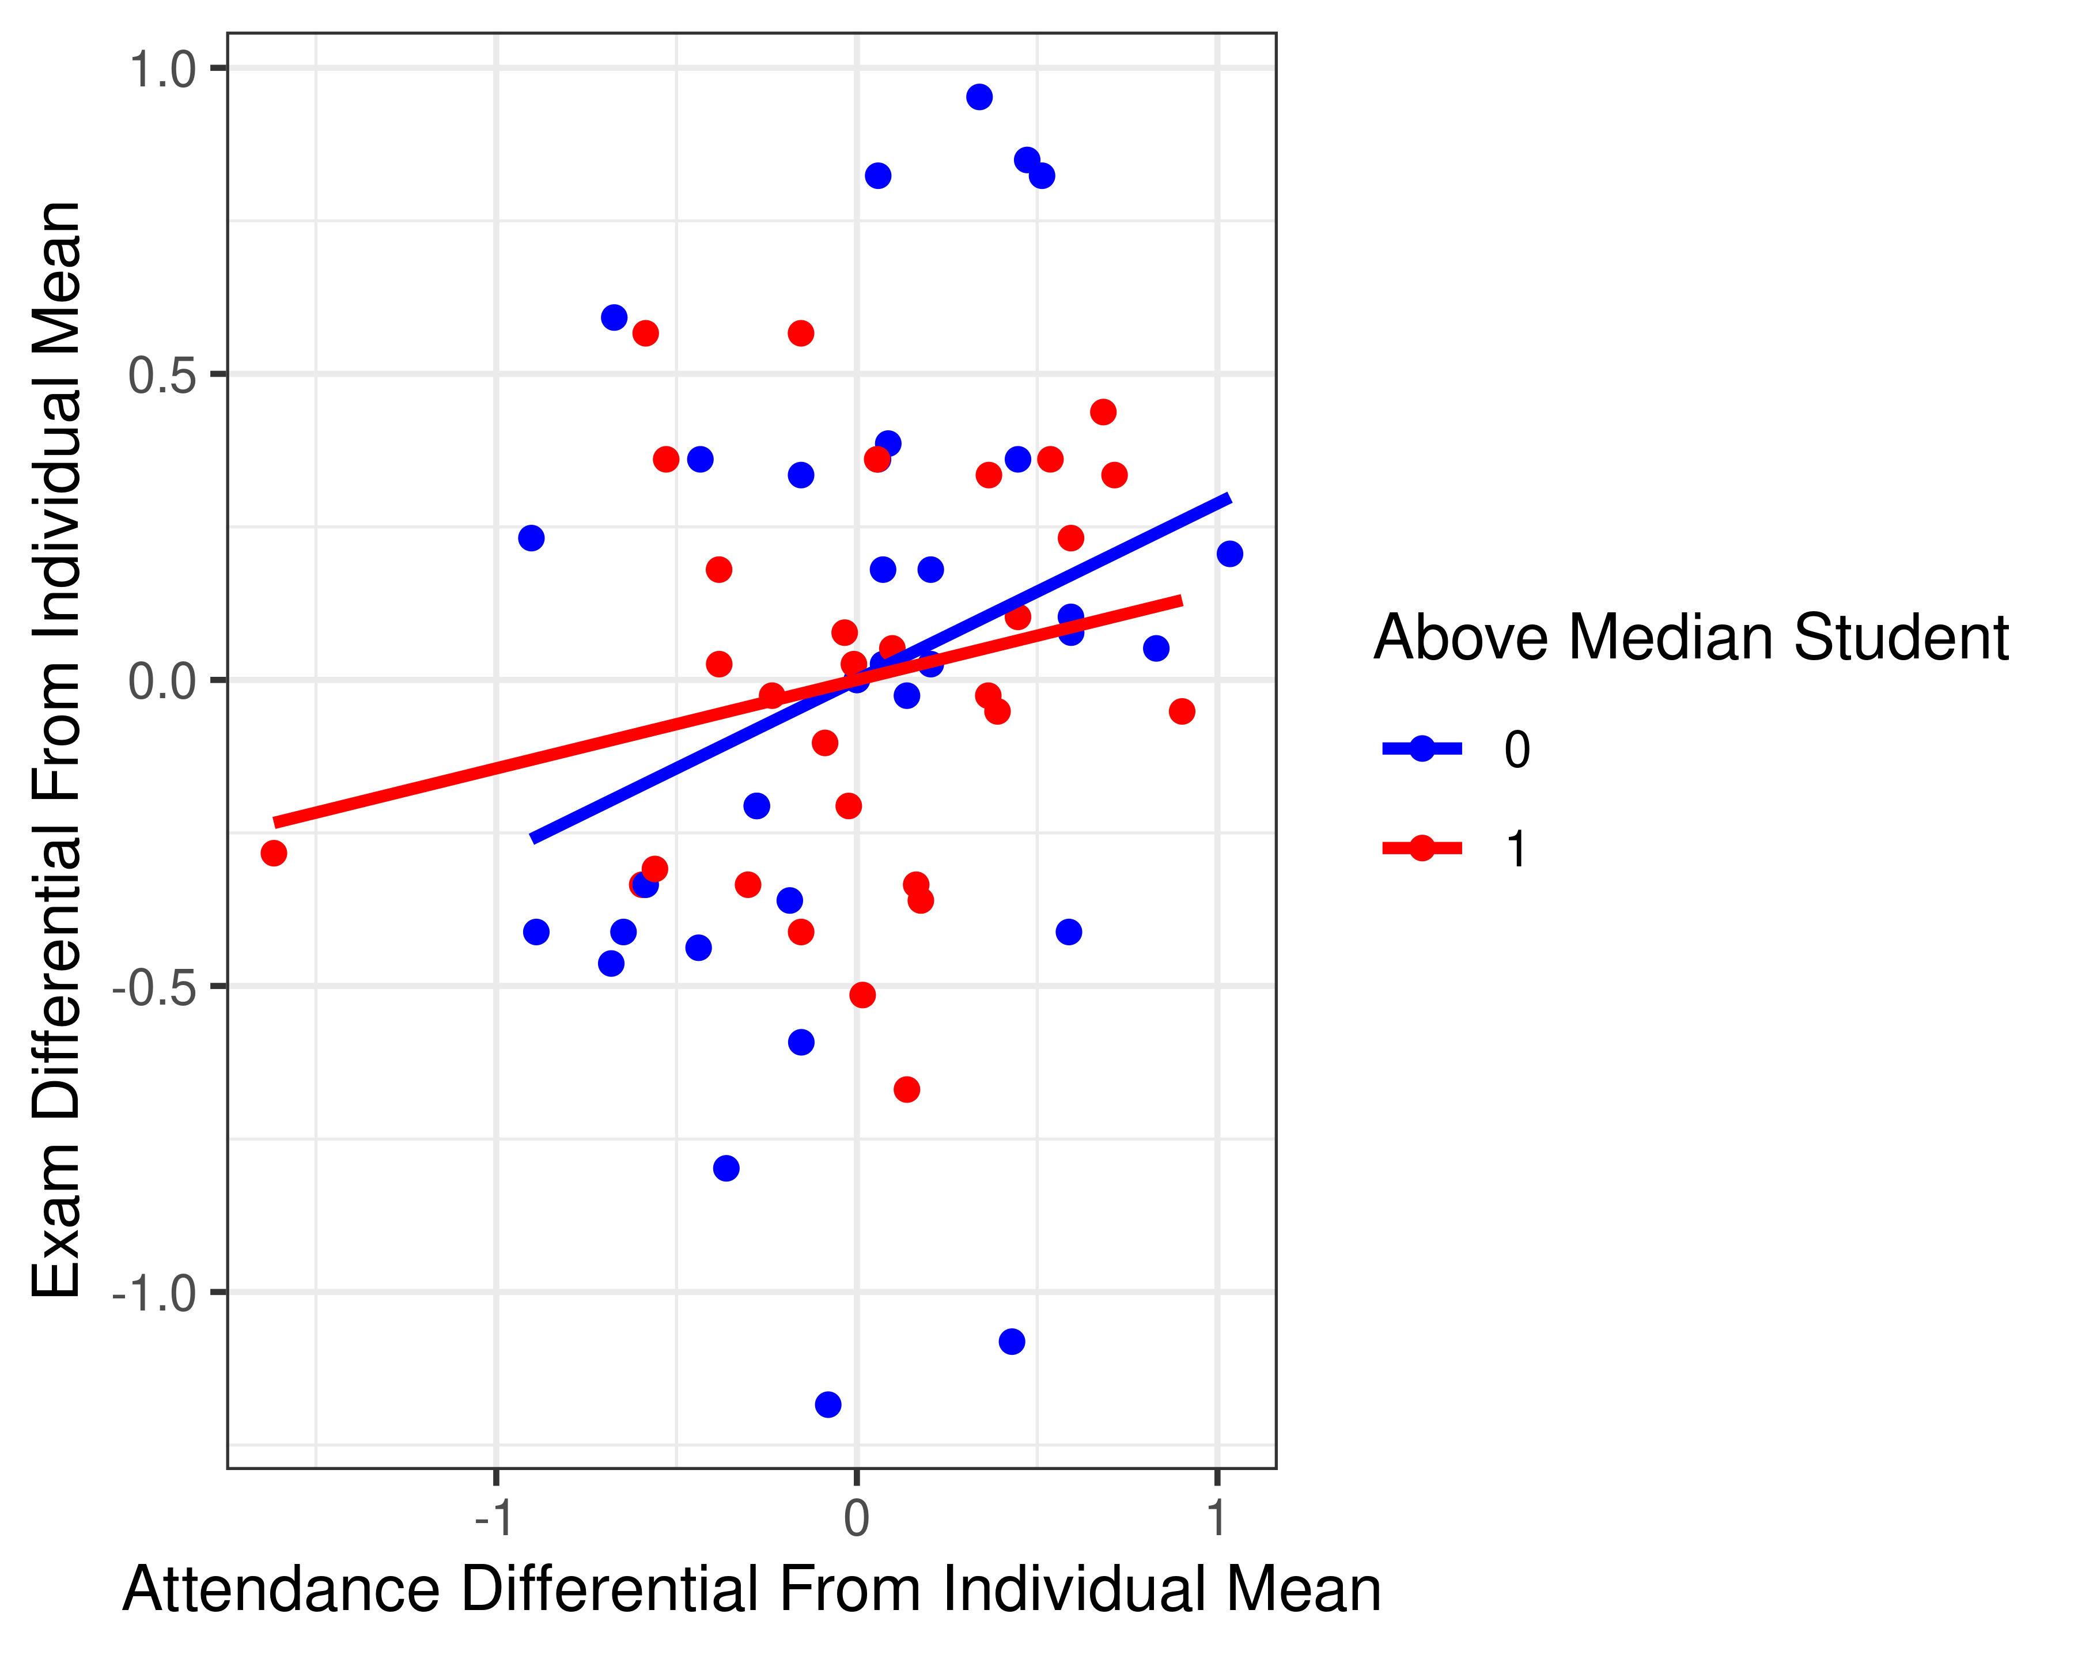
Heterogeneity

Slide 14
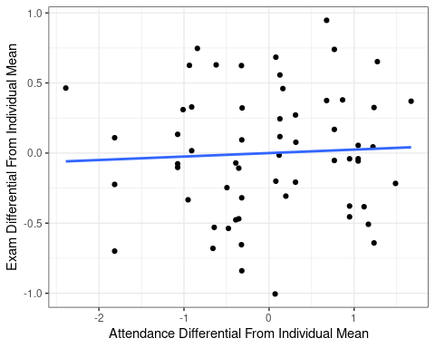
Consistency?

Slide 15
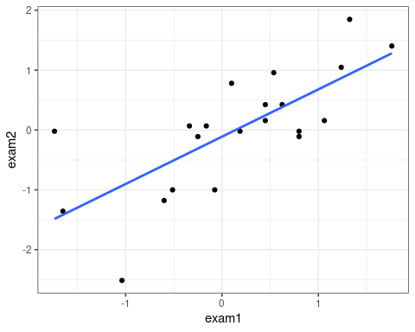
Score Persistence

Slide 16
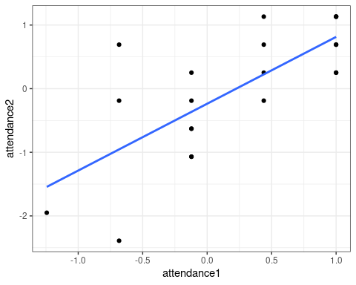
Attendance Persistence

Slide 17
My Takeaways
Exams are consistent for most students
But that I should still offer some ‘cushion points’
Attendance probably improves performance
Effect is probably “small”
“Attendance” is only a proxy for effort. May break down!

Slide 18
Applications
You should apply similar thinking to your job
Everyone will use metrics. But the metrics will be misinterpreted
Sales are down. Why, and what should we do about it?
Our goal is to get an understanding of the statistical properties of data
So that we don’t make decisions based on random chance

Slide 19
Tying it Together
Bad employment outcomes, poor student practices, and poor data analytics are related
By putting effort into learning quantitative skills you’ll be in a better position when you graduate

