Slide 1
Econ 270 Lecture 2
Sam Gifford

Slide 2
Types of Data (1.2.2)
Quantitative
Interval: differences are meaningful
Ratio: nonnegative with a “true zero”
Discrete or Continuous
Discrete use counting numbers
Qualitative (categorical)
Ordinal: order matters
Nominal: No order

Slide 3
Quantitative Examples
Money (ratio)
Weight (ratio)
Time (interval)
Temperature (F or C) (interval)
Kelvin is ratio

Slide 4
Quantitative Data
I don’t care about the distinction between ratio and interval
Important thing is that we can interpret values in context
When comparing income levels of earners, should we compare differences or ratios?
Data classifications aren’t necessarily standardized

Slide 5
Qualitative Examples
Name (nominal)
State (nominal)
Educational Attainment (ordinal)
Student Evaluation (ordinal)
Labeled 1-5, but not a true quantitative variable

Slide 6
Examples
Student ID SAT Score age Grade 1: 1 1537 18 A 2: 2 1618 19 B 3: 3 1516 18 C 4: 4 1760 19 A 5: 5 1633 18 B
A Quantitative B Ordinal C Nominal

Slide 7
Summarizing Data
Some data analysis techniques only work for numeric data
We’ll start with some more holistic measures, then move to single-number summary statistics

Slide 8
Quantiles and Box Plots (2.1.5)
Suppose you have data that consistent of students exam scores
You’re interested in understanding the general distribution of these scores
83 74 87 58 71 59 83 90 80 75 77 87 92 66 63 76 93 98 79 72 85 59 85 83 79 77 78 65 63 80 80 78 77 67 78 90 50 79 99 94 87 67 83 89 82 61 75 61 45 52 90 96 75 72 73 82

Slide 9
Order Statistics
One easy thing we can do is sort the data
What are the largest and smallest values?
45 50 52 58 59 59 61 61 63 63 65 66 67 67 71 72 72 73 74 75 75 75 76 77 77 77 78 78 78 79 79 79 80 80 80 82 82 83 83 83 83 85 85 87 87 87 89 90 90 90 92 93 94 96 98 99

Slide 10
Quantiles and Box Plots (2.1.5)
We define the median as the ‘middle’ value: half of all exam scores are below this, and half are above
If there’s an even number a common convention is to take the average
What is the median of the following data?
13 2 10 8 5

Slide 11
Quantiles and Box Plots (2.1.5)
Median for the exams?
45 50 52 58 59 59 61 61 63 63 65 66 67 67 71 72 72 73 74 75 75 75 76 77 77 77 78 78 78 79 79 79 80 80 80 82 82 83 83 83 83 85 85 87 87 87 89 90 90 90 92 93 94 96 98 99

Slide 12
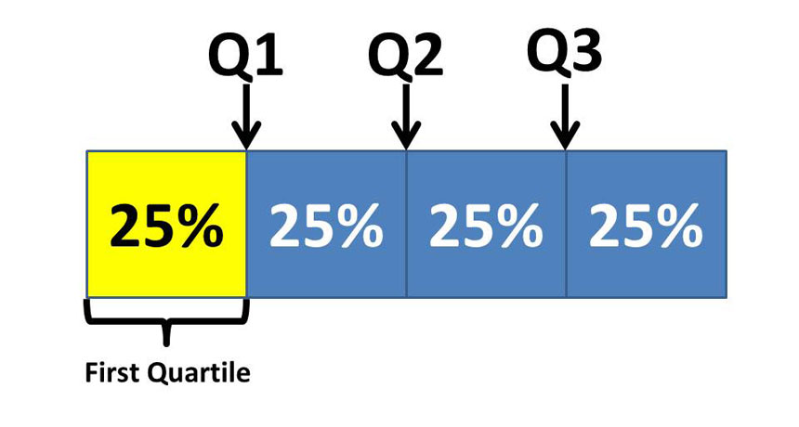
Quantiles and Box Plots (2.1.5)
The median is a measure of central tendency
Often we’re interested in more than just the average student
One more general way is to divide the class into 4 groups instead of 2
from sciencenewsforstudents.org

Slide 13
Quantiles and Box Plots (2.1.5)
What is the third quartile (Q3) of exam scores?
45 50 52 58 59 59 61 61 63 63 65 66 67 67 71 72 72 73 74 75 75 75 76 77 77 77 78 78 78 79 79 79 80 80 80 82 82 83 83 83 83 85 85 87 87 87 89 90 90 90 92 93 94 96 98 99

Slide 14
General quantiles
In general we define as percentile as the number such that p% of the data lies below this point
The probability notation for this is rather confusing: $x:P\left(X≤x\right)≥p$
The 1st, 2nd, and 3rd quartiles are the 25th, 50th, and 75th percentiles
The 2nd quartile is also the median
The top 1% is the 99th percentile

Slide 15
Interquartile Range and Outliers
The difference between the first and third quartiles is called the interquartile range (IQR)
IQR = Q3-Q1
It gives a measure of spread, or dispersion, of the distribution
An outlier is an extreme observation that is atypical
No consistent definition, but sometimes defined to be more than 1.5 times the IQR from the median

Slide 16
Box Plots
Using the quartiles and the IQR we can give a plot that is a good summary of our data
The Q1, the median, and Q3 are all plotted as a line, creating a box
Whiskers extend from the top and bottom of the box until it either reaches the max/min of the data, or until it reaches 1.5 times the IQR, whichever comes first
Any values outside this range (the outliers) are individually plotted

Slide 17
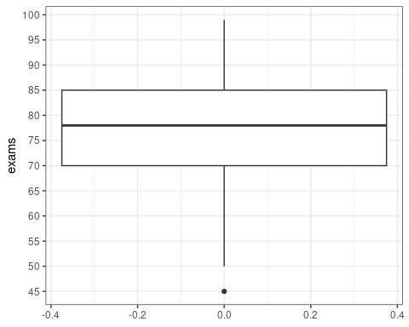
Box Plots

Slide 18
Histogram (2.1.3)
Boxplots provide a good summary, but leave out information
We can instead bin our exams into ranges and count how many students fall in each
e.g. 18 students scored in the 70s, and 15 in the 80s
If the bins are of equal size this plot is called a histogram

Slide 19
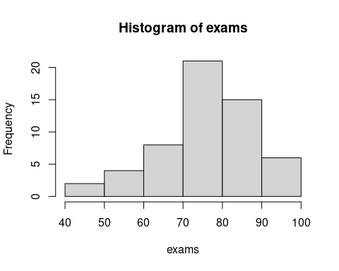
Histogram
This is a ‘left-skewed’ exam

Slide 20
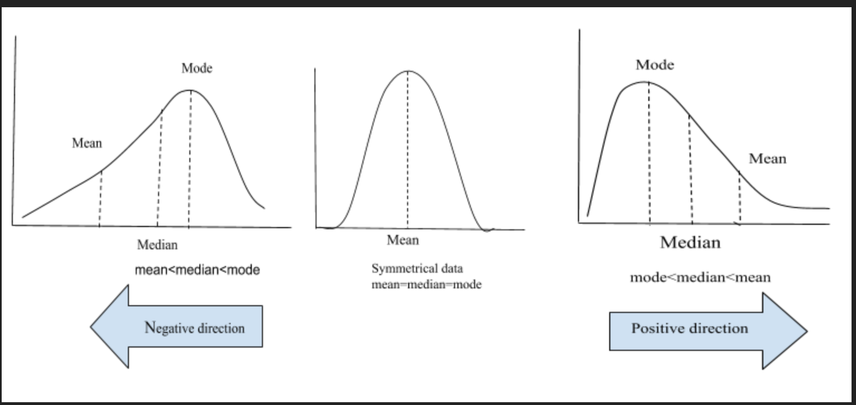
Skewness
If the tail tapers off to the right, a distribution is skewed right
Generally means that the mean (average) is greater than than the median
A distribution with no skew is symmetric
from alevelsmath

Slide 21
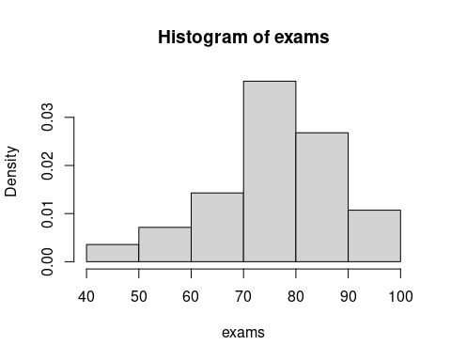
Absolute vs Relative
We can plot histograms with either the counts or the percentages. Percentages tend to be more useful when comparing distributions
This plot uses ‘density’ - multiply by the bin width to get the percentage

Slide 22
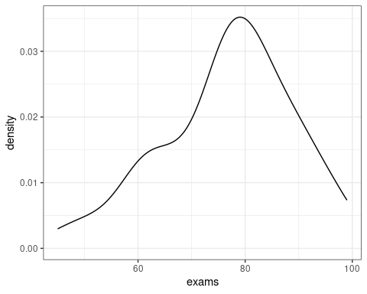
Kernel Density
An alternate way to draw this is with a kernel density plot
Good for overlaying distributions

Slide 23
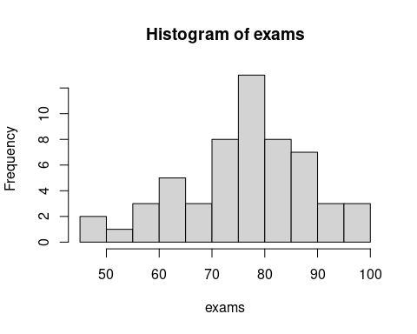
Bin width
More bins will reveal more details, but be less smooth
Optimal bin width is more of an art than a science

Slide 24
Bimodality
The mode is the most frequent observation in data
If the histogram has two peaks, it is called bimodal
The exams are bimodal - there is a peak round 65 and around 75 in the data

Slide 25
View Tradeoffs
Note that in the first histogram the skewness is easier to see, while in the second the bimodality is easier to see
We often want multiple views of data to get a sense of the distribution

Slide 26
Qualitative Data
We can still construct something akin to a histogram for ordinal data
For nominal data, we can construct a regular bar graph to display count information

Slide 27
Summary statistics (2.1.2)
We often want to view the whole distribution, but sometimes we just need a simple summary
Summary statistics can give a brief overview of the data as a single number
The quartiles and median are all examples of such summary statistics

Slide 28
Central Tendency
The center of a distribution is usually important - it represents the ‘average’ data point
The median is one measure of central tendency
The more common one is the mean (or average)

Slide 29
Mean
The mean, $\overset{‾}{x}$, is just the average of a set of data
$\overset{‾}{x}=\frac{x_{1}+x_{2}+...+x_{n}}{n}=\frac{1}{n}\sum_{i=1}^{n}{x_{i}}$
We will see some alternative notation when discussing probability distributions
This is the ‘balancing point’ of a distribution - equal weight is on both sides

Slide 30
Mean vs Median
Consider the following set of numbers. What is the mean?
{1,1,1,2,2,2,3,3,3,22}

Slide 31
Robustness
For the prior sample, removing 22 yields a mean of 2.
By comparison, the median would be 2 in both cases
The median is said to be robust: outliers in the data do not have a large effect
The mean is not robust

Slide 32
Why the mean
If the median is more typical of the average, why use the mean at all?
Consider calculating average insurance claims: the mean is what affects the profitability of the insurance company, not the median!
Usually we (should) care about both

Slide 33
Weighted Means
Sometimes observations are weighted. In this case we can just multiply by the weight before averaging
Consider if our observations were aggregated beforehand. What is the average exam score?
## Score N ## 1: 40 1 ## 2: 50 2 ## 3: 60 8

Slide 34
Weighted Mean Calculation
We can ‘expand’ the data and calculate the mean: {40,50,50,60,60,60,60,60,60,60,60}
Or we can directly weight it: 40/11 + 50*2/11 + 60*8/11
Both answers are identical

Slide 35
Dispersion (spread)
In addition to the center of the distribution, we usually care about the dispersion, or spread
The interquartile range is one example of dispersion
Like the median, it is robust to outliers

Slide 36
Variance (2.1.4)
The more common way of measuring spread is with the variance
The average squared distance of each point to the center
$var\left(x\right)=\frac{{\left(x_{1}−\overset{‾}{x}\right)}^{2}+{\left(x_{2}−\overset{‾}{x}\right)}^{2}+...+{\left(x_{n}−\overset{‾}{x}\right)}^{2}}{n}=\frac{1}{n}\sum_{i=1}^{n}{{\left(x_{i}−\overset{‾}{x}\right)}^{2}}$
Why squared distance?

Slide 37
Practice
What is the variance of the set {1,2,3,4,5}?

Slide 38
Standard Deviation
Squared units are hard to interpret. We usually take the square root of the variance for this reason
This is called the standard deviation, usually labeled as $σ$ (sigma)
$σ=\sqrt{var\left(x\right)}$
$var\left(x\right)$ is sometimes labeled $σ^{2}$

Slide 39
A note on sample vs population
We’re holding off on discussing populations vs samples, but the formulas for variance and standard deviation will be different
We’ll prove this when we get to discussing sampling

Slide 40
Interpreting Standard Deviation
Standard deviation is ‘almost’ the average distance from the mean of the distribution
Chebyshev’s inequality tells us a bit more: $1−\frac{1}{k^{2}}$ of the data is within k standard deviations of the mean
This means that 75% of the data is always within 2 standard deviations of the mean
About 95% of the data is within 4.5 standard deviations of the mean

Slide 41
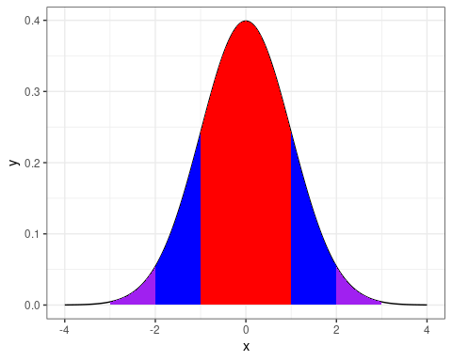
Interpreting Standard Deviation
For a special distribution called a normal distribution, 68% of the data falls within 1 standard deviation of the mean
95% falls within 2 standard deviation, and 99.7% within 3 standard deviations

Slide 42
Z-scores
It is common to ‘normalize’ data by subtracting the mean and dividing by the standard deviation
Gives a new distribution with mean 0 and standard deviation 1
The resulting value is the z-score. It’s the number of standard deviations above or below the mean
Example: Exams had a mean of 76 and standard deviation of 12. A score of 82 would have a z-score of 0.5

Slide 43
Absolute Deviance
Why not just use the average of the absolute distance from the mean, instead of squared distance?
Historically easier to calculate (absolute value is not differentiable)
Has synergy with the normal distribution
Absolute moments are seeing more usage in modern machine learning
Still a tradeoff. General $L^{p}$ spaces in topology are informative

Slide 44
Other moments
We can also use summary statistics to categorize the skewness and tail weight
Skewness relies on cubed deviations from the mean
Tail weight (kurtosis) uses deviations to the fourth power
Deviations raised to an integer power like this are called central moments. We won’t use them much in this class, but are sometimes useful
They’re frequently used in formal proofs of statistical properties

