Slide 1
Econ 270 Lecture 3
Sam Gifford

Slide 2
Two Variable Summaries
Often we want to look at how different variables relate to each other
Like univariate analysis, there are both broad ways to assess this and simpler summary statistics

Slide 3
Contingency Tables (2.2.1)
Also called crosstabulation
Analog of a histogram: given values of two separate variables, how many are in each cell?
Commonly implemented in Excel using pivot tables

Slide 4
Contingency Tables
Suppose I’m looking at exam scores and attendance
One simple thing I can do is split each into ‘above median’ and ‘below median’
This creates 4 possible categories

Slide 5
Contingency tables - scores
Low Grade High Grade Total Low Attendance 6 4 10 High Attendance 3 7 10 Total 9 11 20
Note that cells where attendance and exam scores agree are more populated
Can look across rows or down columns for marginal analysis

Slide 6
Marginal Analysis
What percent of students had low attendance?
Low Grade High Grade Total Low Attendance 6 4 10 High Attendance 3 7 10 Total 9 11 20

Slide 7
Joint Analysis
What percent of students had low attendance but received a high grade?
Low Grade High Grade Total Low Attendance 6 4 10 High Attendance 3 7 10 Total 9 11 20

Slide 8
Conditional Analysis
Among students with low attendance, what percentage received a low exam grade?
Low Grade High Grade Total Low Attendance 6 4 10 High Attendance 3 7 10 Total 9 11 20

Slide 9
Misinterpreting Statistics
What percent of people who play sports are executives?
What percent of executives play sports?
Play Don't Total Exec 2.4 0.1 2.5 Non-Exec 78.0 19.5 97.5 Total 80.4 19.6 100.0

Slide 10

Misinterpreting Statistics
Data from BLS, the Sport and Fitness Industry Association, and Korn Ferry. Data values rounded.

Slide 11
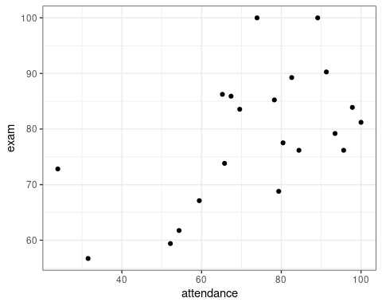
scatterplots (2.1.1)
If we have quantitative data, we can display two variables on a standard x-y plane
The corresponding graph is called a scatterplot

Slide 12
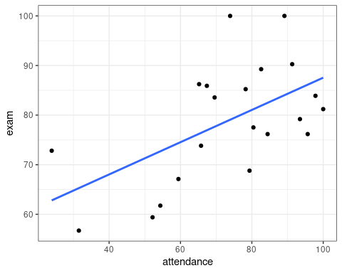
Trendlines
It is common to add a line of best fit, or trendline. You will calculate how to do this in econ300. The best fit line minimizes the sum of squared distances from the line of best fit

Slide 13
positive/negative/uncorrelated
In the prior graph, we saw that as students with higher attendance also had higher exam scores, on average
If we can fit a positive line to data there is a positive association, or correlation between variables
A negative sloping line has a negative association
If the slope is zero, the variables are uncorrelated

Slide 14
correlation as measure
Correlation ranges from -1 to 1. The sign tells us whether there is a positive or negative association. The absolute value tells us the strength
r=1 means a perfect positive association. r=-1 means a perfect negative association. r=0 means no linear association.

Slide 15
Correlation Examples
https://mcfortran.shinyapps.io/correlation/

Slide 16
Correlation Calculation
We likely won’t calculate correlation in this class, but it is actually very similar to variance
$\sum_{i=1}^{n}{\left(x_{i}−\overset{‾}{x}\right)}\left(y_{i}−\overset{‾}{y}\right)$
When x and y are both above or below the mean it contributes positively. When one is above and the other is below it contributes negatively.
Not robust! Outliers in both the x- and y- direction have large influence (‘leverage’)

Slide 17
A note on regression fit
The correlation coefficient, r, tells us how close a line fits the data
It turns out that $r^{2}$ actually has a nice interpretation: it’s the percent of the variation in y that is explained by x
So $r=.7$ means that our regression can explain half of the total variation
This sometimes gets glossed over in econometrics, but it’s something you should know.

Slide 18
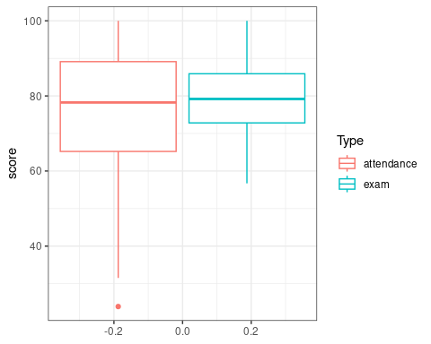
Overlayed histograms/boxplots (2.2.6)
We can also show two histograms or box plots side-by-side to compare distributions

Slide 19
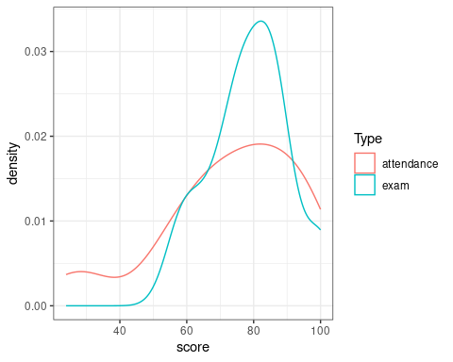
Overlayed histograms/boxplots (2.2.6)

