Slide 1
Econ 270 Lecture 4
Sam Gifford

Slide 2
Descriptive vs Inferential Statistics
What we’ve done so far is describe data using basic statistics
Ideally, we want to make inferences using data
We’ll need some basic probability theory to do this

Slide 3
Introduction to Probability
Probability is a mathematical framework for describing random events
How do we define random?

Slide 4
Random Examples
A flip of a coin
Radioactive decay
A critical hit in Pokemon
The temperature tomorrow
Your height

Slide 5
The role of information
Random is not necessarily the opposite of deterministic
The key element of random events is information
A coin flip is random when we don’t know the inputs

Slide 6
Subjective Probabilities
Different individuals may assess a random event differently
The probability that you’re 6 feet tall is very different from my perspective than from yours
But this doesn’t mean that probability is a subjective opinion
Most assessments of probability are terrible!

Slide 7
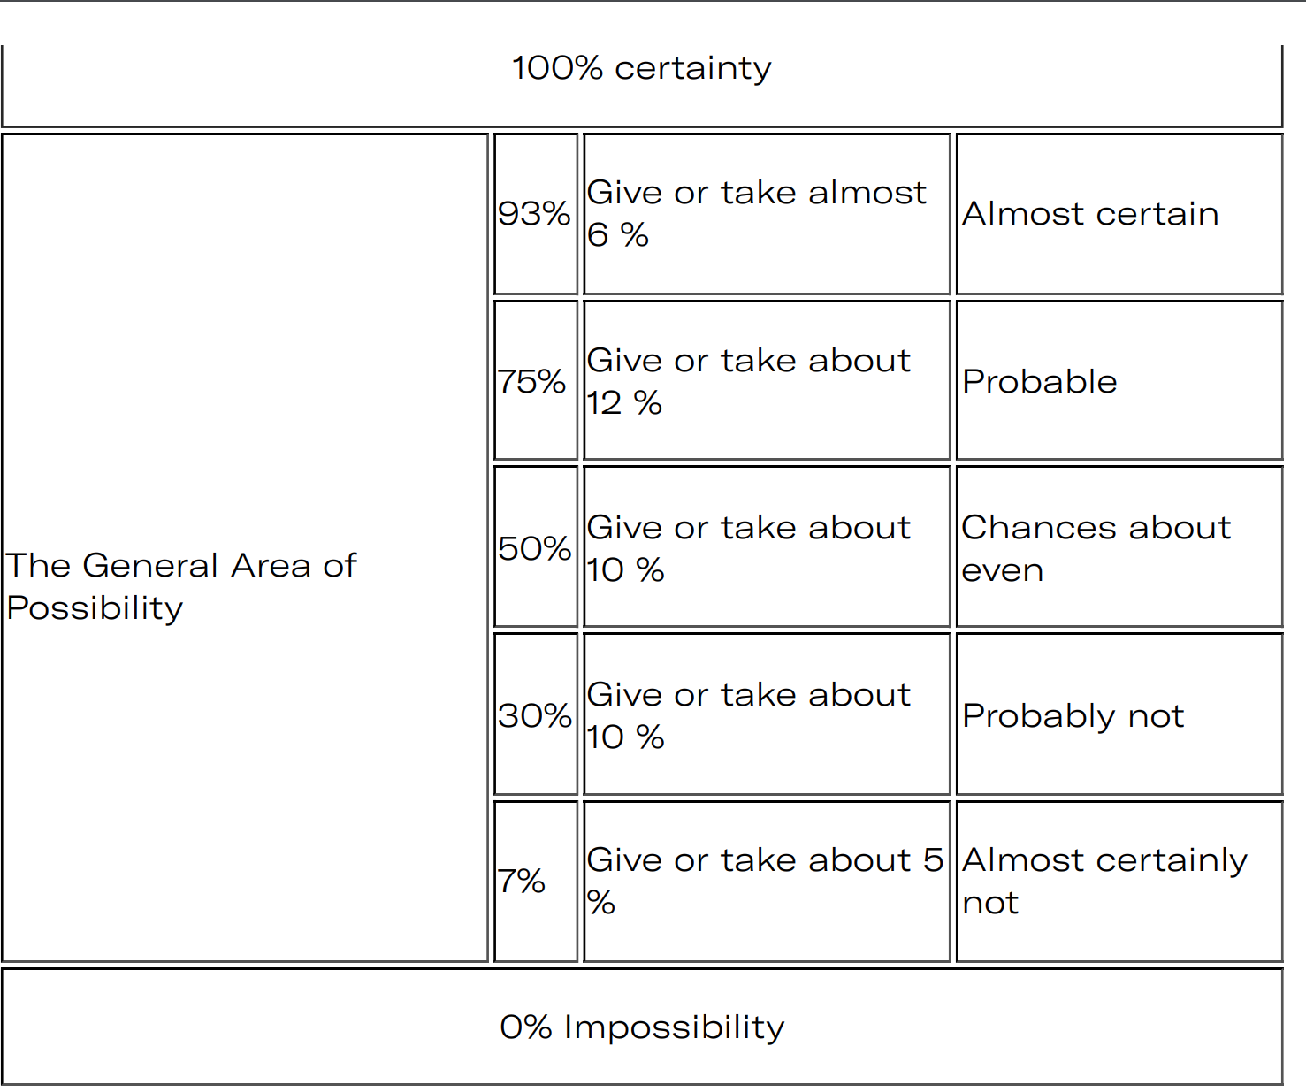
CIA Guidelines for probability

Slide 8
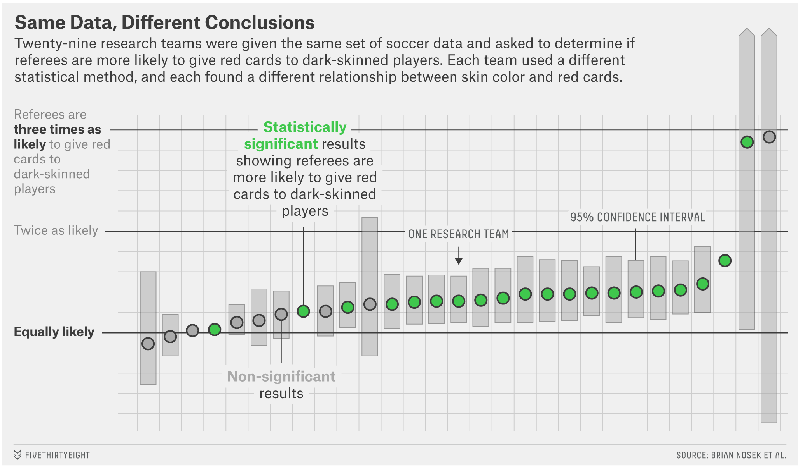
Red Card

Slide 9
Coin Shennanigans
You Can Load a Die, but You Can’t Bias a Coin (Gelman and Nolan, 2002)
Dynamical Bias in the Coin Toss (Diaconis, Holmes, and Montgomery, 2007)
Fair coins tend to land on the same side they started: Evidence from 350,757 flips (Bartos et al 2023)

Slide 10
Probability: Process To Data
In probability, we make assumptions about the data generating process
coin flips are independent with probability 0.5
students enter a classroom at a Poisson rate of 2 per minute
Given these, we can calculate the likelihood that different patterns of data will appear
500 heads in 1000 coin flips?
Probability is pure math - the question is whether our assumptions match reality

Slide 11
Statistics: Data To Process
In statistics, we assume some incomplete knowledge of the world
Coin flips are independent, but that the probability of heads is unknown
Given the data, we then make inferences about what the ‘true’ proportion of heads is
There’s never a ‘correct’ answer in statistics.
Some approaches are more reasonable than others

