Slide 1
Econ 270 Lecture 5
Sam Gifford

Slide 2
Intro to Probability
Consider a fair coin
Two options: $\{H,T\}$
Frequentist view: if all options are equally likely, just need to count
We’ll start with counting, then work on expanding to general probability

Slide 3
Basics of Counting: Sets
Suppose we flip a coin twice. How many ways are there to obtain 1 head?

Slide 4
Counting sets
We can enumerate all possible outcomes: $\{HH,HT,TH,TT\}$. Each is equally likely
2 options with 1 head with 4 possible options
Note that the order matters here

Slide 5
General power sets
Suppose we instead toss 3 coins. How many possible options are there?

Slide 6
General Power Sets
When we toss 1 additional coin, we have all of the previous options, plus either a heads or a tail at the end.
So we end up with twice as many

Slide 7
General Power Sets
Number of possible coin tosses for 10 tosses?
Denominator is easy. But how would we count the number of ways to get 5 heads?

Slide 8
Simple counting example
You roll two six sided dice. How many possible outcomes are there (assuming that order matters)?
What’s the probability that the sum of the two dice is a 4?

Slide 9
Permutations
First consider the number of ways to order distinct items
How could we arrange the letters A,B,C?
How does this differ from the number of ways to toss 3 coins?

Slide 10
Permutations: factorial
To find the number of ways you can arrange n distinct items using every item exactly once, use recursion
n choices for first placement, n-1 for second, n-2 for third , …
$n\left(n−1\right)\left(n−2\right)...1≡n!$
read “n factorial”
Number of ways to arrange 4 distinct items?

Slide 11
Permutation: general
Suppose we have 4 distinct items, but we only want to arrange 2 of them. How many ways are there to do this?
Sometimes labeled as $​_{4}P_{2}$
Formula?

Slide 12
Permutations with Repetition
We’re now almost able to deal with counting coins. We just need a way to deal with repetition
Consider the problem of how many ways we can arrange the letters A, B, A. We use each letter once
If the As were different (e.g. one capital one lowercase), we would just have 3!

Slide 13
Permutations with Repetition
Now consider the letters S, T, A, T, S
There are 5! permutations if S and T are differentiated. How much double counting is there?
General formula?

Slide 14
Permutations with Repetition
Suppose we have k items, each appearing $k_{i}$ (possibly 1) times, with $∑k_{i}=n$
Total permutations: $\frac{n!}{Π_{i=1}^{k}n_{i}!}$
$Π$ is product
Total permutations of the letters in banana?

Slide 15
Combinations
Now we can get to counting heads. This is a special case of the prior formula
Suppose you have 5 coin flips and want to how many ways to produce 3 heads * i.e. permutations of HHHTT?

Slide 16
Combinations
When we only have 2 classes (a binary variable) this formula simplifies
If we have n coin tosses, and k are heads, then there must be (n-k) tails
$=\frac{n!}{k!\left(n−k\right)!}$
Usually denoted as $\left({n \atop k}\right)$ and read “n choose k”

Slide 17
Coin Tossing
You toss a coin 6 times. What is the probability you obtain 3 heads?

Slide 18
Poker
Combinations generally work in cases where order doesn’t matter
How many possible 5 card hands are there in poker?

Slide 19
Birthday ‘Paradox’
Suppose there are 23 students in a room. What is the probability that two people share a birthday?

Slide 20
Probability Axioms
With counting problems, we can calculate probabilities as long as every outcome is equally likely
In general, we need a way to deal with outcomes that are not identical
We start with some axioms of probability, then draw parallels where we can with the basic counting approach

Slide 21
Probability Axioms
We start with a set of all possible outcomes, called a sample space
For tossing two coins, the sample space is $S=\{HH,HT,TH,TT\}$
An event is a subset of the sample space
The event that you obtain 1 head is $\{HT,TH\}$
We define a function P that measures the probability of any event. We require $P\left(S\right)=1$ and $P\left(∅\right)=0$, where $∅$ is the empty set

Slide 22
Probability Axioms
In general, we assign a probability to each atom (individual element) of the sample space
$P\left(\{HH\}\right)=P\left(\{HT\}\right)=P\left(\{TH\}\right)=P\left(\{TT\}\right)=\frac{1}{4}$
We then have a rule for combining elements in an event. If we have two disjoint (or mutually exclusive) events A and B, then the probability that either A or B occurs is $P\left(A\right)+P\left(B\right)$
“A or B” is sometimes written as $A∪B$ for set union
This is formally called sigma subadditivity

Slide 23
Mutual Exclusion
Two events are mutually exclusive if they don’t share any elements. Mathematically: $A∩B=∅$
$A∩B$ is the intersection of A and B, or more simply “A and B”
$\{HT,TH\}$, and $\{HH\}$ are mutually exclusive.
Tossing exactly two heads and exactly 1 heads
$\{HT,TH,HH\}$ and $\{HH\}$ are not mutually exclusive
Tossing at least one head and tossing exactly two heads have elements in common: $\{HT,TH,HH\}∩\{HH\}=\{HH\}$

Slide 24
Example
What is the probability that a randomly drawn card in a standard deck of 52 is either a club or a heart?
What about the probability that it’s either a club or a king?

Slide 25
General Addition
If events aren’t mutually exclusive, then we can’t just add their probabilities
The intersection of the two events ends up getting double counted in the process
Easy correction: just subtract out the intersection
$P\left(A∪B\right)=P\left(A\right)+P\left(B\right)−P\left(A∩B\right)$

Slide 26
General Addition
Suppose that 75% of students are econ majors, and 50% of students arrive to class late. 30% of students are econ students who arrive to class late. What percent of students are either econ students or arrive to class late?

Slide 27
Complement
Sometimes, it’s easier to indirectly count probability
What is the probability of obtaining 1 or more heads in 10 coin tosses?
$P\left(H=1\right)+P\left(H=2\right)+...+P\left(H=10\right)$
OR $1−P\left(H=0\right)=1−\frac{1}{1024}=\frac{1023}{1024}$
Usually labeled as either $P\left(A′\right)$ or $P\left(A^{c}\right)$

Slide 28
Basic Examples
Roll a 6 sided die and let the events $A=\{2,4,6\},B=\{4,5,6\}$
What is $A∪B$? $A∩B$? $A′?$
$P\left(A∪B\right)$
$P\left(A∪A′\right)?$

Slide 29
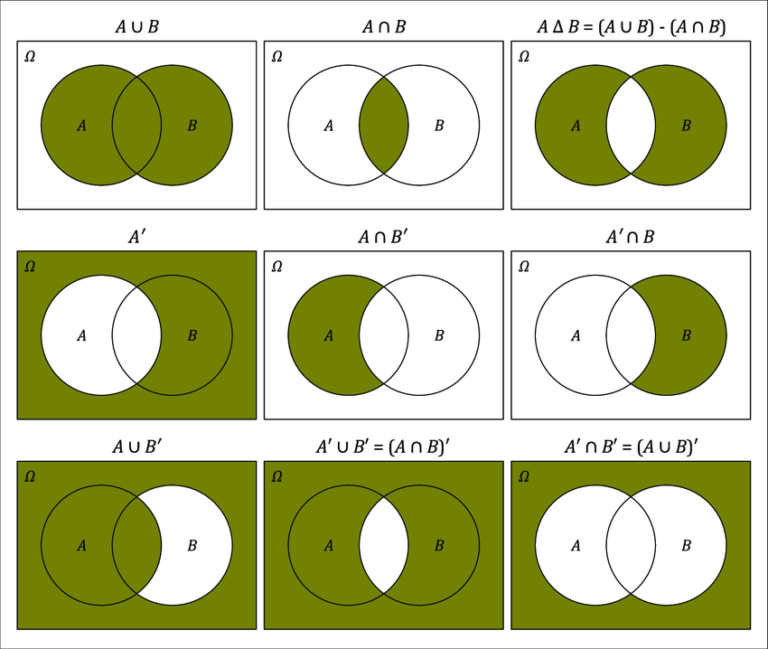
Venn Diagram
Image from Dora Sanford

Slide 30
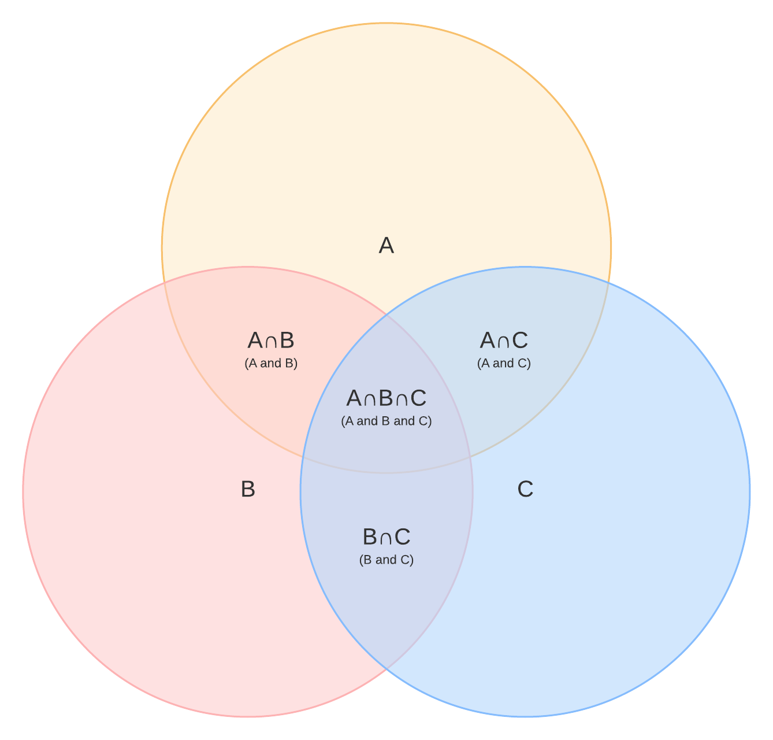
Venn Diagram

Slide 31
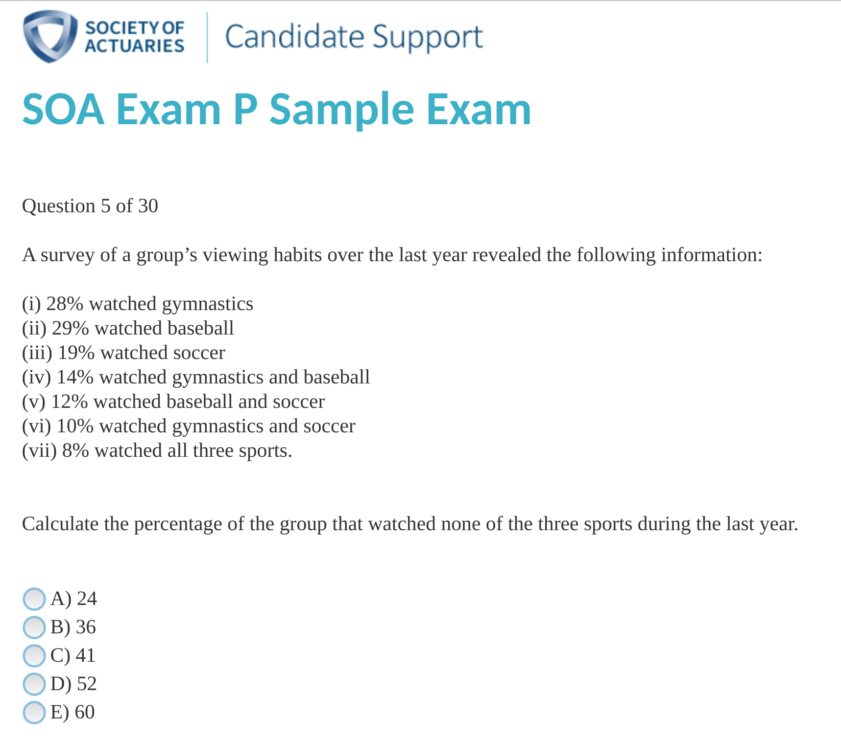
Exam P Question

Slide 32
conditional probability/multiplication rule
Sometimes we want to know the probability of an event when we’re given additional information
$P\left(A|B\right)$ is the probability of A given B
We’re just restricting our sample space to B first
$P\left(A|B\right)=\frac{P\left(A∩B\right)}{P\left(B\right)}$
Or $P\left(A|B\right)P\left(B\right)=P\left(A∩B\right)$

Slide 33
Conditional Probability
Suppose 60% of people like peanut butter, 50% like jelly, and 40% like both. Given that a randomly sampled person likes peanut butter, what’s the probability that they also likes jelly?
Given that a randomly sampled person likes jelly, what’s the probability they also like peanut butter?

Slide 34
Independence
In the previous example, learning that someone likes peanut butter changes the probability that they like jelly. $P\left(J\right)=50\%$, but $P\left(J|P\right)=67\%$
Become peanut butter and jelly are complements, learning someone likes one means they’re more likely to like the other
Two events are independent if $P\left(A∩B\right)=P\left(A\right)P\left(B\right)$
or $P\left(A|B\right)=P\left(A\right)$ and $P\left(B|A\right)=P\left(B\right)$
No information about A is gained when B is revealed

Slide 35
Independence
Suppose $P\left(A\right)=0.3$ and $P\left(B\right)=0.7$. Can you calculate $P\left(A∪B\right)$? $P\left(A|B\right)$?
What if they’re independent?
Examples of independent events?

Slide 36
Joint Probability Distributions
If we can fill in missing information ($P\left(A∩B\right)$ we can specify a probability distribution)
Equivalent to being able to fill out a full venn diagram
We can also convert to a table

Slide 37
Joint Probability Distributions
Suppose $P\left(A\right)=0.4$, $P\left(B\right)=0.5$, $P\left(A∩B\right)=0.1$
$P\left(A∪B\right)$?
B B' Total A A' Total

Slide 38
Marginal Probabilities
Sometimes we’re given a joint distribution of A and B, but only want A
Let A be the distribution of major, and B of year. What is the distribution of A?
What percent of students are psych majors?
Freshman Sophomore Junior Senior Total Econ 0.1 0.1 0.05 0.05 Math 0.05 0.05 0.05 0.1 Psych 0.15 0.1 0.1 0.1 Total 1

Slide 39
Marginal probabilities: Formula
Getting marginals from a table is easy. But if we don’t have a table?
PX=Y​PX,Y
We’re just summing across a row or column
$P\left(X\right)$ as calculated above always sums to 1 itself, so it is a valid distribution
X​Y​PX,Y=1
The formulas can look complicated, but they’re based on simple principals

Slide 40
Law of Total Probability
You have three bags of marbles. Bag 1 has 60 red and 40 blue marbles. Bag 2 has 50 red and 50 blue marbles. bag 3 has 5 red and 15 blue marbles.
You choose a bag at random, then select a marble within that bag.
What is the probability that the marble is red

Slide 41
Law of Total Probability
Let $B_{1},B_{2},...B_{n}$ be a partition of S. i.e. $B_{i}∩B_{j}=∅ ∀i,j$ and $⋃_{k}B_{k}=S$
$P\left(A\right)=P\left(A|B_{1}\right)P\left(B_{1}\right)+P\left(A|B_{2}\right)P\left(B_{2}\right)+...+P\left(A|B_{n}\right)P\left(B_{n}\right)$
Simple version: $P\left(A|B\right)P\left(B\right)+P\left(A|B′\right)P\left(B′\right)$
Scary formula, easy intuition!

Slide 42
Law of Total Probability
When the weather is good, the probability that you will arrive to class is 90%. But when the weather is bad, the probability that you arrive to class if only 50%
Suppose there is a 25% chance of bad weather
What is the probability you arrive to class?

Slide 43
Bayes Theorem
You have three bags of marbles. Bag 1 has 60 red and 40 blue marbles. Bag 2 has 50 red and 50 blue marbles. bag 3 has 5 red and 15 blue marbles.
You choose a bag at random, then select a marble within that bag.
What is the probability that the marble came from bag 1, given that it’s a red marble?

Slide 44
Bayes Theorem
$P\left(A|B\right)=\frac{P\left(A∩B\right)}{P\left(B\right)}=\frac{P\left(B|A\right)P\left(A\right)}{P\left(B|A\right)P\left(A\right)+P\left(B|A′\right)P\left(A′\right)}$

Slide 45
Monty Hall Problem
You choose between 1 of 3 doors, behind which there is a prize. One of these doors has the grand prize. After choosing, the gameshow host will reveal 1 door at random that you did not choose, but he will never reveal the grand prize in the process.
After he reveals one of the doors, he gives you the option to switch doors. What is the probability that you win the grand prize if you switch doors?

Slide 46
Random Variables
We’ve already learned how to calculate probability and defined events, but sometimes it makes sense to perform operations on an entire distribution
A Random Variable contains all of the information about a probability distribution
Mathematically it just maps events to it’s sample space
For this class, we care more about the operations we can perform on it than it’s definition

Slide 47
Random Variables
Toss a coin 10 times and let the random variable $X$ denote the number of heads that occur
The shorthand $X=5$ denotes the event that 5 heads occurs. $P\left(X=5\right)=\left({10 \atop 5}\right){\left(\frac{1}{2}\right)}^{10}$
We can similarly denote $P\left(X=0\right),P\left(X=10\right),P\left(X≥3\right)$, etc
Generically, we use $P\left(X=x\right)$ to denote the probability of obtaining x coin flips
$P\left(X=x\right)=\left({10 \atop x}\right){\left(\frac{1}{2}\right)}^{10}$

Slide 48
Random Variables: probability mass function
For a discrete random variable we use the shorthand $p\left(x\right)=P\left(X=x\right)$ to denote the probability that an event occurs
When graphed, the pmf is anologous to the empirical histogram

Slide 49
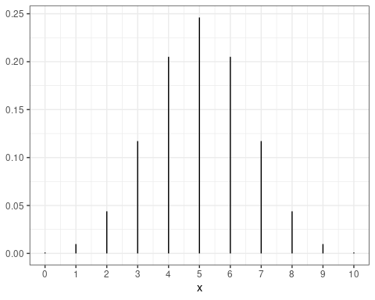
pmf: 10 coin flips

Slide 50
CDF
The pmf gives us all of the information we need to calculate probabilities, but what if we need to calculate $P\left(3≤X≤7\right)$?
Need $p\left(3\right)+p\left(4\right)+p\left(5\right)+p\left(6\right)+p\left(7\right)$
One convenient tool is the cumulative distribution function (CDF): $F\left(x\right)=P\left(X≤x\right)$
The above is then $F\left(7\right)−F\left(2\right)$
How would we get the median?

Slide 51
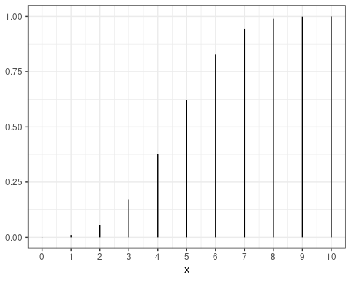
CDF

Slide 52
Expectation
We can also calculate an average of a random variable. We call this the expectation and use the operator E
$μ=E\left[X\right]$
The mean is an average weighted by the probability:
$E\left[X\right]=∑xp\left(x\right)$
We can similarly calculate $var\left(X\right)=E[{\left(X−E\left[X\right]\right)}^{2})$
Expectation is a linear operator, so $E\left[aX+bY\right]=aE\left[X\right]+bE\left[Y\right]$
Also $cov\left(X,Y\right)=E\left[\left(X−E\left[X\right]\right)\left(Y−E\left[Y\right]\right)\right]$

Slide 53
Random Variable Operations
We partly define random variables to introduce the concepts of pmf/CDF and expectation, but mostly we want to do operations on random variables
Let $X_{1}$ be the roll of a 6-sided die, and $X_{2}$ be the roll of a second 6-sided die. What is $X_{1}+X_{2}$?
$Y=X_{1}+X_{2}$ is its own random variable with a pmf, cdf, and expectation
Expectation is easy to calculate. Variance is slightly harder. The pmf is much harder.

Slide 54
Random Variable Addition: Expectation
First, note that $X_{1}$ and $X_{2}$ are identical, so e.g. $E\left[X_{1}\right]=E\left[X_{2}\right]$
We can get $E\left[X_{1}\right]=∑xp\left(x\right)=\frac{1}{6}\left[1+2+3+4+5+6\right]=3.5$
We have calculated this before, the only difference is the syntax
To get $E\left[X_{1}+X_{2}\right]$, use linearity. General formula: $E\left[∑α_{i}X_{i}\right]=∑α_{i}E\left[X_{i}\right]$
So $E\left[X_{1}+X_{2}\right]=E\left[X_{1}\right]+E\left[X_{2}\right]=2E\left[X_{1}\right]=7$

Slide 55
Random variable addition: Variance
For variance, we have $E\left[{\left(X−E\left[X\right]\right)}^{2}\right]$. First we can distribution the inner part, then we apply linearity of expectation:
$E\left[X^{2}−2XE\left[X\right]+E{\left[X\right]}^{2}\right]=E\left[X^{2}\right]−E\left[2xE\left[X\right]\right]+E\left[E\left[X^{2}\right]\right]=E\left[X^{2}\right]−2E\left[X\right]E\left[X\right]+E\left[X^{2}\right]=E\left[X^{2}\right]−E{\left[X\right]}^{2}$
This means that $var\left(X+Y\right)≠var\left(X\right)+var\left(Y\right)$
General formula: $var\left(aX+bY\right)=a^{2}var\left(X\right)+b^{2}var\left(Y\right)+2cov\left(X,Y\right)$
If the variables are independent, the last term is 0

Slide 56
Random variable addition: pmf
In general, finding the pmf of the sum of random variables is a difficult problem
It makes use of a convolution
px+y=PX+Y=z=x​z−xPX=x,Y=z−x=x​z−xpxpz−x if independent
Sometimes the CDF is easier to calculate: $P\left(Z≤z\right)=P\left(X+Y≤z\right)$
Conceptually this is easy, but in practice it’ll be hard without some special tricks we’ll introduce later.

