Slide 1
Econ 270 Lecture 6
Sam Gifford

Slide 2
Random Variables
We’ve already learned how to calculate probability and defined events, but sometimes it makes sense to perform operations on an entire distribution
A Random Variable contains all of the information about a probability distribution
Mathematically it just maps events to it’s sample space
For this class, we care more about the operations we can perform on it than it’s definition

Slide 3
Random Variables
Toss a coin 10 times and let the random variable $X$ denote the number of heads that occur
The shorthand $X=5$ denotes the event that 5 heads occurs. $P\left(X=5\right)=\left({10 \atop 5}\right){\left(\frac{1}{2}\right)}^{10}$
We can similarly denote $P\left(X=0\right),P\left(X=10\right),P\left(X≥3\right)$, etc
Generically, we use $P\left(X=x\right)$ to denote the probability of obtaining x coin flips
$P\left(X=x\right)=\left({10 \atop x}\right){\left(\frac{1}{2}\right)}^{10}$

Slide 4
Random Variables: probability mass function
For a discrete random variable we use the shorthand $p\left(x\right)=P\left(X=x\right)$ to denote the probability that an event occurs
When graphed, the pmf is anologous to the empirical histogram
What is $p\left(x\right)$ for a random variable that represents the number of heads in 10 coin flips?

Slide 5
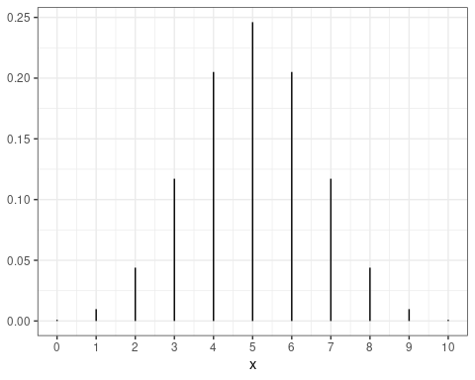
pmf: 10 coin flips

Slide 6
Binomial Distribution
We can fully specify a distribution by giving it’s probability mass function.
The binomial distribution is the distribution of getting x successes from n independent events each with probability p
Coin flipping is a specific case when p=0.5:
$p\left(x\right)=\left({n \atop x}\right)p^{x}{\left(1−p\right)}^{\left(n−x\right)}$
If you’re good at algebra, you can confirm $\sum_{x=0}^{x=n}{p}\left(x\right)=1$

Slide 7
Expectation
We can also calculate an average of a random variable. We call this the expectation and use the operator E
$μ=E\left[X\right]$
The mean is an average weighted by the probability:
EX=x​xpx
We can similarly calculate $var\left(X\right)=E[{\left(X−E\left[X\right]\right)}^{2})$
=x​x−μ2px

Slide 8
Expectation Example
Let X be a binomial variable with n=3, p=.5 ($X∼Binom\left(3,0.5\right)$)
This is the number of heads in 3 tosses of a coin
Calculate $E\left[X\right]$

Slide 9
Random Variable Operations
We partly define random variables to introduce the concepts of pmf and expectation, but mostly we want to do operations on random variables
Let $X_{1}$ be the toss of a fair coin, and $X_{2}$ be the toss of a second fair coin. What is $X_{1}+X_{2}$?
$Y=X_{1}+X_{2}$ is its own random variable with a pmf and expectation
Expectation is easy to calculate. Variance is slightly harder. The pmf is much harder.

Slide 10
Expectation Example
Let X be a censored Poisson random variable defined by the following pmf:
$p\left(0\right)=.36,p\left(1\right)=.36,p\left(2\right)=.18,p\left(3\right)=.06,p\left(4\right)=.04$
Calculate E[X]
Let $Y={\left(X−2\right)}^{2}+5$. Calculate $E\left[Y\right]$

Slide 11
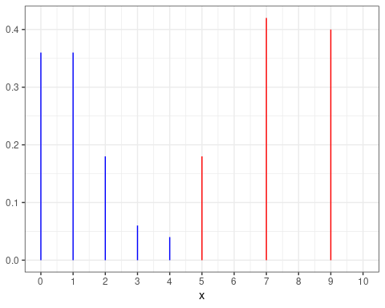
Expectation Example: pmf

Slide 12
The Bernoulli Random Variable
First, let’s define $X_{1}$ as the success of an event with probability p
$X=1$ if there is a success, $X=0$ otherwise
What is $p\left(x\right)$?
What is $E\left[X\right]$?

Slide 13
Random Variable Addition: Expectation
First, note that $X_{1}$ and $X_{2}$ are identical, so e.g. $E\left[X_{1}\right]=E\left[X_{2}\right]$
To get $E\left[X_{1}+X_{2}\right]$, use linearity. General formula: $E\left[∑α_{i}X_{i}\right]=∑α_{i}E\left[X_{i}\right]$
$E\left[X_{1}+X_{2}\right]=E\left[X_{1}\right]+E\left[X_{2}\right]$

Slide 14
Random Variable Addition: Example
Let X be a binomial variable with n=10, p=.5 ($X∼Binom\left(10,0.5\right)$)
This is the number of heads in 10 tosses of a coin
Calculate $E\left[X\right]$

Slide 15
Random Variable Addition: Example
In Dungeons and Dragons, the damage of the spell meteor swarm is calculated by rolling 20 6-sided dice and adding up all of the values.
Calculate the average damage dealt by meteor swarm

Slide 16
Random variable Variance
For variance, we have $E\left[{\left(X−E\left[X\right]\right)}^{2}\right]$. First we can distribution the inner part, then we apply linearity of expectation:
$var\left(X\right)=E\left[X^{2}\right]−E{\left[X\right]}^{2}$
This means that $var\left(X+Y\right)≠var\left(X\right)+var\left(Y\right)$
General formula: $var\left(aX+bY\right)=a^{2}var\left(X\right)+b^{2}var\left(Y\right)+2cov\left(X,Y\right)$
If the variables are independent, the last term is 0

Slide 17
Bernoulli Variance
Let X be a Bernoulli random variable with probability p
Calculate var(X)

Slide 18
Binomial Variance
Let X be a binomial variable with n=3, p=.5 ($X∼Binom\left(3,0.5\right)$)
Calculate $var\left(x\right)$

Slide 19
Variance example
What is the variance of X, where X represents the roll of a fair 6-sided die?
What is the standard deviation of meteor swarm?

Slide 20
Variance example
Suppose that your total grade is the sum of your quiz scores and an exam score
Aggregate quiz scores have variance of 340 while exam scores have variance of 3100
The correlation between quiz and exam scores is .4
Calculate the variance of total grade

Slide 21
Variance Example
Your quiz subtotal is made up of 4 quizzes, each having variance of 30
The variance of your aggregate quiz score is 340
The pairwise correlation between all quizzes is identical
What is the correlation between quizzes (e.g. $cor\left(quiz1,quiz2\right)$)?

Slide 22
Summary of Expectation rules
General formula: EX=μX=x​xpx
Linearity: $E\left[aX+bY\right]=aE\left[X\right]+bE\left[Y\right]$
Variance: $var\left(x\right)=σ_{X}^{2}=E\left[X^{2}\right]−E{\left[X\right]}^{2}$
Variance Linear Combinations: $var\left(aX+bY\right)=a^{2}var\left(X\right)+b^{2}var\left(Y\right)+2ab cov\left(X,Y\right)$
$cov\left(X,Y\right)=σ_{XY}=E\left[XY\right]−E\left[X\right]E\left[Y\right]$
If Independent, $cov\left(X,Y\right)=0$
$ρ_{xy}=\frac{cov\left(X,Y\right)}{σ_{x}σ_{y}}$

Slide 23
CDF
The pmf gives us all of the information we need to calculate probabilities, but what if we need to calculate $P\left(3≤X≤7\right)$?
Need $p\left(3\right)+p\left(4\right)+p\left(5\right)+p\left(6\right)+p\left(7\right)$
One convenient tool is the cumulative distribution function (CDF): $F\left(x\right)=P\left(X≤x\right)$
The above is then $F\left(7\right)−F\left(2\right)$

Slide 24
Uniform CDF
The continuous uniform distribution has CDF $F\left(X\right)=x,0≤x≤1$
Calculate $P\left(.3≤x≤.7\right)$

Slide 25
CDF
The geometric distribution gives us the time until the first success for an event with independent draws of probability p
The geometric distribution has CDF $P\left(X≤x\right)=1−{\left(1−p\right)}^{x},x≥1$
How would we get the median?

Slide 26
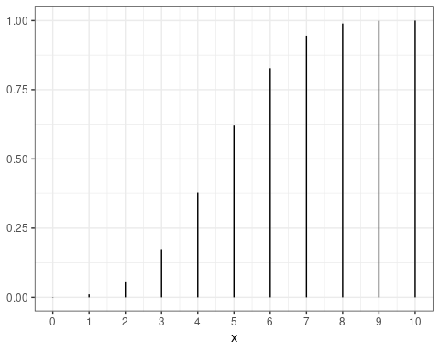
CDF

Slide 27
Continuous random variables
We previously had a uniform distribution defined by $F\left(x\right)=x,0≤x≤1$
Calculate $P\left(0.499≤x≤0.501\right)$
What is $P\left(X=0.5\right)$?

Slide 28
Continuous Random Variables
The uniform distribution is tricker than it appears. We can calculate $P\left(X=x\right)=F\left(x\right)−F\left(x^{−}\right)=0$ for every possible value of x
There is 0 probability that any event happens. We say that this almost certaintly does not happen. A probability of 0 does not mean impossible!
The trick is that there are an uncountably infinite number of points between 0 and 1, each of which is equally likely.

Slide 29
Continuous Random Variables
We need calculus to add these up
$F\left(x\right)=\int_{−∞}^{x}{f}\left(y\right)dy$ rather than $F\left(x\right)=\sum_{k=−∞}^{x}{p}\left(k\right)$
We call $f\left(x\right)$ the probability density function rather than the probability mass function
The values integrate to 1 rather than add to 1
These are not probabilities! They are likelihoods. They only give relative probabilities of occurring.

Slide 30
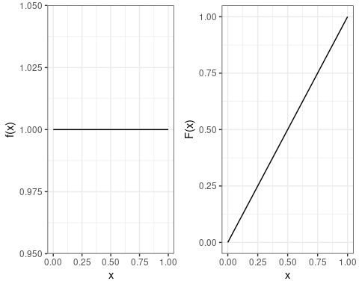
Continuous Random Variables: Uniform Graph

Slide 31
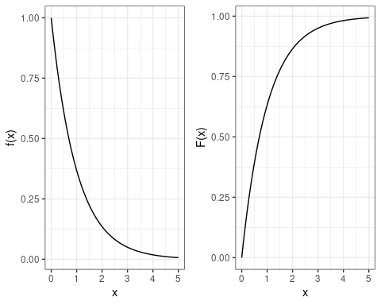
Continuous Random Variables: Exponential Graph

Slide 32
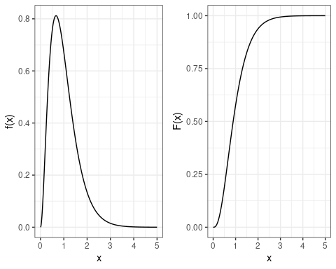
Continuous Random Variables: Gamma Graph

Slide 33
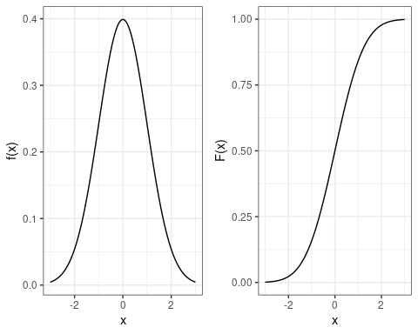
Continuous Random Variables: Normal Graph

Slide 34
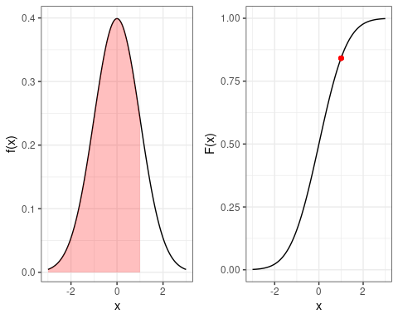
Normal Probability

Slide 35
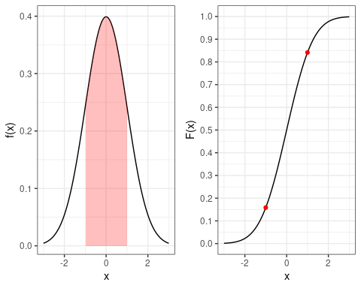
Normal Probability

Slide 36
The (standard) normal distribution
The standard normal distribution has a distinct bell shape
For now the formula just comes out of left field:
$f\left(x\right)=\frac{1}{\sqrt{2π}}e^{−\frac{x^{2}}{2}}$
Some neat integration tricks confirms $\int_{−∞}^{∞}{f}\left(x\right)dx=1$
$F\left(x\right)=\int_{−∞}^{x}{f}\left(x\right)dx=Φ\left(x\right)$
No closed form solution. We look up the values in a table or using software.
$μ=0$ and $σ^{2}=1$

Slide 37
Calculating Standard Normal Probabilities
$P\left(−0.5≤x≤1\right)$
x F(x) x F(x) 1: -3.0 0.00 0.0 0.50 2: -2.5 0.01 0.5 0.69 3: -2.0 0.02 1.0 0.84 4: -1.5 0.07 1.5 0.93 5: -1.0 0.16 2.0 0.98 6: -0.5 0.31 2.5 0.99 7: 0.0 0.50 3.0 1.00

Slide 38
Calculating Standard Normal Probabilities
$P\left(−.25≤x≤1.25\right)$
x F(x) x F(x) 1: 0.00 0.50 1.00 0.84 2: 0.25 0.60 1.25 0.89 3: 0.50 0.69 1.50 0.93 4: 0.75 0.77 1.75 0.96 5: 1.00 0.84 2.00 0.98

Slide 39
Quantiles
What is the 99th percentile of a standard normal distribution?
x F(x) x F(x) 1: 2.0 0.977 2.5 0.994 2: 2.1 0.982 2.6 0.995 3: 2.2 0.986 2.7 0.997 4: 2.3 0.989 2.8 0.997 5: 2.4 0.992 2.9 0.998 6: 2.5 0.994 3.0 0.999

Slide 40
The Normal Family
In general, we can refer to a normal distribution with mean $μ$ and standard deviation $σ$
$X∼N\left(μ,σ\right)$
The normal distribution has an important property: if $X∼N\left(μ,σ\right)$ and $Z=\frac{X−μ}{σ}$, then $Z∼N\left(0,1\right)$
The normal distribution is the only finite-variance distribution with this property!
This means that we only need the standard normal CDF
If we calculate the z-score of a normal random variable, we will have a standard normal distribution

Slide 41
Normal Calculations
The height for males (in inches) in the US is approximately normally distributed with mean 69 and standard deviation 3
Calculate the probability that a randomly selected male is between 66 and 72 inches (5’6” and 6’)

Slide 42
Normal Approximation
The normal distribution was independently discovered several times
If $X$ is a Poisson random variable with mean $λ$, as $λ→∞$, $X→N\left(λ,\sqrt{λ}\right)$
If $X∼Binom\left(n,p\right)$, $X→N\left(μ_{X},σ_{X}^{2}\right)$ as $n→∞$
If $X∼Gamma\left(α,λ\right)$ $X→N\left(\frac{α}{λ},\frac{\sqrt{α}}{λ}\right)$ as $r→∞$
If $X$ is any finite variance distribution, and $X_{i}$ represents independent samples from X, then $\overset{‾}{X}∼N\left(μ_{x},\frac{σ_{x}}{\sqrt{n}}\right)$ as $n→∞$

Slide 43
Normal Approximation
Approximately normal distributions arise fairly frequently in nature, and their probabilities are easier to calculate than most other types of distributions
We only need to know $μ$ and $σ^{2}$ to generate probabilities using a normal random variable
Suppose we flip a fair coin independently 1024 times. What is the probability that the we obtain between 480 and 544 heads?

Slide 44
Normal approximation
Suppose we flip a fair coin independently 1024 times. What is the probability that the we obtain between 480 and 544 heads?
x F(x) x F(x) 1: -3.0 0.00 0.0 0.50 2: -2.5 0.01 0.5 0.69 3: -2.0 0.02 1.0 0.84 4: -1.5 0.07 1.5 0.93 5: -1.0 0.16 2.0 0.98 6: -0.5 0.31 2.5 0.99 7: 0.0 0.50 3.0 1.00

Slide 45
Normal Approximation
Suppose we flip a fair coin independently 1024 times
We become suspicious that the coin is biased if there is a less than 1 percent chance of observing at least as many heads as are obtained
Calculate the fewest number of heads we would need to observe to become suspicious

Slide 46
Normal approximation
Suppose we flip a fair coin independently 1024 times. What is the 99th percentile of heads we obtain?
p x:p=F(x) 1: 0.900 1.282 2: 0.950 1.645 3: 0.975 1.960 4: 0.990 2.326 5: 0.995 2.576

Slide 47
Normal approximation
Suppose we aren’t concerned specifically that the coin is biased towards heads, but that the coin could be biased towards either heads or tails
We become suspicious that the coin is biased if we observe a result outside of the middle 99 percent
How many heads or tails would we need to observe in order to become suspicious that the coin is biased?

Slide 48
Normal approximation
Suppose we flip a fair coin independently 1024 times. How many heads would we need to obtain to become suspicious of the coin?
p x:p=F(x) 1: 0.900 1.282 2: 0.950 1.645 3: 0.975 1.960 4: 0.990 2.326 5: 0.995 2.576

Slide 49
A note on hypothesis testing
Here we become suspicious of the coin if the conditional probability of obtaining a result this extreme is under 1 percent given that the coin is fair
A coin that is slightly biased may appear to be fair
What is the probability that we are not suspicious of a biased coin that has $p=.51$?
This is a false negative

Slide 50
Calculating false negative for p=.51
If our coin is biased with p=.51, we want to know the probability that we obtain at least 553 heads or less than 470 heads
$μ=.51*1024=522,σ=\sqrt{1024*.51*.49}=16$
$z_{1}=−3.25,z_{2}=1.9375$
$Φ\left(−3.25\right)+\left(1−Φ\left(1.9375\right)\right)=2.7\%$
We are very unlikely to suspect that this coin is biased!

Slide 51
A note on hypothesis testing
Similarly, a coin that is truly unbiased will occasionally be suspicious
This is a false positive
We designed the probability of a false positive (conditional on a fair coin) to be 1%
To calculate the probability of making an error, we need additional information

Slide 52
A note on hypothesis testing
Suppose that there is a 50% chance that the coin is fair, and a 50% chance that the coin is biased with p=.51
What is the probability that we misclassify the coin?
suspicious of fair coin: $.01*.5=.005$
not suspicous of biased coin: $.973*.5=.4865$
Probability of misclassification: $.005+.4865=.4915$

