Slide 1
Econ 270 Lecture 8
Sam Gifford

Slide 2
A recap
The first section introduced basic probability, which then led into basic statistical inference
We defined a sampling distribution, and distinguished it from the population distribution and a sample distribution
We used the characteristics of the sampling distribution to compute confidence intervals, which give us a level of precision around statistical estimates

Slide 3
Where we’re headed
We want to perform various types of hypothesis tests
Are financial markets efficient?
Does welfare reduce employment?
Do harsh criminal sentences reduce crime?
Do firms increase green energy investments in response to subsidies?
Do cats respond to cat music?

Slide 4
Hypothesis Testing Roadmap
Hypothesis testing for proportions (5.3, 6.1)
Differences in proportions (6.2)
Goodness of Fit (6.3)
t-distribution (7.1,7.2)
ANOVA (7.4)

Slide 5
General theme with hypothesis testing
Calculate the standard error
$\sqrt{\frac{\hat{p}\left(1−\hat{p}\right)}{n}}$
Calculate a test statistic
$\frac{\hat{p}−p_{0}}{σ_{\hat{p}}}$
Look up the value in a table
Here a normal table
Depending on what we’re testing, these all change a bit

Slide 6
General theme with hypothesis testing
Our base case is the null hypothesis, $H_{0}$
we either reject $H_{0}$ (if $p<α$) or fail to reject $H_{0}$
we make a type I error if we incorrectly reject $H_{0}$, and a type II error if we incorrectly fail to reject $H_{0}$

Slide 7
Confidence Interval Refresher
We randomly survey 100 UIC students and find that 60 are female. Calculate a 95% confidence interval for the proportion of students who are female at UIC
p x:p=F(x) 1: 0.900 1.282 2: 0.950 1.645 3: 0.975 1.960 4: 0.990 2.326 5: 0.995 2.576

Slide 8
Transitioning to Hypothesis Testing
Is this result consistent with the hypothesis that half of UIC students being female?
Calculate the probability that a sample of 100 students would contain at least 60 women given that the true proportion is 0.5.

Slide 9
A basic Z Table
x F(x) x F(x) 1: -3.0 0.00 0.0 0.50 2: -2.5 0.01 0.5 0.69 3: -2.0 0.02 1.0 0.84 4: -1.5 0.07 1.5 0.93 5: -1.0 0.16 2.0 0.98 6: -0.5 0.31 2.5 0.99 7: 0.0 0.50 3.0 1.00

Slide 10
Two tailed
Suppose that we don’t know whether to expect more or less than half of students to be female. Calculate the probability that $\left|p−\hat{p}\right|>0.1$ in a sample of 100 given $p=.5$

Slide 11
Wald-test vs NHST
Compare the answers to the confidence-interval approach and the two-tailed approach
When we reject the null hypothesis, we’re saying that the results are inconsistent with our hypothesis. The proportion of women is not exactly 0.5 (but it could be close to 0.5)
When we fail to reject the null hypothesis, we’re saying the results are consistent with our hypothesis. The range of reasonable values for $\hat{p}$ includes 0.5
If our confidence interval is wide, this may also be consistent with, say, $\hat{p}=0.7$ or even $\hat{p}=0.99$

Slide 12
Conceptual Question
You are testing whether a coin is fair. You fail to reject the null hypothesis with $σ_{\hat{p}}=0.001$. You conclude:
A The coin is fair
B The coin is not fair
C The coin is very likely fair
D The coin is either fair, or very close to fair
E The coin is not fair, but the degree of bias is small

Slide 13
General Hypothesis Steps for Proportions
Write $H_{0}$ and $H_{1}$
Calculate standard error $σ_{\hat{p}}=\sqrt{\frac{\hat{p}\left(1−\hat{p}\right)}{n}}$
This is the Wald approach. Can also calculate using $p_{0}$ instead of $\hat{p}$
Calculate test statistic: $z=\frac{\hat{p}−p_{0}}{σ_{\hat{p}}}$
Calculate p-value (2 tailed): $1−\left[Φ\left(z\right)−Φ\left(−z\right)\right]$
Compare $p$ to $α$
Make conclusion

Slide 14
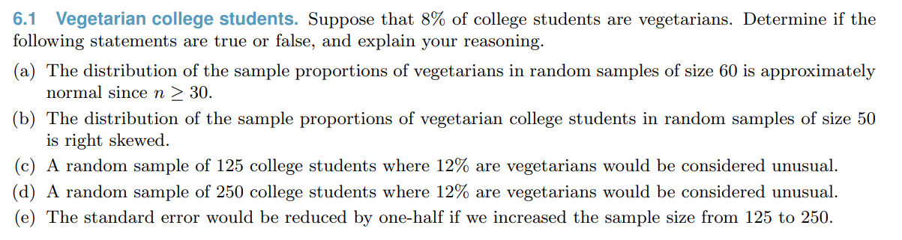
Book Question

Slide 15
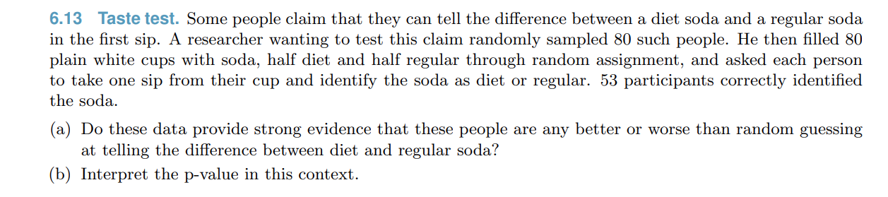
Book Question

Slide 16
A note on power
The probability of of correctly rejecting a null hypothesis is called power (labeled $β$, the complement of the type II error rate)
This differs by ‘effect size’ (the distance from our null hypothesis)
If our null is that $p=.5$, it would be very easy to reject if $p=.99$, but very hard if $p=.501$

Slide 17
Power Calculation
Our null hypothesis is $p_{0}=0.5$. We sample with $n=100$ individuals. Calculate the probability that we reject the null hypothesis if the true proportion is $p=0.6$ (using a two-tailed test)

Slide 18
Power Curve
We can calculate the probability of rejecting the null when $p=0.55$, $p=0.6$ ,$p=0.99$, etc.
We can graph all of these, yielding a power curve

Slide 19
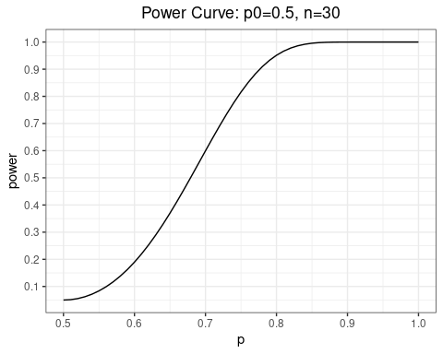
Power Curve (n=30)

Slide 20
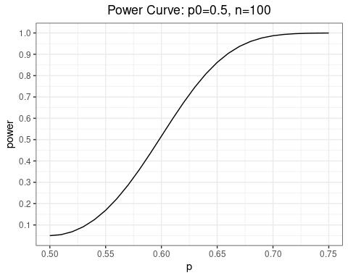
Power Curve (bigger sample)

Slide 21
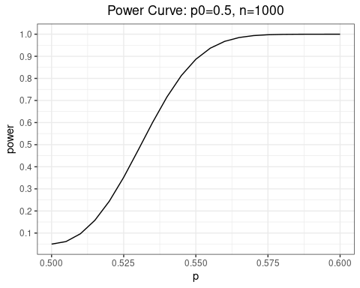
Power Curve: bigger sample

Slide 22
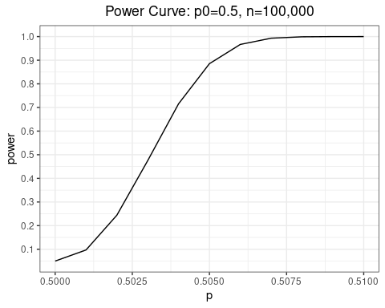
Power Curve: Diaconis

Slide 23
Calculating Sample Size
When designing experiments, we sometimes get to choose the sample size. Larger samples are more expensive, so we want to use the smallest sample that will still give us power to achieve the results we want.

Slide 24
Calculating Sample Size
You’re studying the effect of obtaining a bachelor’s degree on future earnings. You want to be able to detect at least a 1% effect size, which in this case is $400. Earnings have a mean of $40,000 with a standard deviation of $10,000. Calculate the minimum sample size you need to be able to detect this effect with at least 95% power. Assume the standard error is identical for both distributions.

Slide 25
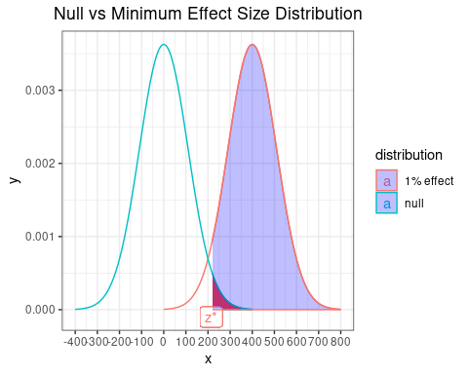
Sample Size Diagram

Slide 26
Brief summary on power
Similar to type I and type II errors, we can summarize conclusions with respect to power:
Reject $H_{0}$ with low power: large but imprecise effect
Reject $H_{0}$ with high power: precise effect, may not be of practical significance
Fail to reject $H_{0}$ with low power: imprecise null. Very little can be concluded.
Fail to reject $H_{0}$ with high power: precise null. We can rule out even modest effects.

Slide 27
Differences in Proportions
Suppose we want to make a comparison across populations involving a proportion. Say we’re comparing the proportion correct of multiple choice answers for male and female students.
We want to test the null hypothesis that $p_{1}=p_{2}$
How would we go about this?

Slide 28
Differences in Proportions
Before, $\hat{p}∼N\left(p,σ_{\hat{p}}\right)$ - the sampling distribution was approximately normal by the central limit theorem with standard deviation equal to the standard error
Now we need the distribution of ${\hat{p}}_{1}−{\hat{p}}_{2}$, which we compare against 0
How do we find the distribution of ${\hat{p}}_{1}−{\hat{p}}_{2}$?

Slide 29
Differences in Proportions: Standard Errors
${\hat{p}}_{1}∼N\left(p_{1},σ_{{\hat{p}}_{1}}\right)$, ${\hat{p}}_{2}∼N\left(p_{2},σ_{{\hat{p}}_{2}}\right)$
A linear combination of normal random variables is normal
$var\left(X−Y\right)=var\left(X\right)+var\left(Y\right)$ for independent random variables
${\hat{p}}_{1}−{\hat{p}}_{2}∼N\left(p_{1}−p_{2},\sqrt{σ_{{\hat{p}}_{1}}^{2}+σ_{{\hat{p}}_{2}}^{2}}\right)$

Slide 30
Difference in Proportion: Standard Errors
Directly substituting in values, the difference in proportions is normal with mean ${\hat{p}}_{1}−{\hat{p}}_{2}$ and standard error equal to:
$SE=\sqrt{\frac{{\hat{p}}_{1}\left(1−{\hat{p}}_{1}\right)}{n_{1}}+\frac{{\hat{p}}_{2}\left(1−{\hat{p}}_{2}\right)}{n_{2}}}$
It’s just two copies of our formula glued together

Slide 31
Difference in Proportions: Example
Your class has 30 female and 20 male students. Female students correctly answered 80% of the multiple choice questions, while male students correctly answered 70%. Do you have evidence to suggest that male and female students are different? Use $α=.05$

Slide 32
Example
Marketing has presented you with two advertisements and want you to choose between them. You run a pilot where you show the advertisements to a test group and see what percentage react favorably. A group of 100 individuals are shown each advertisement. 40 percent of participants respond favorably for advertisement 1 compared to 55 percent for advertisement 2. Calculate a 95% confidence interval for the difference in favorability of the advertisements.

Slide 33
General one-sample means
When testing single proportions, we used the point value of $\hat{p}$ and calculated the standard error as $\sqrt{\frac{\hat{p}\left(1−\hat{p}\right)}{n}}$.
In general, we can calculate our point estimate as $\overset{‾}{x}$ and calculate a standard error as $\frac{s}{\sqrt{n}}$
If our sample size is large, everything else remains identical

Slide 34
Example
Your average teaching evaluation is 4.474 with a standard deviation of 0.080. You want to know the typical range of evaluations you might receive the following semester. Calculate a 95% confidence interval.
What assumptions are required for this to be a reasonable method?

Slide 35
The t-distribution
If x is a normal random variable, then $\frac{x−μ}{σ\sqrt{n}}$ is also normally distributed
But if we don’t know $σ$, then we instead estimate $s$ from the data - it’s a random variable
It turns out that $\frac{x−\overset{‾}{x}}{s\sqrt{n}}$ is only asymptotically normal
s follows a chi-square distribution (we’ll cover later)
This transformation yields something called a t-distribution

Slide 36
The t-distribution
When we estimate s from the data, our standardized value $\frac{\overset{‾}{x}−μ_{0}}{s\sqrt{n}}∼t\left(ν=n−1\right)$
This is a t-distribution with $ν=n−1$ degrees of freedom
We look up the values in a t-table. There is a separate table for each degree of freedom

Slide 37
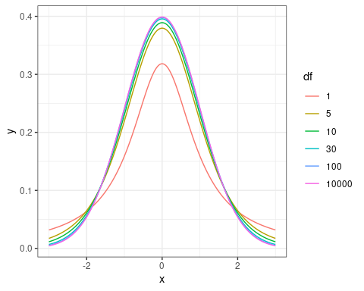
T distribution Graph

Slide 38
Basic T-table
p df=5 df=10 df=30 z 1: 0.900 1.372 1.341 1.310 1.282 2: 0.950 1.812 1.753 1.697 1.645 3: 0.975 2.228 2.131 2.042 1.960 4: 0.990 2.764 2.602 2.457 2.326 5: 0.995 3.169 2.947 2.750 2.576

Slide 39
When we use a t-distribution
As $n→∞$, the t-distribution approaches a normal distribution. If our sample size is above around 100 we can just use a normal distribution
For smaller values of n, we use a t-distribution instead. In addition to independent, identically distributed samples, we also require that the underlying distribution is normally distributed
In practice we’ll use the t-distribution for small samples even if this is violated since it’s still a better estimate than the normal distribution

Slide 40
Differences in Means
The most common application for a t-test is assessing whether the mean of two groups is different
To calculate the standard error, we use the same trick as before:
$σ_{x_{1}−x_{2}}=\sqrt{\frac{s_{1}^{2}}{n_{1}}+\frac{s_{2}^{2}}{n_{2}}}$
degrees of freedom is $n_{1}+n_{2}−2$ if the variances of the two groups are equal
If not you need software to calculate. Just use $n_{1}+n_{2}−2$

Slide 41
Example
You randomly assign patients to either receive blood pressure medication or a placebo with each group having 11 individuals. The placebo group ends up with a mean systolic blood pressure of 135 mm Hg with standard deviation of 8, while the treatment group has a mean blood pressure of 130 mm Hg with a standard deviation of 10. Can we conclude that the medication reduces blood pressure?

Slide 42
Paired t-test
You assign 11 individuals to a blood pressure medication, and measure their blood pressure before and after treatment. Before treatment they had mean 135 with standard deviation 8. Afterwards they had mean 125 with standard deviation 10. The difference between the two has mean -10 with standard deviation of 4. Was there a statistically significant drop in blood pressure?

Slide 43
Some accounting
In the previous example, the before group had sd of 8, the after group had sd of 10, and the difference had sd of 4. How?
A This is a flawed example - the numbers don’t match reality
B Before and After are negatively correlated. This implies treatment effects depend on initial blood pressure level
C Before and After are positively correlated. Since the individual is the same, relative results will tend to be close together.
D We’re using within-individual variation instead of across-individual variation, which is generally much smaller

Slide 44
Cross-sectional vs paired differences
A paired t-test only uses within-individual variation, which is often much lower than across-individual variation. As a result, standard errors are usually lower
We have the same number of observations, but we also have additional information linking the two datasets. This additional information gives us more precision in our estimate

Slide 45
Chi-Square
So far we’ve tested for differences in means among two groups
While this is powerful, occasionally we’ll have many different groups that we want to compare
One common way this arises is testing if data comes from a specific distribution

Slide 46
Motivating Example
You buy a bag of Laffy Taffy Fruit Combos. It contains four flavor combinations: Strawberry-Kiwi, Mango-Passionfruit, Wildberry-Banana, and Strawberry-Orange
You want to know if the the flavor combinations are uniformly distributed
In a package of 16, you obtain 7, 2, 3, and 4 of the flavors above, respectively
How can we go about answering this question?

Slide 47
Combining Results
If we were just testing if strawberry-kiwi were different from 25%, we would calculate the standardized value of the difference: $z_{1}=\frac{\frac{7}{16}−\frac{4}{16}}{SE}$
We can calculate the same for each of the three other categories to get $z_{2},z_{3}$, and $z_{4}$
We then combine them in a smart way: $z_{1}^{2}+z_{2}^{2}+z_{3}^{2}+z_{4}^{2}$

Slide 48
Introducing the Chi-Square Distribution
Our null hypothesis is that 25% of the candy falls in each category. On average we’d expect 4 of each
We can calculate the deviance from this distribution: the sum of the squared differences between expected and observed results
If we assume that individual deviations are normally distributed, then our total deviance is the sum of 4 squared normal distributions: $χ^{2}=\sum_{i=1}^{4}{Z_{i}^{2}}$
This is a chi-square distribution with 3 degrees of freedom

Slide 49
Chi-Square Test Statistic
Our standard errors need to be modified slightly when dealing with multiple comparisons. The actual test statistic ends up as the following:
$χ^{2}=\sum_{i=1}^{k}{\frac{{\left(Observed_{i}−Expected_{i}\right)}^{2}}{Expected_{i}}}$a
This follows a $χ^{2}$ distribution with $k−1$ degrees of freedom

Slide 50
Looking up a p-value with chi-square
Good news: the chi-square distribution only takes on non-negative values (why?)
There’s only ever 1 tail in the test
For a p-value, always take $1−F\left(χ^{2}\right)$ where $F\left(χ^{2}\right)$ is the corresponding value in the table

Slide 51
Basic chi-square table
p df=2 df=3 df=4 df=5 1: 0.900 4.605 6.251 7.779 9.236 2: 0.950 5.991 7.815 9.488 11.070 3: 0.975 7.378 9.348 11.143 12.833 4: 0.990 9.210 11.345 13.277 15.086 5: 0.995 10.597 12.838 14.860 16.750

Slide 52
Example: distribution
Students walk by a classroom at a rate of 2 students/minute. You want to test whether this follows a Poisson process. A poisson random variable has the following pmf (with number of students in each of 60 1 minute intervals labeled as N) :

Slide 53
Example: distribution
x p N 1: 0 0.14 7 2: 1 0.27 15 3: 2 0.27 19 4: 3 0.18 12 5: 4 0.09 6 6: 5+ 0.05 1

Slide 54
Testing Independence
Suppose we’re interested in knowing whether there’s a relationship between pet ownership and major. You are given the following contingency table. How can we test for independence?
math econ art total dog 10 5 15 30 cat 10 12 5 27 bunny 0 3 0 3 total 20 20 20 60

Slide 55
The F-test (ANOVA)
Chi-square can be thought of as the multivariate version of a difference-in-proportions test
We can do the same analog for a differences-in-means test among many variables
Our null hypothesis will be that $μ_{1}=μ_{2}=...=μ_{n}$

Slide 56
F-test intuition
If our groups are identical, then our within-group variance and our across-group variance will differ only by sample size
$\frac{MSG}{MSE}=1$
Calculate the ratio of within- to across- variance
A higher across-group variance implies differences between groups’
The ratio of normal distributions is an F-distribution - look up in a table

Slide 57
F-test statistic
$F=\frac{MSG}{MSE}$
$MSG=\frac{1}{k−1}\sum_{i=1}^{k}{n_{i}}{\left({\overset{‾}{x}}_{i}−\overset{‾}{x}\right)}^{2}$
$MSE=\frac{1}{n−k}\left[\left(n_{1}−1\right)s_{1}^{2}+\left(n_{2}−1\right)s_{2}^{2}+...+\left(n_{k}−1\right)s_{k}^{2}\right]$
Ew. We just let software calculate this for us

Slide 58
The F-distribution
The F-distribution has 2 degrees of freedom (yay)
The numerator degrees of freedom is $k−1$, where k is the number of groups
The denominator degrees of freedom is $n−k$, where n is the sample size

Slide 59
F-test assumptions
iid sample, as always
The f distribution is the ratio of two normal distributions. Thus, we require normality
Homoskedasticity (constant variance). We’re testing for differences by using a variance decomposition. Thus we need variance to be constant across groups (even if means aren’t!)

Slide 60
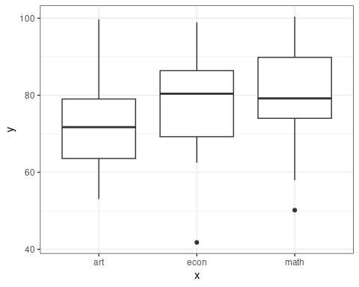
Example

Slide 61
Example
major mean_score variance n 1: art 72.1 147.5 20 2: econ 77.9 187.7 20 3: math 79.9 170.8 20 4: total 76.6 174.1 60

Slide 62
Example
Df Sum Sq Mean Sq F value Pr(>F) x 2 658 329.0 1.951 0.152 Residuals 57 9614 168.7

Slide 63
Candy!
Bag1 Bag2 Bag3 Tot SK 7 4 7 18 MP 2 6 6 14 WB 3 2 4 9 SO 4 5 1 10 Tot 16 17 18 51

