Slide 1
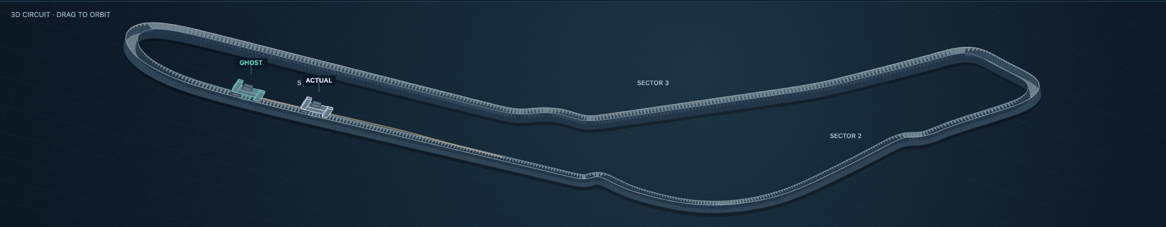
TRACKSHIFT 2026 · TYRE DEGRADATION INTELLIGENCE
Orb v1
Clean tyre curves from Friday. A live pit call on Sunday. An honest audit after the flag.
Friday lies twice. We correct the lie you can measure and learn the one you cannot.
Samuel Christ · A Vydehi · IIT Madras
Team Orb v1 · TrackShift 2026, Plaksha University, 12 to 13 September 2026
Idea-round entry: ClearStint. Disclosed pre-work: the estimator and a six-weekend validation (5 September); the rest was built at Plaksha.
Ghost Strategy, Monza 2026: the recorded car and the changed tyre plan on the same circuit, rendered offline from recorded positions (current build).
Notes:
Orb v1 turns public timing data into three things a strategist uses: a clean tyre-degradation curve from Friday, a live pit call on Sunday that only sees laps already run, and an audit afterwards that replays the race with a different tyre plan. Friday lies twice: about what the tyre did, and about what it will do on Sunday. We correct the first lie and learn the second.

Slide 2
THE PROBLEM
Friday practice is a biased sample of the race
A Friday lap time mixes five things, and only one of them is the tyre
0.285
0.042
7×
+74 s
Hungary 2026 medium, s per lap of tyre age, from a straight line through Friday laps
what the race showed, same estimator on race laps
too high
cost of racing the Friday line against the best plan, Hungary replay
1
The tyre wearing what we want: a little slower every lap of age
2
Fuel burning off 1.1 kg a lap in 2026, worth about 0.033 s a lap, pulling the other way (more before 2026: slide 13)
3
Track evolution rubber goes down and everyone gets faster: 0.6 to 0.8 s per hour at Madrid on Friday
4
Traffic within 60 m of another car the lap is slow for reasons that are not the tyre
5
The driver warming up, learning the circuit, pushing harder or easing off
ORB V1 · TrackShift 2026 · Tyre Degradation Intelligence
2
Notes:
A practice lap time is not a tyre measurement. Hungary 2026, medium: a straight line through Friday laps says 0.285 s per lap of tyre age; the race showed 0.042. A plan built on that line costs +74 s against the best plan in the replay. Five things pollute the lap and only one of them is the tyre. Sources: out/lock.json validation_rows (Hungary MEDIUM), strategy.Hungary.

Slide 3
THE SOLUTION
One engine, three jobs: forecast, call, audit
The same cleaned estimator runs on practice and race laps; every screen reads one locked, hashed file
BEFORE THE RACE
DURING THE RACE
AFTER THE RACE
Forecast
Live call
Audit
Clean every practice lap, refuse weak signal, learn the Friday-to-Sunday ratio, publish a hashed race curve with a band and a pit plan.
→
Update the tyre state every lap from laps already run; rank pit actions by modelled gain, 80% range and probability.
→
Replay the driver’s own race with a different stop on the 3D Race Twin; score every forecast against the race.
Screen: Forecast
Screens: Live Predictor, Decision board
Screens: Ghost Strategy, Validation
64 / 148
483
58,569
6
weekends / compound-weekends scored, 2023 to 2026, each held out
prepared strategy simulations across ten 2026 races
forecast origins the learned model is trained and tested on
whole weekends sealed before tuning, opened once
ORB V1 · TrackShift 2026 · Tyre Degradation Intelligence
3
Notes:
Before the race Orb v1 cleans every practice lap and publishes a hashed race curve with a band and a pit plan. During the race the Live Predictor updates the tyre state lap by lap from laps already run. After the race Ghost Strategy replays the driver's own laps with a different tyre plan and every forecast is scored. Scale: 64 weekends and 148 compound-weekends scored across 2023 to 2026 (out/validation/ghost_scorecard.json), 483 prepared strategy simulations over 10 races (out/counterfactual), 58,569 learned-model forecast origins (out/tyreformer/evaluation.json), and 6 sealed weekends (evaluation/holdout).

Slide 4
THE SCIENCE · 1 OF 3
How a lap is cleaned
The same regression on practice and race, so the Friday-to-Sunday ratio is a property of the data
1
Drop what cannot inform the tyre. pit, yellow and safety-car laps, deleted laps, laps with over 30% of the distance within 60 m of a car, runs under five laps, broken telemetry; every drop listed with its reason
HUNGARY 2026 · MEDIUM · S PER LAP OF AGE
0.285
Straight line through Friday laps
2
Compare each run only to itself. one constant per stint absorbs driver, car, set-up and fuel load (stint fixed effects)
0.122
After cleaning
3
Subtract the fuel effect. a stated prior: 1.1 kg per lap at 0.03 s per kg in 2026; not estimated from practice, where fuel and tyre age move together
0.058
× held-out Sunday ratio 0.47
4
Subtract track evolution. measured per session from every driver’s push laps against session time
0.042
Race, same estimator
5
What is left is the tyre. seconds lost per lap of age, per compound, with a standard error
ORB V1 · TrackShift 2026 · Tyre Degradation Intelligence
4
Notes:
Drop laps that cannot inform the tyre; compare each run only to itself so driver, car and fuel load cancel; subtract the stated fuel effect and the measured evolution; what is left is the tyre. Hungary medium goes from 0.285 to 0.122 cleaned, and to 0.058 after its held-out Sunday ratio 0.47, against 0.042 in the race. Source: out/lock.json validation_rows.

Slide 5
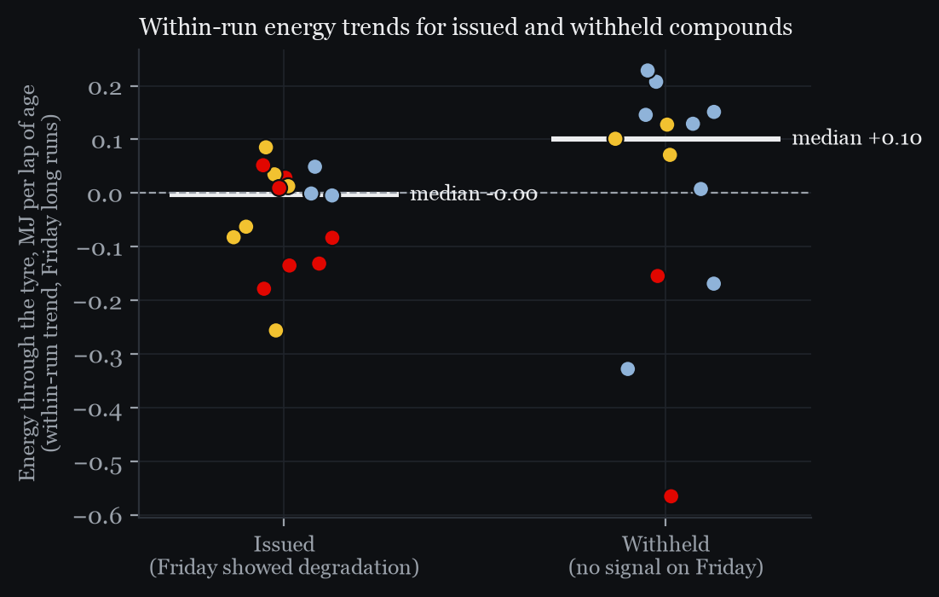
THE SCIENCE · 2 OF 3
The fifth confounder is the driver’s push
Tyre demand per lap from the public 3.7 Hz traces: m × (∫v²κ ds + ∫|dv| v)
+0.10
0.00
MJ per lap of age, median energy trend, withheld compounds
MJ per lap of age, issued compounds
Wrong-way cleaned slopes: 9 of 9 came with rising energy.
Push profile explains about two-thirds of the pooled gap on 16 issued cases; per-case shares vary widely.
Practice and race energy coefficients differ by at most 0.01 s/MJ at Austria and Barcelona.
Diagnostic and second opinion, not the predictor.
ORB V1 · TrackShift 2026 · Tyre Degradation Intelligence
5
Notes:
Some Fridays show a tyre getting faster with age, which wear cannot do. The energy the driver puts through the tyre, computed from public speed and position traces, shows why: where the cleaned Friday slope pointed the wrong way (9 cases) the driver was ramping up in each of them; the 4 falling-trend cases were withheld. The push profile explains about two-thirds of the pooled Friday-to-Sunday gap on the 16 issued cases (per-case shares vary widely). It is a diagnostic and second opinion: easing off can itself be a response to degradation. Source: out/lock.json validation_rows, validation.push_diagnostic.

Slide 6
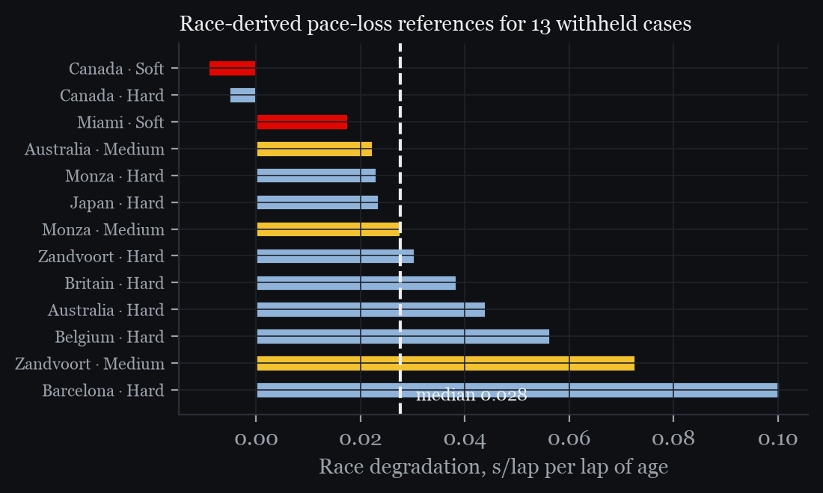
THE SCIENCE · 3 OF 3
Learn the second lie, and refuse honestly
Transfer factors learned leave-one-weekend-out; a withheld curve is still a forecast
SEASON TRANSFER FACTOR · RACE ÷ CLEANED FRIDAY
S
×0.97
M
×0.45
H
not applied
Soft
Medium
Hard
applied only when at least three weekends exist and most sit within ±50% of their median
THE GATE AND THE FALLBACK
Issue a curve only with 30+ clean long-run laps and a cleaned slope above +0.02 s/lap
Otherwise withhold, and forecast the median race degradation of the other withheld cases
Withheld compounds and what the race did
Withheld compounds degraded at a median 0.028 s/lap in the race; 11 of 13 below 0.06; fallback band covered 9 of 13; fallback error 0.023 against 0.106 naive
ORB V1 · TrackShift 2026 · Tyre Degradation Intelligence
6
Notes:
The same estimator runs on race laps, so for every past weekend we know how much Sunday shrank Friday, per compound. For a new weekend the median of the other weekends is applied only when they agree. When Friday has no signal we withhold and forecast low degradation from the other withheld cases: withheld compounds degraded at a median 0.028 s/lap in the race; 11 of 13 below 0.06 s/lap; the fallback band covered 9 of 13. Source: out/lock.json, out/lock_v2.json validation.by_compound.

Slide 7
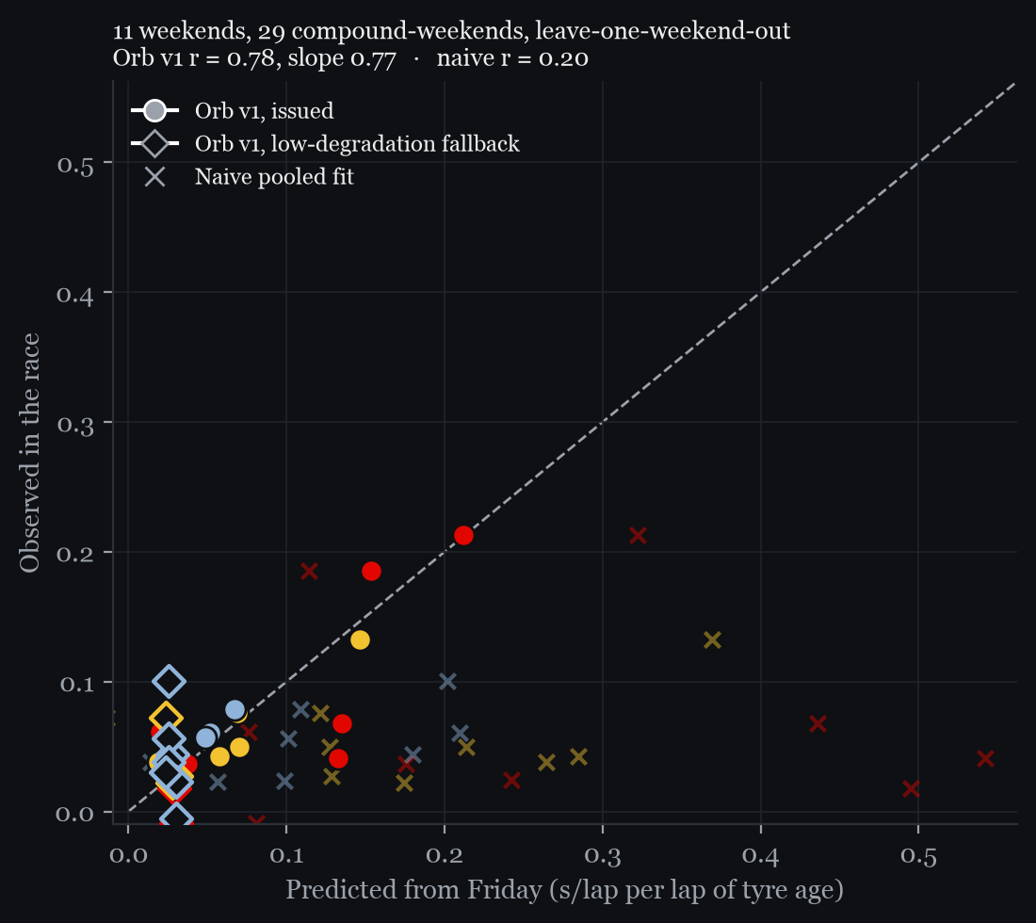
THE PROOF · 2026
11 weekends, 29 compound-weekends, each one held out
Mean absolute error against the race-derived reference, s per lap of tyre age
Predictor | Cases | MAE | Calib. slope | r
Naive straight line | 29 | 0.137 | +0.07 | 0.20
Cleaned Friday curve, issued | 16 | 0.045 | +0.45 | 0.67
Orb v1, issued | 16 | 0.023 | +0.76 | 0.82
Orb v1, every case with fallback | 29 | 0.023 | +0.77 | 0.78
28/29
0.016 to 0.030
11/13
cases where Orb v1 beats the naive line
90% bootstrap interval on the error
withheld cases below 0.06 s/lap in the race
Predicted from Friday against observed in the race: filled = issued, open = fallback, × = naive
ORB V1 · TrackShift 2026 · Tyre Degradation Intelligence
7
Notes:
Source: out/lock_v2.json validation. Each weekend is left out of its own training pool. Naive MAE 0.137 against Orb v1 0.023 s/lap; Orb v1 beats the naive line on 28 of 29; calibration r 0.78 and slope 0.77.

Slide 8
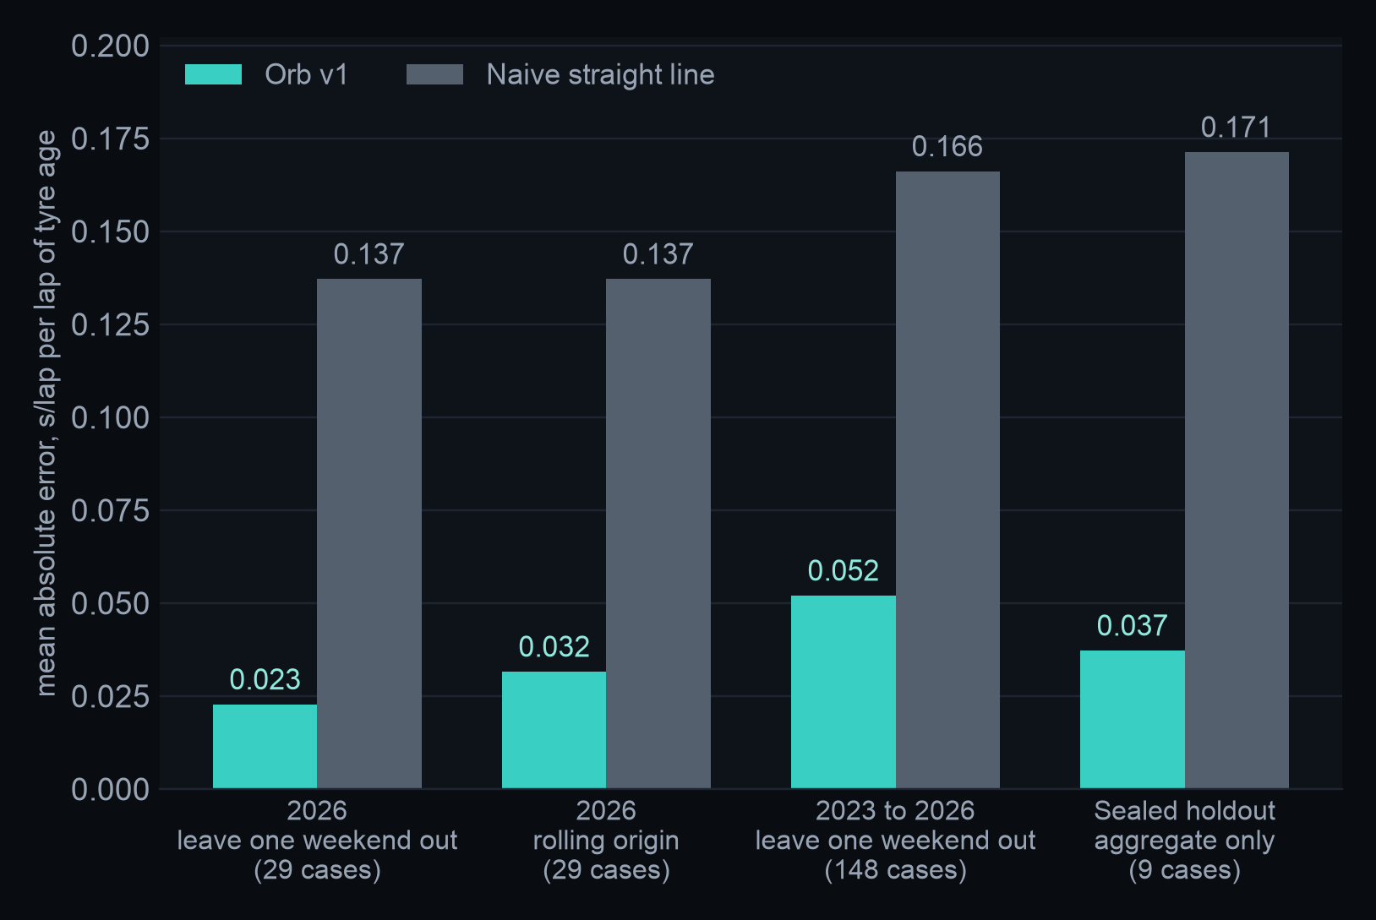
THE PROOF · HARDER TESTS
Four tests, including six sealed weekends
Mean absolute error, s per lap of tyre age; every forecast made without its own race
WHERE IT WEAKENS
Across 2023 to 2025 Friday says less about Sunday: calibration r 0.27 over 148 cases against 0.78 in 2026, and 86% band coverage. Every test still beats the naive line.
WHAT WE DID ABOUT IT
A per-compound constant scores 0.033 across all 148 cases. A learned transfer model (robust regression) reaches 0.030, but on untouched 2026 it scores 0.028 against Orb v1's 0.023. Kept as a second opinion, not adopted.
ORB V1 · TrackShift 2026 · Tyre Degradation Intelligence
8
Notes:
Sources: out/validation/ghost_scorecard.json (by_season 2026, rolling_origin_2026.pooled, development_pool, sealed_holdout.aggregate, labelled "sealed holdout, aggregate only"); out/tyreformer/prerace/PRERACE.md for the learned transfer model. The sealed holdout was scored once after the model freeze: 5 weekends forecast, 1 abstained (too few clean practice laps), 9 compound-weekends. Across 2023 to 2026 the calibration correlation is 0.27 (0.78 in 2026) and band coverage 86%. A per-compound constant, no practice input, scores 0.033 over those 148 cases; the learned transfer model scores 0.030. Trained on 2023 to 2025 and tested on 2026 it scores 0.028 against Orb v1 0.023, so it stays a second opinion. One candidate cause of the weaker 2023 to 2025 figures, not yet tested: the fuel assumptions are 2026 values applied to every season (slide 13).

Slide 9
THE PROOF · ROBUSTNESS
It holds up, and the misses are on the slide
Sensitivity to every stated choice, and two honest results
Variant (2026, 29 cases) | Issued | MAE | r
Baseline (fuel 1.1 kg/lap, 0.03 s/kg, traffic 30%, runs 5+) | 16 | 0.023 | 0.78
Fuel prior 0.9 or 1.3 kg/lap | 14 / 16 | 0.026 / 0.023 | 0.74 / 0.76
Fuel cost 0.025 or 0.035 s/kg | 14 / 16 | 0.025 / 0.023 | 0.75 / 0.78
Traffic threshold 20% or 40% | 15 / 16 | 0.027 / 0.021 | 0.59 / 0.79
Minimum run 4 or 7 laps | 15 / 13 | 0.026 / 0.027 | 0.70 / 0.65
BARCELONA AND AUSTRALIA: THE MISSES
Strategy replay: Barcelona (+55 s against 0 s for naive) and Australia (+25 s against +14 s for naive). At Barcelona our soft prediction ran low and the naive line happened to imply the right plan. Said on stage before anyone asks.
LIQUID NEURAL NETWORK, THE ABLATION
A continuous-time (CfC) cell read each race stint lap by lap, scored on held-out stints. Per-lap inputs cut the age-only error by about a quarter; the continuous-time network on the same inputs beat the best simple baseline in only 9 of 31 cells. Reported, not deployed.
ORB V1 · TrackShift 2026 · Tyre Degradation Intelligence
9
Notes:
The headline barely moves across every stated choice (out/sensitivity.json). The misses: in the strategy replay Barcelona (+55 s against 0 s for naive) and Australia (+25 s against +14 s for naive); and the liquid neural network, which did not beat simple baselines given the same inputs (out/liquid.json). The inputs were the discovery, not the network.

Slide 10
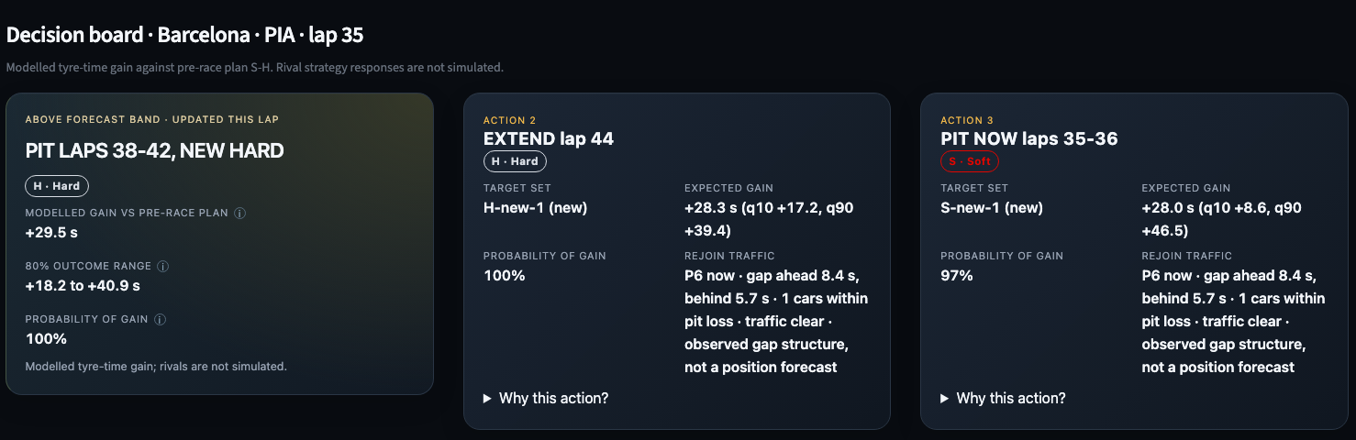
FROM CURVE TO CALL
Curves become decisions: 10 races replayed
Every one- and two-stop plan enumerated and costed under race-derived curves; the live board ranks the same actions lap by lap
Race | Naive plan | Cost | Orb v1 plan | Cost | Best plan
Australia | S-S-M | +14 s | S-M 47/11 | +25 s | S-M
Austria | M-M-H | +60 s | S-M-M 18/26/27 | +26 s | S-M-S
Barcelona | S-H-H | 0 s | S-H 12/54 | +55 s | S-H-H
Belgium | S-S-M | +31 s | M-H 18/26 | +10 s | S-M
Canada | S-H | +75 s | S-S-H 30/32/6 | +30 s | S-H
Hungary | M-H-H | +74 s | S-M-M 16/26/28 | +24 s | S-S-M
Japan | M-H-H | +21 s | M-H 43/10 | +7 s | M-H
Miami | M-H-H | +80 s | S-M 40/17 | +6 s | S-M
Monza | M-H | +47 s | S-M 44/9 | 0 s | S-M
Zandvoort | S-M | +155 s | S-S-M 30/32/10 | +2 s | S-S-H
8 of 10
25%
2026 races where the Orb v1 plan beats the naive plan
of 40 weekends within 5 s of the hindsight best (naive 12%)
LIVE: THE DECISION BOARD, BARCELONA LAP 35
Assumptions on screen: linear curves, no safety car, rivals not simulated; rejoin traffic is the observed gap structure, not a position forecast.
ORB V1 · TrackShift 2026 · Tyre Degradation Intelligence
10
Notes:
A curve only matters as a decision. Replayed on the 10 scored 2026 weekends with the race-derived curves as the reference, Orb v1 beats the naive plan on 8 of the 10; the two misses are Barcelona (+55 s against 0 s for naive) and Australia (+25 s against +14 s for naive) (out/lock.json strategy). Over 40 weekends of 2023 to 2026, in a held-out strategy replay under a post-race reference model (out/validation/ghost_scorecard.json regret), the Orb v1 plan finished within 5 s of the hindsight-best plan on 25% of weekends, against 12% for the naive plan and 14% for the strategy actually run; median regret 20.7 s against 22.9 s naive and 27.6 s for the strategy run. Mean regret equals the default plan's (33.7 against 33.8 s), so the edge is in the typical race, not the worst.

Slide 11
RULE CHANGES AND THE TYRE · 2022 TO 2026
What each rule change since 2022 did to the tyres
Tyres, cars, fuel and sporting rules, season by season; sources in the speaker notes
2022
2023
2024
2025
2026
18-inch tyres, ground-effect cars
New C1, stronger fronts
The stable year
Softer range, forced stops
Smaller tyres, lighter cars, less fuel
Rims 13 to 18 inch; diameter 660 to 720 mm
New C1; the old C1 became C0
Same compounds, C0 dropped: C1 to C5
New C6, the softest; aim of 0.5 s between compounds
Tyres 25 mm narrower front, 30 mm rear; C6 dropped
Blankets capped at 70 °C (was 100 °C front)
Stronger front construction
Blanket ban postponed; blankets kept
Monaco: two compounds and two stops
768 kg; downforce -30%, drag -55% (FIA targets)
Following car loses 4% downforce at 20 m (35% in 2021)
Floor edges raised 15 mm
Sprint qualifying moved to Friday
Qatar: 25 laps maximum per set
Active aero; Overtake Mode replaces DRS
Qatar: 18 laps maximum per set
798 kg minimum; E10 fuel
800 kg minimum
100% sustainable fuel; energy-flow limit
TYRE EFFECT
TYRE EFFECT
TYRE EFFECT
TYRE EFFECT
TYRE EFFECT
Designed to overheat less; Pirelli met most targets but saw understeer and front graining.
Less understeer at lower pressures; the Qatar cap forced three stops.
No tyre change: the cleanest baseline between two rule eras.
Where the tyre alone gave one stop, the rules imposed more.
Less load per lap: early one-stops, but hot Barcelona overheated tyres.
ORB V1 · TrackShift 2026 · Tyre Degradation Intelligence
11
Notes:
Every change here came from the FIA or Pirelli and moved how tyres wear, heat or get used. Web research on 13 Sep 2026: Pirelli press releases, FIA regulations (rulebook PDFs searched directly), formula1.com and technical press quoting Pirelli or the FIA. Only items the research marked verified are on the slides; see 'not_verified'. Checked 2026-09-13T11:20+05:30. Caveats: 2022 downforce-loss figures are F1's own design numbers; 2026: 768 kg is the headline figure; the rulebook states 724 kg plus tyre mass; 2026 downforce and drag cuts are FIA targets, not measured values; 70 kg is F1's 2026 fuel target, not a rule. Not verified, so not on the slide: a 110 kg fuel cap in the 2022 or 2025 rulebooks (quoted by the press, not found in the rule text); actual 2026 race-start fuel loads or per-lap burn; the 2026 blanket temperature limit; real 2026 downforce and drag against the FIA targets; stop counts per 2026 race from sources (ours come from the timing data). Sources by season: 2022: https://press.pirelli.com/a-look-into-the-future-of-formula-1-with-new-18-inch-tyres-for-2022-cars/ https://www.formula1.com/en/latest/article/10-things-you-need-to-know-about-the-all-new-2022-f1-car.4OLg8DrXyzHzdoGrbqp6ye https://press.pirelli.com/2022-pirelli-motorsport-season-presentation/ https://www.formula1.com/en/latest/article.we-achieved-most-of-the-targets-pirellis-mario-isola-talks-2022-successes.OUAGhTWFo9aoGneaeouRr.html https://www.fia.com/sites/default/files/formula_1_-_technical_regulations_-_2022_-_iss_11_-_2022-04-29.pdf | 2023: https://www.the-race.com/formula-1/pirellis-new-for-2023-sixth-f1-tyre-compound-explained/ https://www.formula1.com/en/latest/article/pirelli-happy-with-their-tyre-development-in-2023-as-they-talk-plans-for.6r9n0P2HkFCXtuVoJrRr2Q https://www.autosport.com/f1/news/f1-2023-floor-roll-hoop-rules-changes-ratified-ratified-by-fia/10353610/ https://www.autosport.com/f1/news/fia-mandate-maximum-18-lap-stints-in-qatar-gp-due-to-tyre-trouble/10530447/ | 2024: https://racingnews365.com/pirelli-axe-f1-tyre-as-no-new-compounds-to-be-introduced-in-2024 https://www.skysports.com/f1/news/12433/12929352/formula-1-to-keep-tyre-blankets-for-dry-tyres-in-2024-as-proposed-ban-postponed-until-at-least-2025 https://www.motorsport.com/f1/news/f1-sprint-race-weekend-format-reshuffle-2024/10572695/ | 2025: https://www.motorsport.com/f1/news/pirellis-new-softest-c6-good-for-only-part-of-a-lap-in-abu-dhabi-test/10681431/ https://press.pirelli.com/the-c6-is-back-for-baku/ https://www.formula1.com/en/latest/article/fia-world-motor-sport-council-confirms-mandatory-two-stop-strategies-for.UUe16nwpOcqBe9f6PYgkq https://press.pirelli.com/a-maximum-of-25-laps-per-tyre-set-in-qatar/ https://www.the-race.com/formula-1/six-new-f1-rules-you-need-to-know-about-2025/ | 2026: https://press.pirelli.com/pirelli-reveals-2026-f1-tyres-a-fresh-logo-design-and-new-compounds/ https://press.pirelli.com/the-range-of-compounds-for-the-2026-season-has-been-set/ https://www.fia.com/news/new-era-competition-fia-showcases-future-focused-formula-1-regulations-2026-and-beyond https://www.formula1.com/en/latest/article/the-beginners-guide-to-the-2026-regulations.6j0tS0hrHG2T01tpmK6XYz https://www.motorsport.com/f1/news/pirellis-plan-to-combat-continuous-one-stop-races-in-f1-2026/10807616/ https://www.the-race.com/formula-1/f1-drivers-2026-barcelona-gp-nightmare-huge-balloon-tyres/ https://press.pirelli.com/italian-triumph-for-kimi-in-the-pirelli-grand-prix-at-monza/

Slide 12
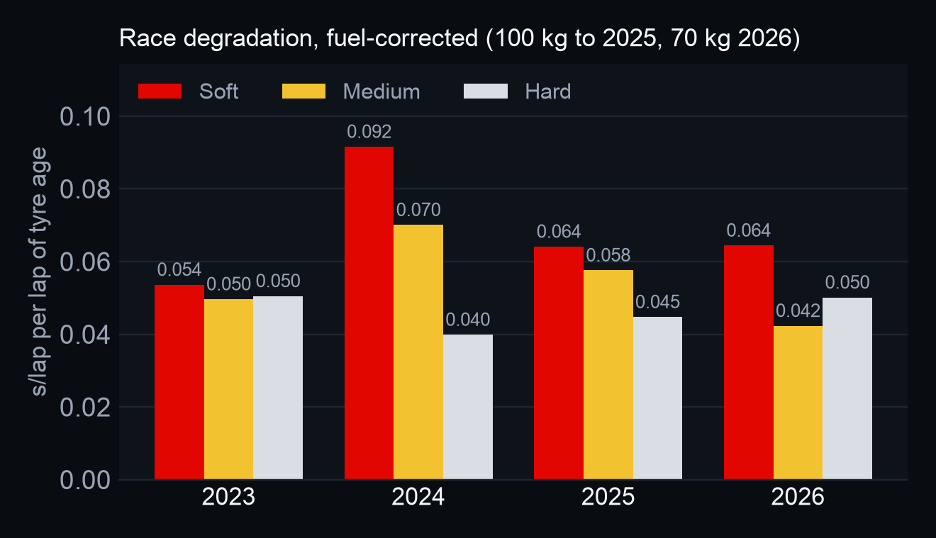
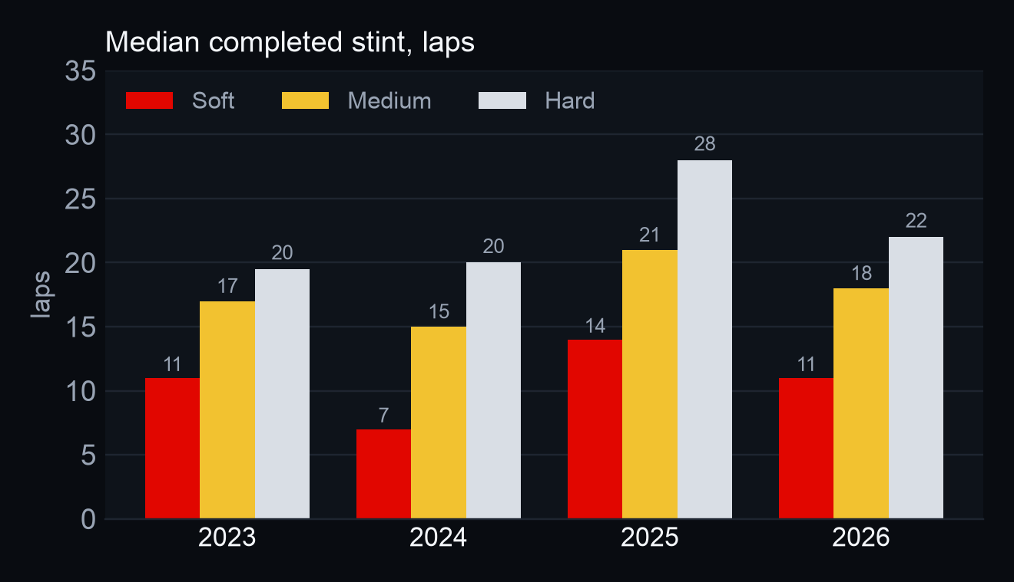
RULE CHANGES AND THE TYRE · MEASURED
What the eras did to degradation, in our own data
Dry races outside the sealed holdout (2023: 15, 2024: 15, 2025: 16, 2026: 10); 2022 is not in our lap data
2023
2024
2025
2026
2026 against 2025, fuel-corrected: soft 0.064 vs 0.064, medium 0.042 vs 0.058, hard 0.050 vs 0.045. Calendars differ: same circuits next.
1.73
1.71
1.64
1.59
stops per finisher · 37% one‑stop
stops per finisher · 47% one‑stop
stops per finisher · 47% one‑stop
stops per finisher · 41% one‑stop
ORB V1 · TrackShift 2026 · Tyre Degradation Intelligence
12
Notes:
Source: deck_src/season_effects.py over the race lap files (feat2023/, feat2024/, feat2025/, feat/) and the race-derived reference slopes in out/tyreformer/prerace/predictions_A.csv; sealed weekends and wet races excluded. Degradation is the median race-derived slope per compound. The reference subtracts 70 kg of fuel in every season, so seasons before 2026 are corrected to a 100 kg start (+0.03 s/kg x 30 kg / race laps). Raw medians S/M/H: 2023 0.039/0.036/0.035; 2024 0.075/0.053/0.022; 2025 0.052/0.042/0.033; 2026 0.064/0.042/0.050. Corrected: 2023 0.054/0.050/0.050; 2024 0.092/0.070/0.040; 2025 0.064/0.058/0.045; 2026 0.064/0.042/0.050. Cases per compound: 2023 soft 7, medium 13, hard 13; 2024 soft 5, medium 14, hard 12; 2025 soft 7, medium 13, hard 11; 2026 soft 6, medium 7, hard 8. Stint length is the median completed stint ending in a pit stop; stops are pit-lane entries per driver finishing 90% of the distance. Each season races a different mix of circuits, so the fair comparison is the same circuit year on year (next slide).

Slide 13
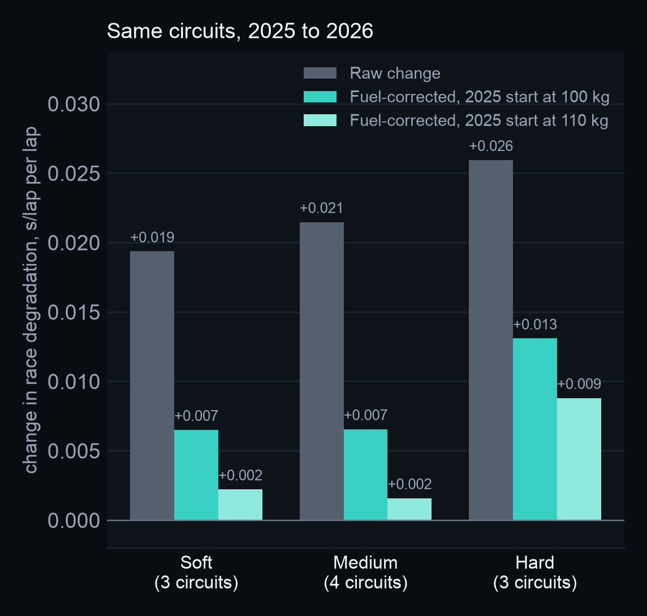
RULE CHANGES AND THE TYRE · FUEL
Less fuel in 2026: the tyre shows through
A lighter start hides less tyre wear in the lap times, and a lighter car loads the tyre less
100 → 70 kg
WHAT THE FUEL DID
On the same circuits degradation rose +0.019 to +0.026 s/lap per lap from 2025. Give 2025 its heavier start and 50% to 90% of that rise disappears. Pirelli also reports less tyre load from the lighter cars: the first 2026 races were one‑stops.
race fuel: about 100 kg in 2020; 70 kg is the 2026 target, not a rule
0.053 → 0.037 s
gained per lap as fuel burns (57-lap race): less wear hidden
WHAT IT MEANS FOR ORB
Our race reference subtracts 70 kg in every season, so pre-2026 slopes read about 0.016 s/lap low. Next: fuel by season.
1.05 → 0.74 s
of tyre loss hidden over a 20-lap stint
ORB V1 · TrackShift 2026 · Tyre Degradation Intelligence
13
Notes:
Facts: 2019: race fuel capped at 110 kg (2020 Sporting Regulations, Art. 30.5); 2022 to 2025: fuel mass flow limited to 100 kg/h; E10 fuel from 2022; 2026: 100% advanced sustainable fuel, limited by energy flow (3,000 MJ/h) instead of mass flow; combustion engine about 400 kW, MGU-K 350 kW, MGU-H removed; 2026: F1 aims for 70 kg of fuel per race against about 100 kg in 2020; no race fuel cap found in the 2026 rulebooks; Rule of thumb: about 0.3 s per 10 kg of fuel (0.03 s/kg), varying by track. Sources: https://api.fia.com/sites/default/files/2020_formula_1_sporting_regulations_-_iss_13_-_2020-11-04.pdf https://api.fia.com/sites/default/files/documents/fia_2025_formula_1_technical_regulations_-_issue_03_-_2025-04-07.pdf https://www.fia.com/system/files/documents/fia_2026_f1_regulations_-_section_c_technical_-_iss_15_-_2025-12-10_0.pdf https://www.formula1.com/en/latest/article/more-efficient-less-fuel-and-carbon-net-zero-7-things-you-need-to-know-about.ZhtzvU3cPCv8QO7jtFxQR https://www.the-race.com/formula-1/whos-really-fastest-heading-to-melbourne-gary-andersons-analysis/ https://www.motorsport.com/f1/news/pirellis-plan-to-combat-continuous-one-stop-races-in-f1-2026/10807616/. Our arithmetic, for a 57-lap race at 0.03 s/kg (the lock's fuel cost): 100 kg burns off 0.053 s a lap, 70 kg 0.037 s. Same circuits 2025 to 2026 (deck_src/assets/season_effects.json): raw change in the race-derived slope +0.019 to +0.026; with 2025 at 100 kg +0.007 to +0.013; at 110 kg +0.002 to +0.009. Circuits: soft Austria, Barcelona, Hungary; medium Austria, Barcelona, Hungary, Japan; hard Austria, Hungary, Japan. Three or four circuits per compound: indicative, not a season-wide estimate. Implication for Orb: the scorecard race reference subtracts 70 kg in every season, so slopes before 2026 read about 0.016 s/lap low at a 100 kg start; the season charts in this deck are corrected, the scorecards are not yet.

Slide 14
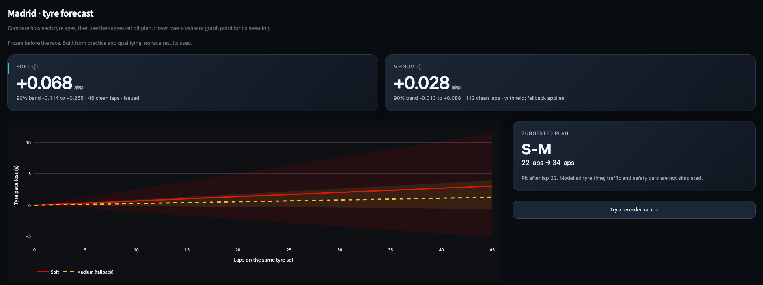
PROSPECTIVE TEST
Madrid: the frozen forecast
FP1, FP2, FP3, Q in; published 21:33 IST. Hashed before the race, verifiable after the event.
S
+0.068 s/lap
issued · 90% band −0.11 to +0.26 · 46 clean laps
M
+0.028 s/lap
withheld, fallback applies · 90% band −0.01 to +0.09 · 112 clean laps
H
no curve
too few clean practice laps; not in the frozen forecast
Plan S-M 22/34 · band-high plan S-M-M · pit loss 21 s
PROVENANCE
forecast JSON sha256 8e5489d5824ae066945225457d0198531db8a8fc246cd6f65d82787f550626ce
forecast PDF sha256 ead466275dddd7c23538e8920405e3042dc47ceade621e47b7a7b3c5e19f40a1
sidecar sha256 30a5f06786fc332faf7934d0ed70cadd3bcba697f538939dfa5c8e905afe2c3c
lock v2 forecast_hash 66e3201e860b19efc410cac30073d6c12bd7d4f9cb894cd70a445747d3d0451a
The race is scored after it is run, against this file, whatever it says.
ORB V1 · TrackShift 2026 · Tyre Degradation Intelligence
14
Notes:
Madrid 2026 races on Sunday evening, after the event closes. The forecast was built from FP1, FP2, FP3, Q and frozen with a hash; nothing in it can change once the race is run. Sources: out/lock_v2.json pre_race_forecast.events.Madrid and the published out/forecast_Madrid_2026.json with its .sha256 sidecar; the build refuses to run if they disagree. Full digests: JSON 8e5489d5824ae066945225457d0198531db8a8fc246cd6f65d82787f550626ce; PDF ead466275dddd7c23538e8920405e3042dc47ceade621e47b7a7b3c5e19f40a1; sidecar 30a5f06786fc332faf7934d0ed70cadd3bcba697f538939dfa5c8e905afe2c3c; lock v2 forecast_hash 66e3201e860b19efc410cac30073d6c12bd7d4f9cb894cd70a445747d3d0451a.

Slide 15
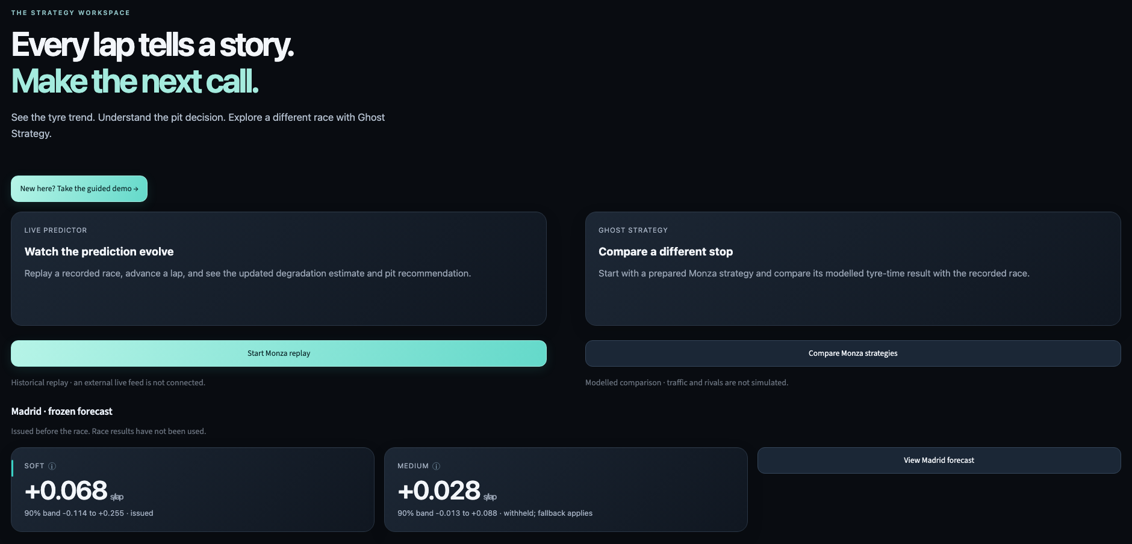
THE PRODUCT
Five destinations, two modes, one locked core
Streamlit dashboard, runs offline; every number traces to the lock, a hashed sidecar or a labelled placeholder
1
Overview
the two modes and the frozen Madrid forecast
2
Forecast
pre-race curves, bands and the suggested plan
3
Live Predictor
lap-by-lap tyre state and the ranked pit call
4
Ghost Strategy
change the stop, replay it on the 3D Race Twin
5
Guided demo
five steps from a lap to a tyre decision
More tools: Decision board · Driver feedback · Validation · Generalisation
30 routes · 3,933 numbers
12/12 rehearsal steps
Offline
checked against the lock, 0 mismatches
five-minute run in 303 s, no external requests
recorded races replay locally; no CDN, no live feed needed
ORB V1 · TrackShift 2026 · Tyre Degradation Intelligence
15
Notes:
The dashboard opens on an overview with the two modes and the Madrid forecast. Live Predictor makes the call during a race and may only see laps already run; Ghost Strategy audits afterwards. A guided demo walks a newcomer through five steps on prepared races. Consistency probe (evaluation/red_team/consistency_probe_report.json, 2026-09-13T06:15:49): 30 routes, 3,933 numbers compared with the lock, 0 mismatches. C6 rehearsal: 303 s, 12/12 steps (checkpoints/C6/checkpoint.md).

Slide 16
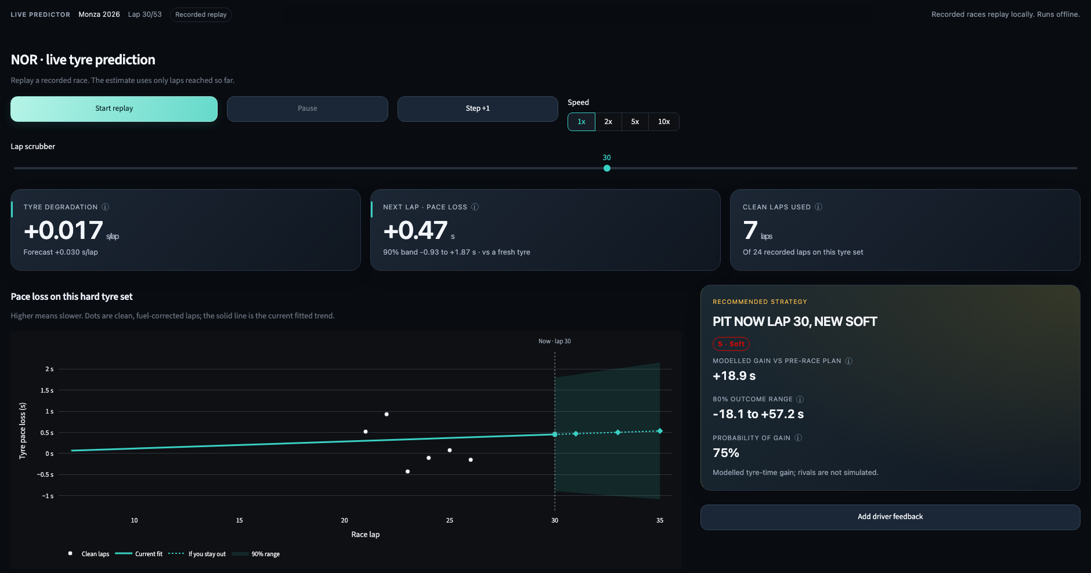
LIVE PREDICTOR
The call during the race, from laps already run
Monza 2026, Norris, lap 30 of 53, recorded replay
0.380 s
89%
next-lap error, against 0.426 s for the prior alone
of next laps inside the 90% band
8.5 laps
0.08
median warning before a detected cliff
false alert episodes per stint
HONEST LIMIT
Cliff warnings are worse than a constant base rate (Brier 0.195 against 0.126). Scored on three replayed races.
ORB V1 · TrackShift 2026 · Tyre Degradation Intelligence
16
Notes:
Kalman estimator of tyre intercept and slope per stint, started from the frozen pre-race prior; it may only read laps up to the replay cursor (asserted in code and in the leakage audit). Scorecard: out/validation/live_scorecard.json, prefix evaluation over Monza, Austria, Barcelona: next-lap error 0.380 s against 0.426 s for the prior alone (1,890 windows); 89% of next laps inside the 90% band; median alert lead 8.5 laps; 0.08 false alert episodes per stint; the recommendation changes on 9% of laps. Weakness: cliff Brier 0.195 against 0.126 for the base rate, worse than a constant; the learned model on slide 18 addresses it. The driver-feedback ablation has not run: no feedback event has been recorded yet.

Slide 17
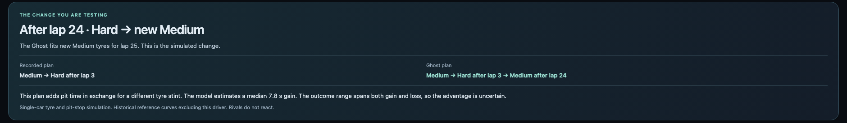
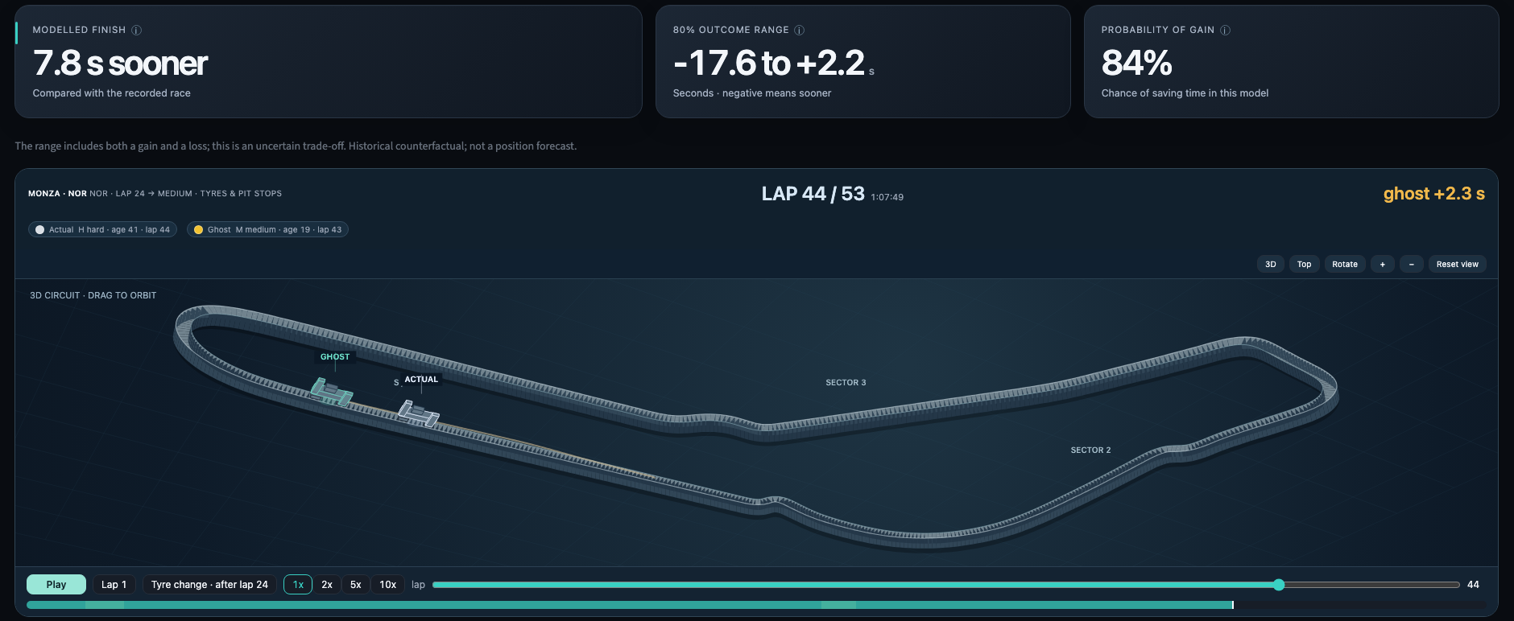
GHOST STRATEGY
Change the stop, see the difference, on the real circuit
Monza 2026, Norris: a new medium after lap 24, replayed against the recorded race
483
prepared simulations across ten races, historical and pre-race curves
518 / 0
identity checks passed / failed; a failing scenario is refused, never written
1.12 vs 1.44 s
next lap after a hidden real stop, against naive; 984 stops
Actual = recorded car · Ghost = changed plan. Modelled tyre time, not rival positions.
ORB V1 · TrackShift 2026 · Tyre Degradation Intelligence
17
Notes:
Ghost Strategy replays the driver's own laps with a different tyre plan: a single-car tyre and pit-stop simulation on reference curves that exclude this driver; rivals do not react, and it is never a position forecast. The 3D Race Twin is a local software renderer on the recorded XY positions; road width, car size and elevation are schematic. Prepared simulations on disk: 232 on the historical race reference and 251 on the pre-race curve, 483 in all, across 10 races (australia, austria, barcelona, belgium, canada, hungary, japan, miami, monza, zandvoort); each passed its identity check before it was written (evaluation/red_team/identity_checks_report.json, 2026-09-13T04:07:52: 518 passed, 0 failed). Races whose reconstruction cannot be reproduced are refused on screen rather than borrowed from another race. Hidden-stop response test (out/validation/ghost_scorecard.json): hide the laps after a real stop and predict them; next-lap error 1.12 s against 1.44 s naive over 984 stops in 56 weekends.

Slide 18
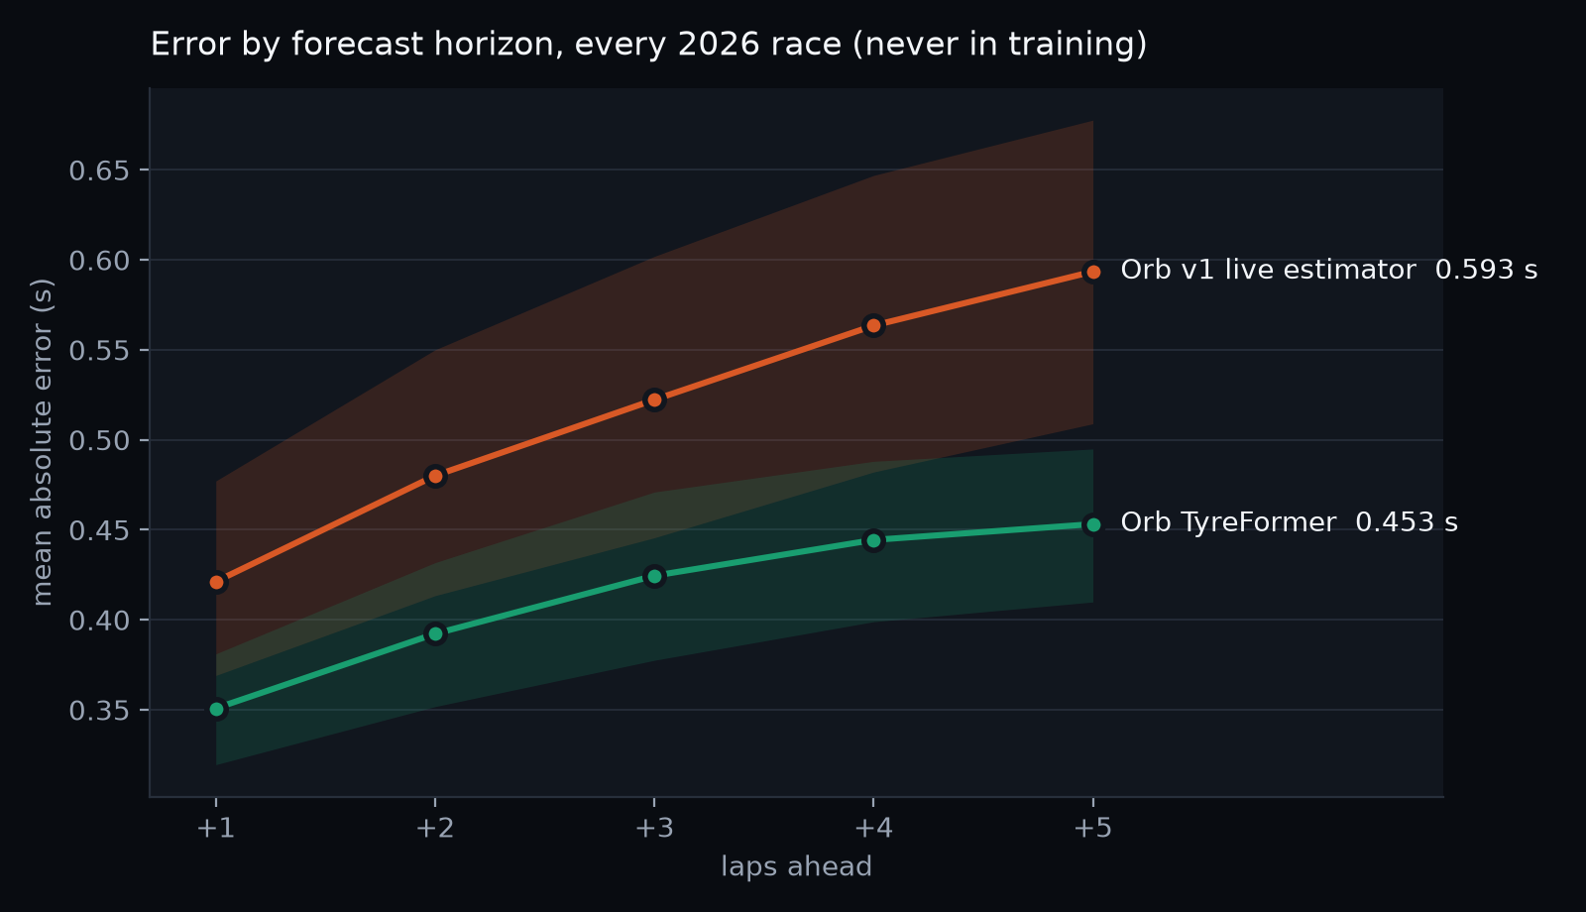
THE LEARNED MODEL
Orb TyreFormer: a learned forecast, scored head to head
Transformer over the lap sequence plus gradient-boosted experts, against the Orb v1 live estimator on identical origins
0.421 → 0.351 s
next-lap error, every 2026 race, deployment protocol, identical origins; better on 12 of 12 races
0.289 → 0.243 s
next-lap error, sealed holdout, aggregate only; better on 5 of 5 weekends
0.593 → 0.453 s
five laps ahead, every 2026 race
47,186 forecast origins from 2023 to 2025 for training and selection, 11,383 from 2026 for testing. Frozen before any sealed weekend was opened.
Limit: cliff risk is calibrated but barely beats the base rate (Brier 0.114 vs 0.120). Not yet in the dashboard.
ORB V1 · TrackShift 2026 · Tyre Degradation Intelligence
18
Notes:
Orb TyreFormer is an ensemble of a transformer over each stint's lap sequence (distribution, cumulative and cliff heads) and gradient-boosted median experts, with conformal 90% bands (out/tyreformer/EVALUATION.md, MODEL_CARD.md). Data: 58,569 forecast origins over 74 weekends of 2023 to 2026 race and sprint stints (47,186 from 2023 to 2025 for training and selection, 11,383 from 2026 for testing); sealed weekends are refused by the data loader. Frozen 06:17 IST before any sealed weekend was loaded (tyreformer/FREEZE.json). Every 2026 race, deployment protocol (2023 to 2025 plus earlier 2026 races), identical origins: next lap 0.421 to 0.351 s, better on 12 of 12 races; five laps ahead 0.593 to 0.453 s; five-lap cumulative 1.958 to 1.478 s. For reference, current pace alone scores 0.420 s at the next lap, so the estimator adds little there. Sealed holdout, aggregate only (out/tyreformer/sealed_holdout_aggregate.json): next lap 0.289 to 0.243 s on 5 of 5 weekends; five laps ahead 0.437 to 0.347 s; next-lap band coverage 90%. Limit: the cliff probability is calibrated but barely beats a constant base rate (Brier 0.114 against 0.120 on 2026). Not the estimator of record and not yet wired into the dashboard.

Slide 19
VALIDATION DISCIPLINE
How we kept ourselves honest
Splits fixed before tuning, freezes before reveals, and automated gates at every checkpoint
Development pool
CHECKPOINTS, 12 TO 13 SEPTEMBER
64 weekends of 2023 to 2026, each forecast with itself left out
C0
C1
C2
C3
C4
C5
C6
GO
GO
GO
GO
GO
GO
GO
Rolling origin
each 2026 race forecast only from the races before it
PASS
518 / 0
0 of 3,933
leakage audit: the live path cannot import race outcomes
counterfactual identity checks passed / failed
on-screen numbers disagreeing with the lock
Sealed holdout
6 whole weekends picked by a fixed rule before any tuning; opened once, aggregate only
326/326
582
Frozen
Prospective
release gate at C6: offline, routes, timing
tests passed at C6 (1 skipped, 1 xfailed)
Orb v1 rules and Orb TyreFormer each frozen before their sealed runs
Madrid, hashed before the race and scored after it
ORB V1 · TrackShift 2026 · Tyre Degradation Intelligence
19
Notes:
Sealed holdout: 6 weekends chosen by rule (holdout_count = clamp(round(0.18 * eligible_weekends), 4, 6)), hashed at 2026-09-12T14:29:44, prohibited for tuning, opened once after the freeze and quoted only as "sealed holdout, aggregate only". Checkpoints (checkpoints/C*/checkpoint.json): C0 GO 09-12 14:31; C1 GO 09-12 15:46; C2 GO 09-12 16:37; C3 GO 09-12 21:06; C4 GO 09-12 23:20; C5 GO 09-13 00:44; C6 GO 09-13 02:22. At C6 the suite ran 582 passed, 1 skipped, 1 xfailed, and the release gate 326/326. Leakage audit (2026-09-13T01:40:48): PASS, 5 checks. Identity checks (2026-09-13T04:07:52): 518 passed, 0 failed. Consistency probe (2026-09-13T06:15:49): 3,933 numbers, 0 mismatches. These records describe the commits they ran on; later uncommitted work is certified only when its own gate runs.

Slide 20
UNDER THE HOOD
Models and methods, by name
What each component is, and how it is validated
Component | Model or method | Validation
Degradation curve | Stint fixed-effects regression; fuel prior and track evolution removed (FastF1 public timing, 3.7 Hz traces) | Weekend holdout; sensitivity sweep
Friday to Sunday | Per-compound median ratio, weekend left out, agreement rule | 29 cases 2026; 148 across 2023 to 2026; sealed holdout
Abstention | Selective prediction with a leave-one-out median fallback | Risk-coverage scorecard
Tyre demand index | Energy per lap from speed, path curvature and speed changes | Feed-quality gates; practice/race scale
Strategy | Exact one- and two-stop enumeration; posterior Monte Carlo on the live board | 10 replayed races; regret over 40 weekends
Live estimator | Kalman filter on intercept and slope; pre-race prior; pit resets | Prefix evaluation: next 1, 3, 5 laps; Brier; alert lead
Counterfactual | Iso-context paired replay on the recorded safety-car schedule | Identity checks; hidden-stop response
Orb TyreFormer | Transformer (distribution, cumulative, cliff heads) + gradient-boosted medians; conformal bands; PyTorch | Weekend-grouped CV; every 2026 race; sealed holdout
Learned transfer | Robust (Huber) regression on practice features, conformal band | Leave-one-weekend-out 2023 to 2026; 2026 temporal test
Neural ablation | CfC continuous-time cell (Hasani et al.), ncps / PyTorch | Stint-grouped folds; not adopted
Product | Streamlit + Plotly; local canvas 3D Race Twin | Consistency probe; release gate; rehearsal
ORB V1 · TrackShift 2026 · Tyre Degradation Intelligence
20
Notes:
Core: stint fixed-effects OLS with physics priors. Transfer: leave-one-weekend-out median ratio with an agreement rule. Gate: selective prediction with a nonparametric fallback. Live: Kalman filter on intercept and slope with fixed regime rules. Counterfactual: iso-context paired replay. Learned: Orb TyreFormer (transformer plus gradient-boosted experts, conformal bands) and a robust-regression transfer model, both second opinions. Ablation: CfC continuous-time cell, reported not deployed. Stack: Python 3.12, NumPy, pandas, statsmodels, scikit-learn, PyTorch, FastF1, Streamlit, Plotly, a local canvas 3D renderer.

Slide 21
REAL-WORLD VIABILITY
What team data would add, and where it scales
Public prototype today; a team adapter is where measurements replace assumptions
Private data (team only) | What it would buy
Fuel mass per lap | retires the largest stated assumption, season by season
Tyre pressures and temperatures | separates graining, blistering and the cliff; sharper bands and earlier alerts, to be validated
Tread depth after runs | the only route to a physical wear number; public mode never shows tread
Engine modes, driver instructions | the push becomes measured instead of inferred
Wheel speeds, steering, brake temperatures | actual slip and the thermal path
WHERE IT SCALES
1
Any Grand Prix, from free data
public timing and position traces; one command rebuilds the lock from a fresh clone
2
Junior series with public timing only
lap times, age, compound and flags suffice; more is withheld and bands widen
3
Race engineers on a laptop
runs offline; no cloud, no CDN, a five-minute guided path
4
Beyond racing: wear from biased samples
the pattern (clean the confounders, learn the transfer, refuse weak signal, audit) fits any wear forecast made from noisy early data
ORB V1 · TrackShift 2026 · Tyre Degradation Intelligence
21
Notes:
The private feeds a team already has would replace our stated assumptions with measurements and tighten the same model. The method needs only lap times, tyre age, compound and flags, so it runs in a degraded mode on any series with public timing; with telemetry it also measures the push. Every scaling claim here still requires validation in that series.

Slide 22
VERSUS THE FIELD
The public repositories on this brief
Checked on 12 September 2026
Entry | Approach | Validation | Where we stand
PITWALL | Same cleaning idea, 12 events; concluded practice curves do not transfer; predicts the value of a fresh tyre | Leave-one-event-out on pit-stop deltas | We deliver the curve the brief asks for; transfer holds at compound-weekend level in 2026 (r 0.78); we say where it weakens
GripTrace | One weekend, 2023 Bahrain, soft only; careful; no fuel model | Race held out once | 64 weekends, three compounds, a sealed holdout
TyreIQ | Gradient boosting on synthetic Bahrain data | In-sample on synthetic data | Scored on real races the model never saw
Dr.Tyre, TrackShift AI | Pipelines with simulators and a voice engineer; constants or synthetic toggles | None held out | Every number on our screens traces to the lock, a hashed sidecar or a labelled placeholder
TIREX, others | Kalman plan (backend only), a negative-result study, skeletons | Planned or none | Results, freezes and gates
Among the public repositories we reviewed, we did not find another entry that scores a Friday curve against Sunday across seasons, withholds when it should, removes the driver’s push and forecasts a live weekend.
ORB V1 · TrackShift 2026 · Tyre Degradation Intelligence
22
Notes:
The field, from a public sweep on the morning of 12 September. PITWALL is the only rival we reviewed with comparable rigour and it concluded the practice curve cannot be delivered; the rest are one weekend, synthetic data, or simulators without a scorecard. We deliver the literal brief at season scale, with abstention, a live forecast and a scored audit.

Slide 23
QUESTIONS
Eight questions we expect, with our one-line answers
1
What did you build here?
2
Where is the AI?
Three past seasons and seven more 2026 weekends, the gate, the push diagnostic, the dashboard with its 3D Race Twin and guided demo, the sealed holdout and Orb TyreFormer. The estimator was disclosed pre-work.
A transfer factor learned across weekends; Orb TyreFormer, a transformer and boosted ensemble beating our live estimator on every 2026 race (12 of 12); a CfC network tested and set aside.
3
Does the Friday curve really transfer?
4
What breaks it?
In 2026, yes: r 0.78 over 29 held-out cases. Across 2023 to 2025 it is weaker (r 0.27), so we show that and keep a learned transfer model as a second opinion.
Green tracks and new circuits (the gate withholds, the fallback answers), degraded feeds (refused), wet sessions (excluded), and a new rule era, which needs its own fuel and priors.
5
Where could the race leak into the forecast?
6
Madrid races after we close. What do you show?
Nowhere we left open: factors and fallback come from other weekends, the live path reads only laps already run (audited), and only the scorecard sees the race.
Recorded races replayed lap by lap, and a Madrid forecast hashed before the race (sha256 8e5489d5824a, 21:33 IST), verifiable after it.
7
Did the 2026 rules change degradation?
8
Would this work in Formula 2, without telemetry?
Both ways at once: lighter 2026 cars load the tyre less, but a lighter start hides less wear in lap times. On the same circuits, 50% to 90% of the raw rise from 2025 is that fuel effect (3 to 4 circuits per compound).
Yes, in a degraded mode: lap times, age, compound and flags drive the estimator; more is withheld and bands widen. Accuracy there requires validation.
ORB V1 · TrackShift 2026 · Tyre Degradation Intelligence
23
Notes:
8 questions we expect, each with the answer we will give. Longer written answers are in The Case and the talk track.

Slide 24
DISCLOSURE AND NEXT STEPS
What was built when, and what comes next
Disclosed pre-work
Built at Plaksha
Next
4 to 5 September
12 to 13 September
after the event
Stint fixed-effects estimator with the fuel prior and evolution
Seven more 2026 weekends and three past seasons
TyreFormer on the Live Predictor as a labelled second opinion
Six-weekend validation and the first transfer factors
Gate, fallback, push diagnostic, replay scoring
Score the Madrid forecast against the race
Hungary and Austria strategy replay
Lock contract, sealed holdout, checkpoints C0 to C6
Season-specific fuel load in the race reference
Live Predictor, Ghost Strategy, 3D Race Twin, guided demo
A learned, calibrated abstention gate
Orb TyreFormer and the learned transfer model
Team-data adapter: fuel, pressures, temperatures
Rule-era analysis, 2022 to 2026
Friday lies twice. Orb v1 corrects one lie, learns the other, and says so when it cannot tell.
ORB V1 · TrackShift 2026 · Tyre Degradation Intelligence
24
Notes:
Disclosure first. The estimator and the six-weekend validation were pre-work disclosed in the idea round. Everything else was built at Plaksha between 12 and 13 September. Next: wire Orb TyreFormer into the Live Predictor as a labelled second opinion, score Madrid after the race, give each season its own fuel load in the reference, learn the abstention gate, and build the team-data adapter.

