Slide 1
Review: Networking
A network is a collection of connected entities, systems or objects that interact with each other with an aim of sharing resources.
A communication channel refers to a physical or wireless transmission medium in which the data signal flows.

Slide 2
Data Communication
Data communication is the process of transmitting data signals from one point to another through computer networks.
DOT
Data signal- the stream of binaries represented by using voltage levels if electronic circuits.
Modulations and Demodulation- Mod. Is the process of con verting digital signal into analog signal to be transmitted over analog Systems.

Slide 3
Networking
Multiplexing- Is the process of sending multiple data signals through the same medium.
Demultiplexing is the process of splitting multiplexed data signal back into multiple channels.
Bandwith- Is the maximum amount of data that a transmission media can carry for a time. Eg 1mbps..
Baseband Signal-Signal generated and fed into the transmission media without modulation.

Slide 4
Networking
Broadband- Frequency in which data is sent through.
Attenuation-Is the signal loss from decrease in strength and energy as it progressively moves along a transmission media.

Slide 5
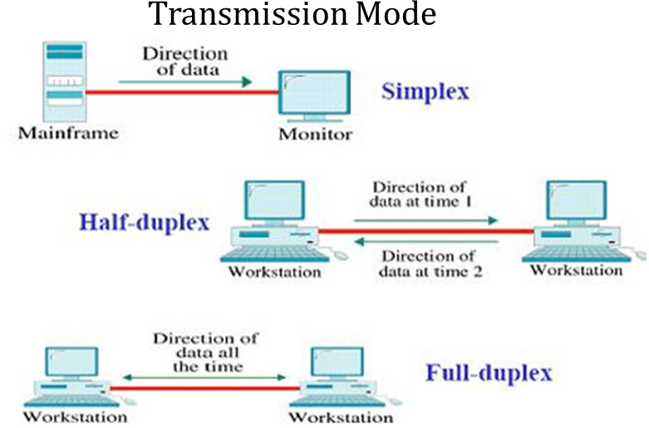

Slide 6
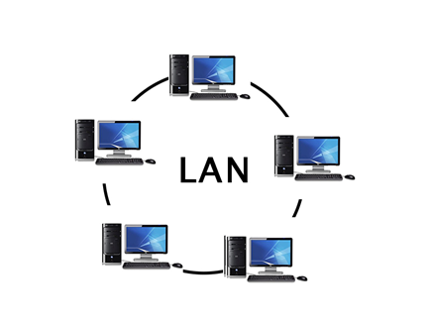
Types of Computer Networks

Slide 7
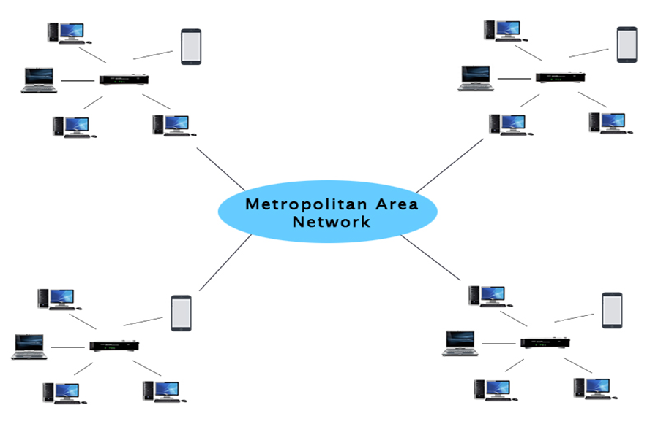
Metropolitan Area Network

Slide 8
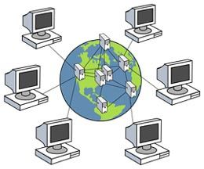

Slide 9
Elements of Networking
They are components that facilitate sharing and exchange of data from one point to another in a communication system.They are Data communication Media,Communication Devices and Network Software.
Data communication medium reffers to a channel used for transmitting data and information from one point to another.They are either
Physical
Wireless

Slide 10
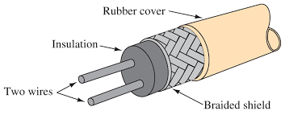
Data Communication Media
Physical Communication Media
They are the physical channels in which copper and optic cables are transmitted through.They Include:

Slide 11
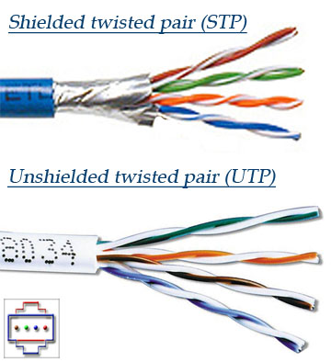

Slide 12
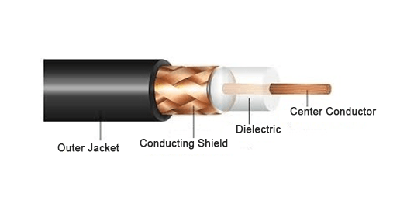
Coaxial Cables

Slide 13
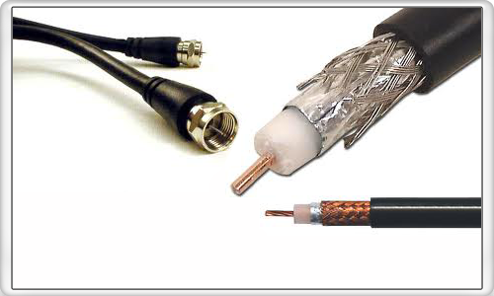
Types of Coaxial Cabling

Slide 14
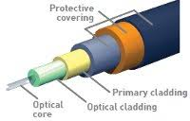
Fibre Optic

Slide 15
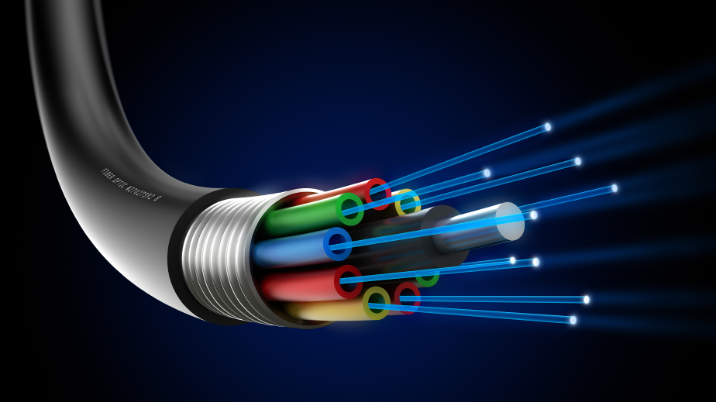

Slide 16
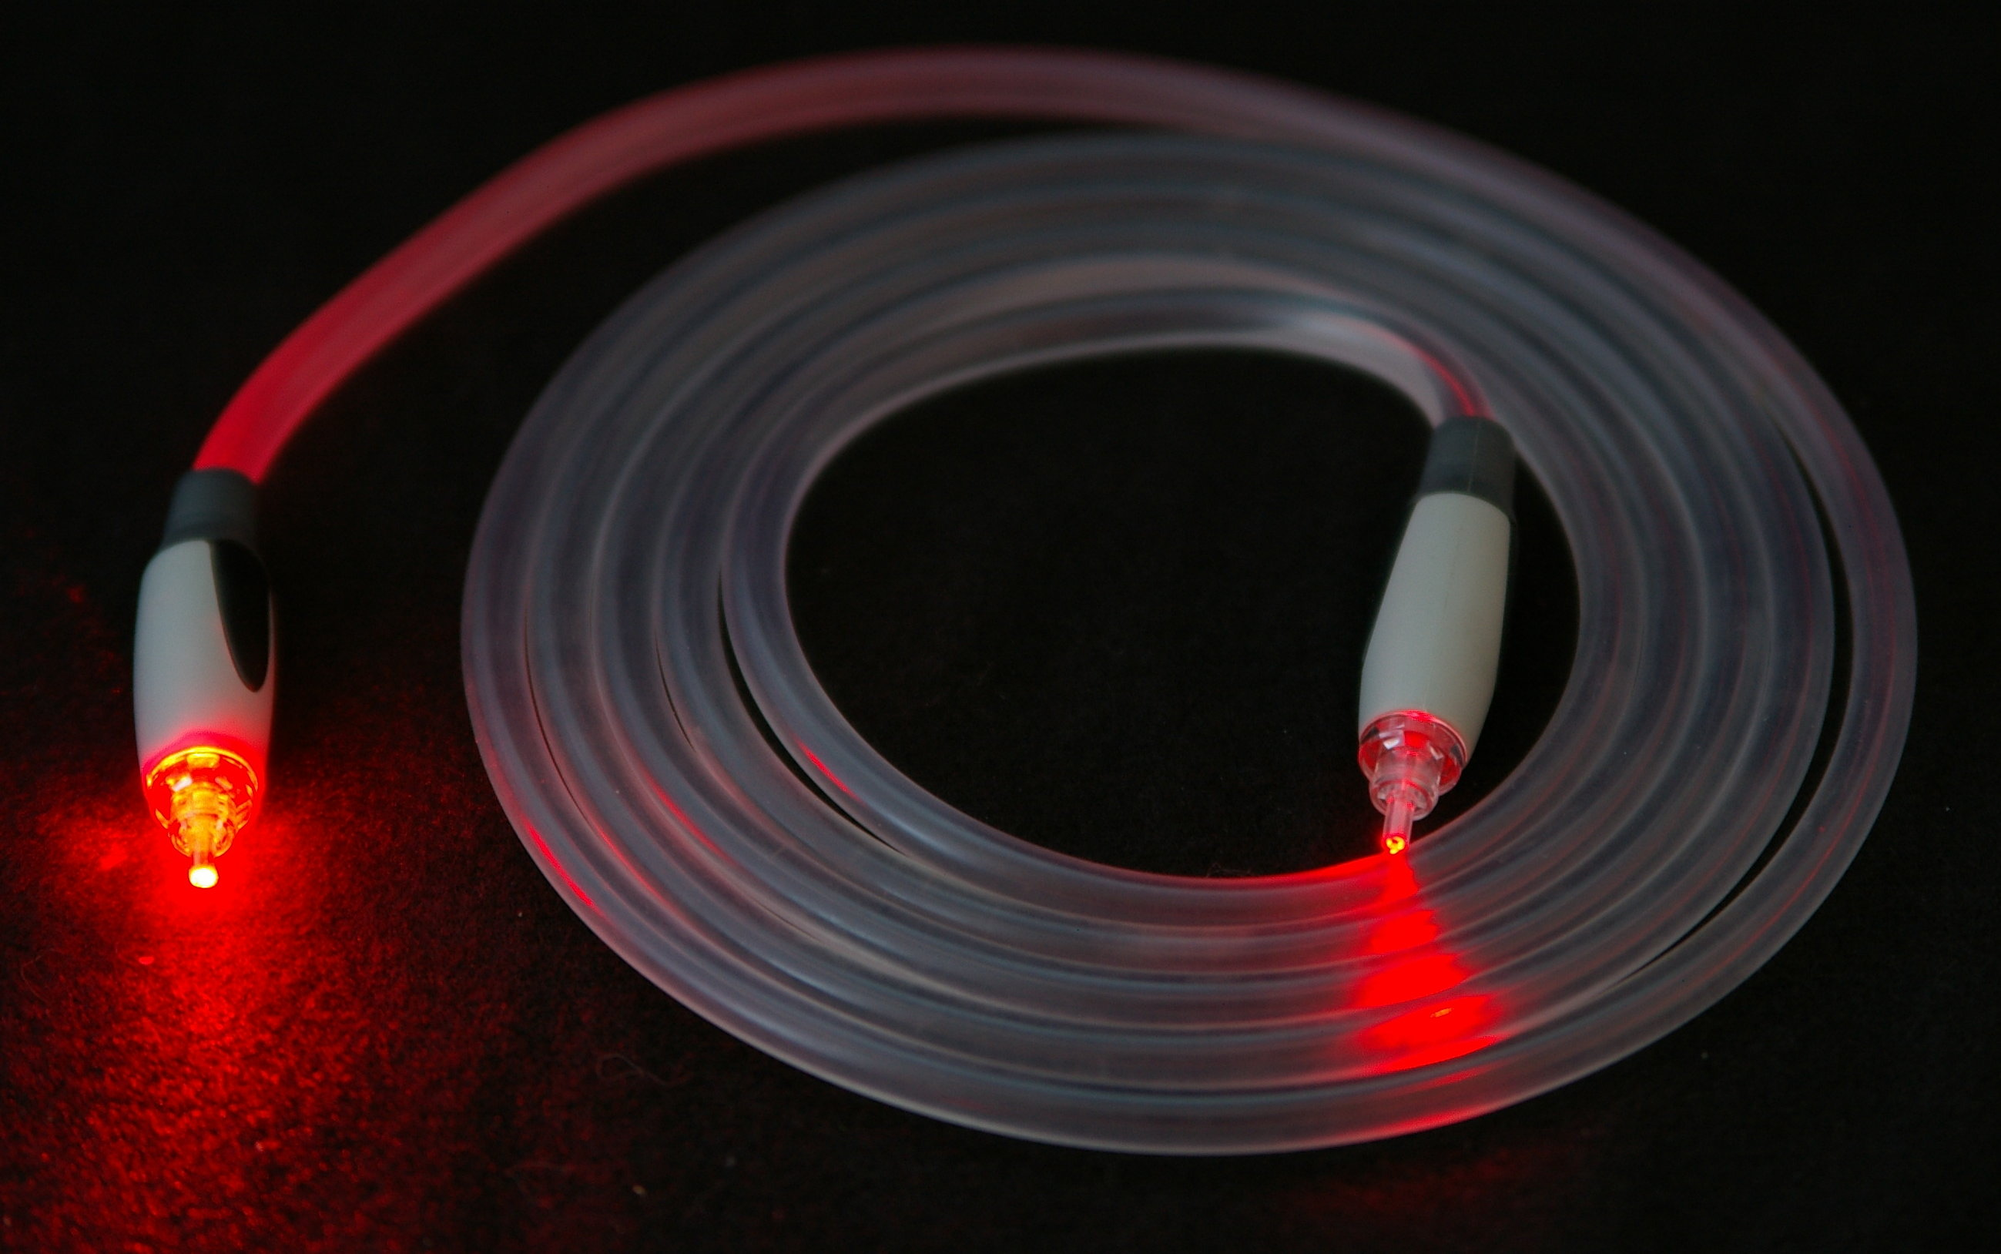

Slide 17
Wireless Communication Media
Wireless communication is the transmission of data through space/air using electromegnetic spectrum.
They mostly include Radio waves, Micro Waves and Infrared.

Slide 18
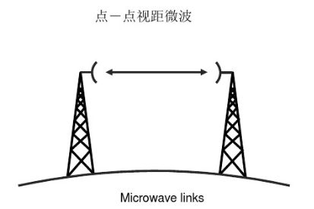
Microwave Communications
Microwave transmission is the transmission of information by microwave radio waves. It is Suitable for:
Terrestrial Microwave Communications

Slide 19
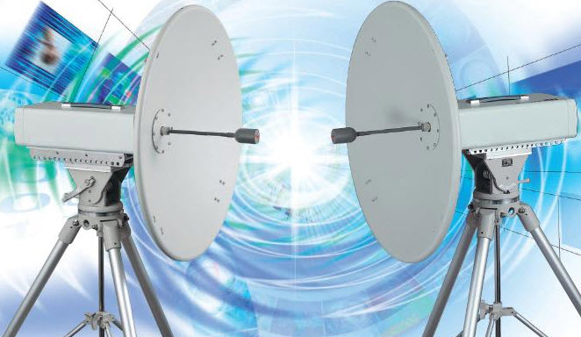

Slide 20
Satellite Microwave Communication
Satellite communications use microwaves for these unique advantages that these waves provide:
Transparency:Microwave frequencies are capable of freely propagating through the atmosphere.
Less Fading:Due to Line of Site Propagation ,there is less fading effect and hence it is more reliable.

Slide 21
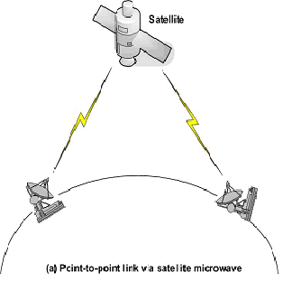

Slide 22
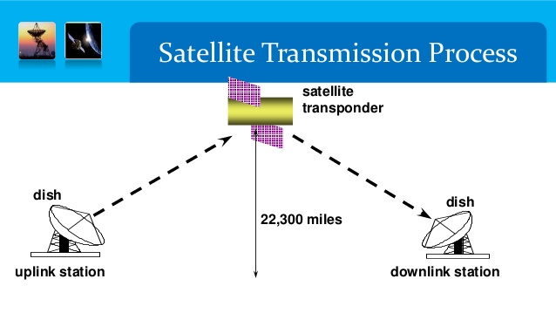

Slide 23
An Uplink is the link used to send data from the ground up to the satellite.
A Downlink is link used to send data from the satellite.
Very Small aperture terminal is a two-way satellite ground station with a dish antenna

Slide 24
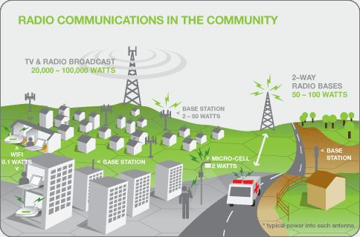
Radio Communication
High Frequency,UHF, VHF,

Slide 25
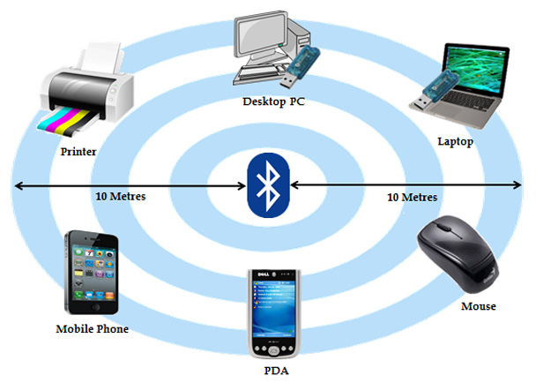
Bluetooth Communication
Its a short range radio communication of devices. Ranges to less than 10 metres.

Slide 26
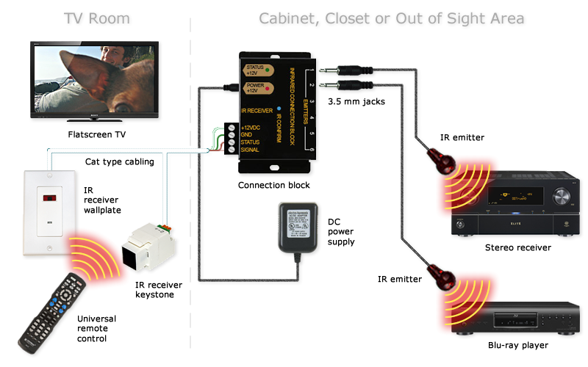
Infrared Transmission

Slide 27
Data Communication Devices
They are devices that are used to facilitate the process of receiving and transmitting data through communication media.
They maybe classified into 2:
Data terminal equipment (DTE)→They send or receive data
Data Circuit-Terminalting Equipment(DCE) →Include Modems, switched used to interface between DTE and communication media.

Slide 28
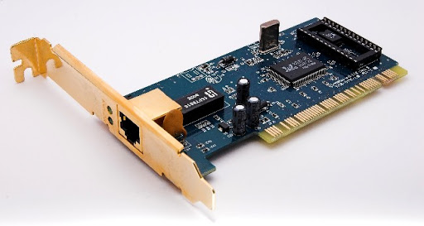
Network Interface Adapter
They are used to connect the computer to the transmission media. Formerly NIC.

Slide 29
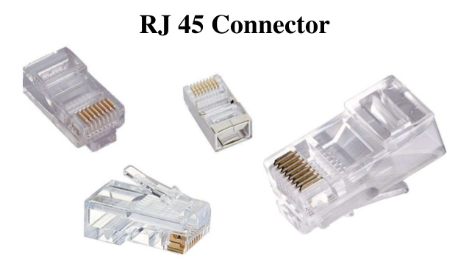

Slide 30
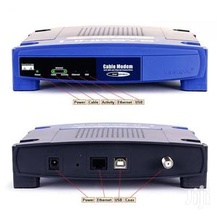

Modem

Slide 31
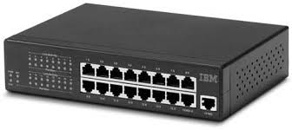
Network Hub
It Interconnects computers in LAN. A hub transmits data from each and every node.
They produce Broadcast storms where there is a lot of traffic in the network.

Slide 32
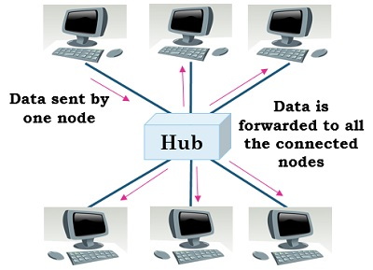

Slide 33
A Bridge
It is used to connect multiple networks segments into an agreggate network.
It has an address filtering mechanism that helps it to determine the address of the message.
They expand the size that a network segment and also help reduce the size of the overall broadcast traffic by restricting messages to the destination segment.

Slide 34
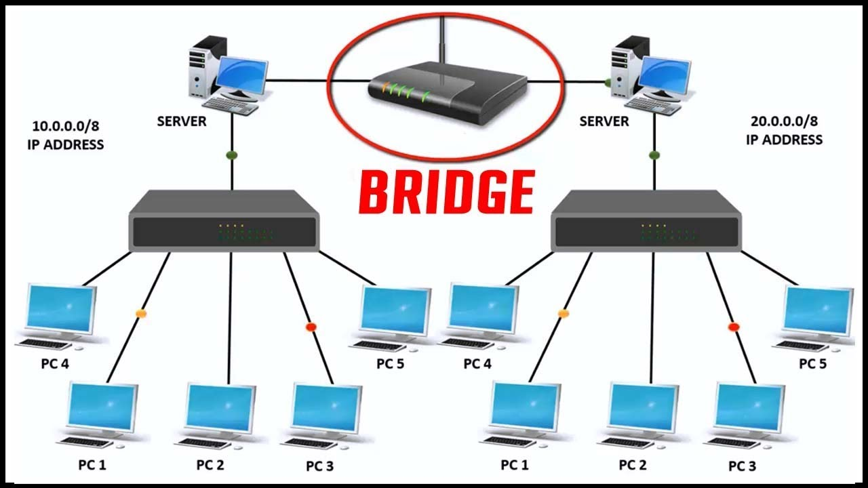

Slide 35
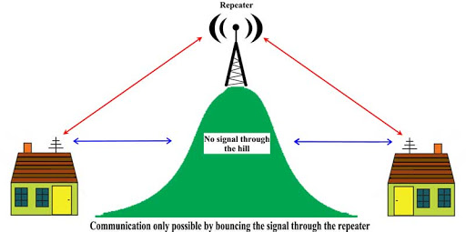
Repeater
a repeater is an electronic device that receives a signal and retransmits it. Repeaters are used to extend transmissions so that the signal can cover longer distances or be received on the other side of an obstruction.

Slide 36
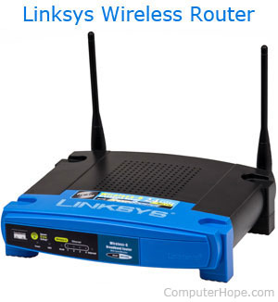
A Router
It is used to connect devices from different networks.
Some routers have combined their functionalities of a router and bridge and thus they are called brouters.

Slide 37
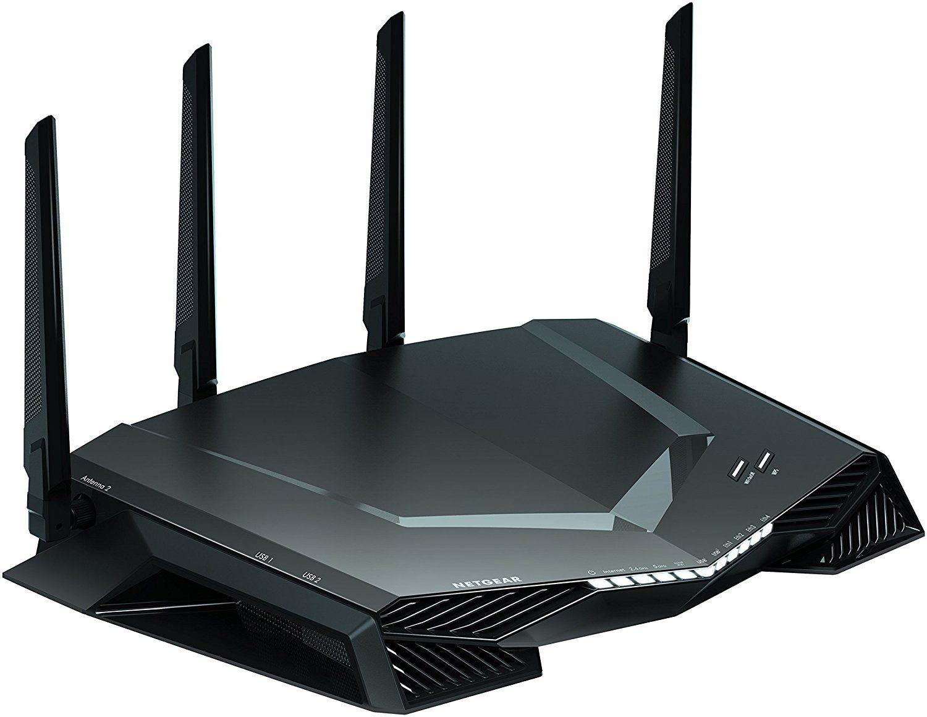

Slide 38
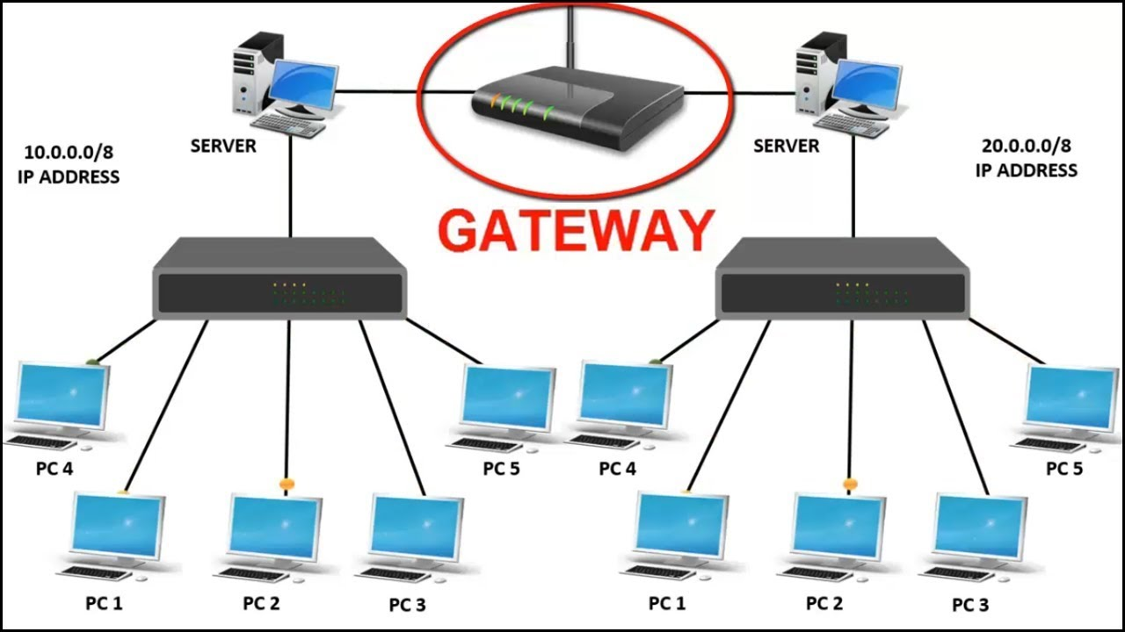
Gateway
A device that allows other devices access the internet. It has the ability to route data packets to different networks.

Slide 39
Wireless Access Point
Provides a wireless access point to devices into the network.
Most Routers have combined this ability to create a wifi Access point.
They have external antenna capable of sending and receiving data via radio waves, micro waves or Infrared.

Slide 40
Networking Softwares
Networking softwares are fundamental elements that provides software tools and utilities for deploying,configuring,managing and monitoring a computer network.
It is responsible for enforcing security,interoperability,load balancing and resource sharing.
They include Network Operating systems and Protocols

Slide 41
Network Operating System
They are designed to optimise networked computers to respond to the service requests.
They include:
Windows Server 2016,
Linux Operating System
Unix Operating systems

Slide 42
Network Operating systems
Functions:
Provides access to network resources
Enables nodes in the networks to communicate efficiently
Supports interprocess communication
Responds to requests from application programs running on the network
Enforce Network Security

Slide 43
Network Administrator
Roles:
Secure network against unauthorised access
Track Network Usage and keep the log files
Ensure interoperability between various systems
Monitor network performance.

Slide 44
Protocols
Protocols are set of rules and procedures that govern communication between devices on a network.
An example is the OSI model that helps develop the protocols which helps sharing and communication of devices in a network regardless of their differences.
Its divided into 2 layers where the 3 upper layers are implemented in Software and deal with application issues while the lower 4 deals with networking and data transmission.

Slide 45
OSI
Layer 7 protocols
Provides access to services through software applications eg. Browsers,email clients.The protocols under this include HTTP,HTTPS,SMTP,FTP etc.
Layer 6 protocols
They define a format in which data is presented. They include jpeg,mp3,avi,GIF etc.
Layer 5 protocols
This layer establishes, manages and terminates sessions between 2 communicating devices.They include ZIP,SCP and NETBIOS

Slide 46
Layer 4 protocols
Sets up and maintains connection between 2 devices. Protocols include TCP,UDP etc
Layer 3 protocols
Provide routing functions that enable multiple data channels to be combined into an internetwork. Protocols include IP,ARP,ICMP
Layer 2 protocols
Its responsible for data transmission across the network through physical addressing.

Slide 47
Layer 1 protocols
Defines Mechanical, electrical and functional specifications for data transmitting.They address how data is transmitted through physical/wireless media

Slide 48
Network Topologies
Logical Network Topology
This deals with how data is passed from one node to another. It comprises of
Ethernet topology→ This is where the computers listen to the network channel and can only send data when none is sending.
Token ring topology→ Data is packaged into tokens and passed around the network but only the computer whose address is on the token reads the packet.

Slide 49
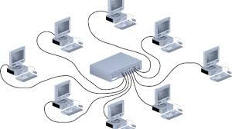
Physical Network topology
Reffers to the arrangement of computersand other devices on the network. They include:
Star Topology

Slide 50


Slide 51
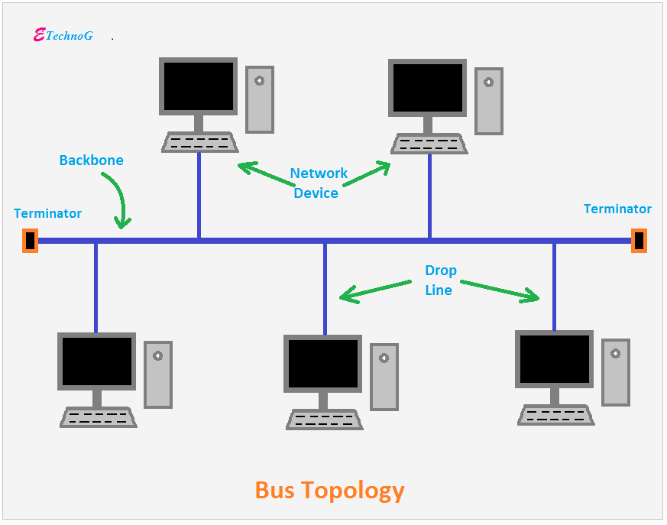
Bus Topology

Slide 52
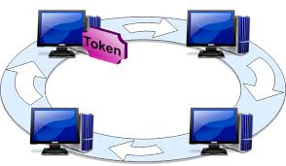
Ring Topology

Slide 53
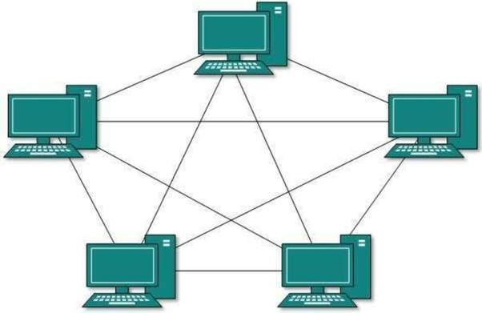
Mesh Topology

Slide 54
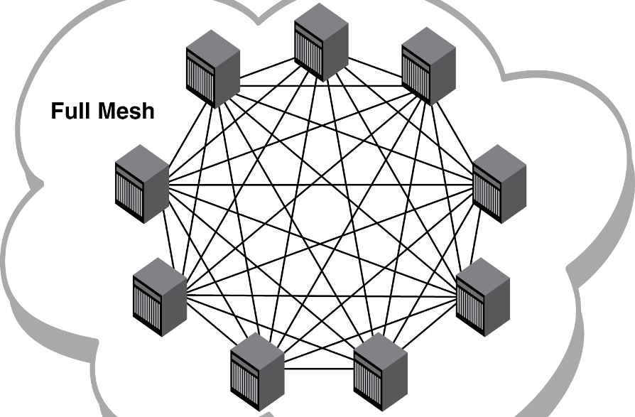

Slide 55
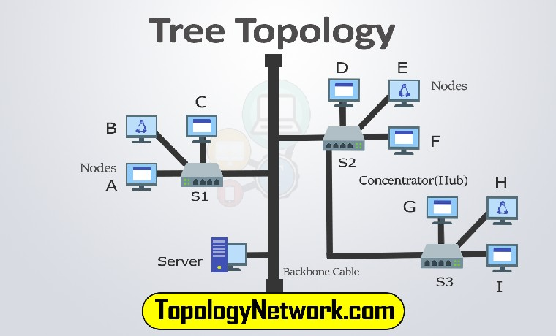
Tree Topology

Slide 56
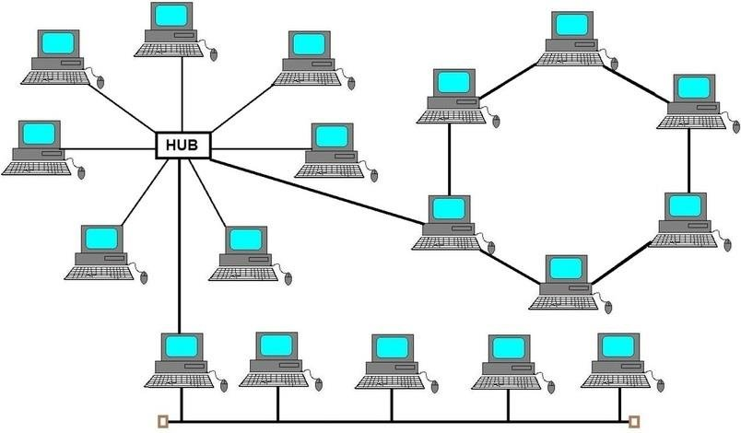
Hybrid Topology

