Slide 1
Computer Vision with Convolutional Neural Networks

Slide 2
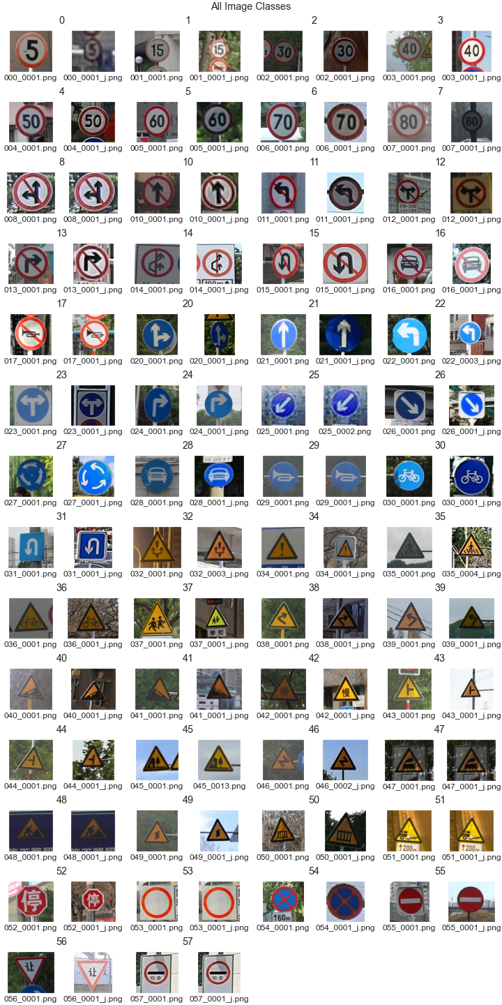
The Dataset
Source:
National Laboratory of Pattern Recognition
Total Images: 6164 .png files
Train Split: 4170
Test Split: 1994
Misc:
Varying Angles and Lighting
Various sizes and resolutions

Slide 3
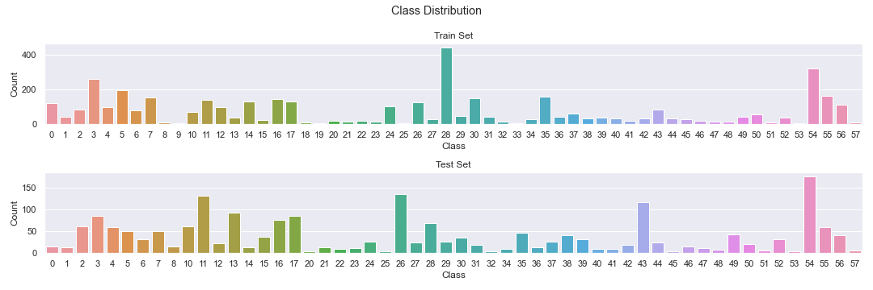

Slide 4
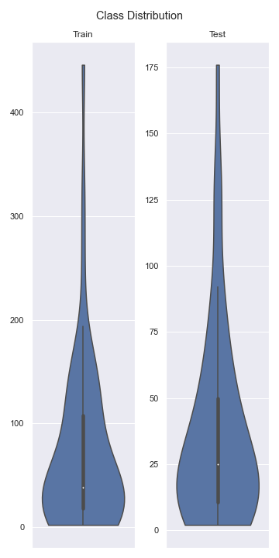

Slide 5
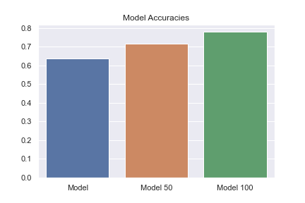

Slide 6
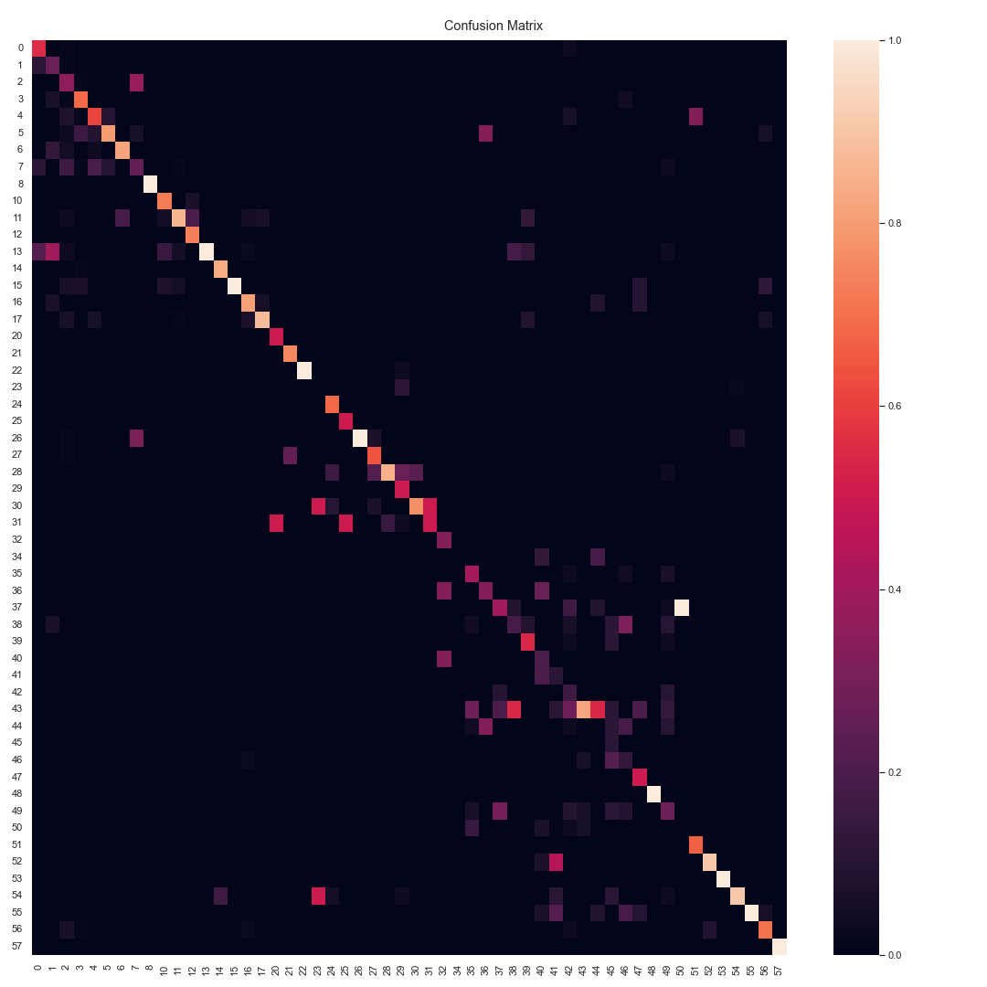

Slide 7
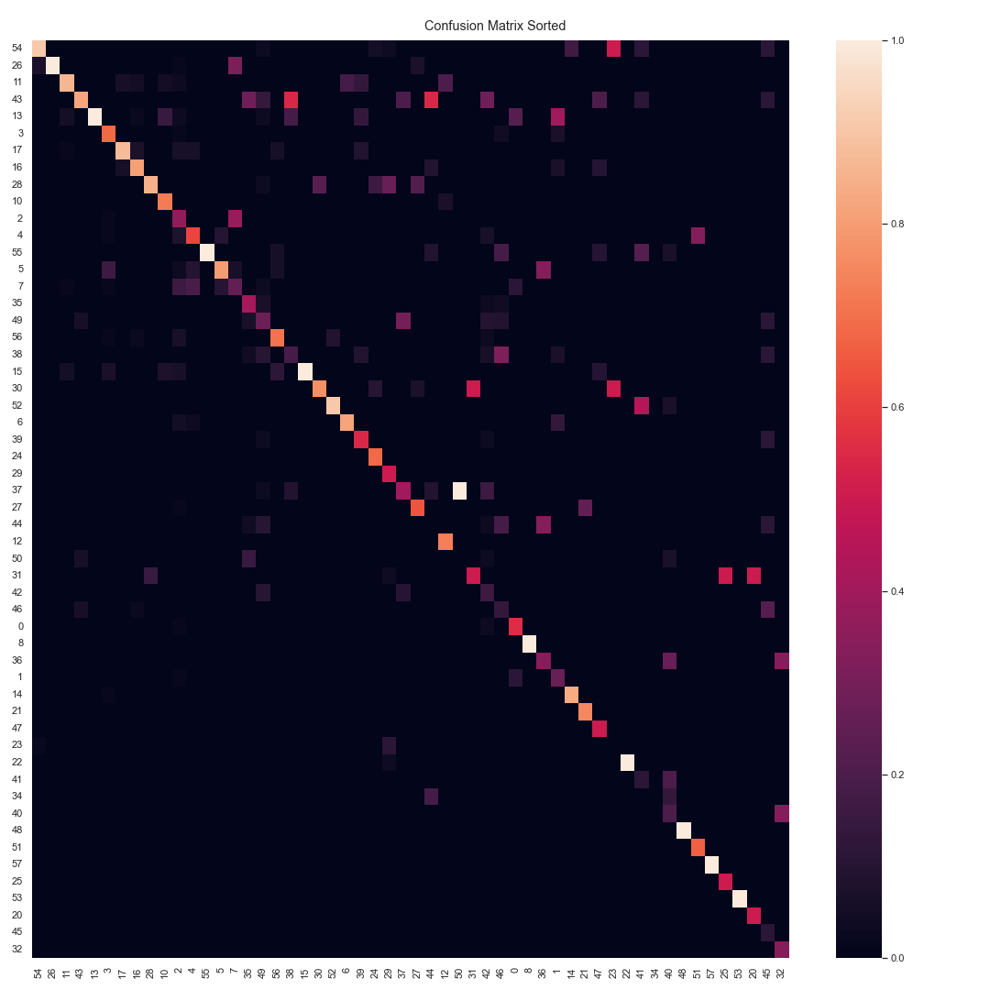

Slide 8
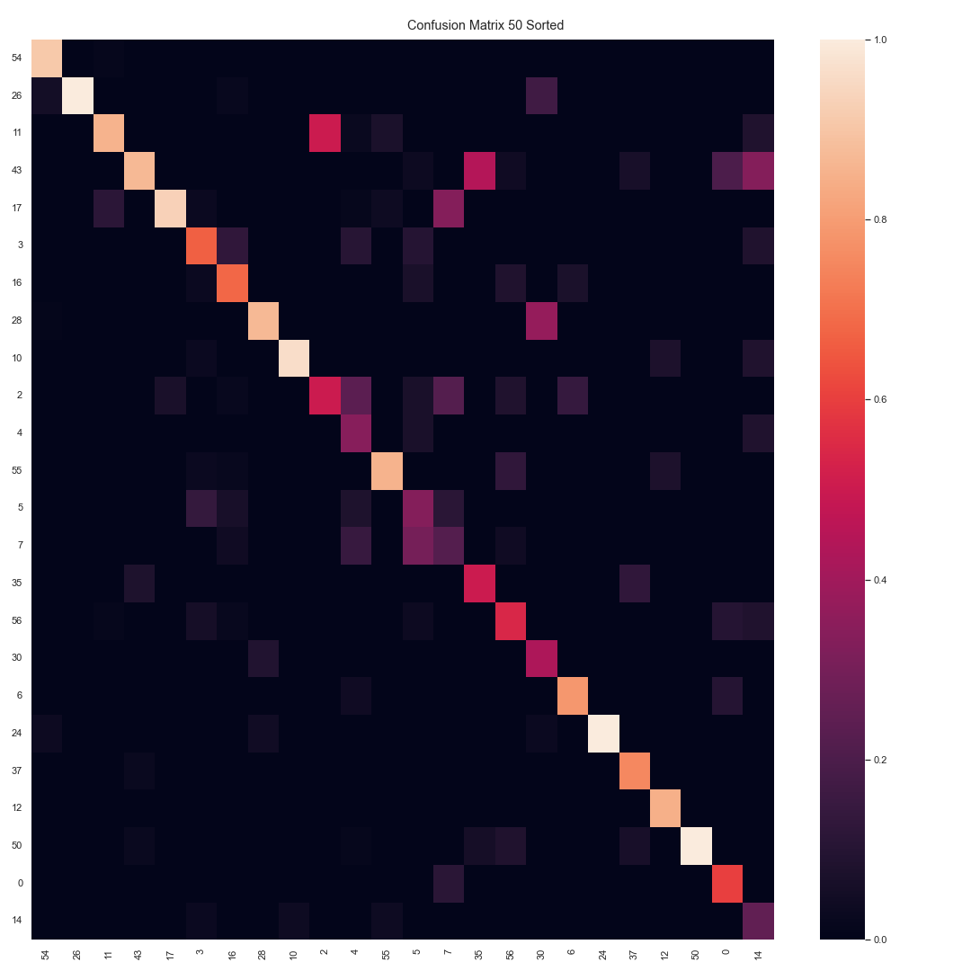

Slide 9
