Slide 1
Computer Vision with Convolutional Neural Networks

Slide 2
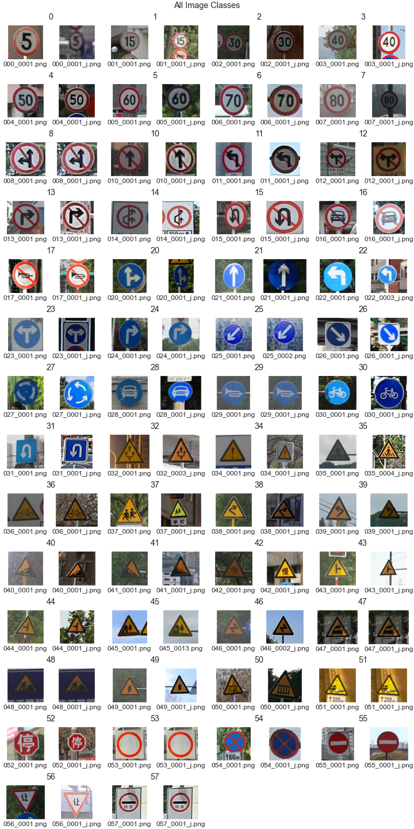
The Dataset
Source:
National Laboratory of Pattern Recognition
Total Images: 6164 .png files
Train Split: 4170
Test Split: 1994
Images:
Varying Angles and Lighting
Various sizes and resolutions

Slide 3
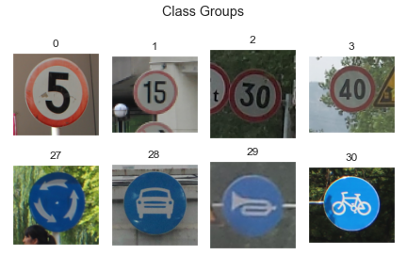

Slide 4
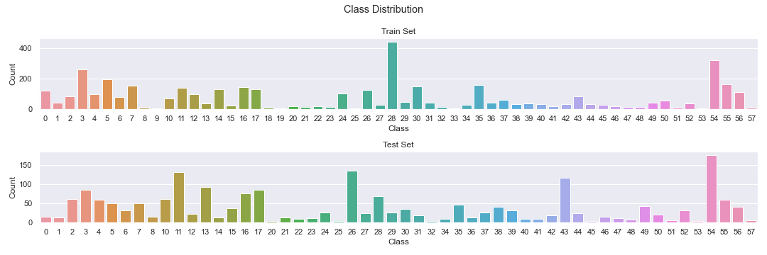

Slide 5
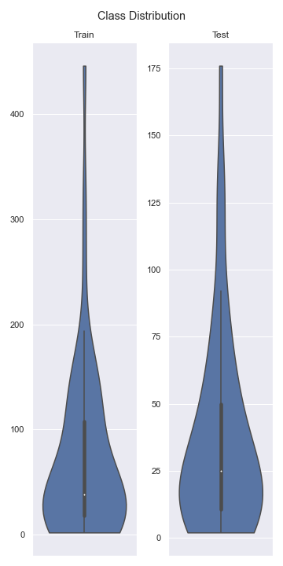

Slide 6
No Filter
Sample Size Threshold:
50
Sample Size Threshold:
100
Dataset 1
Dataset 2
Dataset 3

Slide 7
Convolutional Layer
Convolutional Layer
Convolutional Layer
Max Pooling Layer
Max Pooling Layer
Max Pooling Layer
Dense Layer
Result
Dense Layer

Slide 8
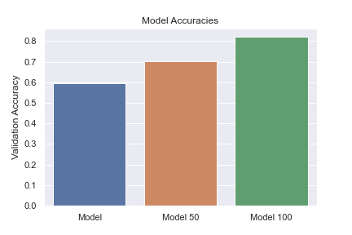
Baseline Accuracy: 10-12 %

Slide 9
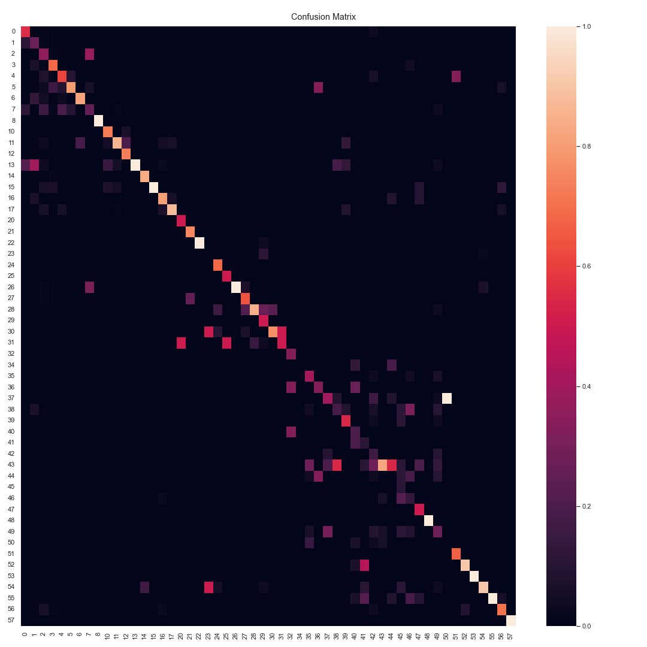
No Filter
Dataset 1

Slide 10
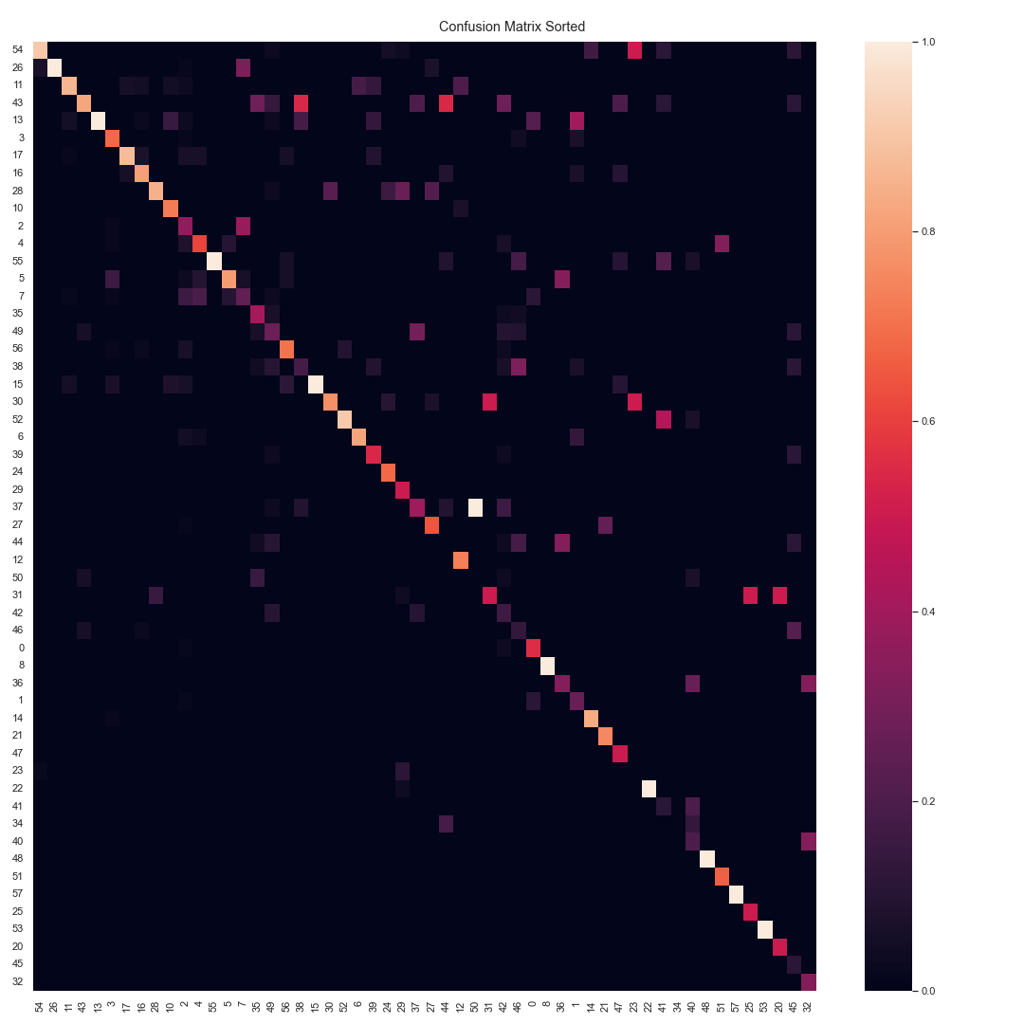
No Filter
Dataset 1

Slide 11
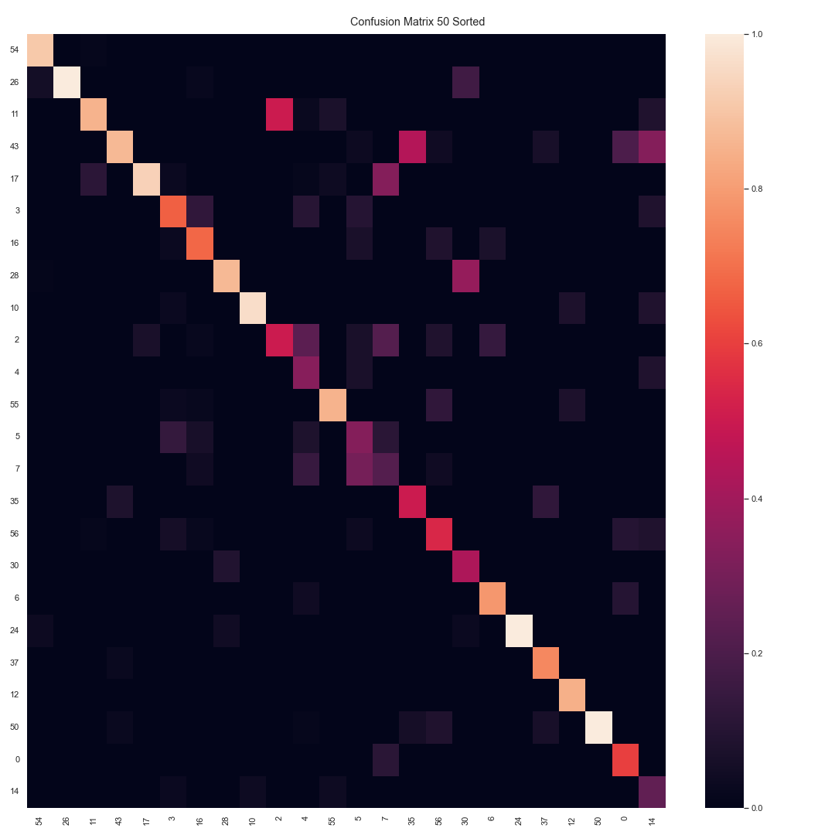
Sample Size Threshold:
50
Dataset 2

Slide 12
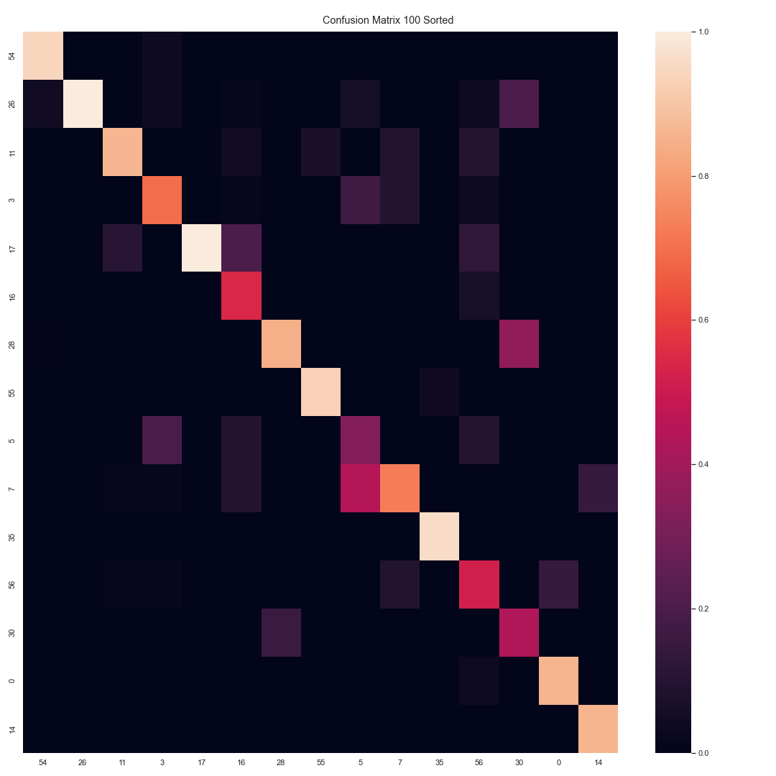
Sample Size Threshold:
100
Dataset 3

Slide 13
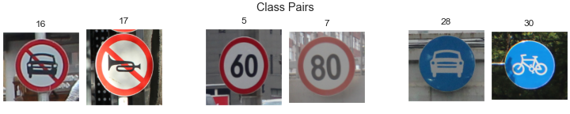

Slide 14
Further Exploration
Model’s performance with a more complete dataset
Ensemble Models

