Slide 1
Food Sales Predictions
By: Samuel Nojadera

Slide 2
Project Overview
Goal
Predict sales using regression algorithms
Determine the most important features that affect sales.
Models Used
Linear Regression
KNN Regression
Random Forest Regression

Slide 3
Data Cleaning
Null Values
Features:
Item_Weight
Outlet_Size
Dropping null values would result in dropping 5 unique outlets – a significant portion of the dataset as there only 10 unique outlets.
Methods Used
Item_Weight: mean
Outlet_Size: mode

Slide 4
Models – Finding Optimum Parameters
Optimum Parameters for KNN and Random Forest Regression
KNN:
N Neighbors range: 1 to 500
Random Forest:
N Estimators range: 10 to 500

Slide 5
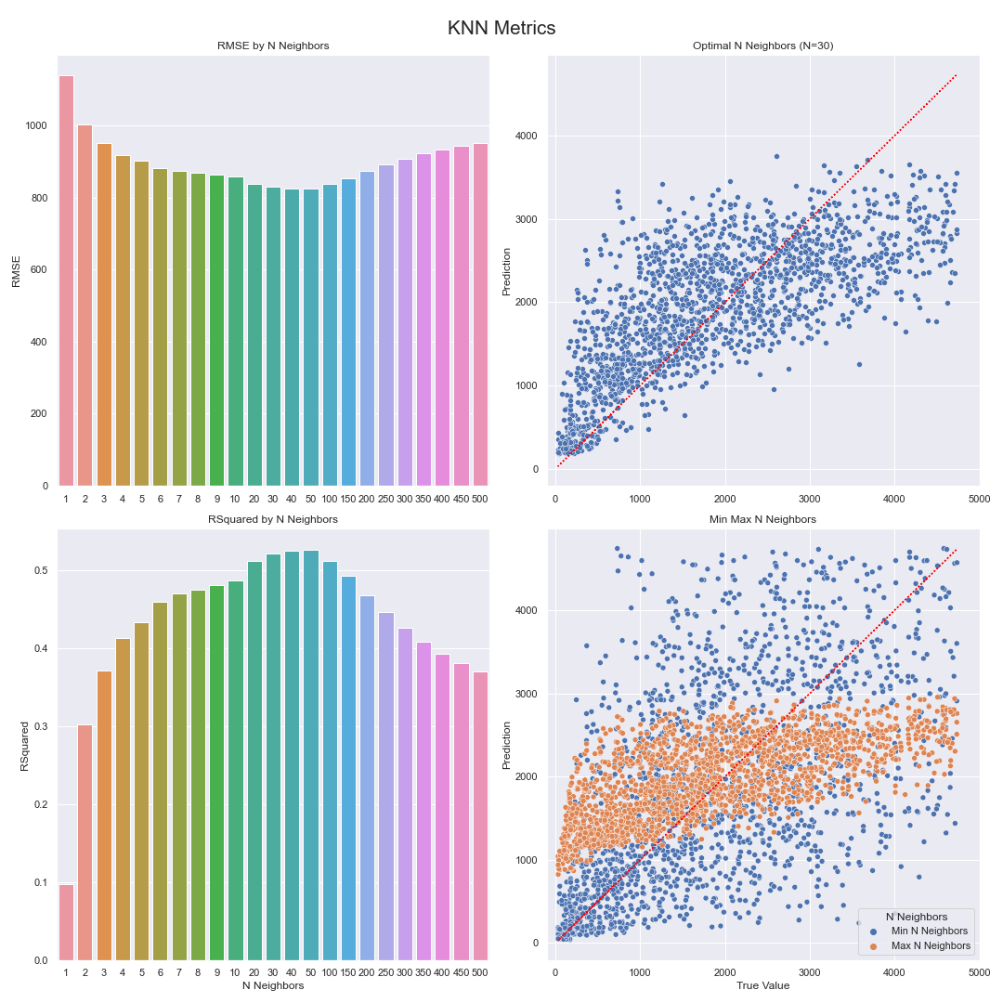
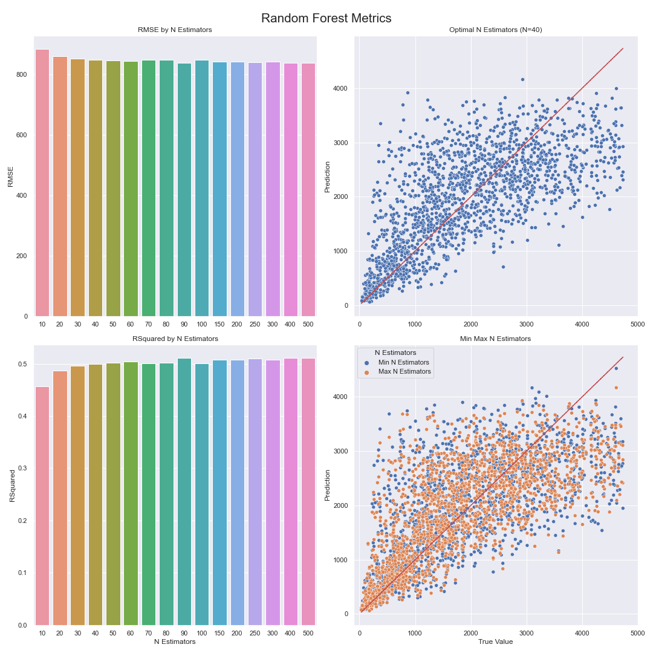

Slide 6
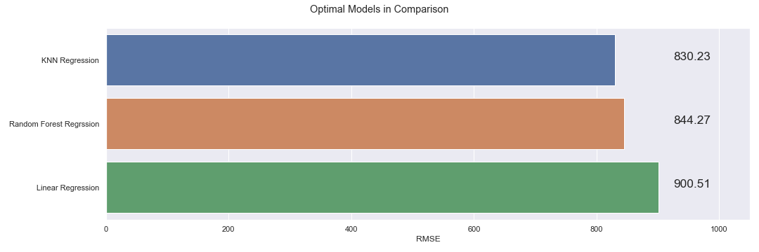
Models – In Comparison

Slide 7
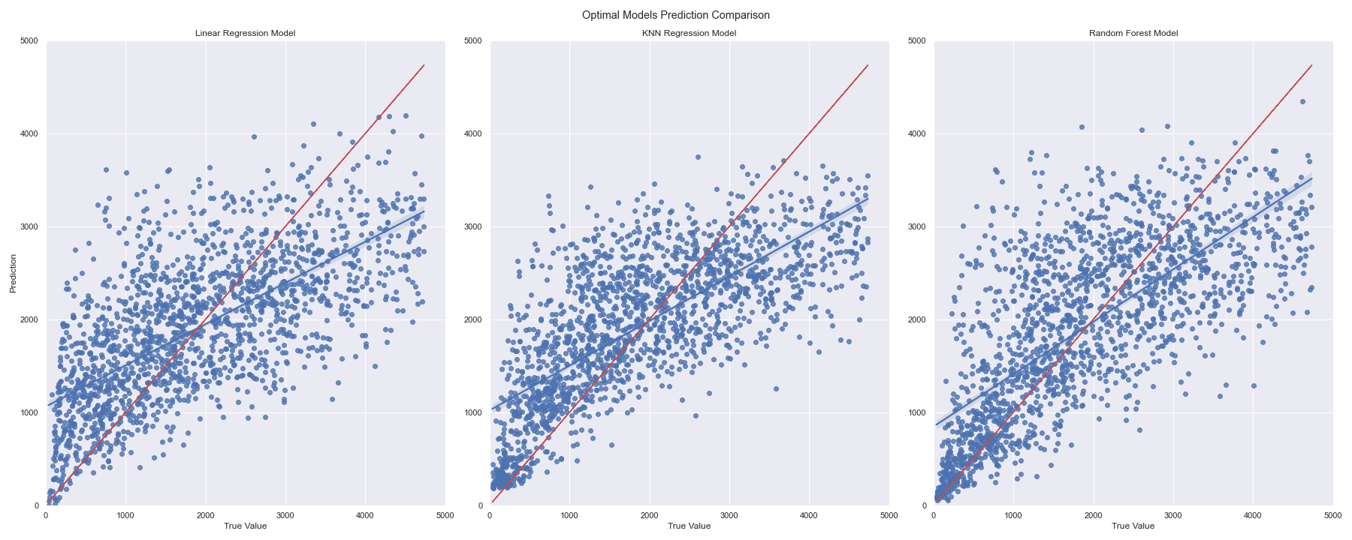
Models – In Comparison

Slide 8
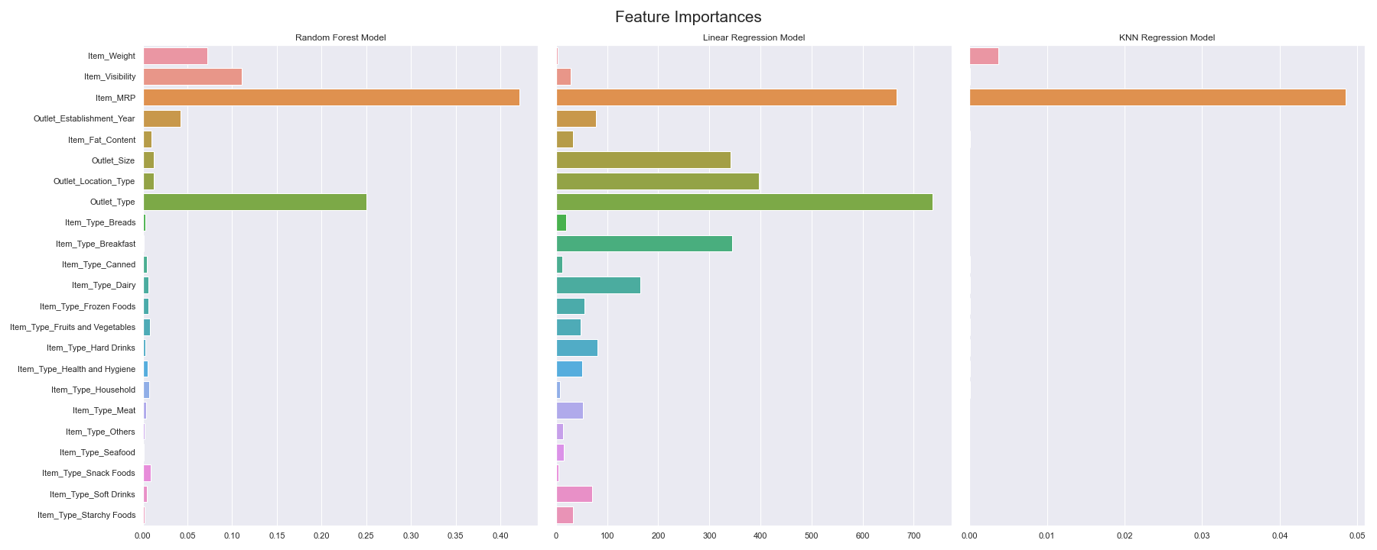
Models – Feature Importance

Slide 9
Models – Feature Importance
Item MRP
It is the obvious most relevant feature.
Outlet Type
Affects sales at a sufficient level.
Actionable.

Slide 10
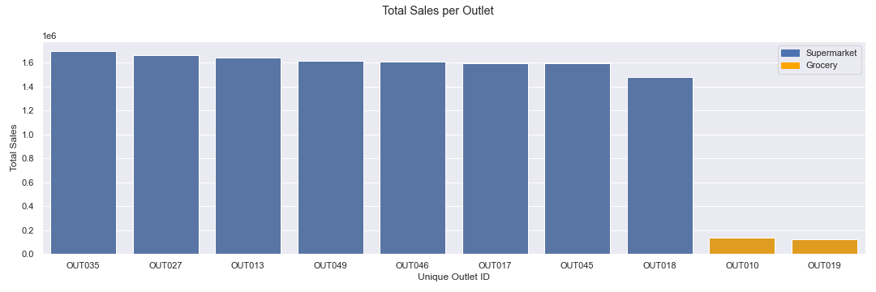
Sales Per Outlet

Slide 11
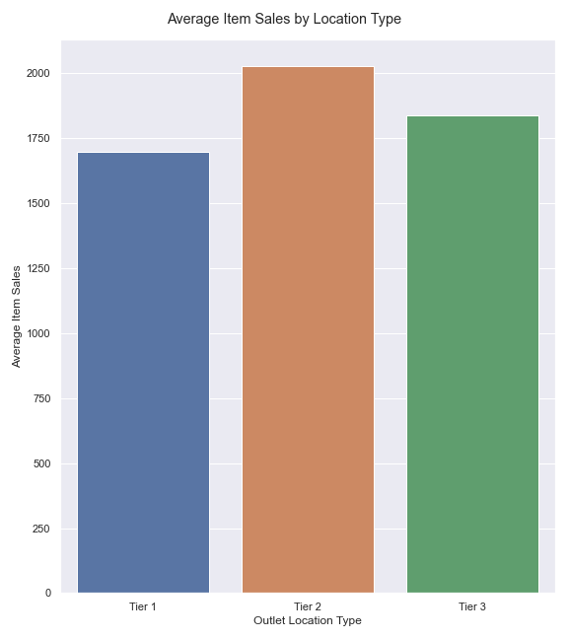
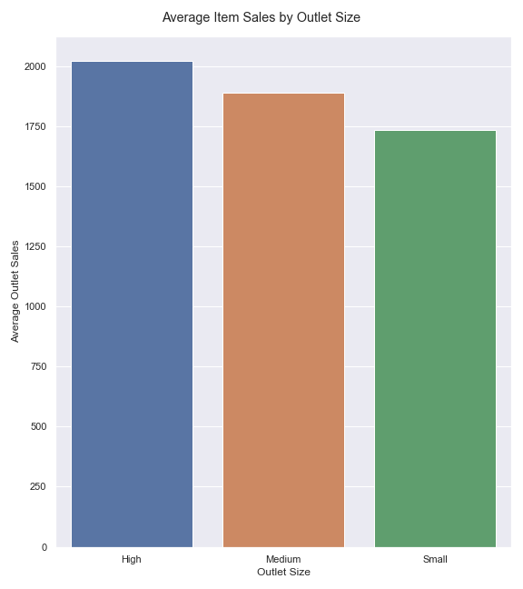
Average Sales

Slide 12
Recommendations
Focus development on supermarkets.
Location tier and outlet size average out to similar sales values meaning that its effects on sales is minor.
Final Model Choice
Random Forest Regression

