Slide 1
Web Scraping Craigslist
Manhattan Apartments

Slide 2
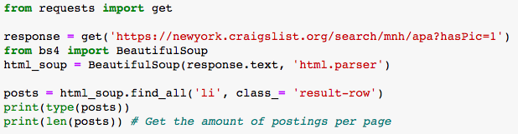
Getting the Data
BeautifulSoup was used to scrape data
Found the number of posts on each page to be 120

Slide 3
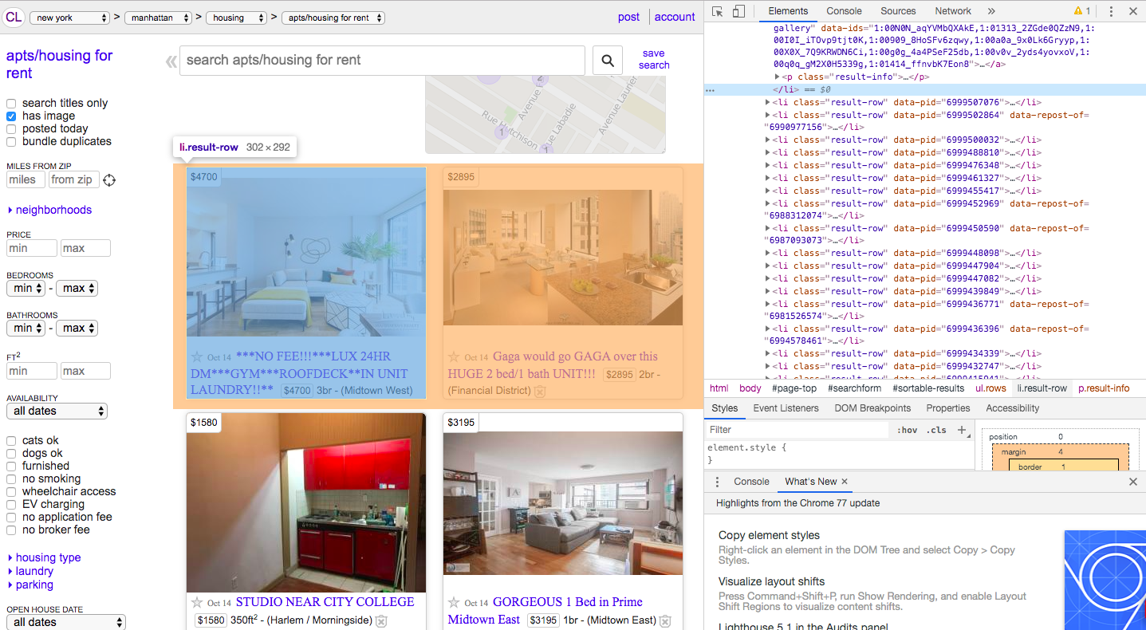
Getting the Data
Notes:
Found the results for each post belonging to the <li> tag

Slide 4
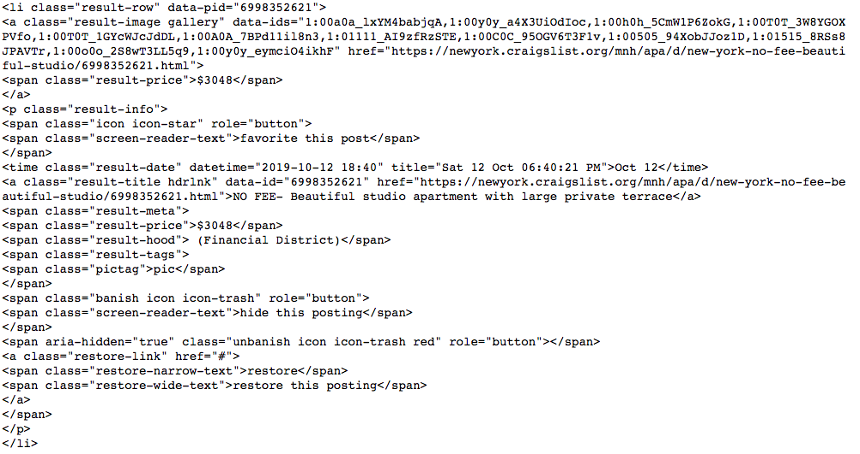
Getting the Data
Found the attributes for:
Time Posted
Neighborhoods
Number of bedrooms
Square Feet
URL
Price
Notes:
The output data I used to define the attributes

Slide 5
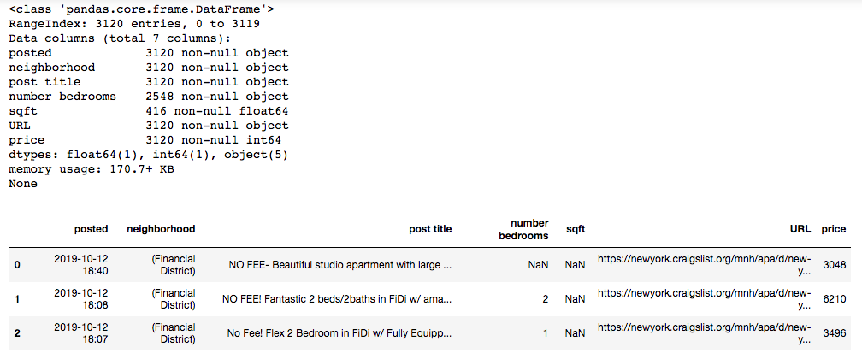
Getting the Data
An overview of the data that was scraped
Notes:
Dataframe of the values

Slide 6
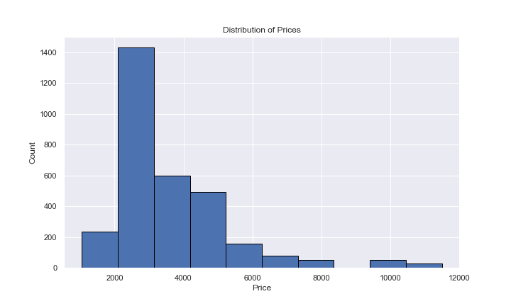
Data Analysis
Plot of Manhattan apartment listing prices
Histogram of Overall Prices
Notes:
Distribution of the prices

Slide 7
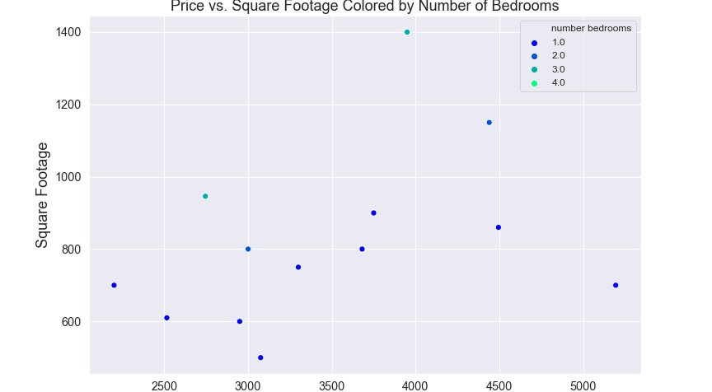
Data Analysis
Scatterplot for Price versus Square Feet
Notes:
Try to find relationship between square feet, somewhat of a positive correlation, didn’t have a good amount of data

Slide 8
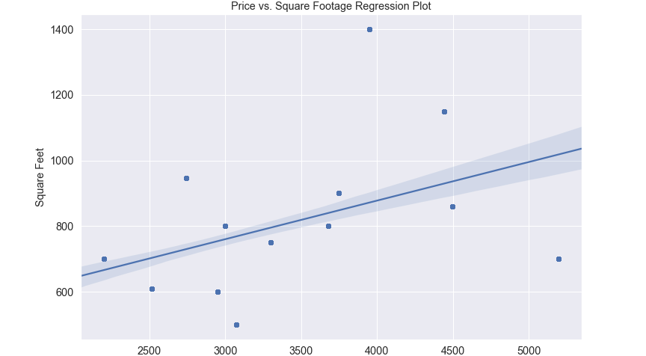
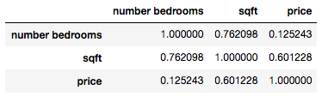
Data Analysis
Regression plot for Price versus Square Feet
Notes:
Shows the correlation between the variables

Slide 9
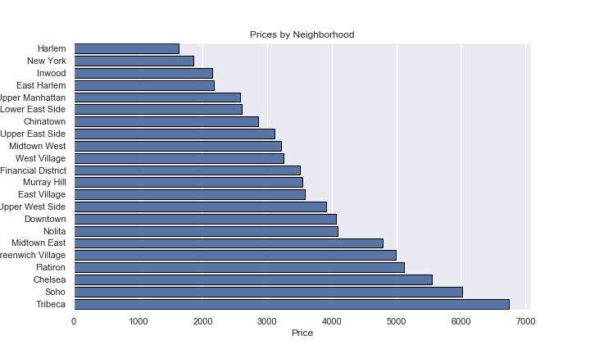
Data Analysis
Bar graph for the base Price of Manhattan Neighborhoods
Notes:
Average price per Neighborhood

