Slide 1
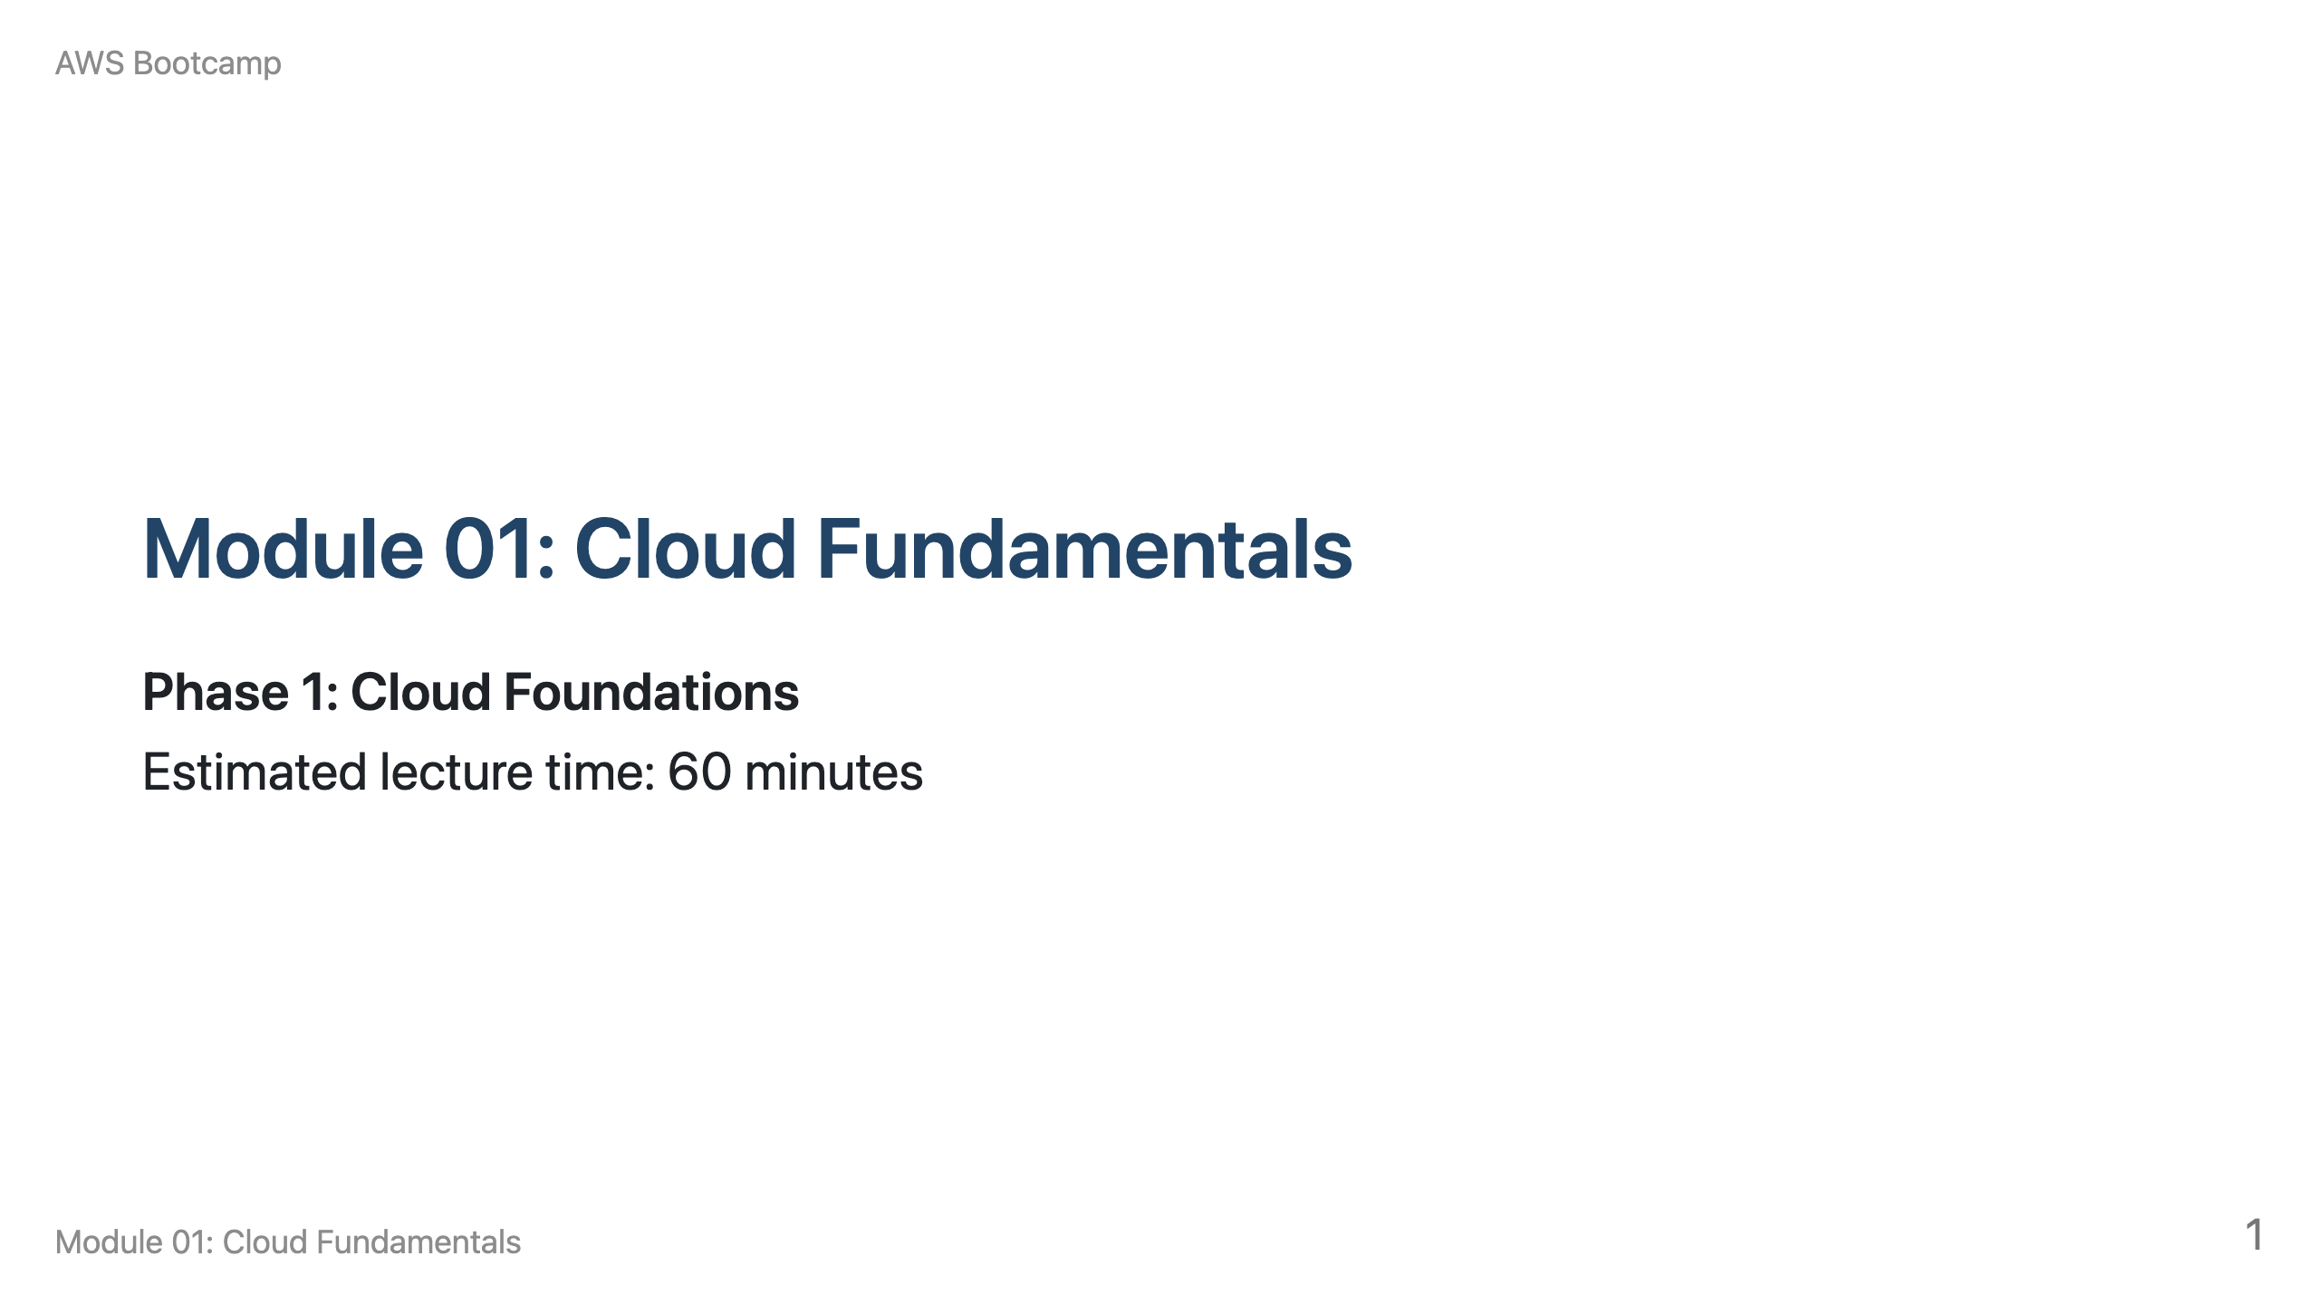
Notes:
Speaker notes: Welcome students to the first module of the AWS Bootcamp. This module covers the foundational concepts that every subsequent module builds on. Total lecture time is approximately 60 minutes: 10 min cloud computing basics, 10 min service/deployment models, 15 min AWS global infrastructure, 10 min shared responsibility, 15 min discussion and Q&A.

Slide 2
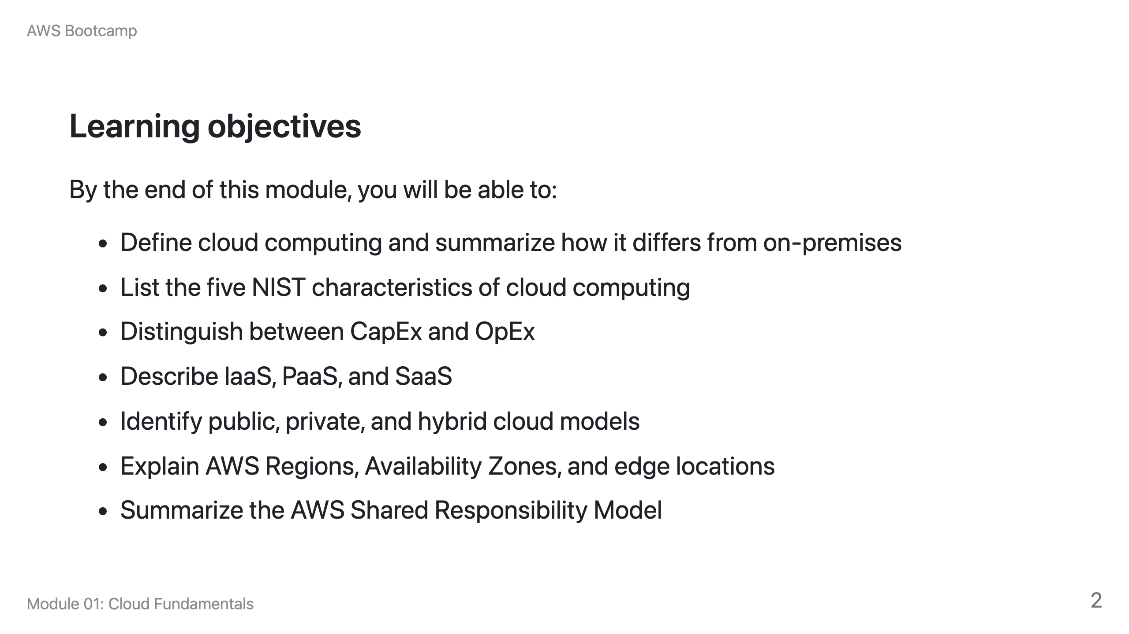

Slide 3
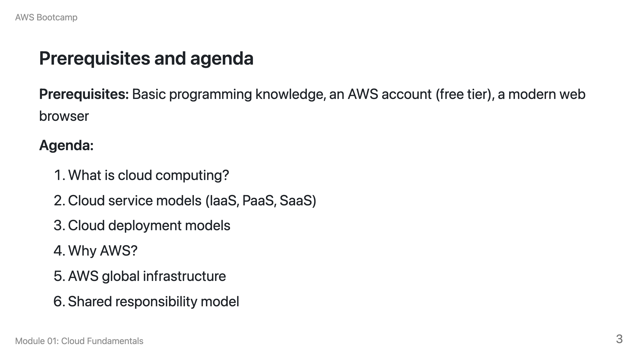

Slide 4
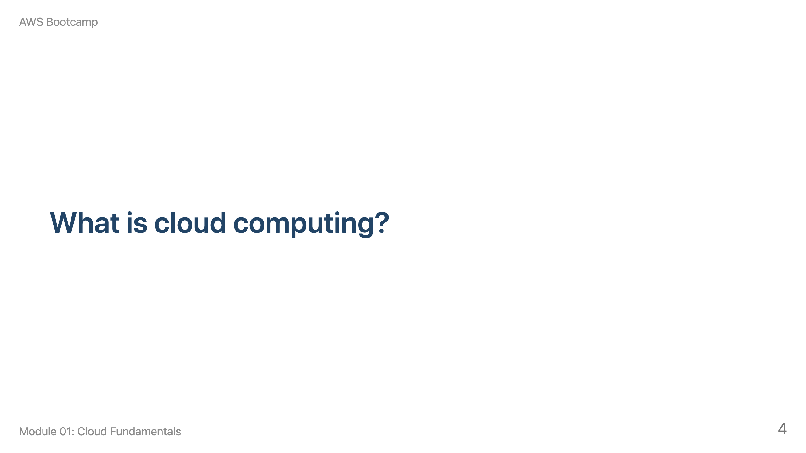
Notes:
Speaker notes: This section takes approximately 10 minutes. Start by asking students how they think traditional IT infrastructure works, then contrast it with cloud computing.

Slide 5
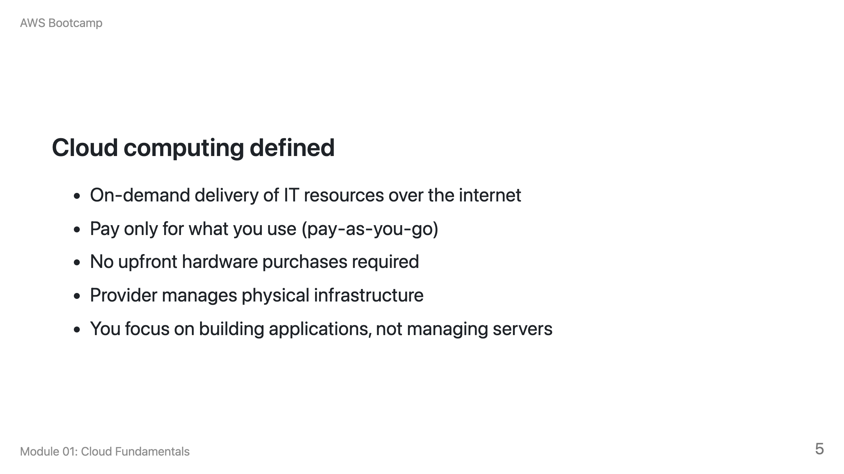

Slide 6
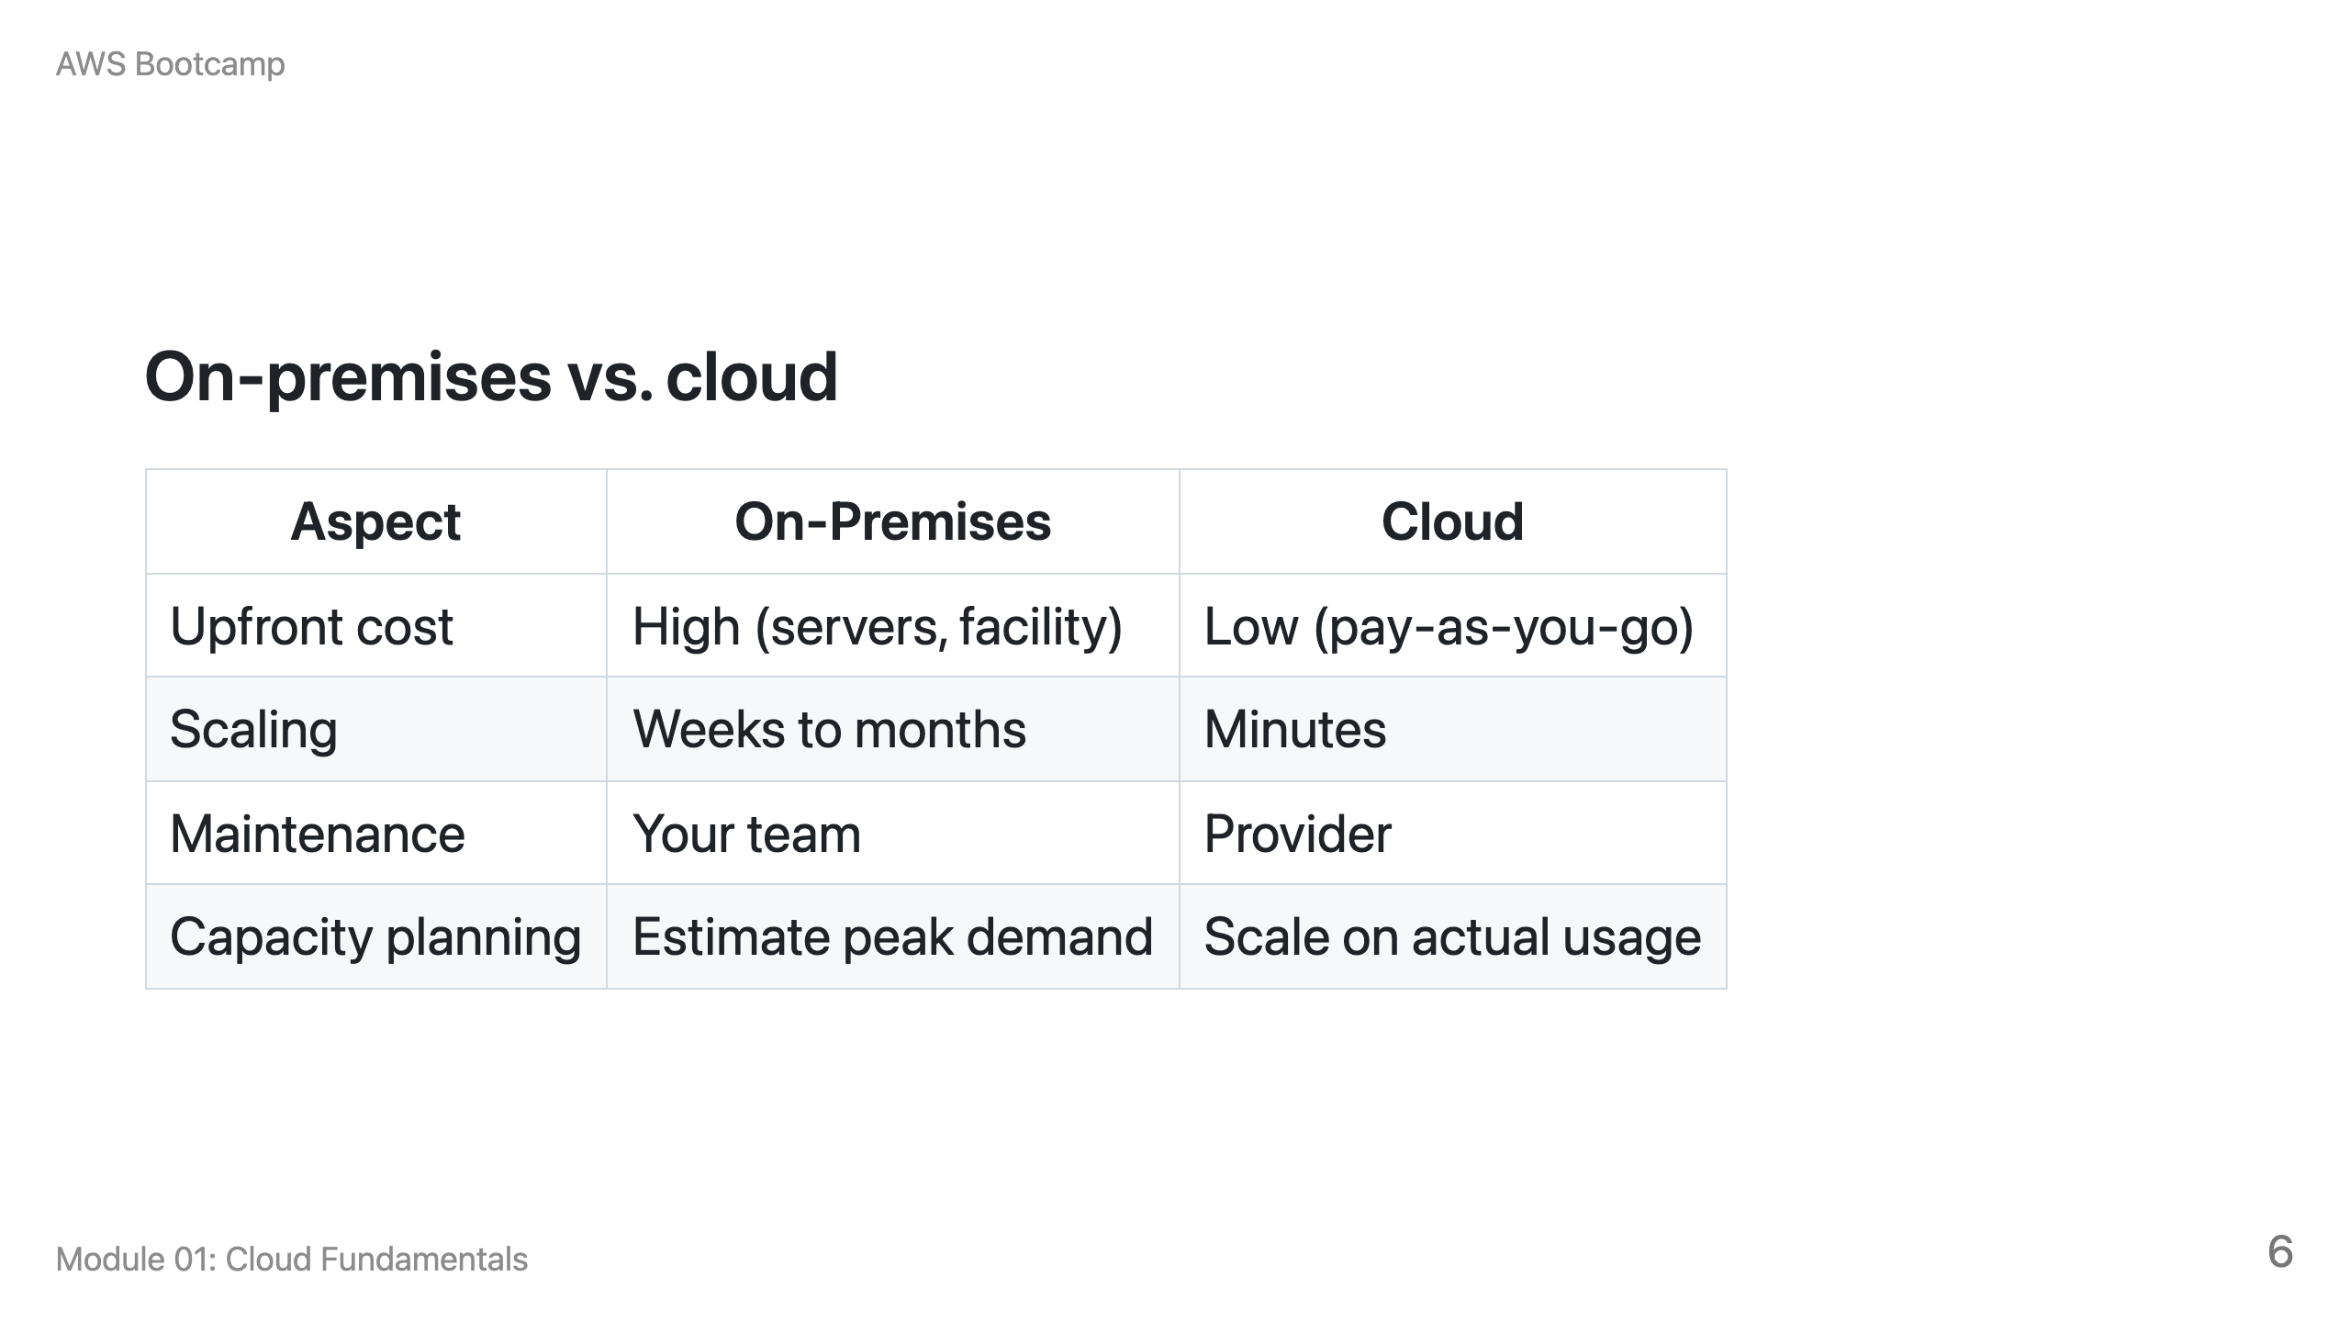

Slide 7
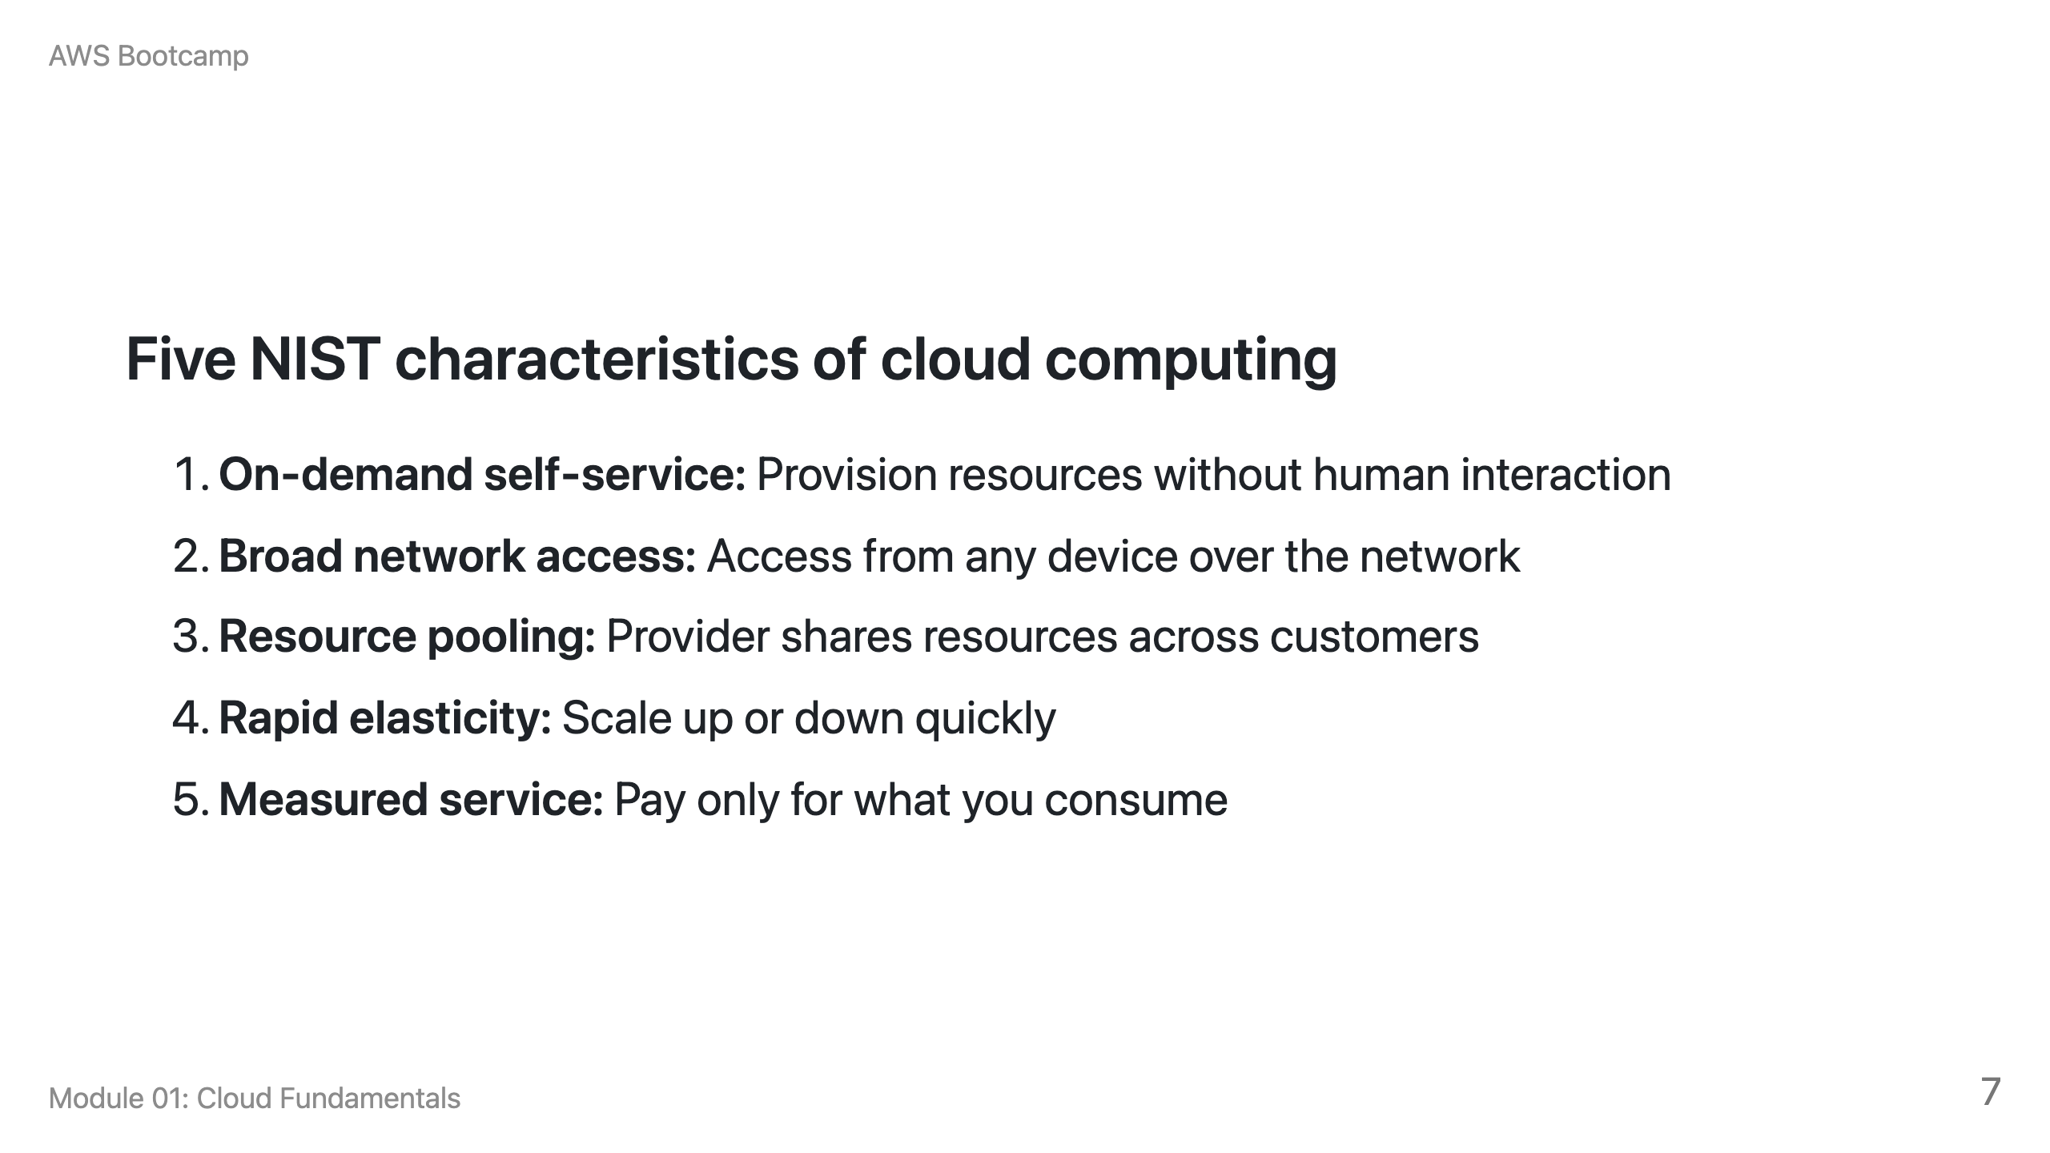

Slide 8
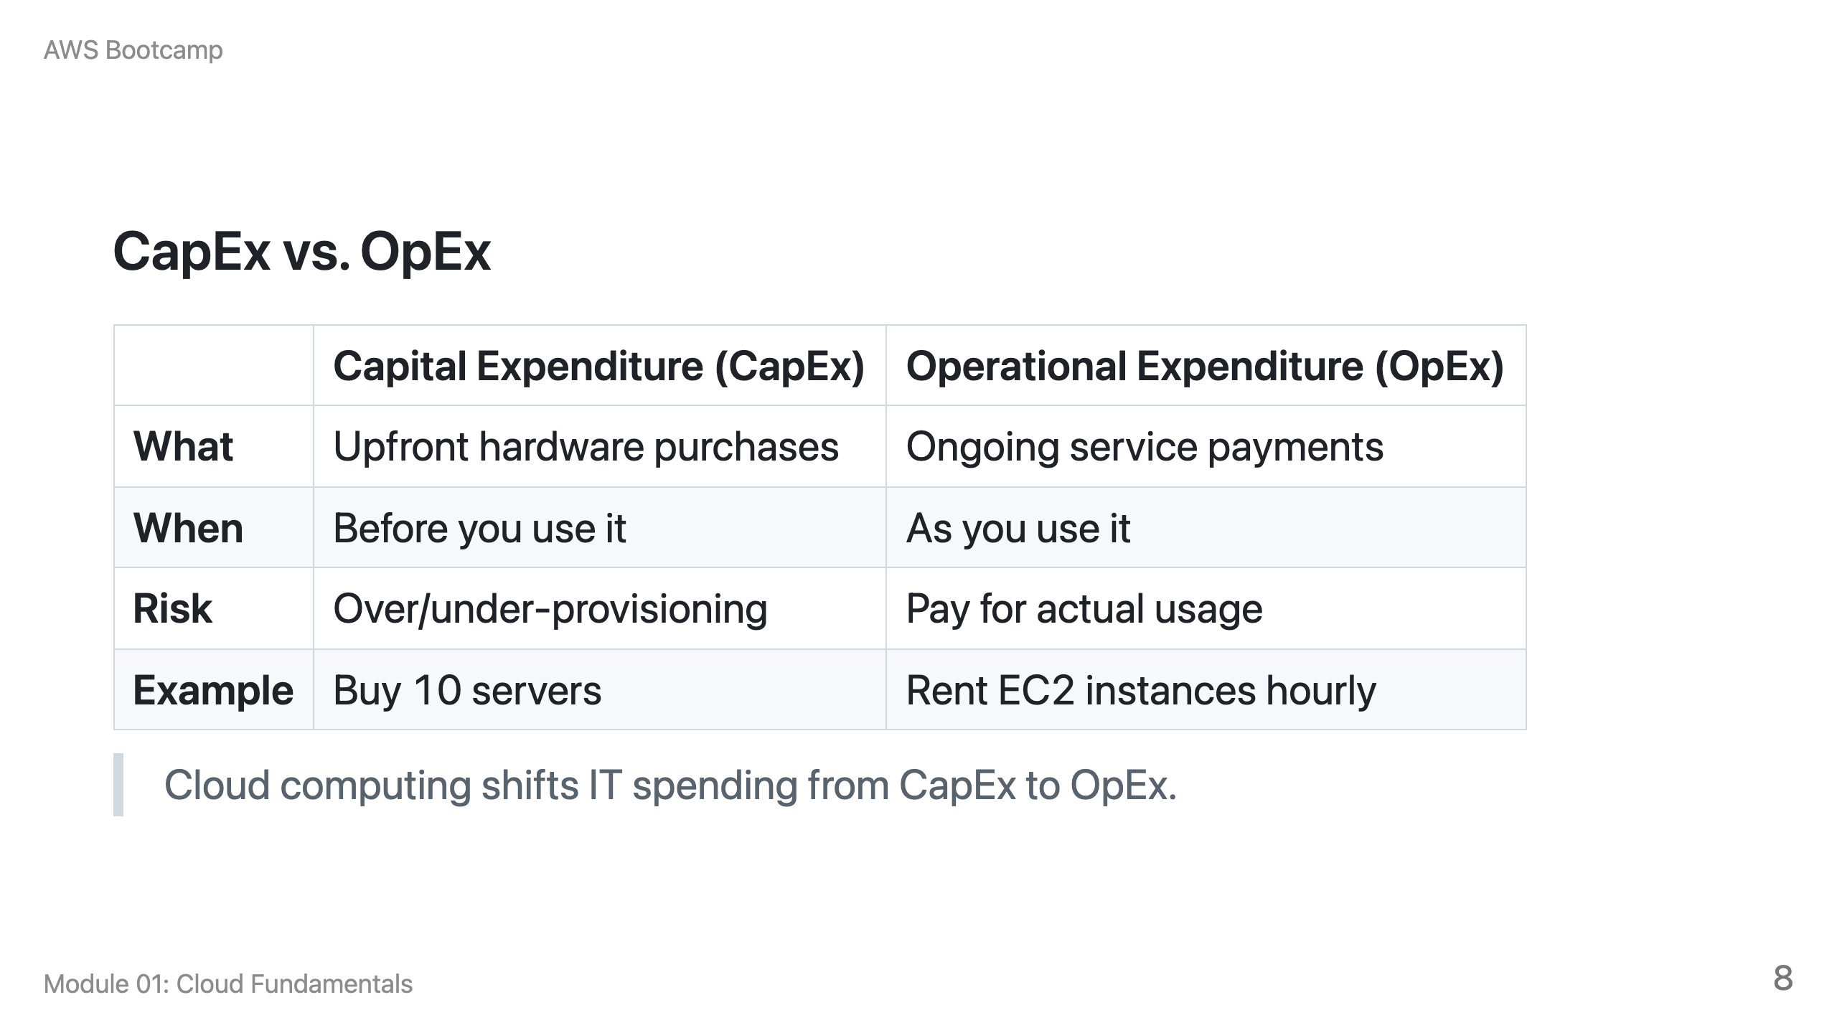

Slide 9
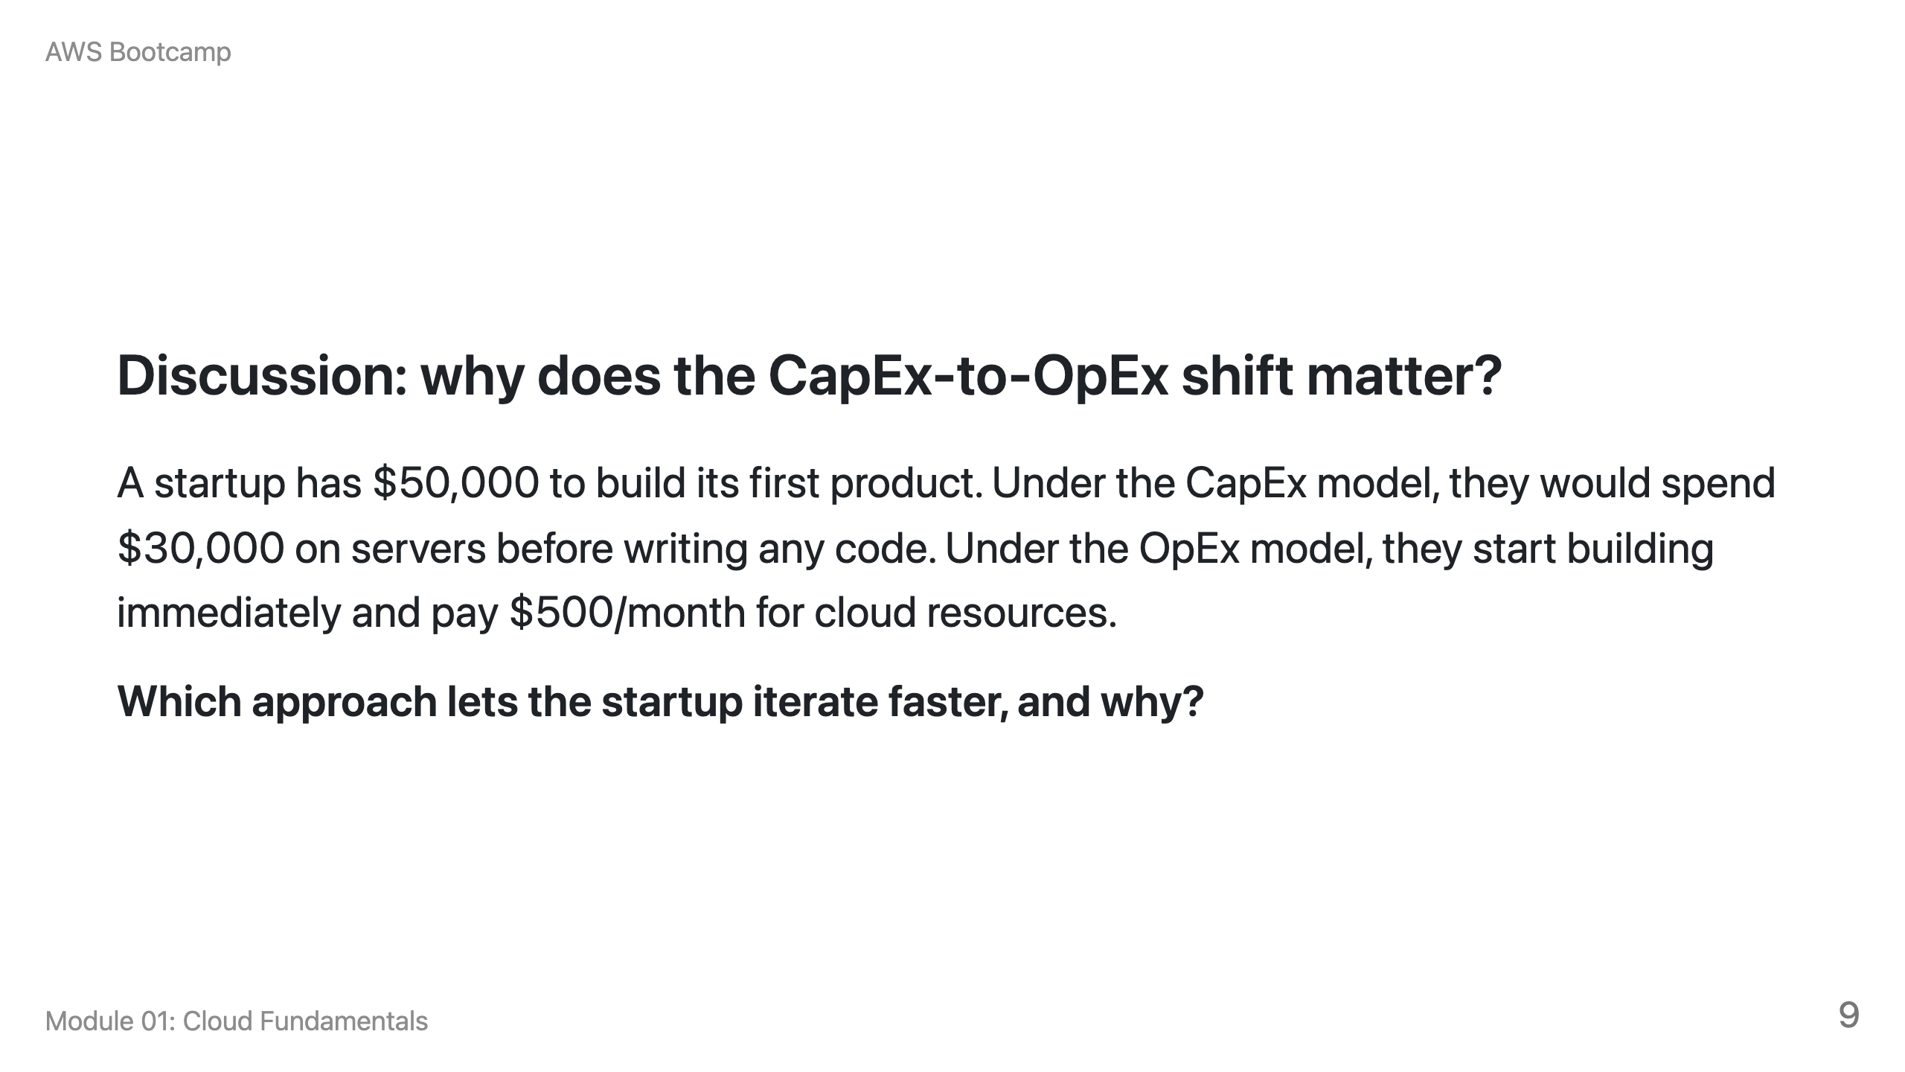
Notes:
Speaker notes: Expected answer: OpEx (cloud) lets them start immediately, adjust resources as they learn what they need, and avoid the risk of buying the wrong hardware. The $30,000 CapEx investment is a sunk cost even if the product pivots.

Slide 10
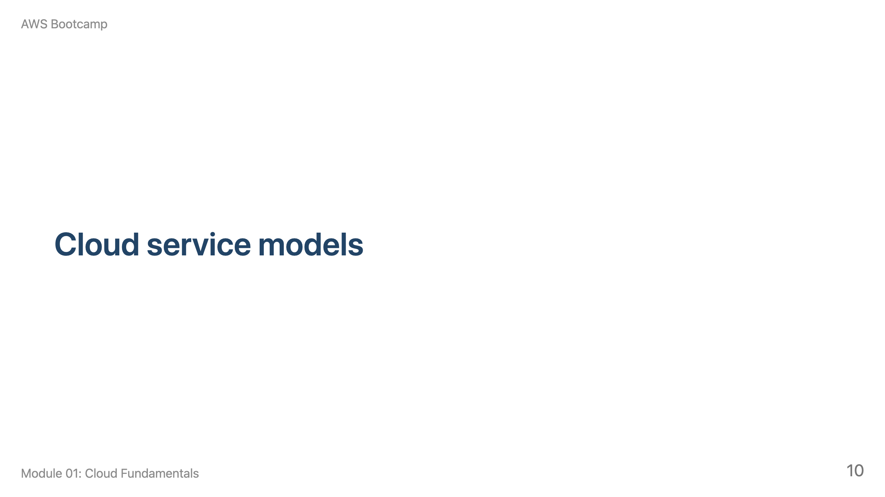
Notes:
Speaker notes: This section takes approximately 5 minutes. Use the table on the next slide to show the spectrum from IaaS (you manage most) to SaaS (provider manages most).

Slide 11
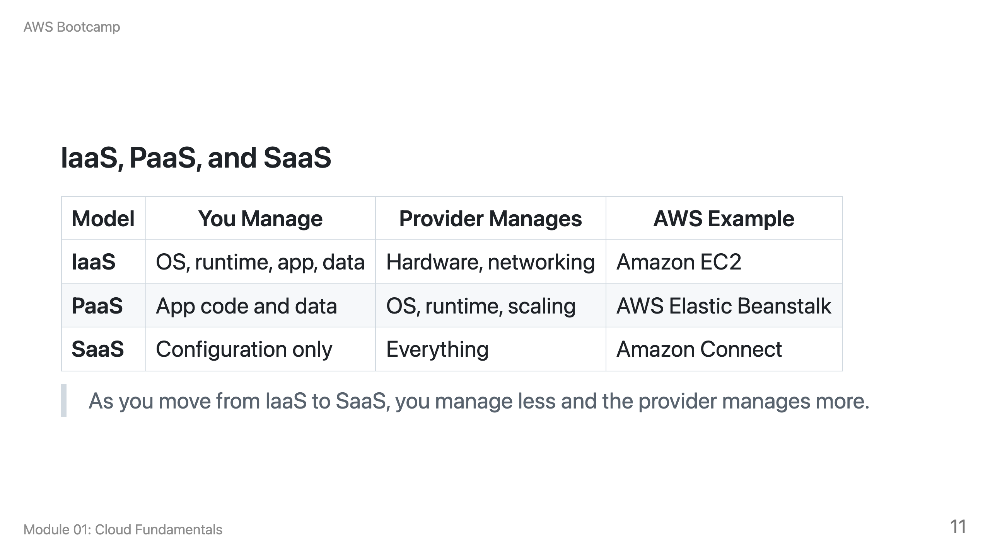

Slide 12
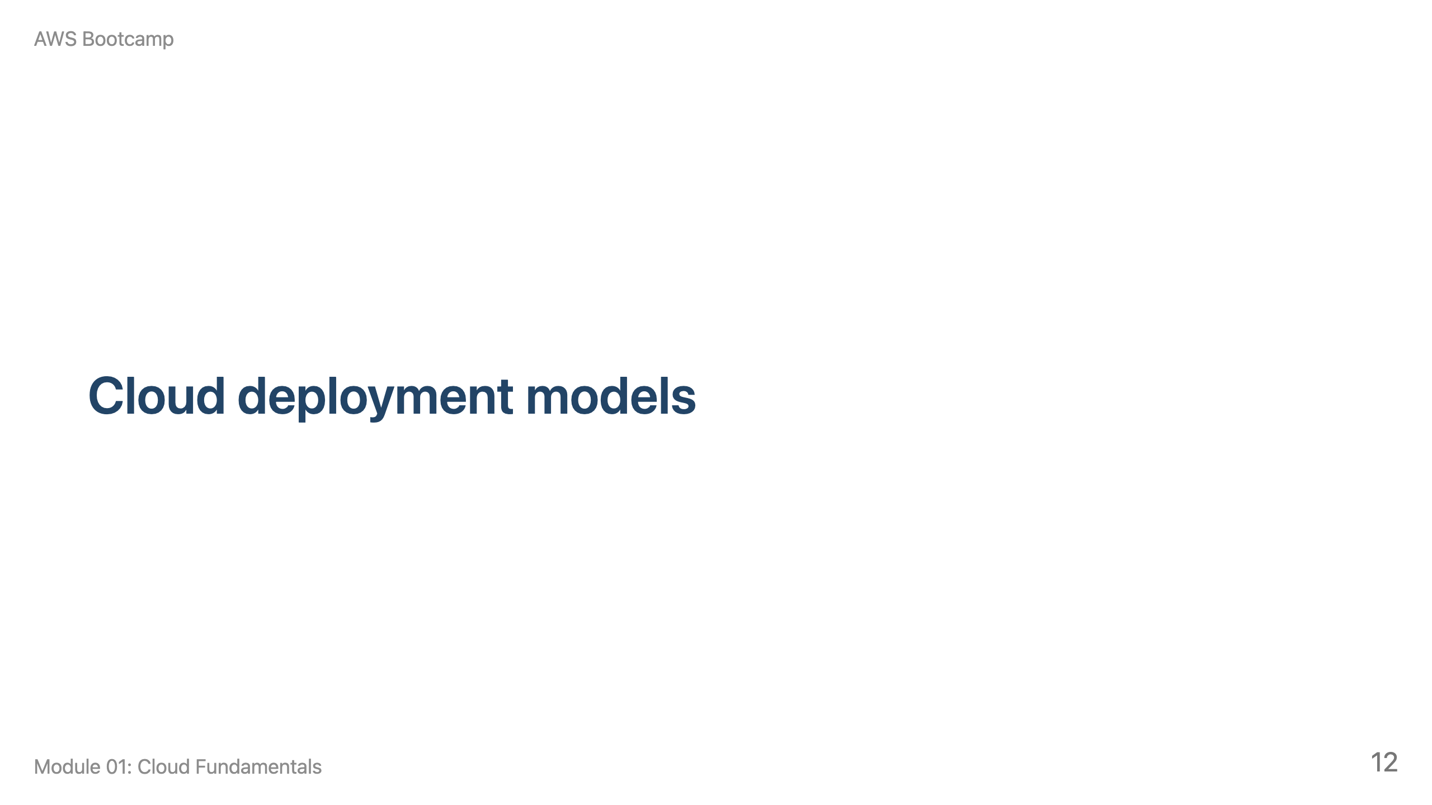
Notes:
Speaker notes: This section takes approximately 5 minutes. Emphasize that most bootcamp labs use the public cloud model.

Slide 13
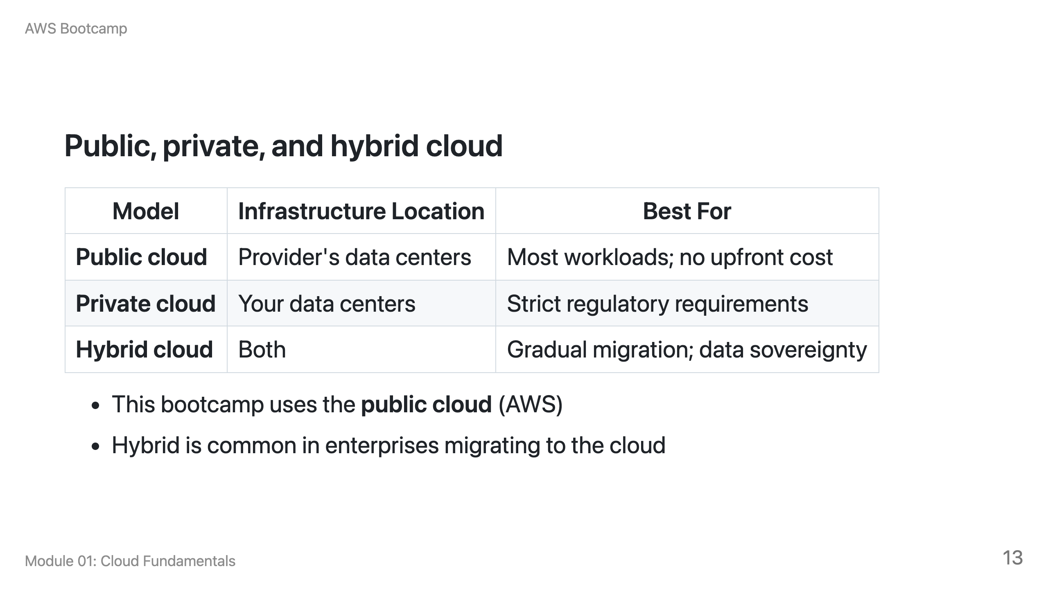

Slide 14
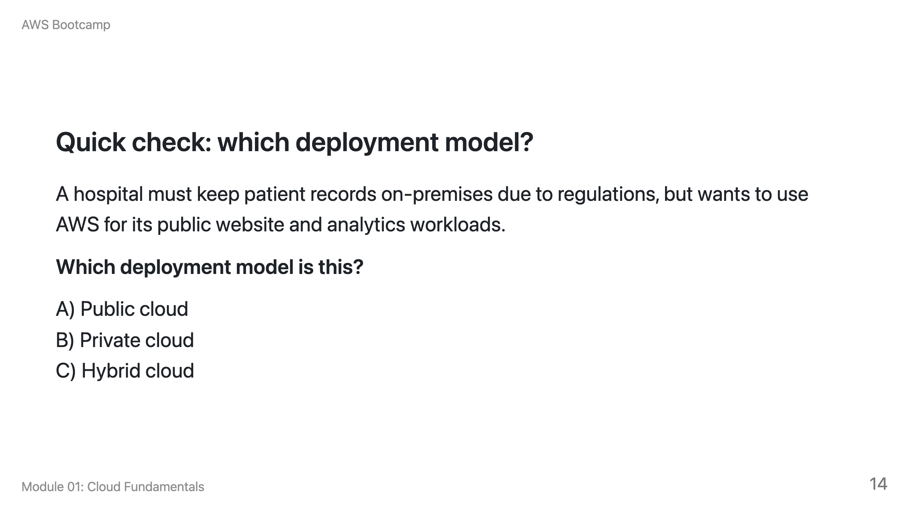
Notes:
Speaker notes: Answer: C) Hybrid cloud. The hospital uses on-premises for regulated data and public cloud for non-regulated workloads. This is a common pattern in healthcare and financial services.

Slide 15
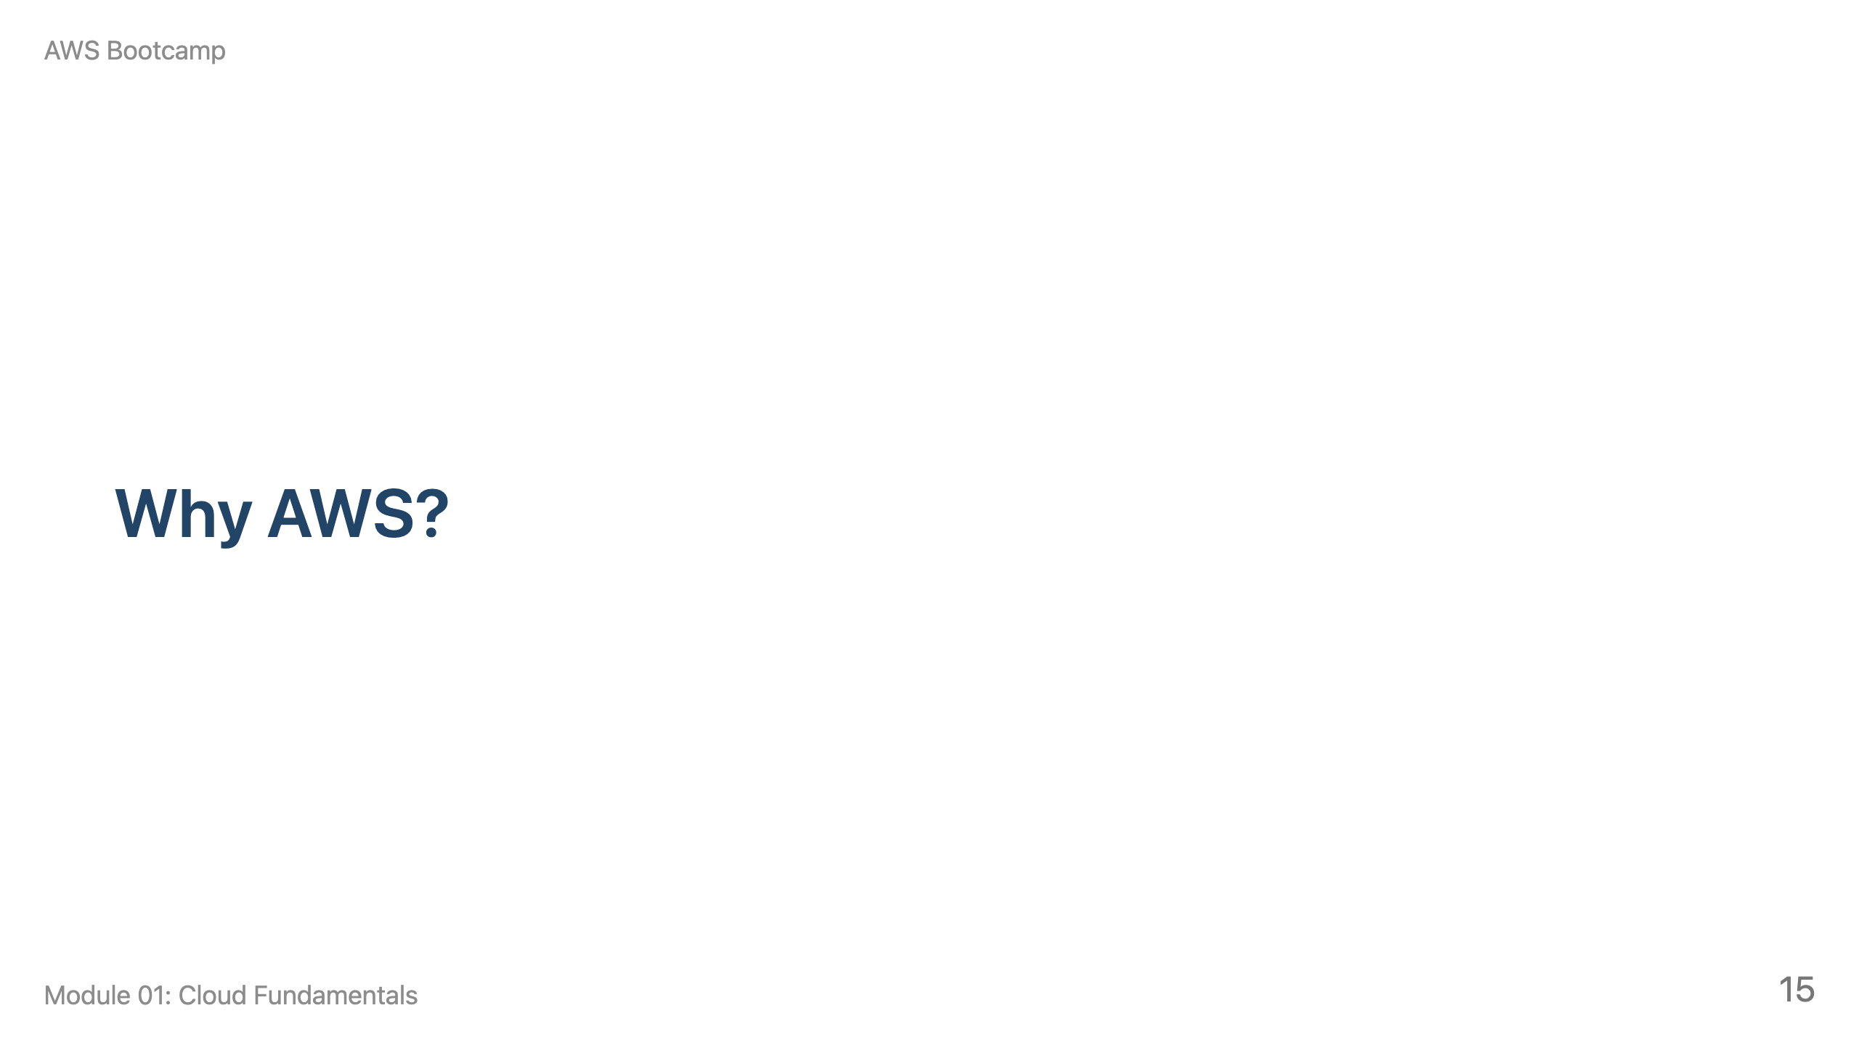
Notes:
Speaker notes: This section takes approximately 15 minutes. Cover the global infrastructure, then the shared responsibility model. Use the map analogy: Regions are cities, AZs are neighborhoods, edge locations are local post offices.

Slide 16
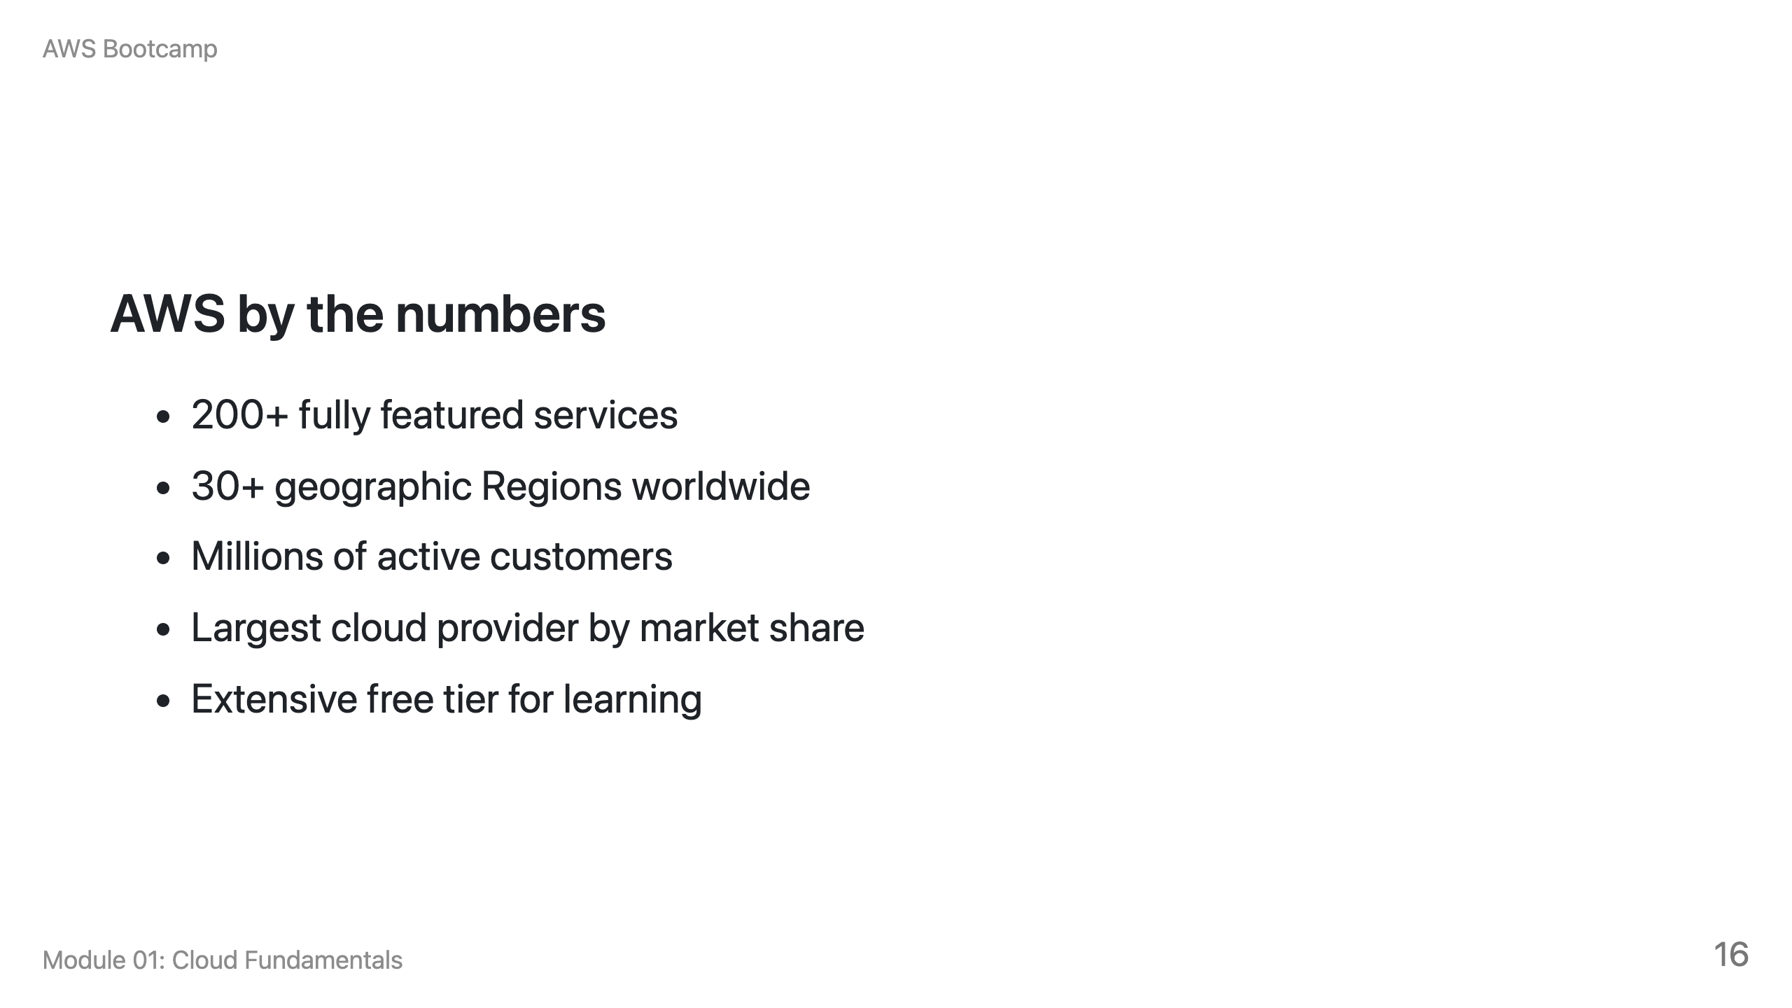

Slide 17
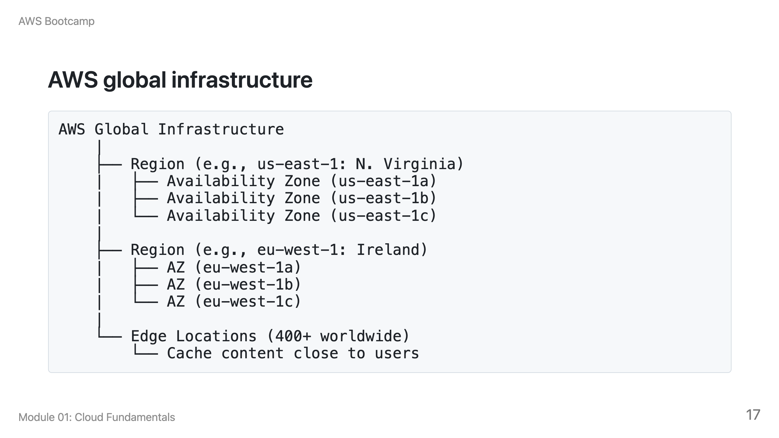

Slide 18
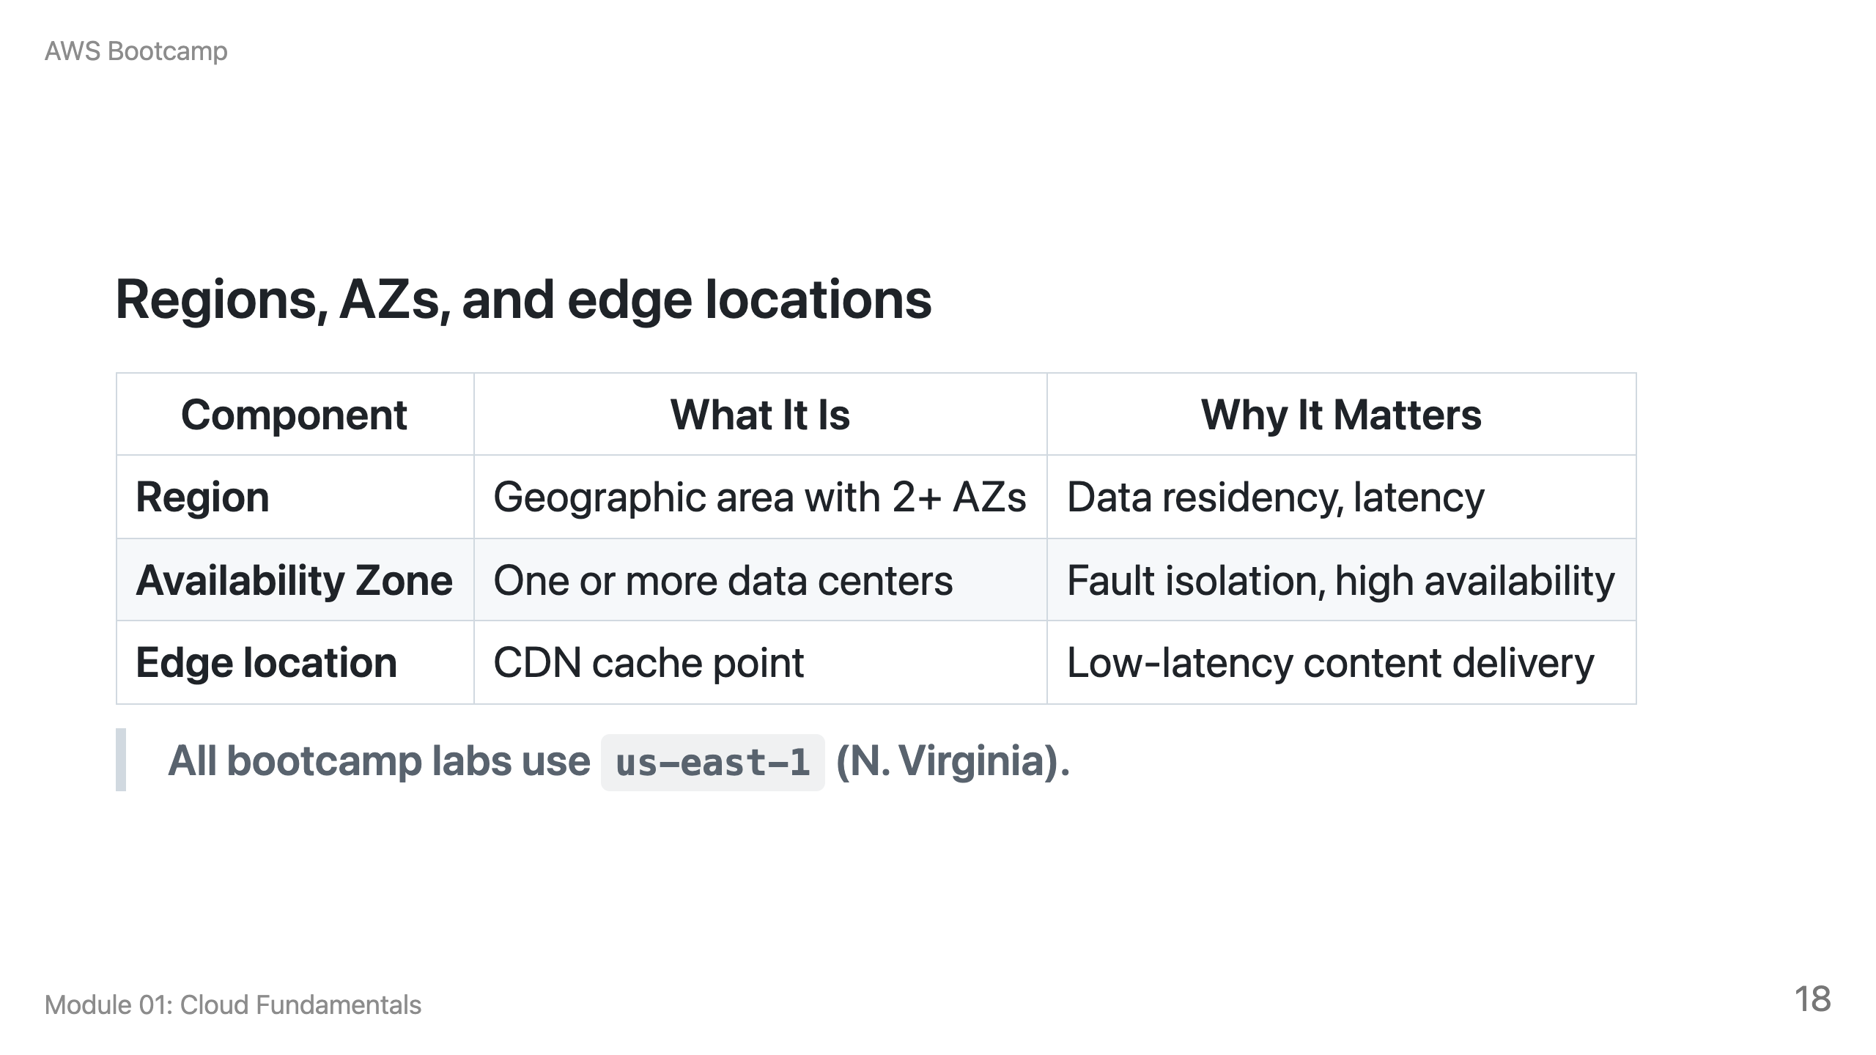

Slide 19
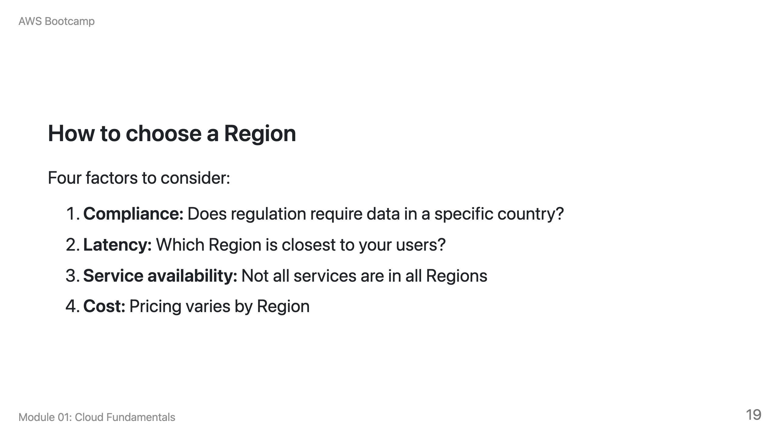

Slide 20
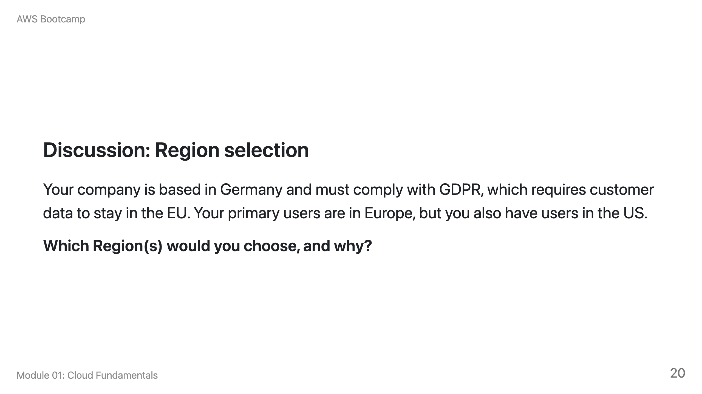
Notes:
Speaker notes: Expected answer: eu-central-1 (Frankfurt) or eu-west-1 (Ireland) for the primary deployment to meet GDPR requirements. For US users, consider a second deployment in us-east-1 or use CloudFront edge locations to reduce latency. This is a multi-Region discussion that previews Module 16 (Reliability and DR).

Slide 21
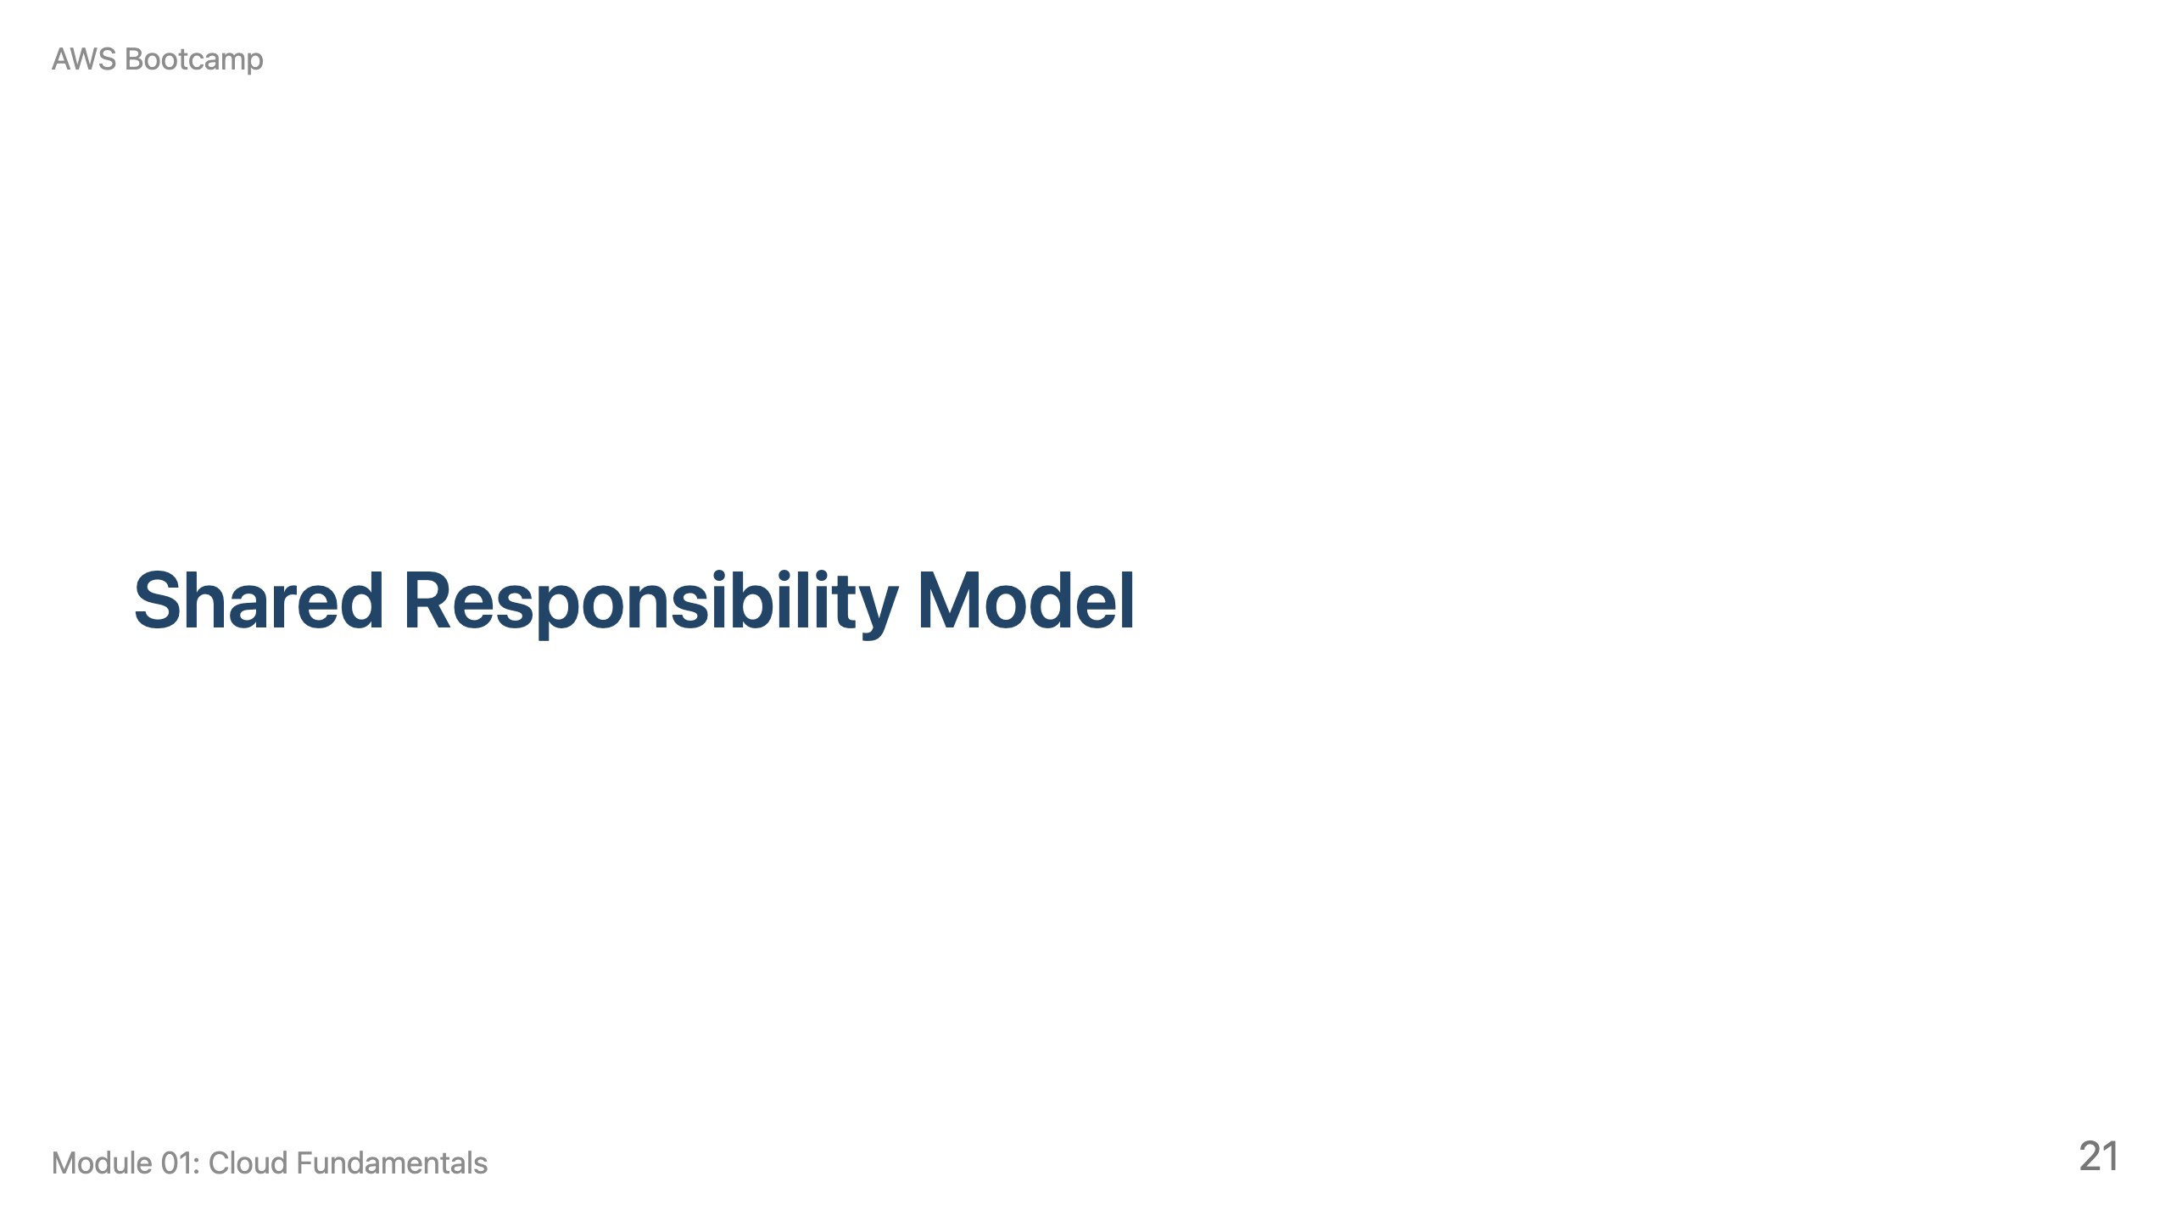
Notes:
Speaker notes: This section takes approximately 10 minutes. This is one of the most important concepts in the entire bootcamp. Draw the dividing line on the whiteboard: AWS below, customer above.

Slide 22
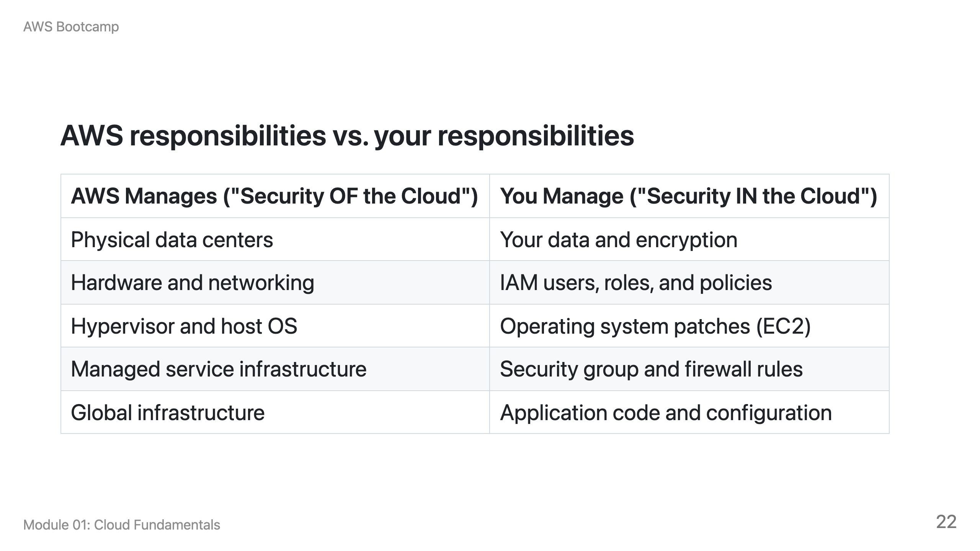

Slide 23
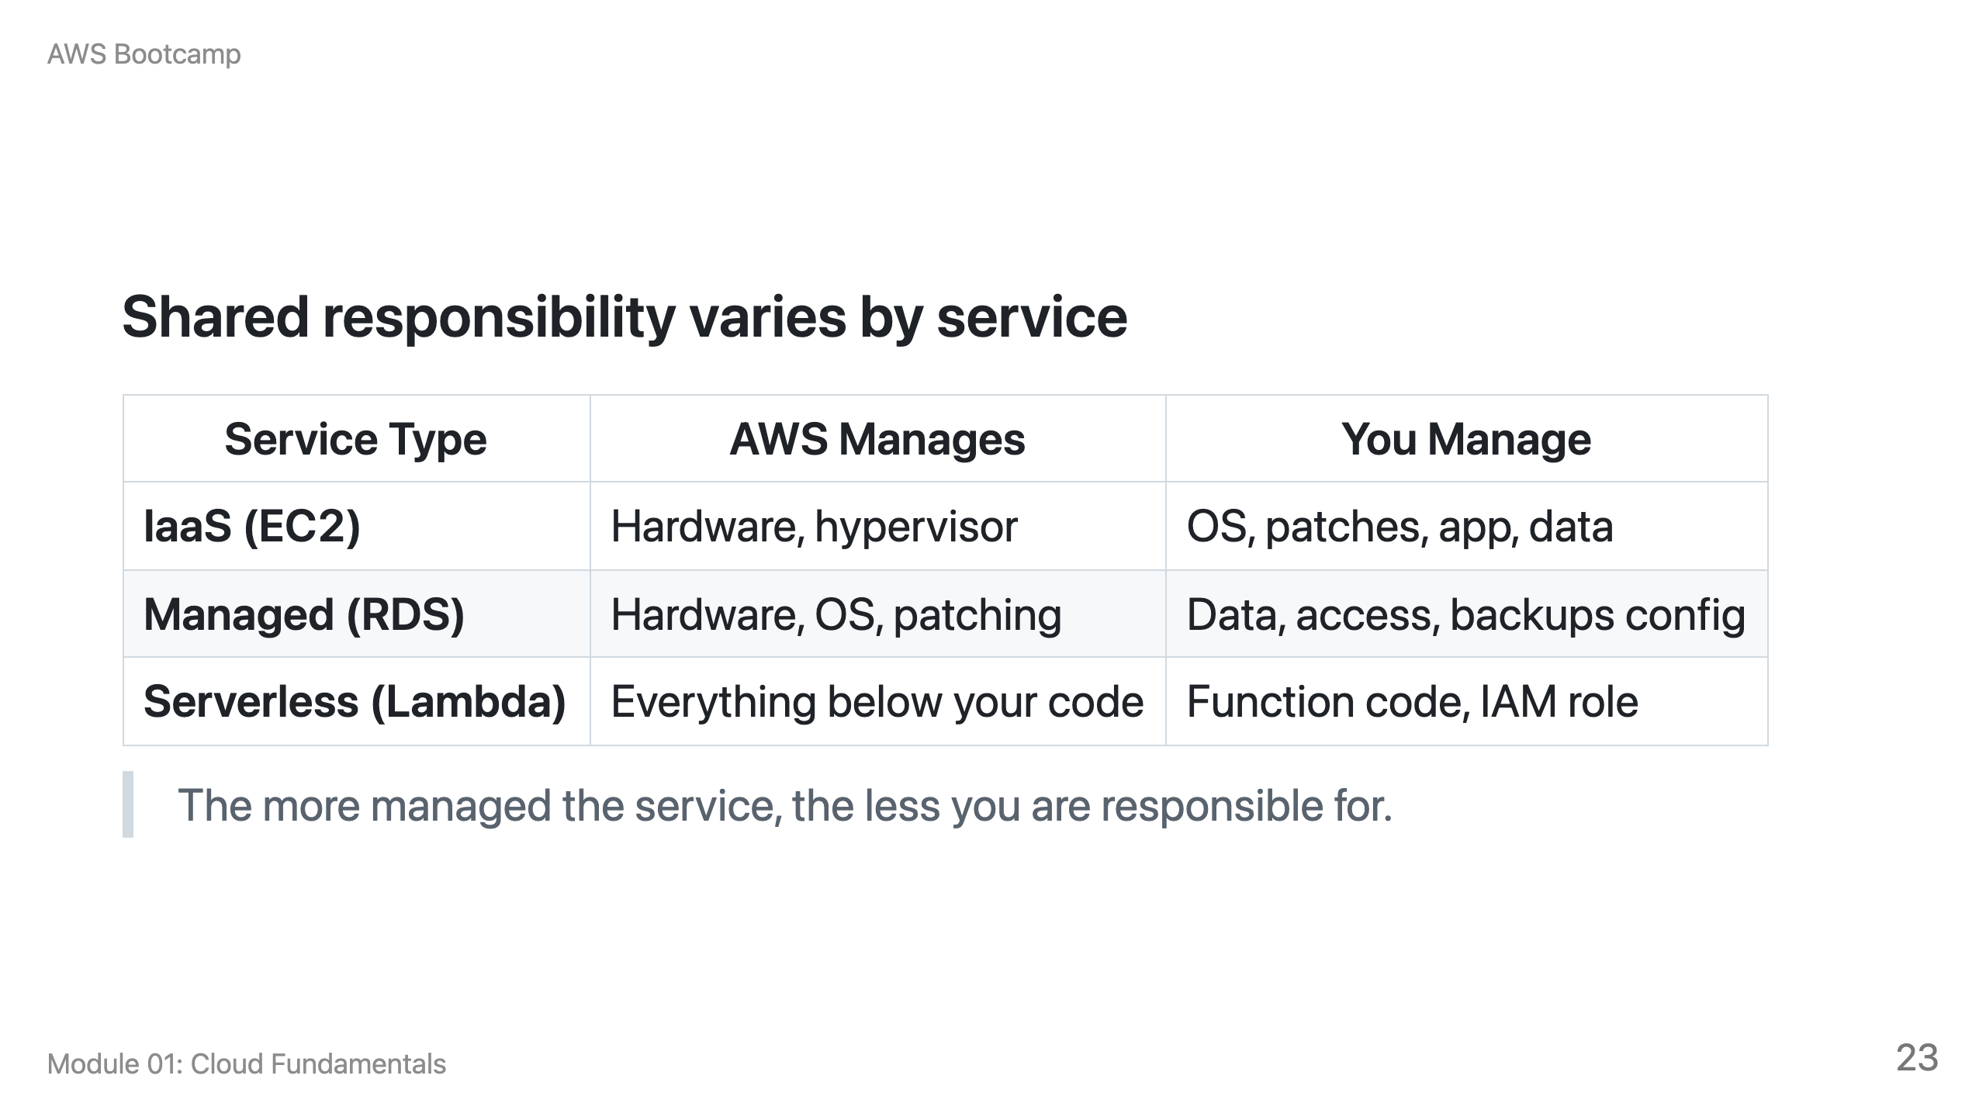

Slide 24
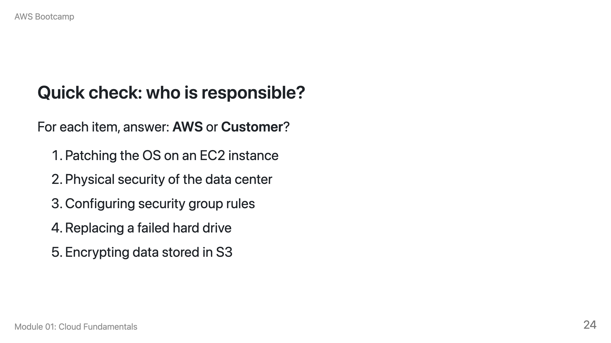
Notes:
Speaker notes: Answers: 1) Customer, 2) AWS, 3) Customer, 4) AWS, 5) Customer. Walk through each answer and explain why. Emphasize that if you can configure it in the console, you are responsible for configuring it securely.

Slide 25
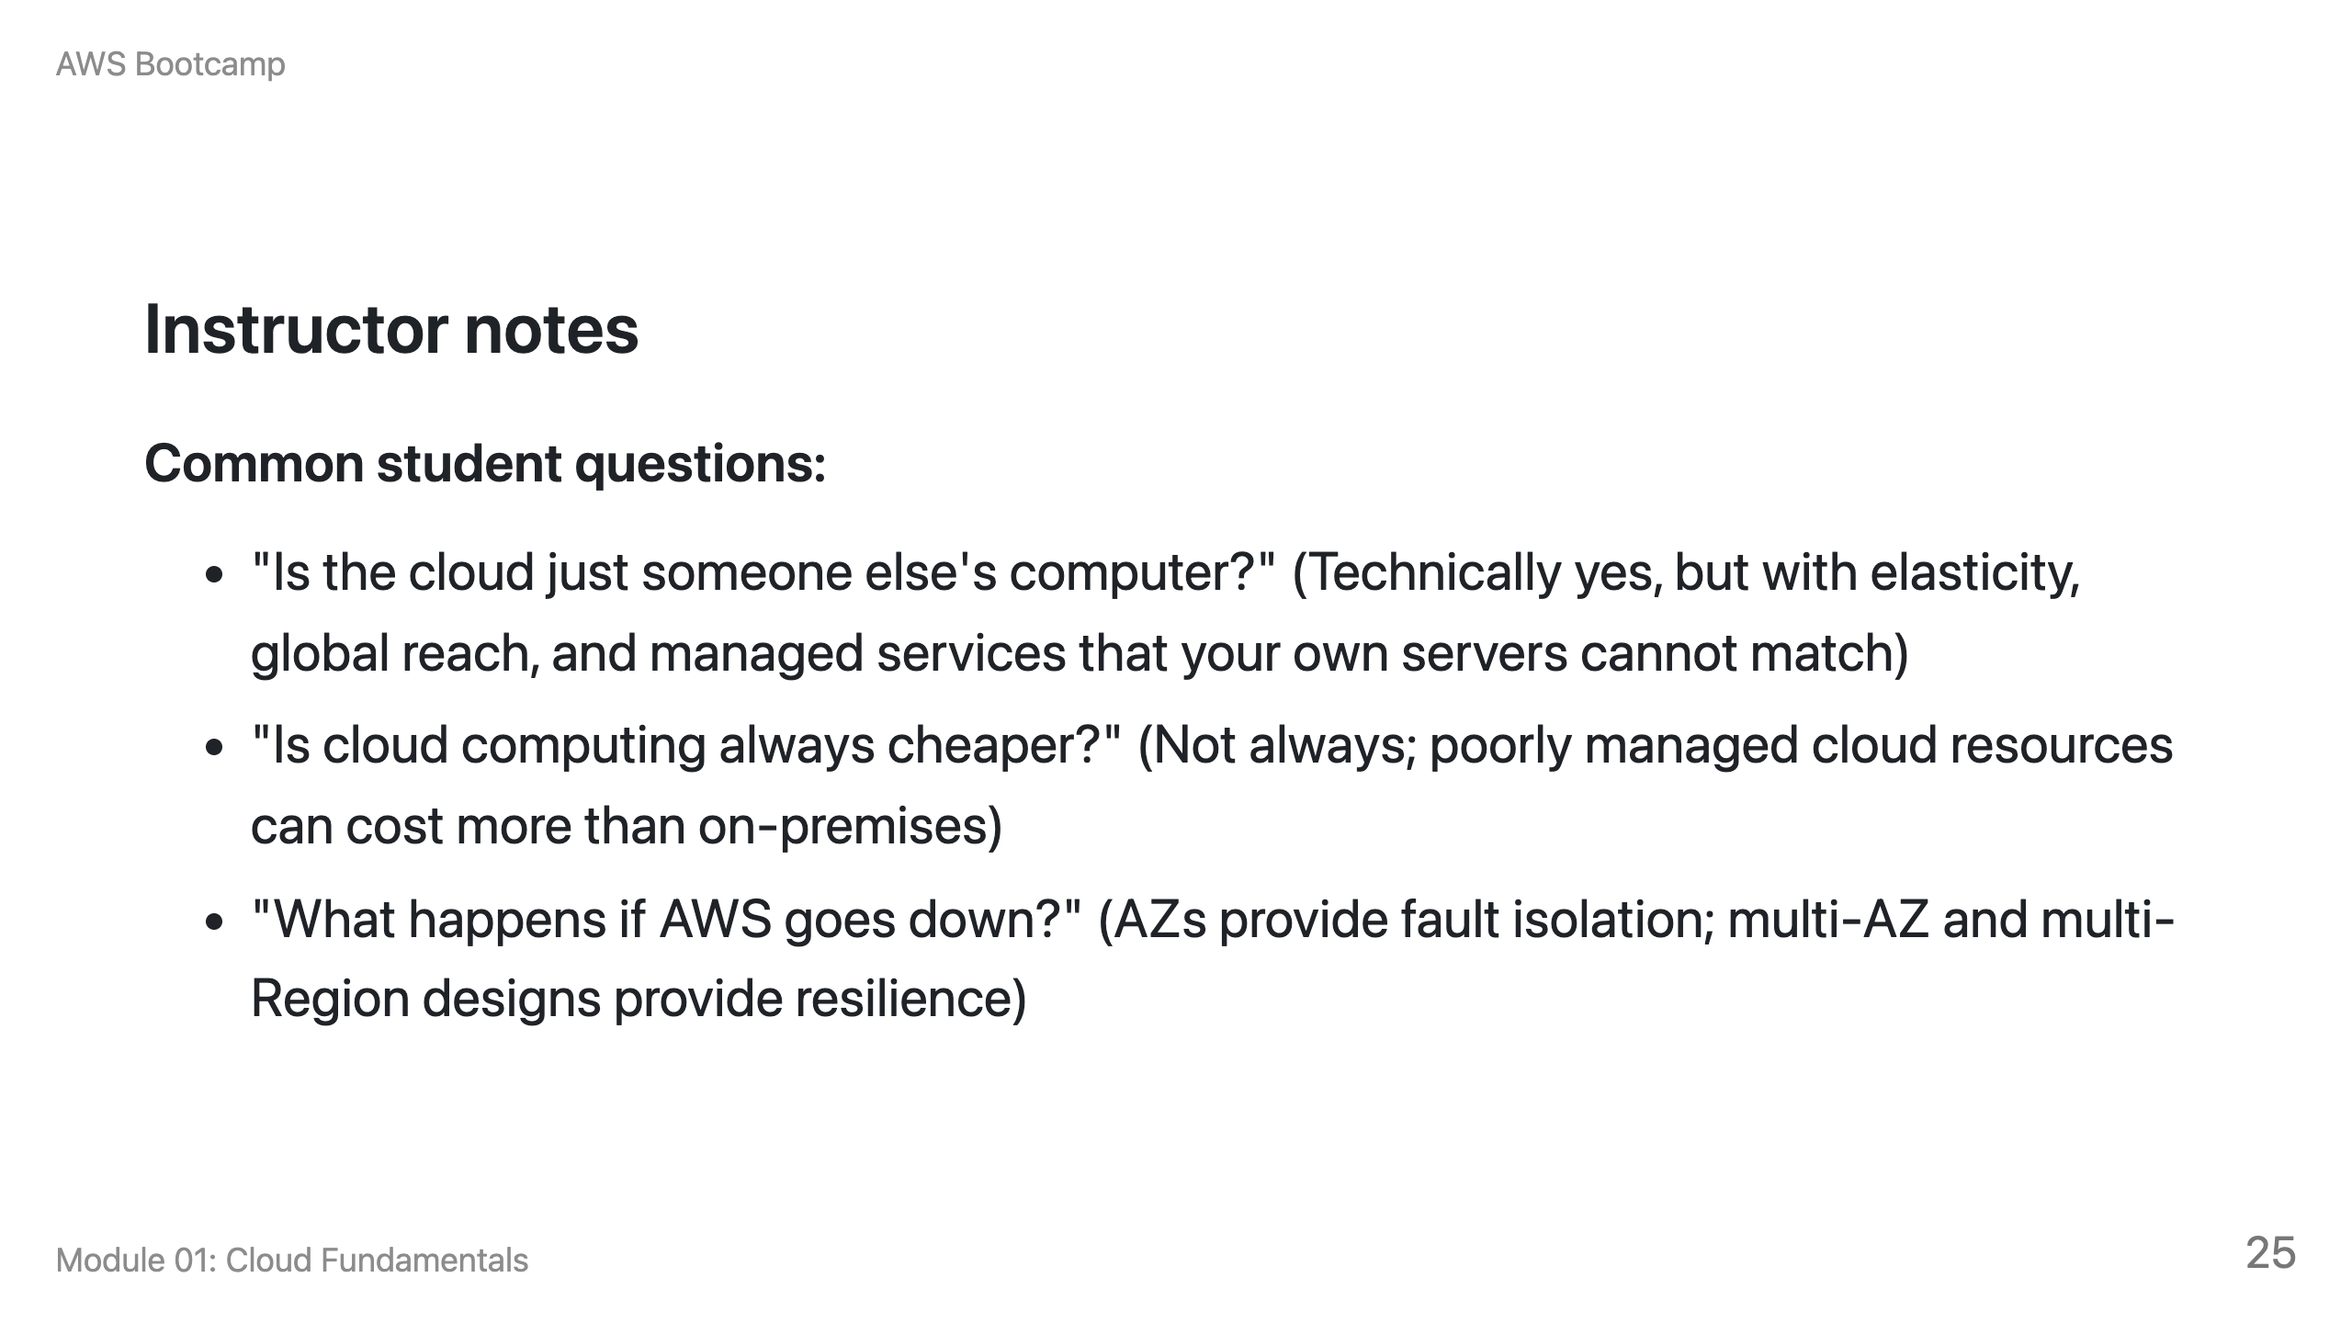

Slide 26
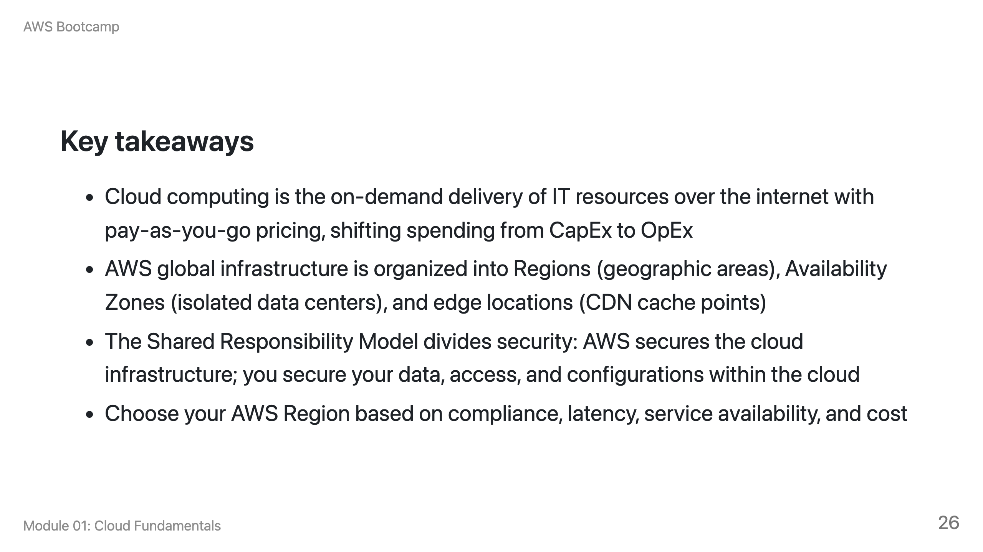

Slide 27
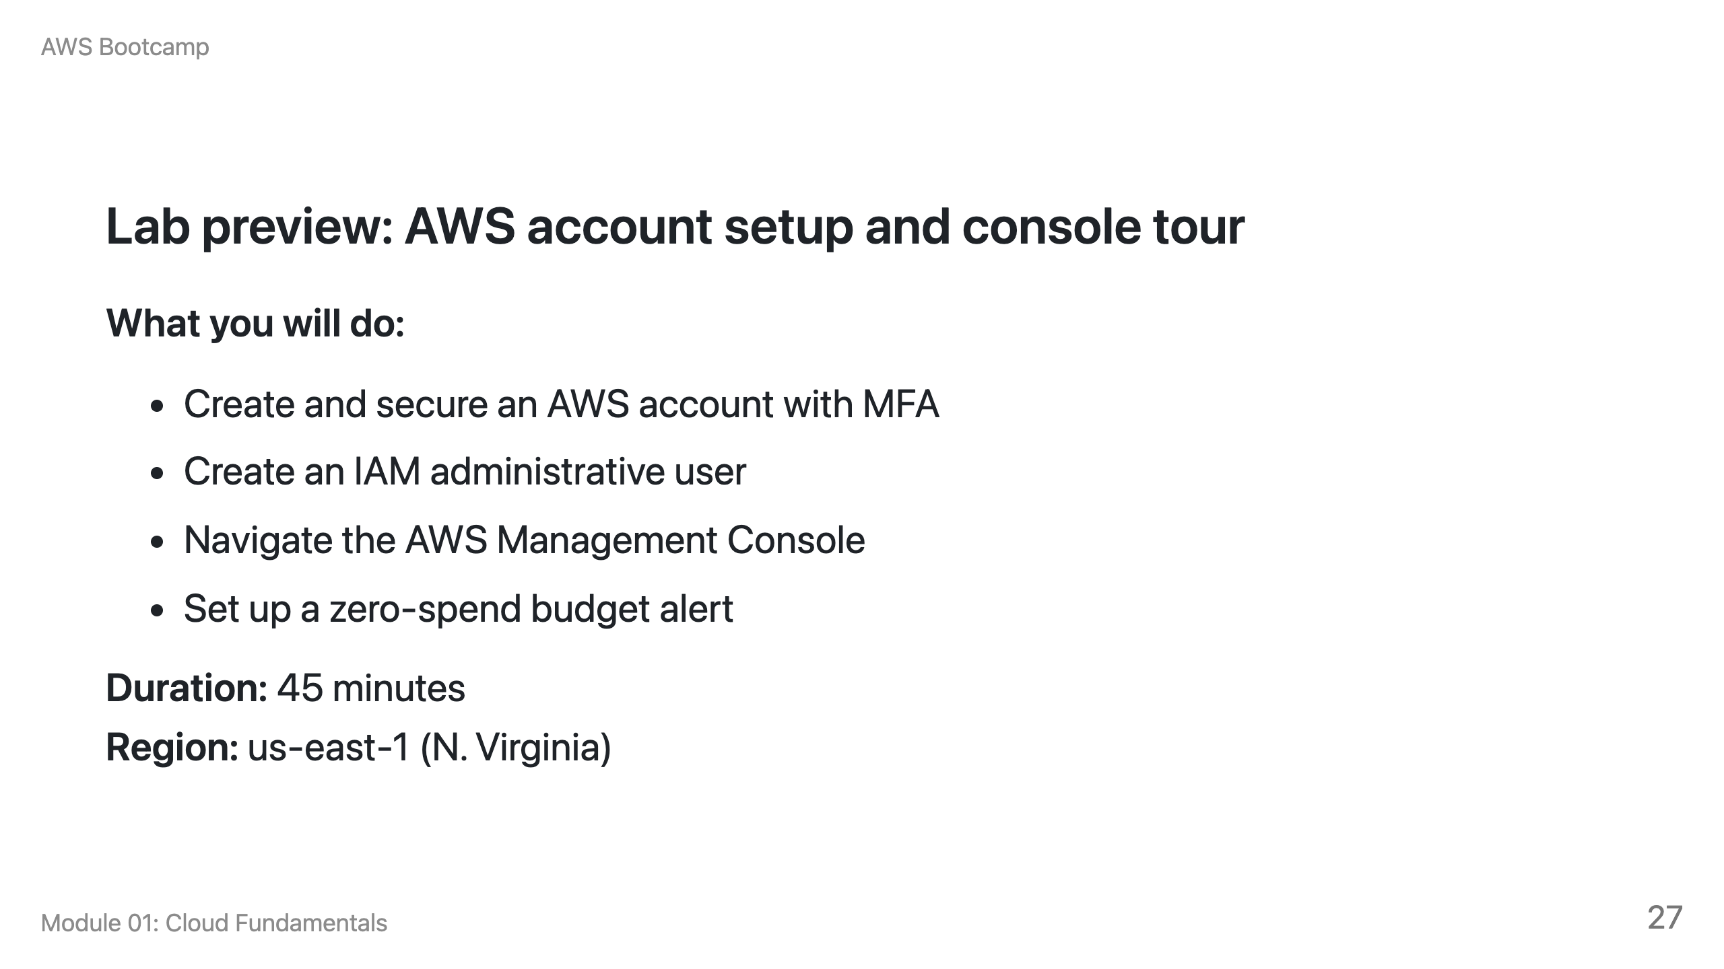

Slide 28
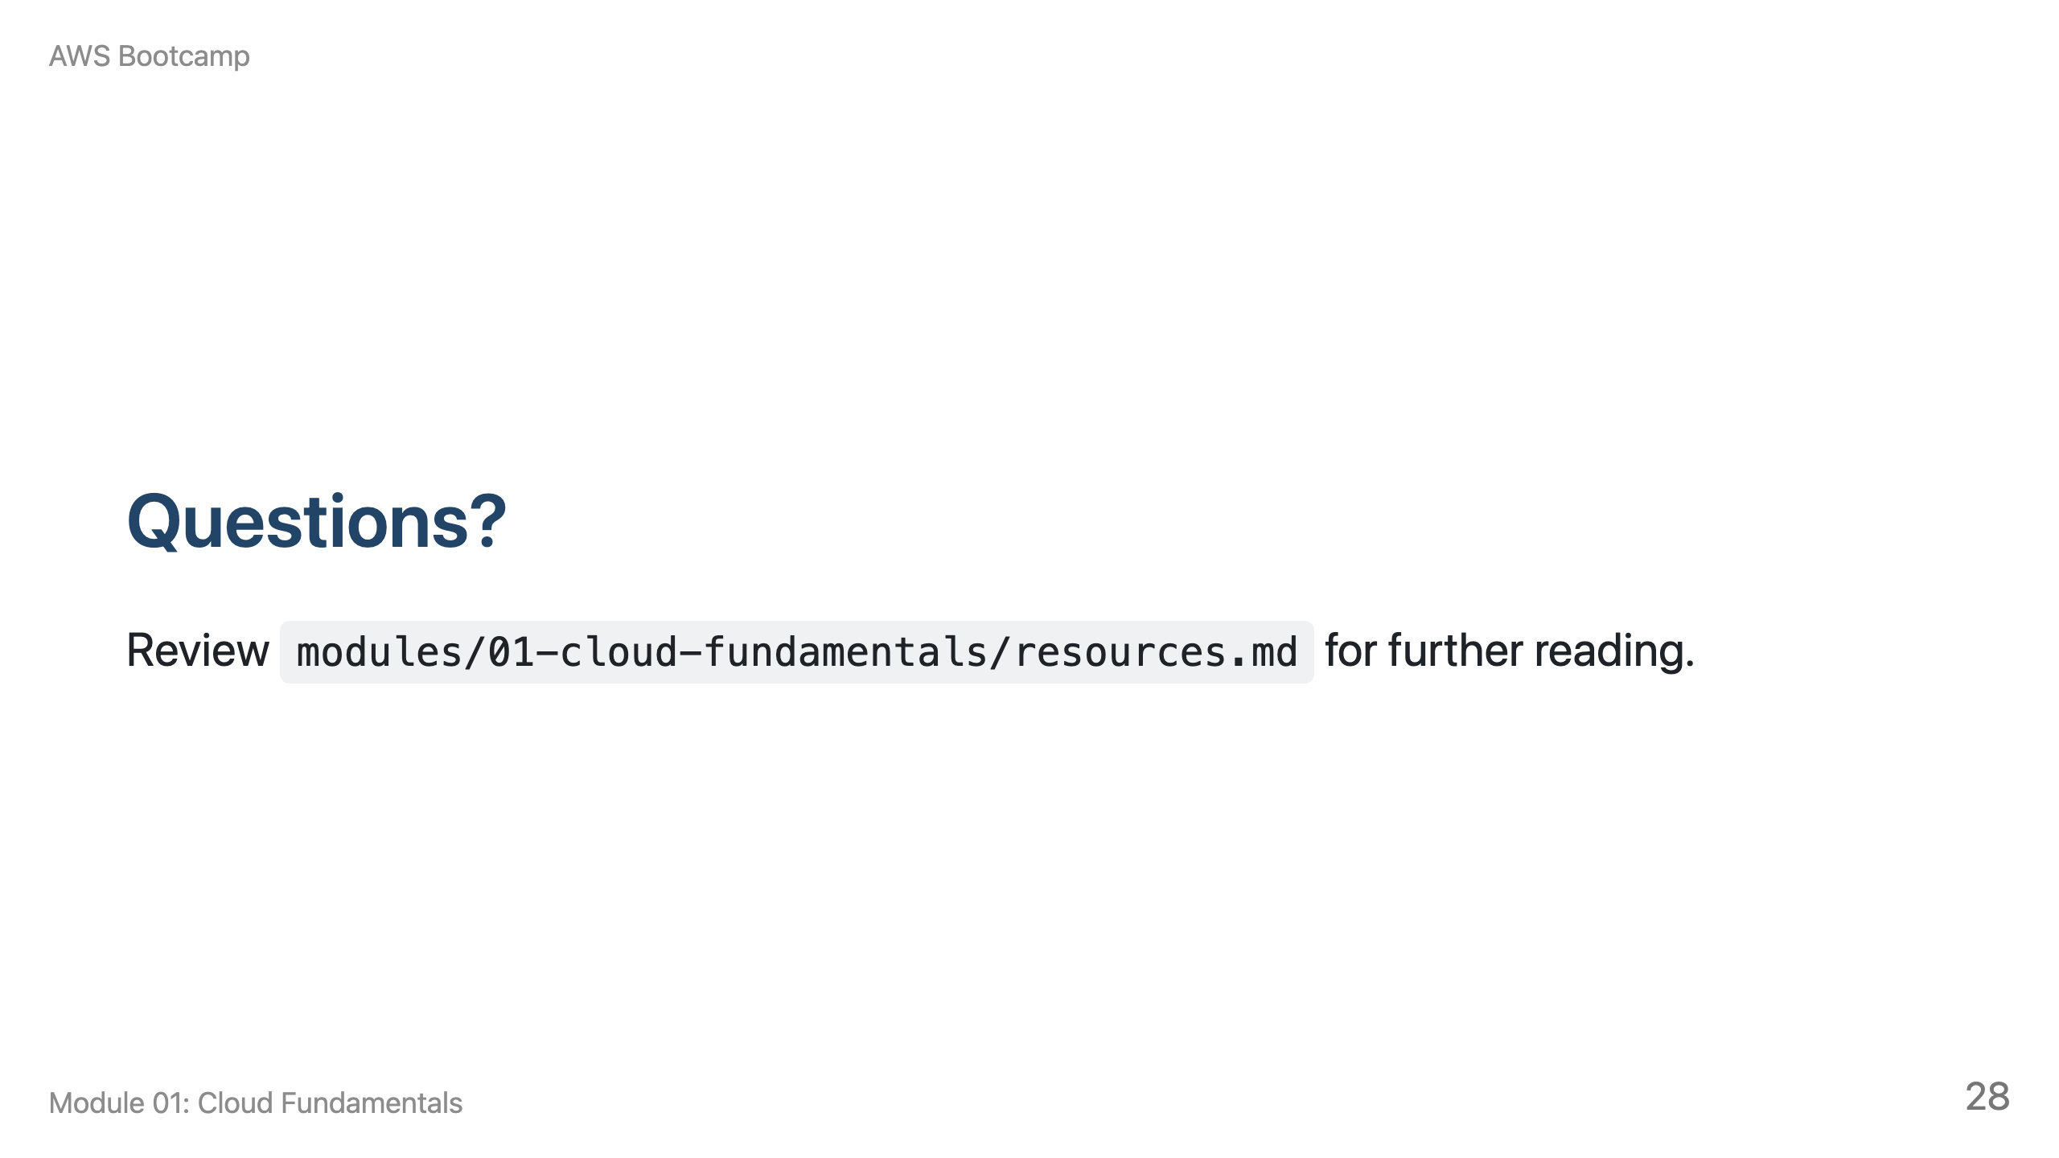
Notes:
Speaker notes: Take 5-10 minutes for questions. If no questions, transition to the lab. Remind students to have their MFA app ready before starting the lab.

