Slide 1
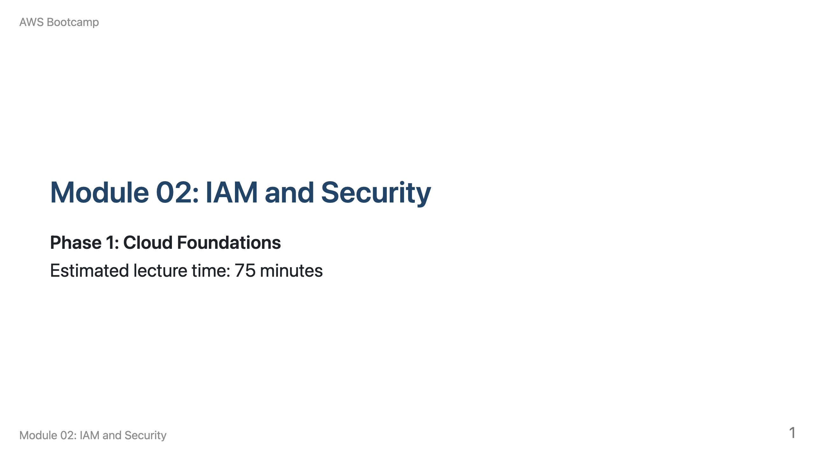
Notes:
Speaker notes: This module builds directly on Module 01's Shared Responsibility Model. Remind students that IAM is how they fulfill the customer side of that model. Timing: 15 min IAM overview, 15 min users/groups/policies, 10 min roles, 10 min policy JSON, 10 min Organizations/SCPs, 10 min best practices, 5 min Q&A.

Slide 2
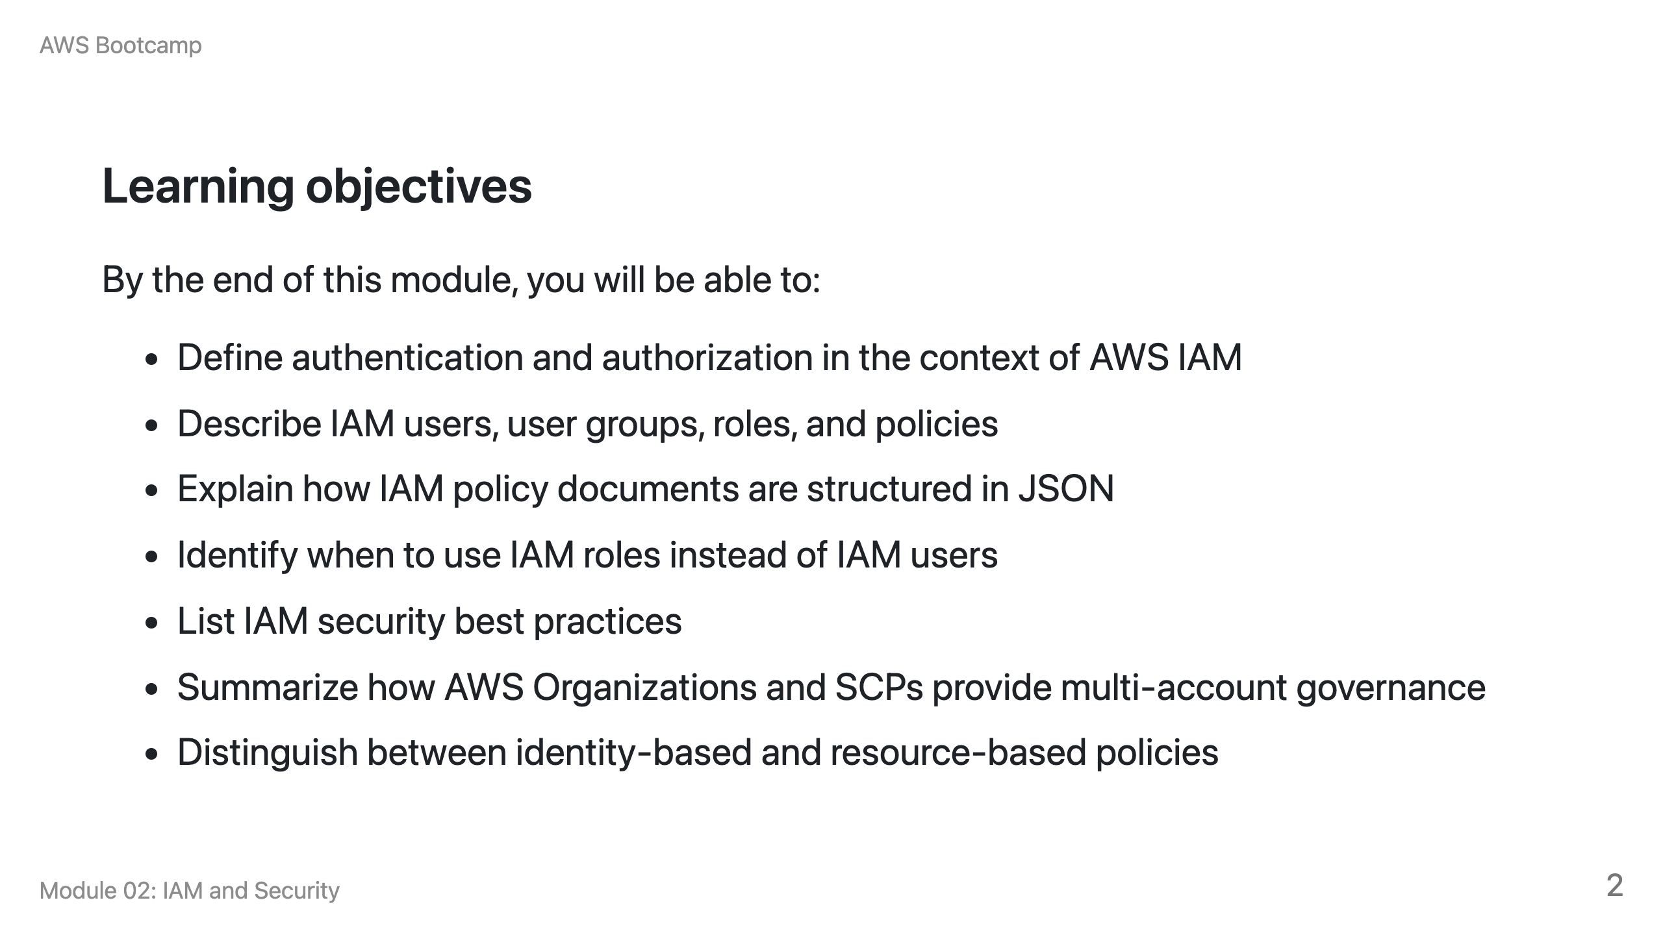

Slide 3
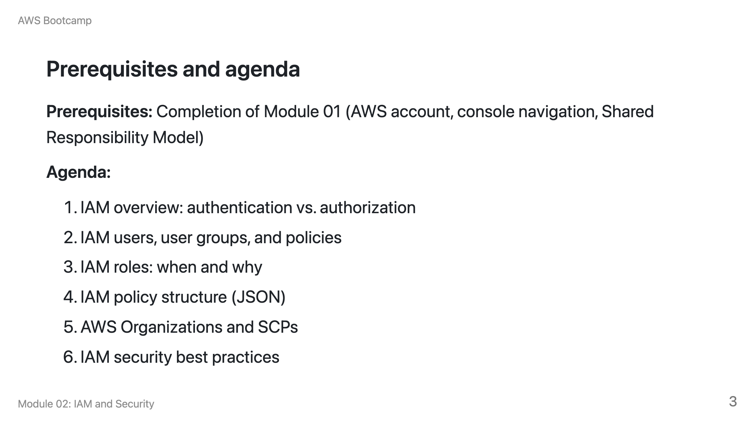

Slide 4
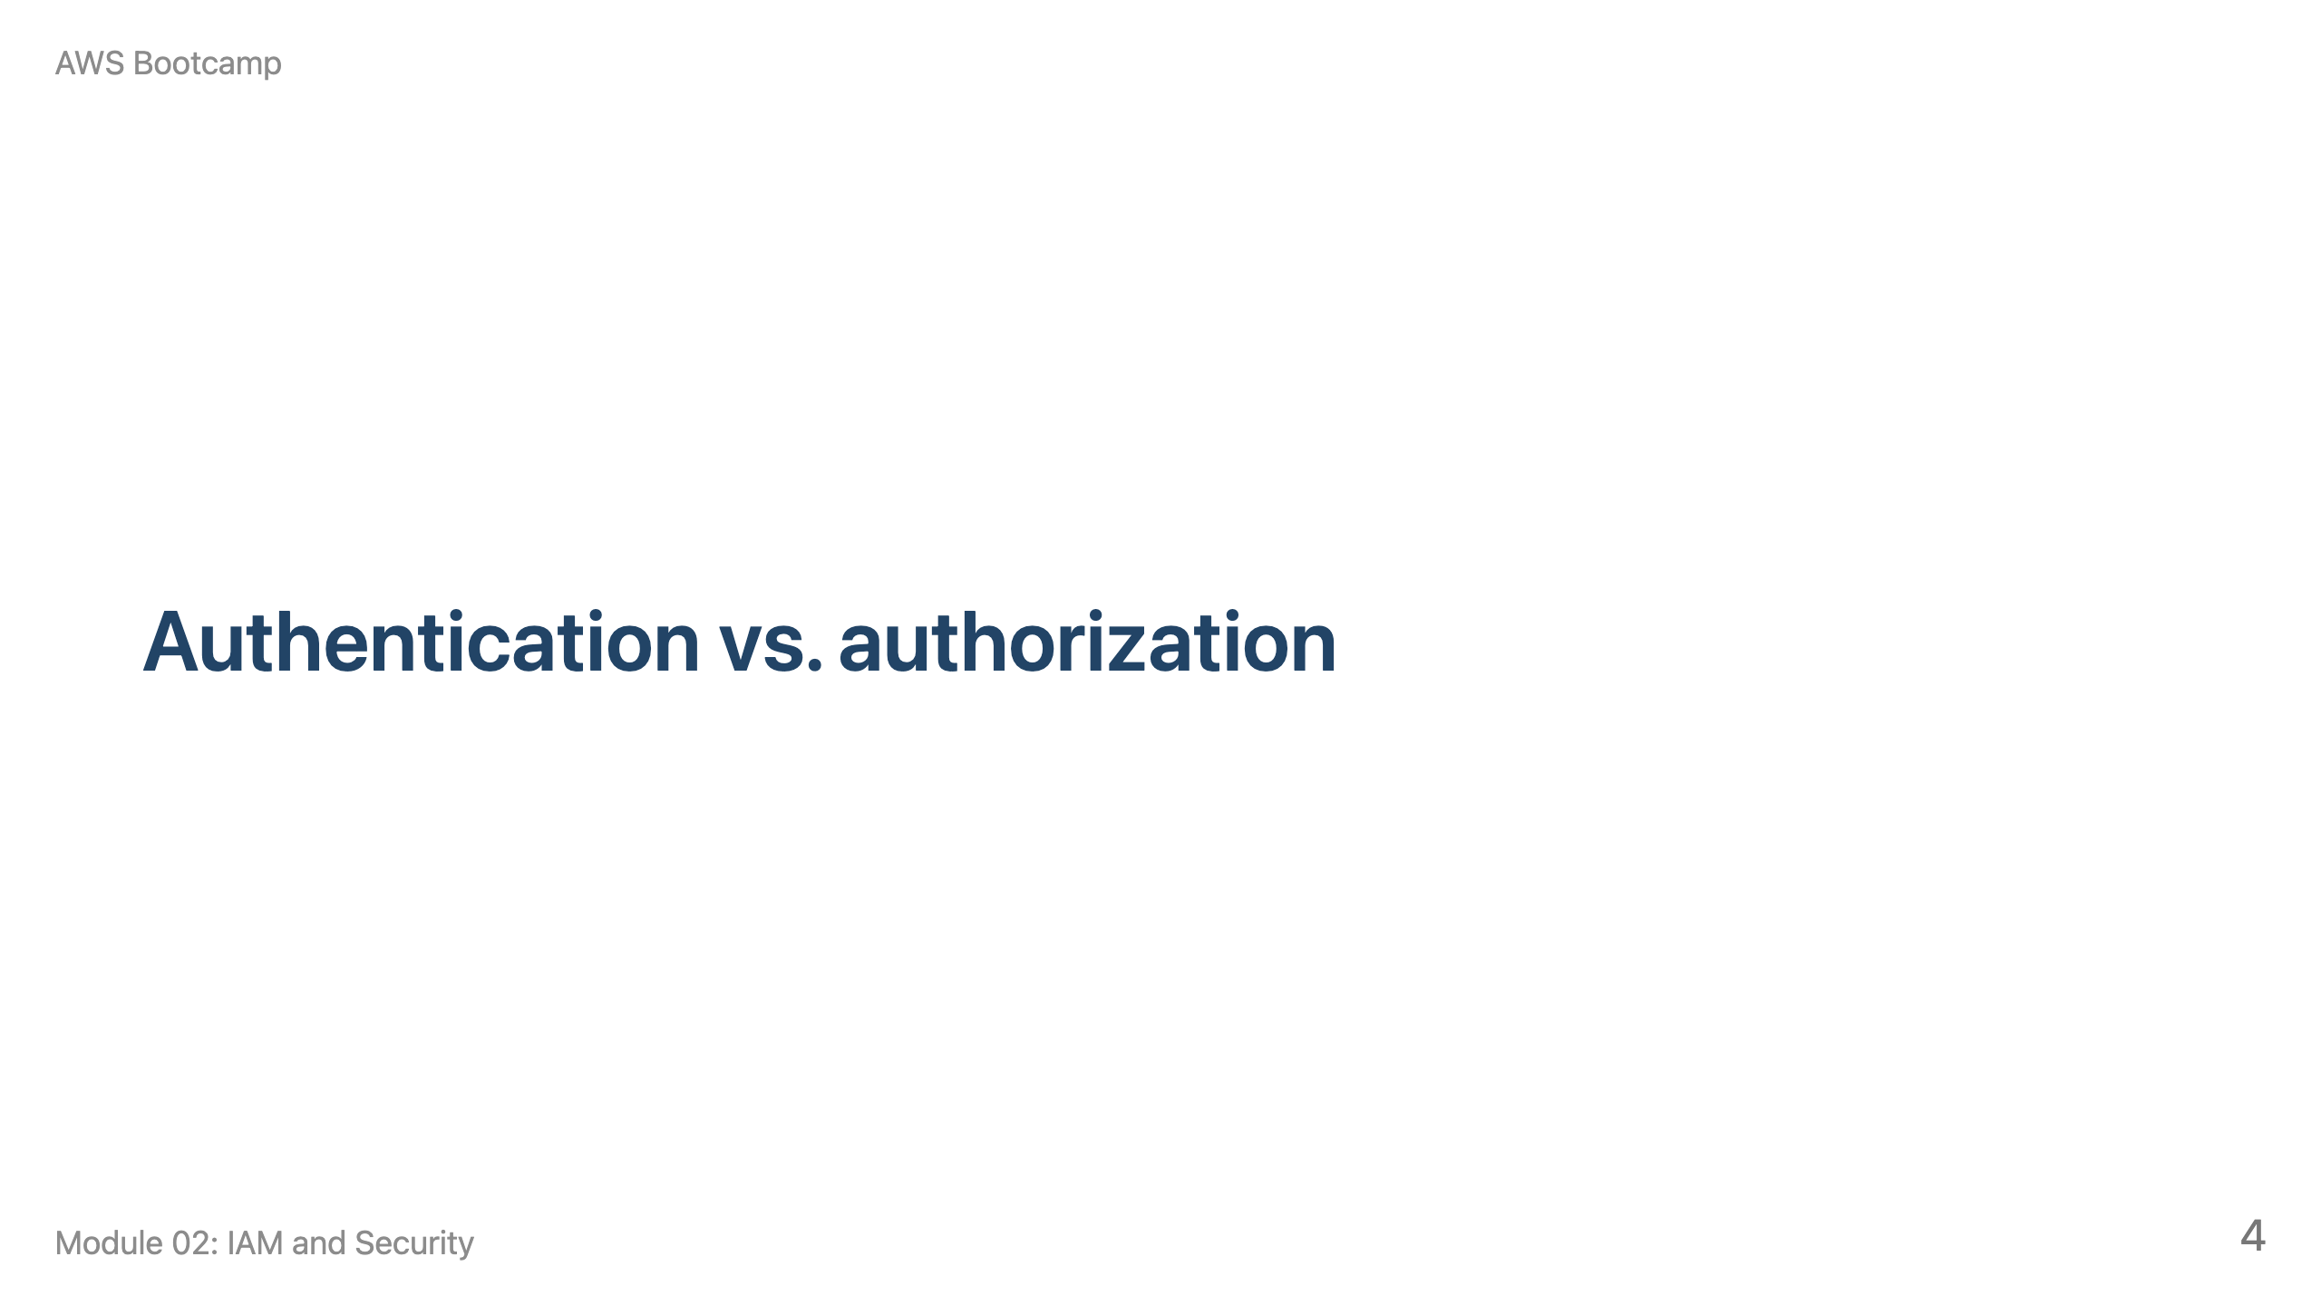
Notes:
Speaker notes: 15 minutes for this section. Start by asking students: "What is the difference between proving who you are and proving what you are allowed to do?"

Slide 5
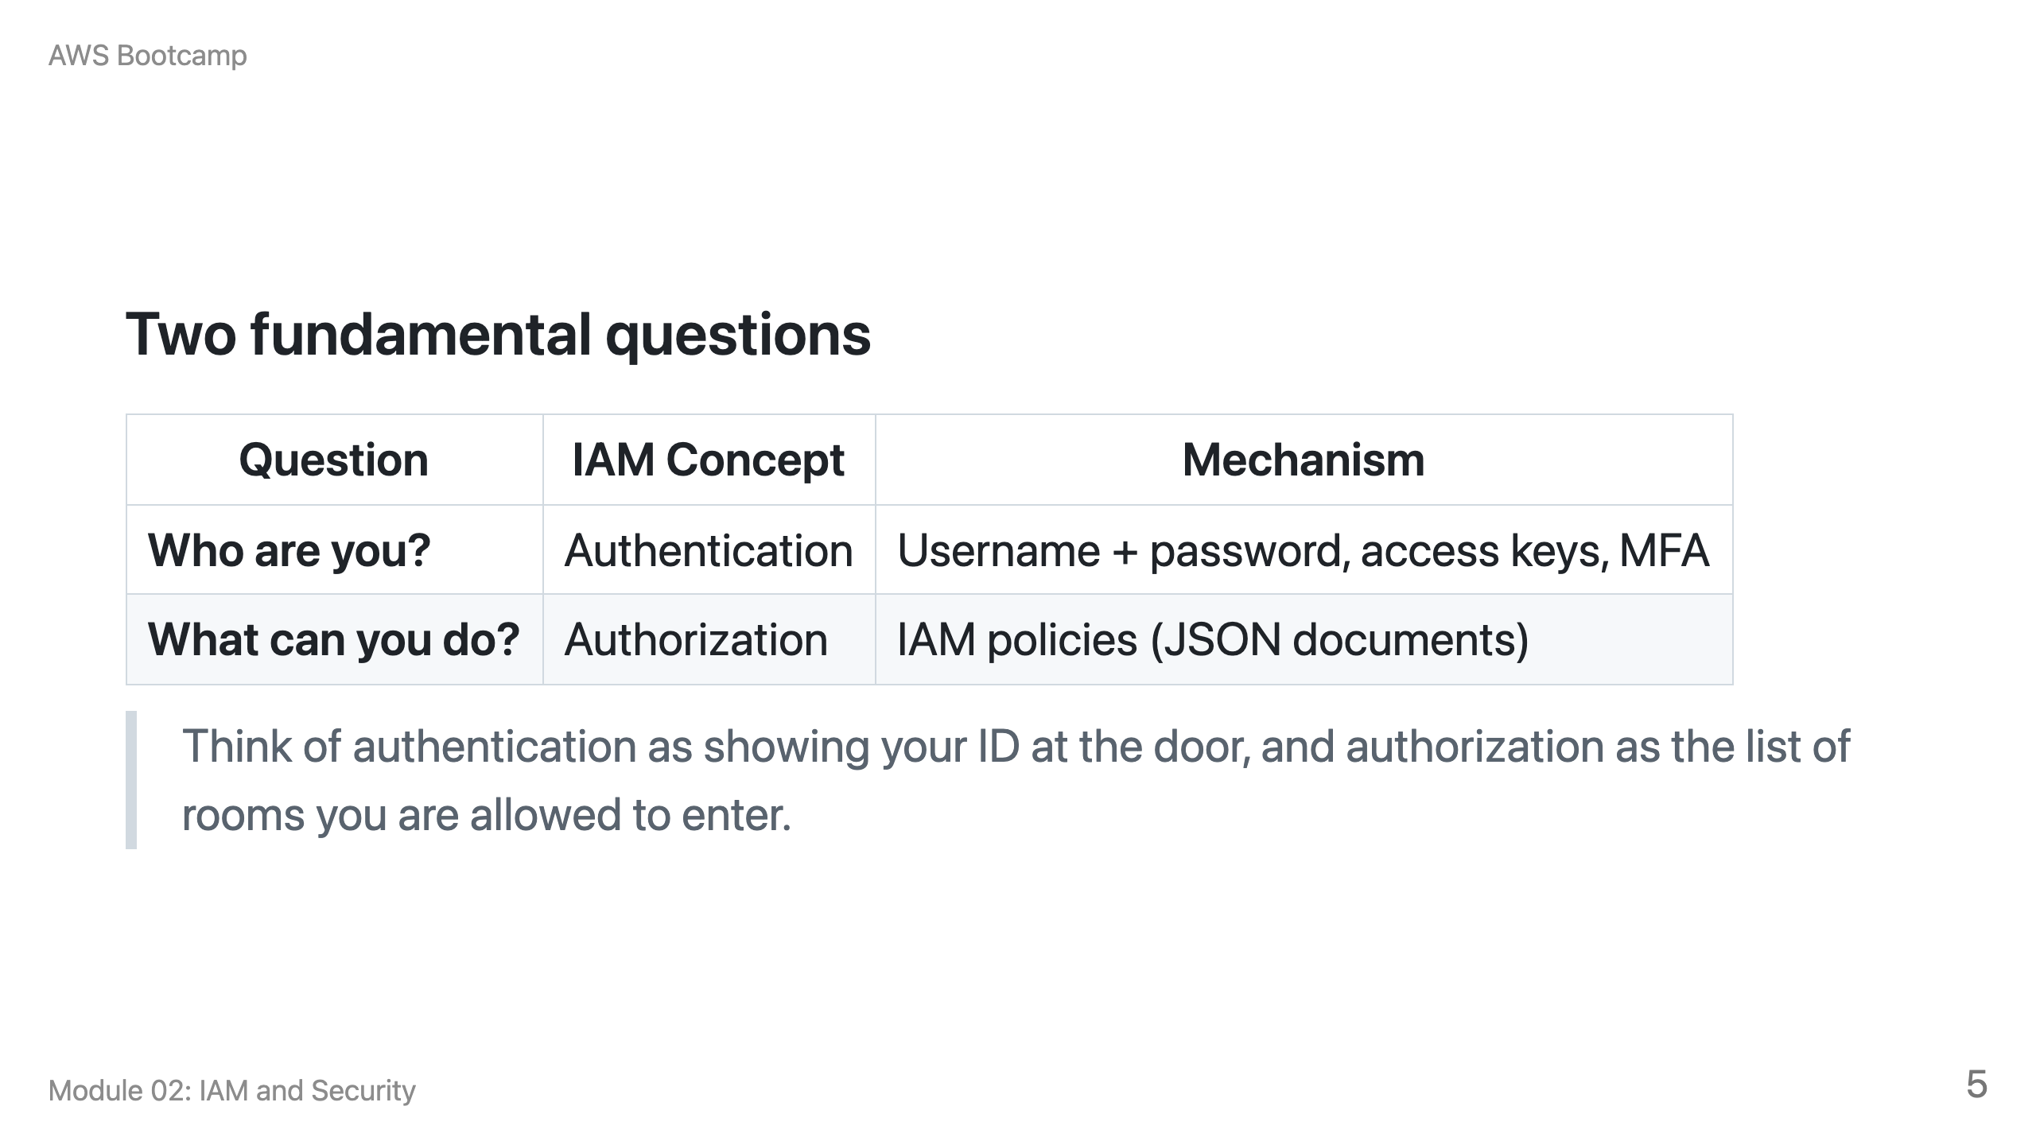

Slide 6
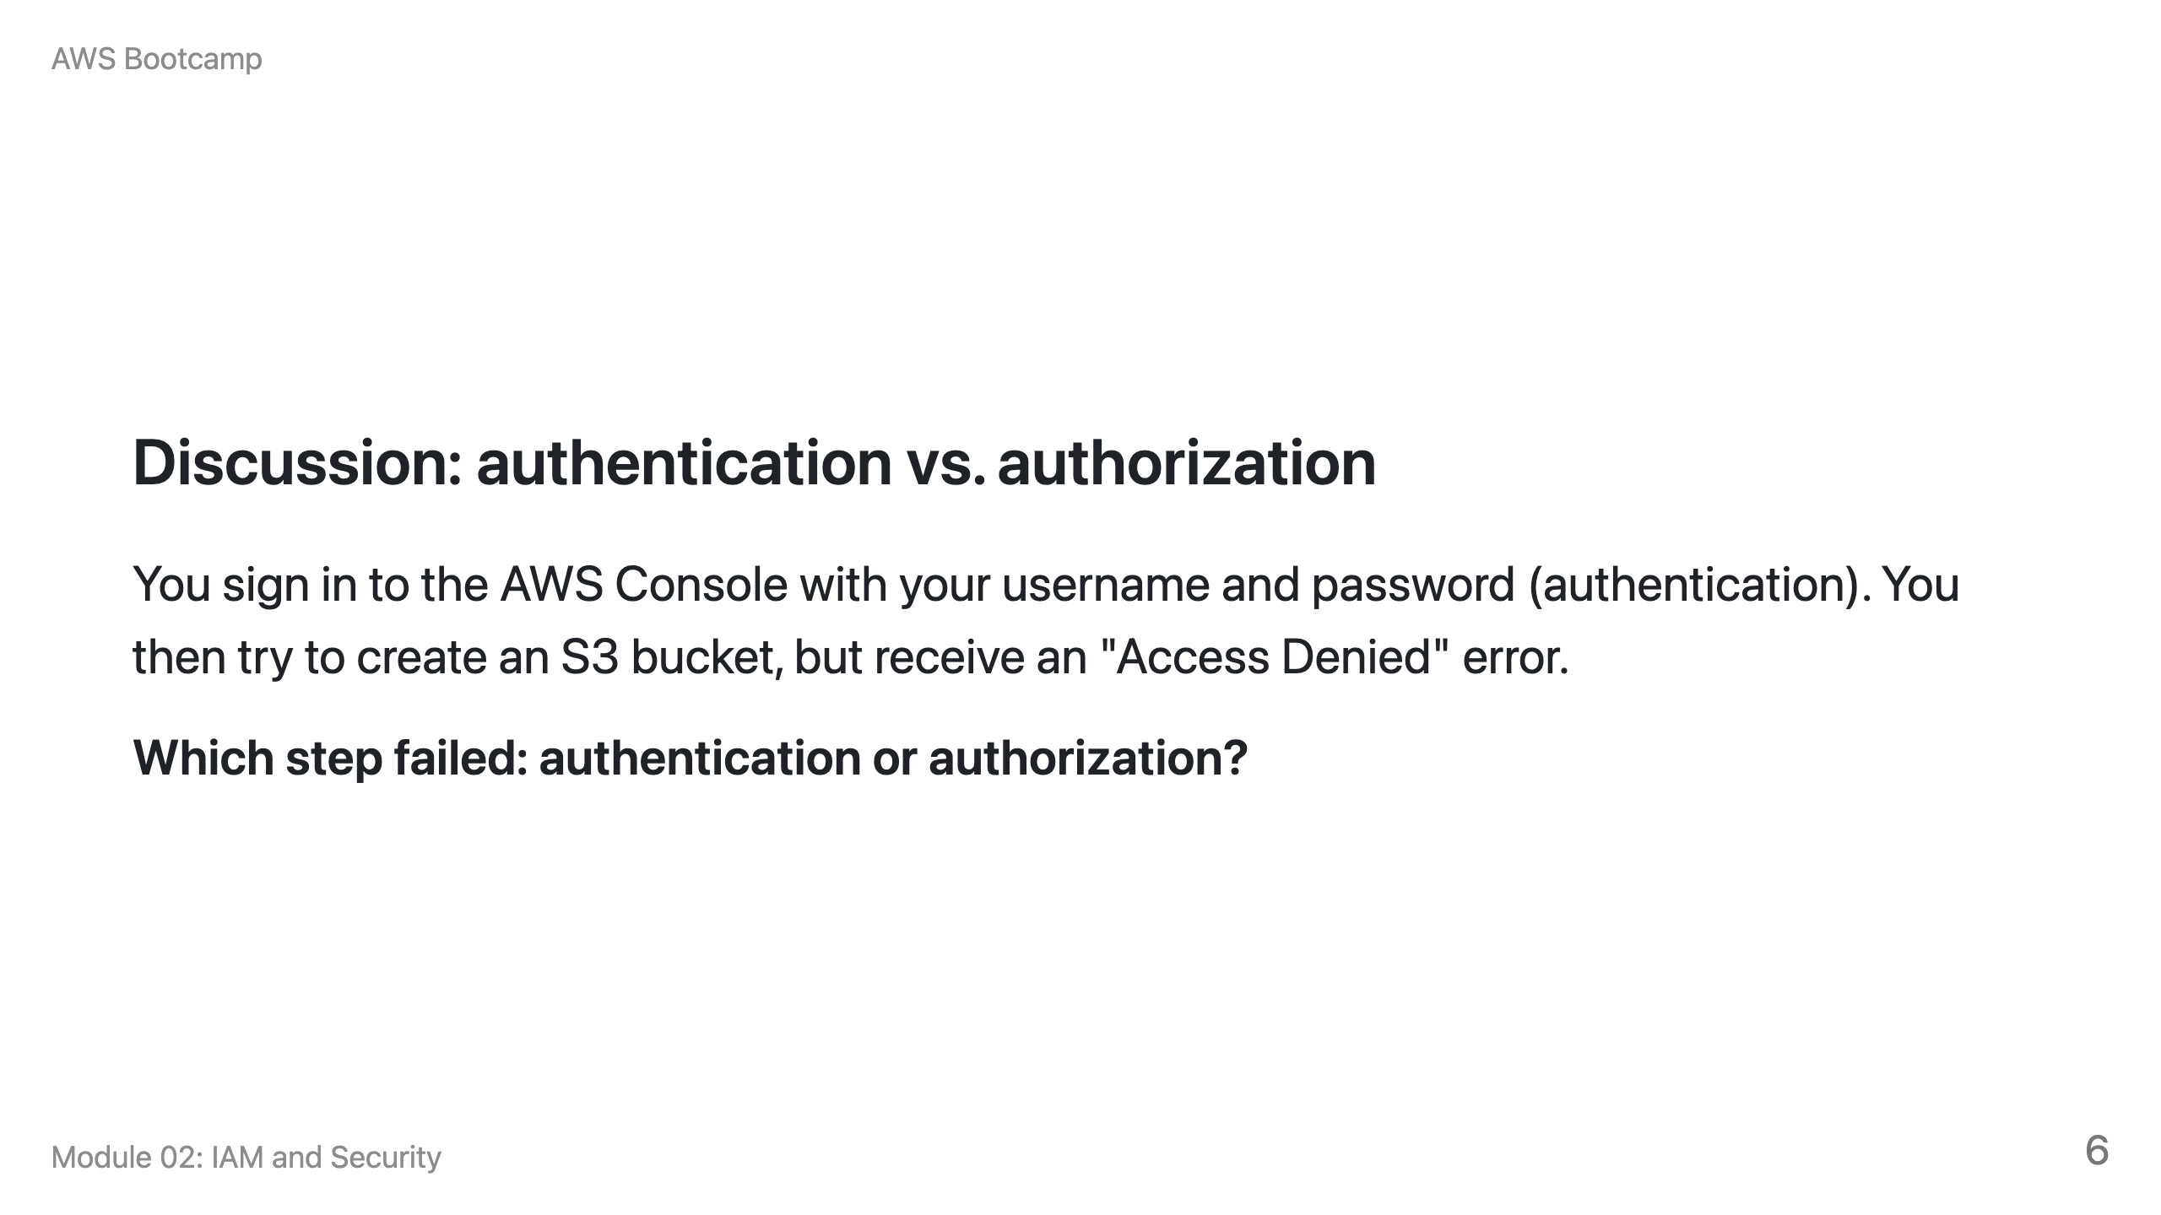
Notes:
Speaker notes: Answer: Authorization failed. Authentication succeeded (you signed in), but the IAM policy attached to your user does not grant s3:CreateBucket permission. This is the most common confusion for beginners.

Slide 7
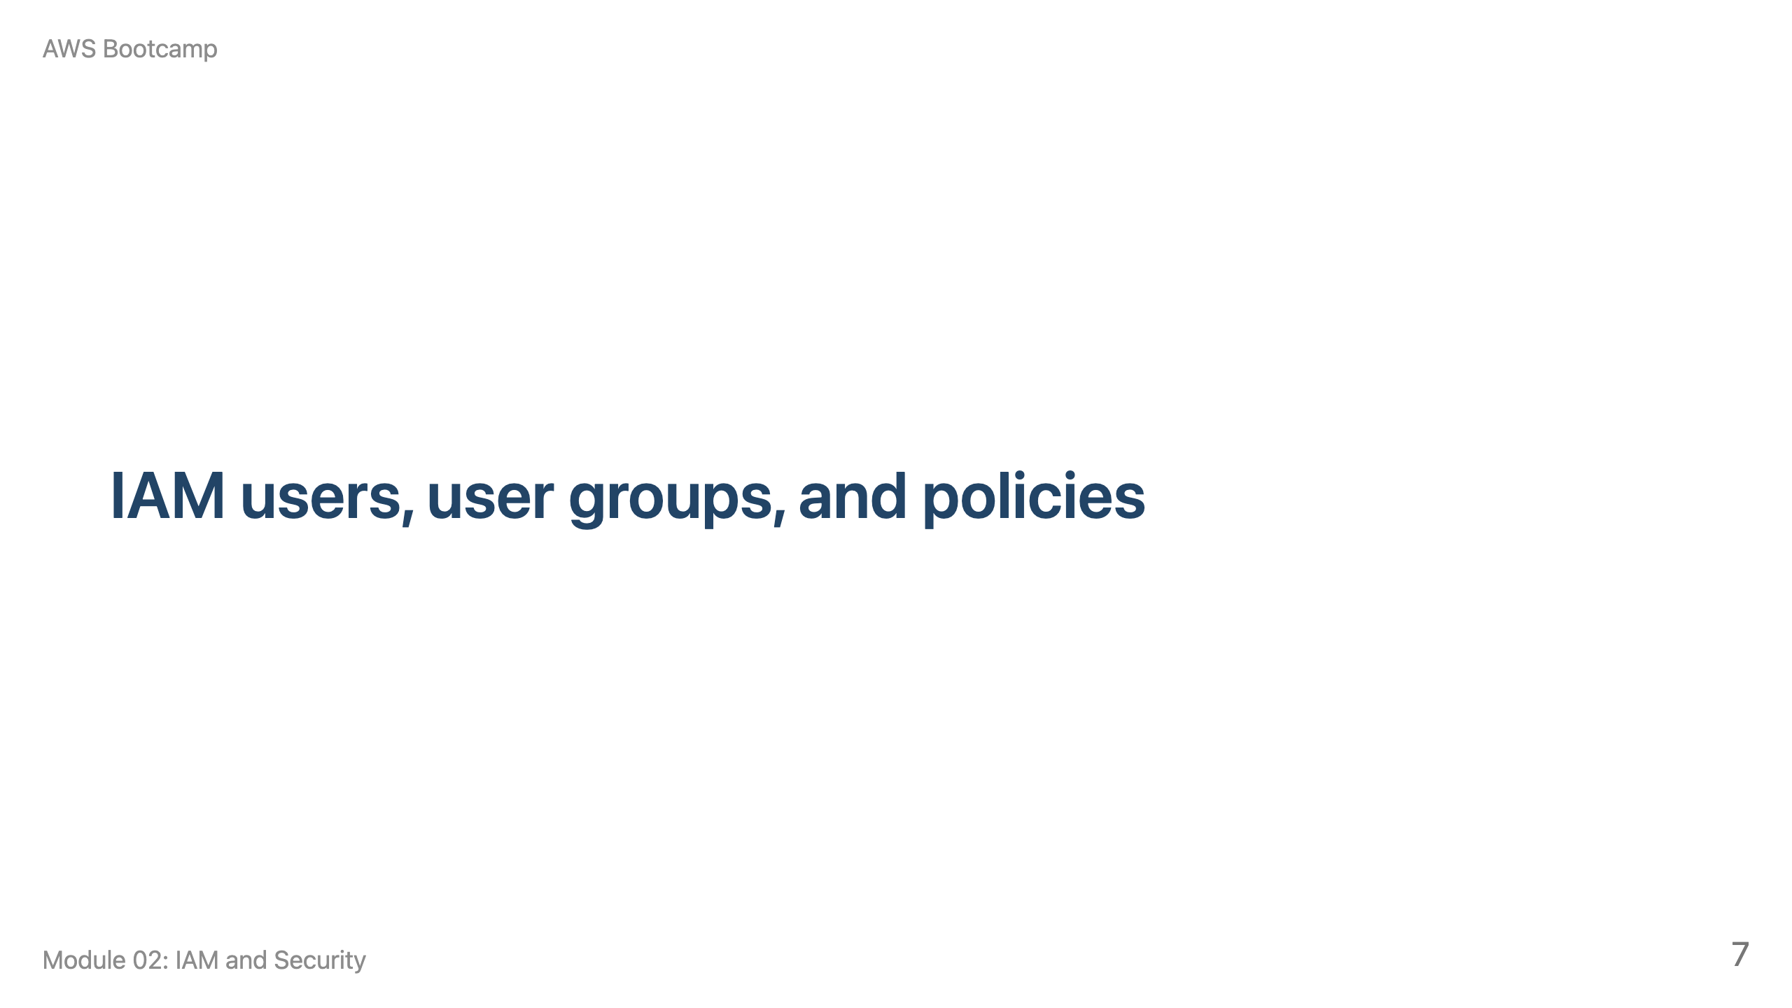
Notes:
Speaker notes: 15 minutes. Emphasize that groups simplify permission management: assign policies to groups, then add users to groups.

Slide 8
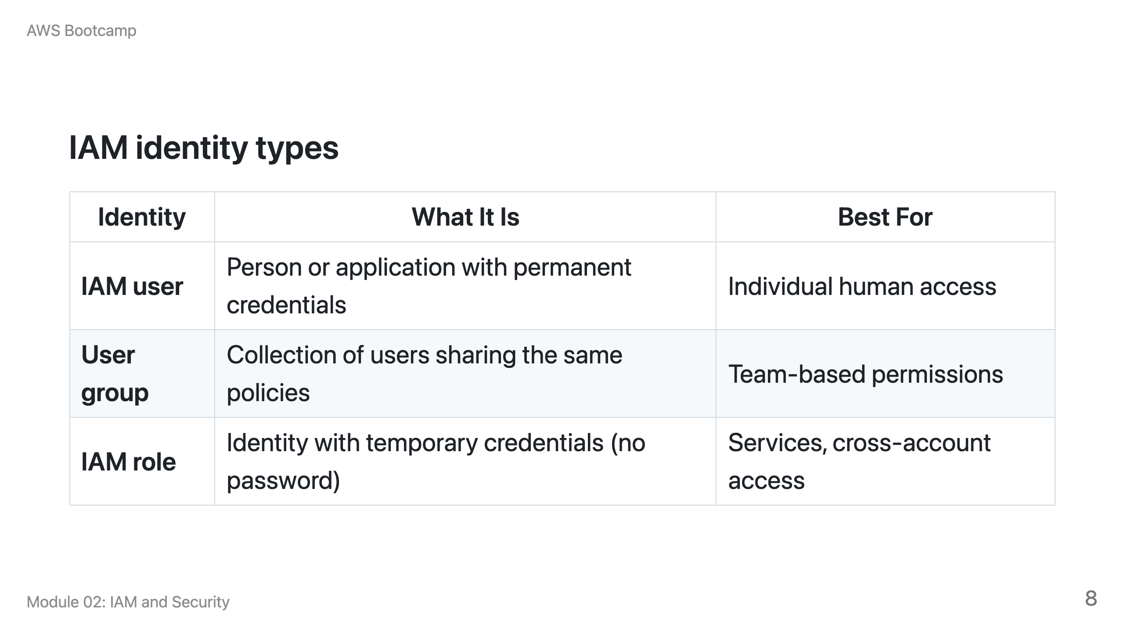

Slide 9
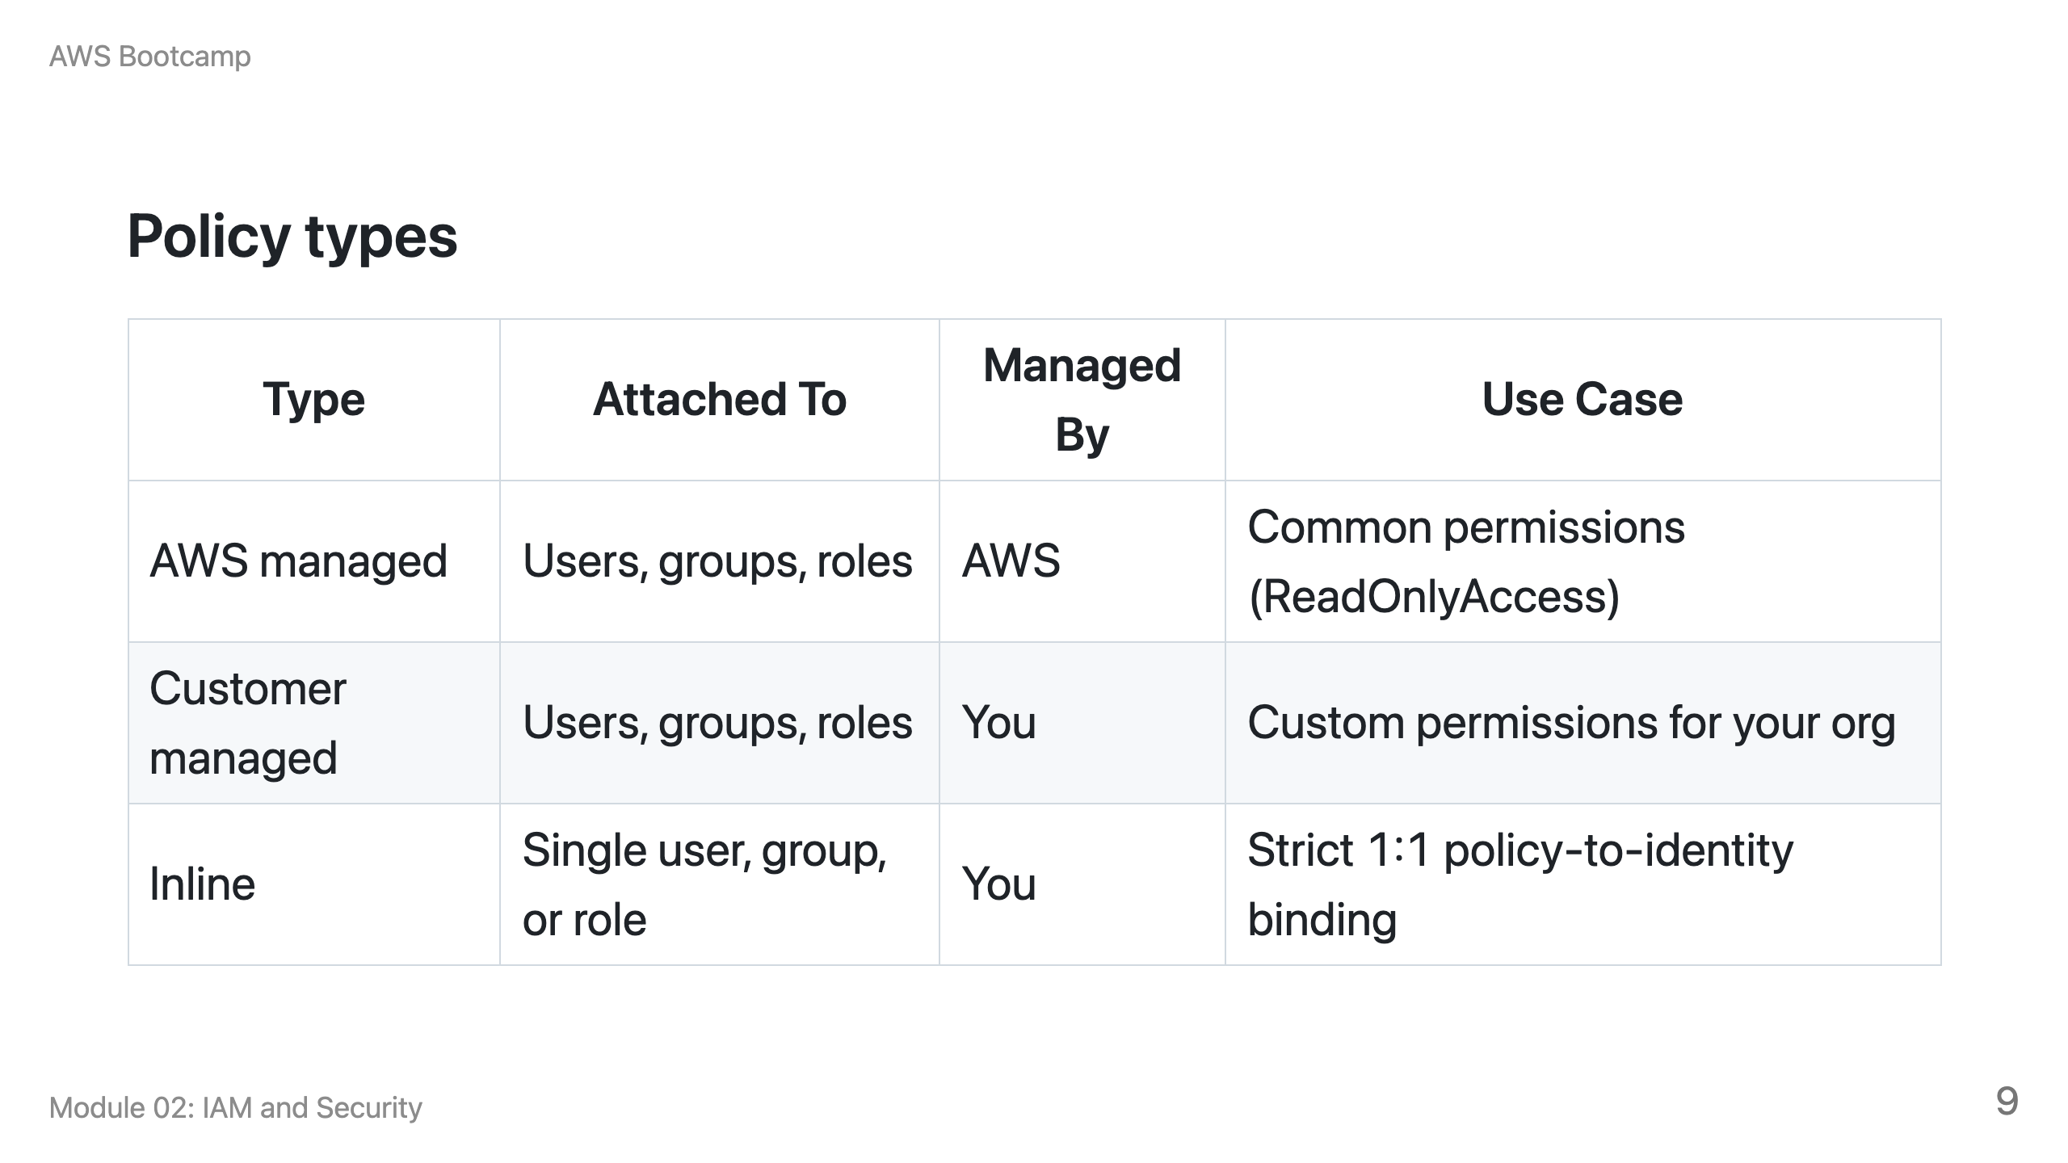

Slide 10
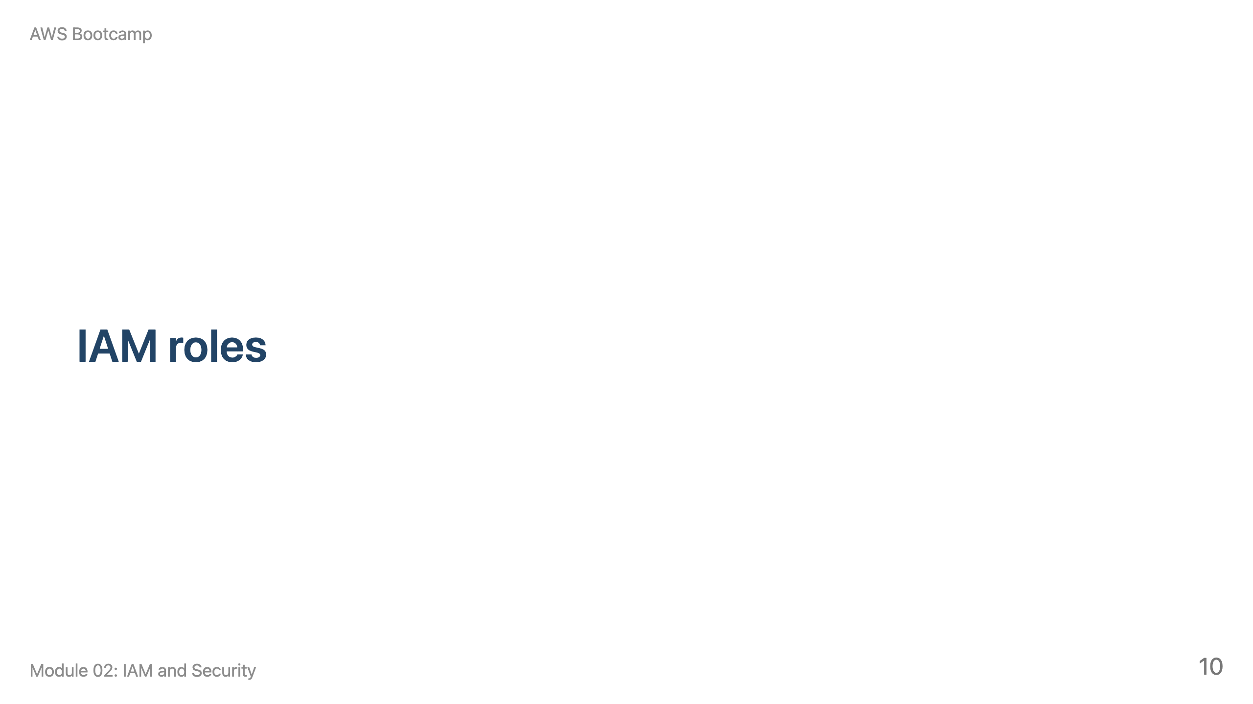
Notes:
Speaker notes: 10 minutes. Key point: roles provide temporary credentials via STS. Never embed long-lived access keys in code.

Slide 11
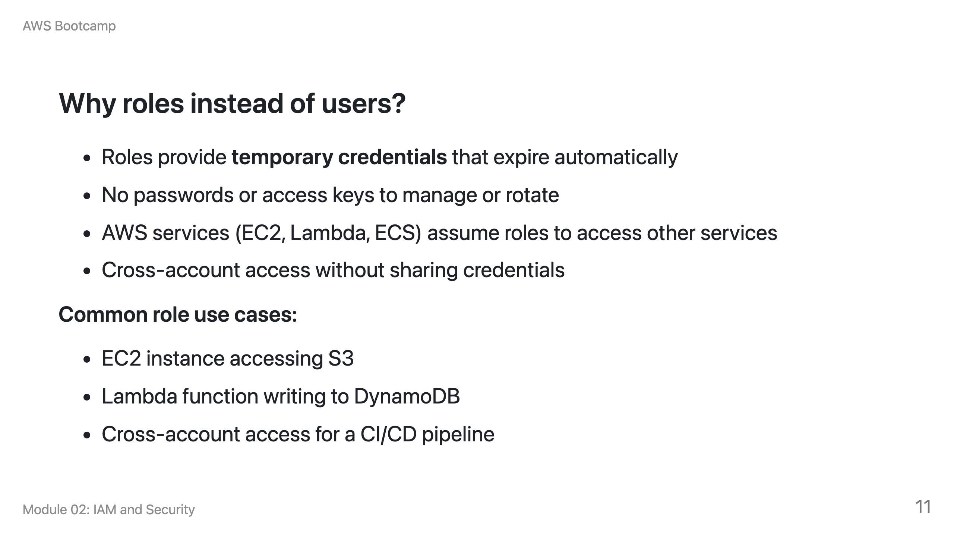

Slide 12
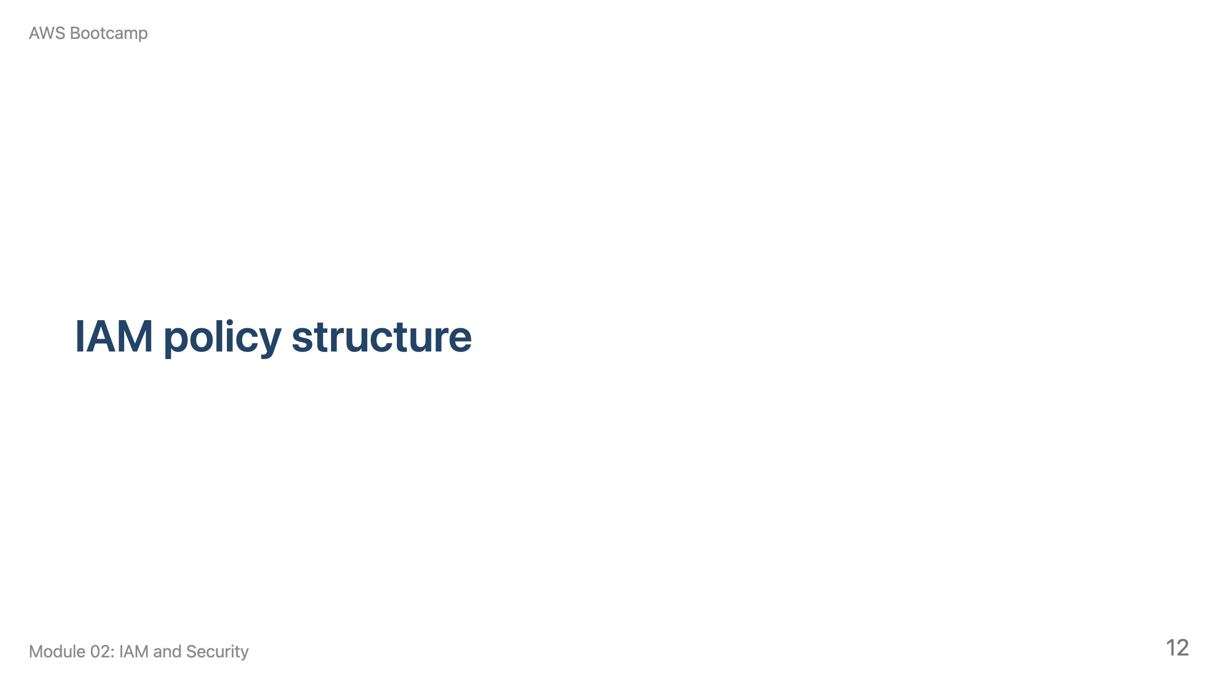
Notes:
Speaker notes: 10 minutes. Walk through the JSON structure on the next slide. Emphasize the Effect/Action/Resource pattern.

Slide 13
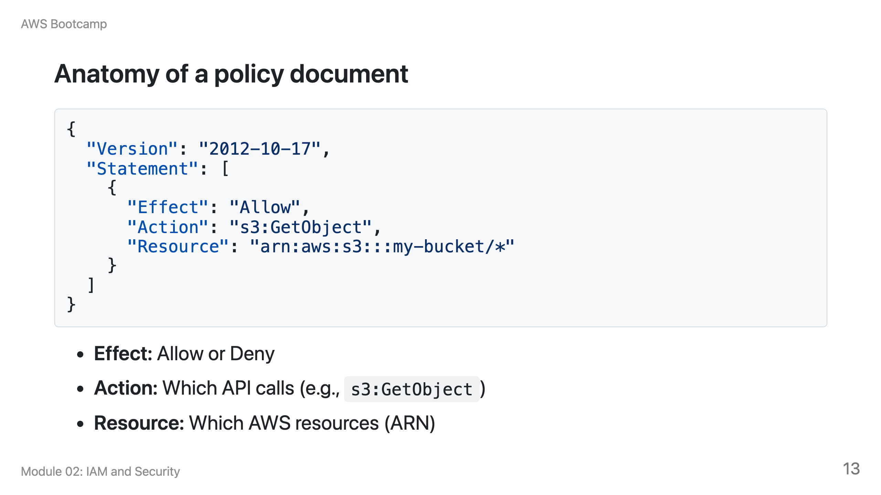

Slide 14
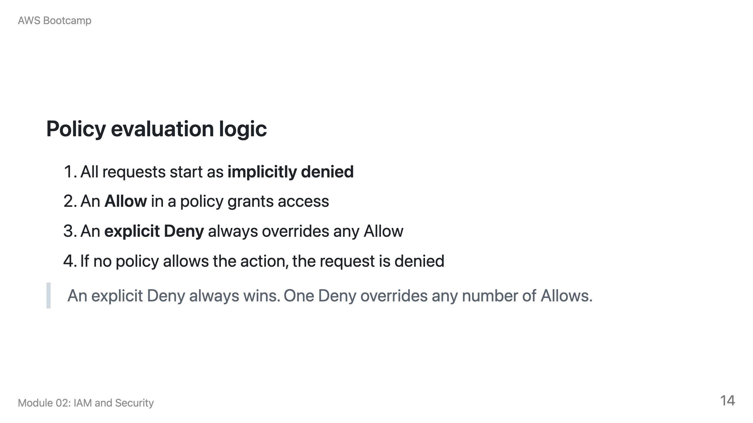

Slide 15
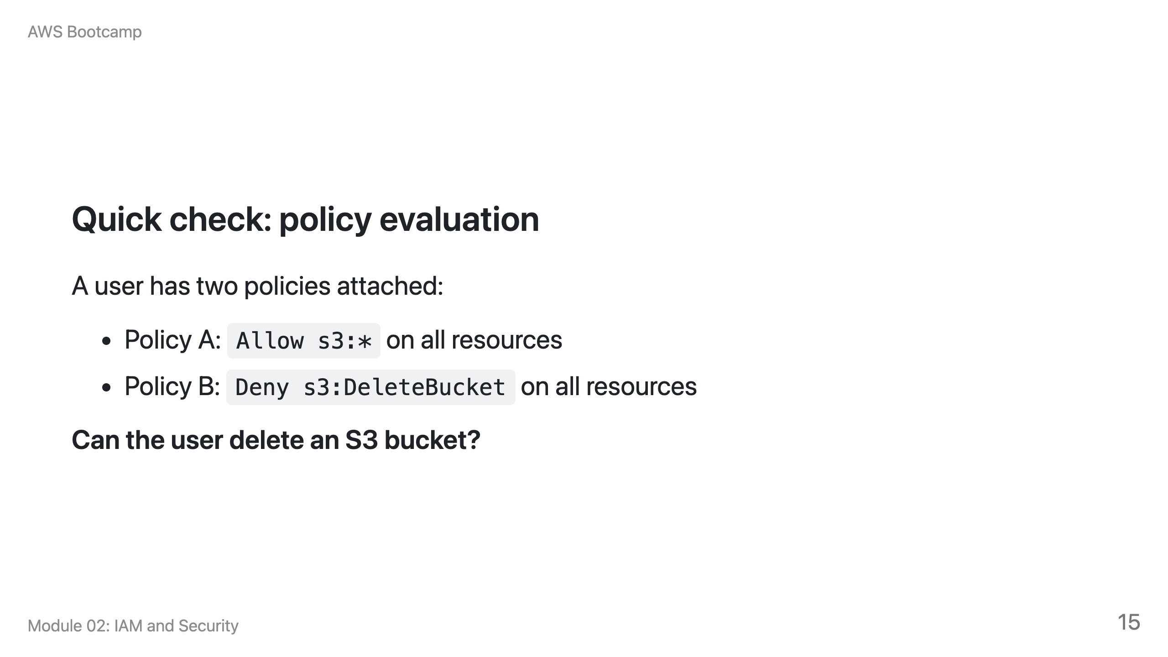
Notes:
Speaker notes: Answer: No. The explicit Deny in Policy B overrides the Allow in Policy A. This is the most important rule in IAM policy evaluation.

Slide 16
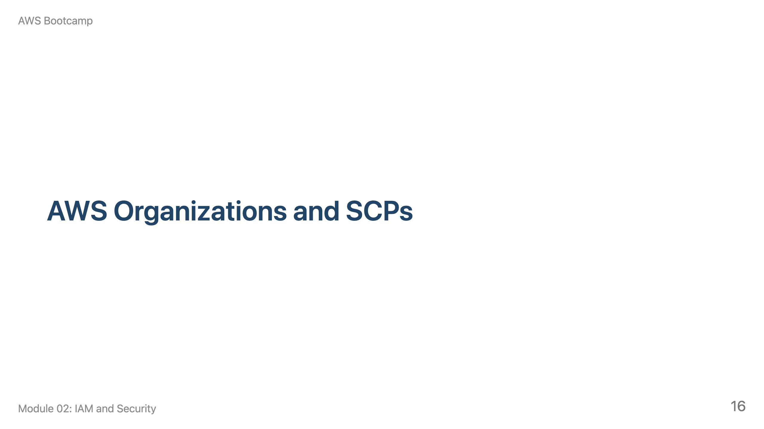
Notes:
Speaker notes: 10 minutes. Explain that Organizations is for multi-account governance. SCPs set the maximum permissions boundary for an entire account.

Slide 17
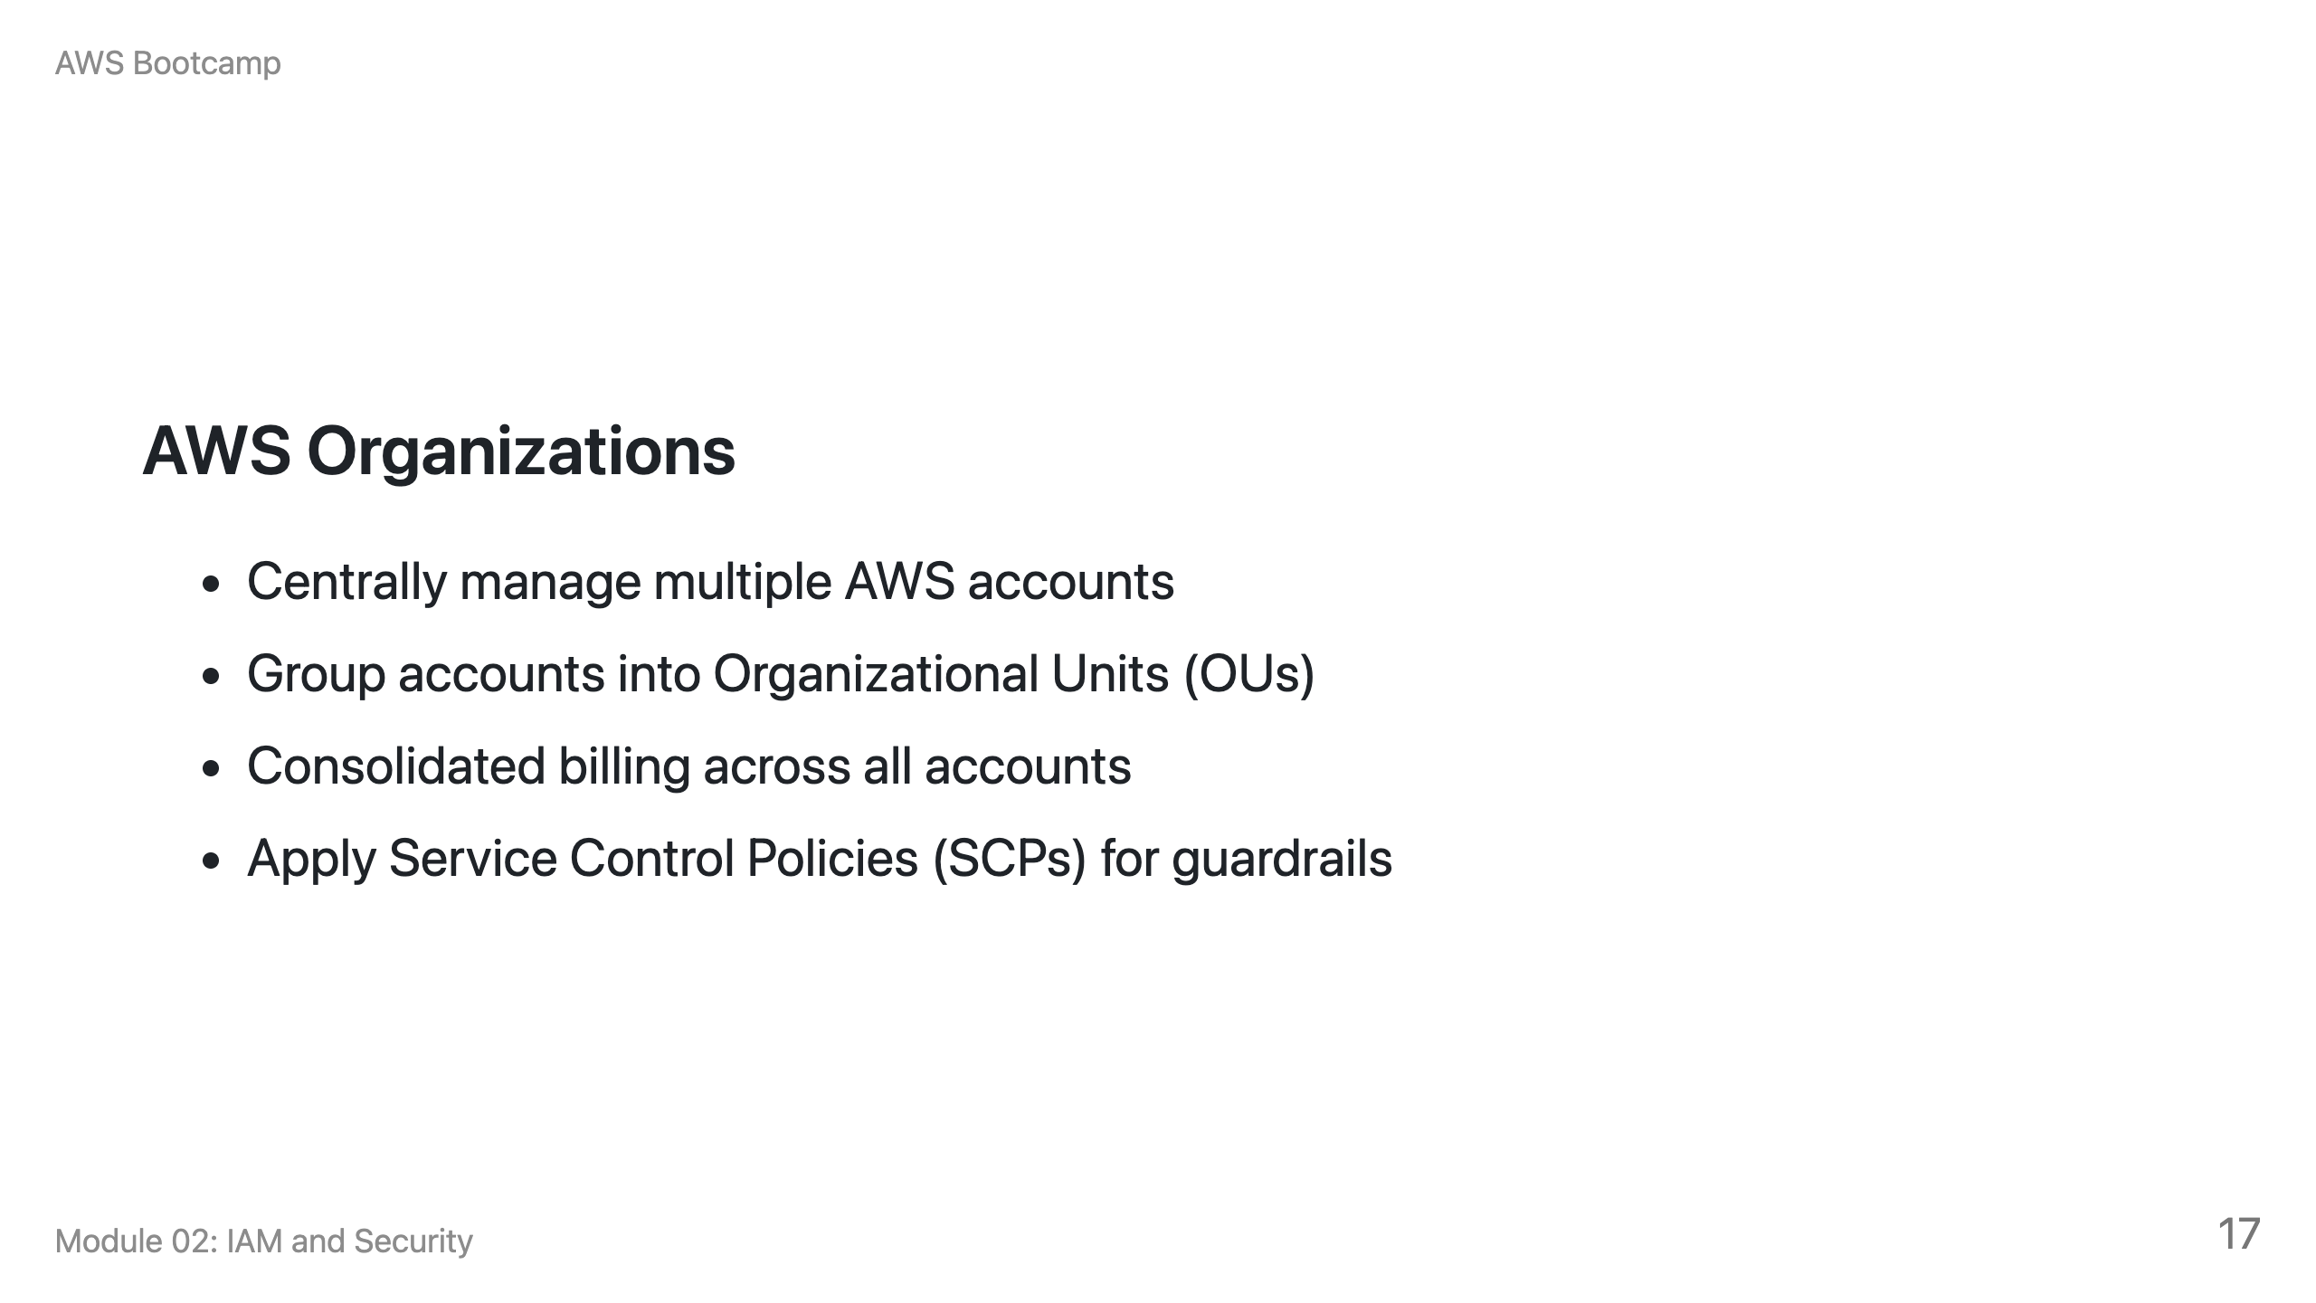

Slide 18
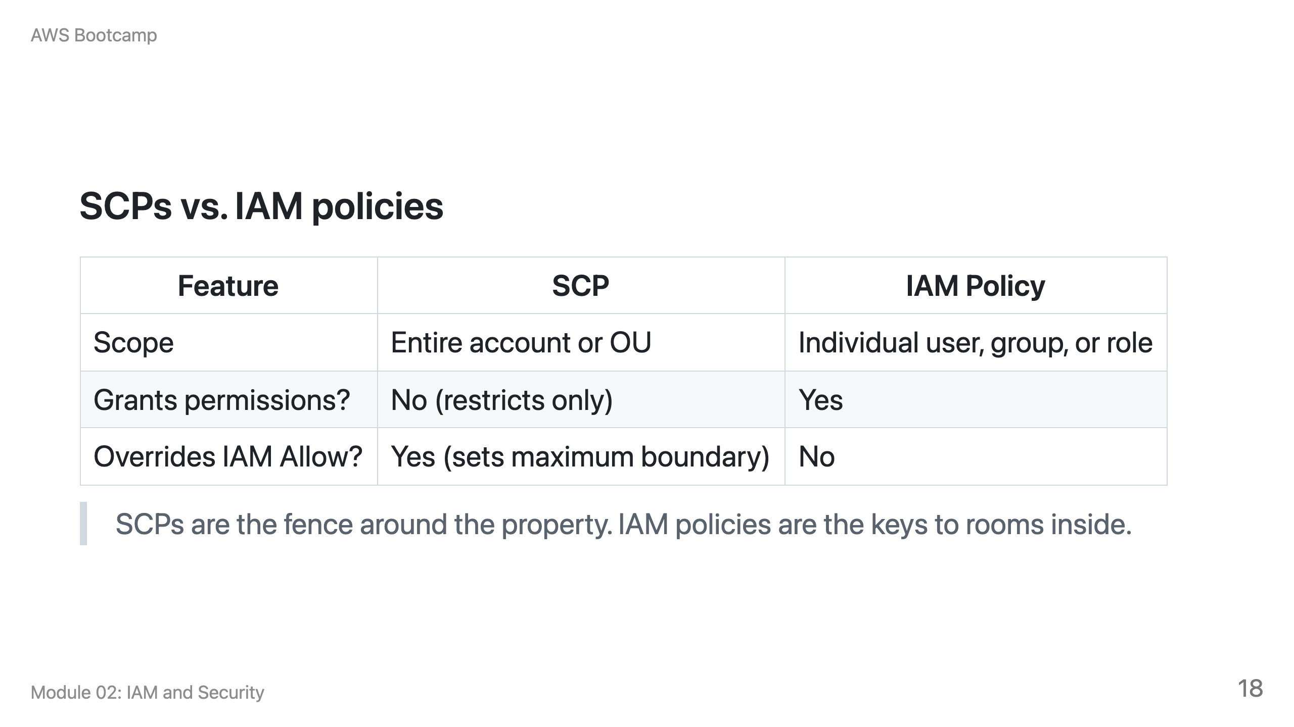

Slide 19
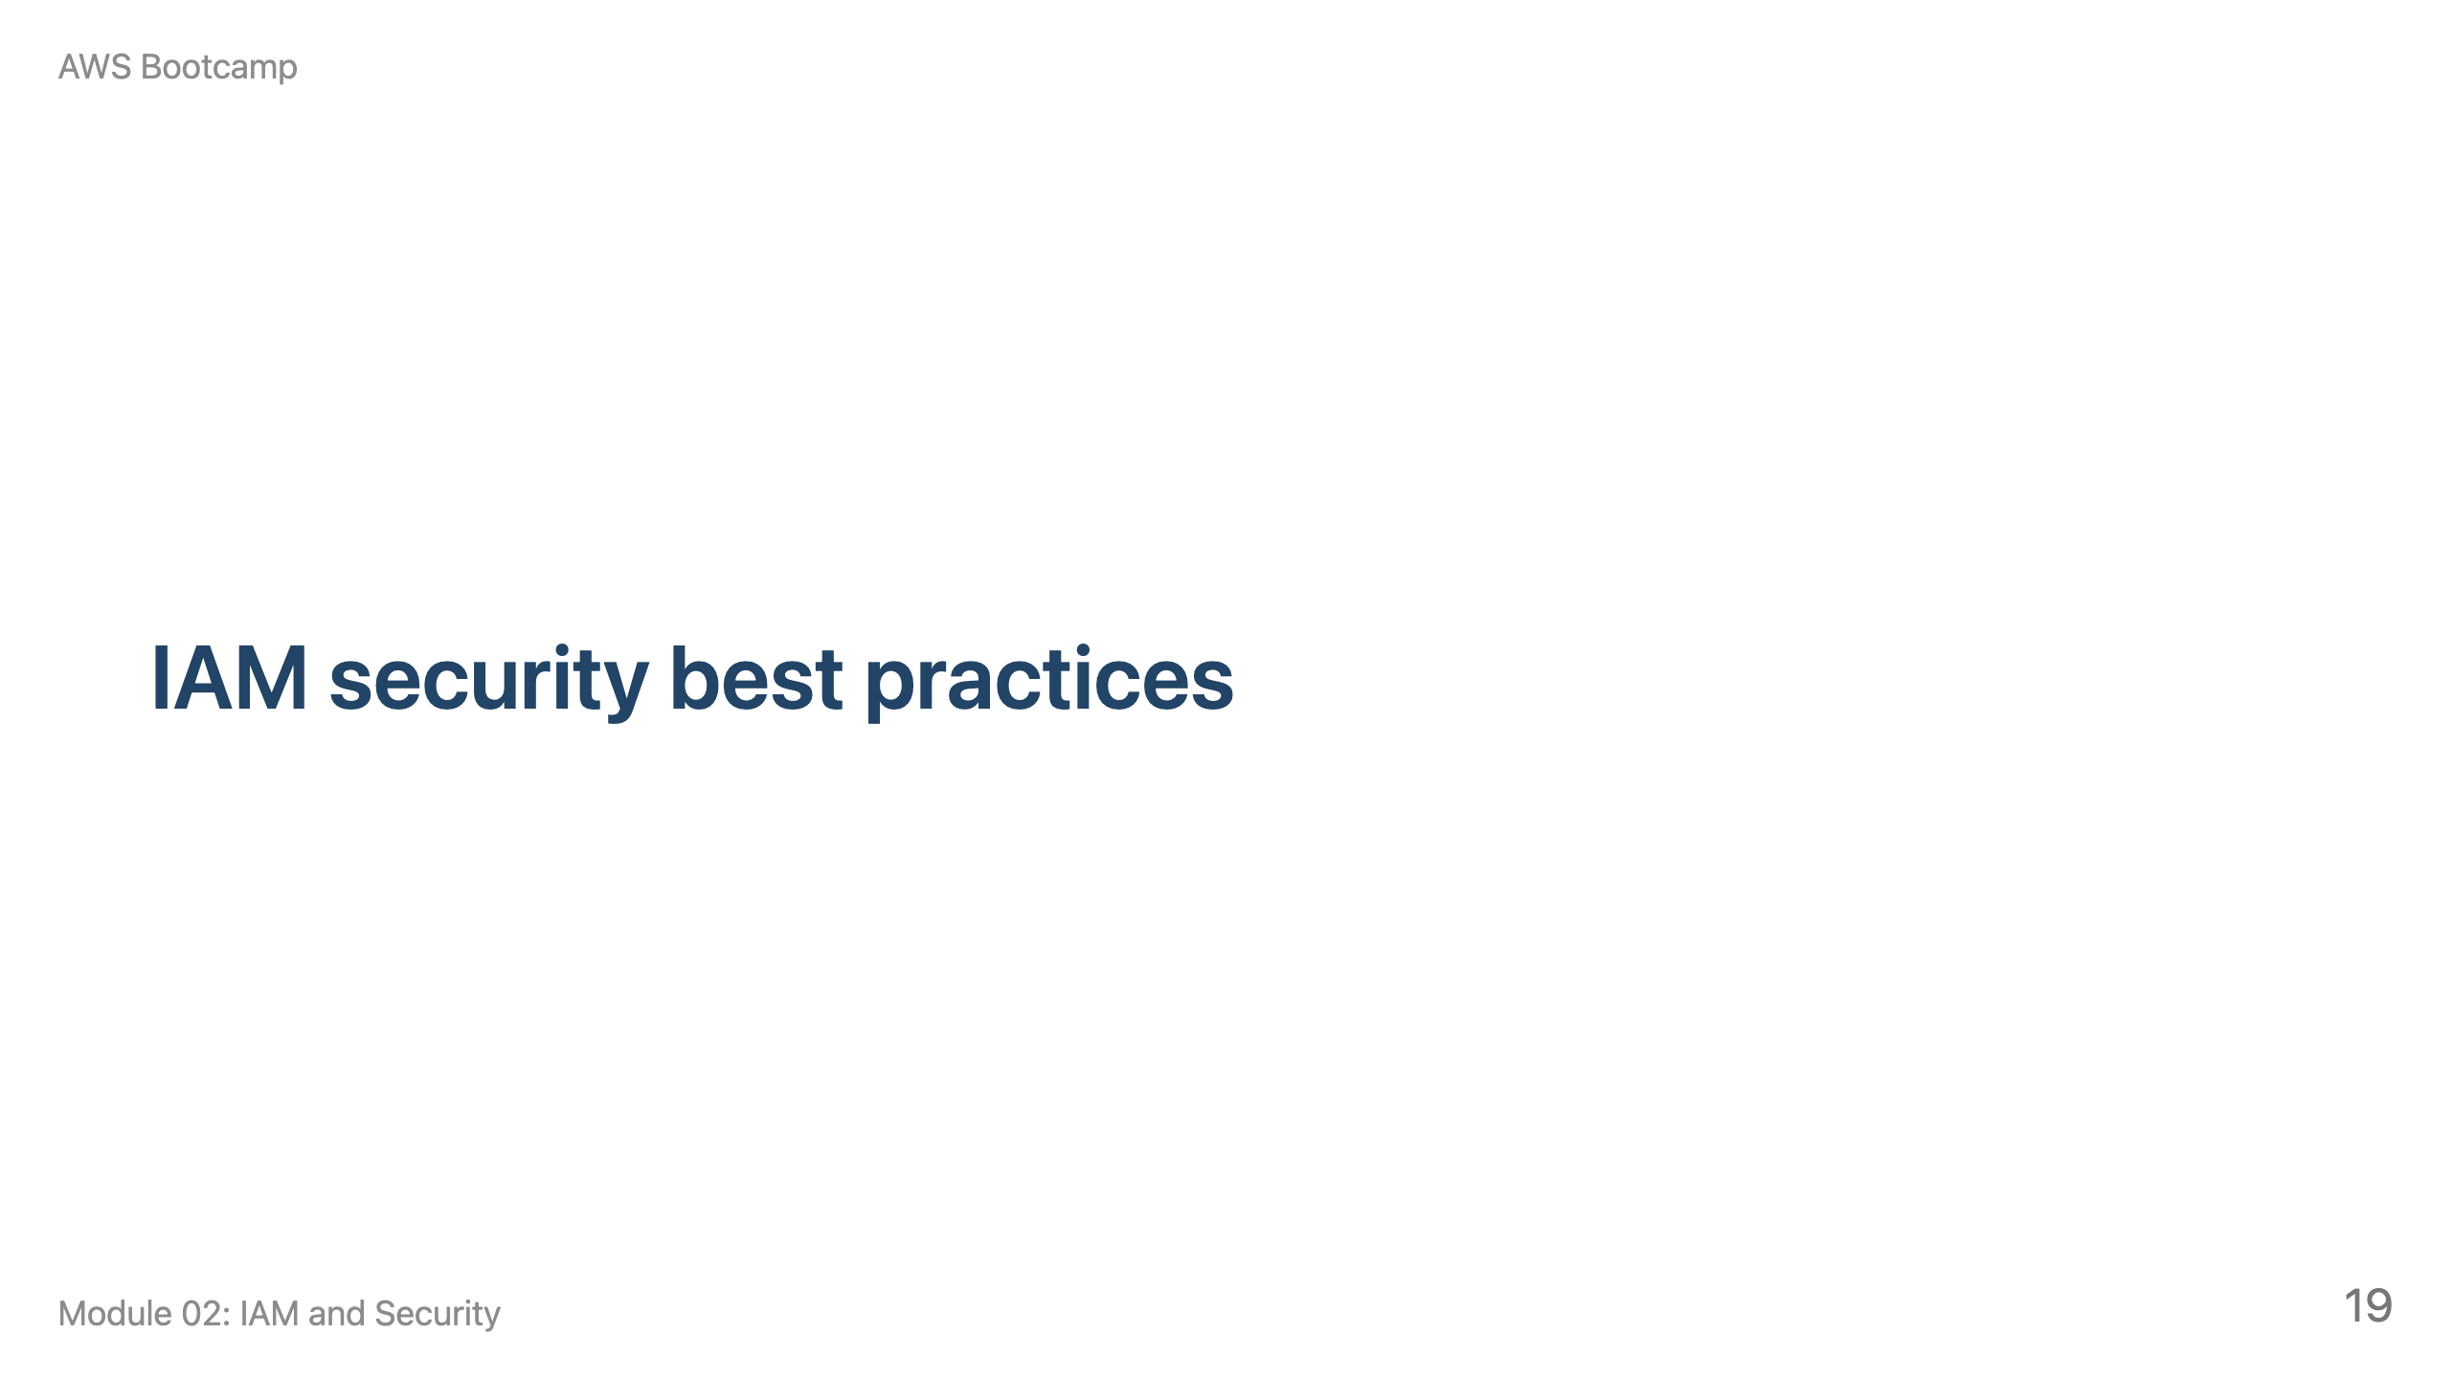
Notes:
Speaker notes: 10 minutes. These are the practices students should follow for every lab and project in the bootcamp.

Slide 20
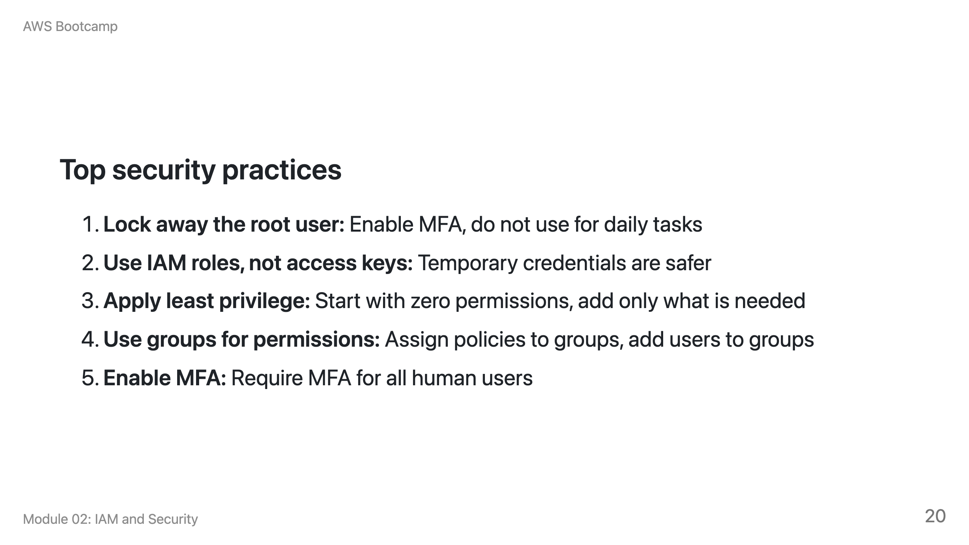

Slide 21
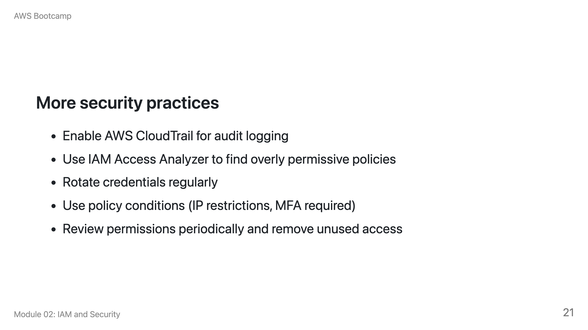

Slide 22
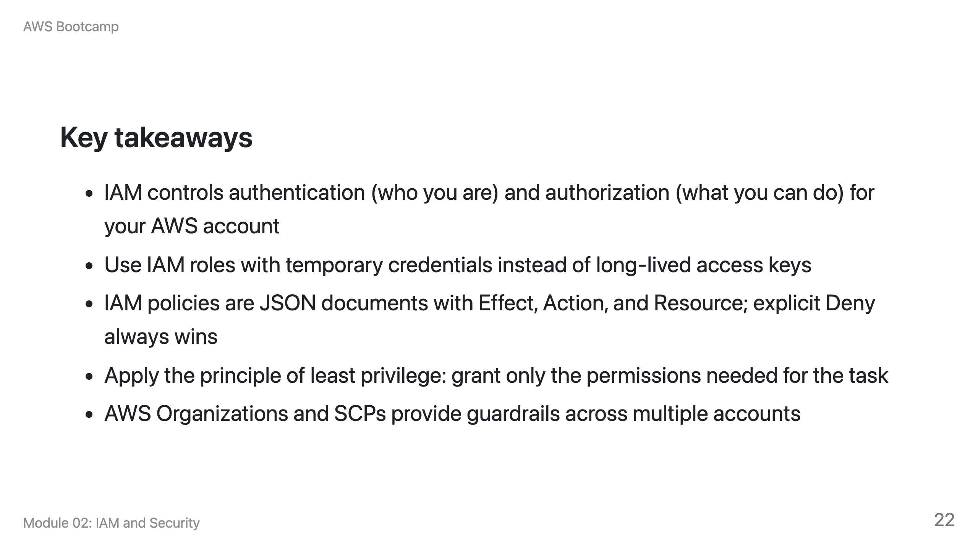

Slide 23
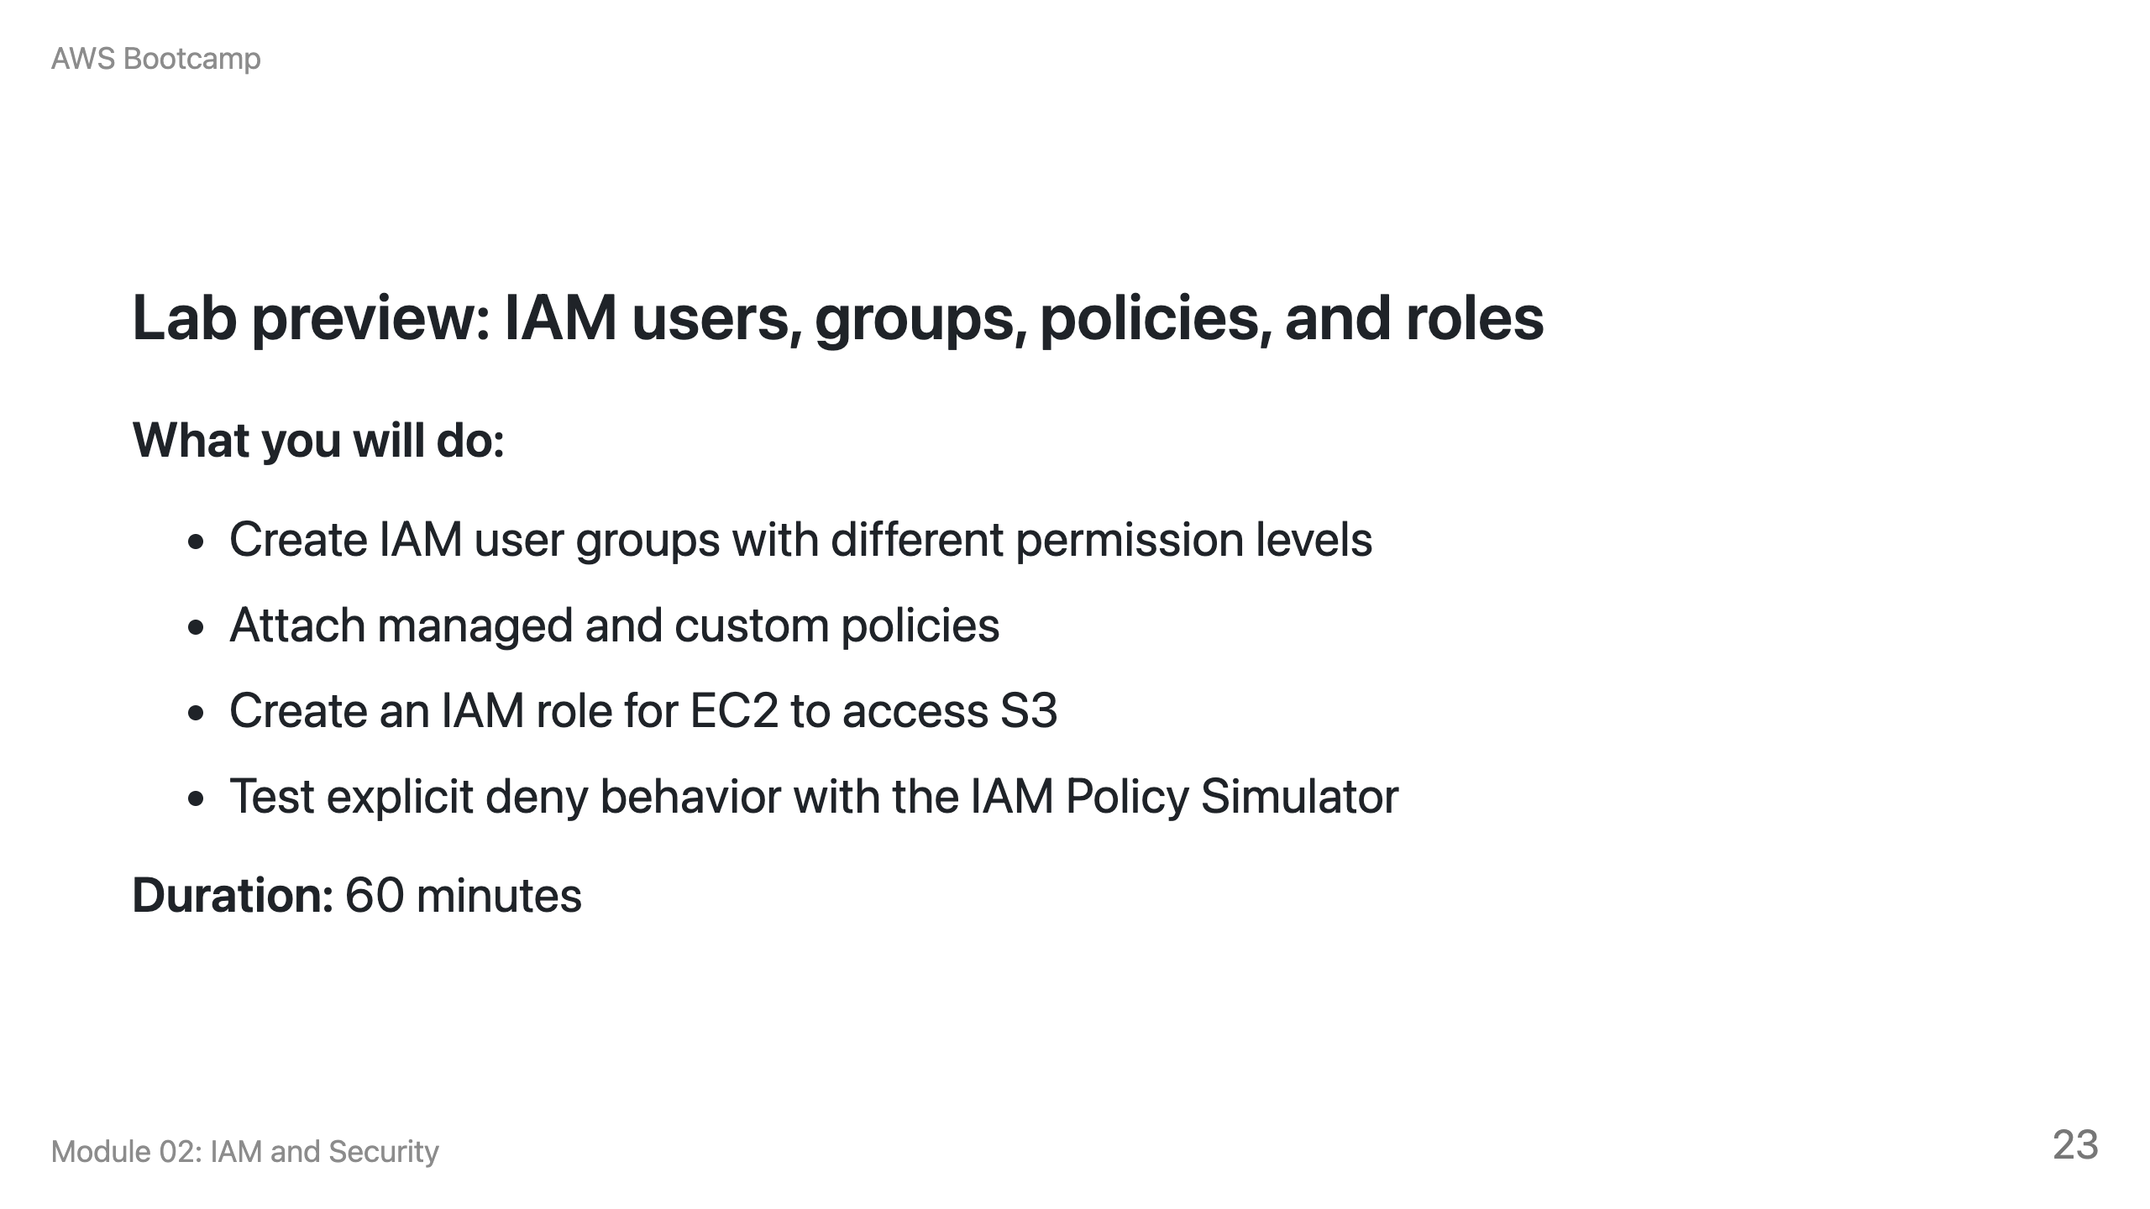

Slide 24
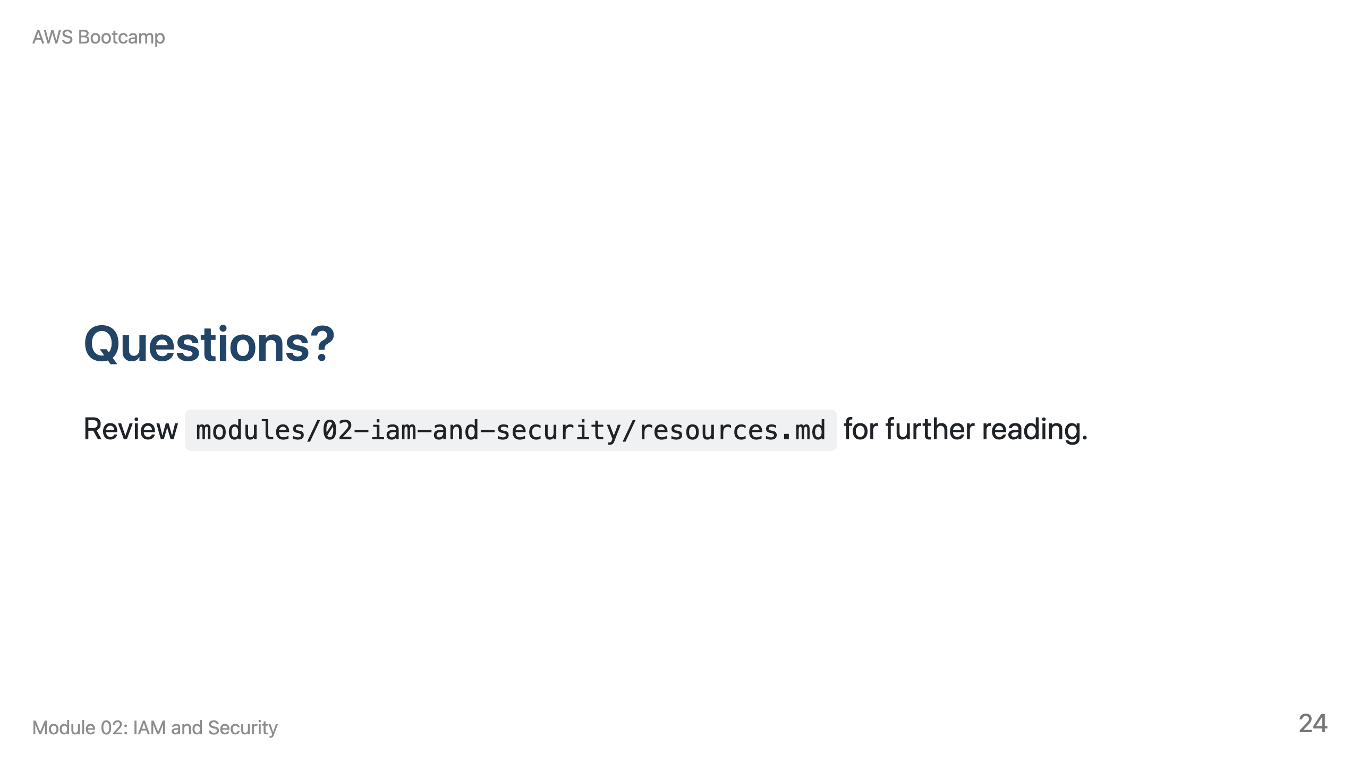
Notes:
Speaker notes: Take 5 minutes for questions. Common question: "Do I need to memorize the JSON policy syntax?" Answer: No, but you need to understand the Effect/Action/Resource structure and how evaluation works.

