Slide 1
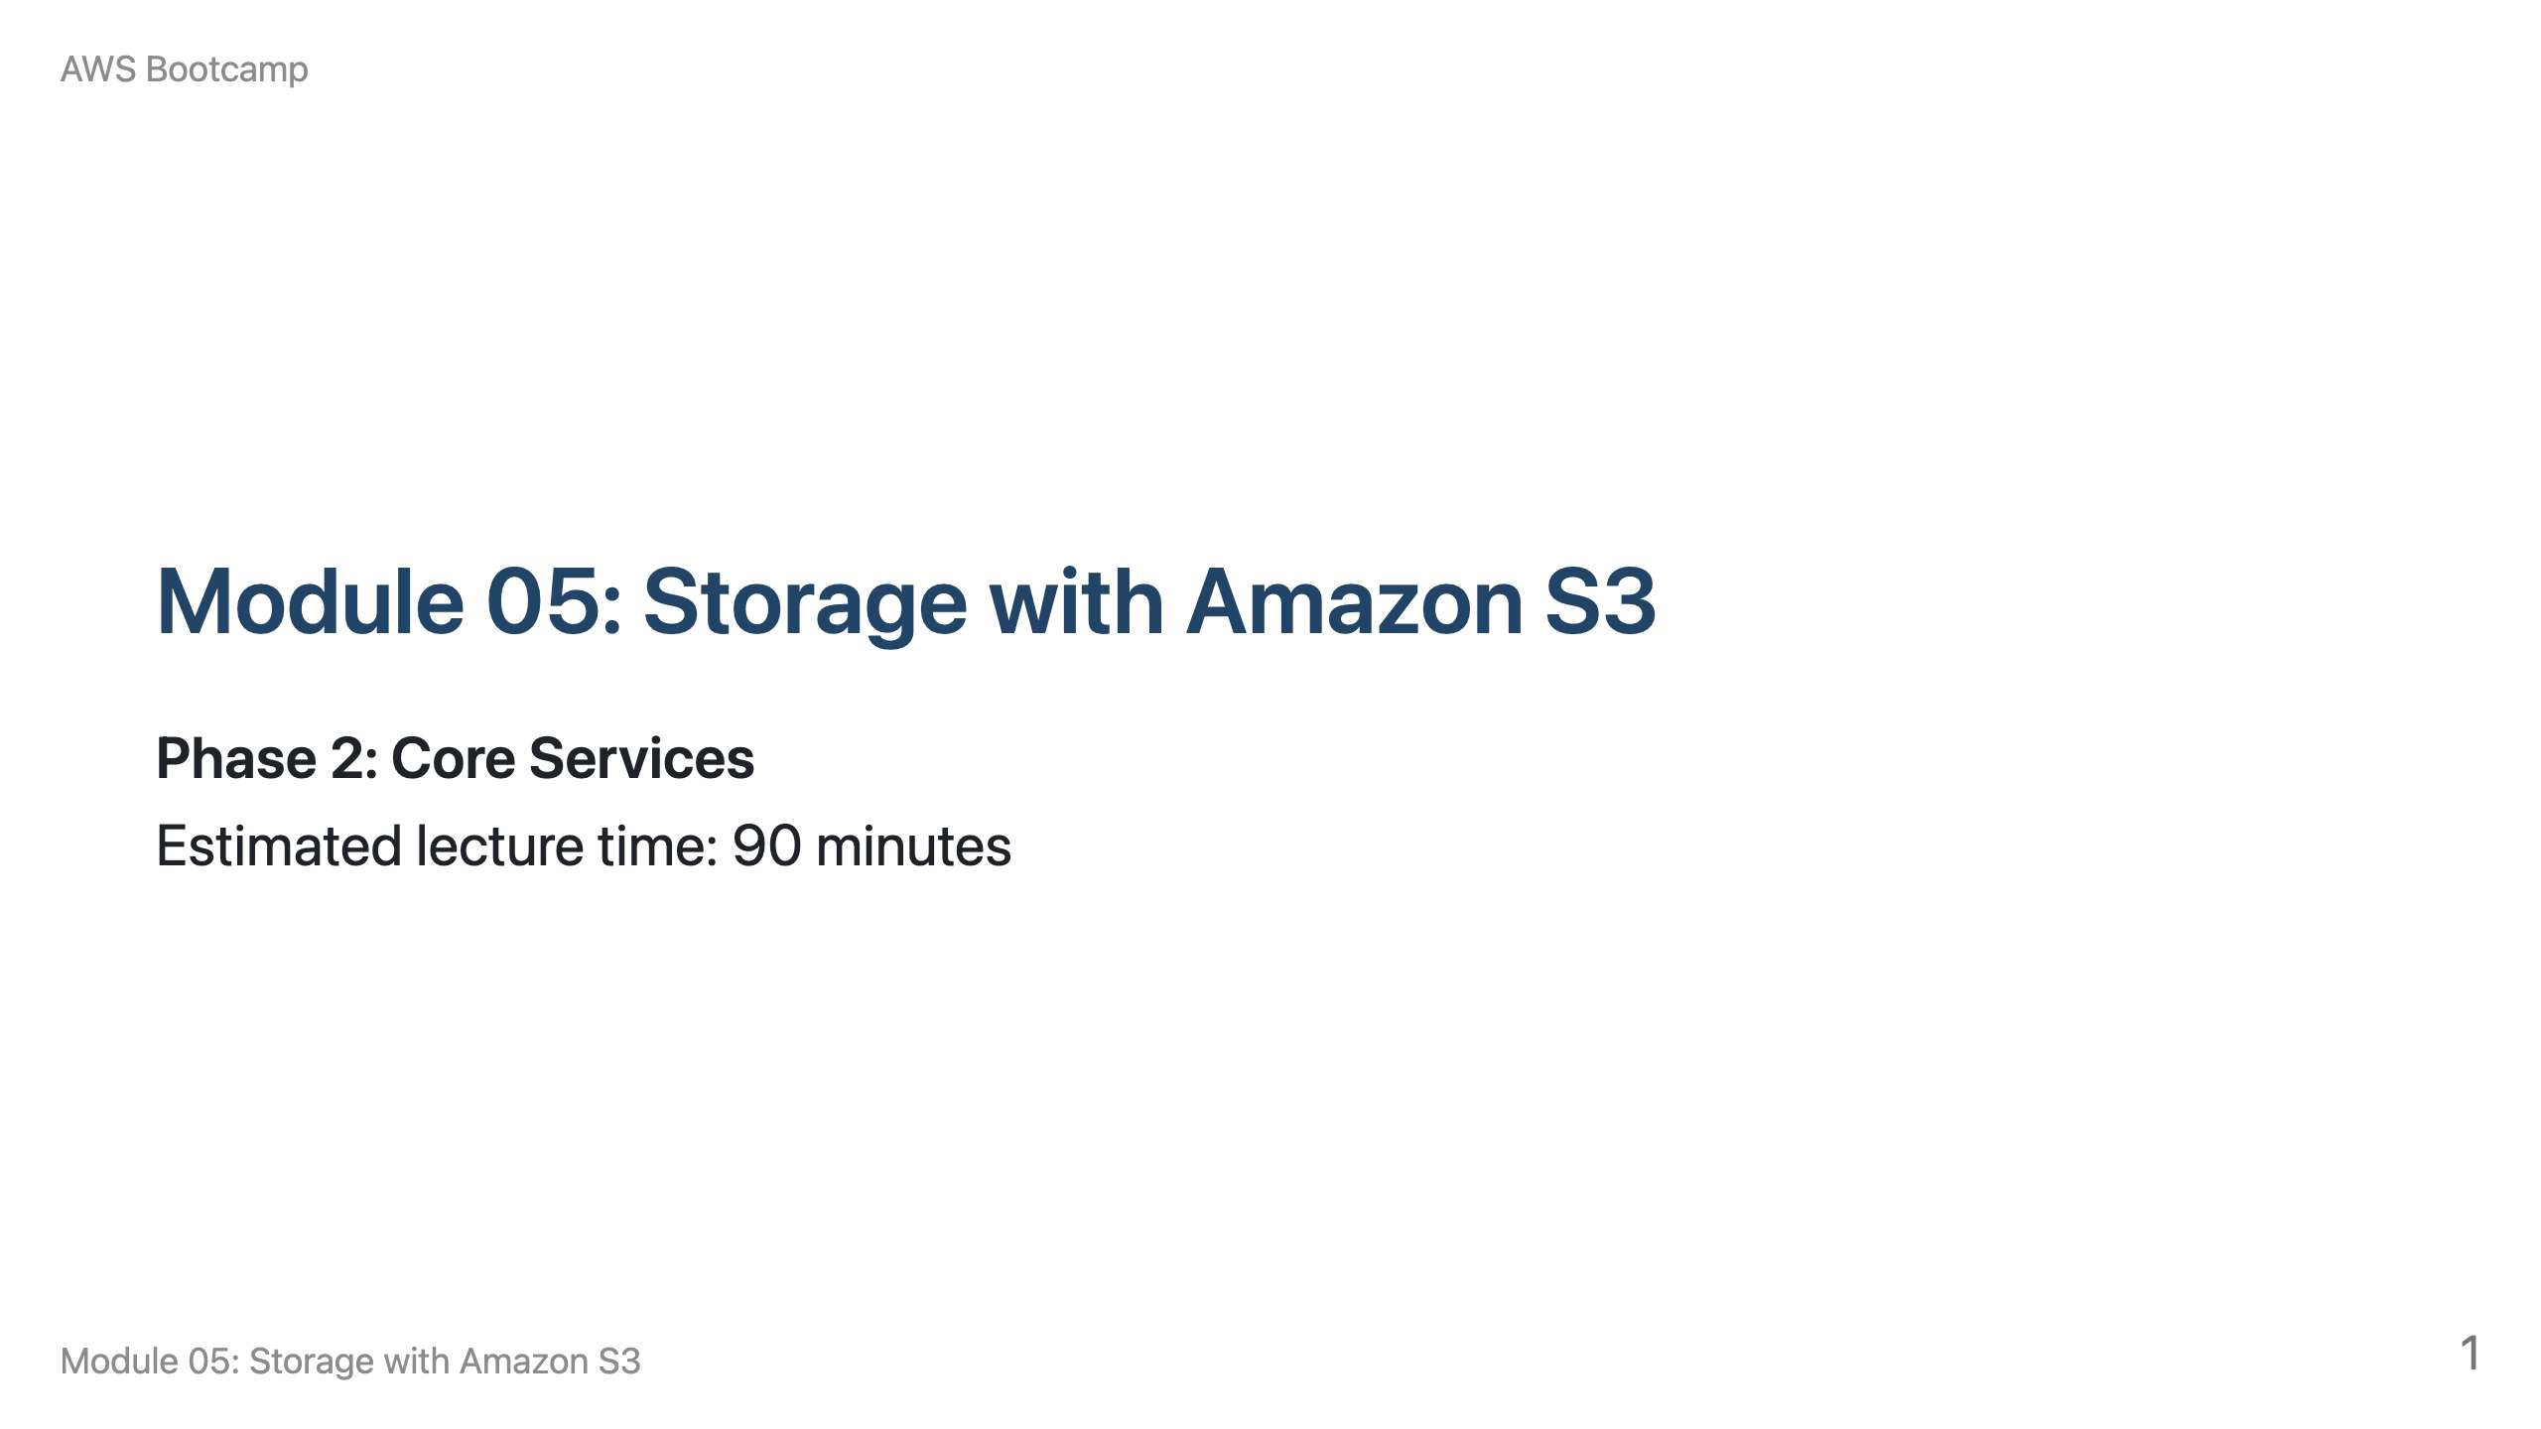
Notes:
Speaker notes: Welcome to Module 05. This module covers S3 object storage, one of the most widely used AWS services. Breakdown: 10 min S3 overview, 15 min storage classes, 10 min versioning, 10 min lifecycle policies, 15 min access control, 10 min encryption, 10 min static website hosting, 10 min replication and Q&A.

Slide 2
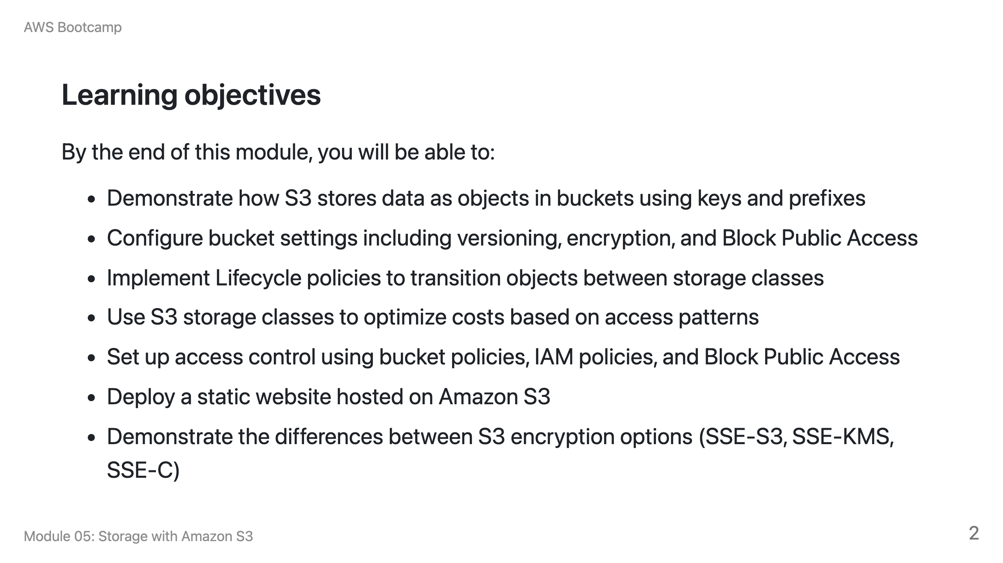

Slide 3
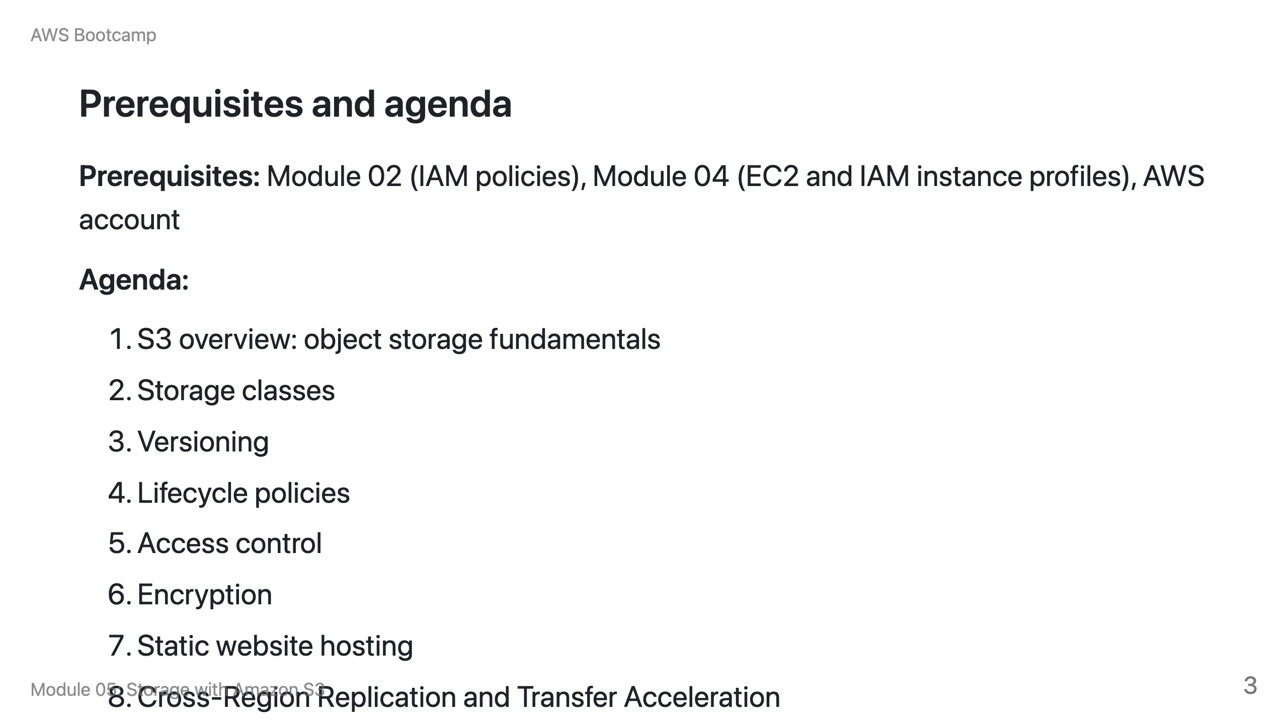

Slide 4
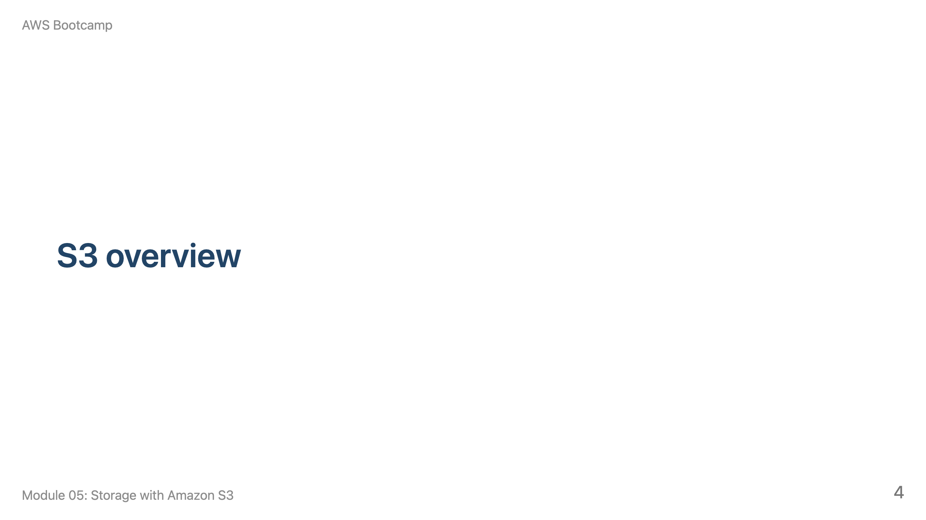
Notes:
Speaker notes: This section takes approximately 10 minutes. Start by contrasting S3 (object storage) with EBS (block storage) from Module 04.

Slide 5
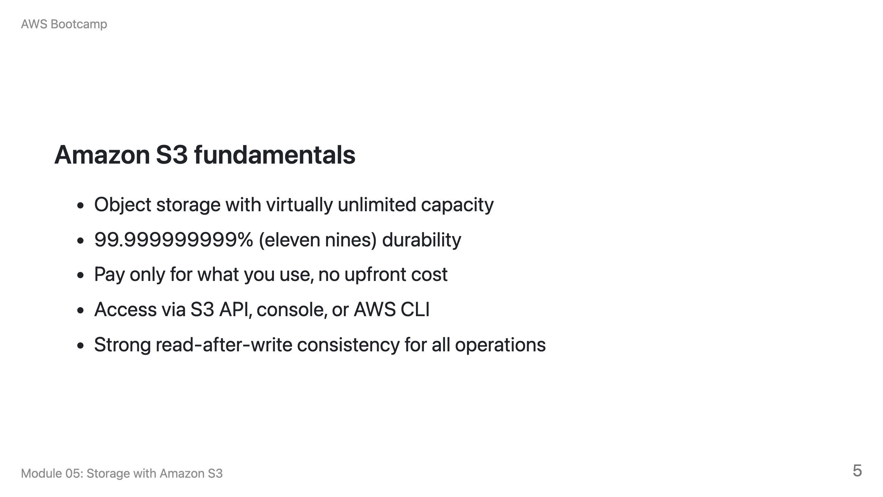

Slide 6
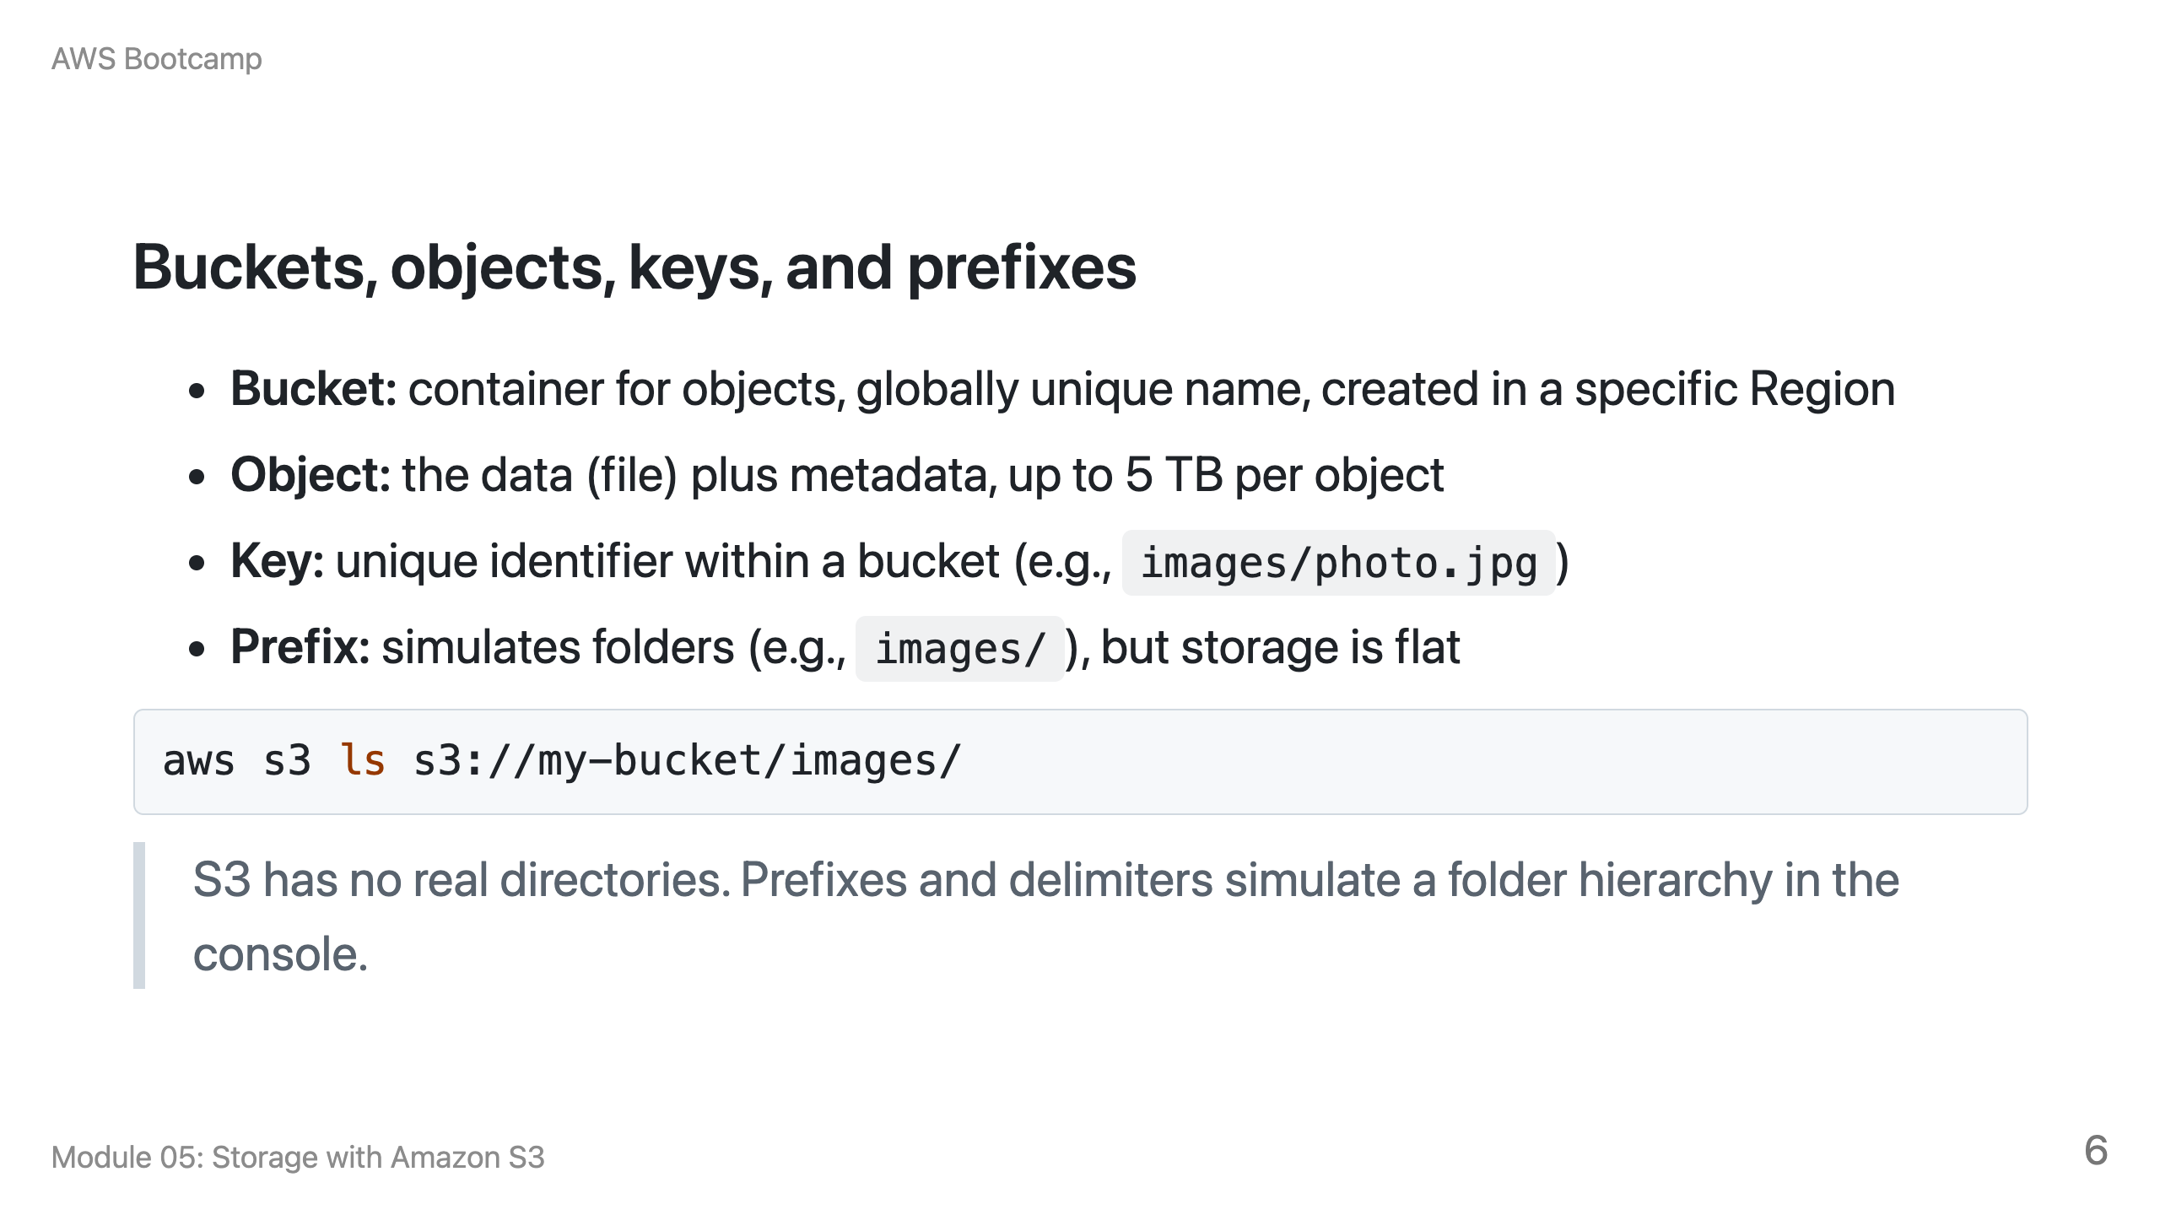

Slide 7
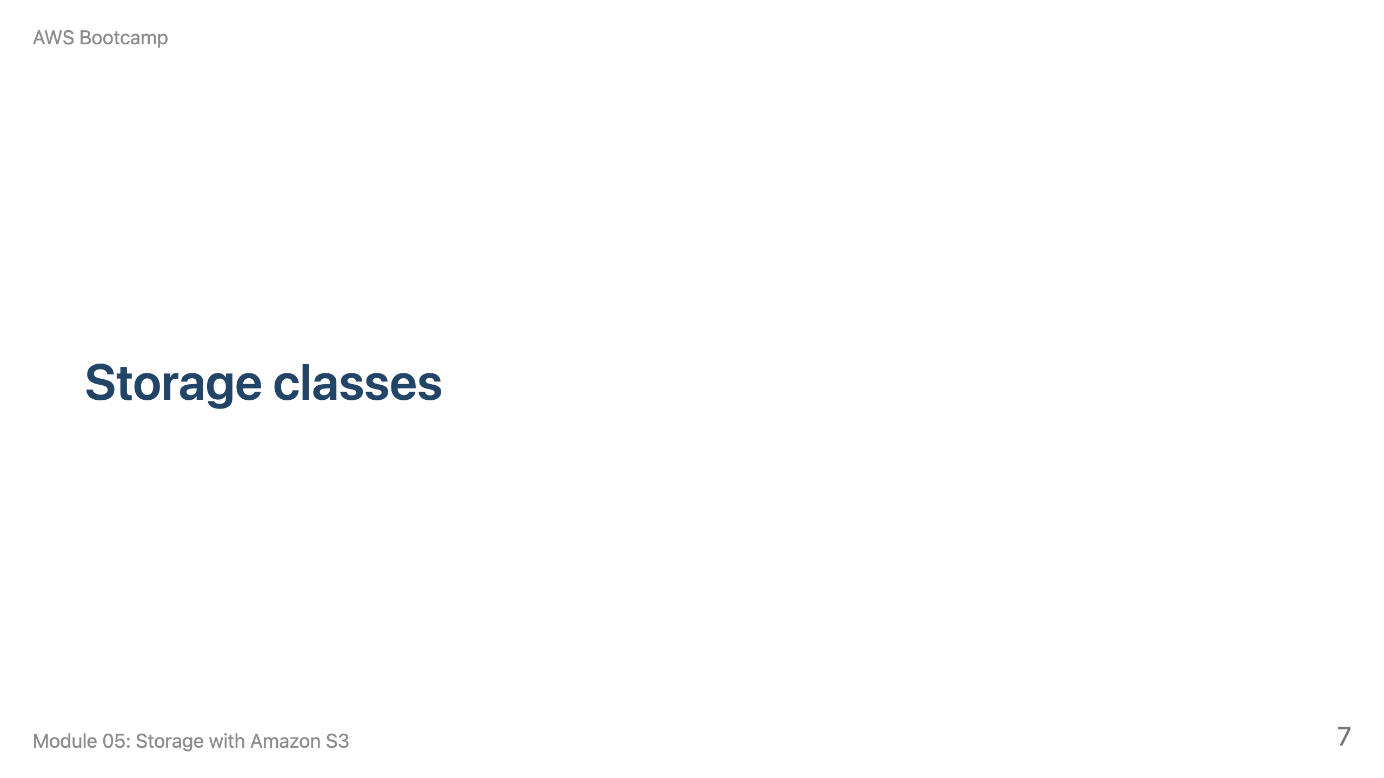
Notes:
Speaker notes: This section takes approximately 15 minutes. Use the filing system analogy: Standard is the desk drawer, Standard-IA is the filing cabinet, Glacier is the offsite warehouse.

Slide 8
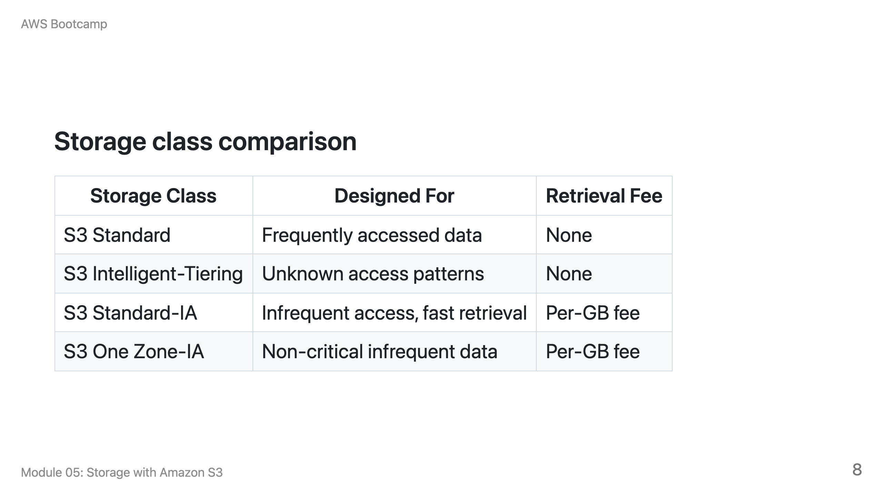

Slide 9
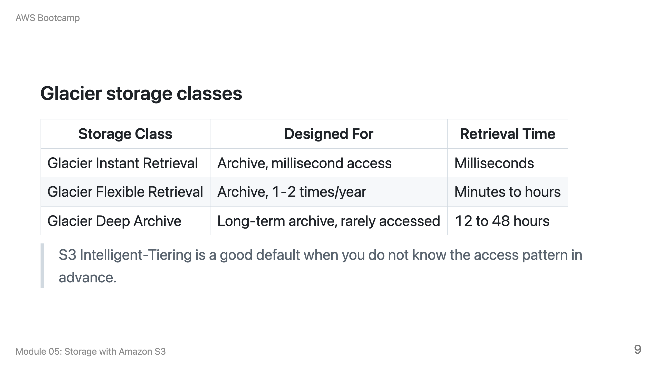

Slide 10
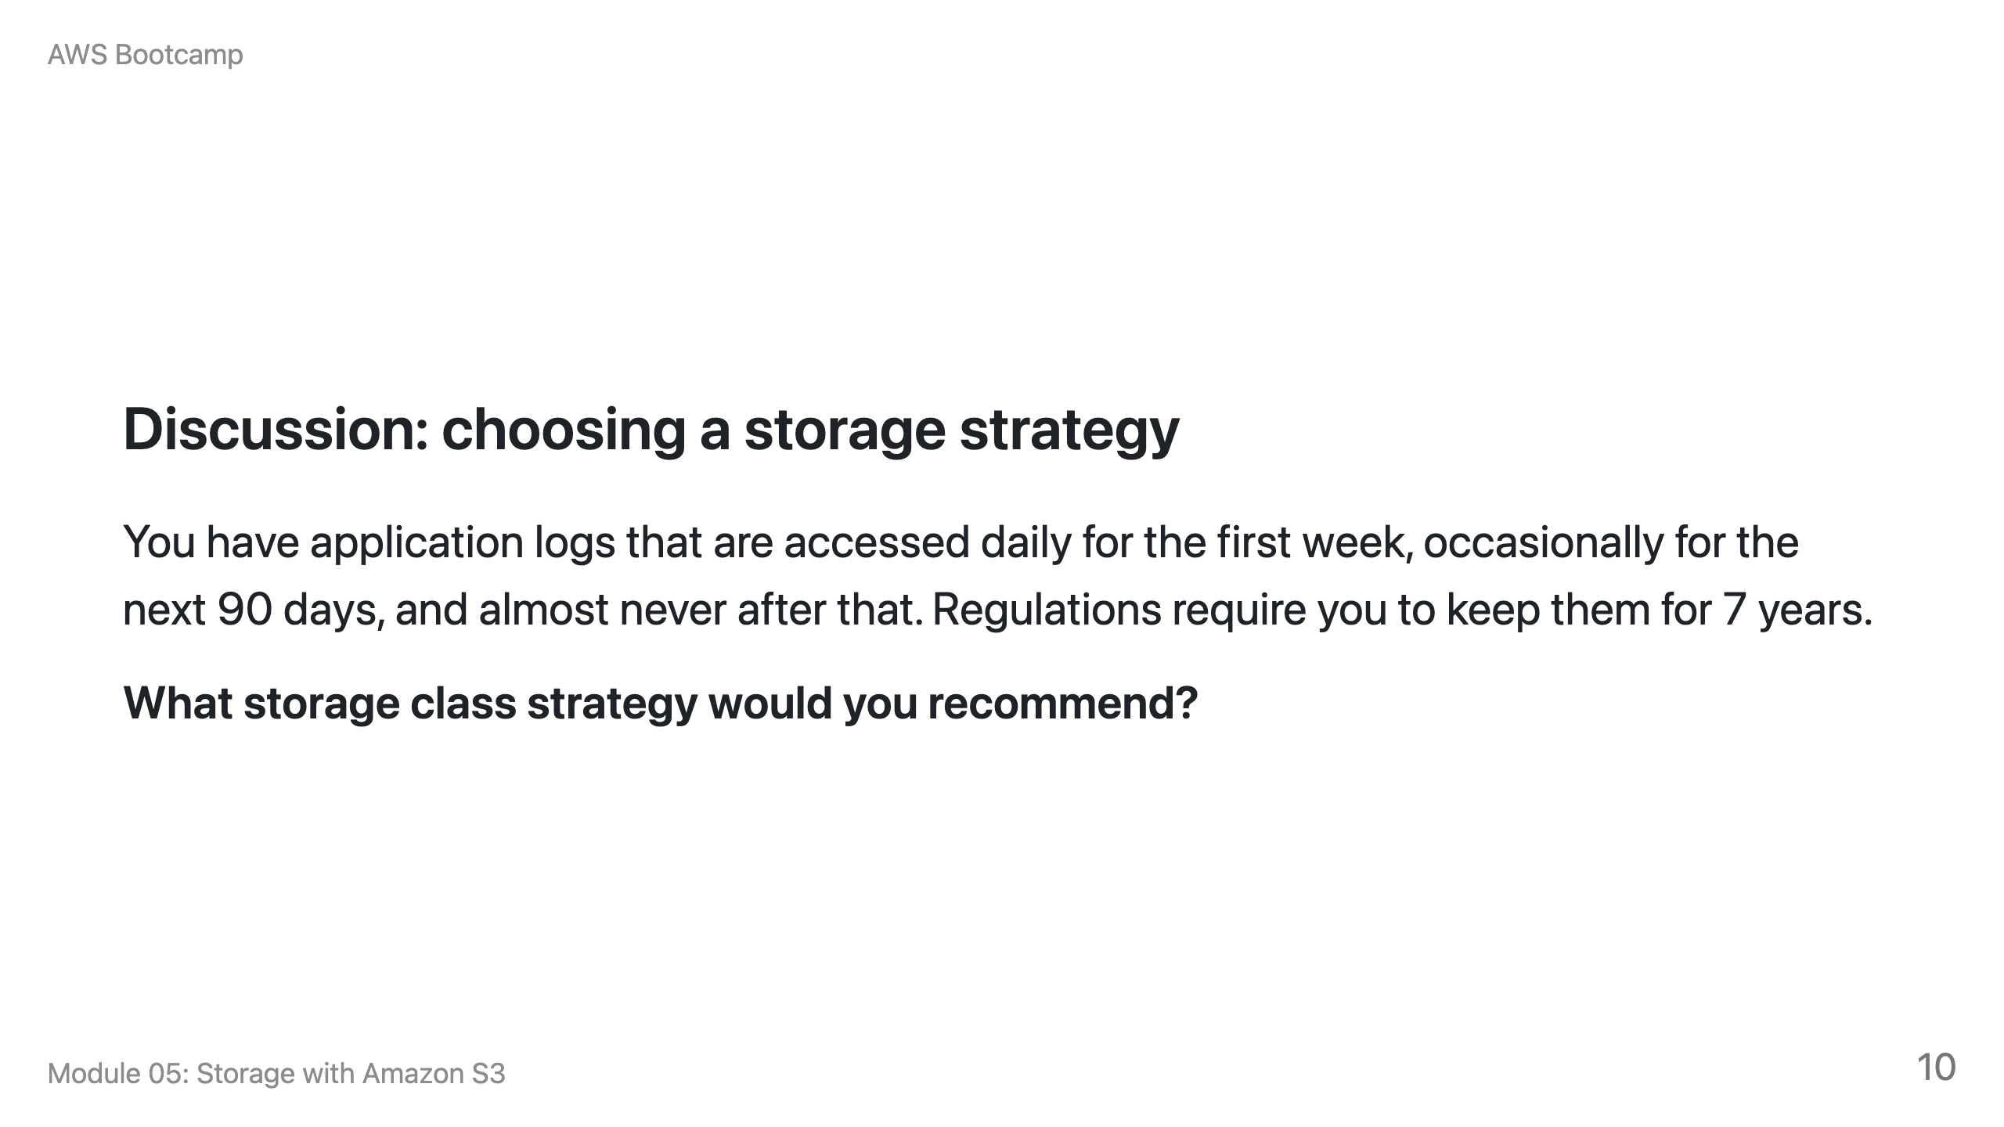
Notes:
Speaker notes: Expected answer: Start in S3 Standard for the first 30 days (active access). Transition to Standard-IA after 30 days (occasional access). Transition to Glacier Flexible Retrieval after 90 days (rare access). Use a Lifecycle policy to automate these transitions. Expire after 7 years (2,555 days). This is a classic tiered storage pattern.

Slide 11
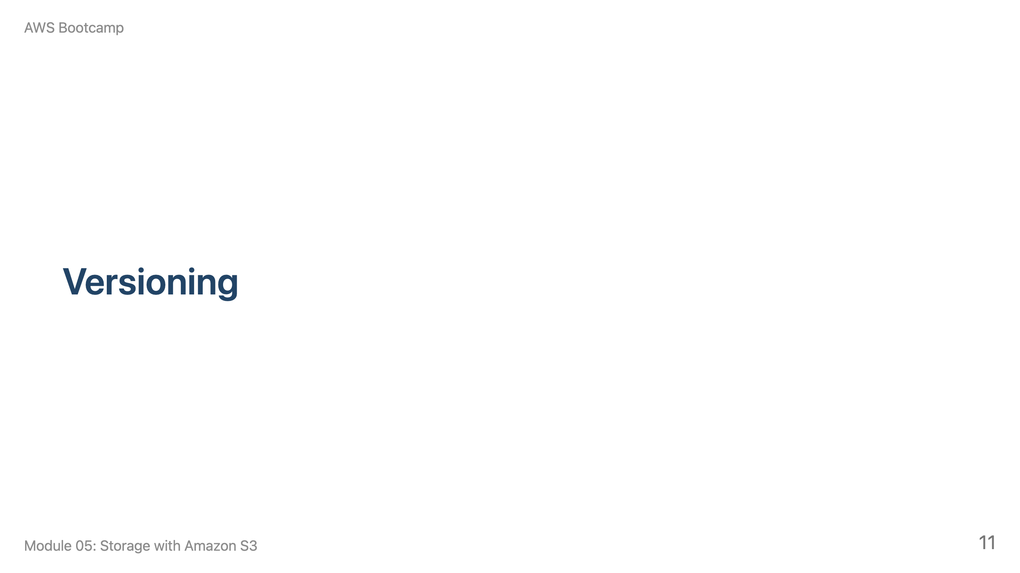
Notes:
Speaker notes: This section takes approximately 10 minutes. Demonstrate by uploading a file, modifying it, uploading again, then showing both versions.

Slide 12
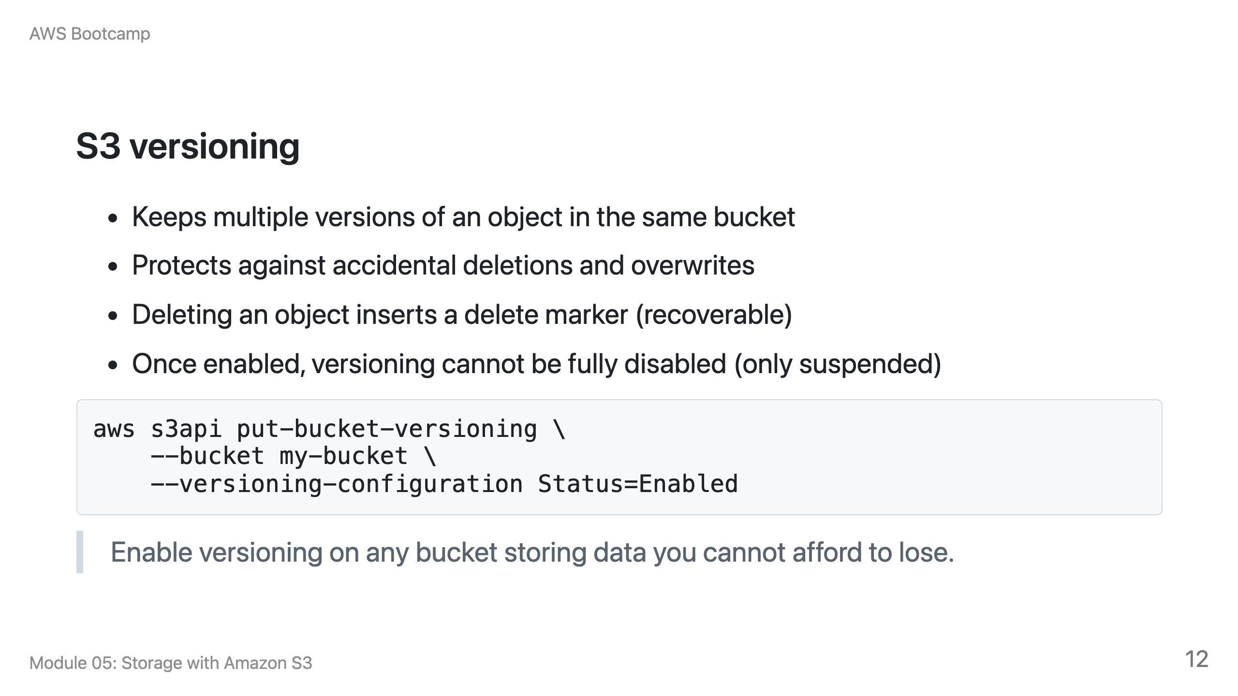

Slide 13
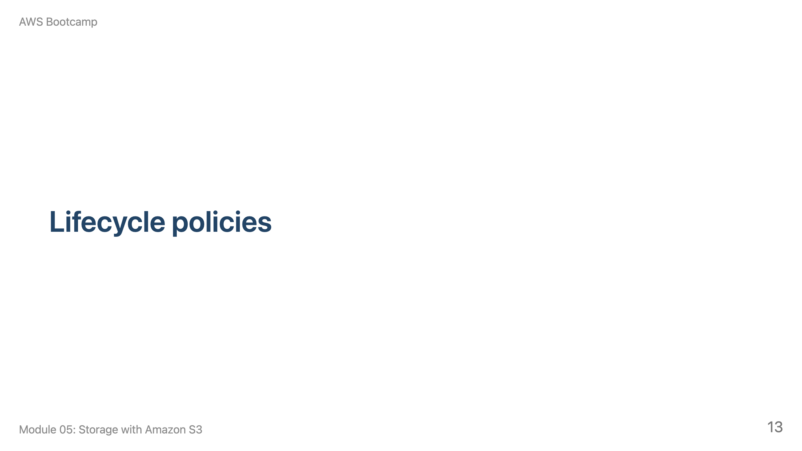
Notes:
Speaker notes: This section takes approximately 10 minutes. Show the transition hierarchy and a JSON example.

Slide 14
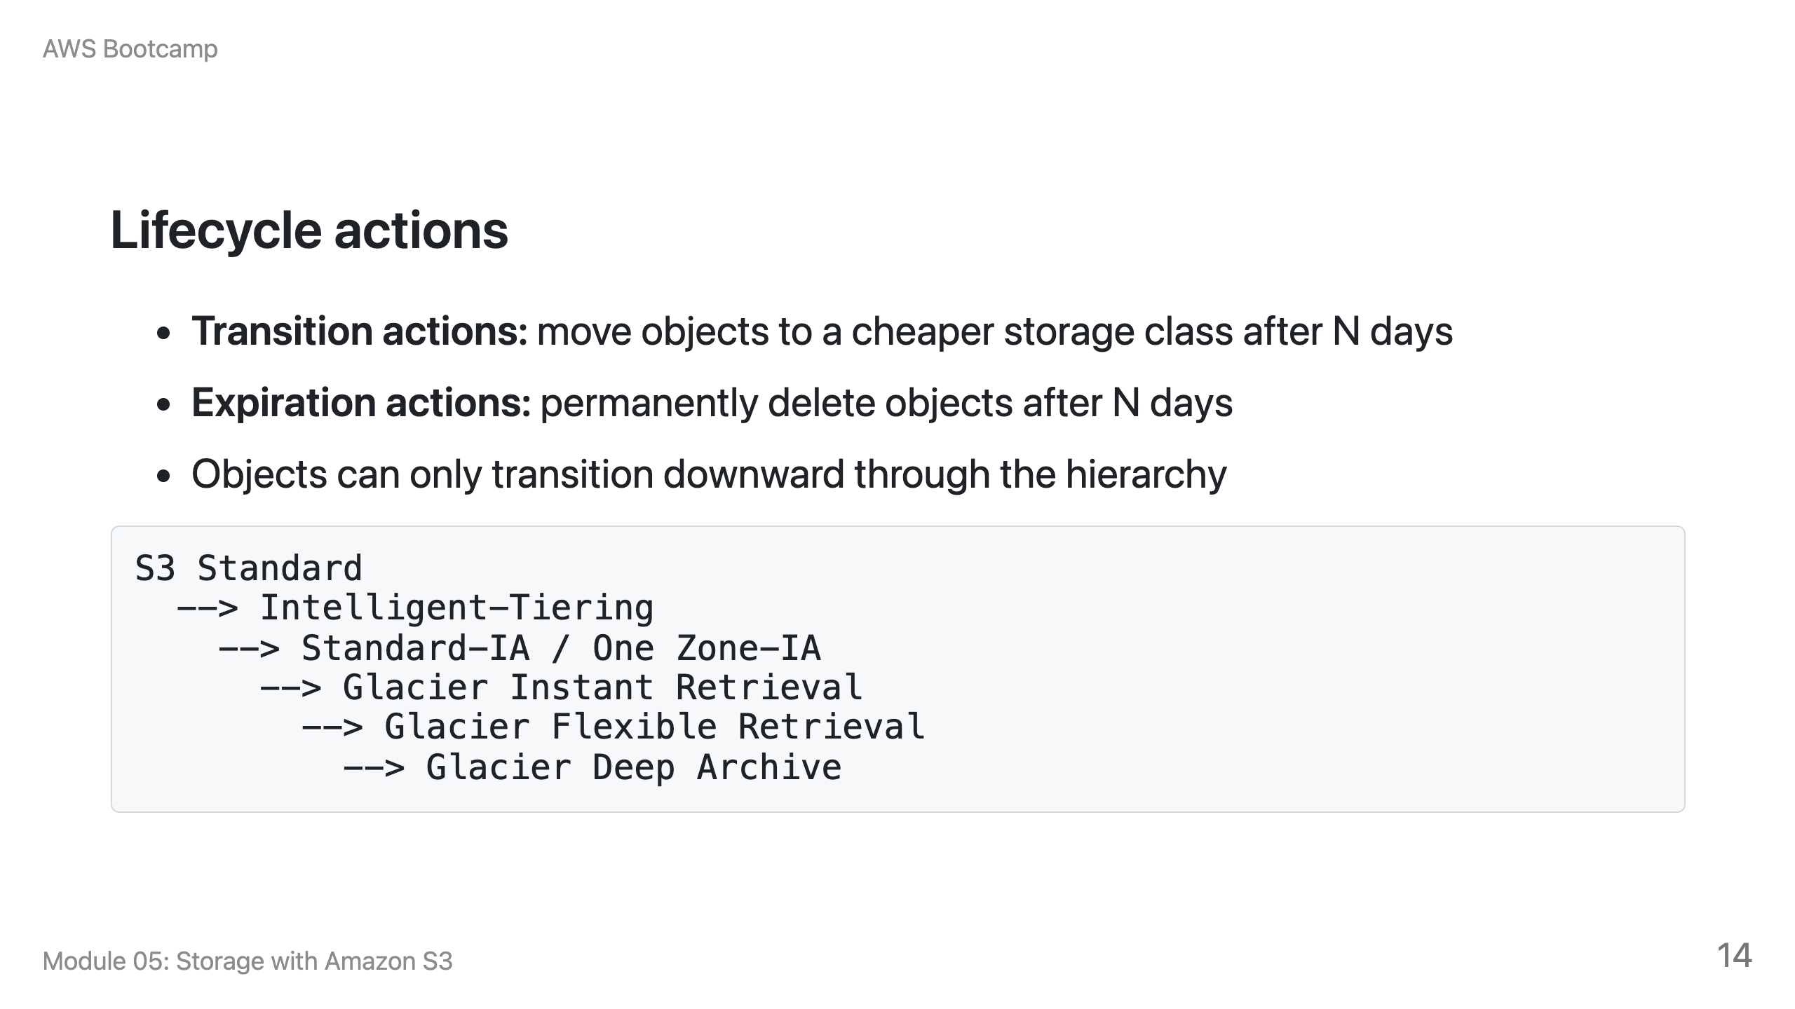

Slide 15
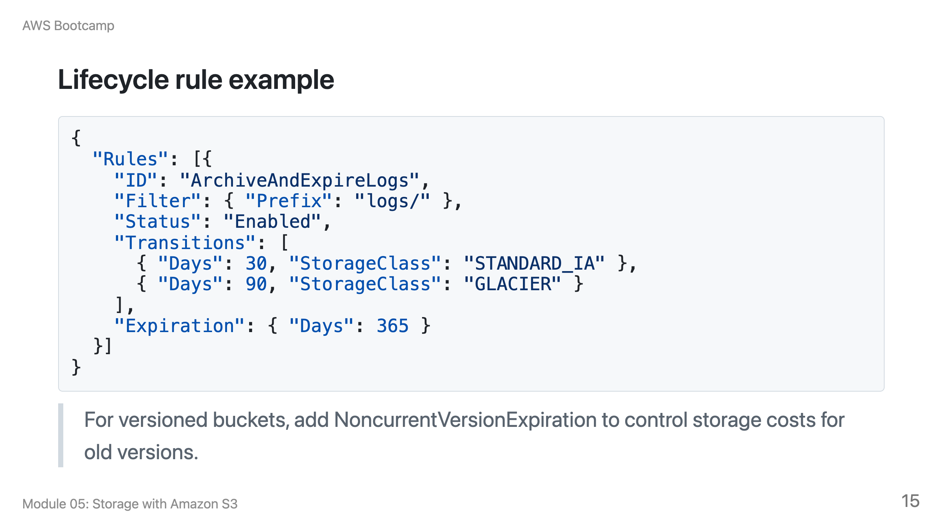

Slide 16
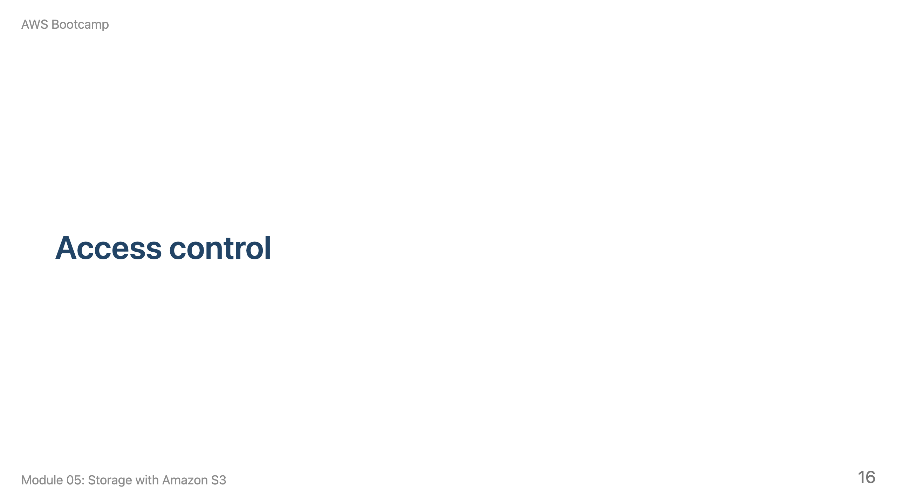
Notes:
Speaker notes: This section takes approximately 15 minutes. Connect to IAM policies from Module 02. Show a bucket policy and IAM policy side by side.

Slide 17
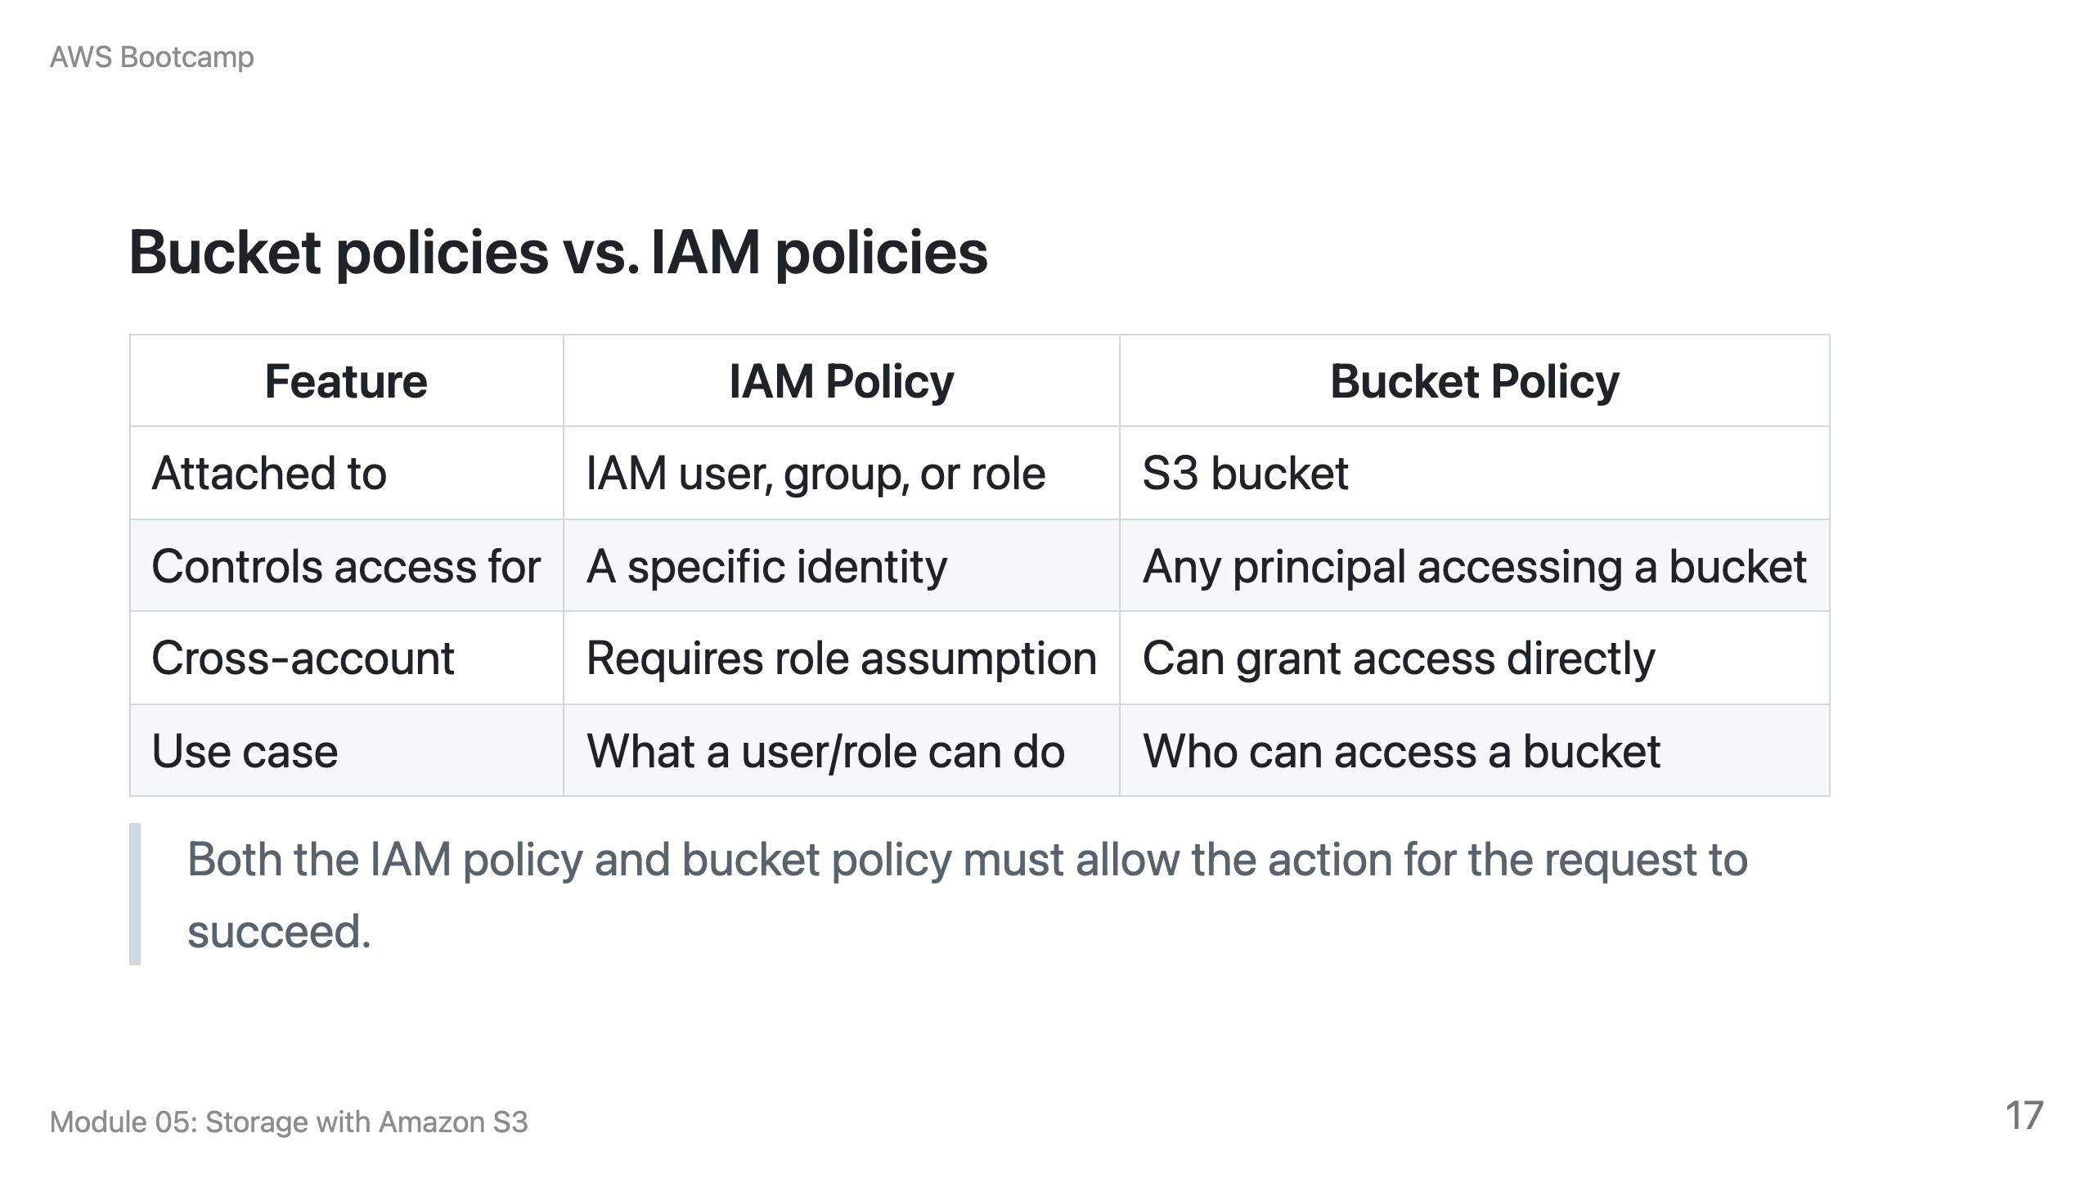

Slide 18
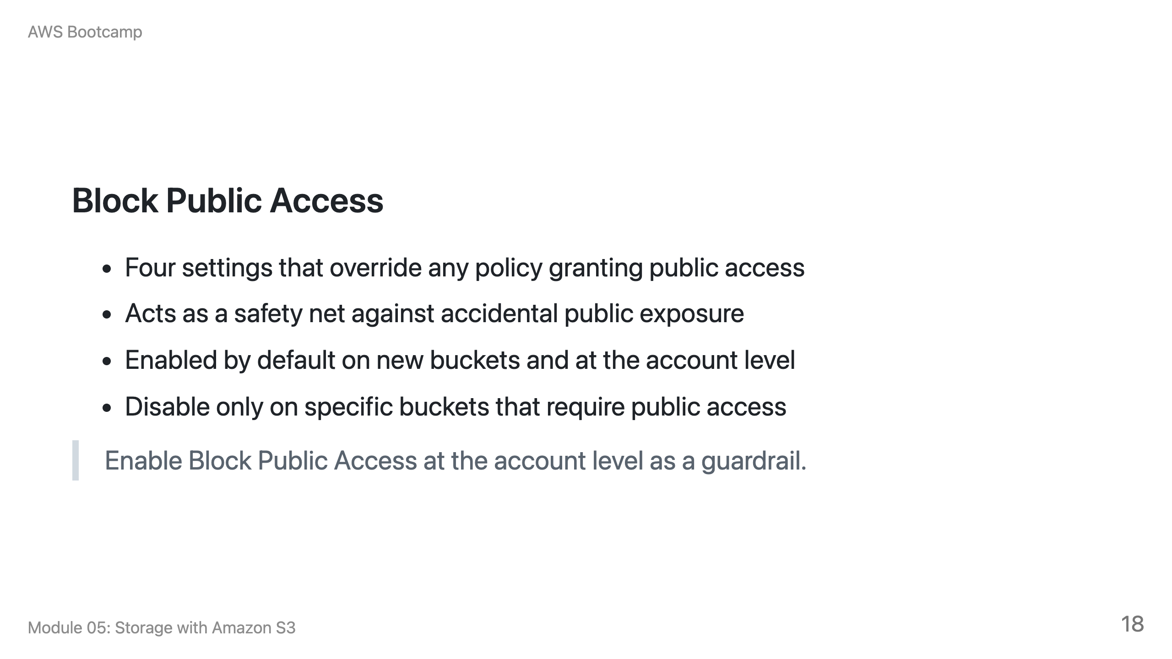

Slide 19
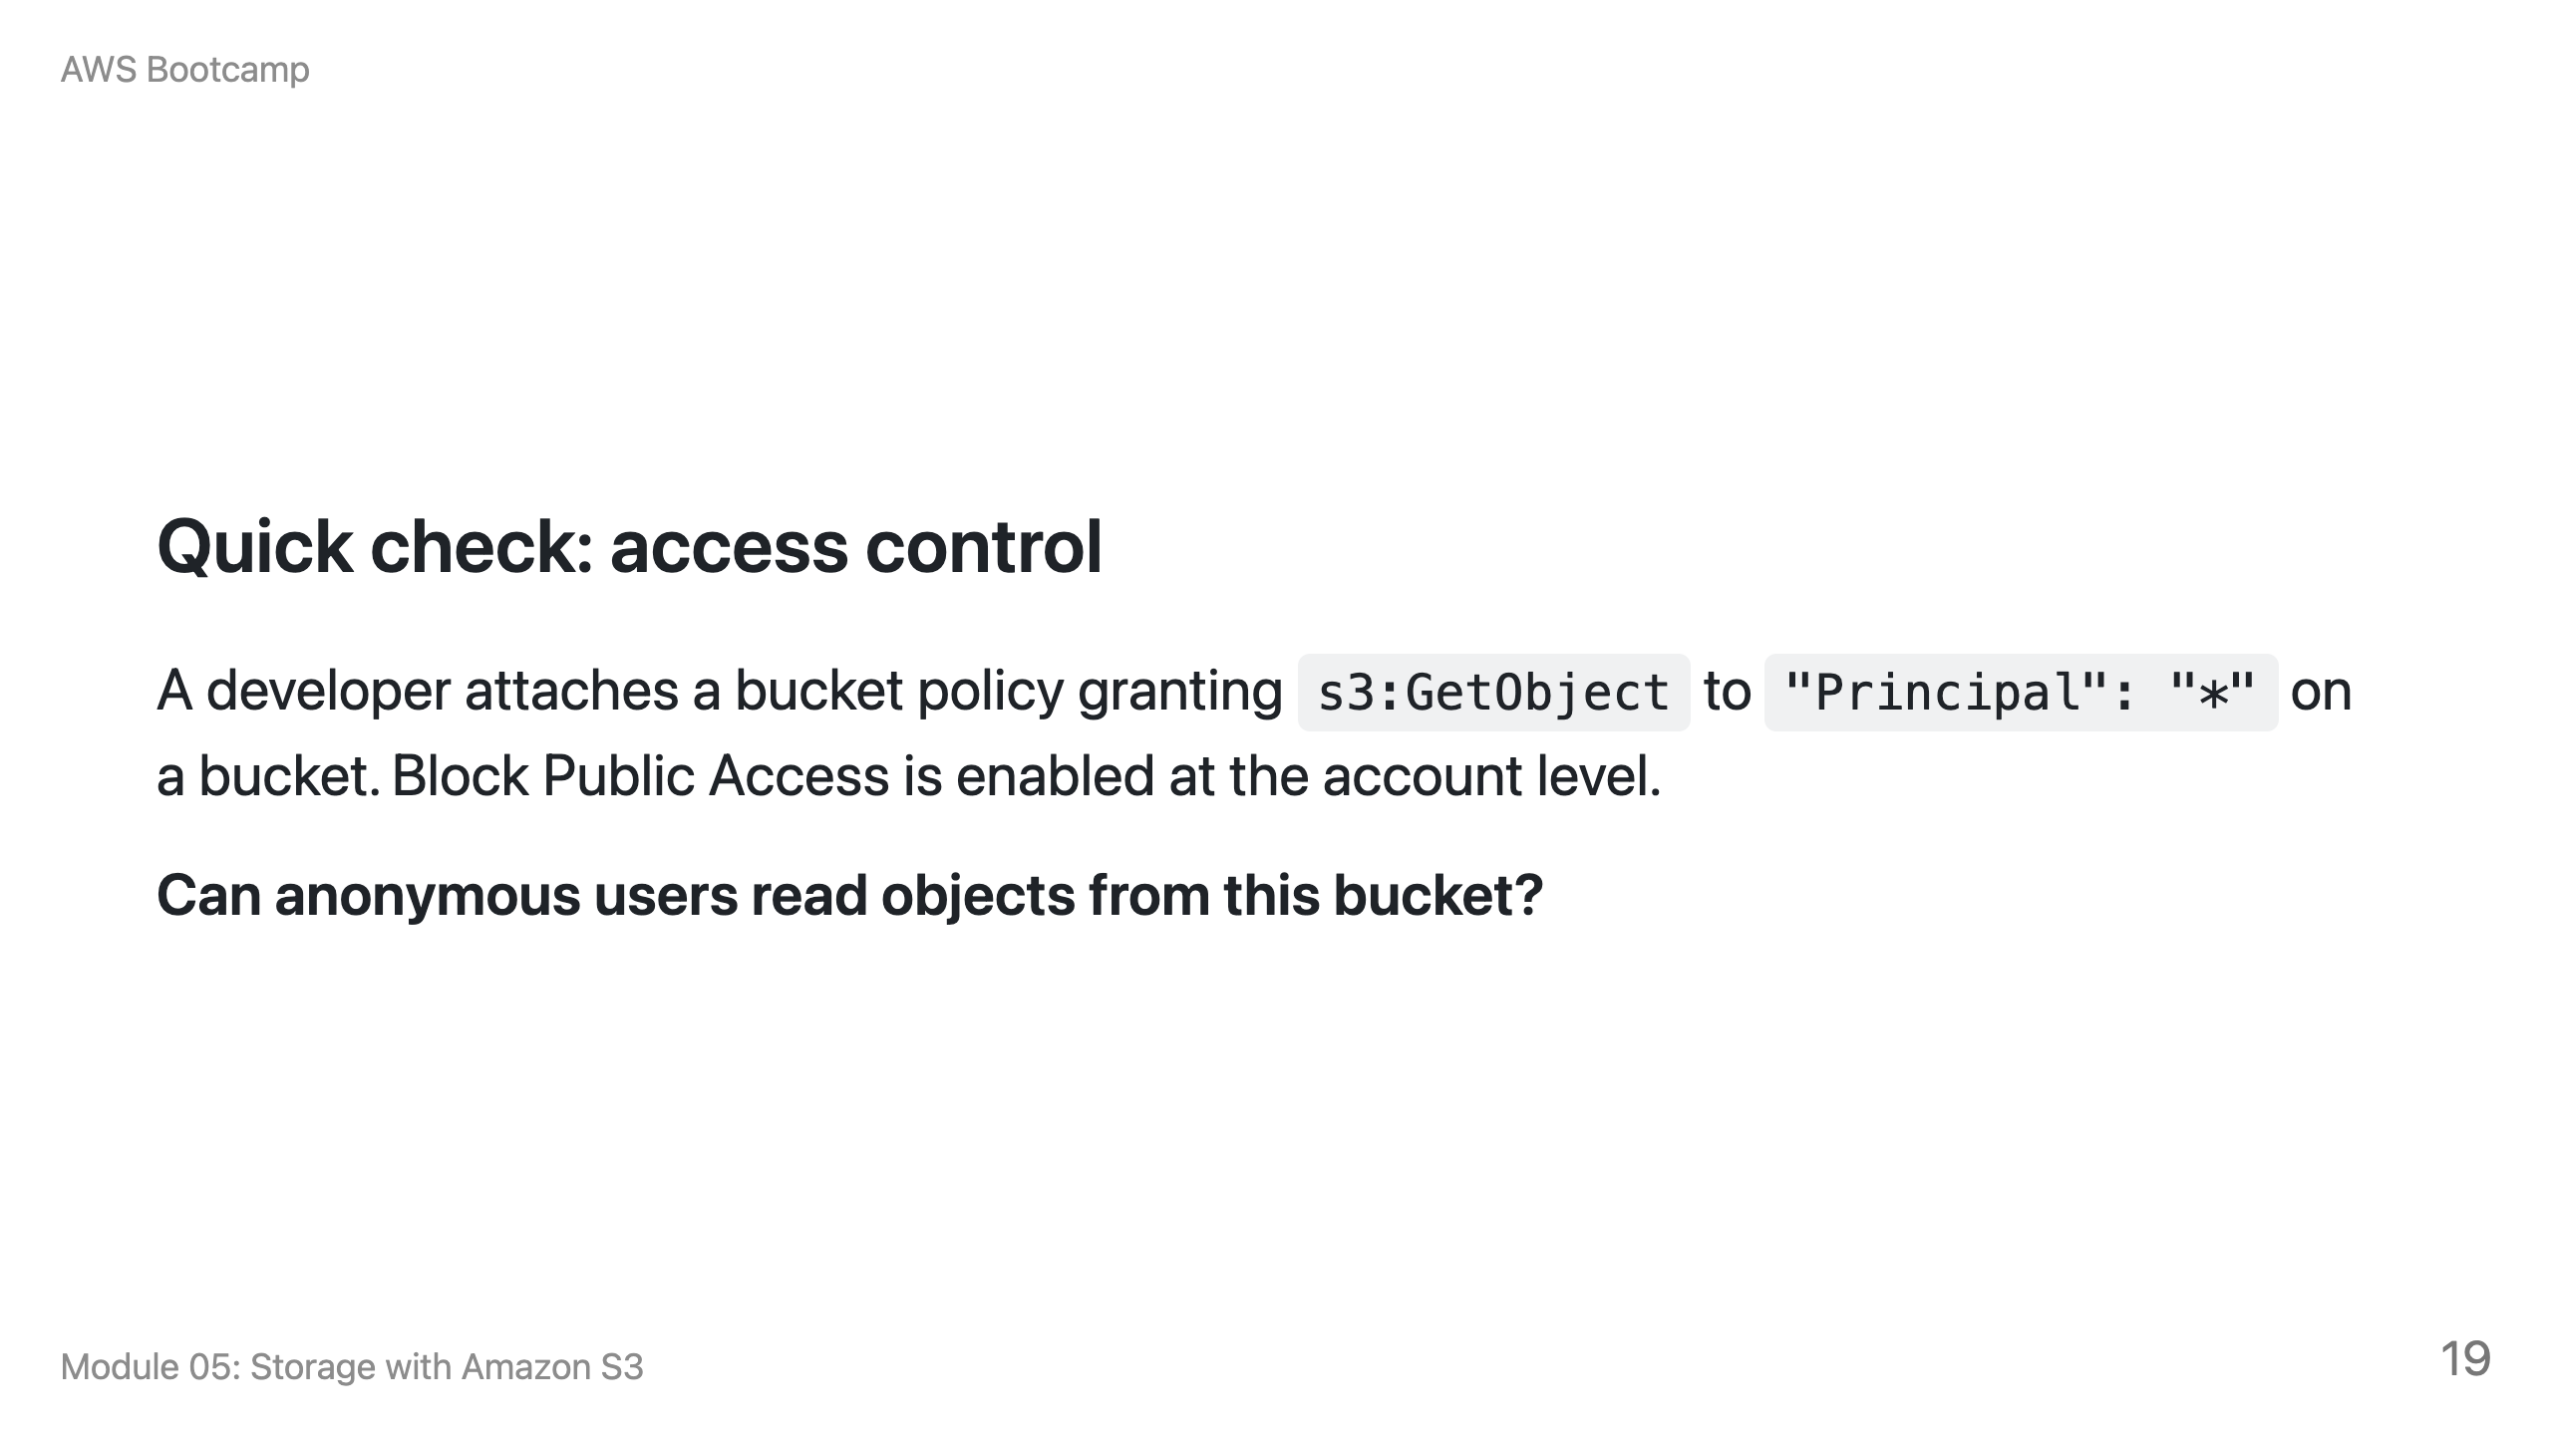
Notes:
Speaker notes: Answer: No. Block Public Access overrides the bucket policy. Even though the policy grants public read, the account-level Block Public Access setting prevents it. The developer must explicitly disable Block Public Access on that specific bucket (and have account-level permission to do so) before the public policy takes effect.

Slide 20
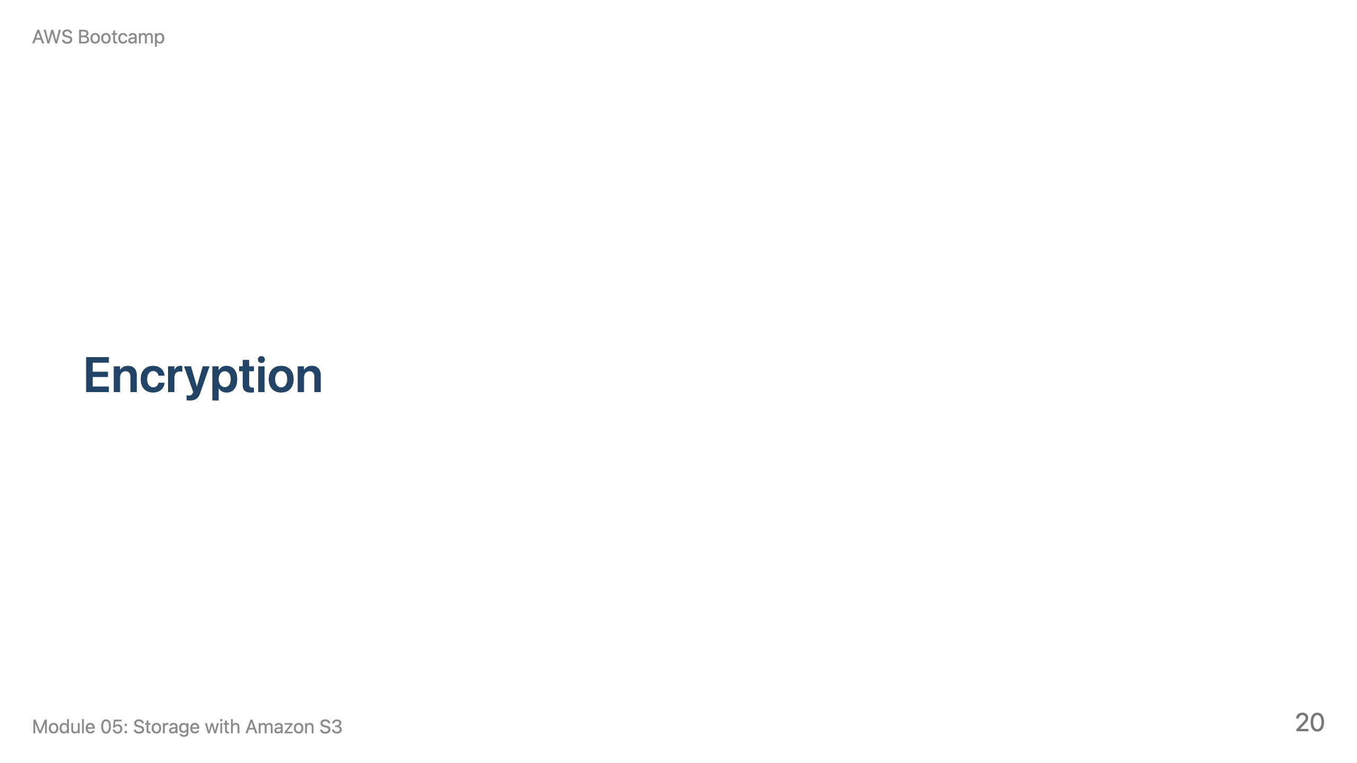
Notes:
Speaker notes: This section takes approximately 10 minutes. Emphasize that SSE-S3 is the default and sufficient for most use cases.

Slide 21
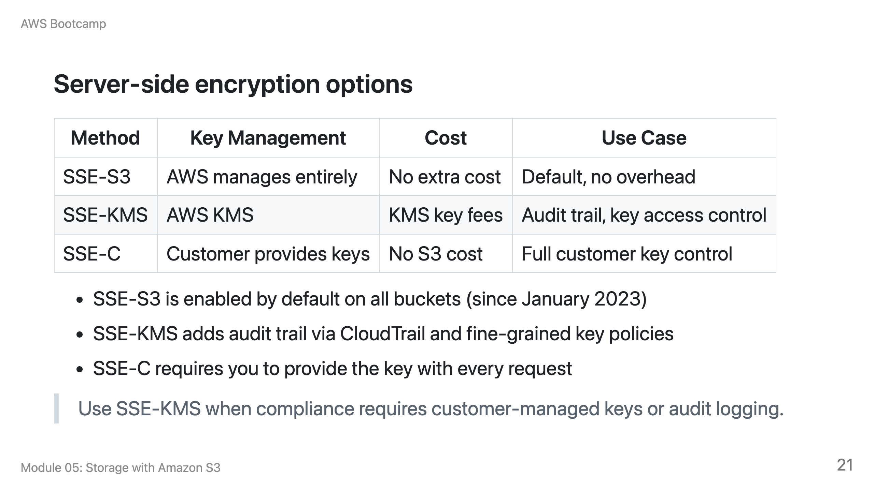

Slide 22
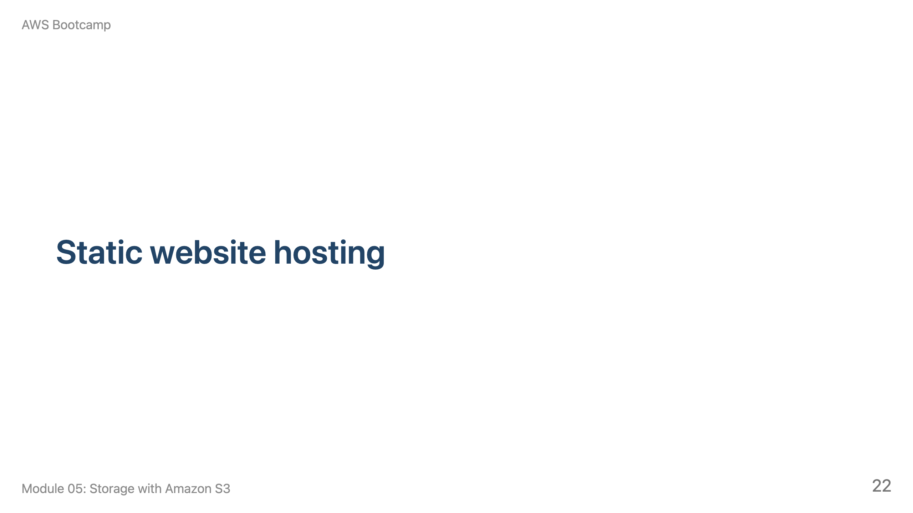
Notes:
Speaker notes: This section takes approximately 10 minutes. Cover the configuration steps and the HTTPS limitation.

Slide 23
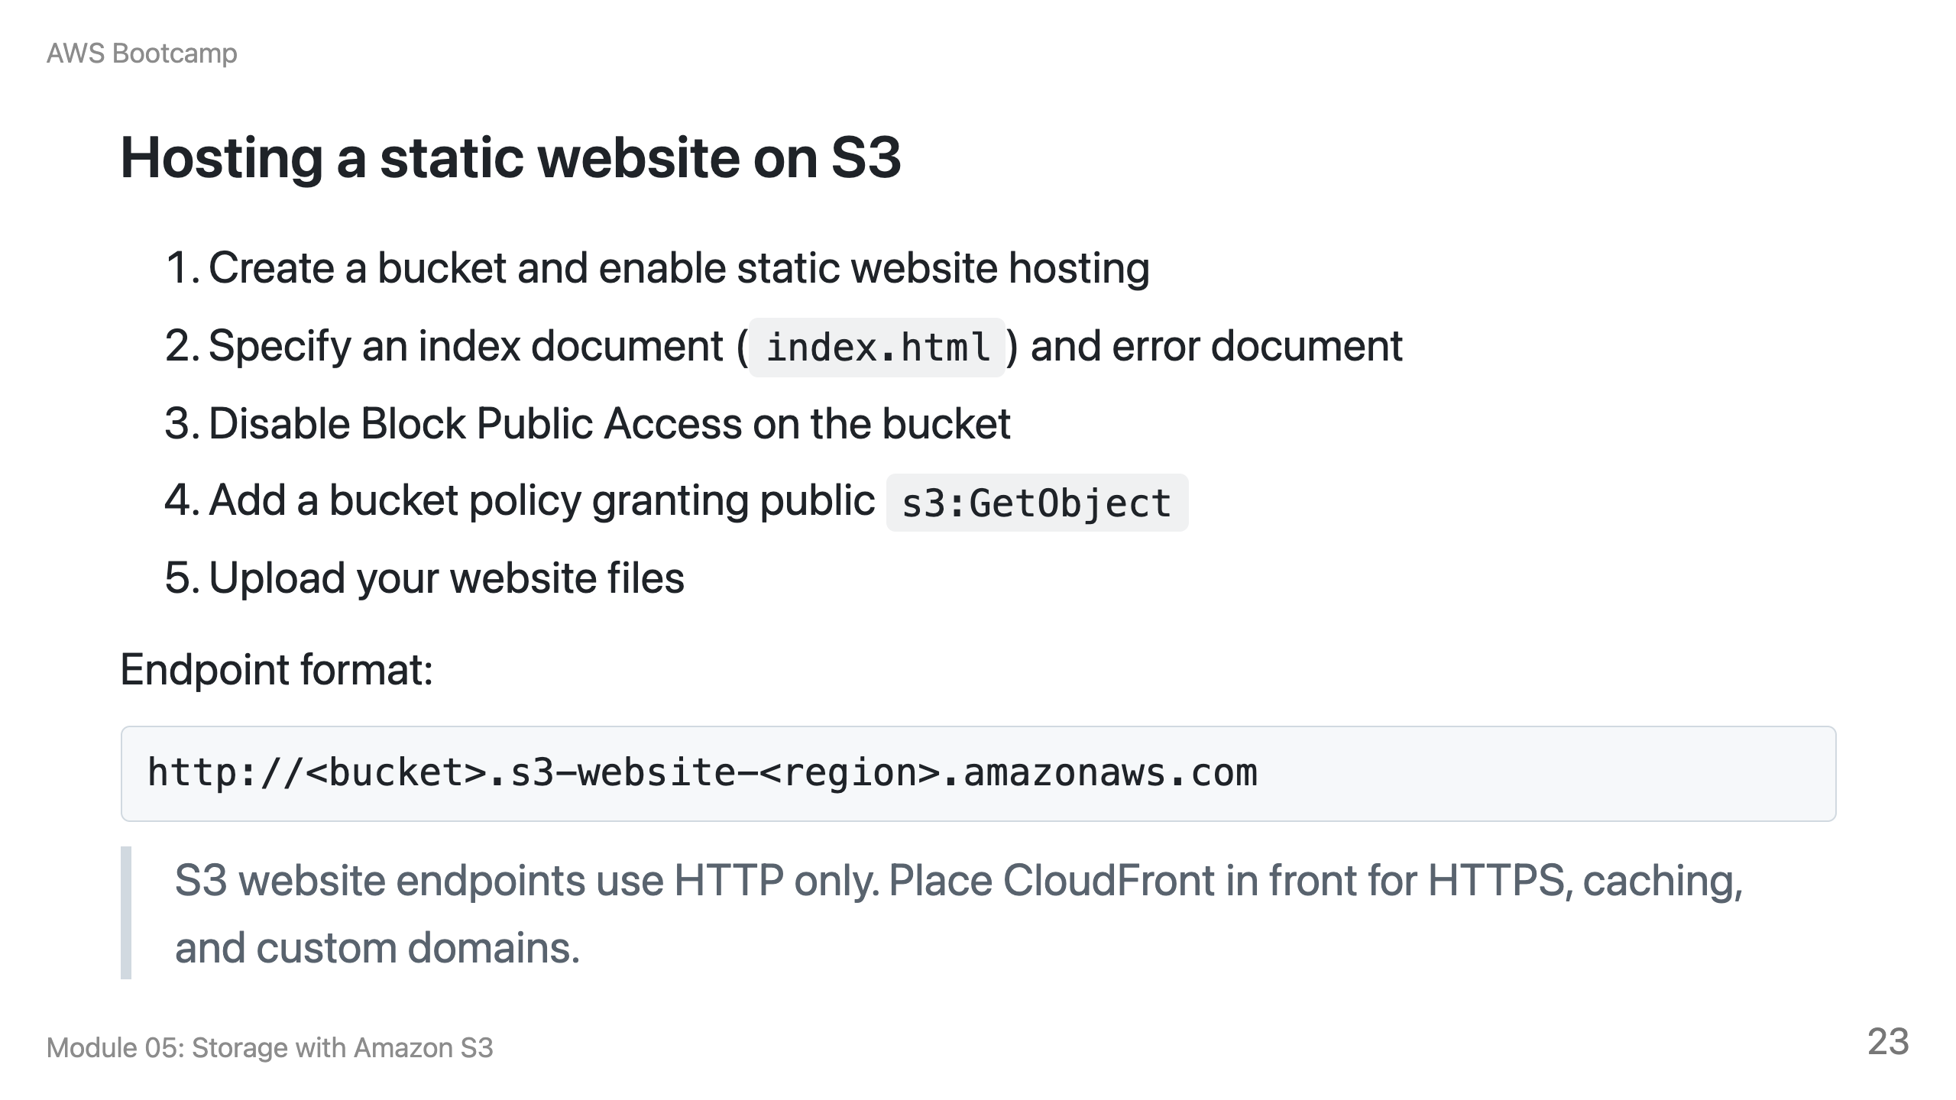

Slide 24
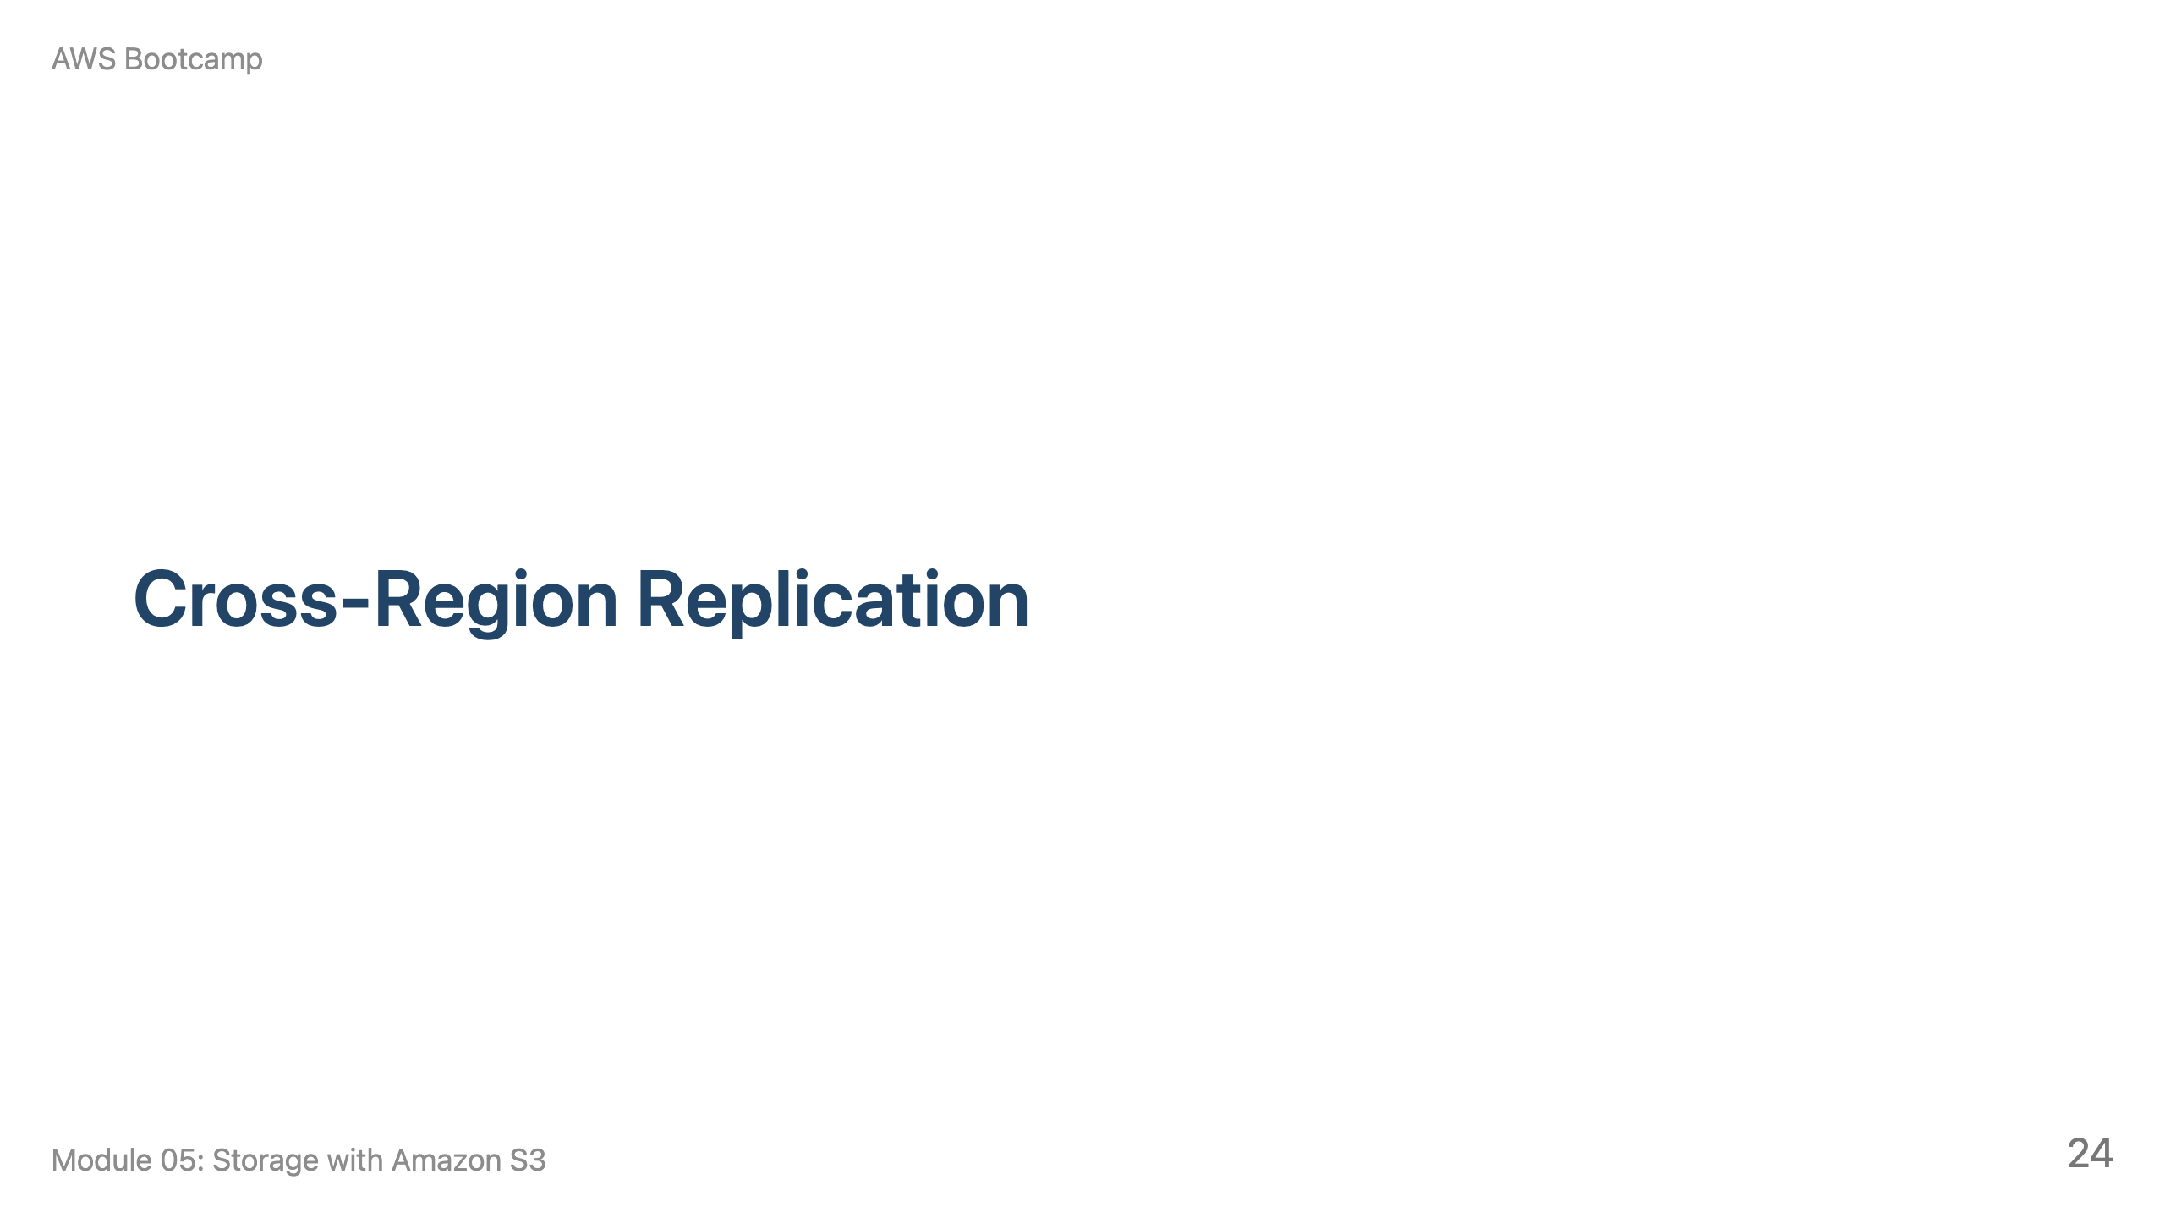
Notes:
Speaker notes: This section takes approximately 5 minutes. Cover CRR and Transfer Acceleration briefly.

Slide 25
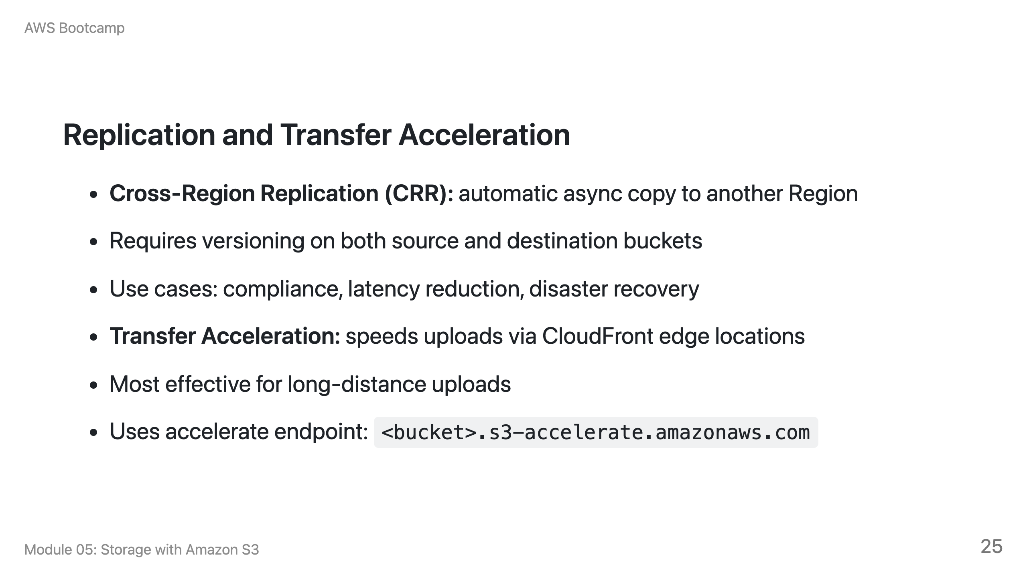

Slide 26
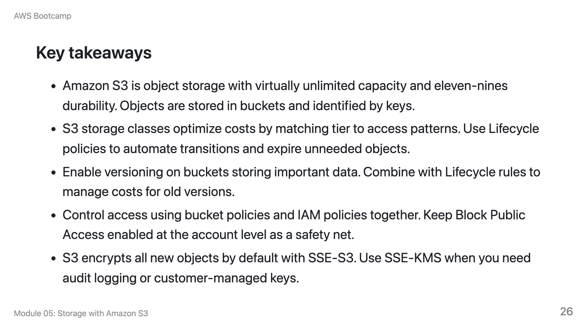

Slide 27
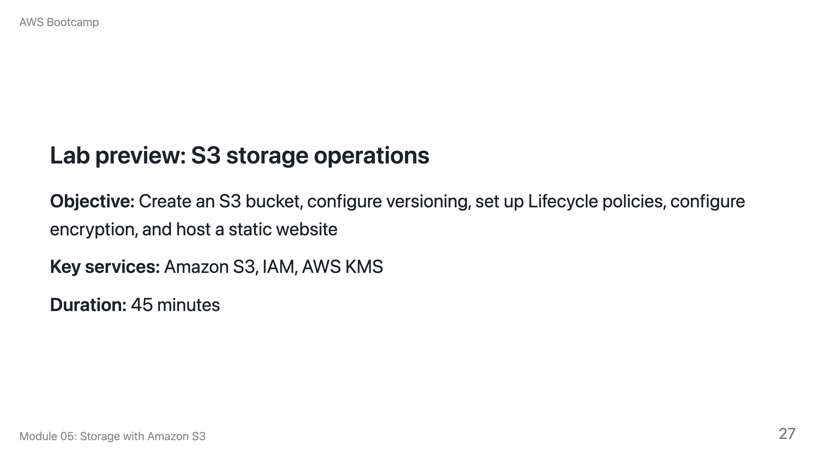
Notes:
Speaker notes: Students will create a bucket in us-east-1, upload objects, enable versioning, create a Lifecycle rule, configure SSE-KMS encryption, and set up static website hosting with a public bucket policy. Remind students to clean up the bucket and objects after the lab to avoid storage charges.

Slide 28
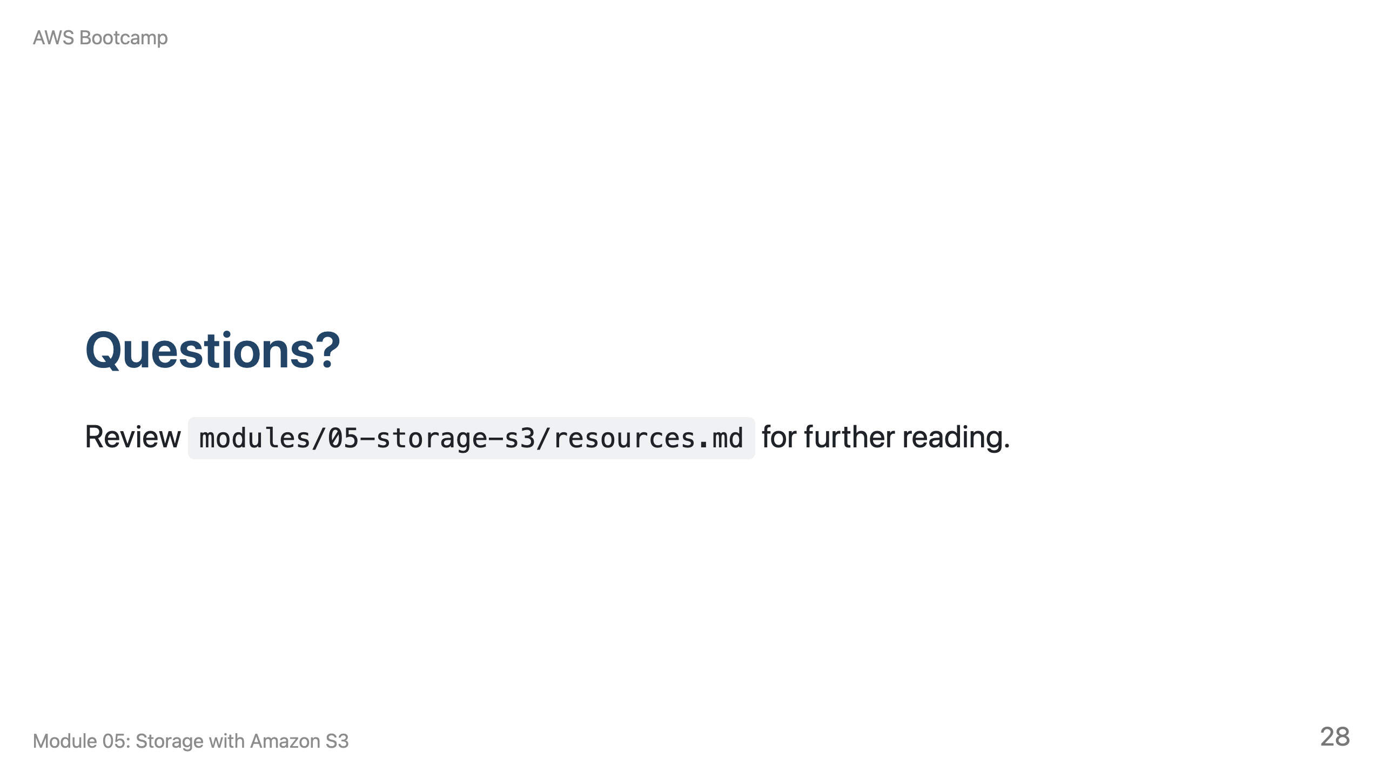
Notes:
Speaker notes: Take 5-10 minutes for questions. Common questions involve the difference between S3 and EBS, and when to use SSE-KMS vs. SSE-S3. Transition to the lab when ready.

