Slide 1
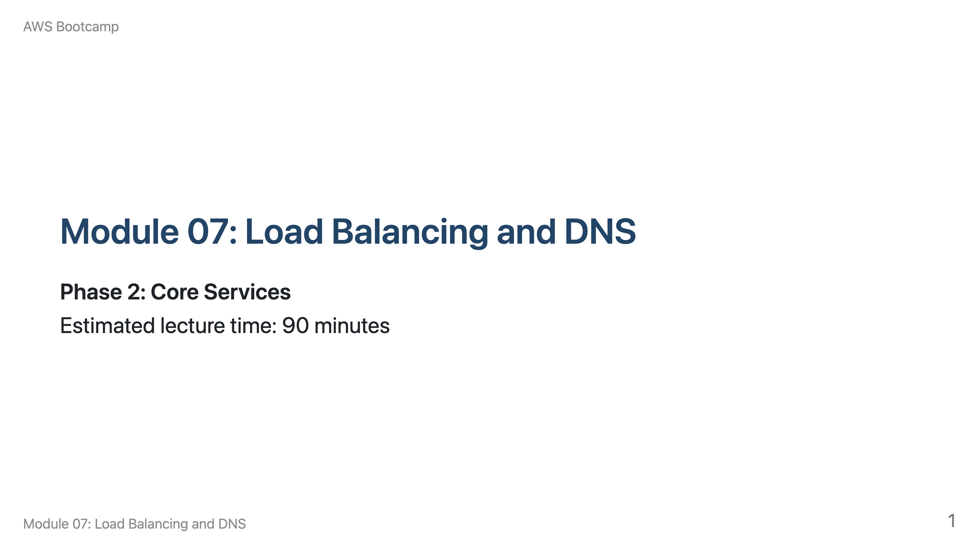
Notes:
Speaker notes: Welcome to Module 07. This module covers Elastic Load Balancing and Route 53. Breakdown: 10 min ELB overview, 10 min ALB vs NLB vs GLB, 15 min ALB deep dive (listeners, rules, target groups), 10 min health checks, 10 min SSL/TLS, 15 min Route 53 (records, routing policies), 10 min Route 53 health checks, 10 min Q&A.

Slide 2
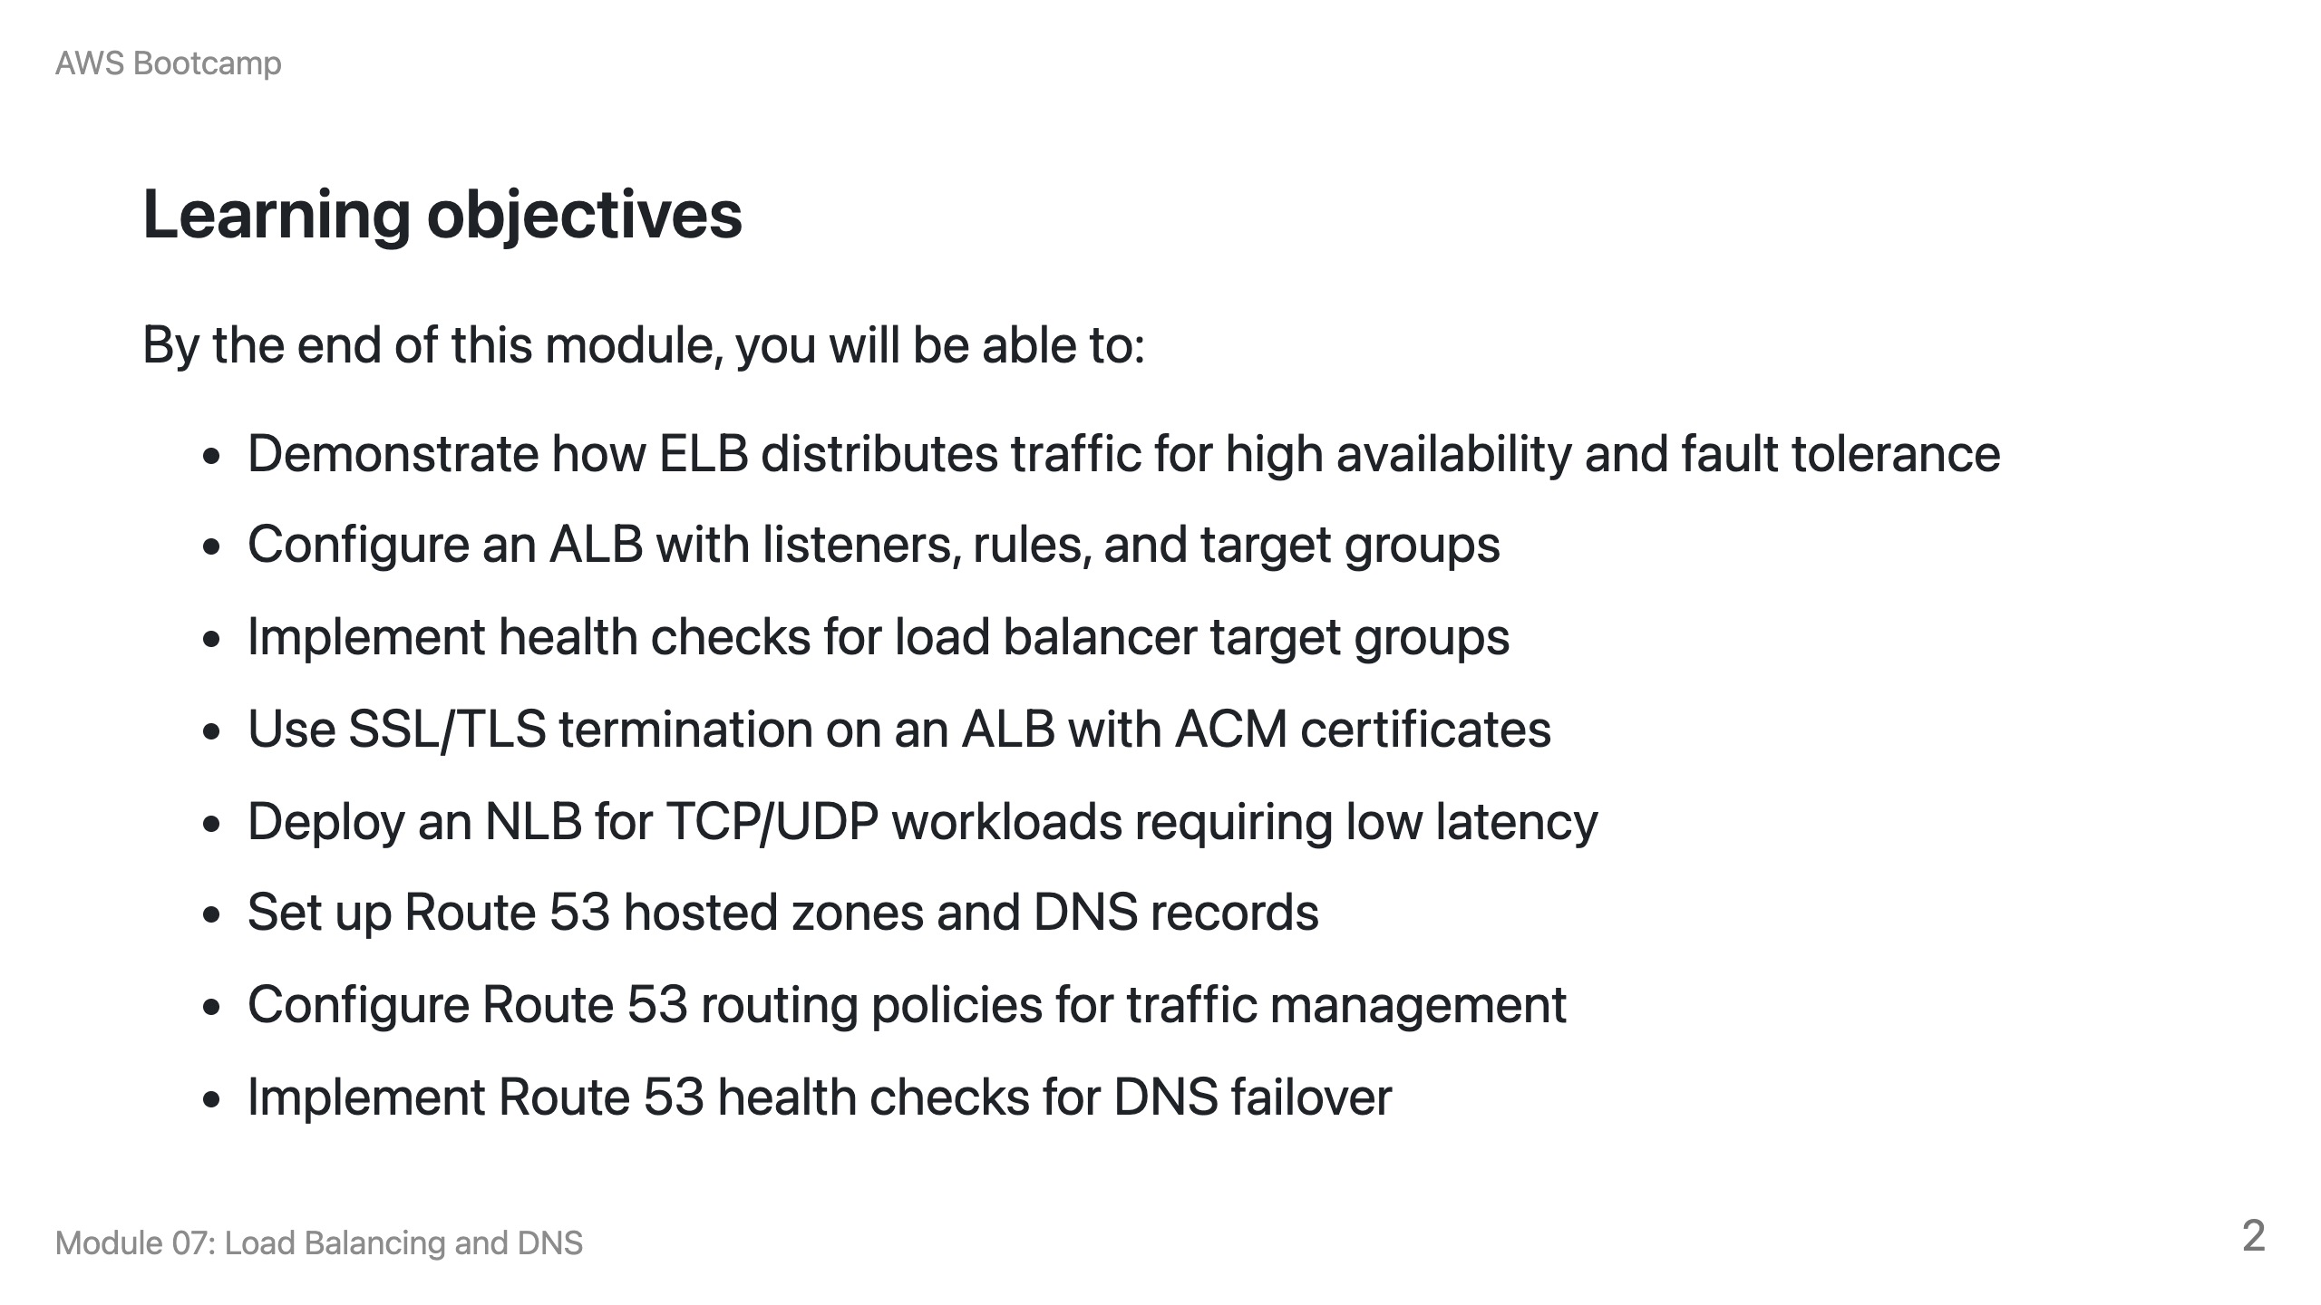

Slide 3
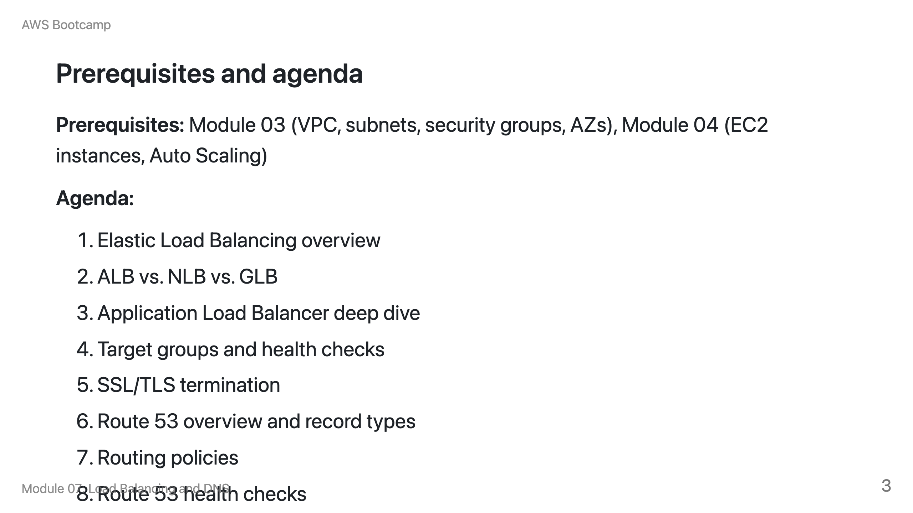

Slide 4
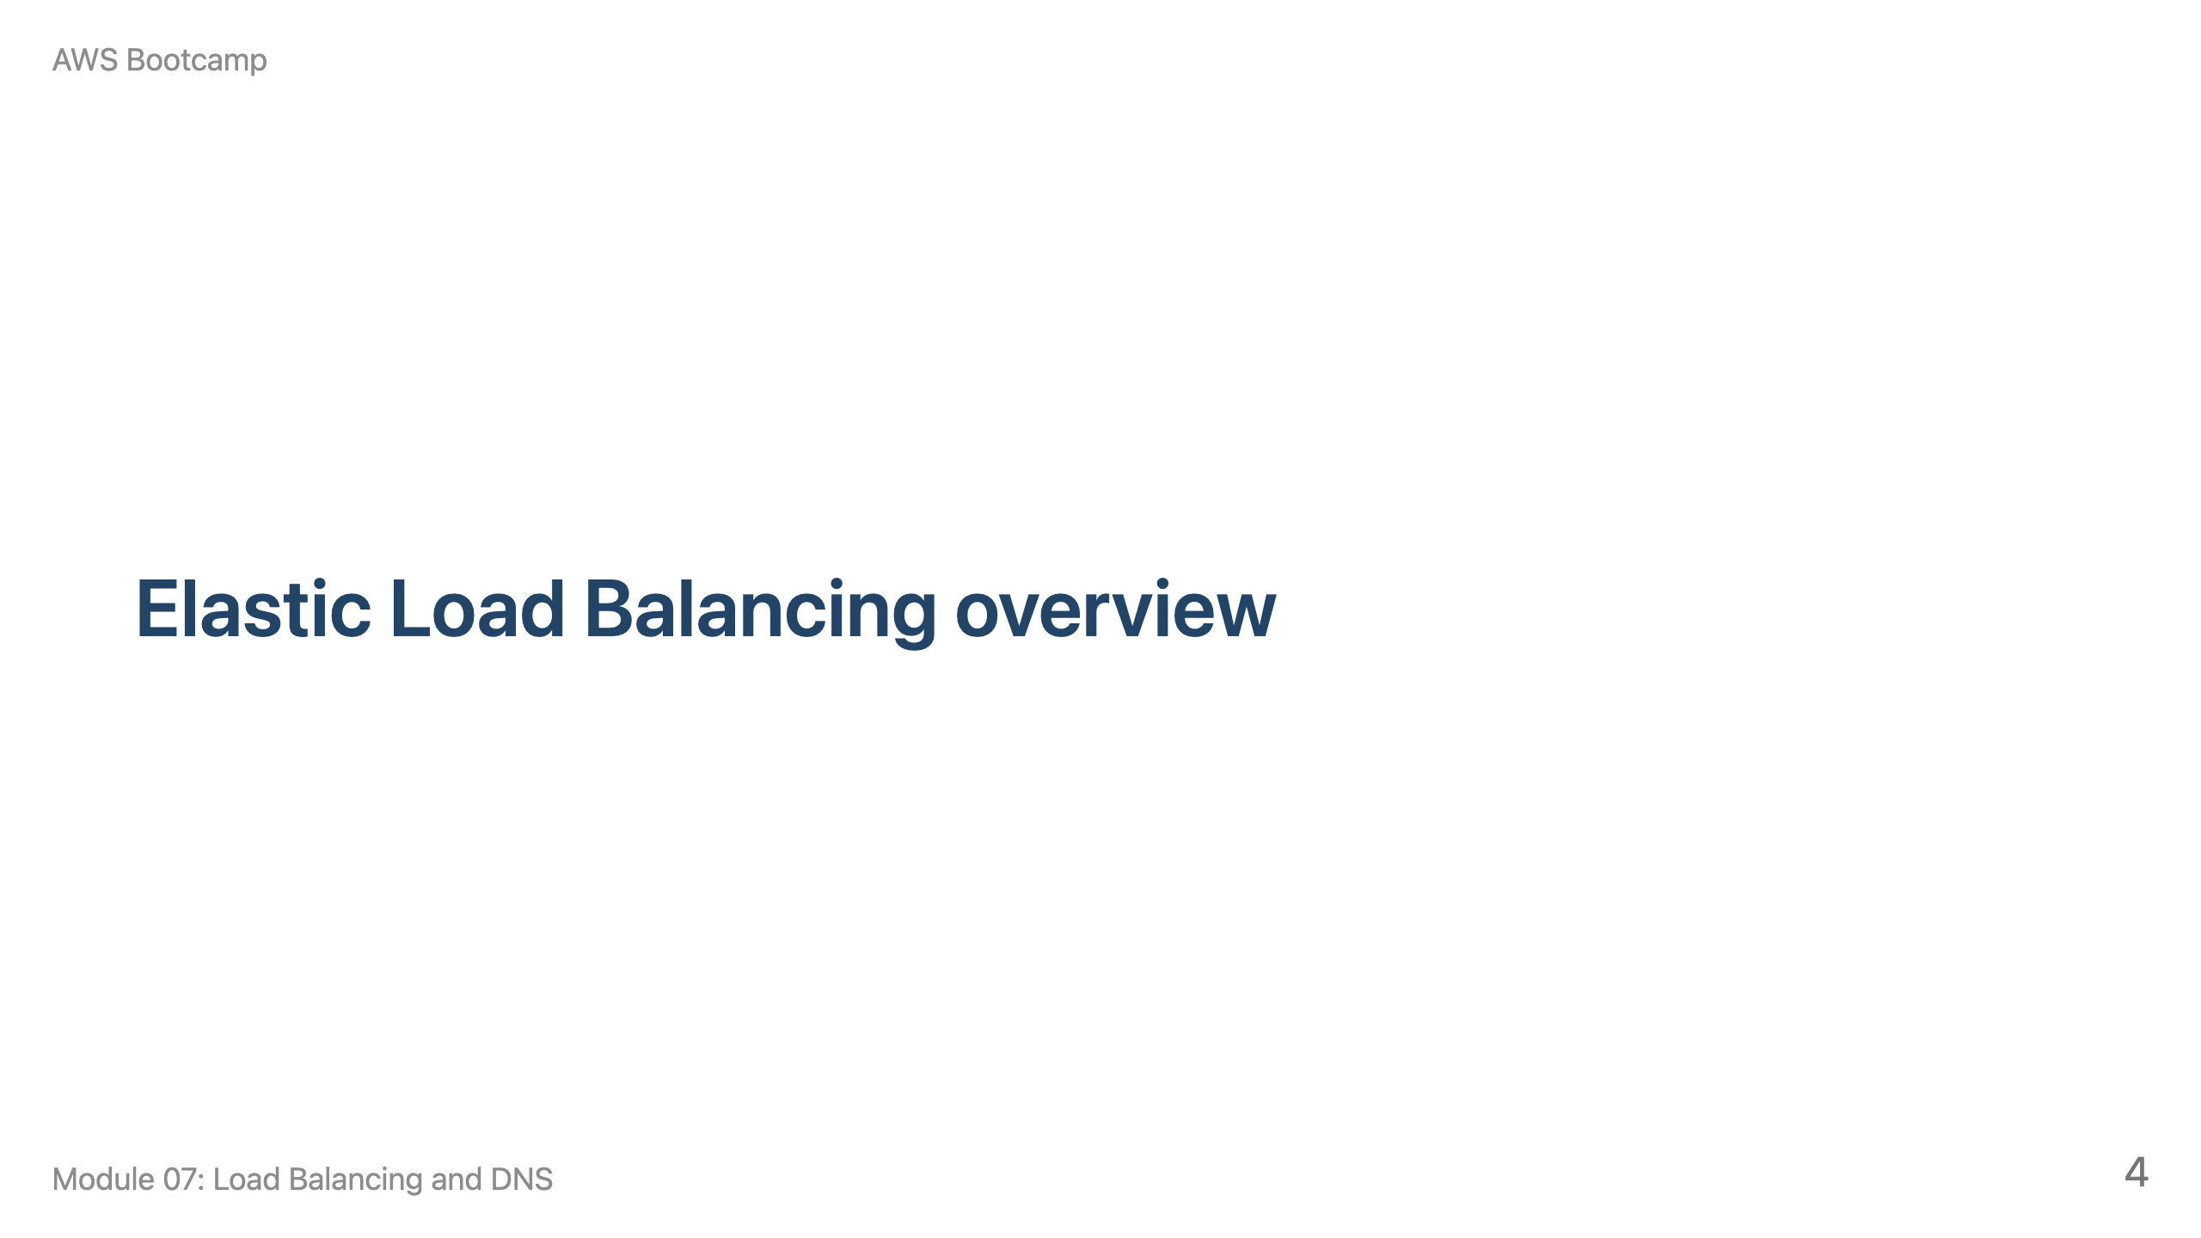
Notes:
Speaker notes: This section takes approximately 10 minutes. Connect to Module 04's Auto Scaling concepts. Draw a VPC with two AZs, EC2 instances, and an ALB in front.

Slide 5
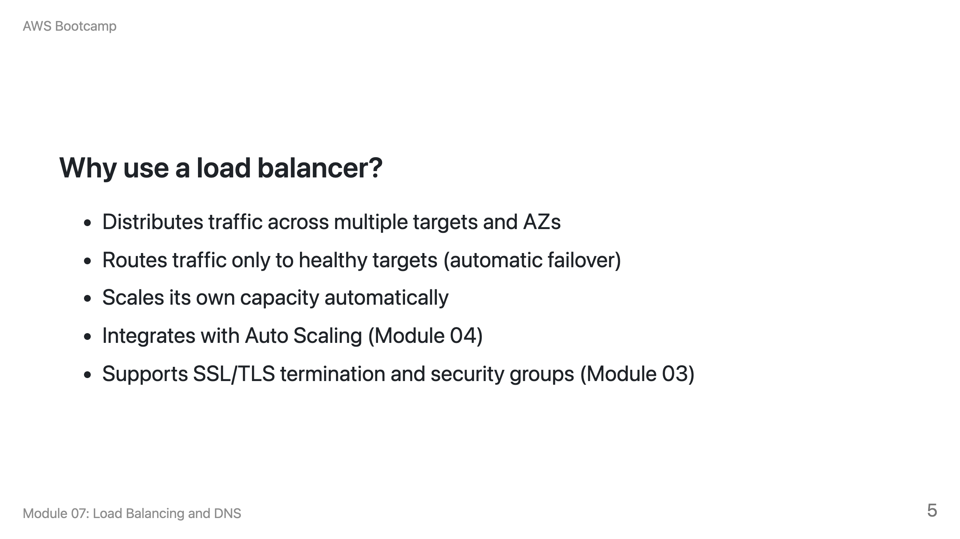

Slide 6
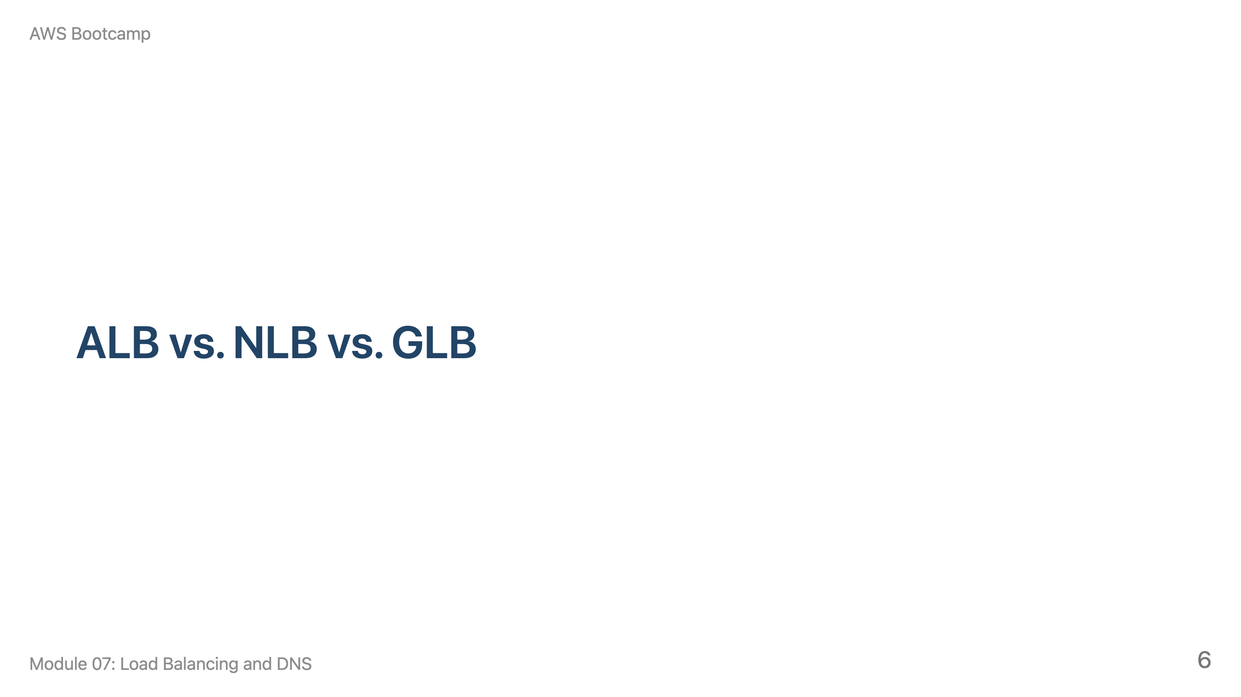
Notes:
Speaker notes: This section takes approximately 10 minutes. Walk through the comparison table and ask students to match scenarios to load balancer types.

Slide 7
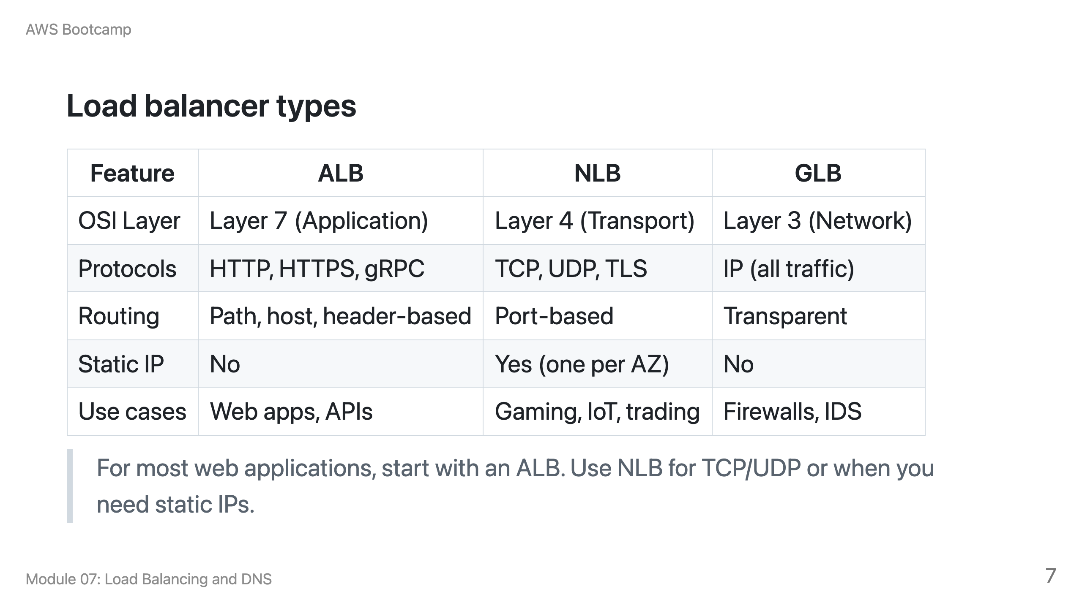

Slide 8
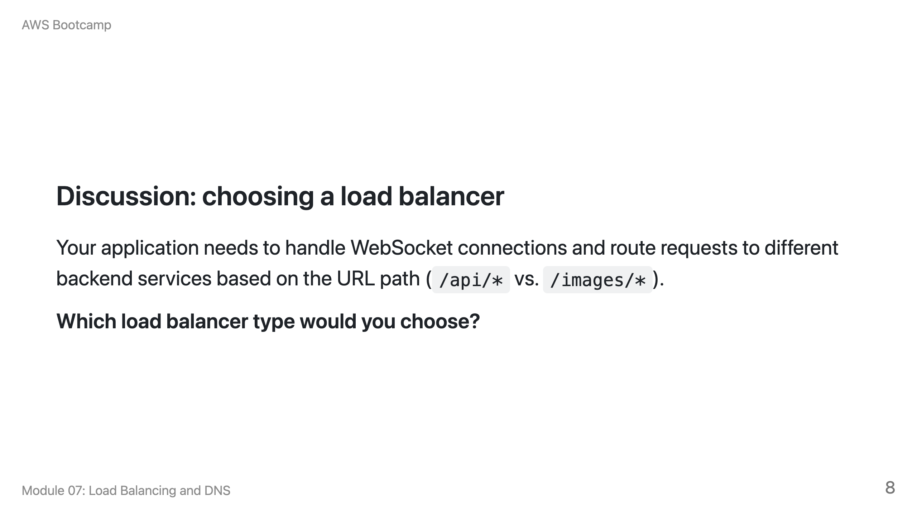
Notes:
Speaker notes: Answer: ALB. It operates at Layer 7 and supports path-based routing, which is needed to route /api/* and /images/* to different target groups. ALB also supports WebSocket connections natively. NLB operates at Layer 4 and cannot inspect HTTP paths.

Slide 9
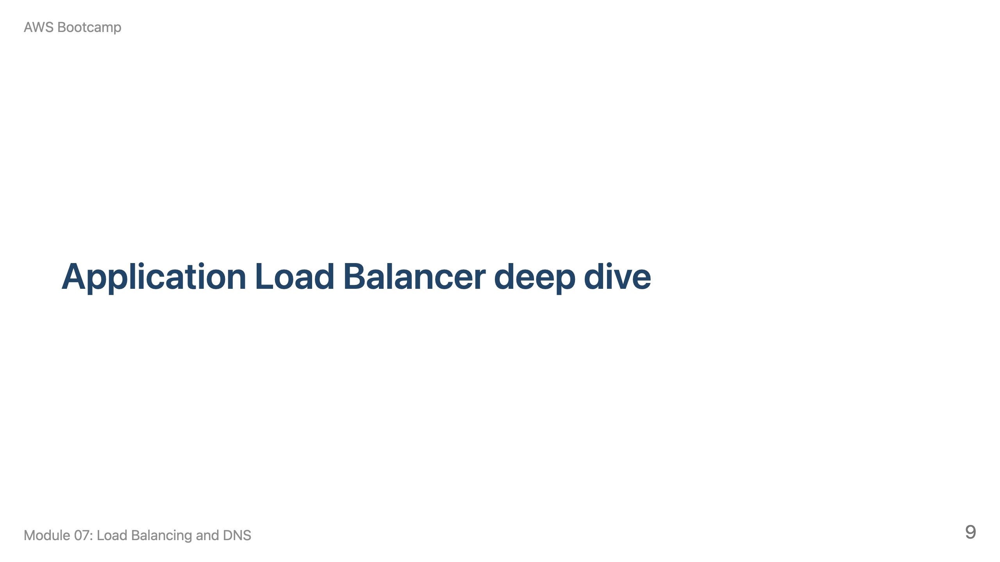
Notes:
Speaker notes: This section takes approximately 15 minutes. Cover listeners, rules, path-based and host-based routing. Use the receptionist analogy.

Slide 10
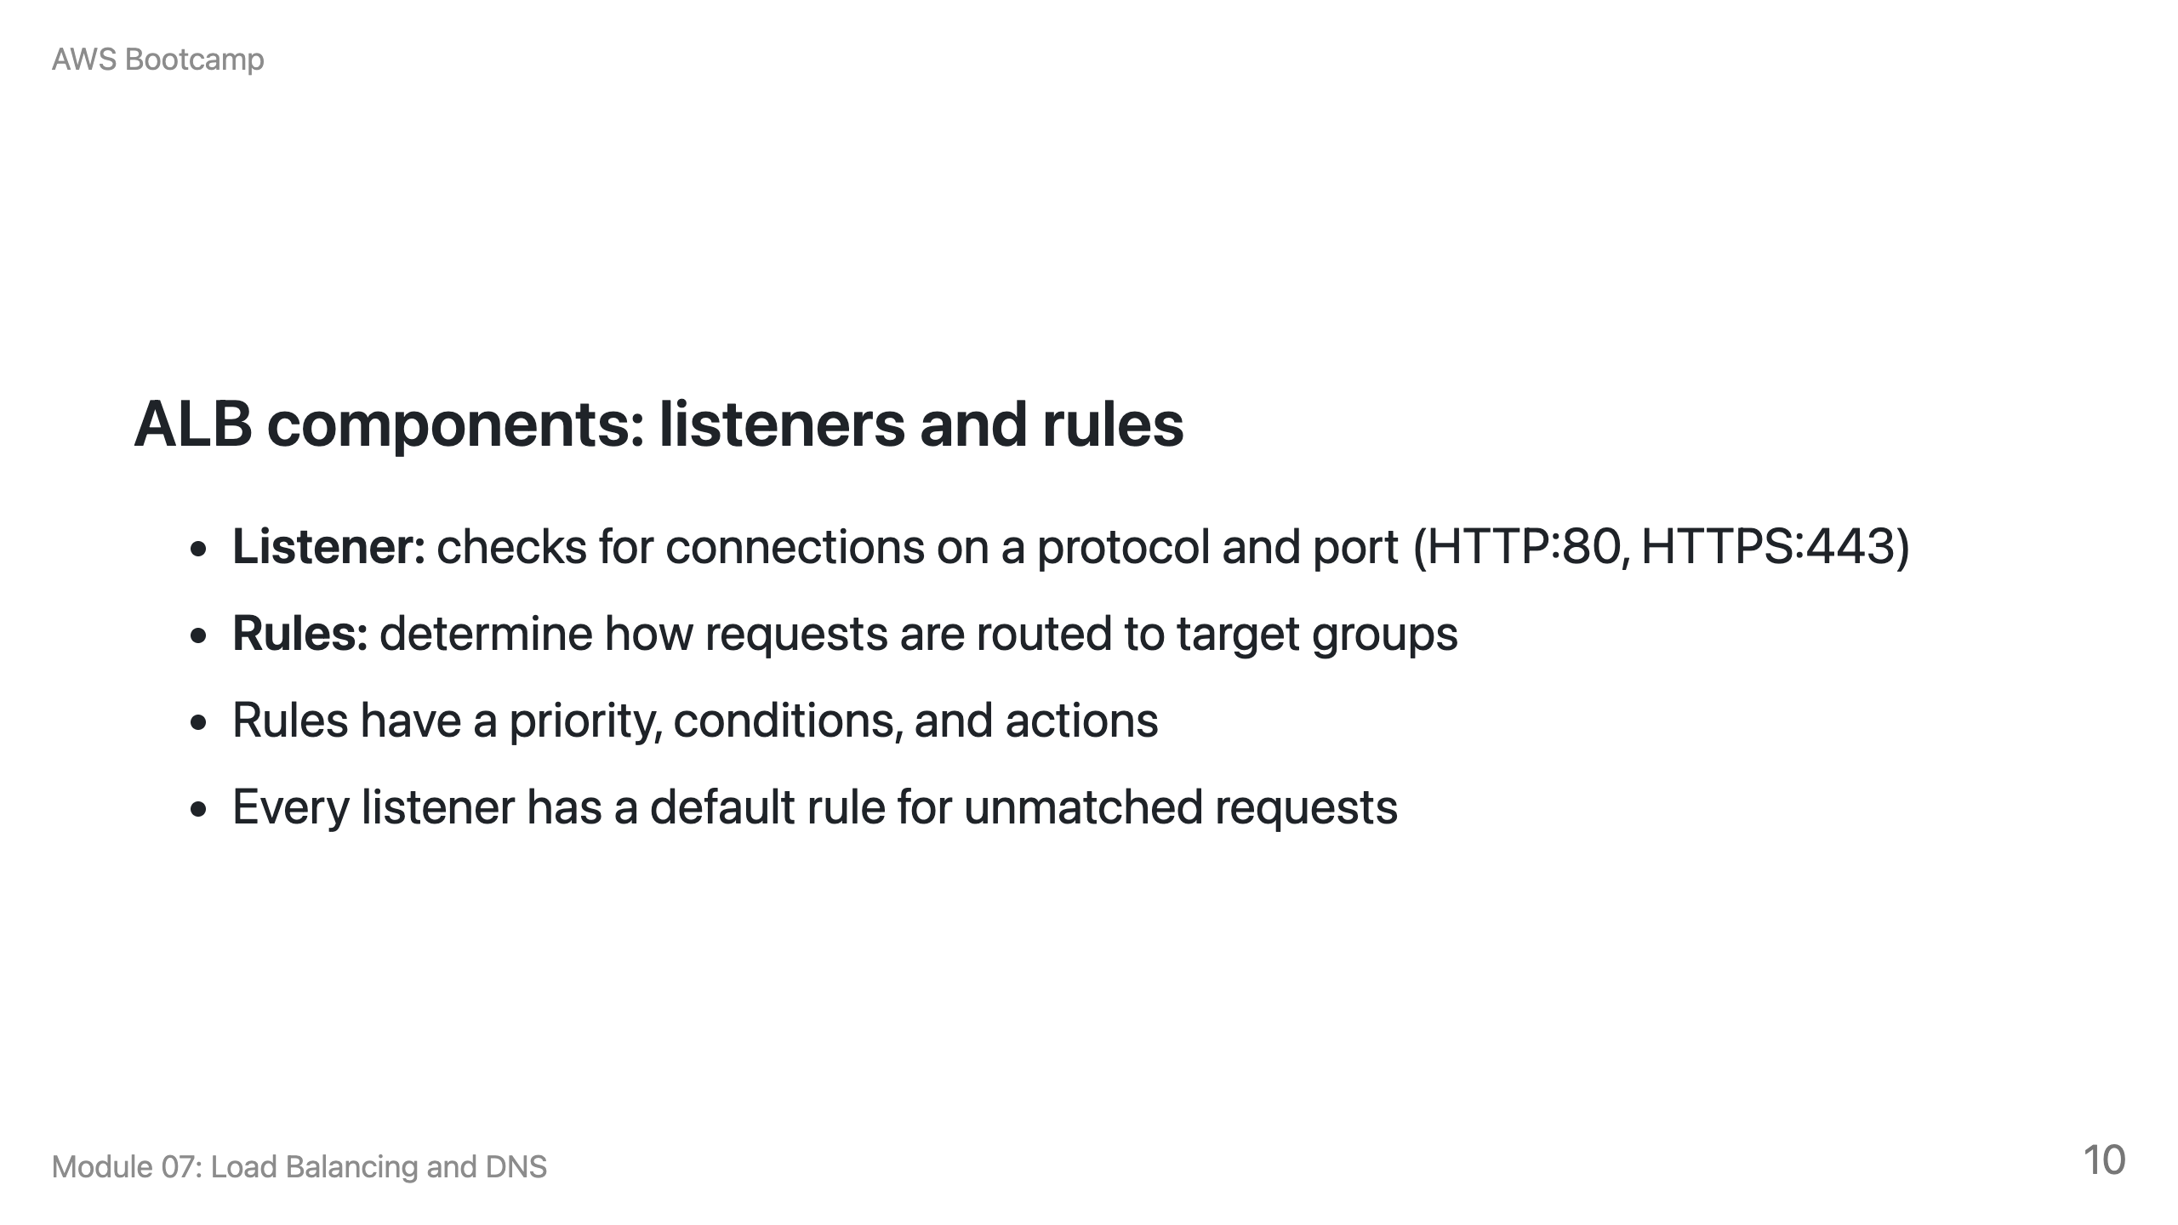

Slide 11
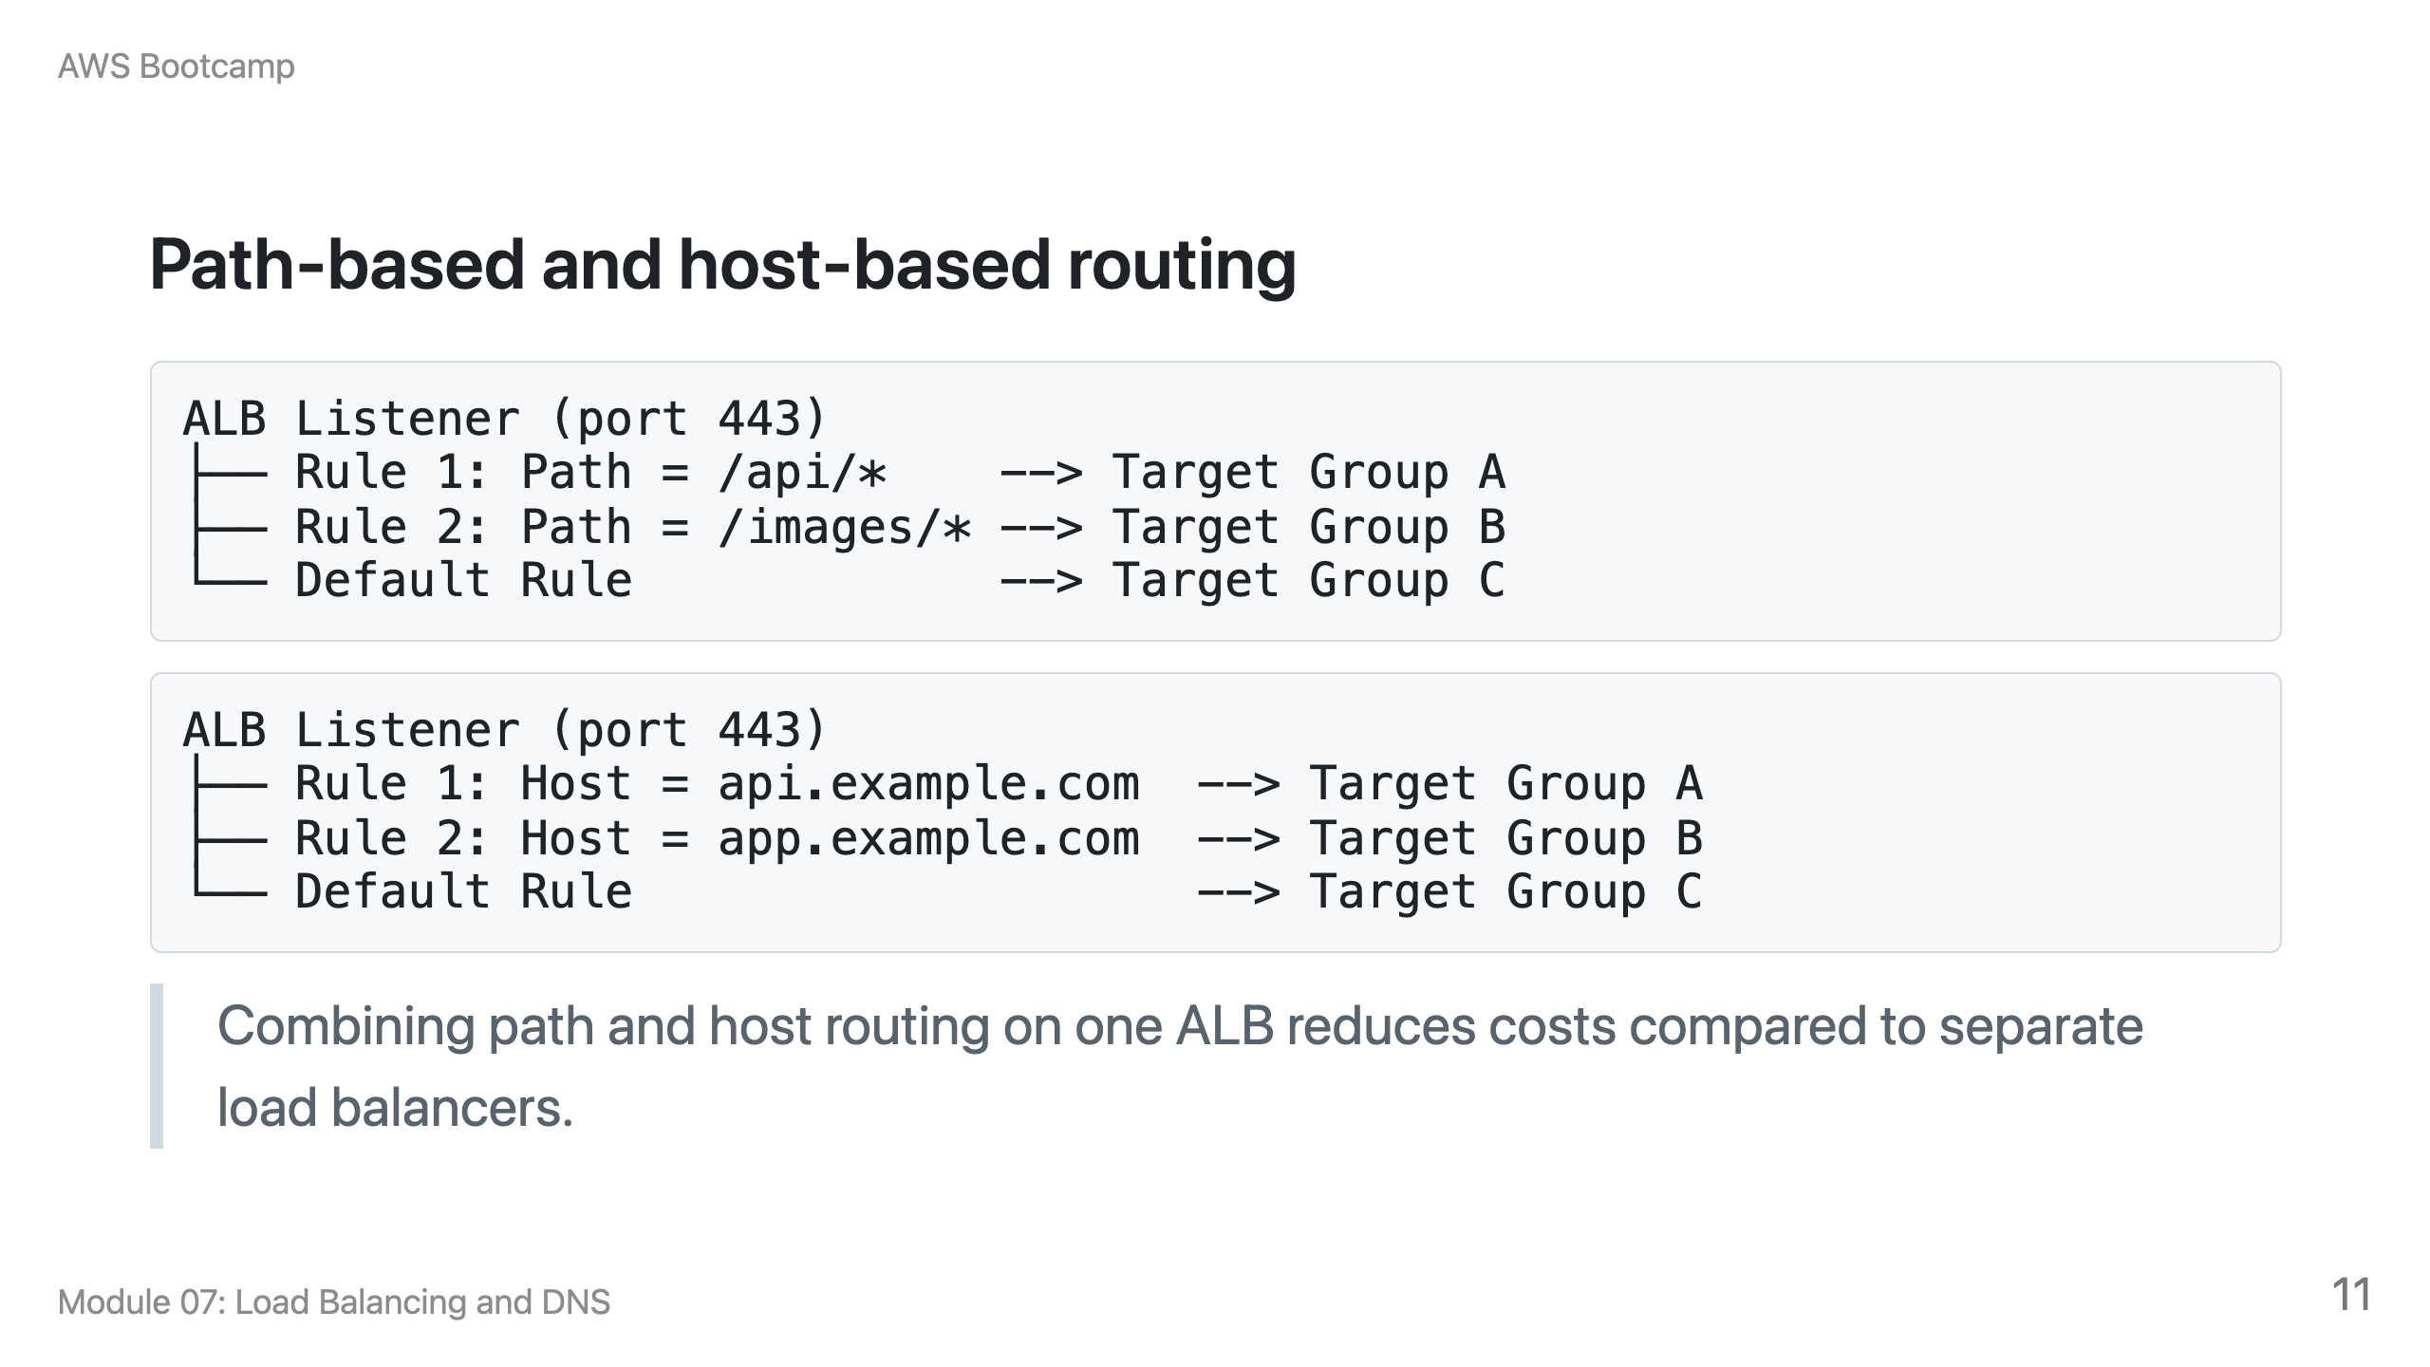

Slide 12
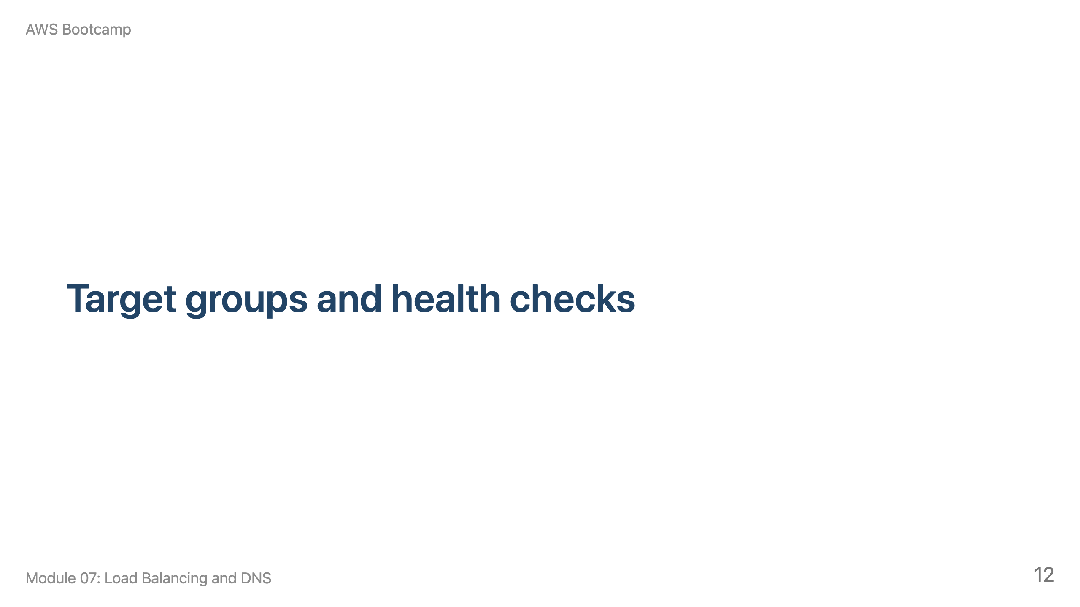
Notes:
Speaker notes: This section takes approximately 10 minutes. Cover target types and health check parameters.

Slide 13
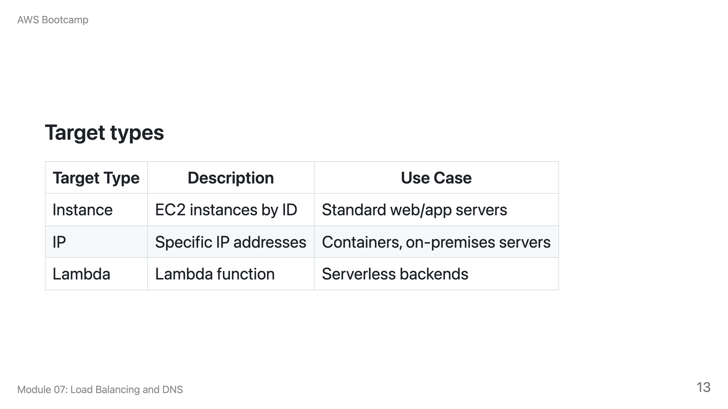

Slide 14
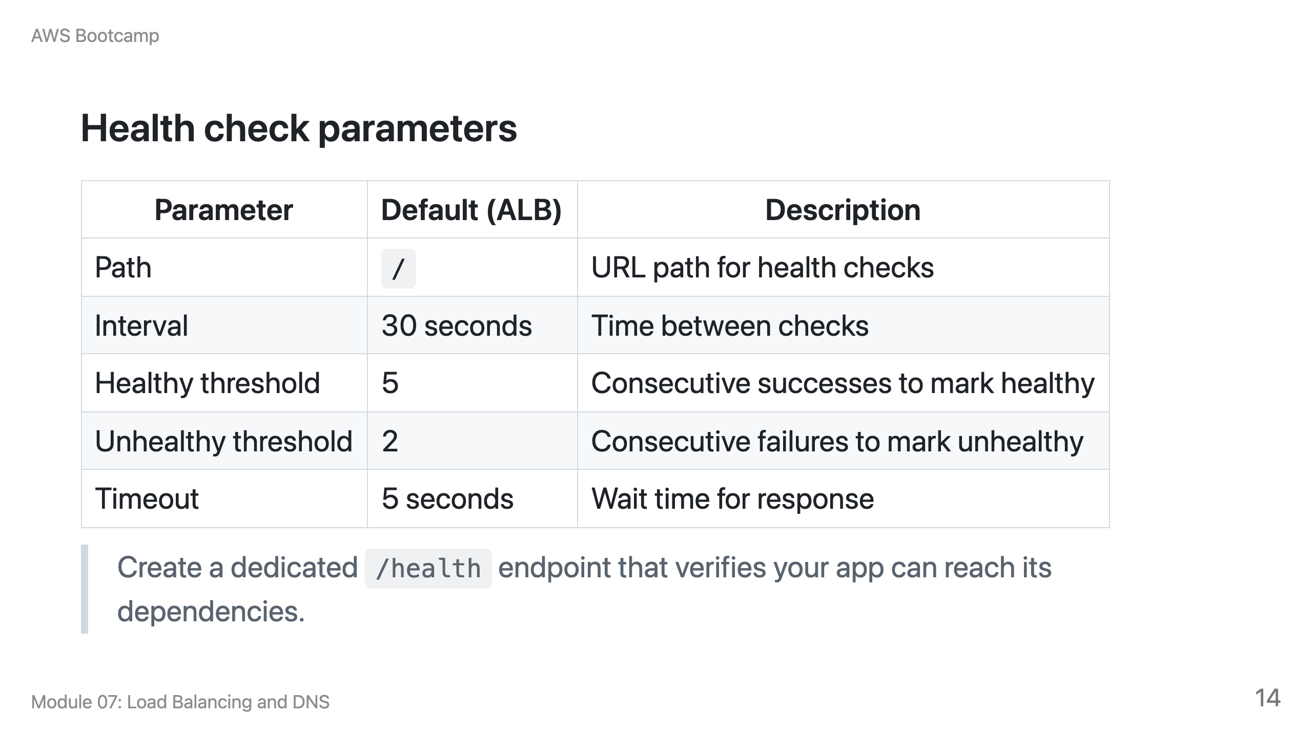

Slide 15
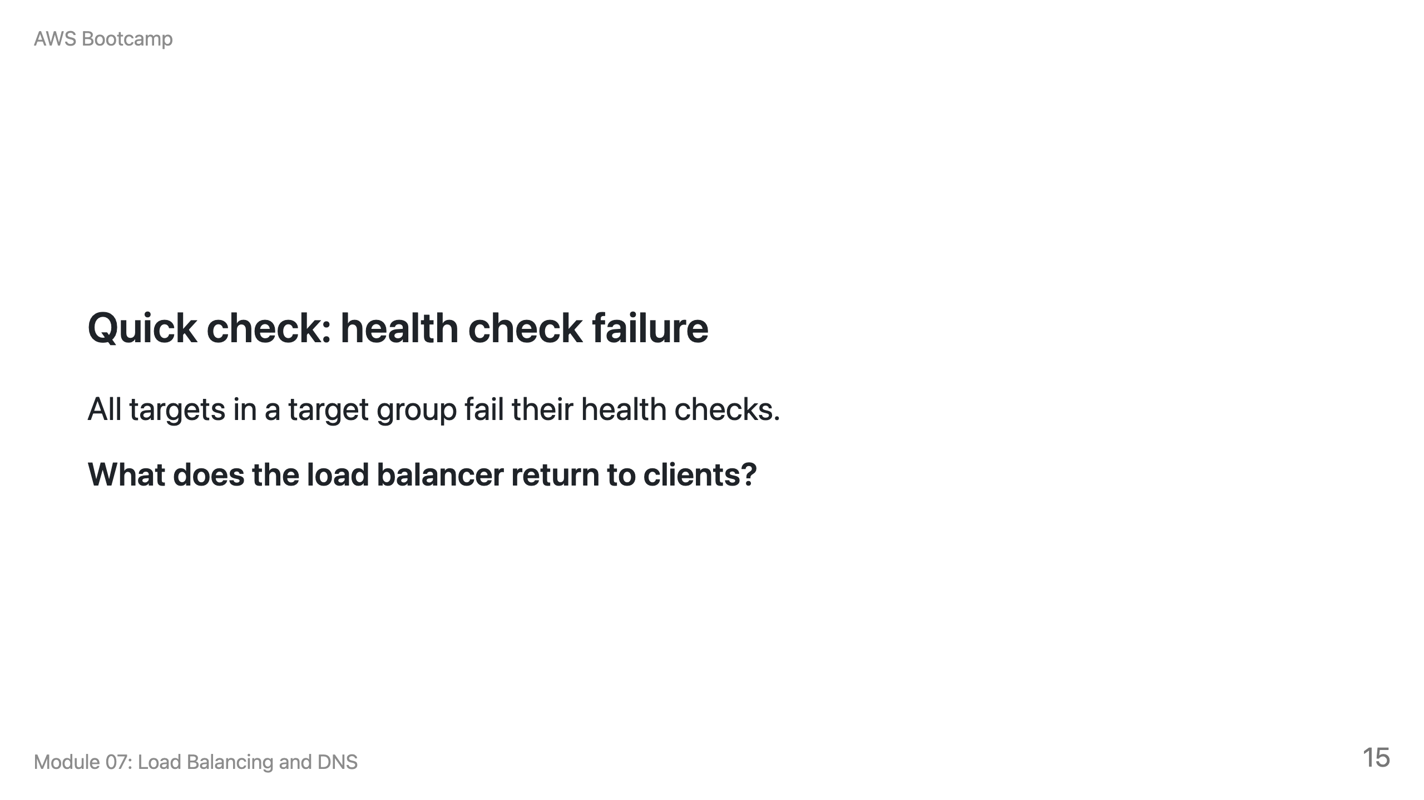
Notes:
Speaker notes: Answer: HTTP 503 (Service Unavailable). The load balancer has no healthy targets to route to. This is why health checks are critical: they prevent the load balancer from sending traffic to broken instances, but if everything is broken, clients get a 503. Monitoring the HealthyHostCount metric in CloudWatch helps detect this situation early.

Slide 16
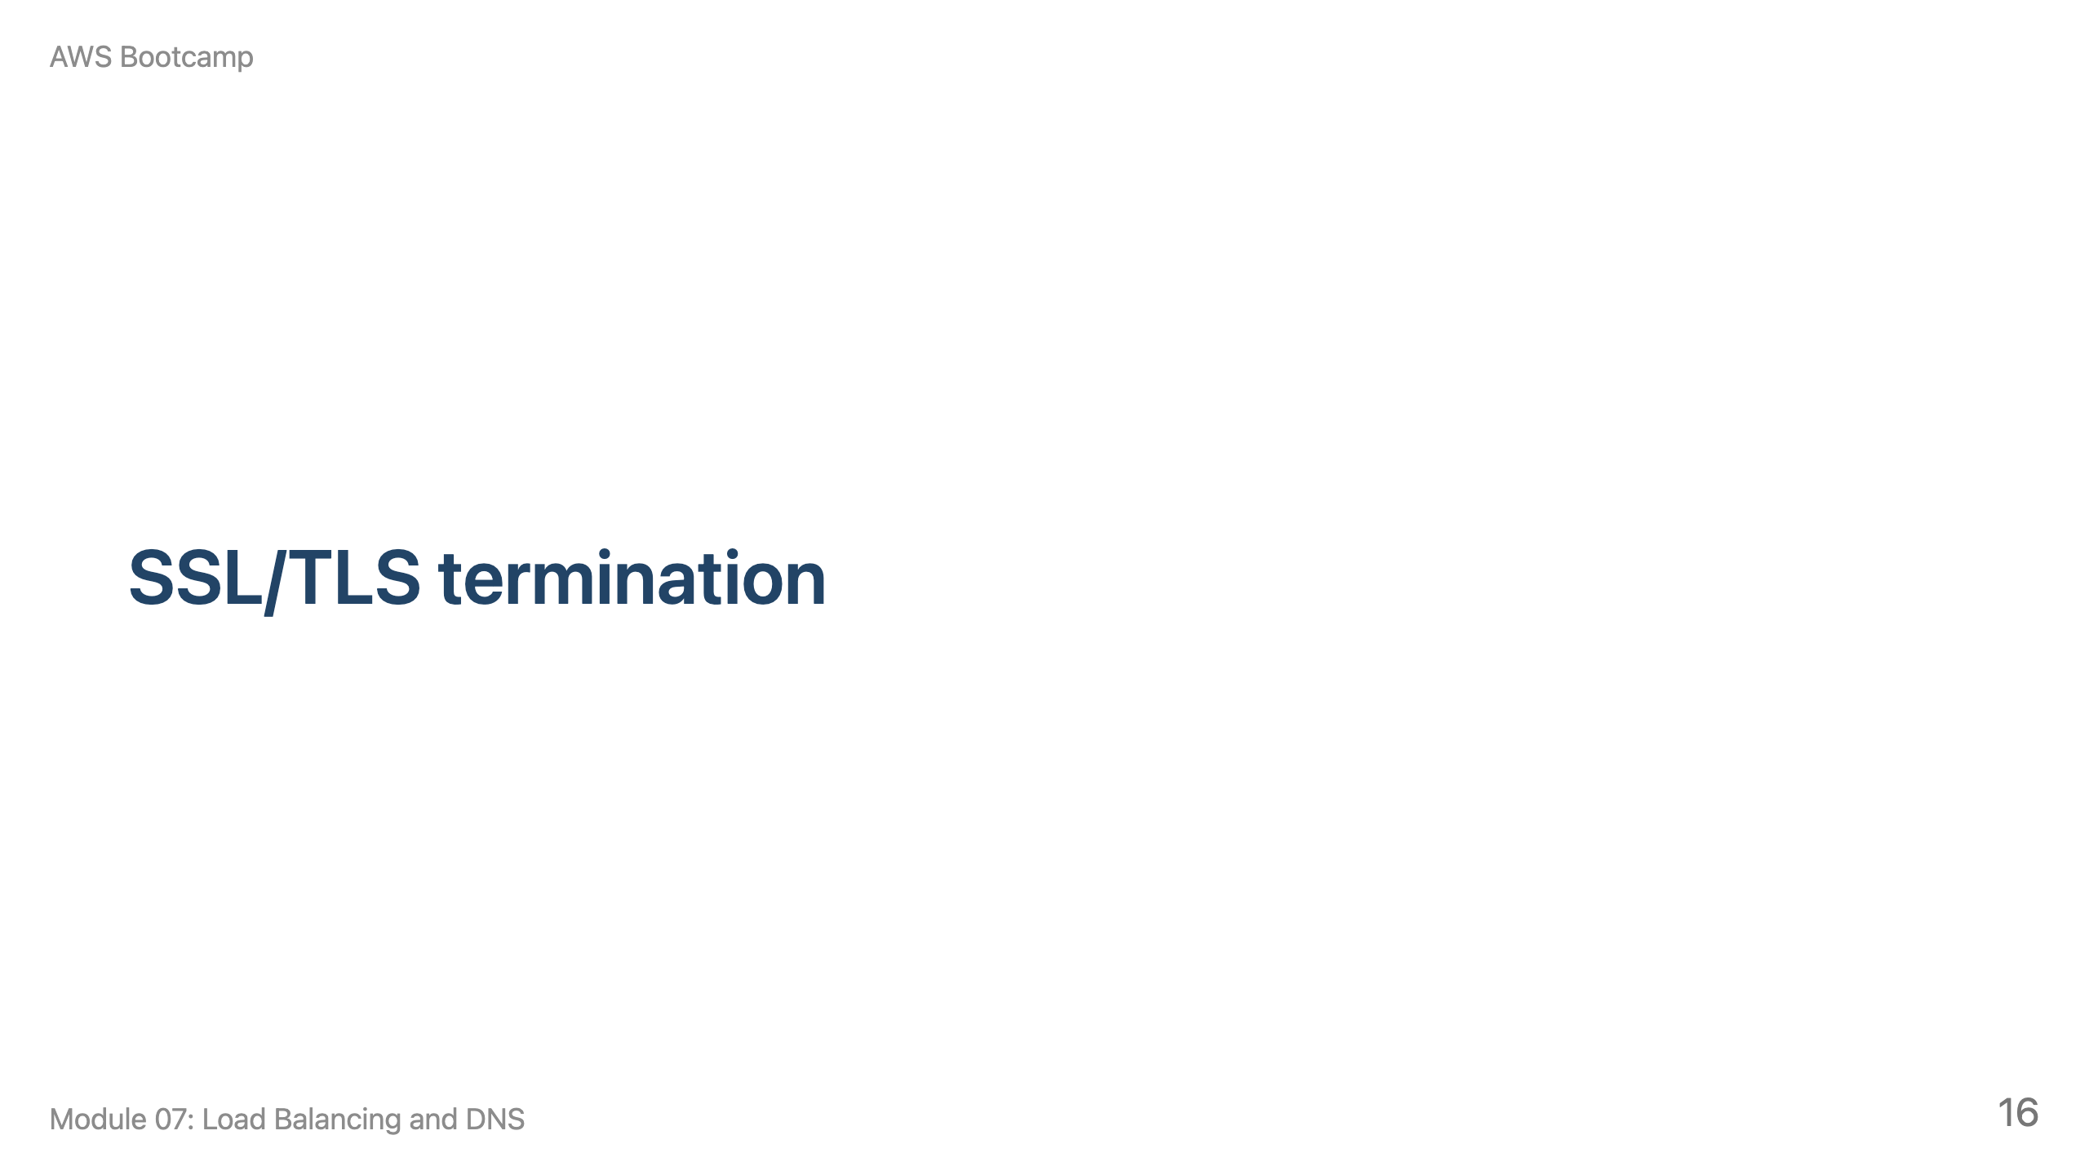
Notes:
Speaker notes: This section takes approximately 10 minutes. Cover ACM certificates and HTTPS listener configuration.

Slide 17
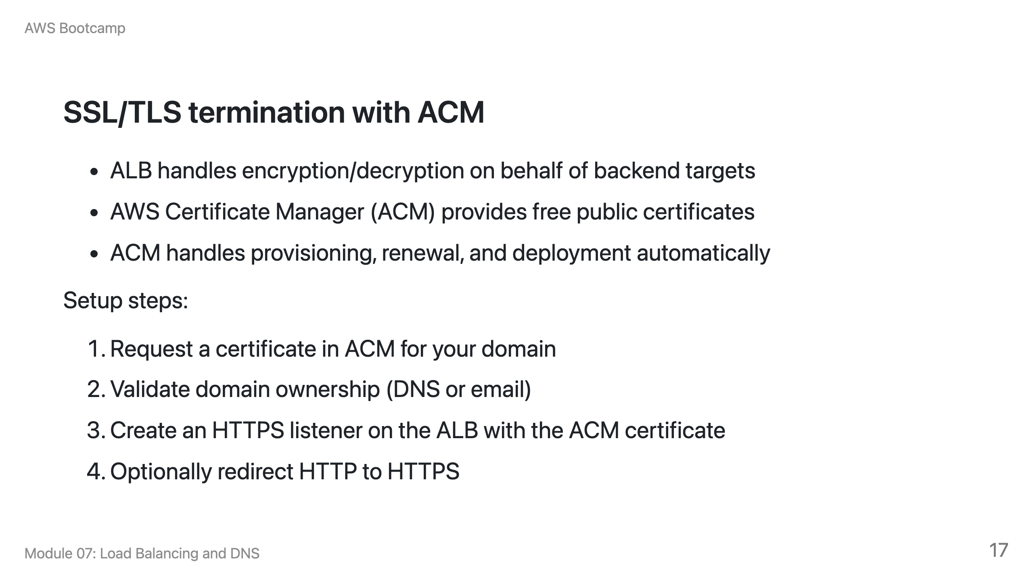

Slide 18
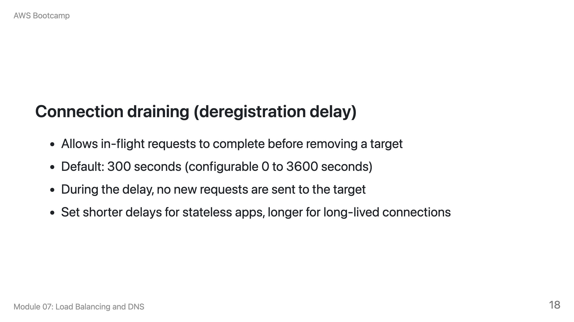

Slide 19
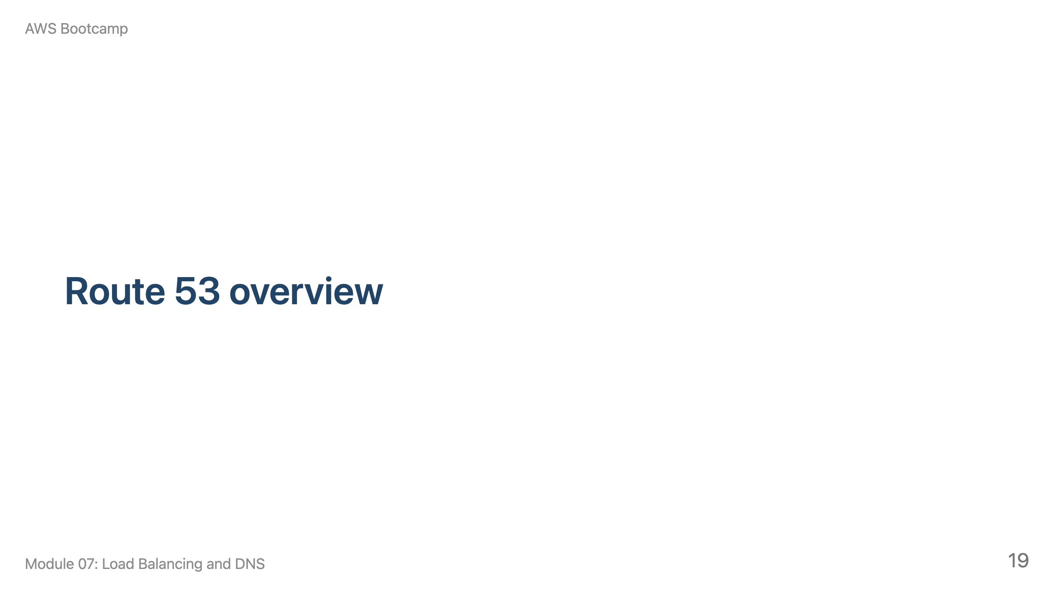
Notes:
Speaker notes: This section takes approximately 15 minutes. Draw the DNS resolution flow on the whiteboard.

Slide 20
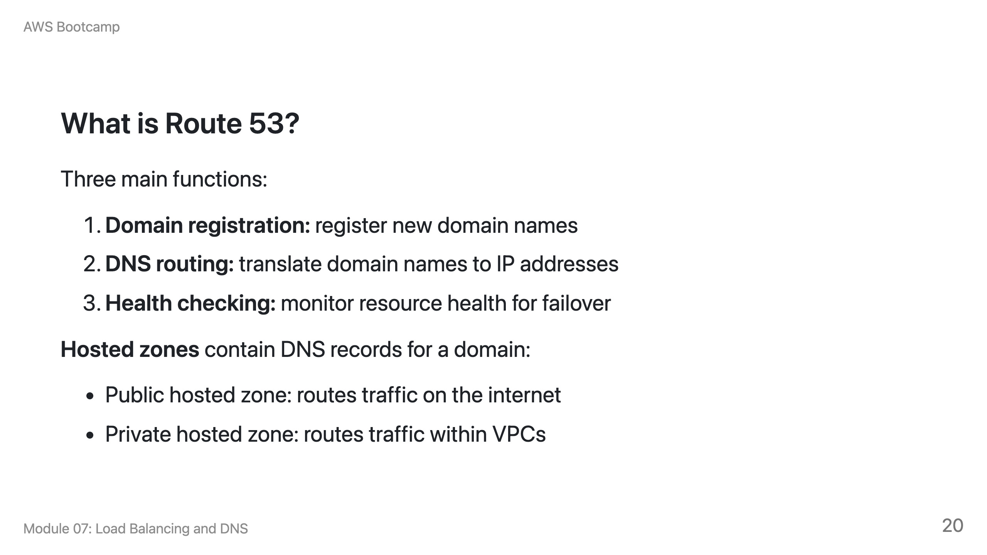

Slide 21
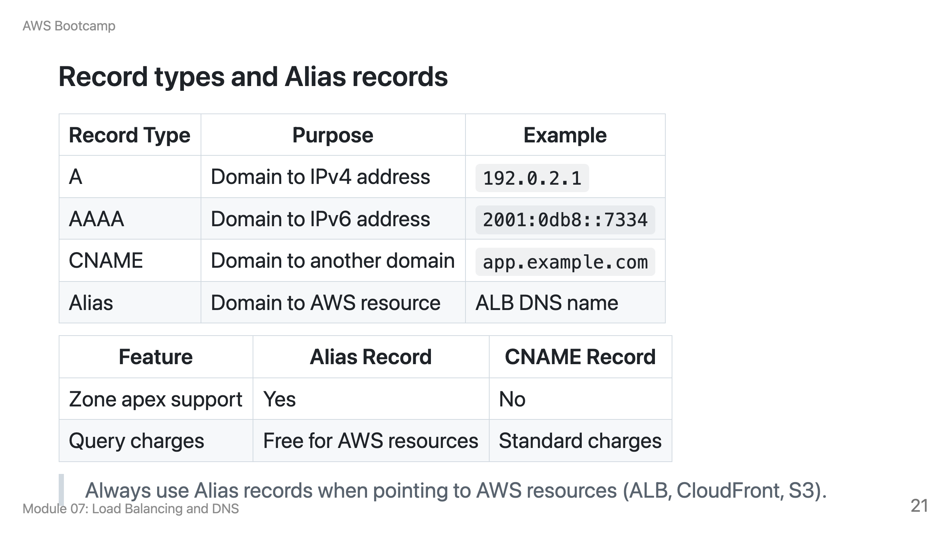

Slide 22
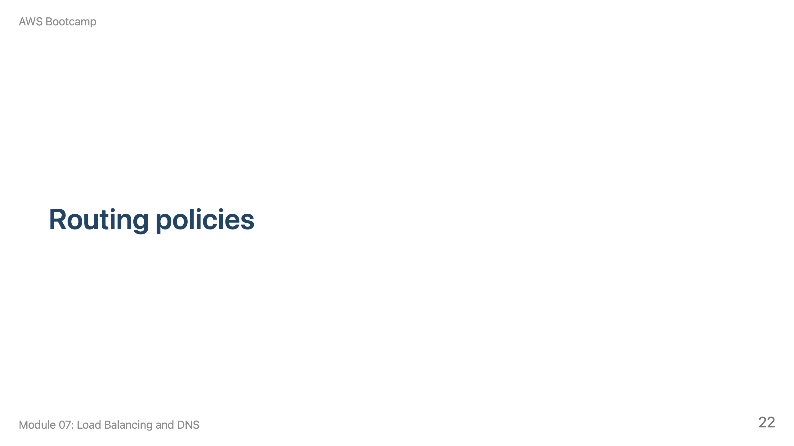
Notes:
Speaker notes: This section takes approximately 10 minutes. Walk through each policy with use cases.

Slide 23
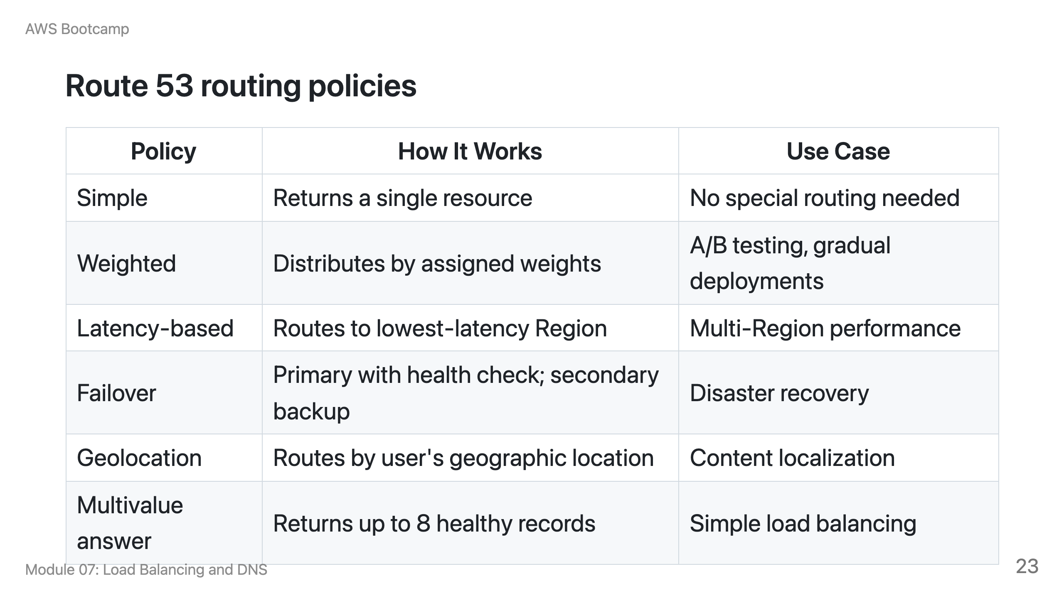

Slide 24
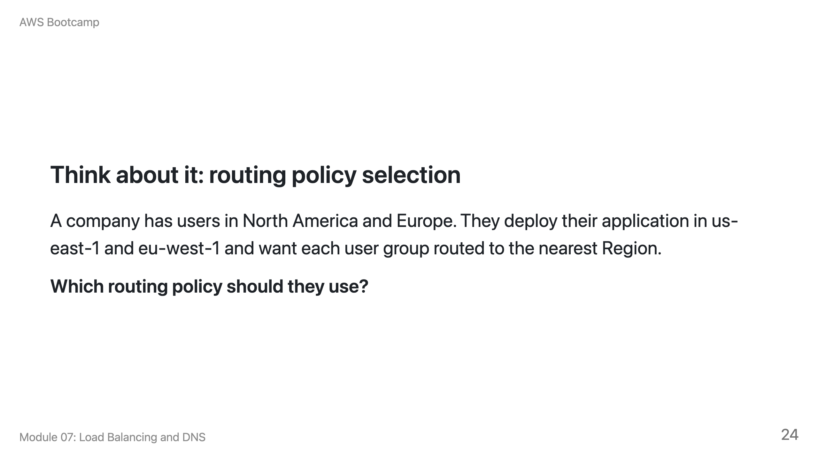
Notes:
Speaker notes: Answer: Latency-based routing. It routes users to the Region with the lowest network latency, which typically corresponds to the nearest Region. Geolocation routing is also a valid answer if they want strict geographic boundaries (e.g., all European users go to eu-west-1 regardless of latency). The key difference: latency-based optimizes for performance, geolocation optimizes for geographic control.

Slide 25
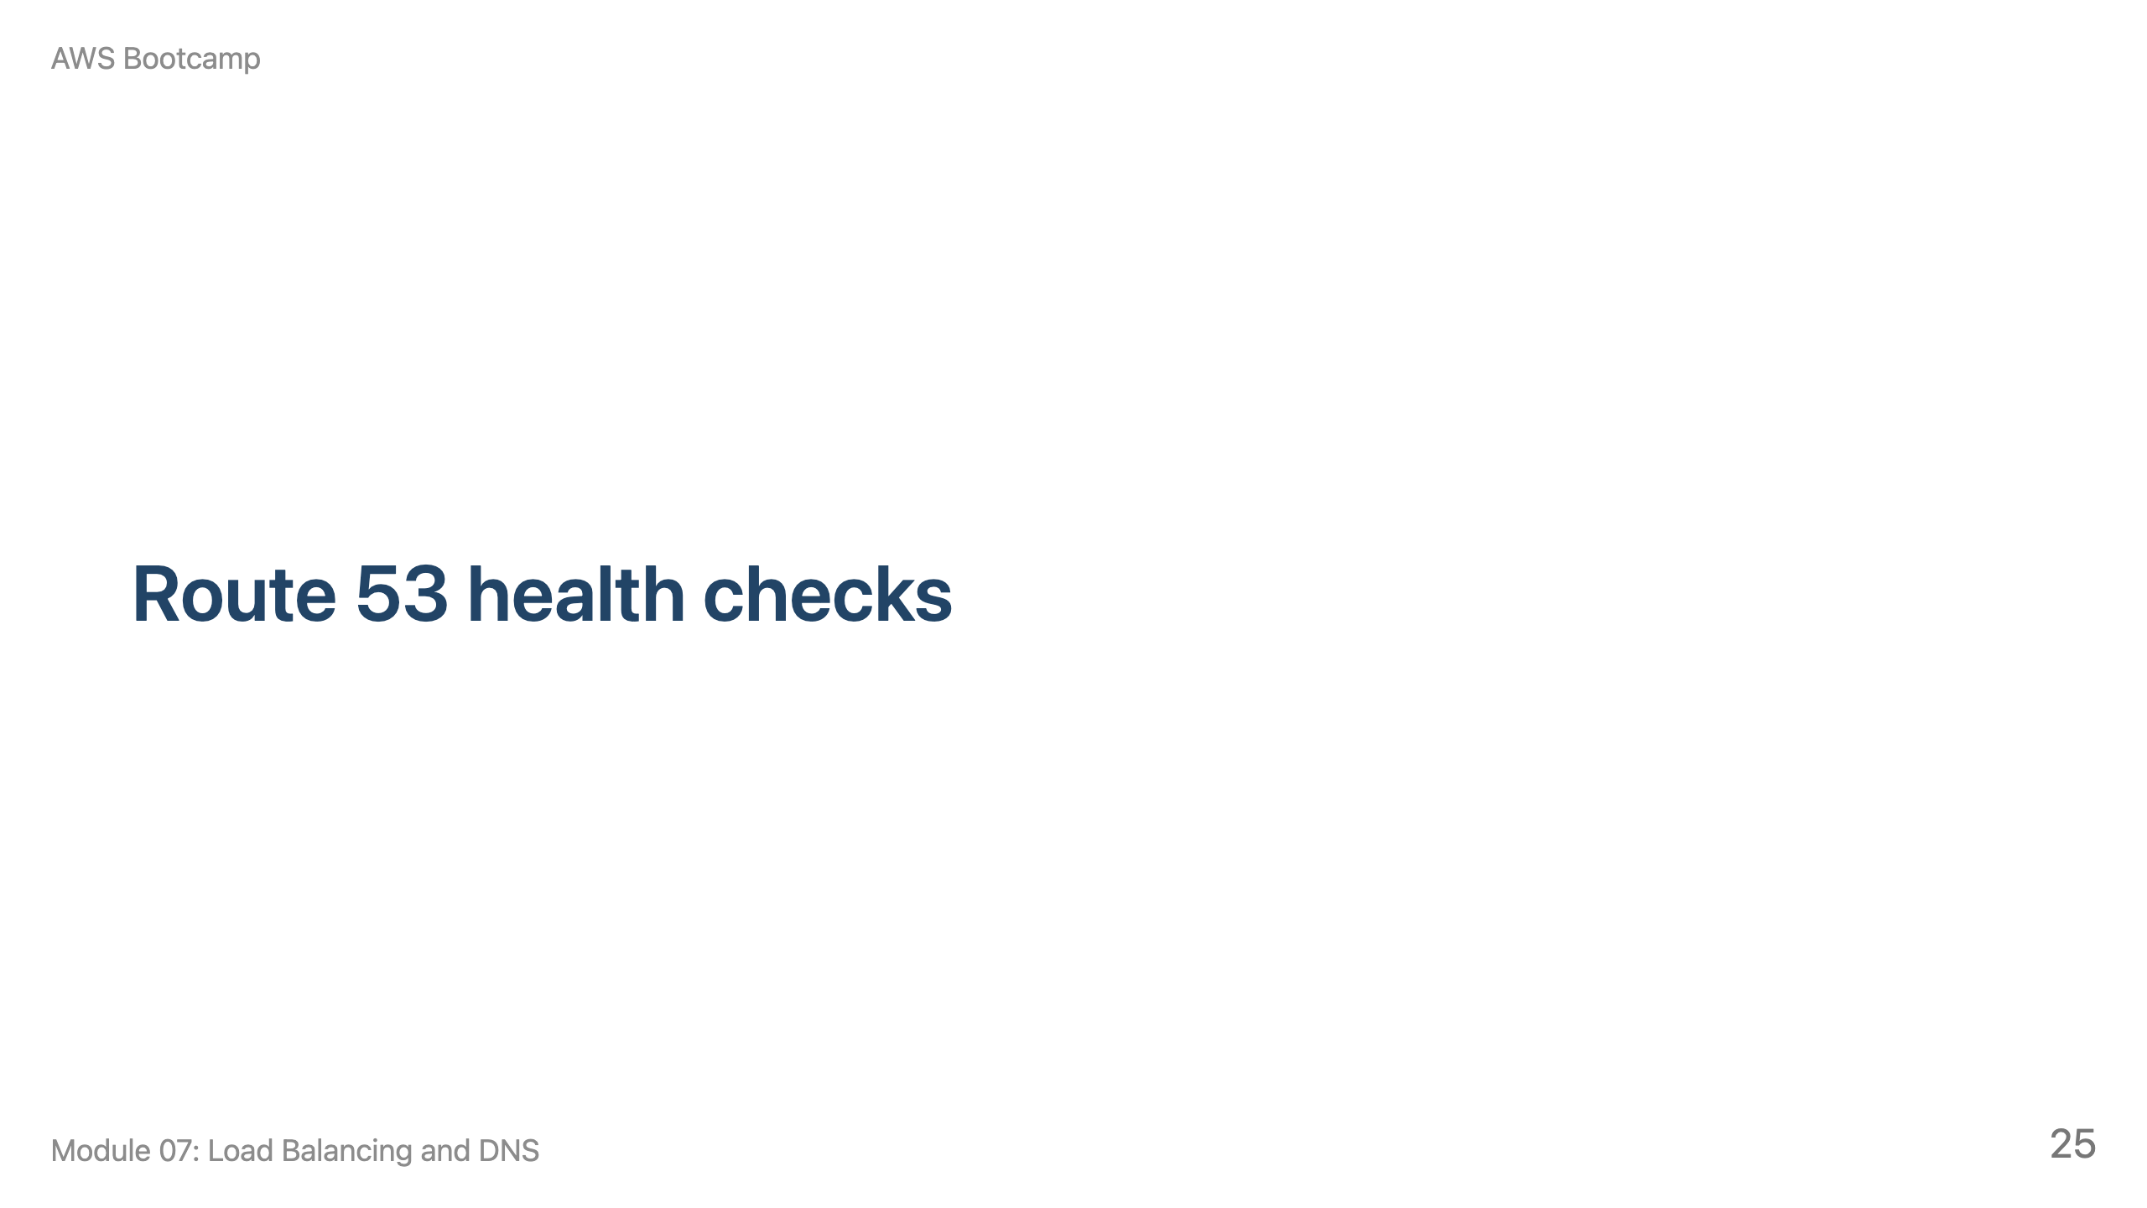
Notes:
Speaker notes: This section takes approximately 10 minutes. Cover the three types and how they enable DNS failover.

Slide 26
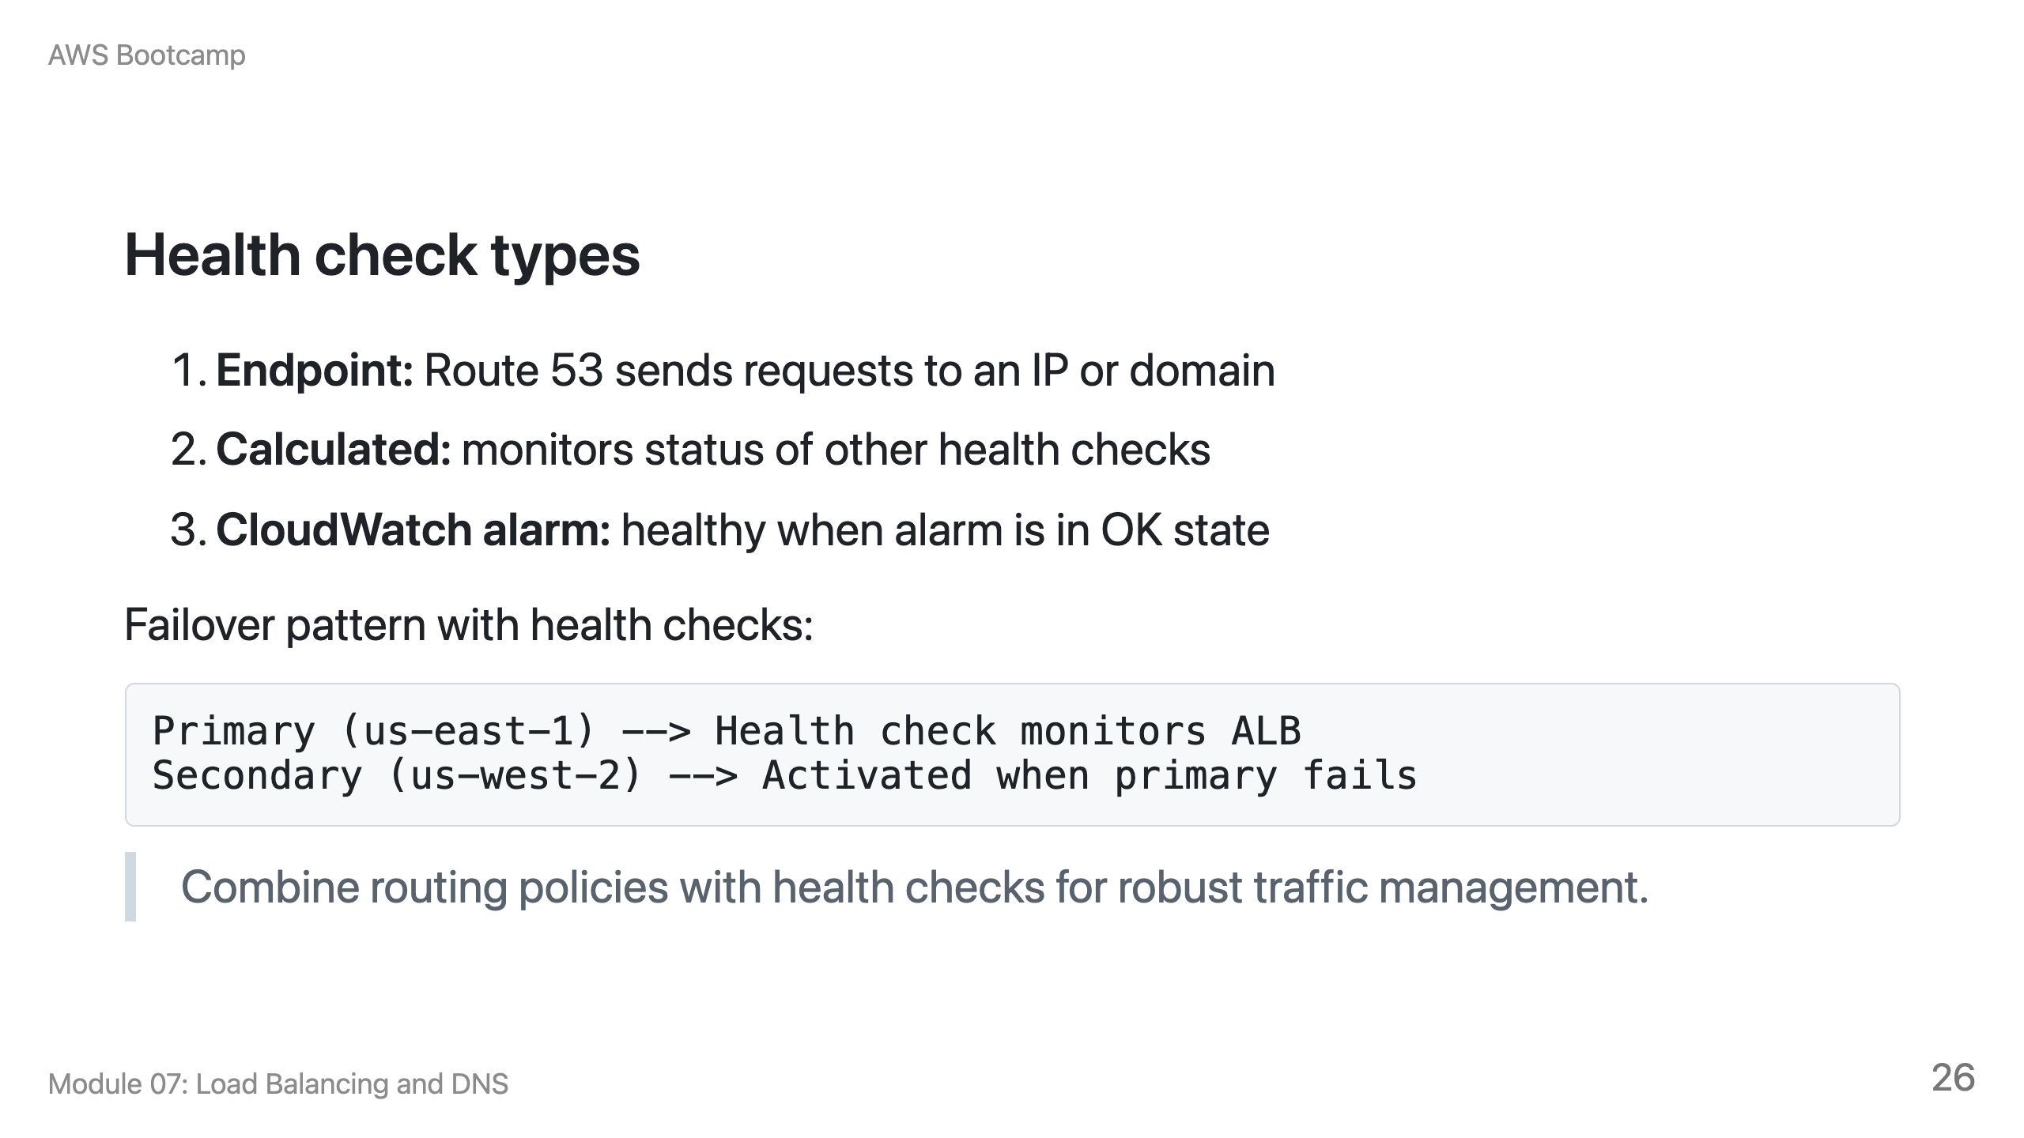

Slide 27
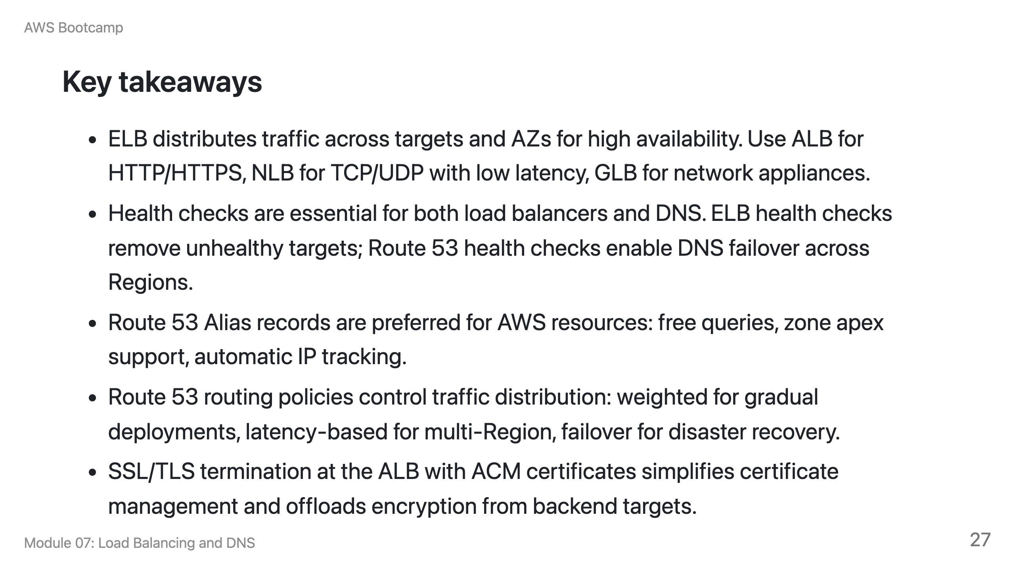

Slide 28
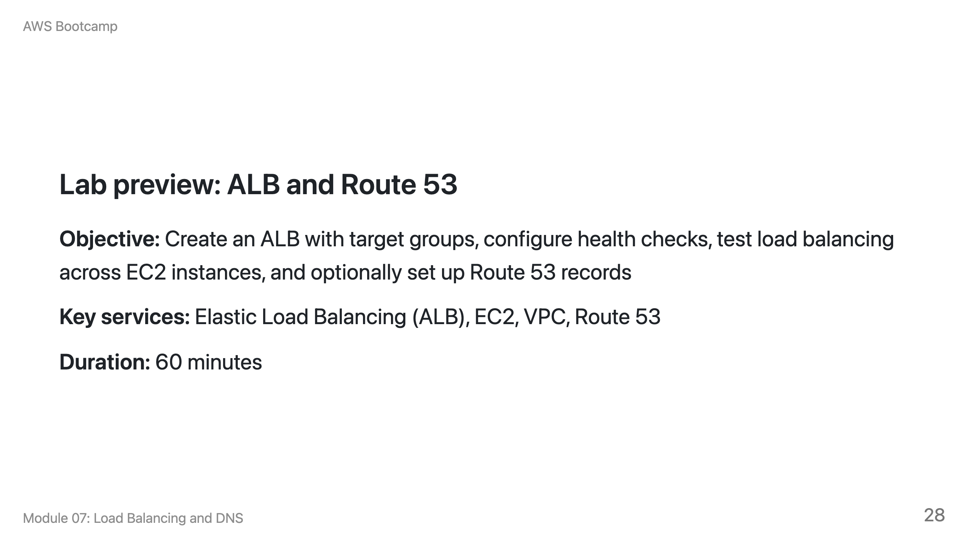
Notes:
Speaker notes: Students will create a VPC with two public subnets, launch two EC2 instances with different web pages, create a target group and ALB, and observe load balancing and health check behavior. The Route 53 section is optional for students who have a registered domain. Remind students to delete the ALB and instances after the lab.

Slide 29
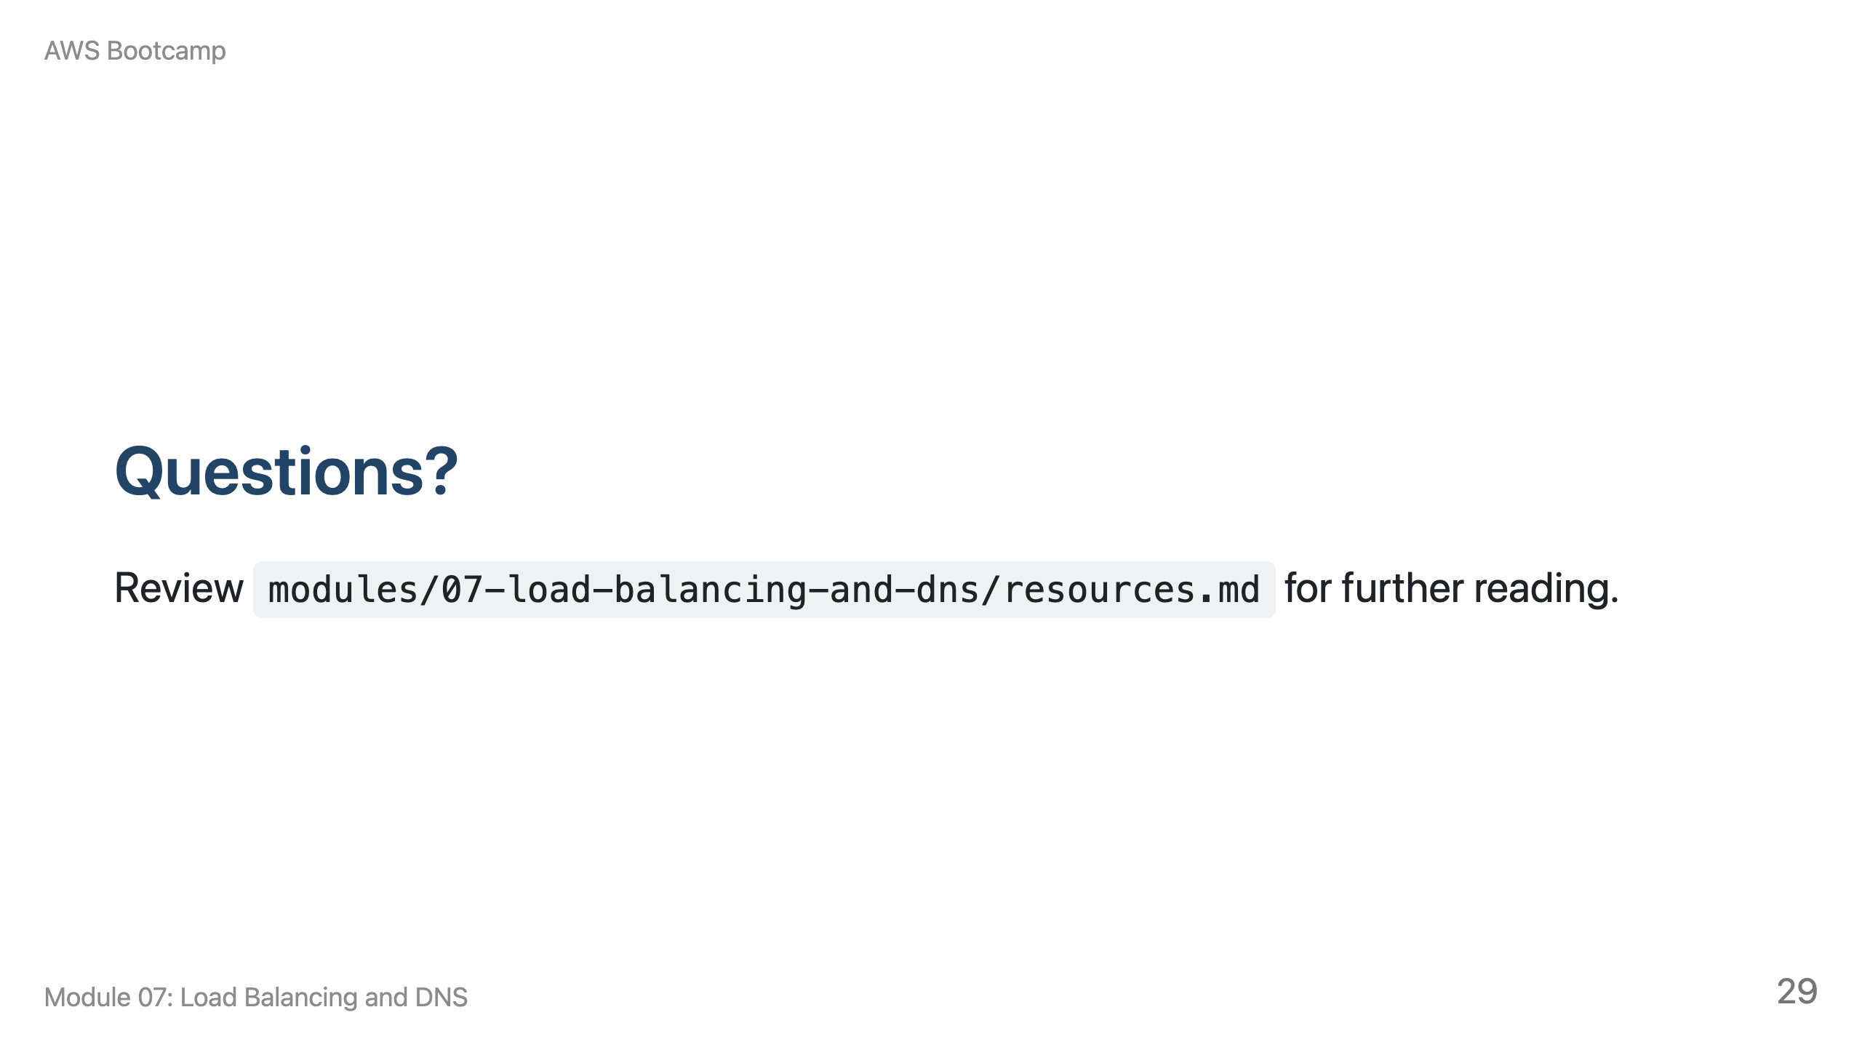
Notes:
Speaker notes: Take 5-10 minutes for questions. Common questions involve ALB vs NLB selection and the difference between ELB and Route 53 health checks. Transition to the lab when ready.

