Slide 1
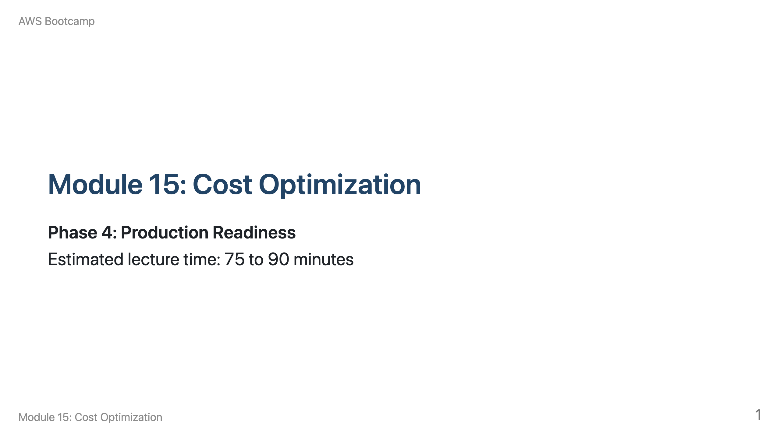
Notes:
Speaker notes: Welcome to Module 15. Start by asking students to estimate how much their bootcamp lab resources would cost if left running for a month. Use the AWS Pricing Calculator to show the actual cost. Breakdown: 10 min pricing models, 10 min Cost Explorer, 10 min Budgets, 15 min right-sizing, 15 min Savings Plans/RIs, 10 min cost traps, 10 min storage optimization, 5 min wrap-up.

Slide 2
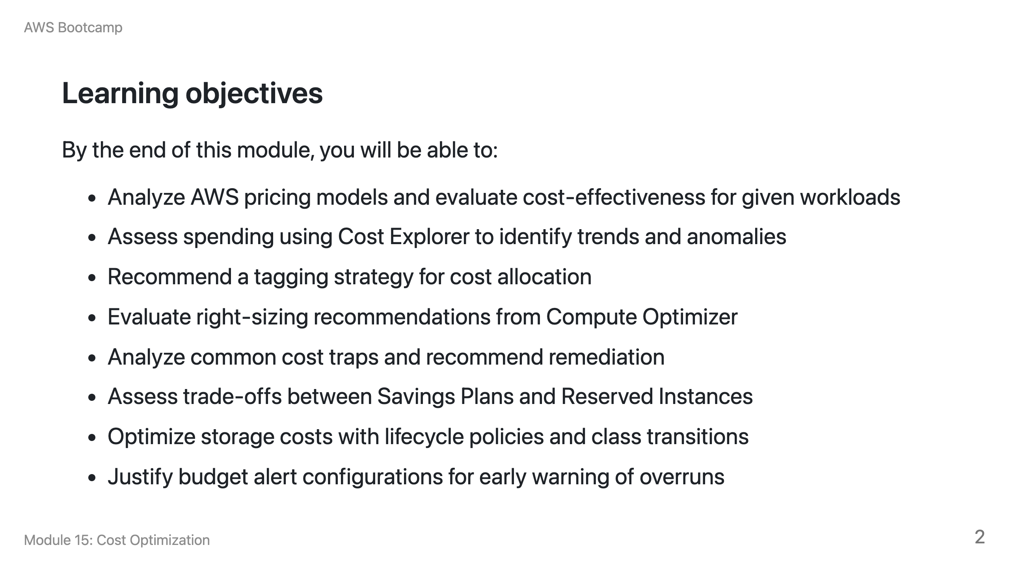

Slide 3
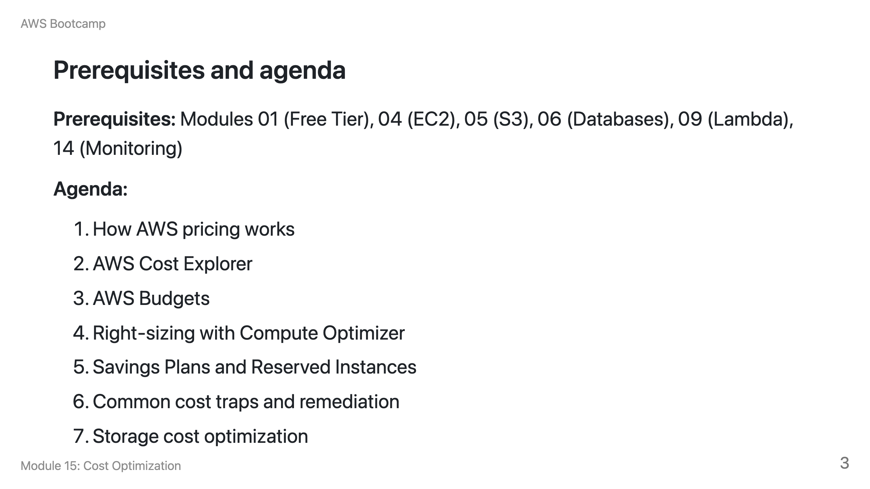

Slide 4
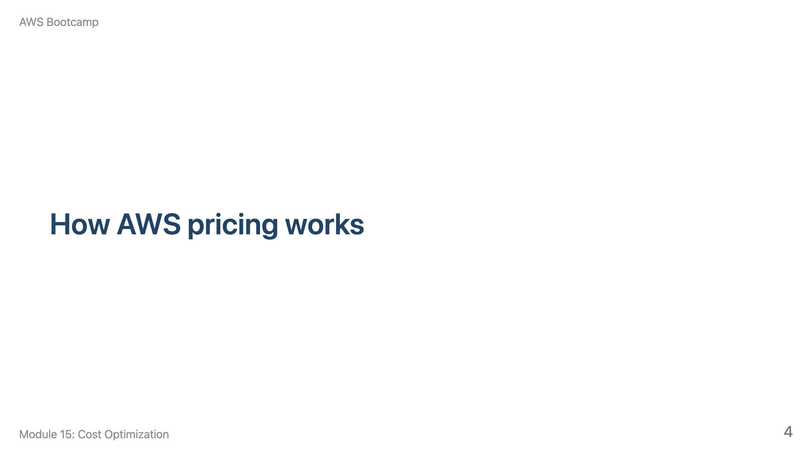
Notes:
Speaker notes: This section takes about 10 minutes. Emphasize that data transfer is the most overlooked cost driver.

Slide 5
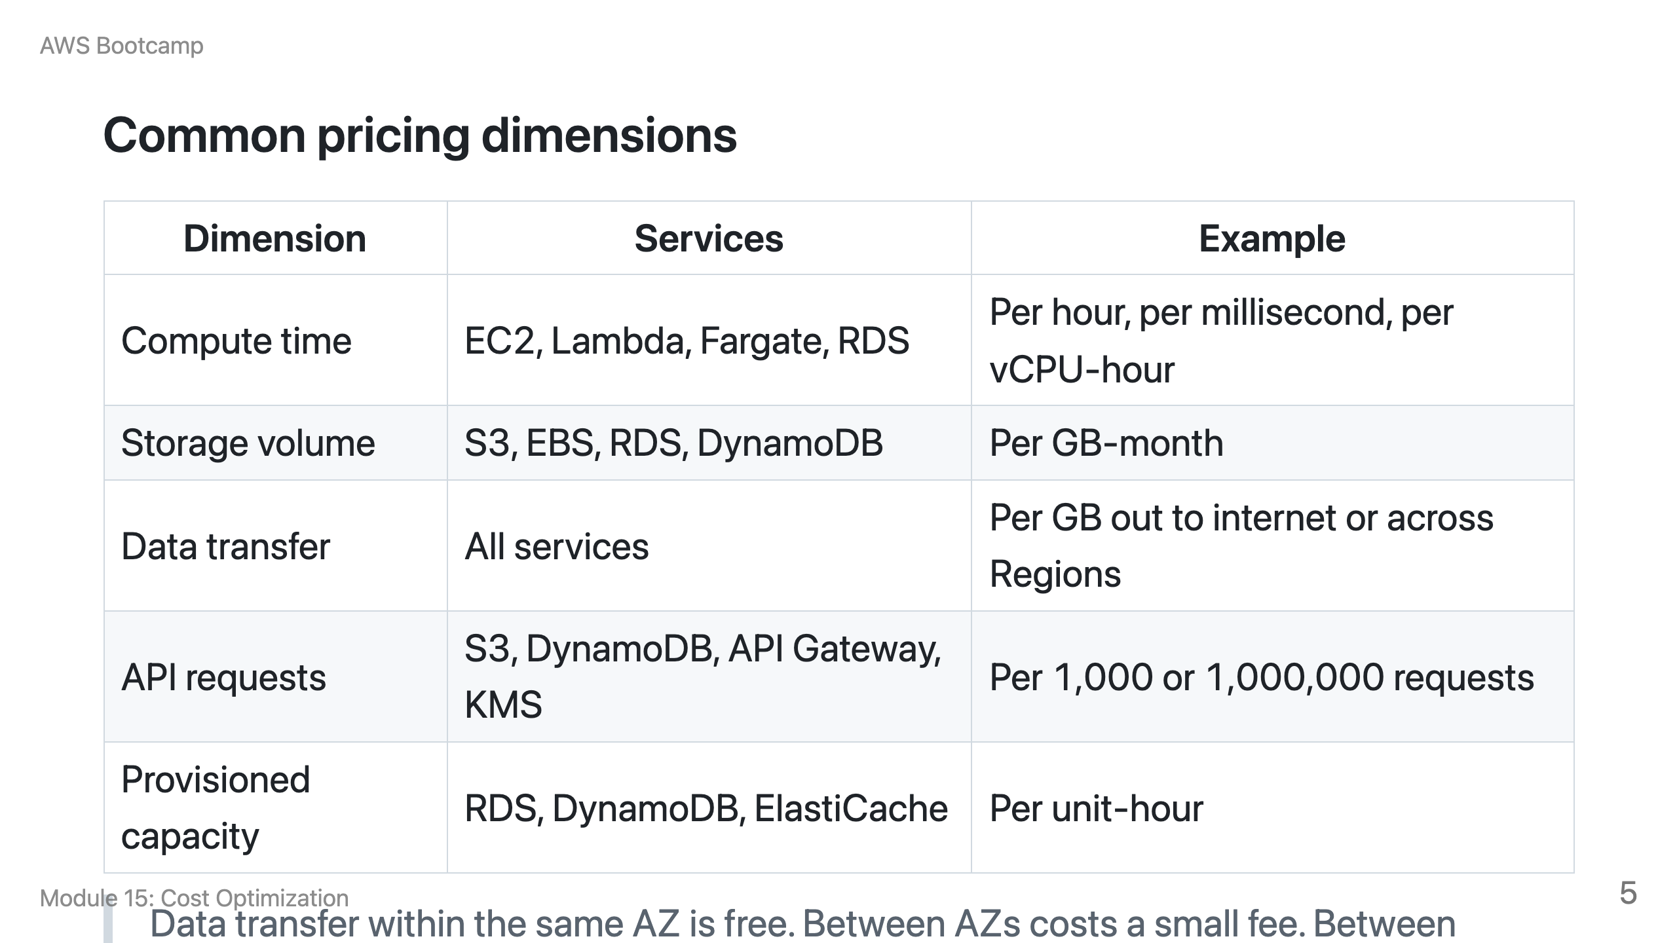

Slide 6
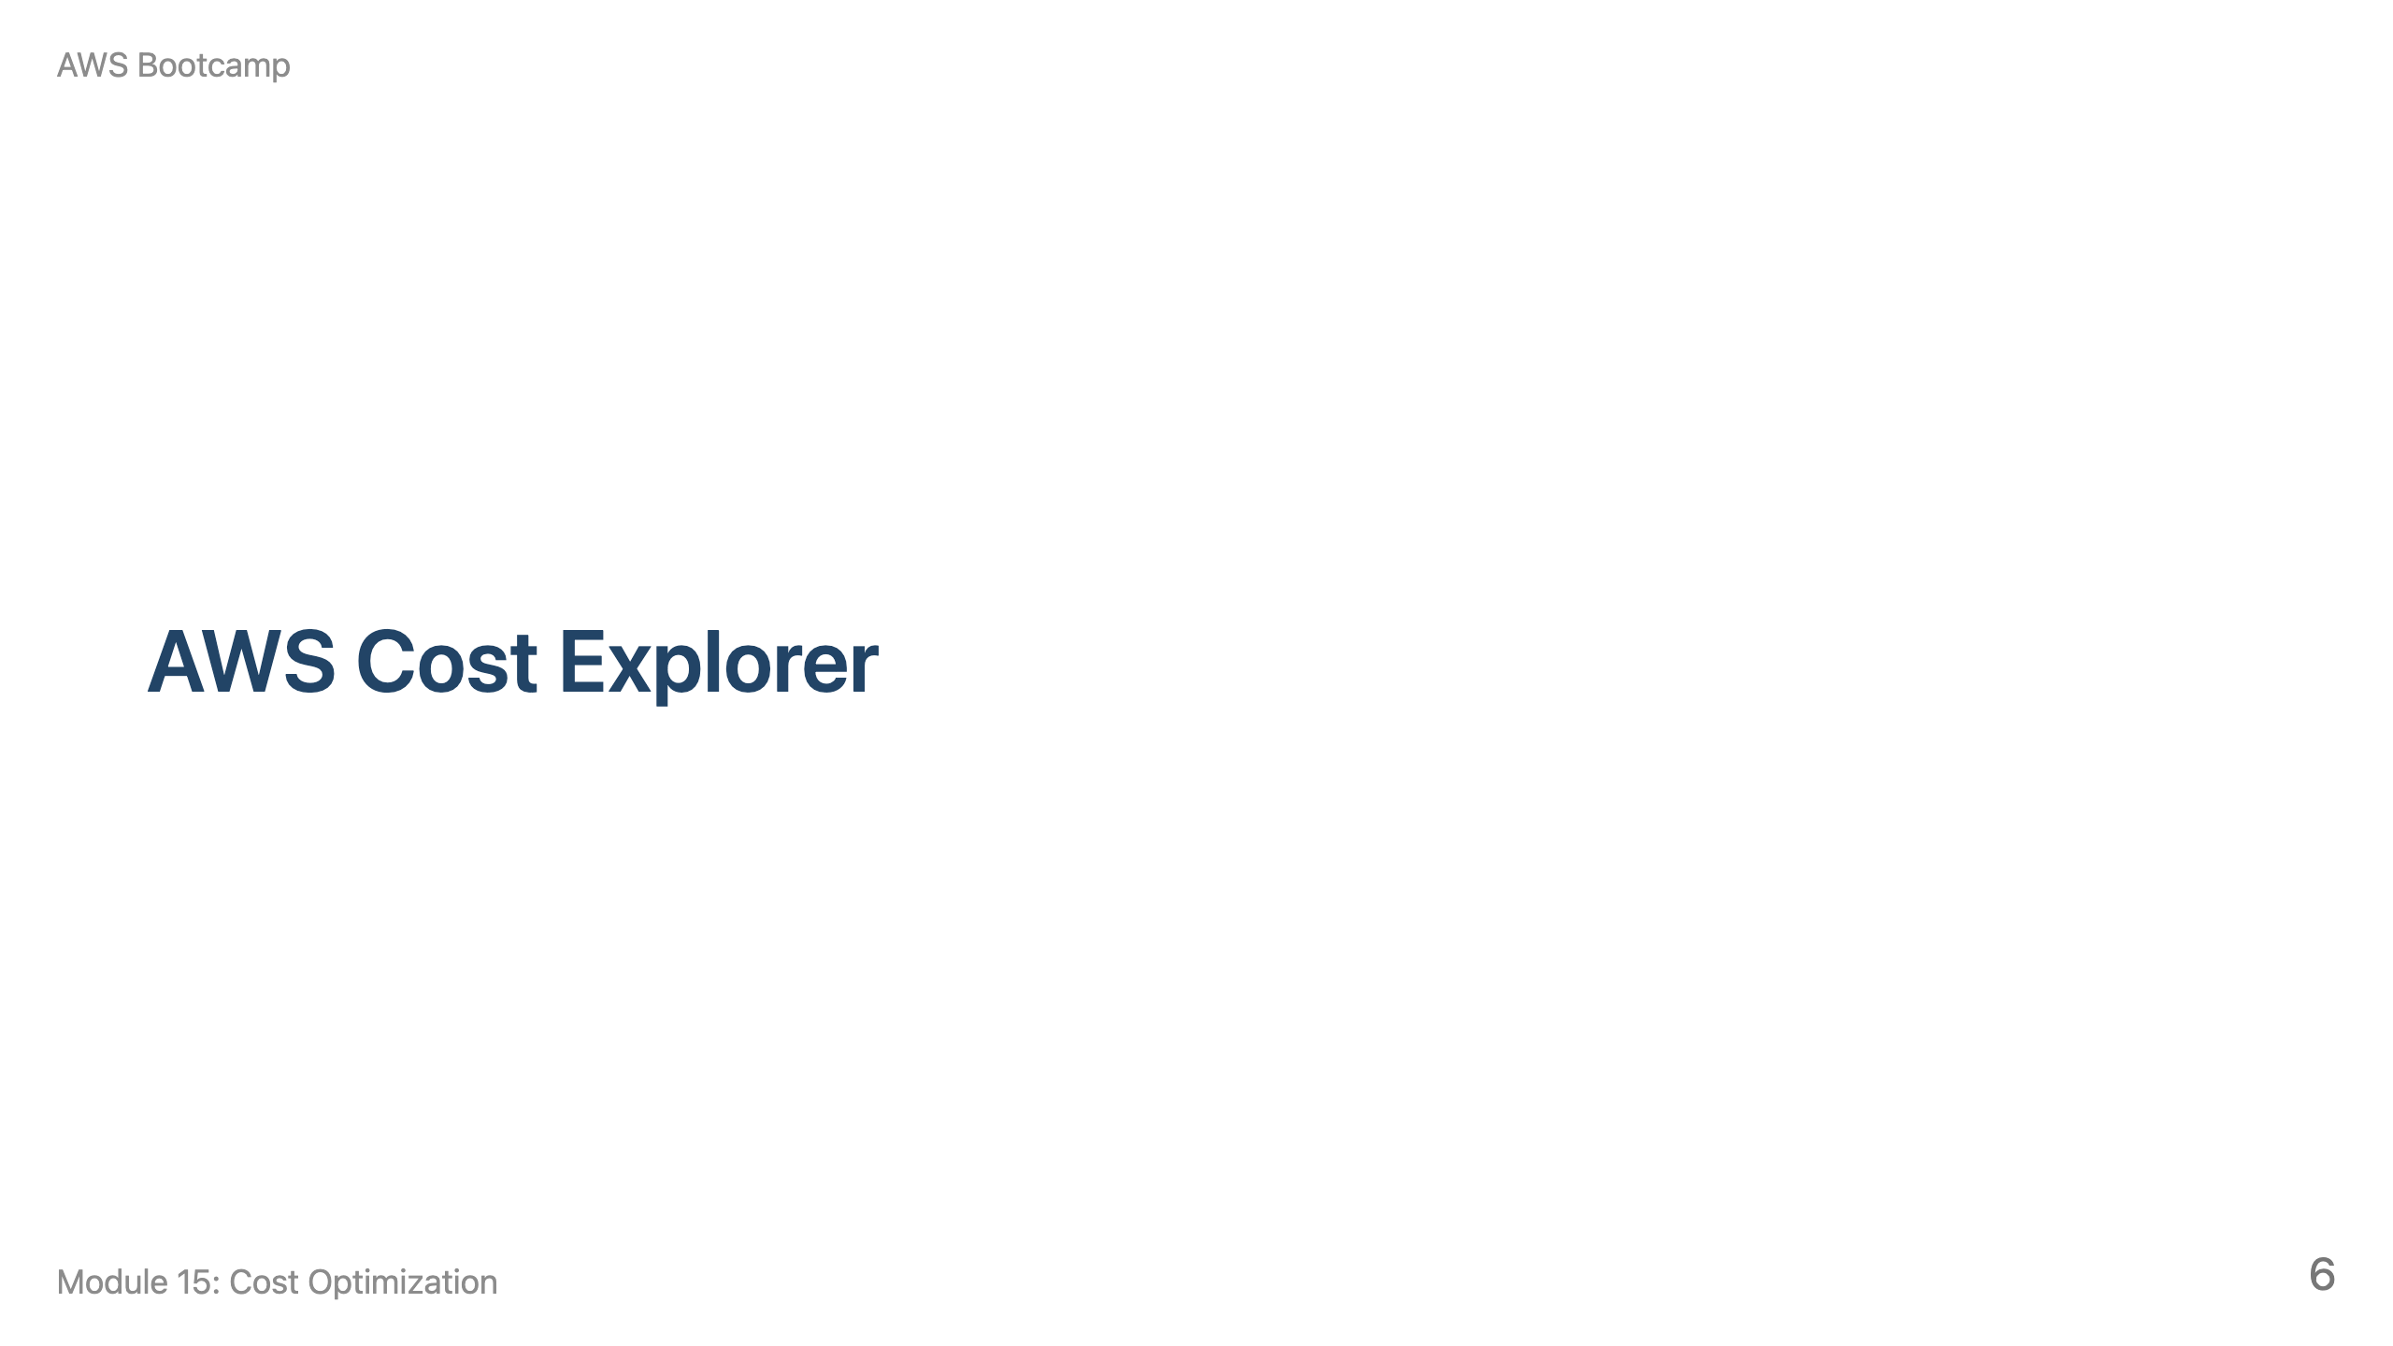
Notes:
Speaker notes: This section takes about 10 minutes. Show Cost Explorer's interface and how to filter by service, tag, and time range.

Slide 7
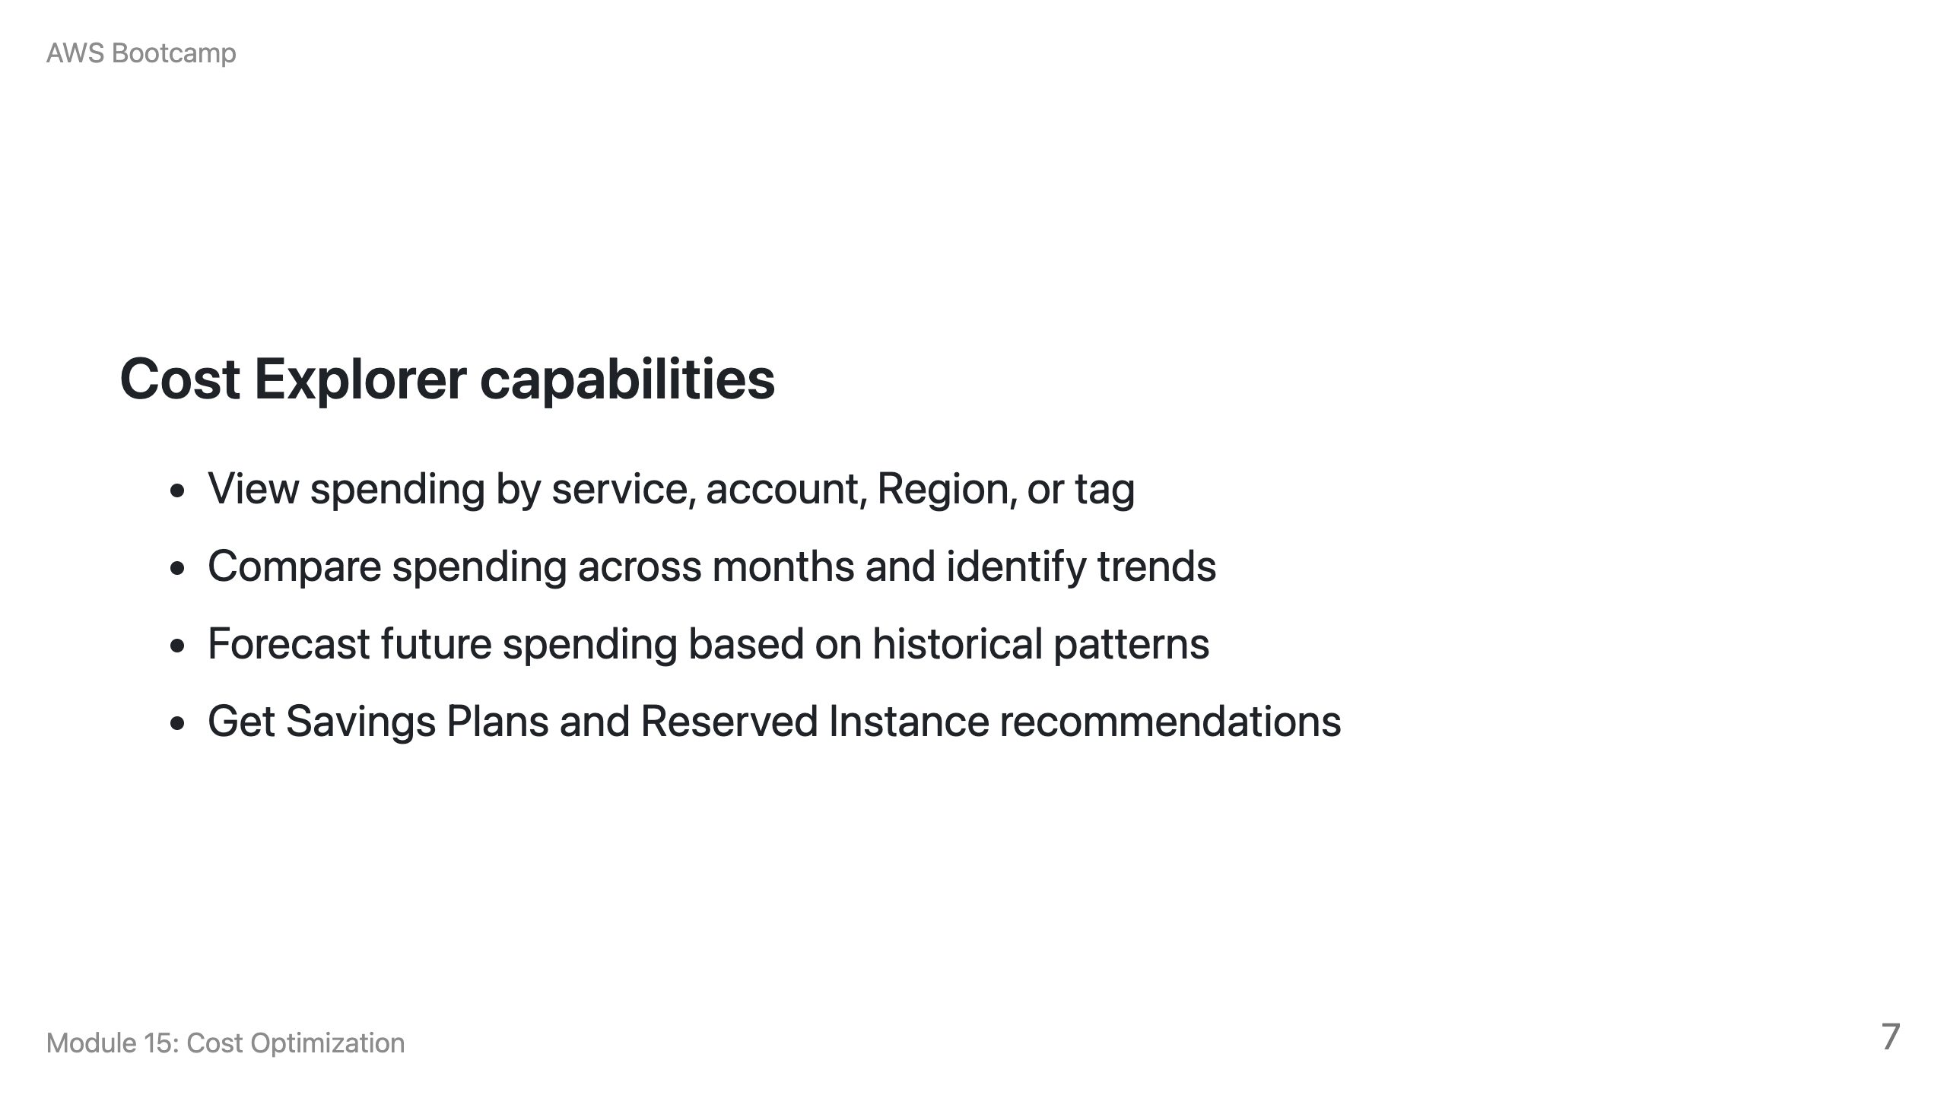

Slide 8
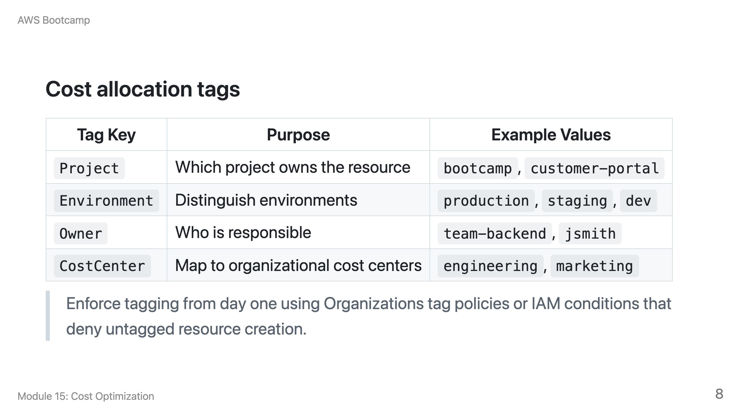

Slide 9
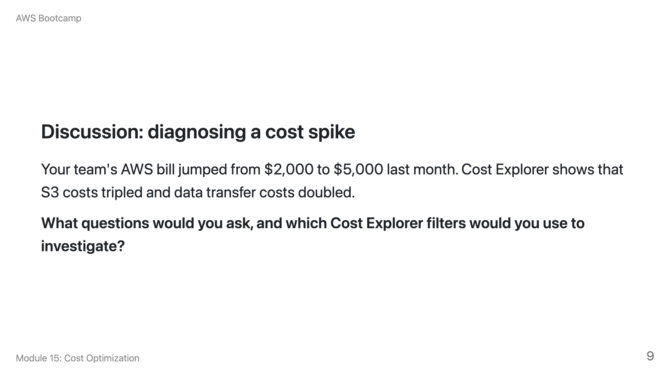
Notes:
Speaker notes: Expected answer: Filter by S3 service, then by tag (which project?), then by usage type (storage vs. requests vs. data transfer). Check if a new data pipeline is writing large volumes. Check if cross-Region replication was enabled. Check if a public bucket is being scraped. Data transfer costs often indicate unexpected external access or cross-Region traffic.

Slide 10
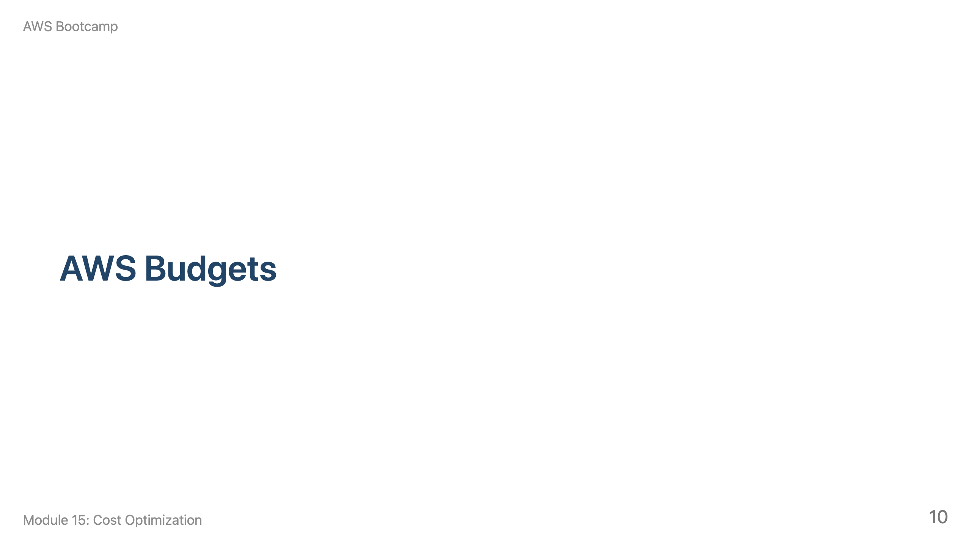
Notes:
Speaker notes: This section takes about 5 minutes. Emphasize that budget alerts are reactive, not preventive.

Slide 11
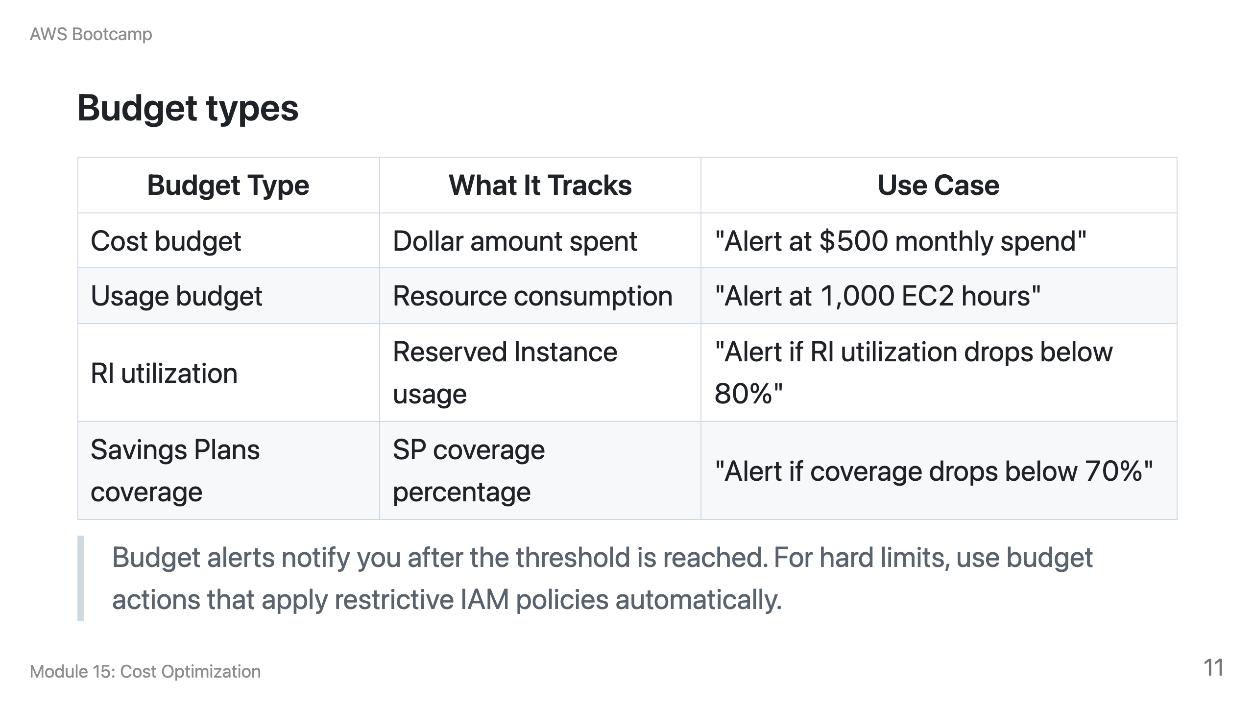

Slide 12
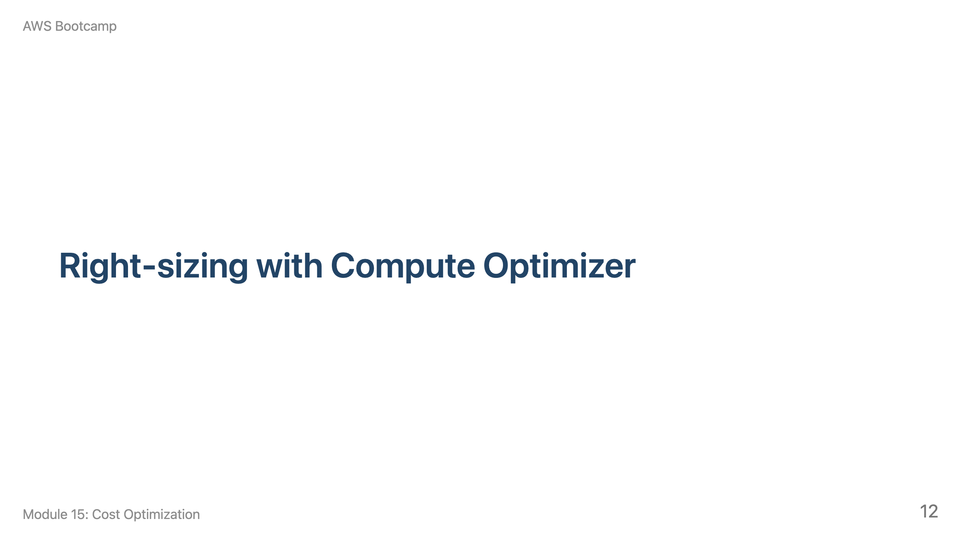
Notes:
Speaker notes: This section takes about 10 minutes. Emphasize: right-size before committing to discounts.

Slide 13
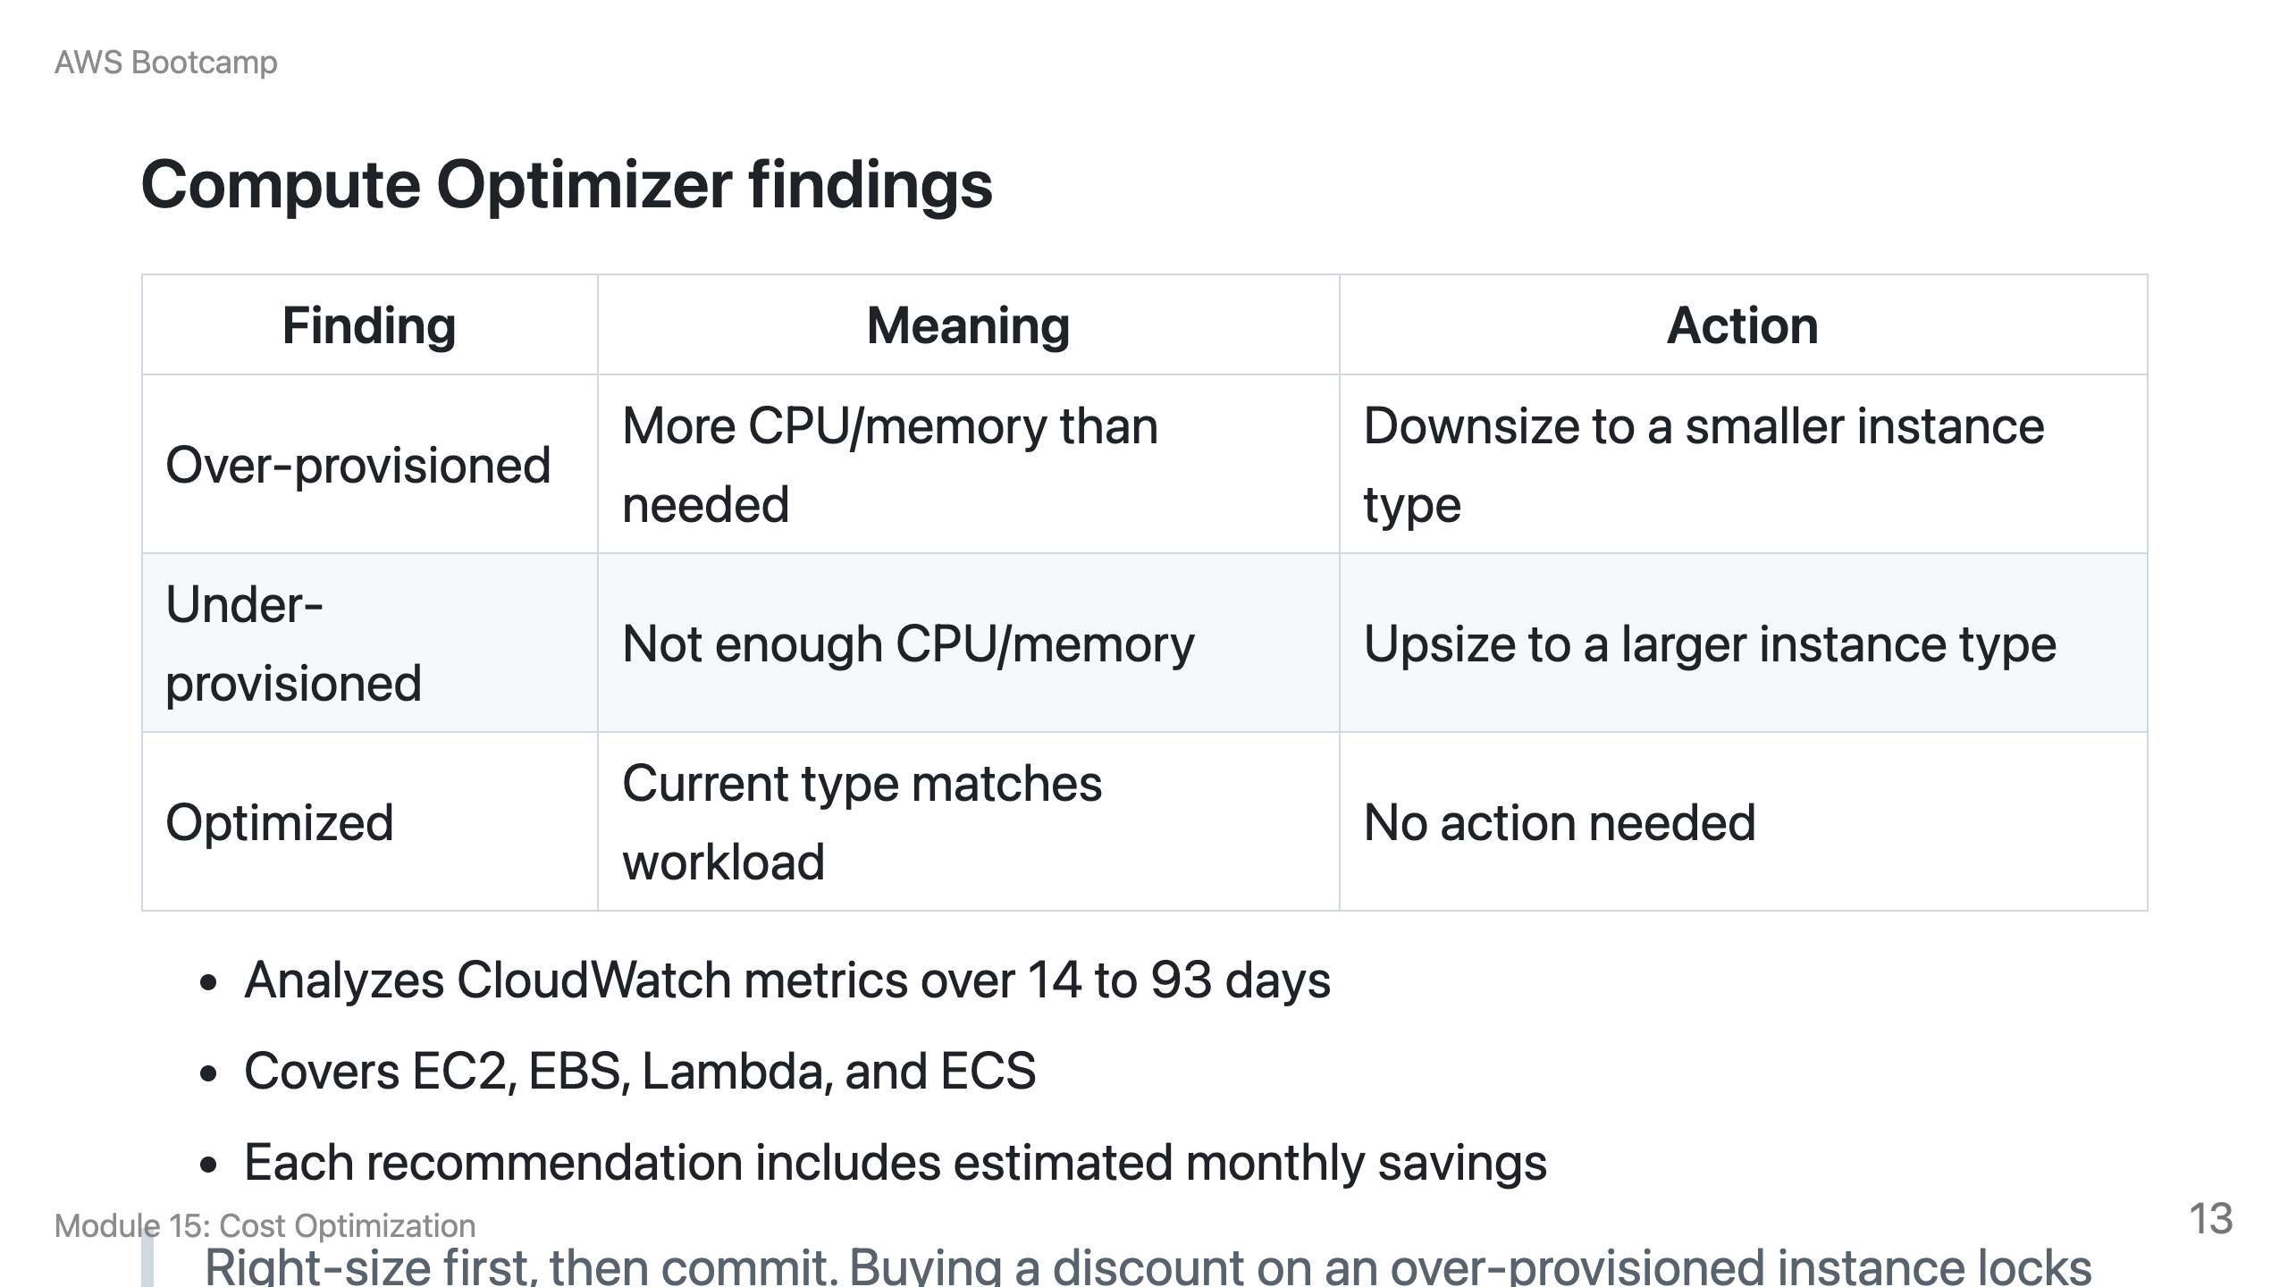

Slide 14
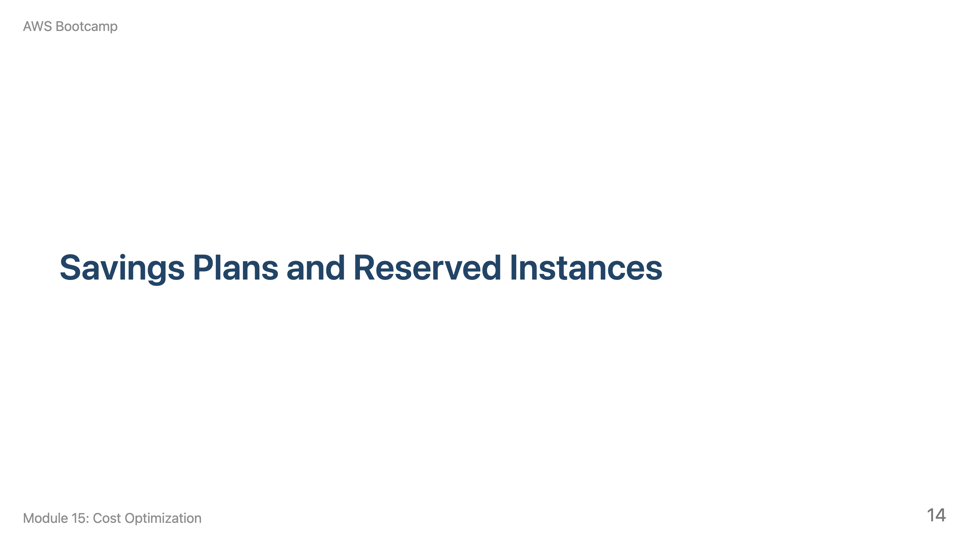
Notes:
Speaker notes: This section takes about 15 minutes. Use the gym membership analogy: Savings Plans work at any gym in the chain (flexible); RIs are for a specific gym location (cheaper but less flexible).

Slide 15
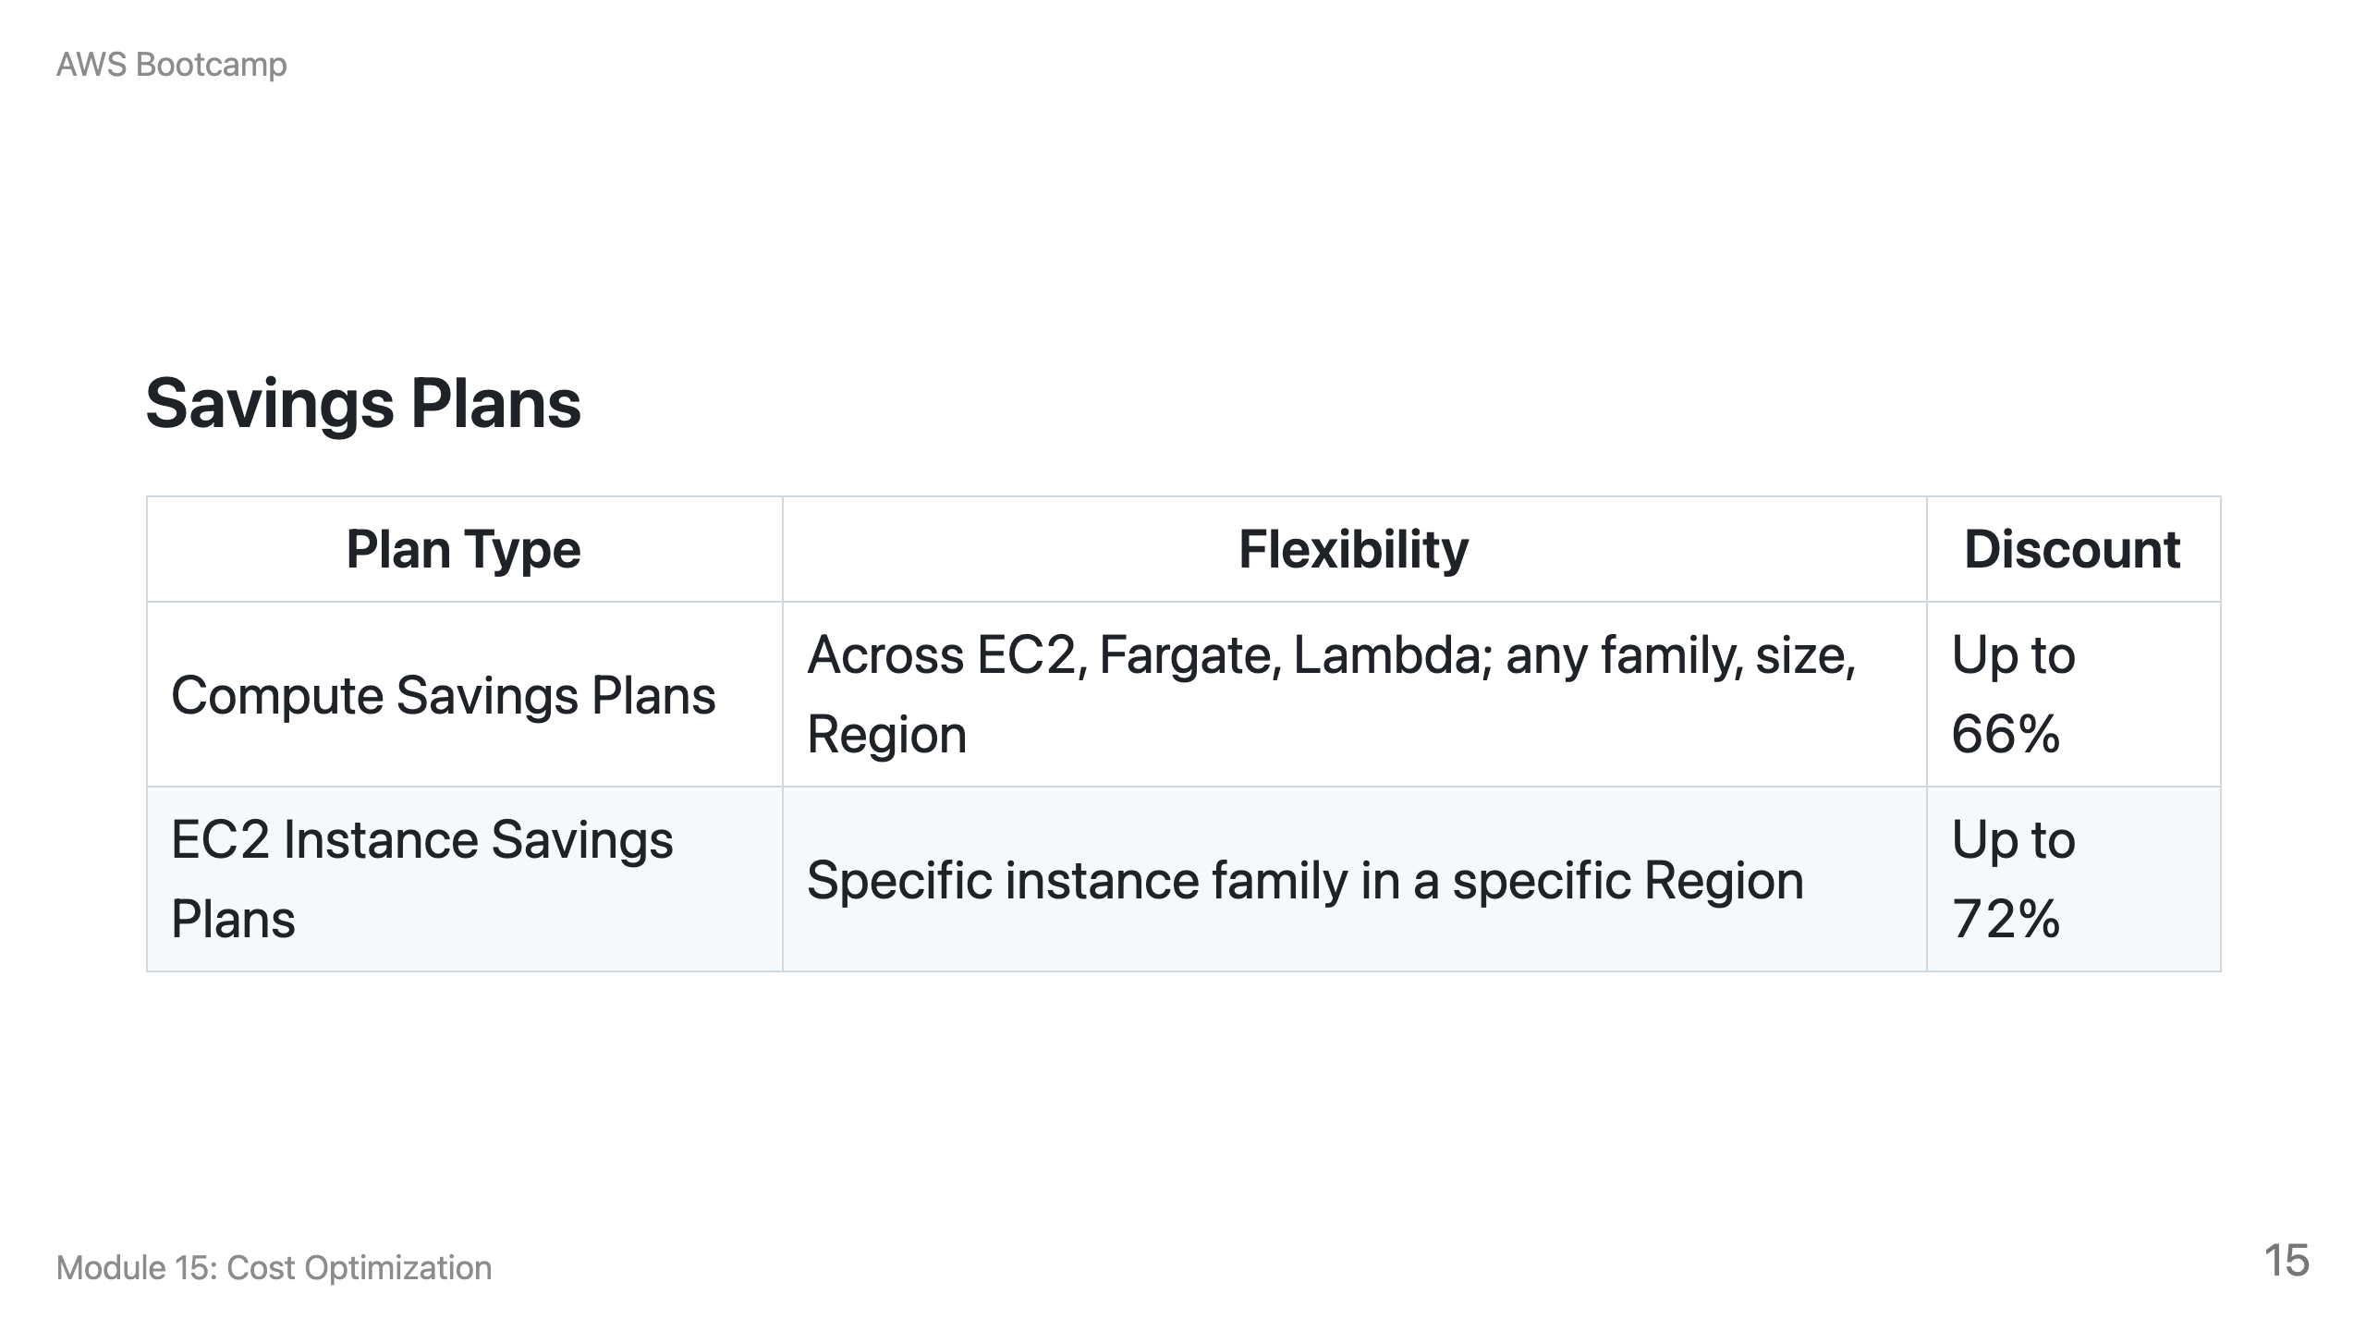

Slide 16
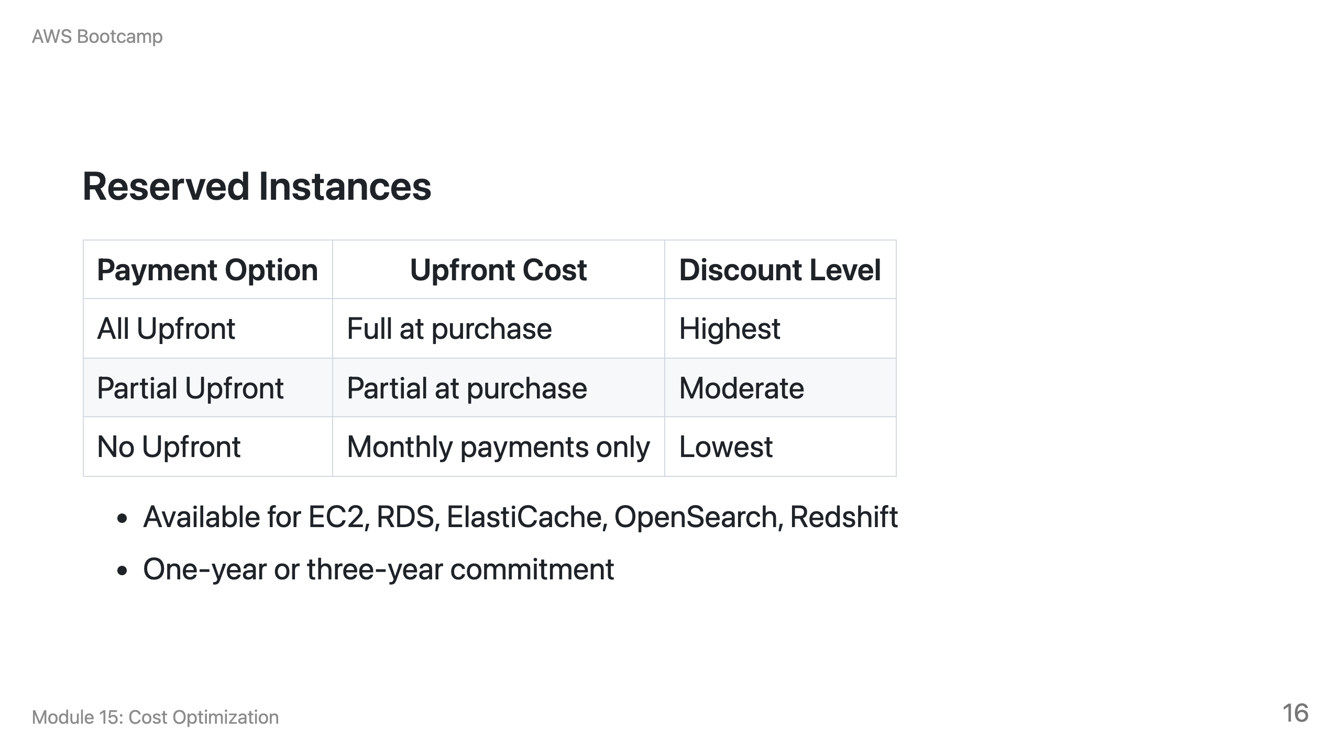

Slide 17
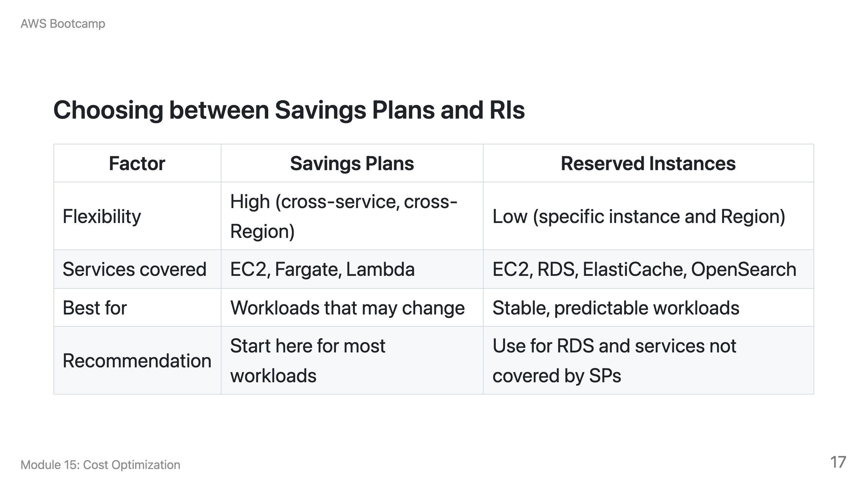

Slide 18
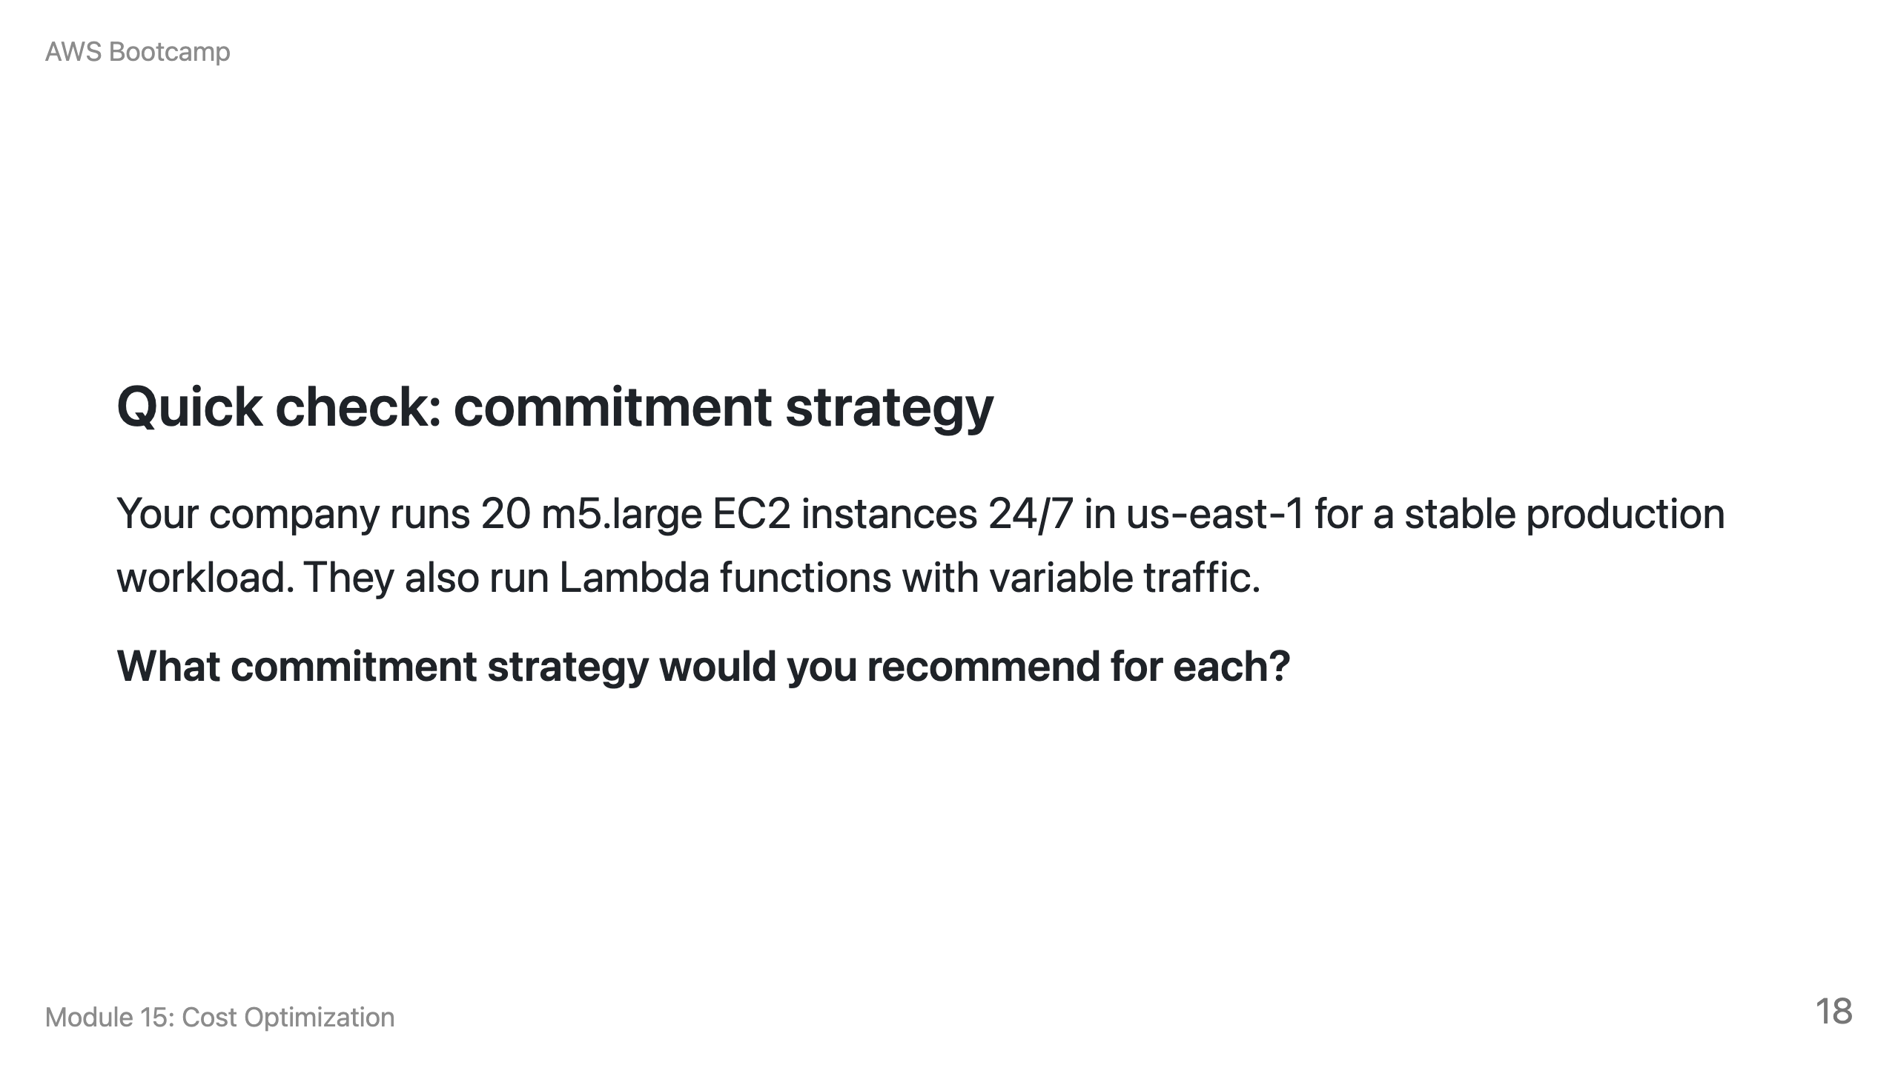
Notes:
Speaker notes: Answer: EC2 Instance Savings Plan for the m5.large instances (highest discount for a stable, known instance family). Compute Savings Plan for Lambda (flexible, applies to variable serverless usage). Start with a conservative commitment covering 70% of baseline EC2 usage and increase over time. Do not use RIs for Lambda (not supported).

Slide 19
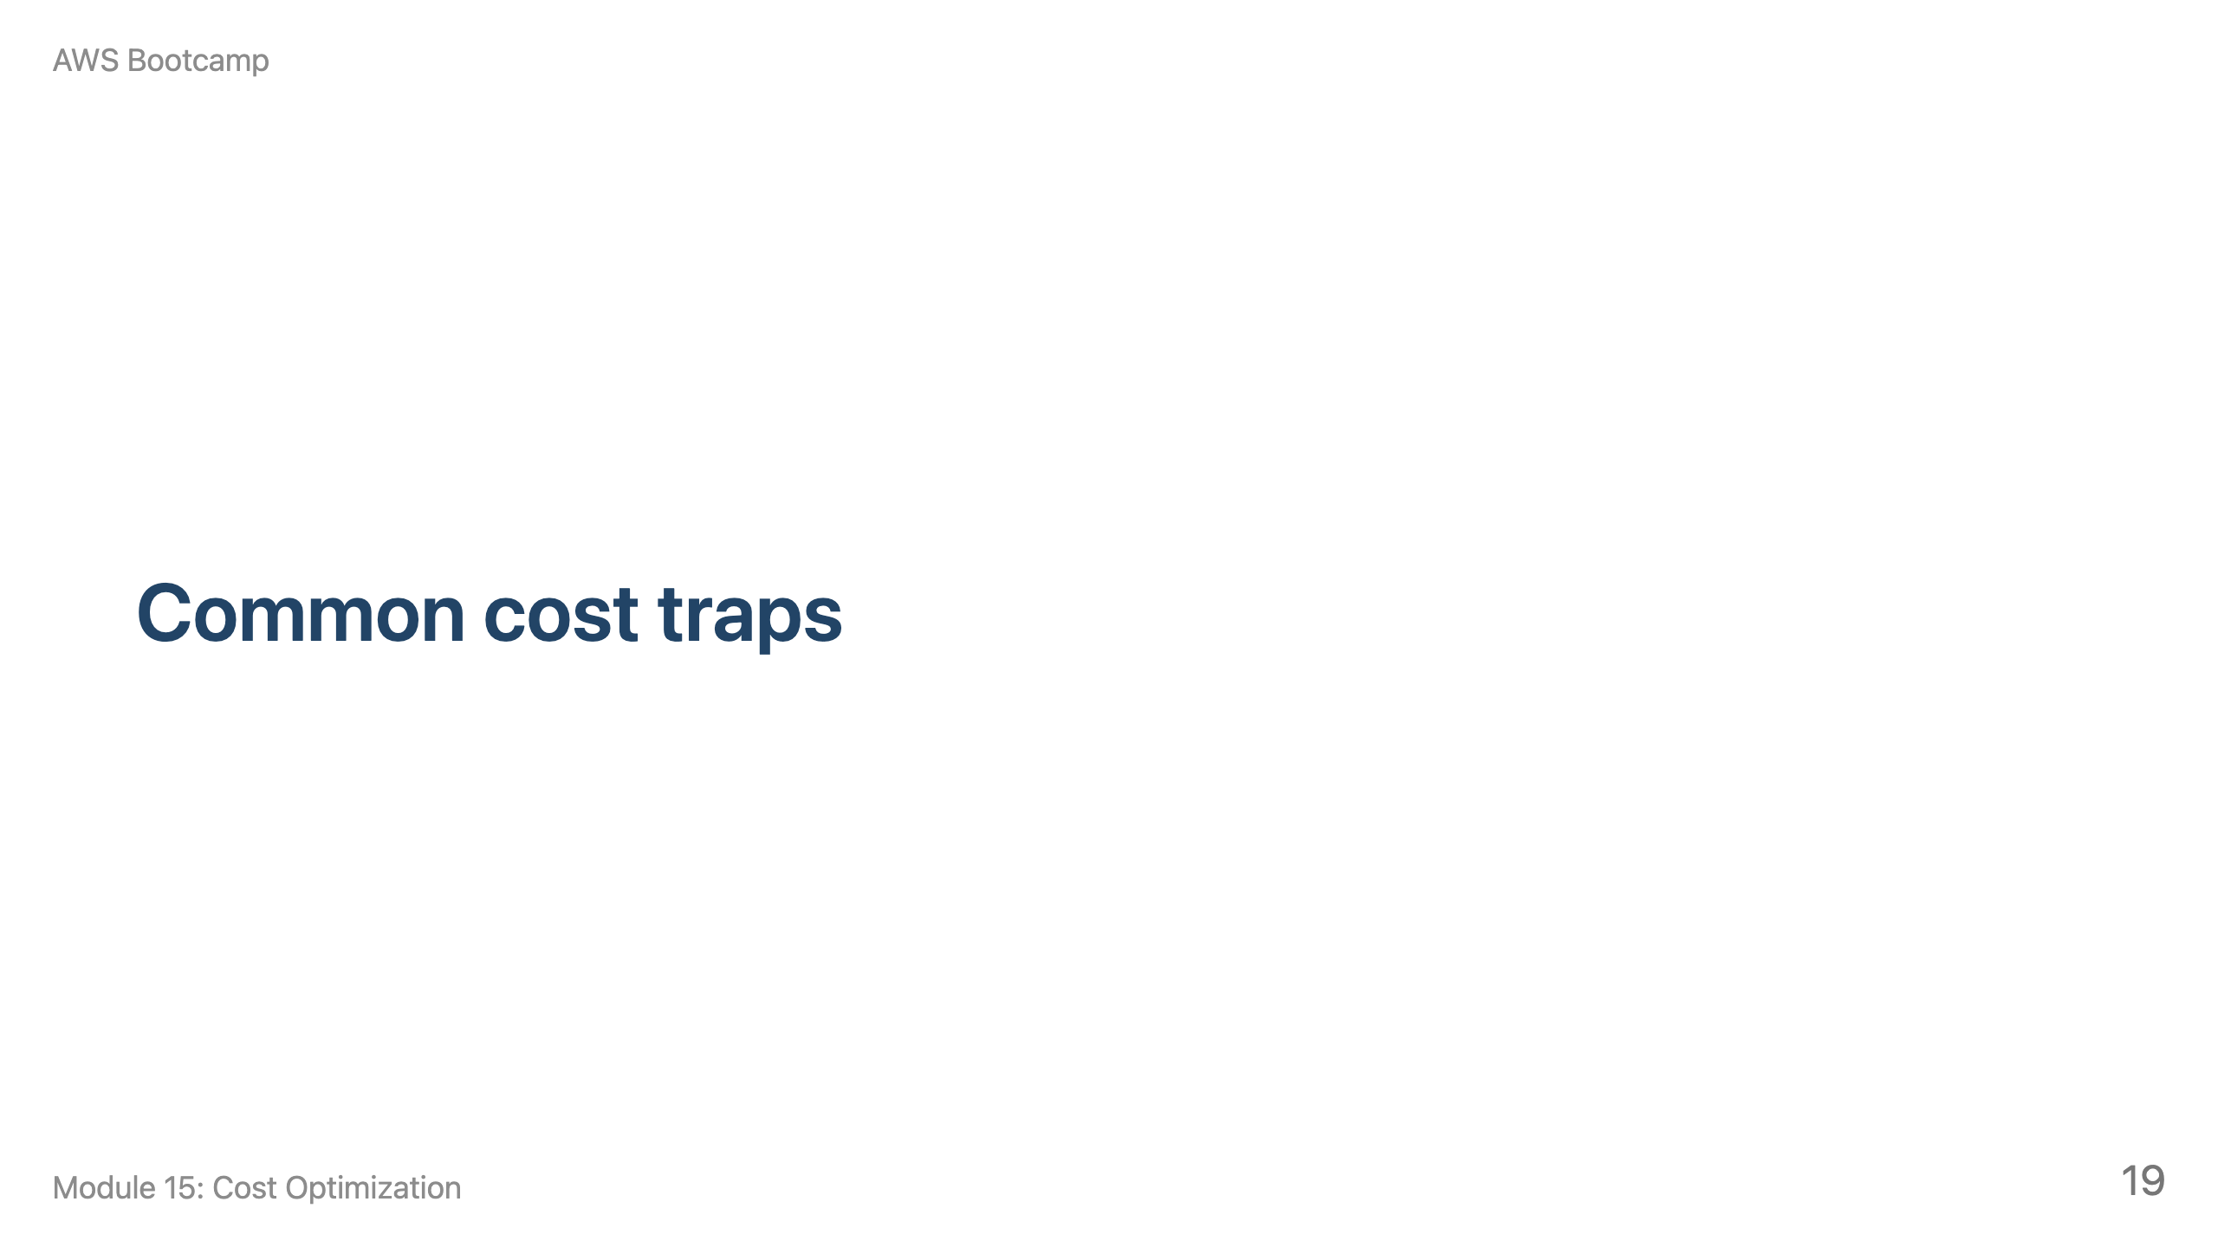
Notes:
Speaker notes: This section takes about 10 minutes. Pause for a group exercise: give each team a mock Cost Explorer report and ask them to identify the top three optimization opportunities.

Slide 20
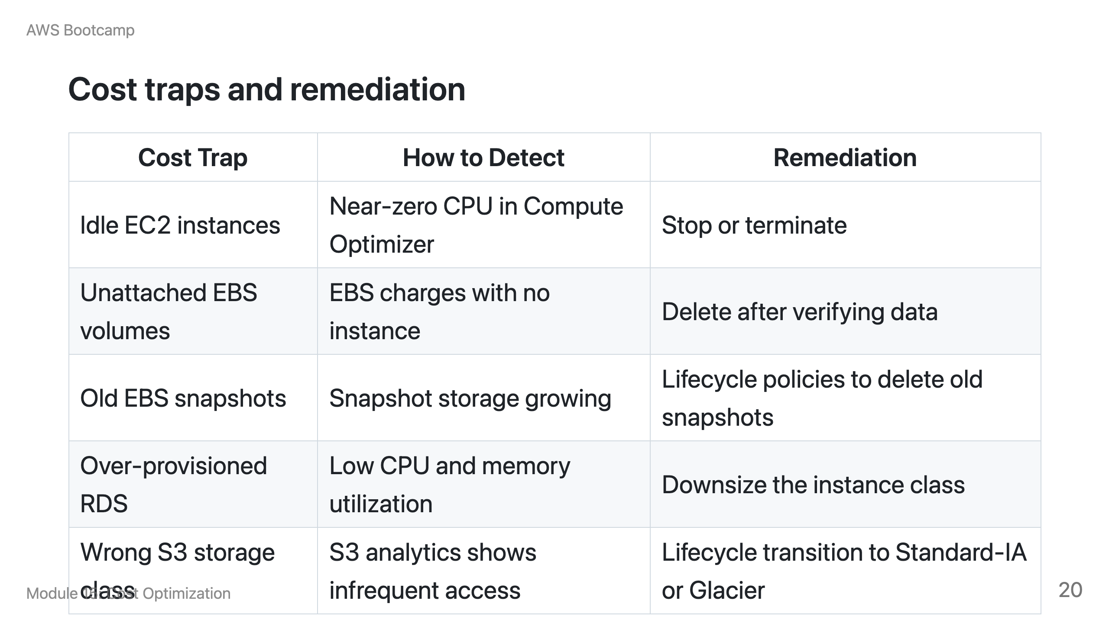

Slide 21
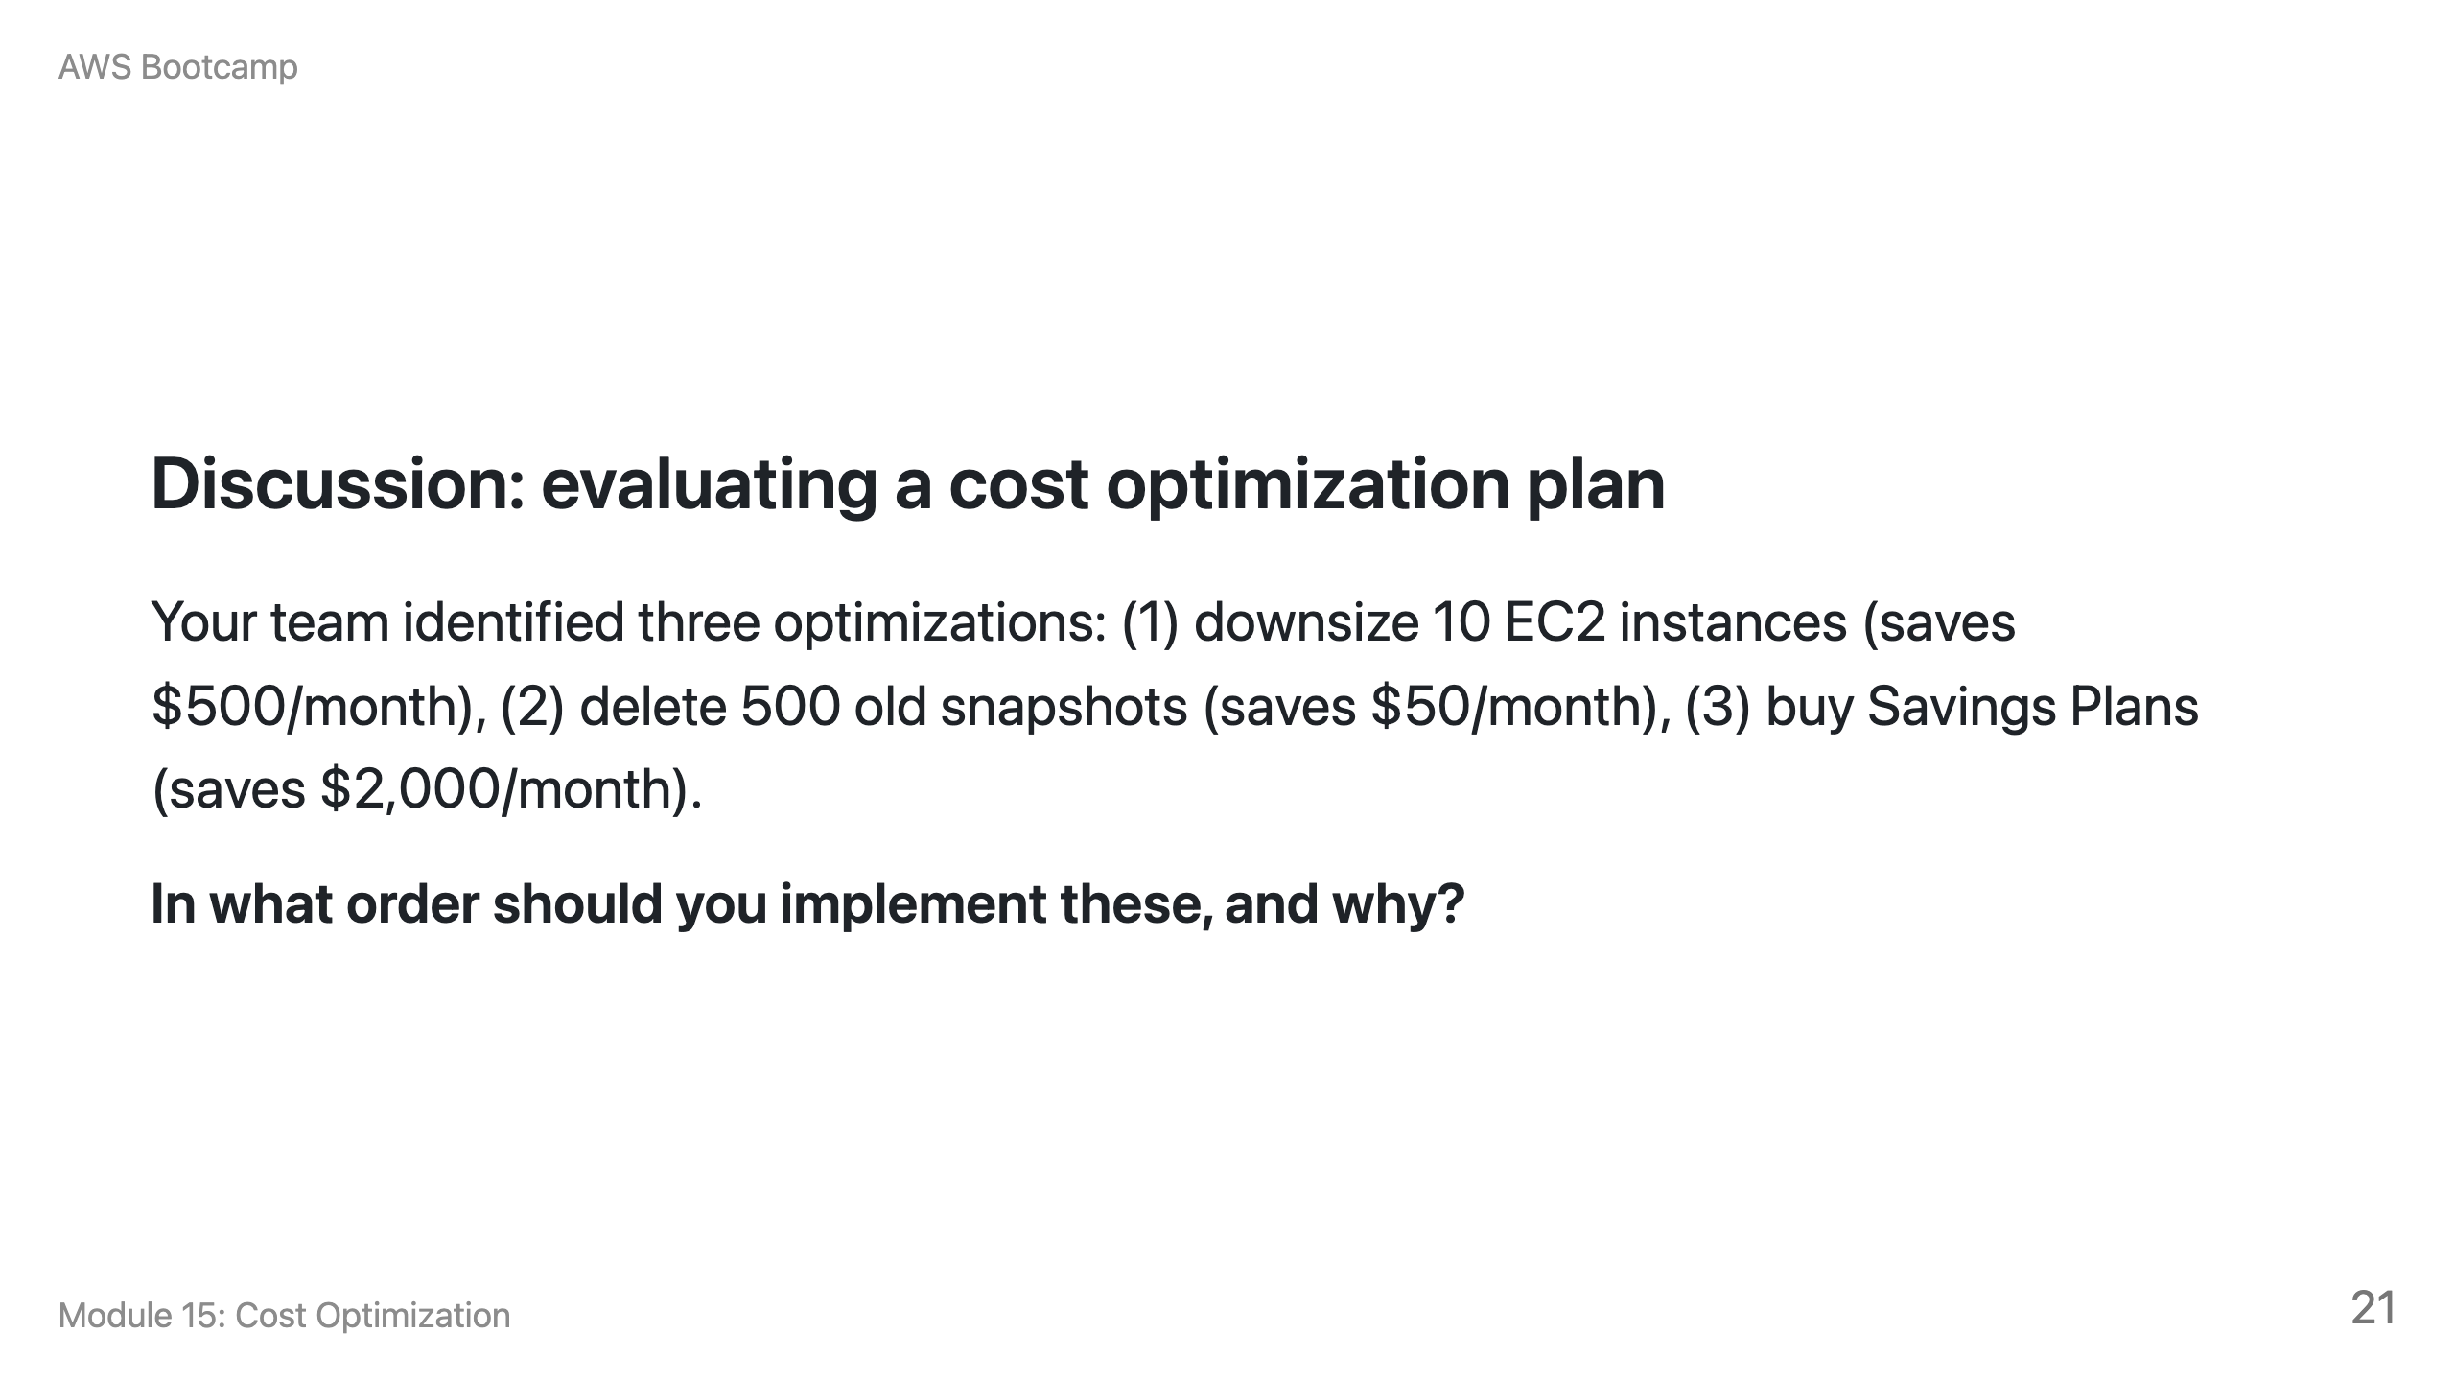
Notes:
Speaker notes: Expected answer: 1) Downsize EC2 first (right-size before committing). 2) Buy Savings Plans based on the optimized instance sizes. 3) Delete old snapshots (lowest impact, do anytime). The key insight is that committing to discounts before right-sizing locks in waste. Always right-size first.

Slide 22
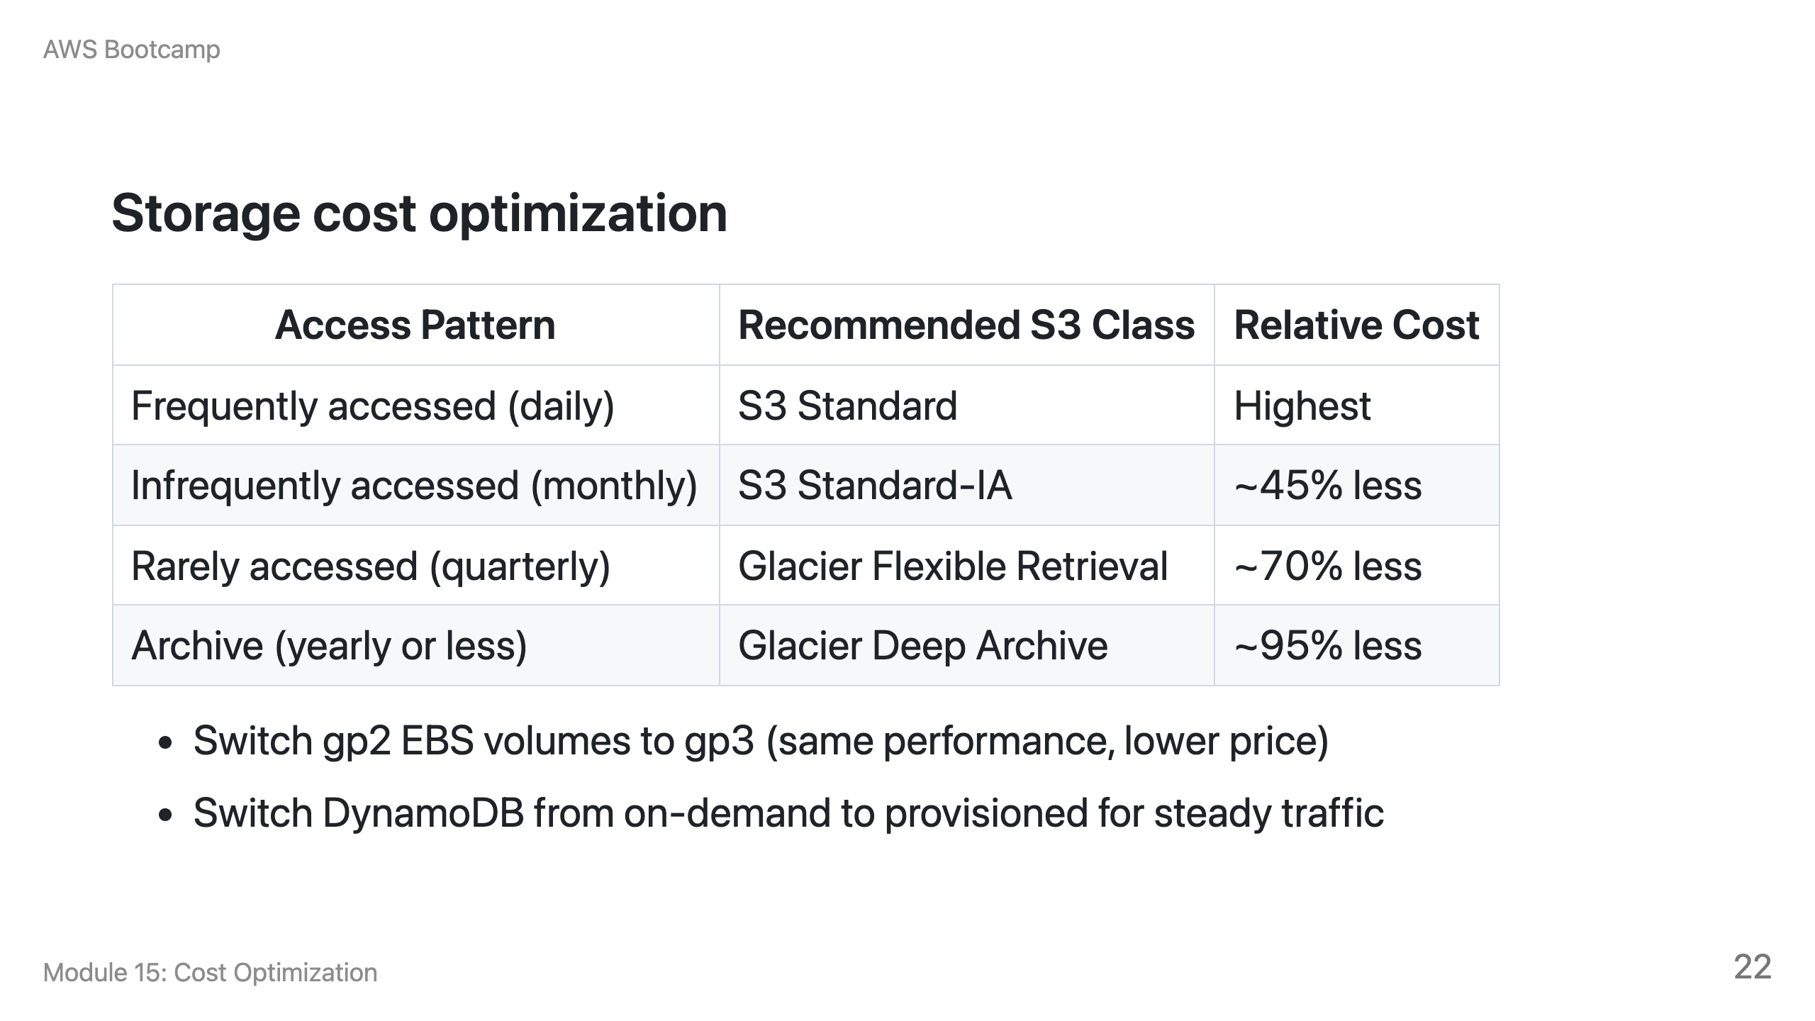

Slide 23
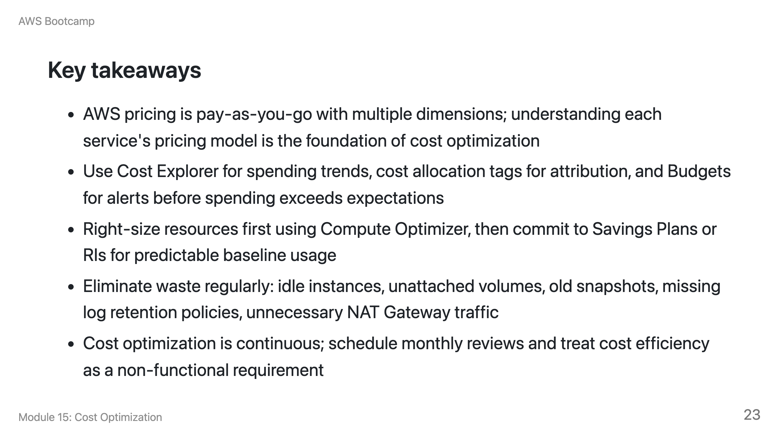

Slide 24
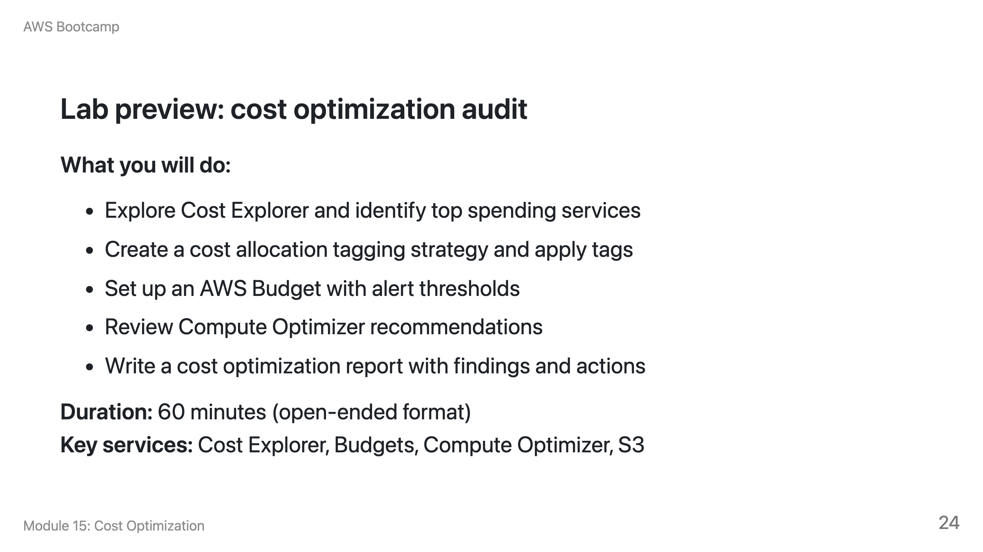
Notes:
Speaker notes: This is the first open-ended lab in the curriculum. Students receive goals and constraints, not step-by-step instructions. Deliverables include a cost optimization report, budget setup, and tagging audit. Encourage students to use the Pricing Calculator to estimate monthly costs.

Slide 25
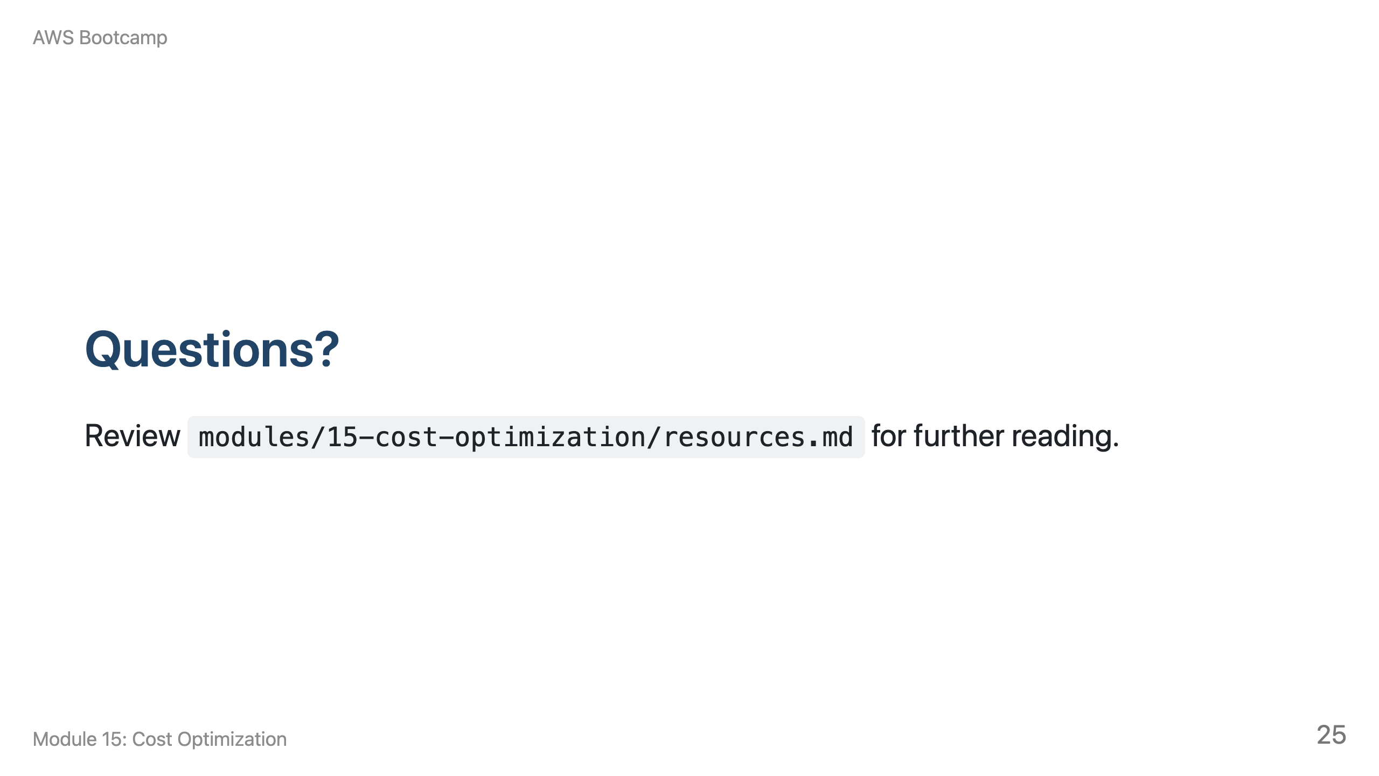
Notes:
Speaker notes: Take 5-10 minutes for questions. Common questions: "Is the Free Tier really free?" (Yes, within limits. Exceeding limits incurs standard charges. Common gotchas: running instances 24/7, creating resources in multiple Regions, forgetting cleanup.) "How much can I realistically save?" (20-40% for most organizations through right-sizing, commitments, and waste elimination.)

