Slide 1
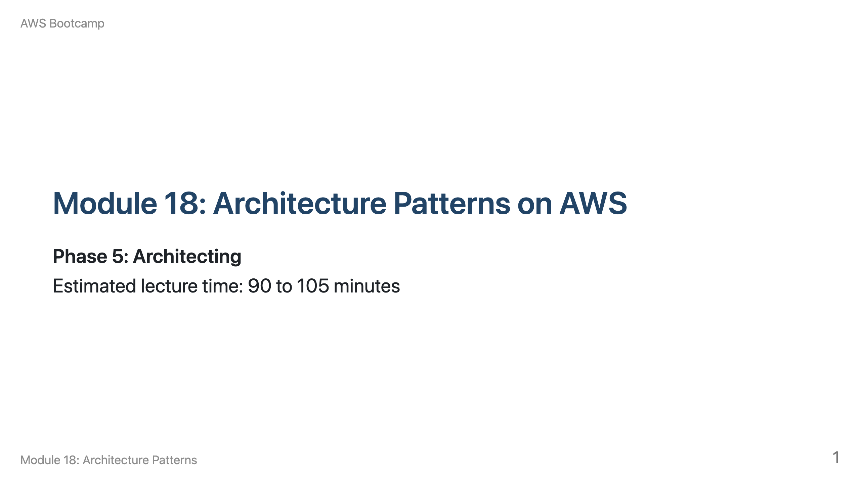
Notes:
Speaker notes: Welcome to Module 18. Start by presenting a scenario: "You are building an e-commerce platform. Walk me through the architecture." Let students propose services, then guide them toward appropriate patterns. Breakdown: 10 min monolith vs. microservices, 10 min three-tier, 10 min serverless API, 15 min event-driven, 10 min static+API, 10 min data pipeline, 10 min CQRS, 10 min strangler fig, 5 min wrap-up.

Slide 2
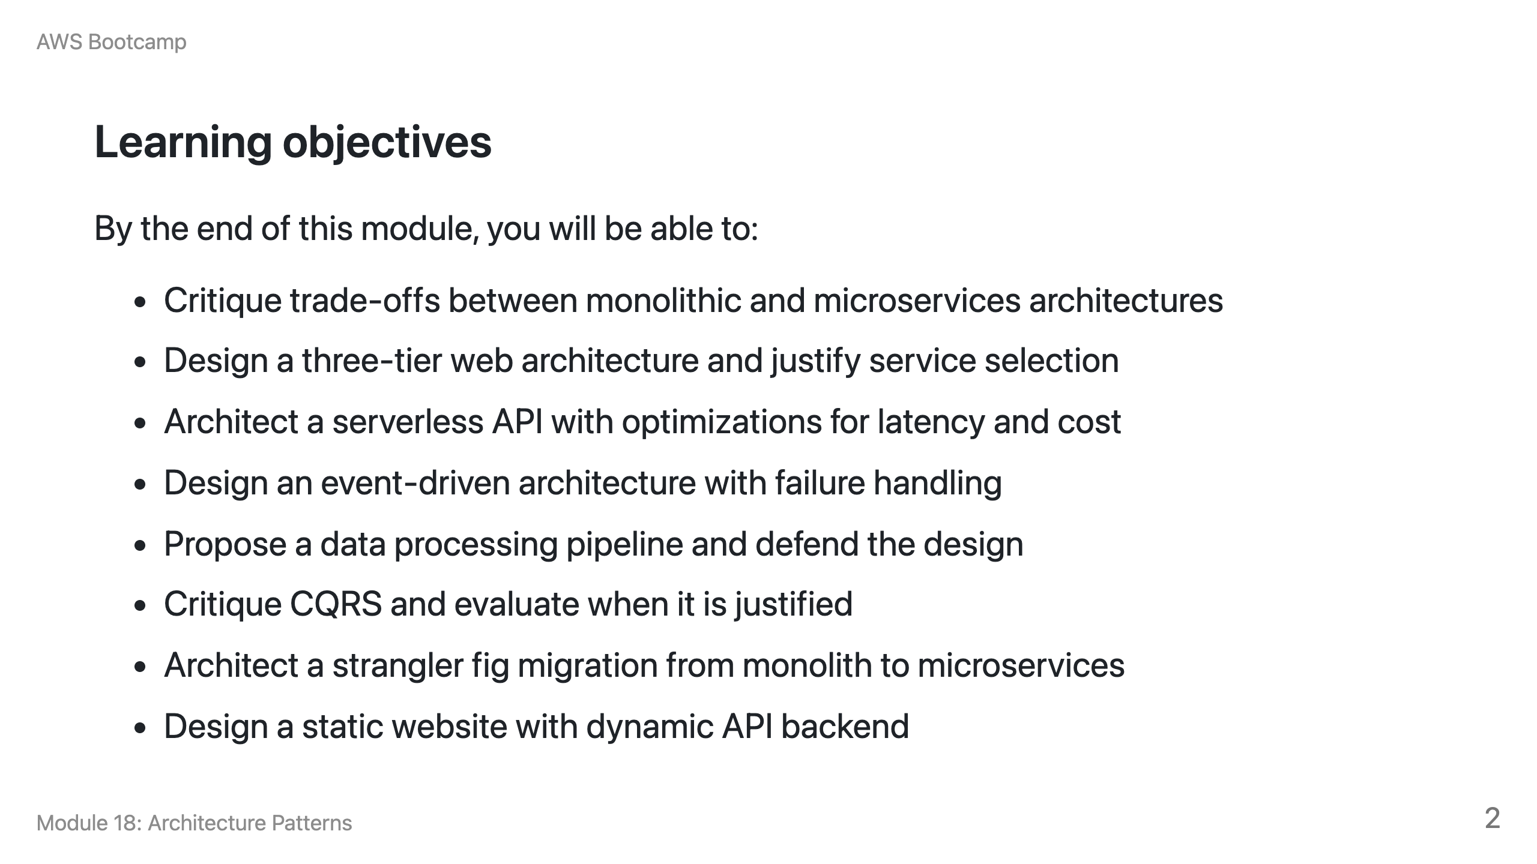

Slide 3
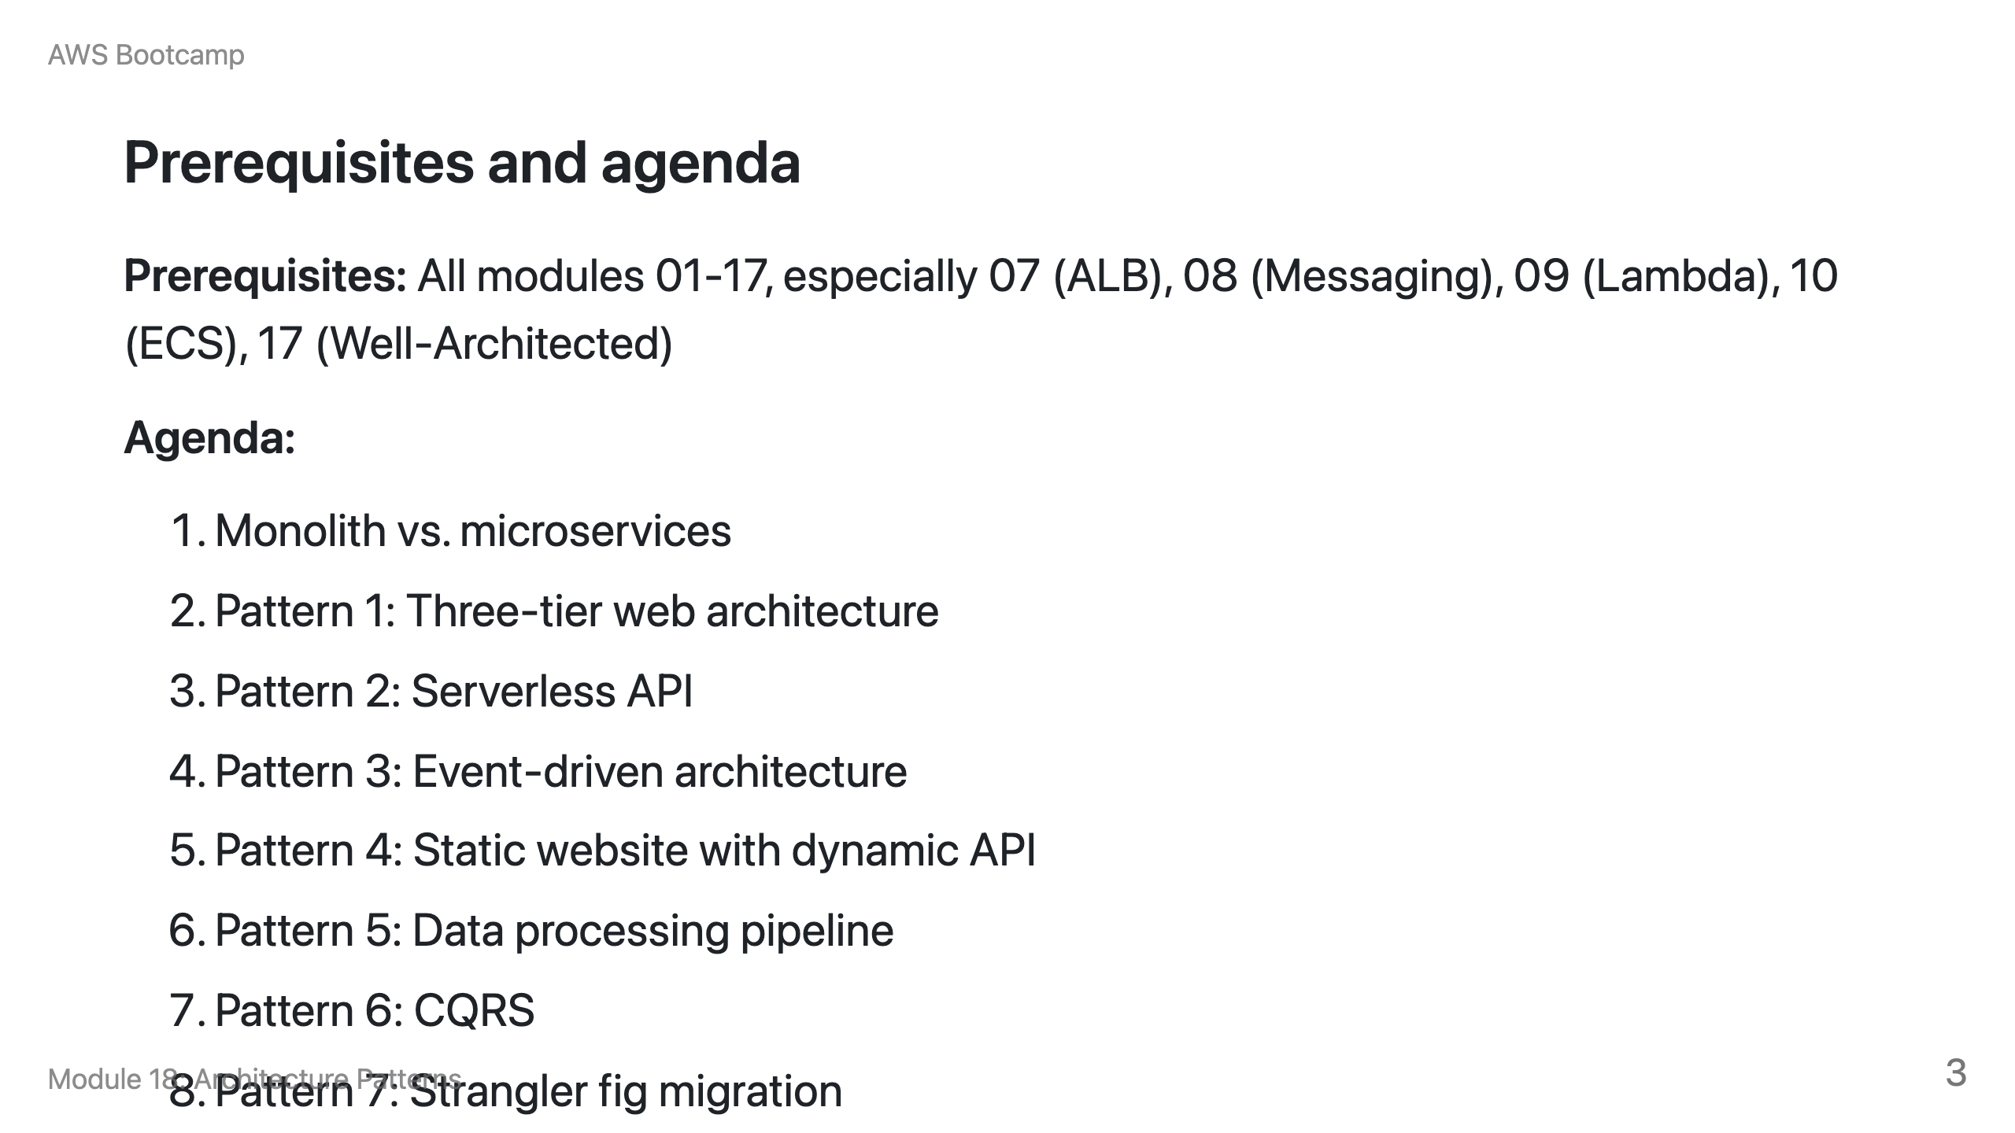

Slide 4
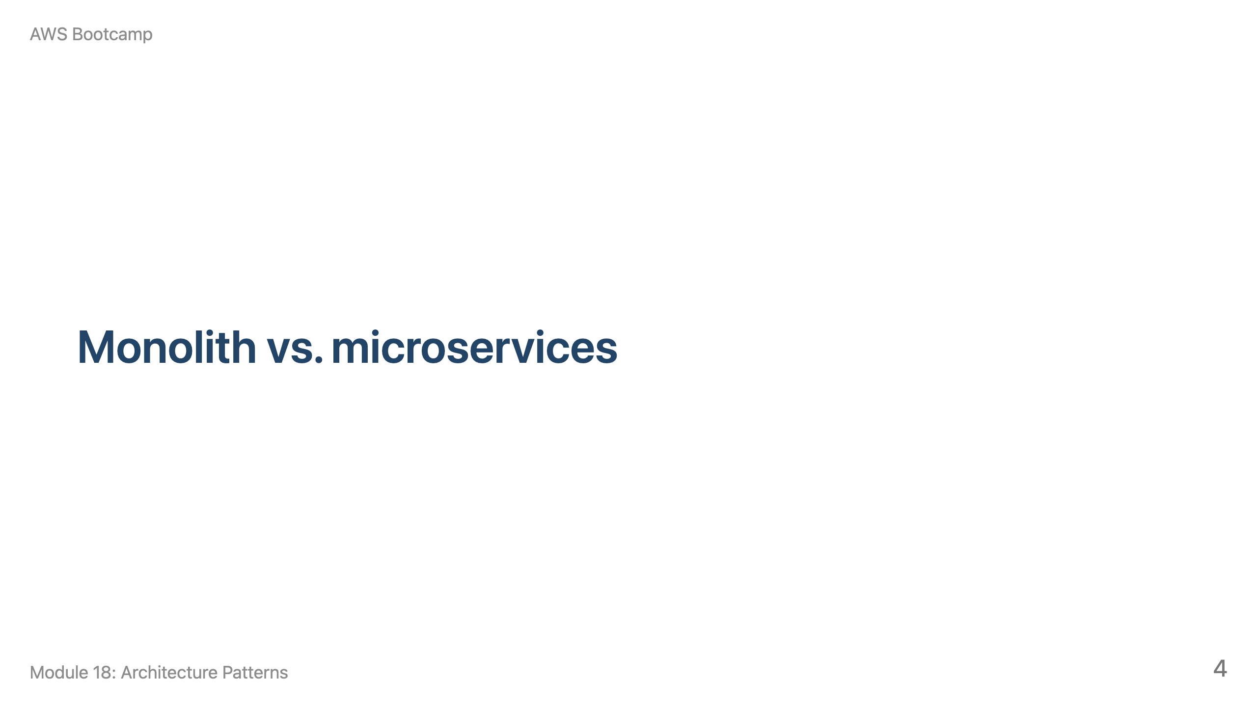
Notes:
Speaker notes: This section takes about 10 minutes. Emphasize that the decision should be driven by organizational needs, not technology trends.

Slide 5
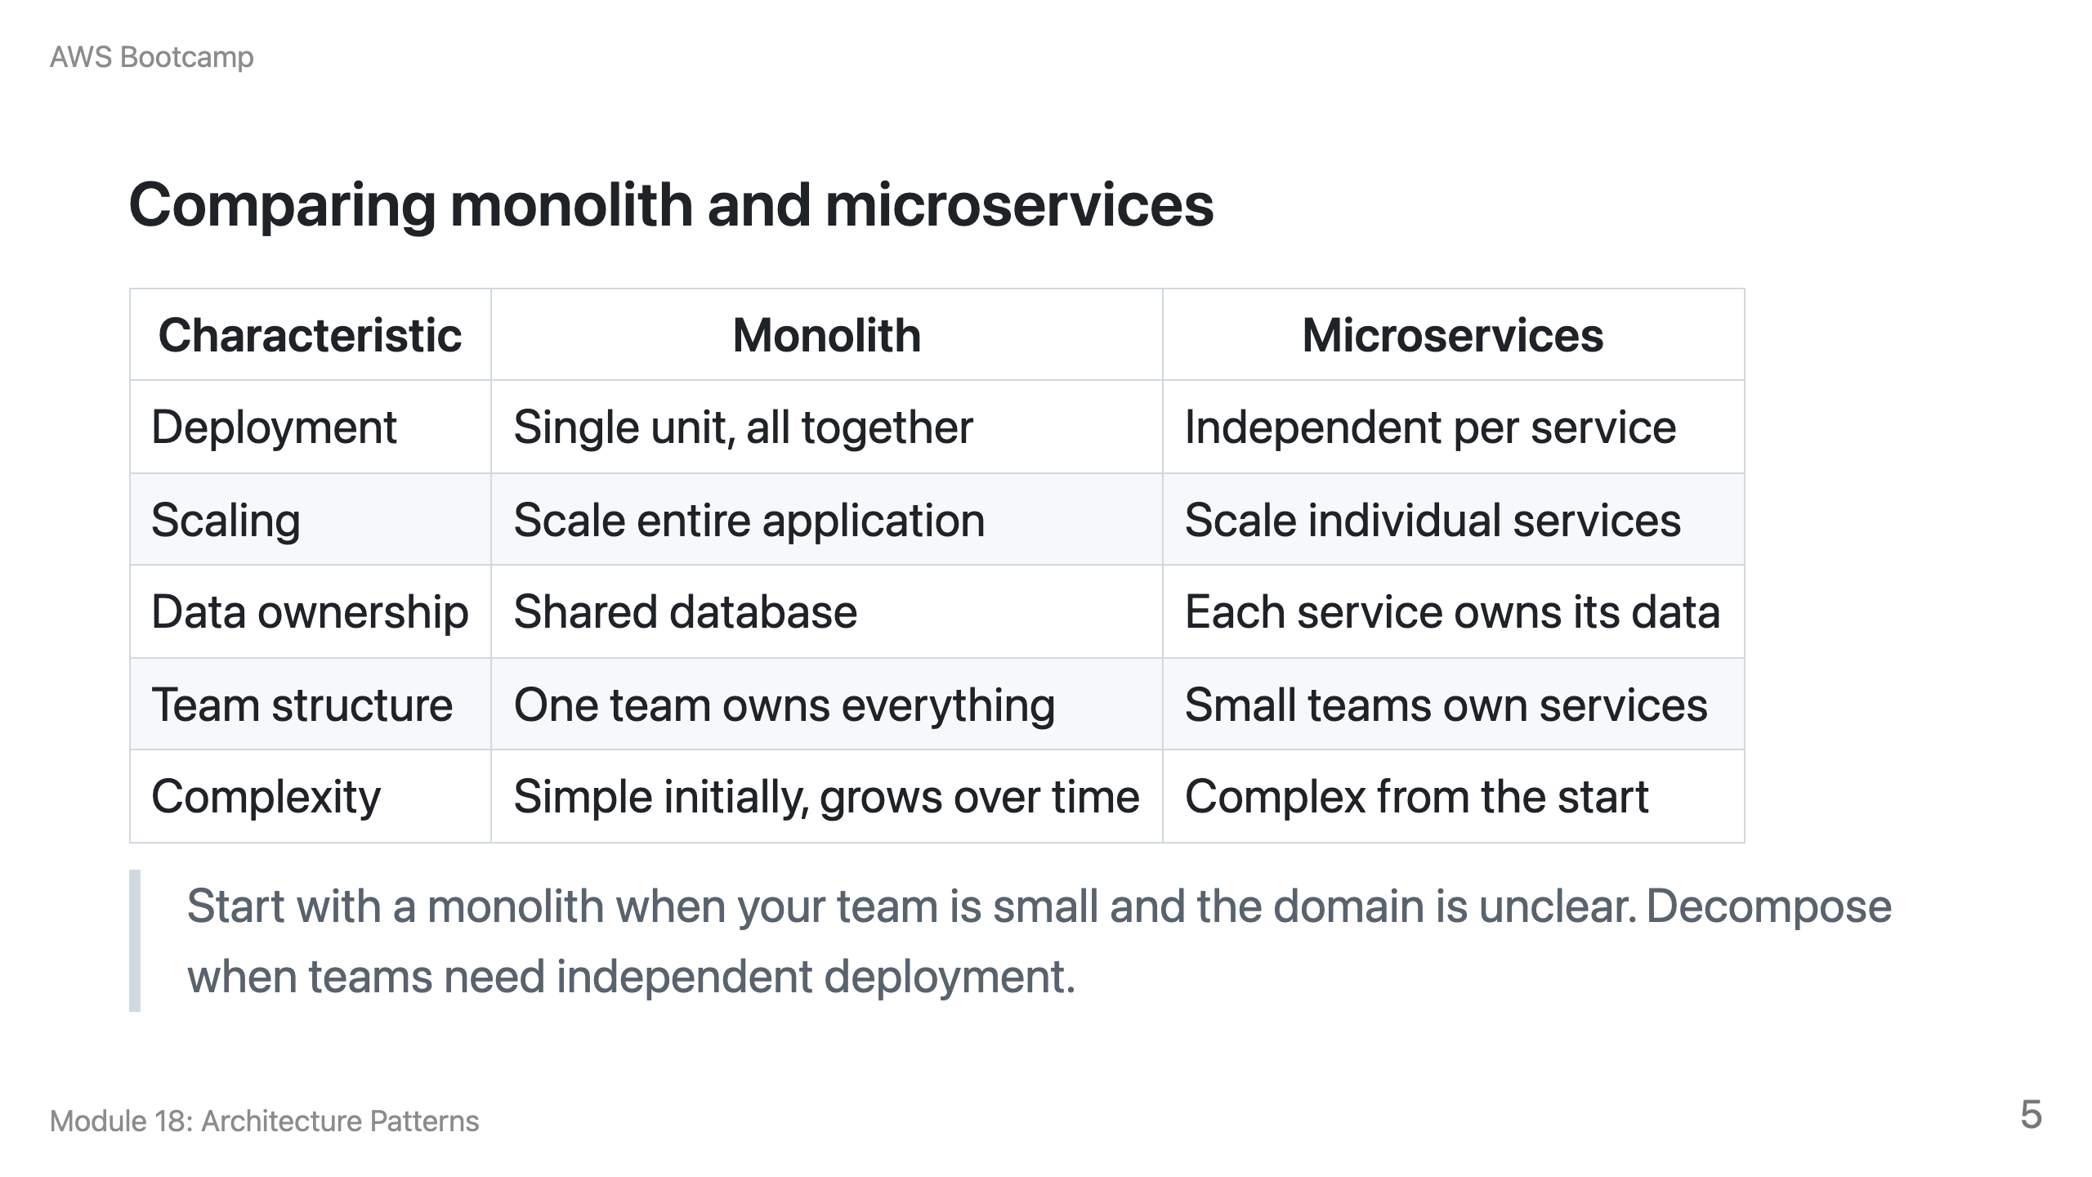

Slide 6
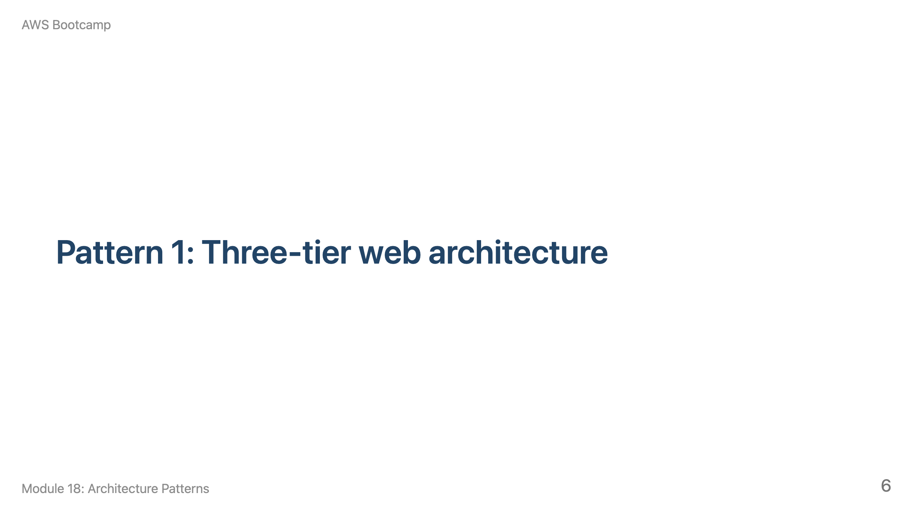
Notes:
Speaker notes: This section takes about 10 minutes. Draw the architecture on the whiteboard first, then discuss service choices.

Slide 7
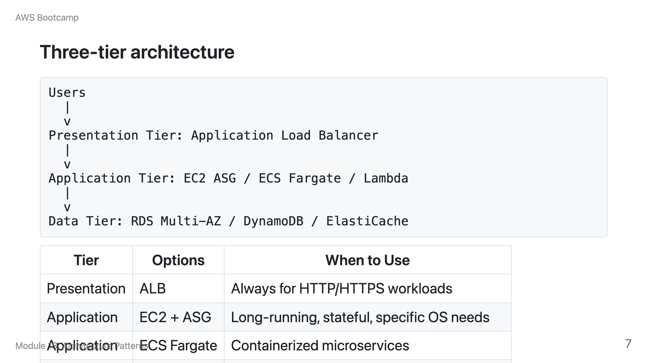

Slide 8
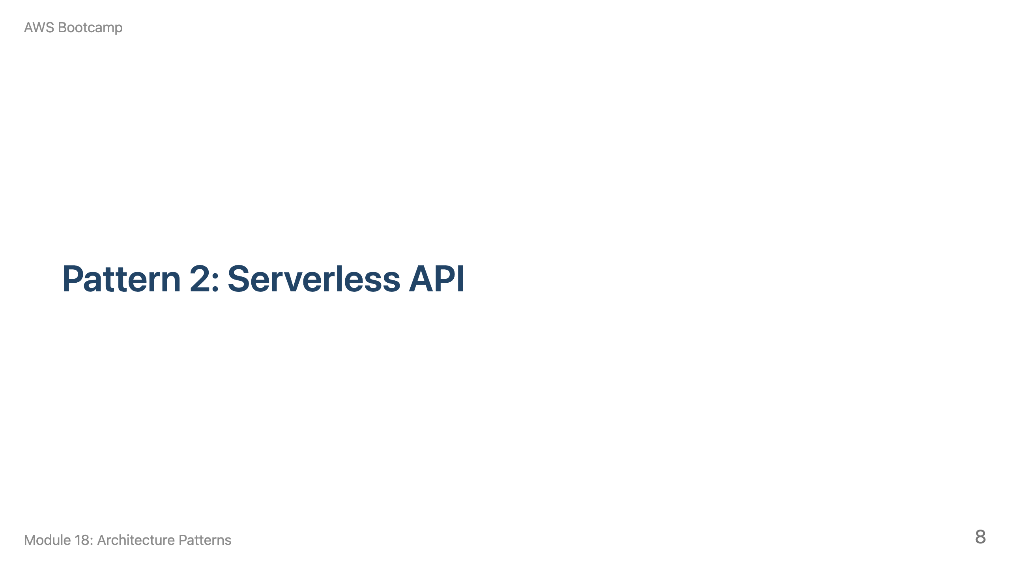
Notes:
Speaker notes: This section takes about 10 minutes. Students built this in Module 09. Now discuss production optimizations.

Slide 9
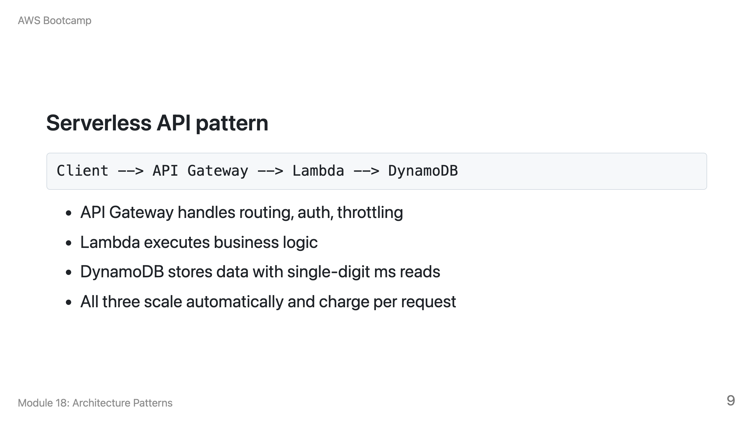

Slide 10
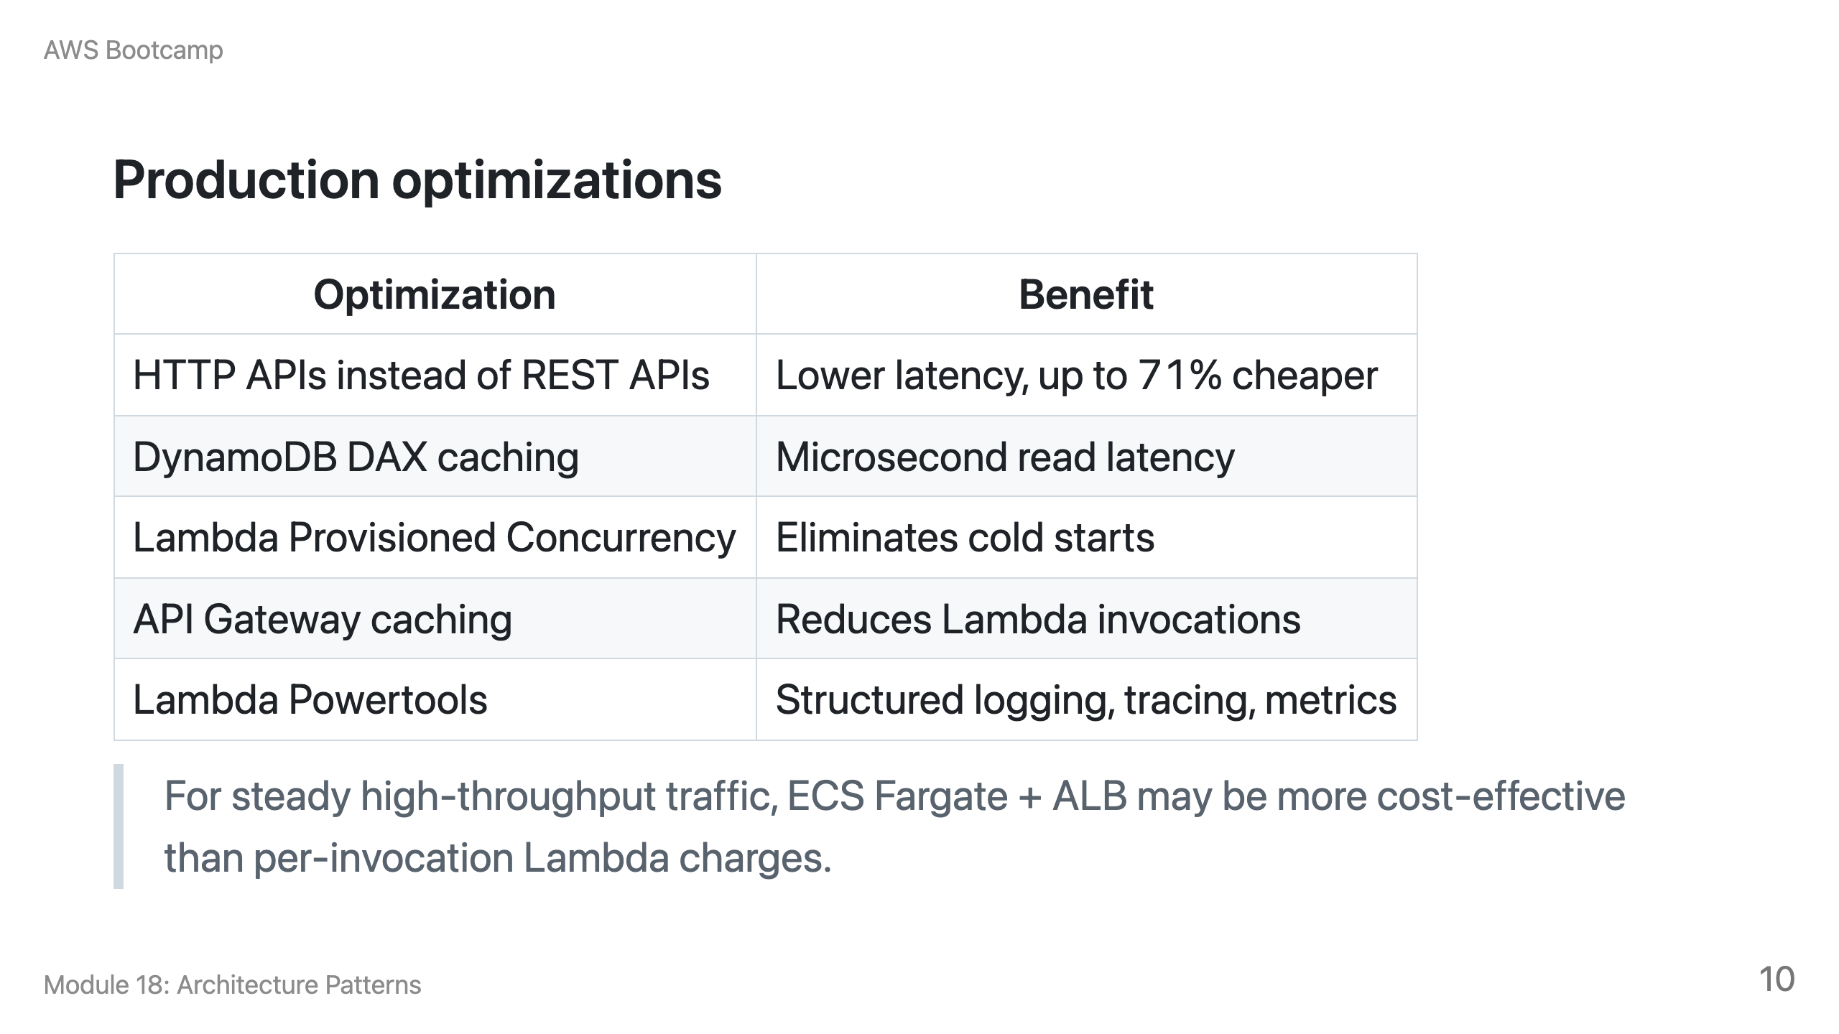

Slide 11
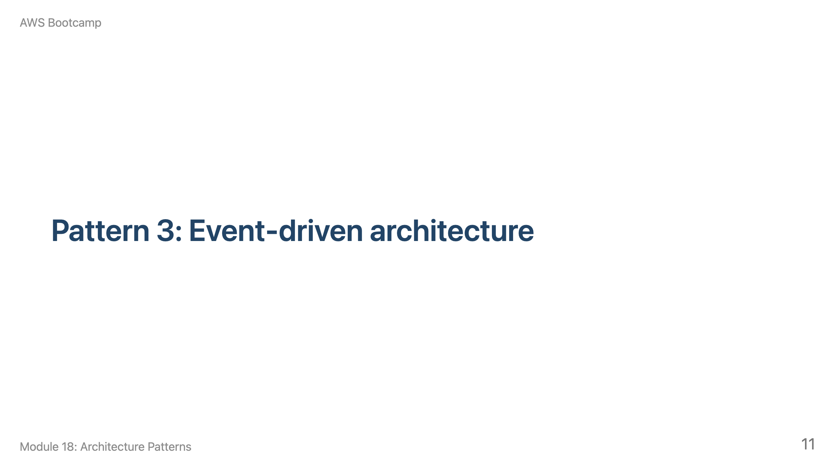
Notes:
Speaker notes: This section takes about 15 minutes. Pause for a group exercise: give each team a scenario and ask them to design an event-driven architecture.

Slide 12
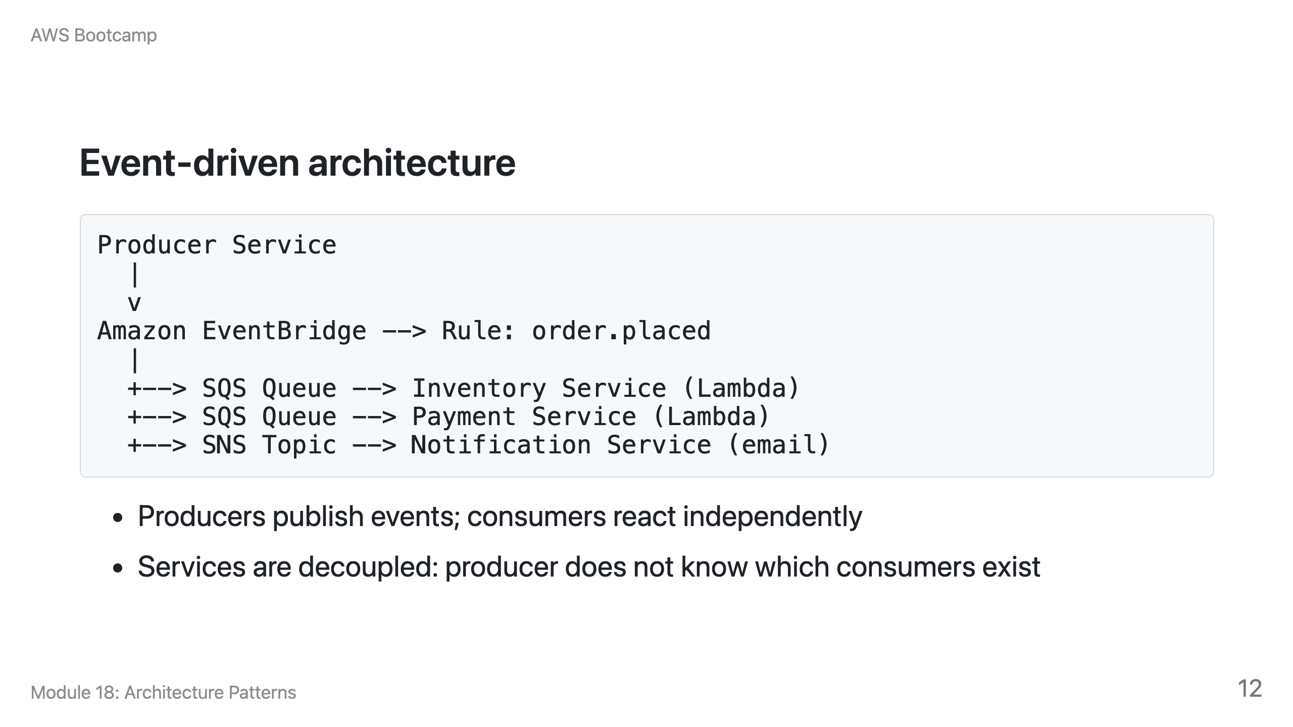

Slide 13
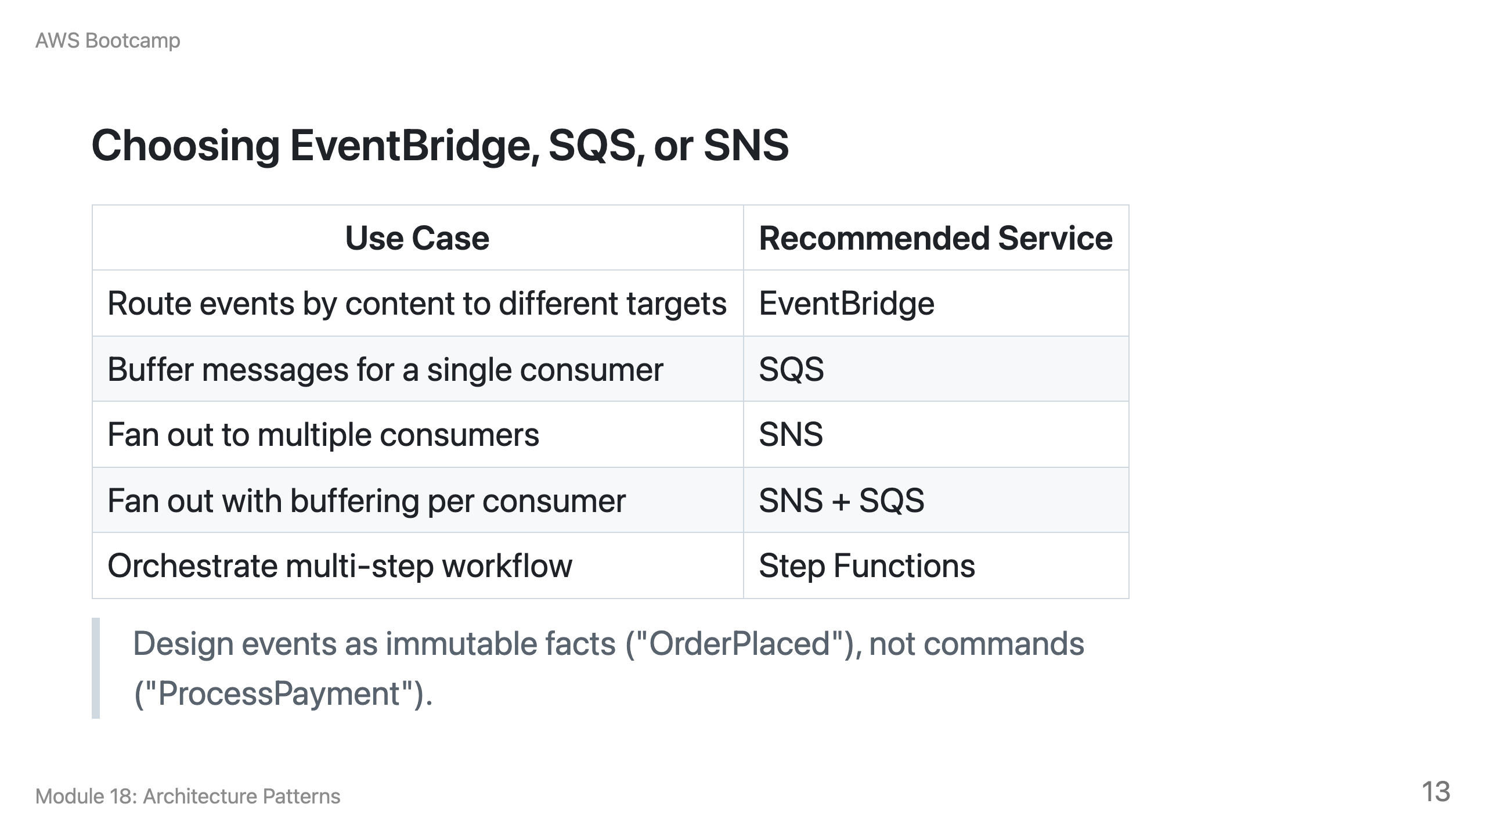

Slide 14
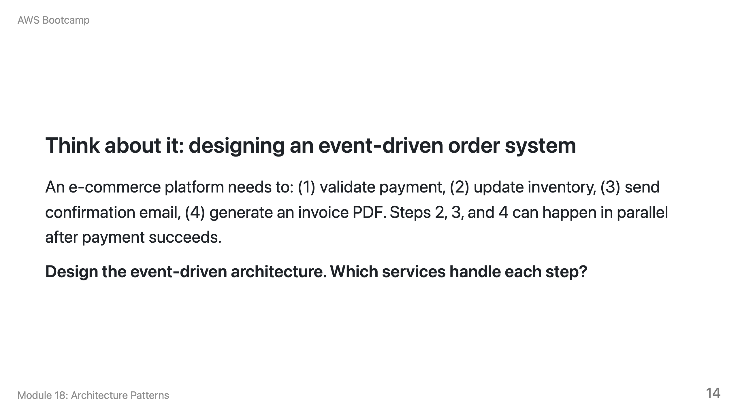
Notes:
Speaker notes: Expected answer: Order placed event published to EventBridge. Rule triggers Step Functions for payment validation (sequential). On payment success, Step Functions publishes PaymentProcessed event. EventBridge routes to: SQS queue for inventory Lambda, SNS for email notification, SQS queue for invoice Lambda. DLQs on each queue for failure handling. This exercises EventBridge routing, Step Functions orchestration, and SQS/SNS fan-out.

Slide 15
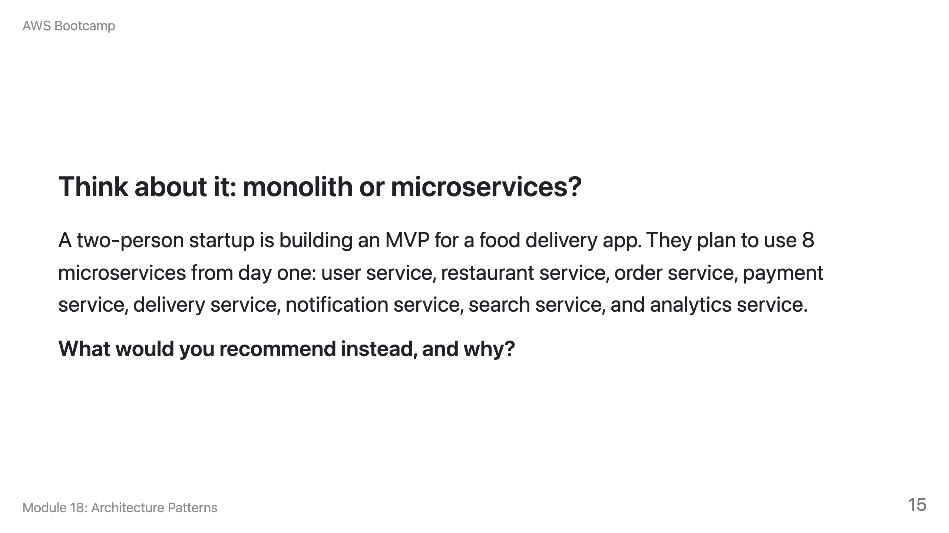
Notes:
Speaker notes: Expected answer: Start with a monolith (or modular monolith). Two developers cannot effectively build, deploy, and operate 8 independent services. The operational overhead (networking, service discovery, distributed tracing, independent deployments) would consume most of their time. Build the MVP as a single deployable unit, validate the product-market fit, then decompose using the strangler fig pattern when the team grows and specific components need independent scaling.

Slide 16
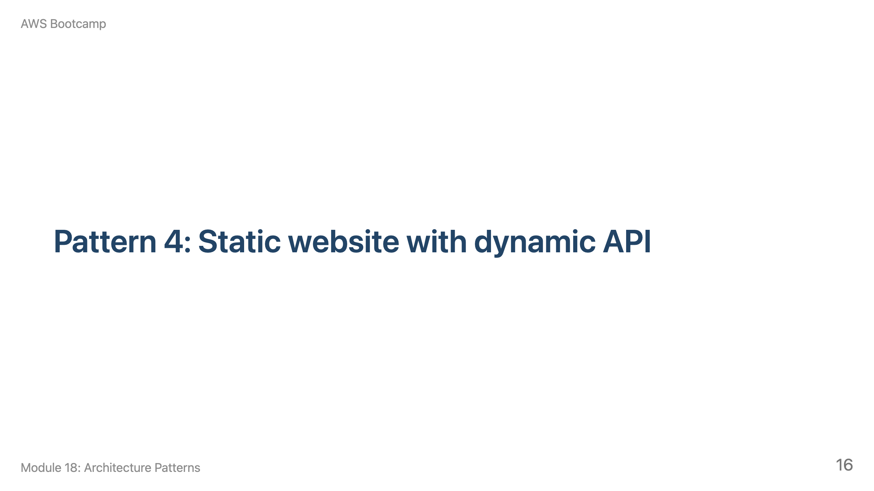
Notes:
Speaker notes: This section takes about 10 minutes. This combines S3 (Module 05) with the serverless API (Module 09) and CloudFront.

Slide 17
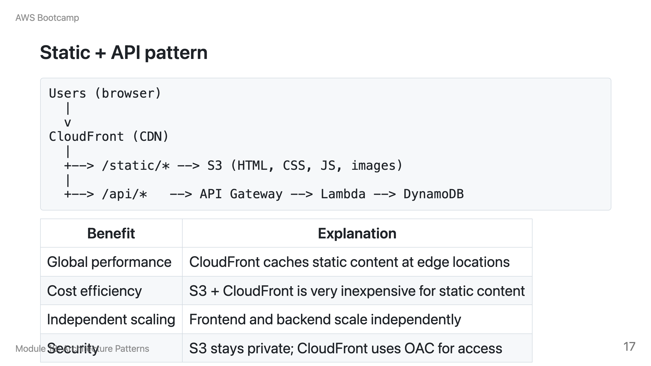

Slide 18
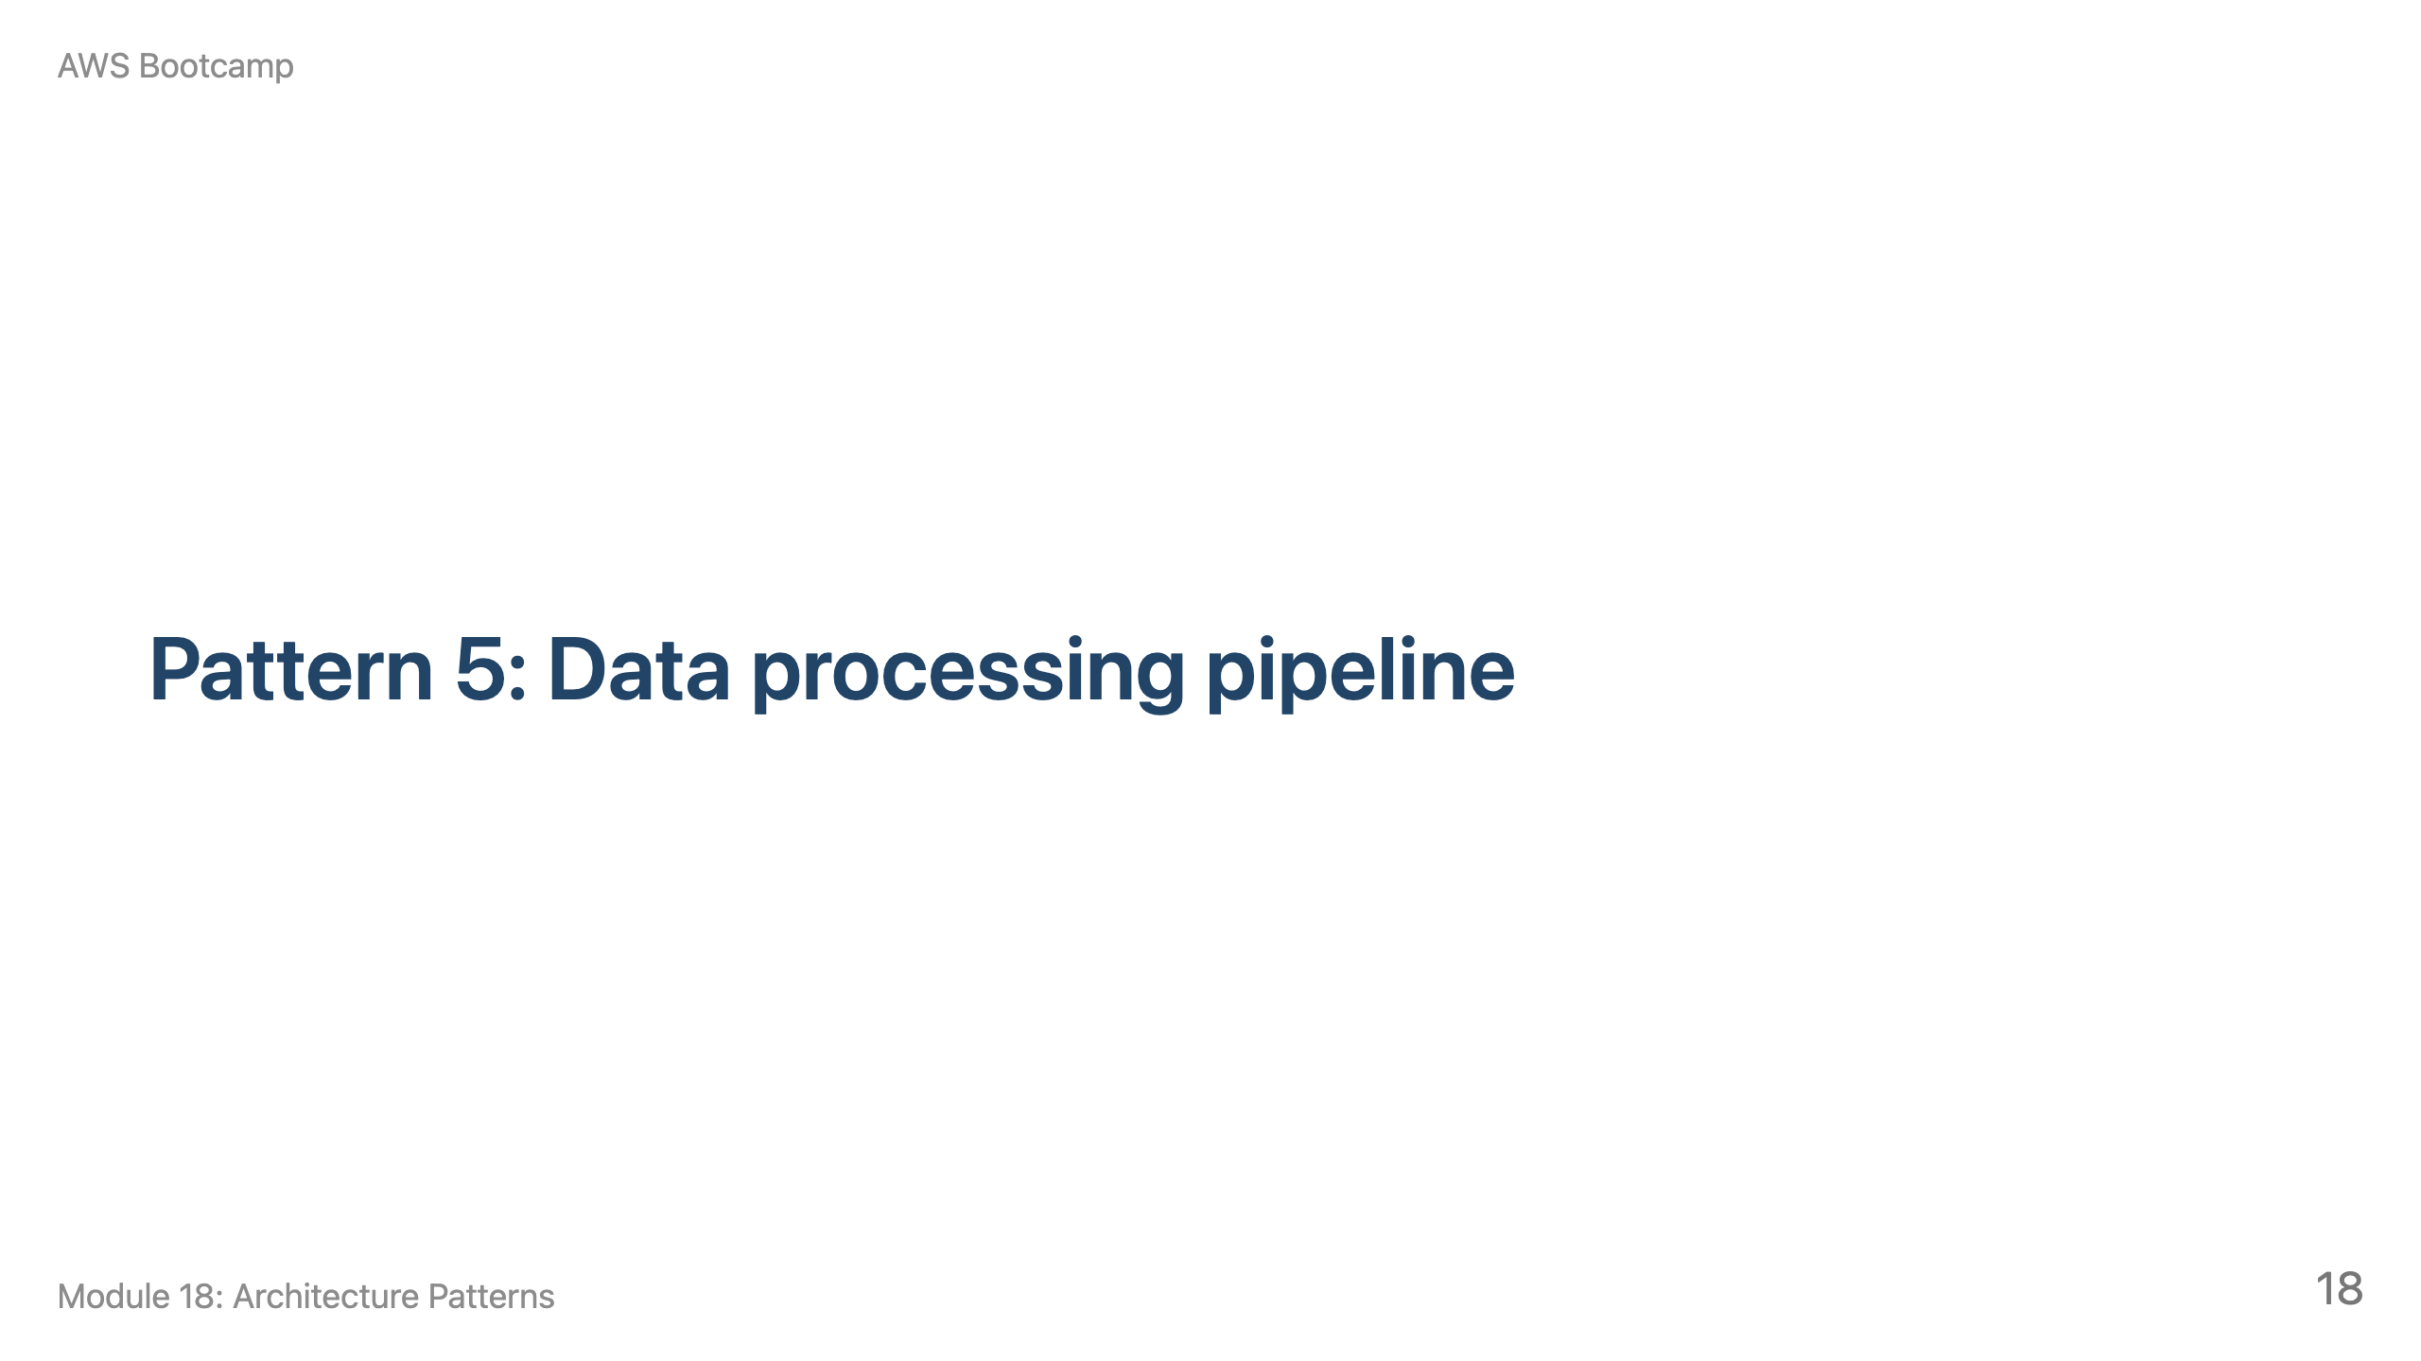
Notes:
Speaker notes: This section takes about 10 minutes. Cover the spectrum from small (Lambda) to large (Kinesis/Glue).

Slide 19
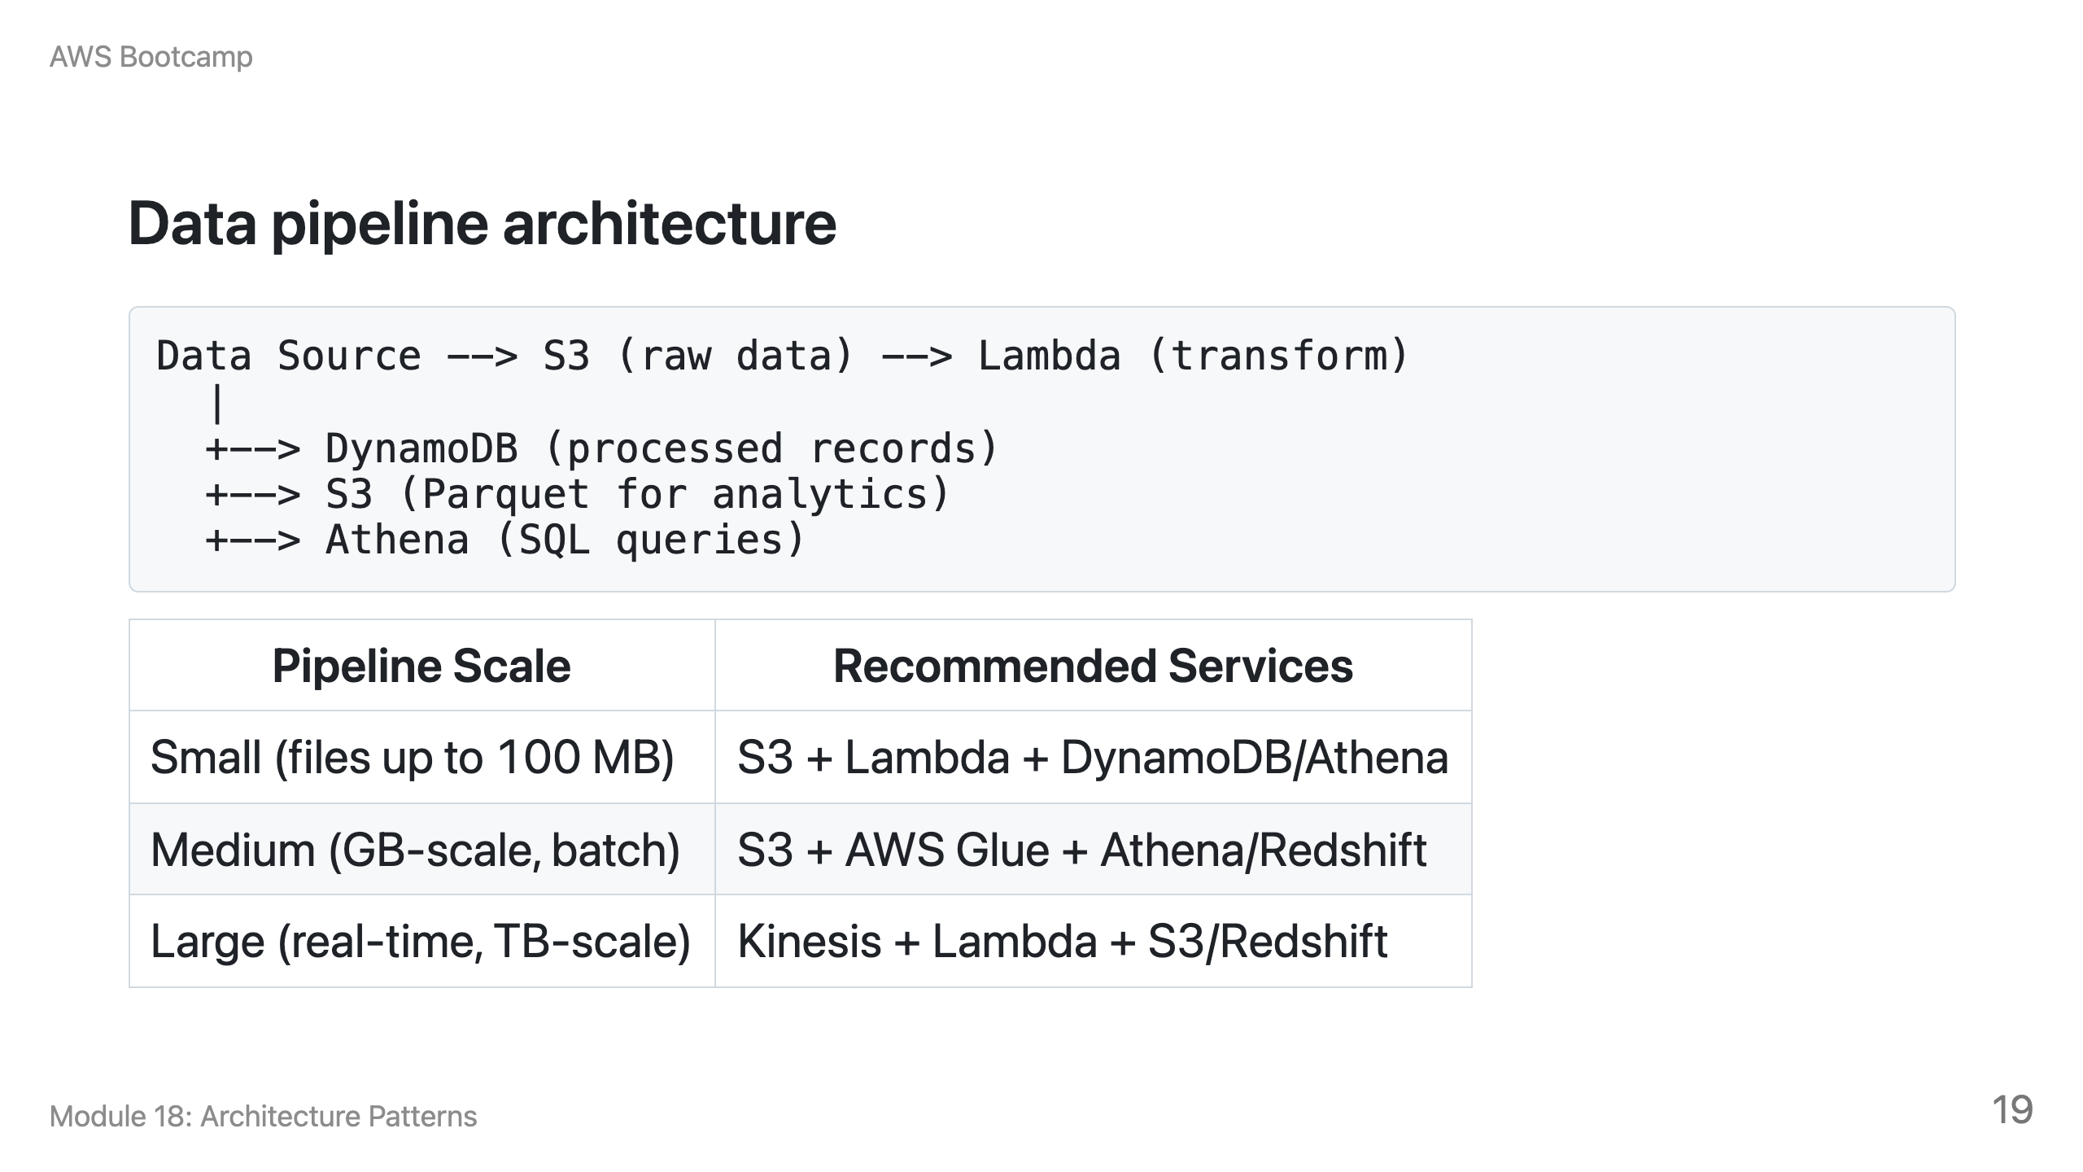

Slide 20
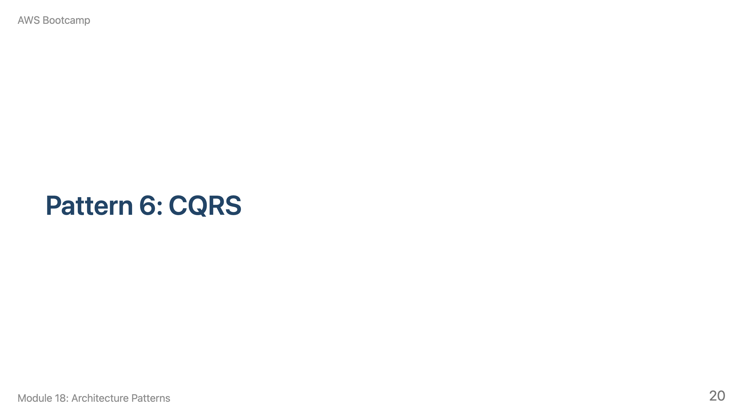
Notes:
Speaker notes: This section takes about 10 minutes. Emphasize that CQRS is overkill for most applications.

Slide 21
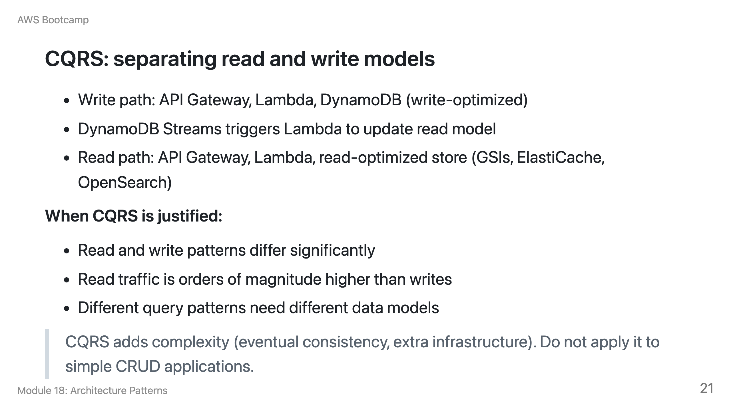

Slide 22
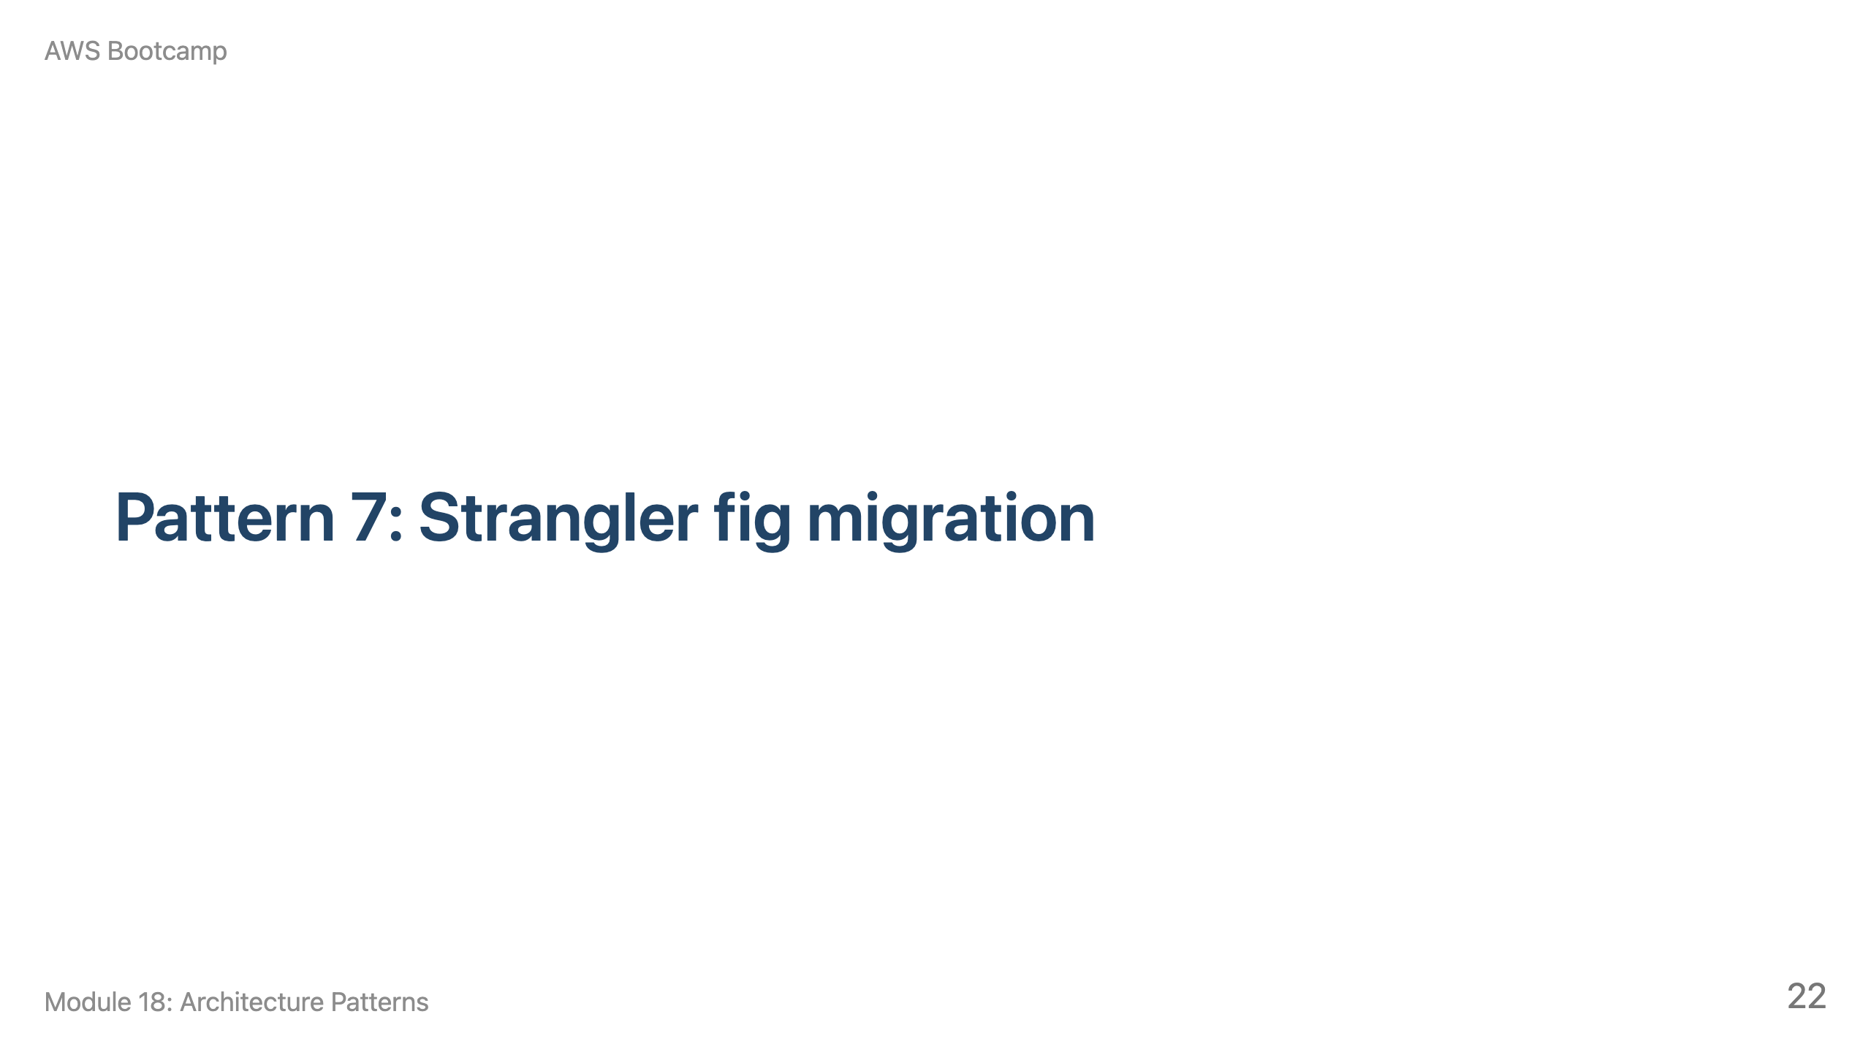
Notes:
Speaker notes: This section takes about 10 minutes. Walk through a concrete example: extracting the order management feature first because it changes weekly.

Slide 23
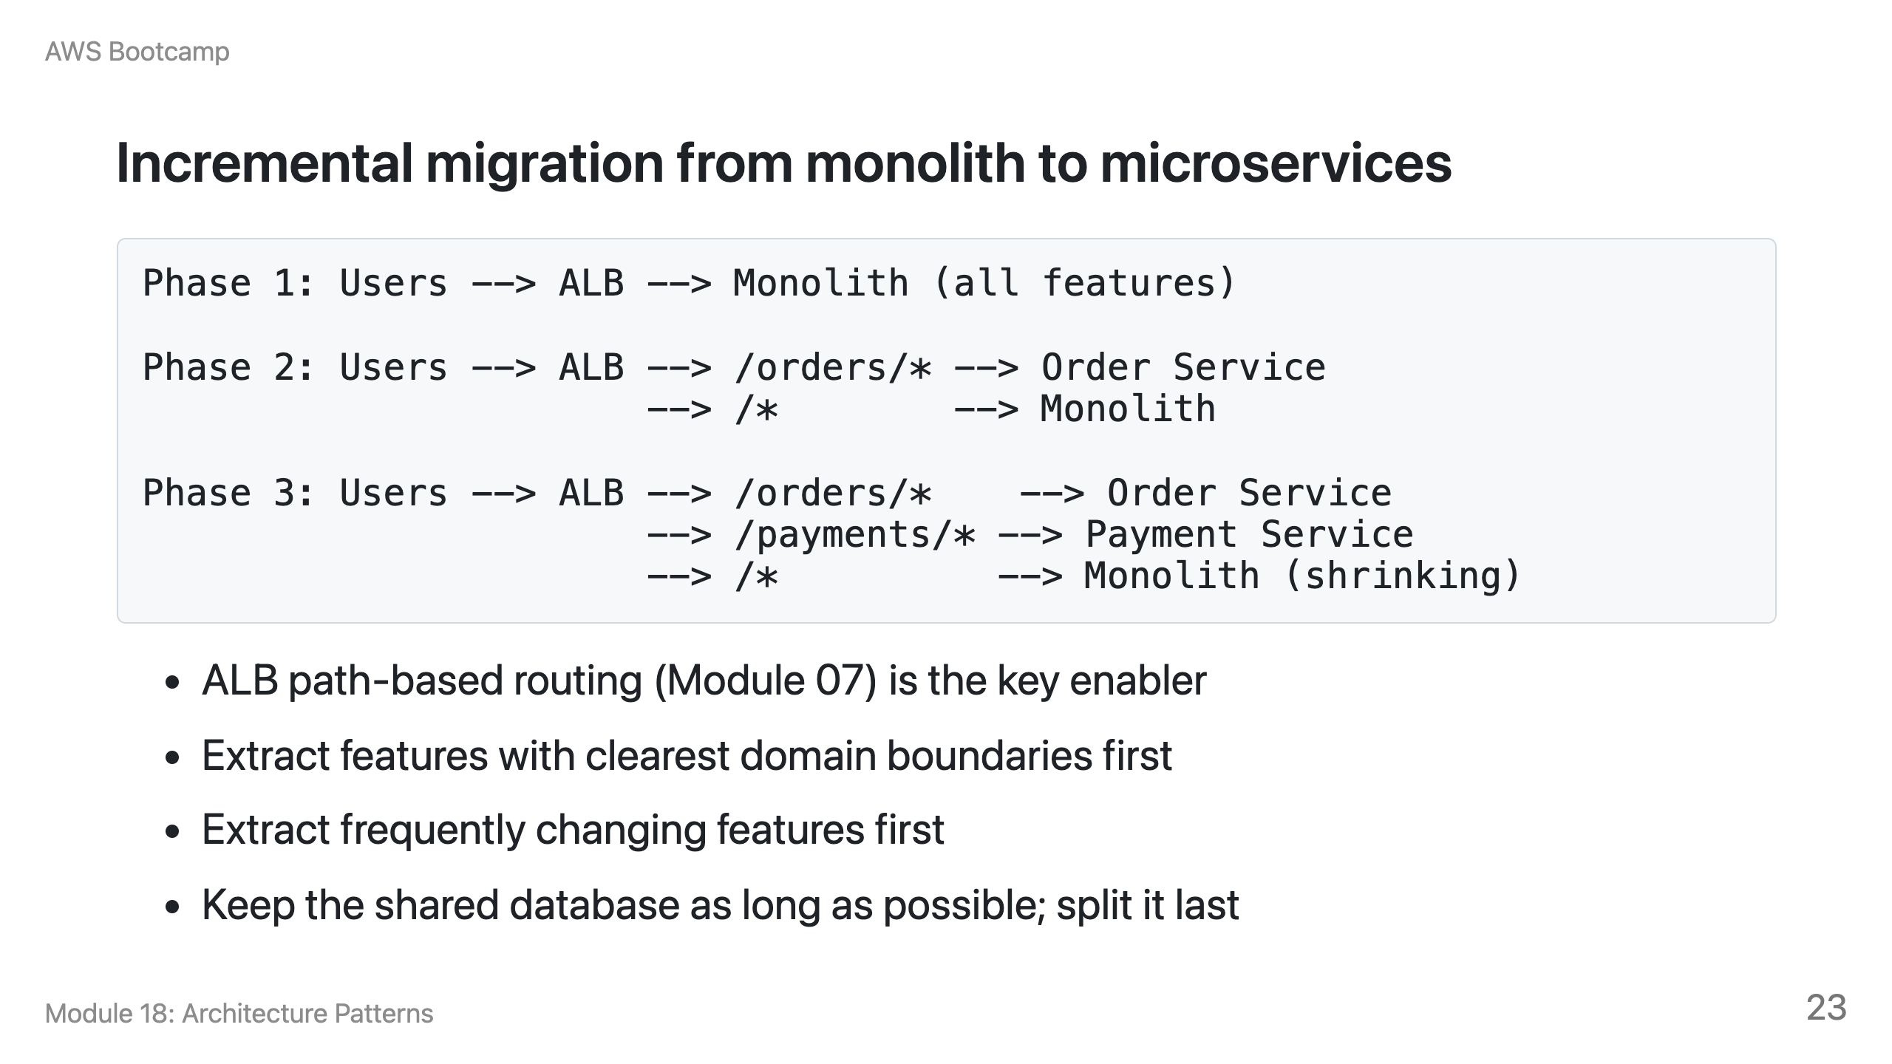

Slide 24
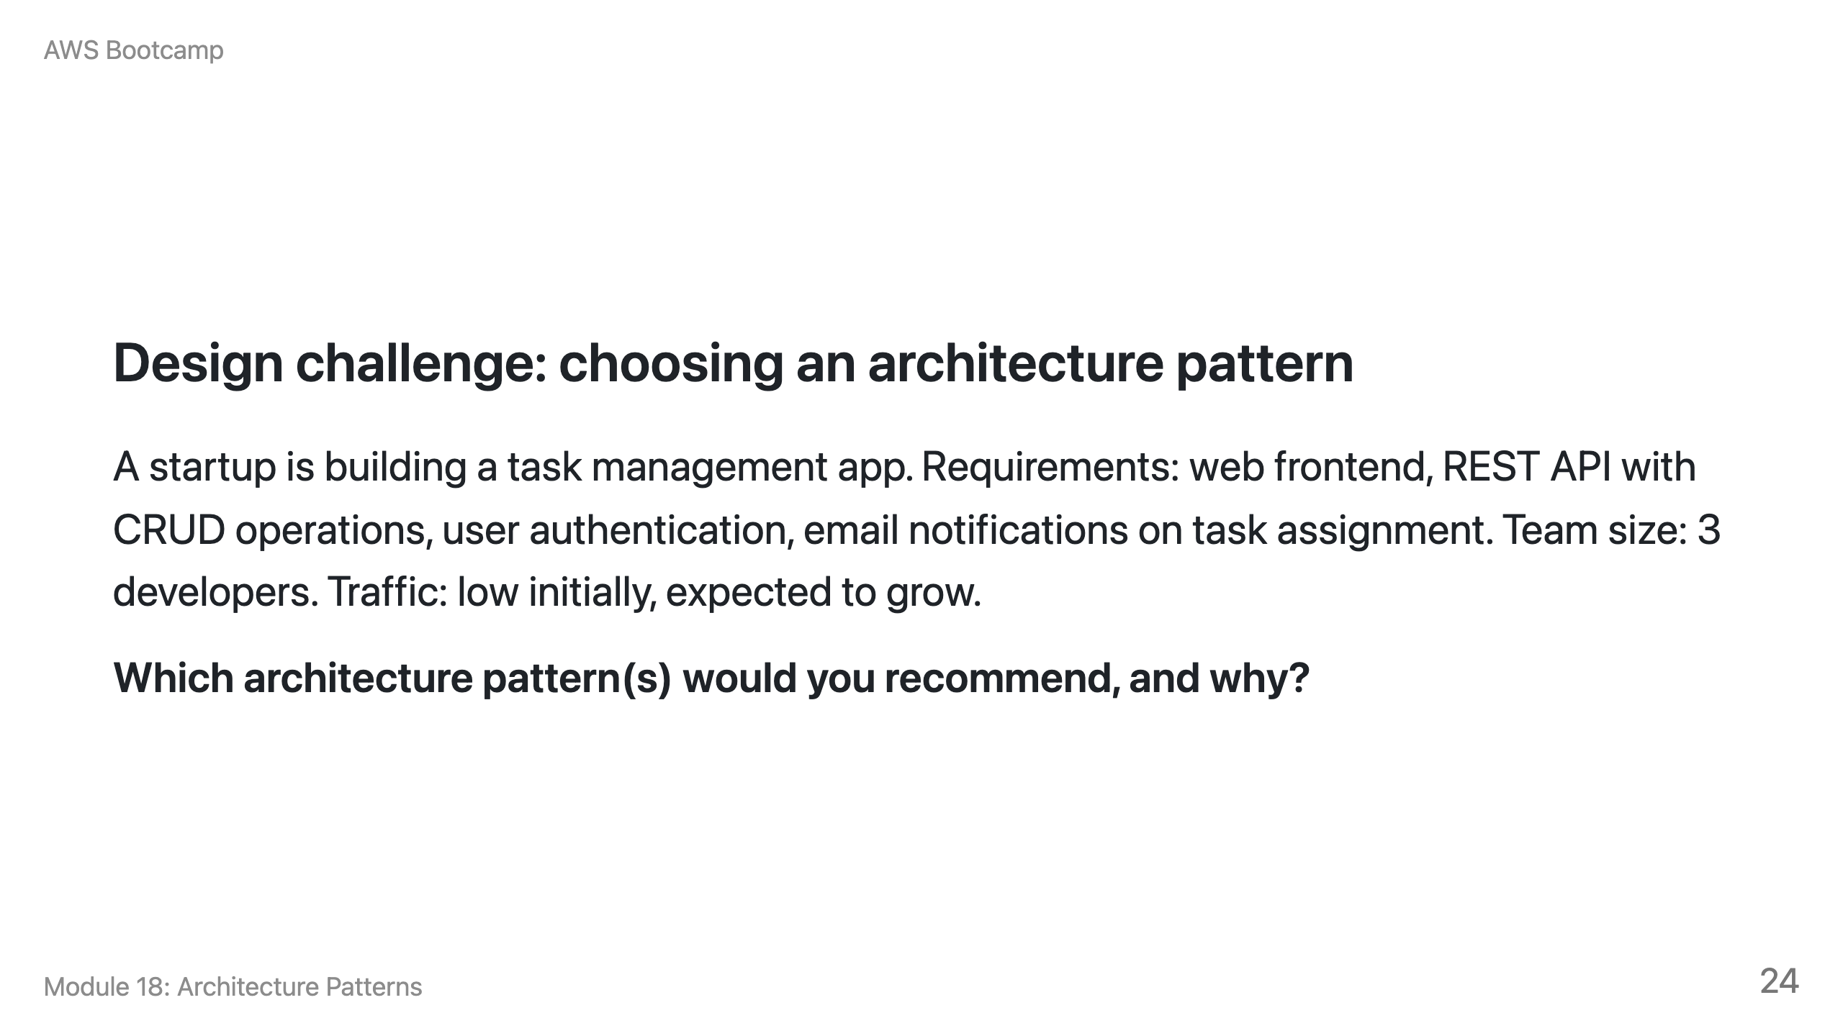
Notes:
Speaker notes: Expected answer: Static website + serverless API pattern. S3 + CloudFront for the frontend. API Gateway + Lambda + DynamoDB for the backend. SNS for email notifications. Reasoning: small team (no microservices overhead), variable traffic (serverless scales to zero), low operational burden. The three-tier pattern with EC2 would work but adds unnecessary server management for a small team. CQRS and event-driven are overkill for simple CRUD.

Slide 25
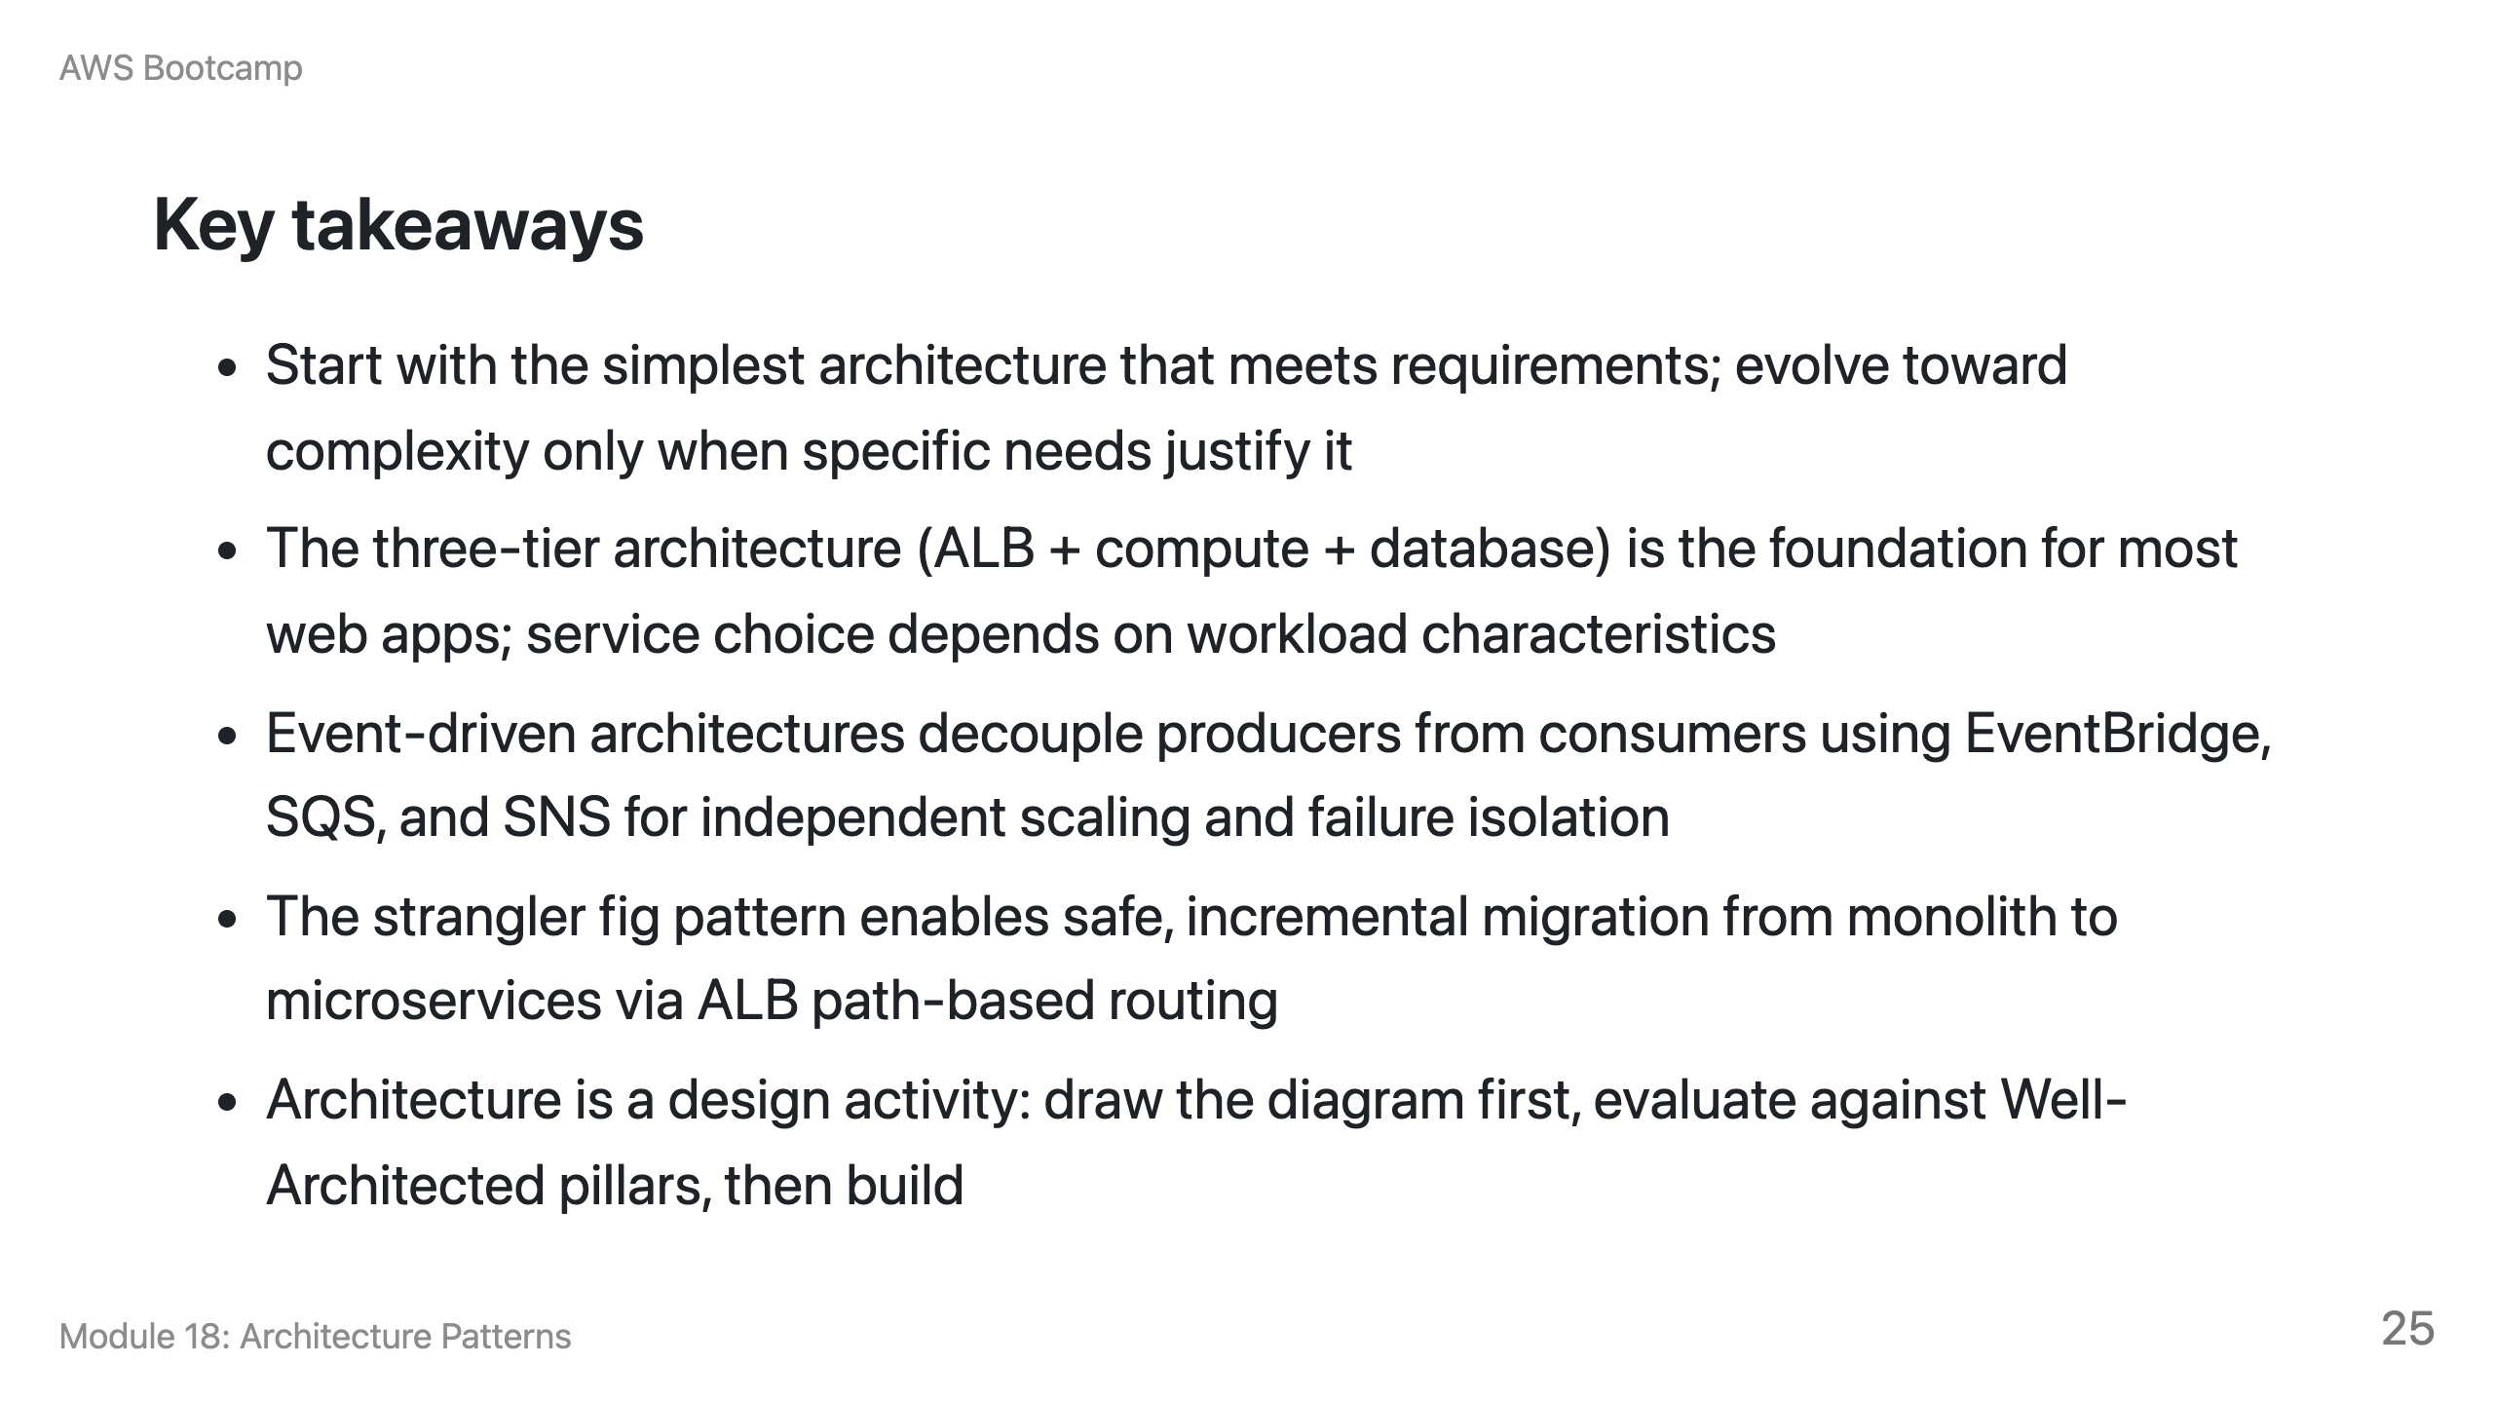

Slide 26
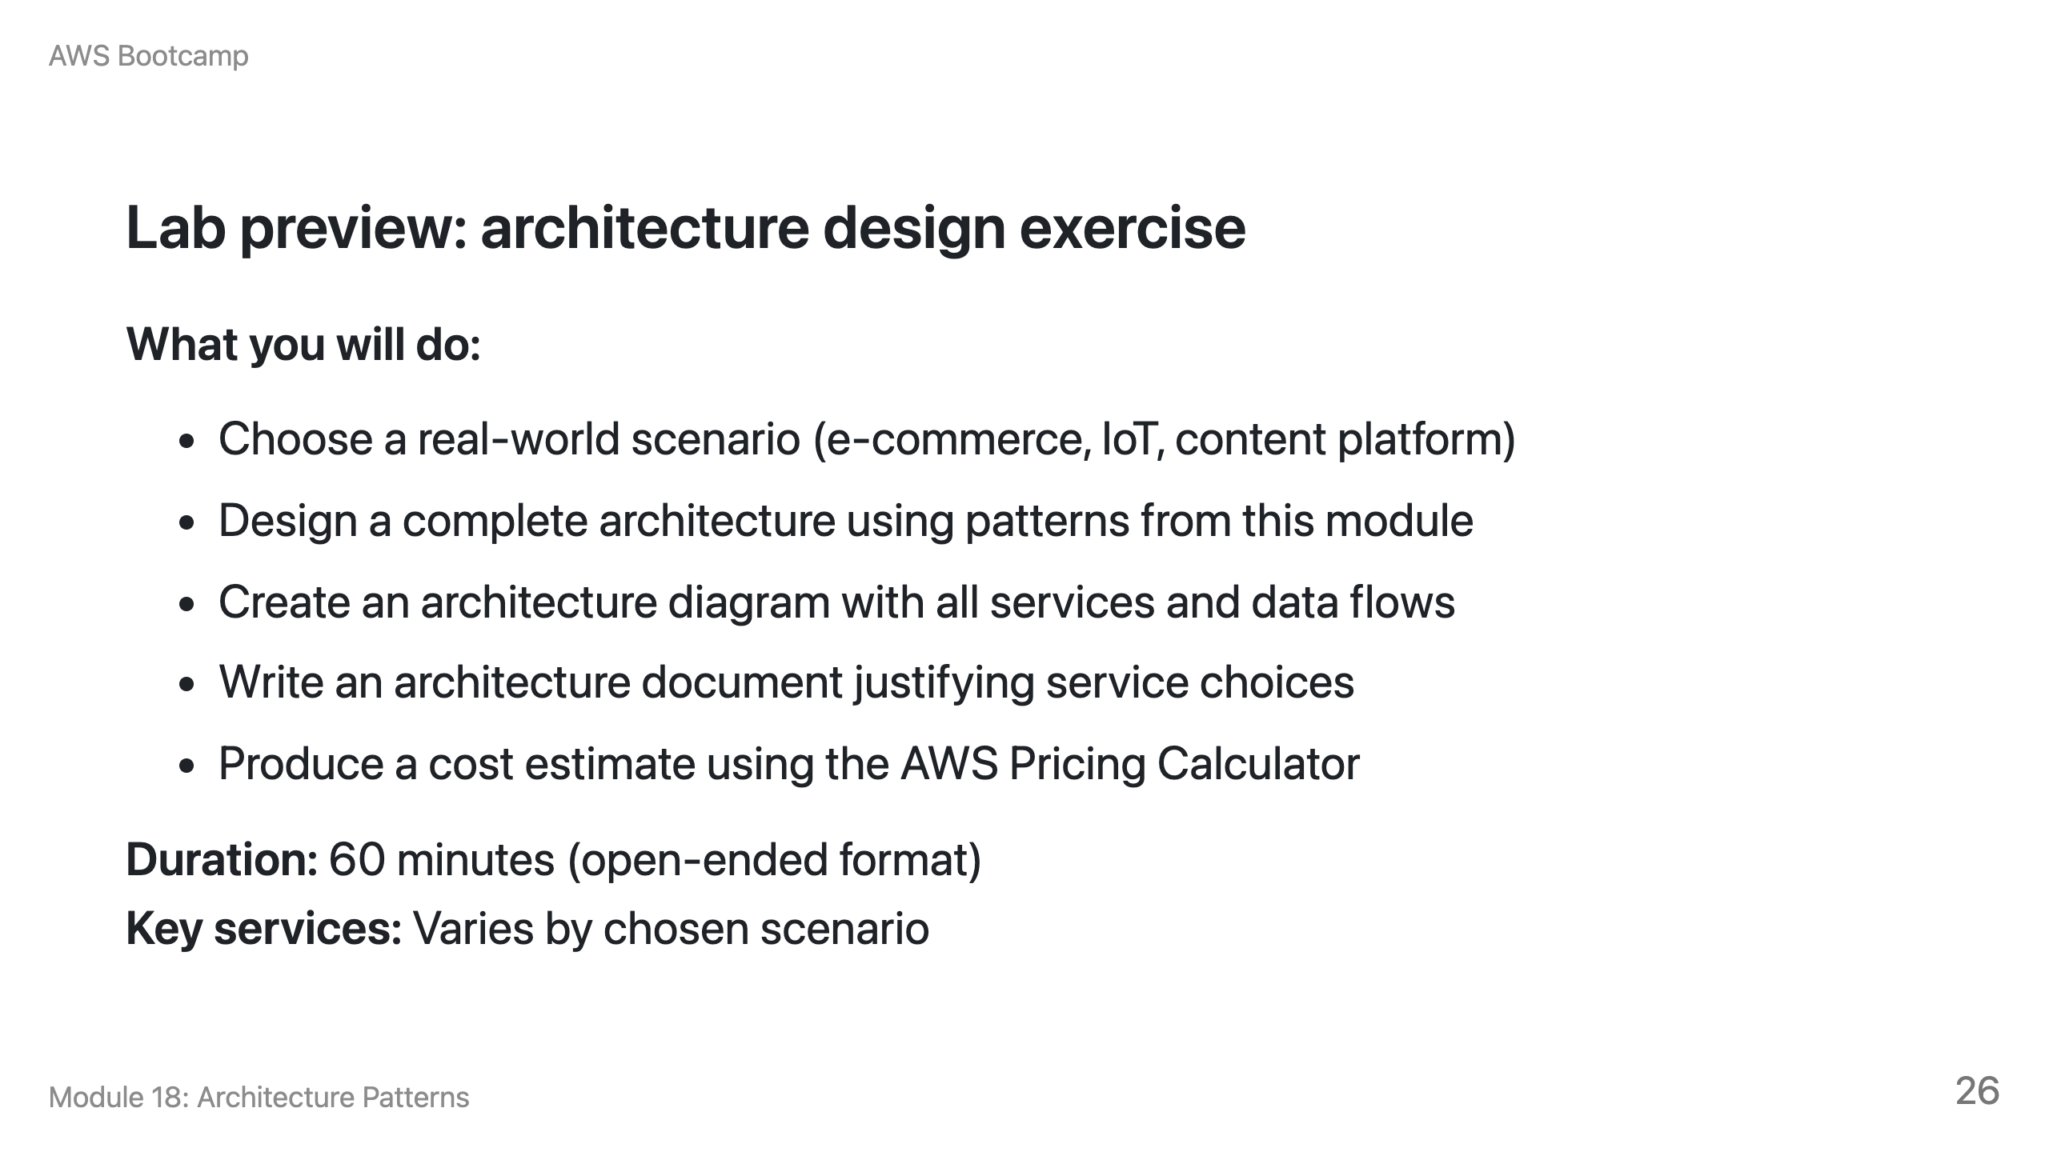
Notes:
Speaker notes: This is a fully open-ended lab. Students design an architecture from requirements. Deliverables include a diagram, document, and cost estimate. Encourage students to evaluate their design against the Well-Architected pillars from Module 17. Schedule peer reviews where teams present their architectures to each other.

Slide 27
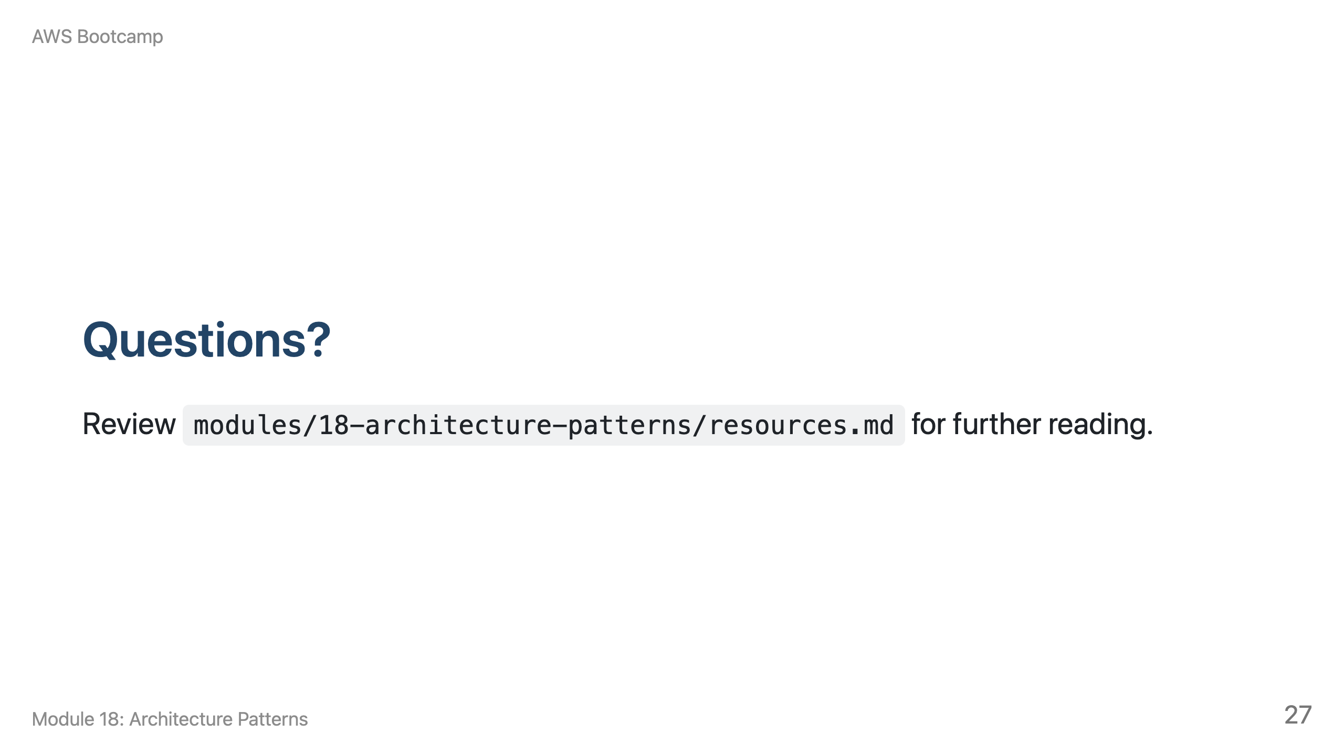
Notes:
Speaker notes: Take 5-10 minutes for questions. Common questions: "Serverless API vs. three-tier?" (Serverless for variable traffic and zero server management; three-tier for steady throughput, long-running processes, or persistent connections.) "When to use CQRS?" (Only when read and write patterns differ significantly. Most apps do not need it.)

