Slide 1
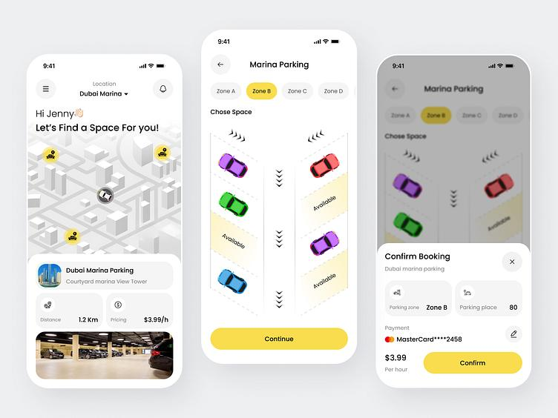
Parking Slot Reservation System
CMPE314 – Software Engineering Project Proposal Samuel Akpoghene Otobo (22100896)

Slide 2
Presentation Outline
Introduction & Problem Statement
Project Aim and Objectives
System Features & Use Cases
Requirements Analysis
Technology Stack
Project Timeline
Expected Benefits & Conclusion

Slide 3
1. Introduction
Overview of the parking management challenge
Background
• Rapid increase in vehicle ownership has created parking challenges.
• Drivers spend unnecessary time searching for parking spaces.
• Manual parking systems lead to delays and congestion.

Slide 4
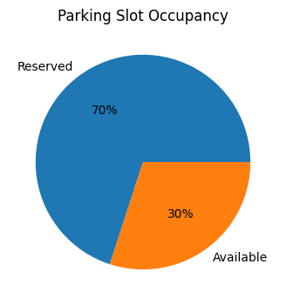
2. Problem Statement
Existing Issues
• No centralized parking reservation platform.
• Drivers cannot check slot availability remotely.
• Traffic congestion increases around parking areas.
• Inefficient slot management and poor reporting.

Slide 5
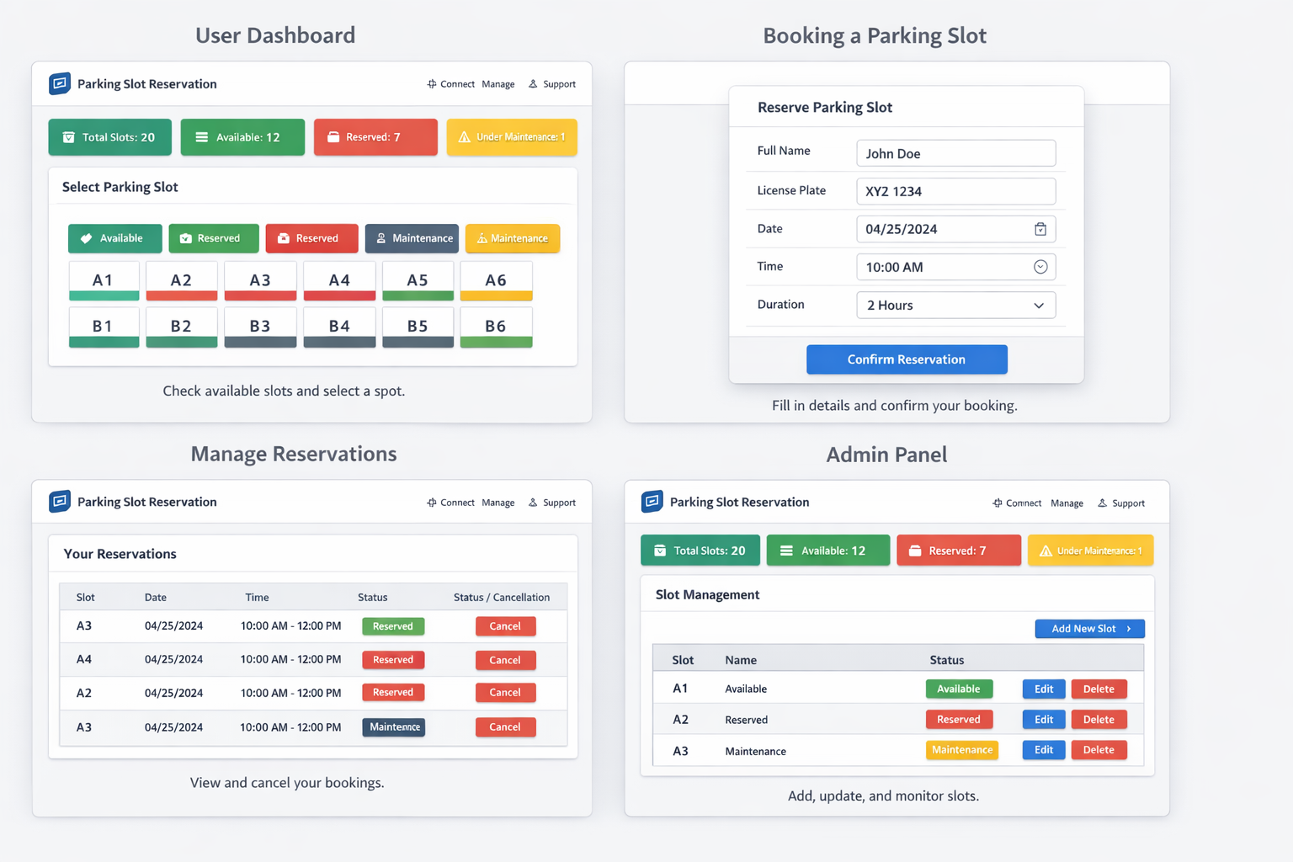
3. Project Aim & Objectives
Project Aim
• Develop a web-based system for reserving parking spaces efficiently.
• Improve user convenience and parking organization.
Objectives
• Provide secure user authentication.
• Enable online reservation and cancellation.
• Provide admin monitoring dashboard.
• Generate reports and notifications.

Slide 6
4. System Features
Authentication
• Secure registration and login system
Slot Availability
• Real-time parking slot updates
Reservation
• Reserve parking slots online and payment
Notifications
• Alerts and reminders
Admin Dashboard
• Manage slots and users
Reports
• Generate parking usage analytics

Slide 7
5. Functional Requirements
FR-01: User Account Creation
FR-02: Secure Login System
FR-03: Display Available Parking Slots
FR-04: Online Reservation System
FR-05: Modify or Cancel Bookings
FR-06: Notification Reminders
FR-07: Admin Slot Management
FR-08: Reports and Analytics

Slide 8
6. Technology Stack
Frontend
• HTML, CSS, JavaScript
Backend
• Django / Node.js
Database
• MySQL / PostgreSQL
Version Control
• Git
Libraries
• Bootstrap

Slide 9
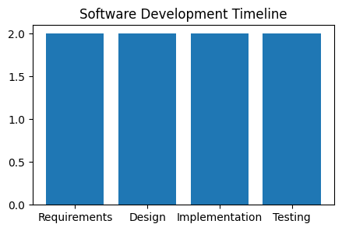
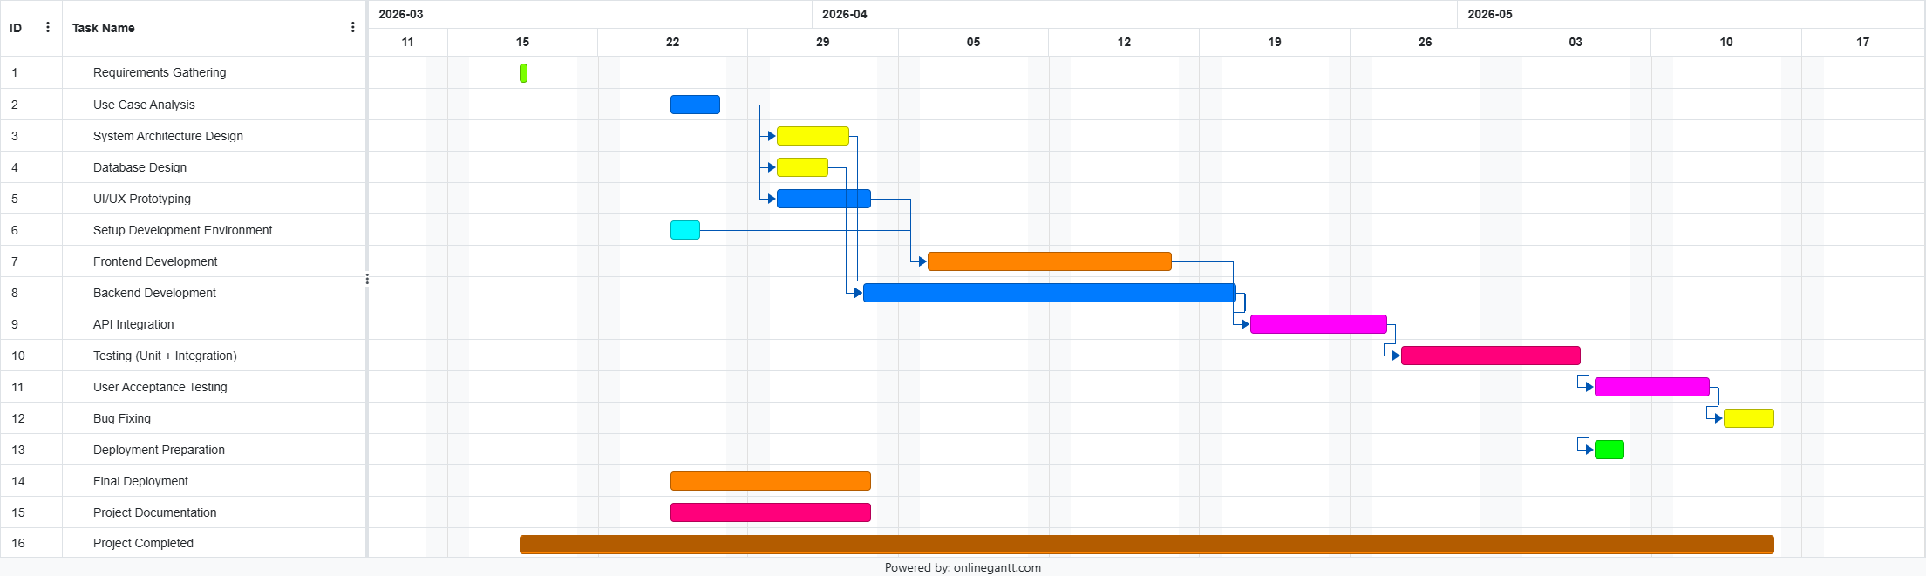
7. Project Timeline and Gaant Chart
Development Phases
• Weeks 1–2: Requirements Gathering
• Weeks 3–4: UML Modeling & System Design
• Weeks 5–6: Core Feature Implementation
• Weeks 7–8: Testing, Documentation & Deployment

Slide 10
8. Expected Benefits
Benefits
• Reduces congestion and waiting time.
• Improves parking efficiency.
• Enhances user experience with online access.
• Provides data analytics for management decisions.
• Supports future scalability and smart parking integration.

Slide 11
9. Conclusion
Summary
• The Parking Slot Reservation System offers an efficient digital parking solution.
• The system demonstrates practical software engineering concepts.
• It improves organization, automation, and user convenience.
• Future improvements may include AI-based smart parking integration.

