Slide 1
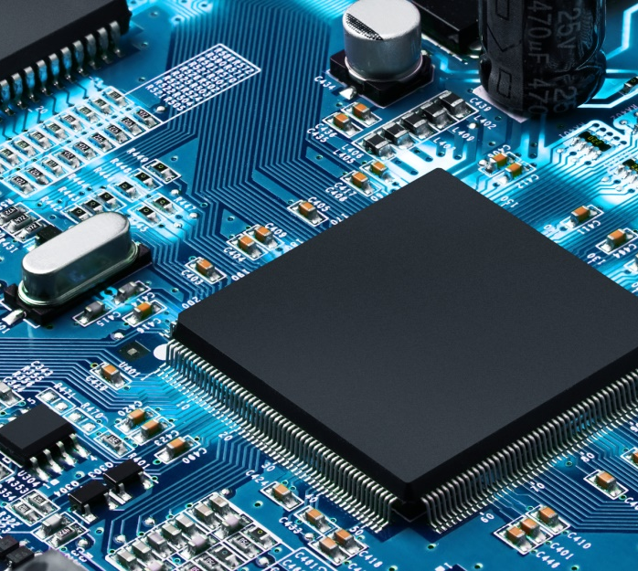
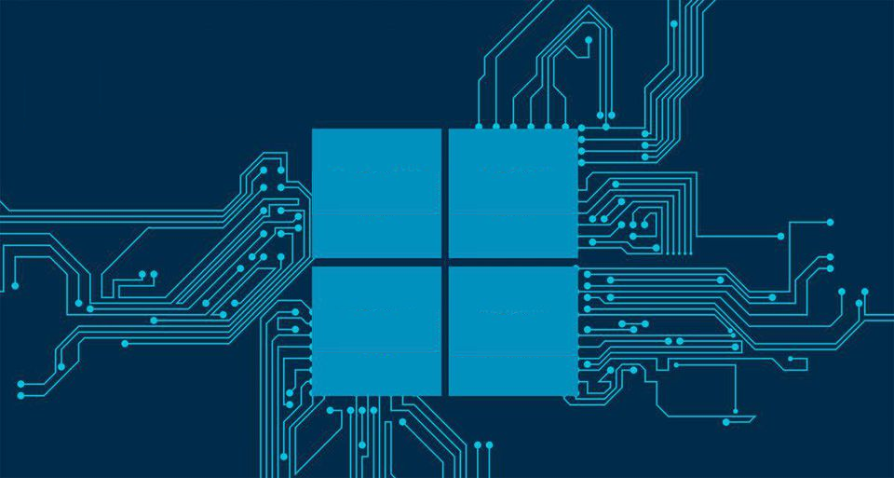

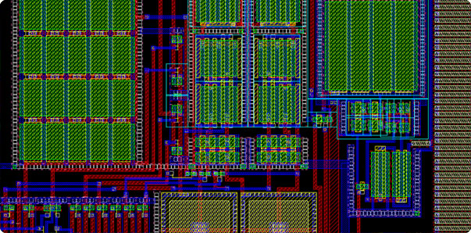
Computer Architecture – Part 1
Samuel Rachapudi
© Mirafra Software Technologies

Slide 2
Topic Outline
Introduction
RISC V Processor : Design
Animations to show how different stages interact
Concept Of Pipelining
Working of Different Pipeline stages
© Mirafra Software Technologies

Slide 3
1. Introduction
Software talks to hardware using a Vocabulary
Words called Instructions
Vocabulary called Instruction Set Architecture (ISA)
A Program is a book, written in words of the Vocabulary
The Complex the ISA the less number of Instructions a program needs.
But the Simple the ISA little Hardware is needed to execute the same.
Let us see the above statements visually.
© Mirafra Software Technologies

Slide 4
RISC V OpCode
X86 OpCode
.section .text
.globl main
main:
# Allocate space for local variables on the stack
addi sp, sp, -16
# Initialize variables
li a0, 5
sw a0, 0(sp)
li a0, 10
sw a0, 4(sp)
# Calculate sum
lw a0, 0(sp)
lw a1, 4(sp)
add a0, a0, a1
sw a0, 8(sp)
# Print result
lw a0, 0(sp)
lw a1, 4(sp)
lw a2, 8(sp)
la t0, format
call printf
# Clean up and return
addi sp, sp, 16
li a0, 0
ret
.section .data
format:
.string "The sum of %d and %d is %d\n"
.section .data
format:
.string "The sum of %d and %d is %d\n“
.section .text
.globl main
main:
# Initialize variables
movl $5, %eax
movl $10, %ebx
# Calculate
sum addl %eax, %ebx
# Print result
pushl %eax
pushl %ebx
pushl %ebx
pushl $format
call printf
addl $16, %esp
# Return xorl %eax, %eax ret
C Language Code
#include <stdio.h>
int main() {
int a = 5;
int b = 10;
int sum = a + b;
printf("The sum of %d and %d is %d\n", a, b, sum);
return 0;
}
In RISC V we need 8 instructions but in X86 we can get our work done in only 3 instructions

Slide 5
Some History
Intel iAPX 432: Most Ambitious 1970s micro, started in 1975
32-bit Capability-based, object-oriented architecture, custom OS written in Ada
Severe Performance, complexity/(Multiple chips), and usability problems; announced in 1981
Intel 8086 (1978, 8Mhz, 29,000 transistors)
“Stopgap” 16-bit processor, 52 weeks to new chip
ISA Architected in 3 weeks
IBM PC 1981 picks Intel 8088 for 8-bit bus (and Motorola 68000 was late)
Estimated PC sales: 250,000
Actual PC Sales: 100,000,000 > 8086 “overnight” success
John Cocke of IBM did an interesting experiment took only handful of powerful Instructions (loads/stores, register-register) from IBM 360 ISA and built a PC around it. They observed that their programs ran 3x faster.
Emer and Clark at DEC in early 1980s
Found VAX (CISC)ISA average Clock Cycle per Instruction (CPI) = 10
Found 20% of VAX ISA > 60% of Microcode, but only 0.2% of execution time.
Dave Patterson built RISC Machines at University of California and Henessy built MIPS Machine at Stanford.

Slide 6

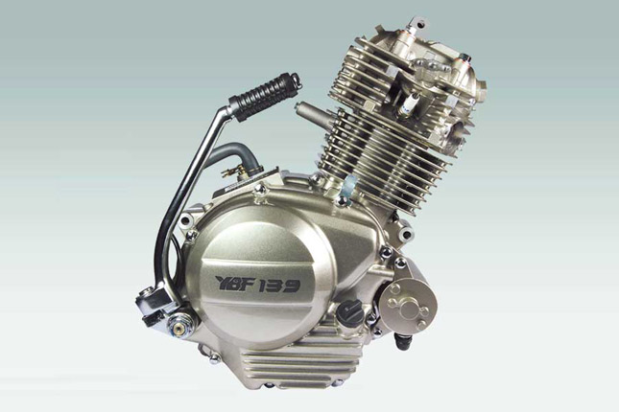
RISC executes more instructions / program (= 25% more instructions) but many fewer clock cycles per instruction (= 1/5 CPI) implies RISC = 4x faster than CISC
If the Number of Instructions are increasing, then how come RISC V is gaining poularity ??
This Factor is the key
Length of Instruction in X86 is 64bits
(PC Era – Desktop and Server Segments)
Time Instructions Clock Cycles Time
= X X
Program Program Instruction Clock Cycle
Instructions Per Program depends on source code, compiler technology, and ISA
Clock Cycles per Instruction (CPI) depends on ISA and underlying Micro Architecture
Time per Clock Cycle depends upon the microarchitecture and base technology
A Simple Cheat Code to understand the above concept is …
Low Power
Specially relevant in the Era of Client-cloud computing
One metric for Post PC Era : 18B/Year in 2016 and 98% are RISC Processors:
15.0B ARM(Advanced RISC Machine)
02.0B Tensilica
01.5B ARC(Argonaut RISC Core)
00.8B MIPS (Microprocessor without Interlocked Pipeline Stages)
Length of Instruction in RISC V is 32bits
(Post PC Era)

Slide 7
High Power
Complex Instructions
PC Era
CISC (X86)
Low Power
Simple Instructions
Post-PC Era
RISC

Slide 8


What is Post-PC Era and Significance of 5G in Post-PC Era:
When process of computing was first thought of they were Engineered with the consideration that they will be tied to the power supply. So, the ISAs were also complex.
But, with the advent of Video games which require minute computing running on batteries portables were introduced and they need simple ISAs.
With Mobile Phone computing (Apple 3g) simple ISAs rose to fame. So, in the post PC Era we need devices that are no longer tied to power supply all the time but able to run powerful programs thanks to RISC ISA.
In earlier generations prior to 5G focus is mainly improving Network latency (Like during 2G our Data Recharge is in the order of 100MB per month, by 3G it is 1GB per month, by 4G it rose to 1GB per day and for 5G it is 1GB per second). One more important observation is until 4G focus is to accommodate one device per person but with 5G a person can connect his phone and any other IOT device like AC and talk to his AC from his phone as we are talking to other phones since they are connected to a network.
Person1
Person 3
person 5
Person 4
Person 2
Person1
Person 3
person 5
Person 4
Person 2
5 G at a speed of 1gbps
1G to 4G

Slide 9

What is Edge Computing
Consider a music app called Spotify.
Earlier we are used to listen music from in-built storage on Phone because accessing them is easy.
As the Mobile networks grew we can now access the same music from cloud server at greater speeds and our phone no longer needs songs stored on our client device to listen as it can be accessed from cloud
So, with Edge computing model we can push more computing to the Edge servers which are placed nearer to the network. This in-turn can reduce the amount of computing we do on our device.
Owing to all the developments stated above RISC Architecture rose to greater importance than any time in history.
Computational Power and Data Storage closer to the edge of the network

Slide 10
In Simple Terms :
RISC Processors are designed to execute a smaller set of simple and efficient instructions, rather than a larger set of complex instructions found in traditional processors. This approach can result in faster Execution times, lower power consumption, and more predictable performance
Of the RISC ISAs RISC V ISA is an Open Source ISA developed at the University of California, Berkeley. Which means no ROYALTIES or LICENSE FEES ☺

Slide 11
2.RISC V Design
To start with Implementation, we must consider the Five Classic Stages in a Instruction Execution and we will build around those stages
1. Instruction Fetch
2. Instruction Decode and Register File Read
3. Execute or Address Calculation
4. Memory Access
5. Write Back
We will be examining an implementation that includes a subset of the core RISC-V instruction set:
The memory-reference instructions load doubleword (ld) and store doubleword (sd)
The arithmetic-logical instructions ‘add’, ‘sub’, ‘and’, and ‘or’
(R-Format Instructions)
The conditional branch instruction branch if equal (beq)
© Mirafra Software Technologies

Slide 12
Shift left by 1
Control Unit
Add
4
Add
ALUControl
RegWrite
MemWrite
PCSrc
Registers
Data Memory
MEMToReg
mux
PC
Read Register 1
Read Data 1
Address
Read Data
INSTRUCTION MEMORY
mux
0
address
Zero
Read Register 2
1
Instruction
Result
Write Register
ALUSrc
1
mux
0
Read Data 2
0
ALU
Write Data
Write Data
1
MemRead
Memory Stage
Instruction Fetch
Imm Gen
Execute
Write
Back
Instruction Decode

Slide 13
lw a0, 0(sp) > 00000000000000101000001000000011
lw a1, 4(sp) > 00000100010000111000001000000011
add a0, a0, a1 >00000001101000101000000000110011
sw a0, 8(sp) > 00000000101001010000000100010011
Instruction Fetch
Third Clock Cycle
Fourth Clock Cycle
First Clock Cycle
Second Clock Cycle
But if you get a branch instruction in Fourth Clock cycle saying that fetch the instructions from 28 your PC has to go there in Fifth Clock cycle
Fifth Clock Cycle
32 bits of instruction <00000000000000101000001000000011> is passed for Decode stage
00000011
00000011
16
0
10000010
10000010
17
1
00000010
00000010
18
2
00000000
00000000
19
3
Second instruction 32 bits
< 00000100010000111000001000000011> are passed to decode stage
PC
00000011
00000011
20
4
10000010
10000010
21
5
mux
01000011
01000011
22
6
00000100
00000100
23
7
Third instruction 32 bits
< 00000001101000101000000000110011> are passed to decode stage
00110011
00110011
24
4
8
10000000
10000000
25
9
10100010
10100010
26
10
00000001
00000001
27
11
Fourth instruction 32 bits
< 00000000101001010000000100010011>
are passed to decode stage
00010011
00010011
28
12
For Branch Instruction we will get a new address from Execute stage
00000001
00000001
29
13
10100101
10100101
30
14
00000000
00000000
31
15
Byte Addressable Instruction Memory Bank 0
Byte Addressable Instruction Memory Bank 1

Slide 14
Instruction Decode
Format For Memory Reference Instructions (load and store)
Load Instruction (I-Format):
31 20 19 15 14 12 11 7 6 0
+-------------------+---------+---------+---------+-------------+
| imm[11:0] | rs1 | funct3 | rd | opcode |
+-------------------+---------+---------+---------+-------------+
Store Instruction (I-Format):
31 25 24 20 19 15 14 12 11 7 6 0
+---------+---------+---------+---------+-------------+-----------------+
|imm[11:5]|rs2 | rs1 | funct3 | imm[4:0] | opcode |
+---------+---------+---------+---------+---------+---------------------+
Load Instruction
Control Unit
RegWrite
Register File
Read Register 1
Read Data 1
Format For R-Format Instructions :
31 25 24 20 19 15 14 12 11 7 6 0
+---------+---------+---------+---------+----------+---------+
| funct7 | rs2 | rs1 | funct3 | rd |opcode |
+---------+---------+---------+---------+---------+------------+
Read Register 2
Instruction from IF Stage is Input
00000000000000101000001000000011
Write Register
Format For Branch-Format Instructions :
31 30 25 24 20 19 15 14 12 11 8 7 6 0
+----------+---------------+---------+---------+------------+--------------+-----------------+-------------+ |imm[11]| imm[9:4] | rs2 | rs1 | funct3 | imm[3:0] | imm[10] | opcode |
+----------+---------------+---------+---------+------------+-------------+------------------+-------------+
Read Data 2
Write Data
Since, number of registers in RISC V ISA is 32 we have 5 bits in the instruction for Register Address
Imm Gen

Slide 15
Format For Memory Reference Instructions (load and store)
Load Instruction (I-Format):
31 20 19 15 14 12 11 7 6 0
+-------------------+---------+---------+---------+-------------+
| imm[11:0] | rs1 | funct3 | rd | opcode |
+-------------------+---------+---------+---------+-------------+
Store Instruction (I-Format):
31 25 24 20 19 15 14 12 11 7 6 0
+---------+---------+---------+---------+-------------+-----------------+
|imm[11:5]|rs2 | rs1 | funct3 | imm[4:0] | opcode |
+---------+---------+---------+---------+---------+---------------------+
Execute
Format For Branch-Format Instructions :
31 30 25 24 20 19 15 14 12 11 8 7 6 0
+----------+---------------+---------+---------+------------+--------------+-----------------+-------------+ |imm[11]| imm[9:4] | rs2 | rs1 | funct3 | imm[3:0] | imm[10] | opcode |
+----------+---------------+---------+---------+------------+-------------+------------------+-------------+
<
From previous stage PC
To the input of IF stage Mux
Shift left by 1
Add
Instruction Decode Stage
ALUControl
Register File
Read Register 1
Read Data 1
Branch-Format Instruction:
We need
1) 64-bit Source Register 1 Data
2) 64-bit Source Register 2 Data
3) Destination Register Address
So, we only provide those connections
Read Register 2
To one input of AND Gate ; other input comes from Control Module ; Output of AND Gate is used as select line of the MUX(PCSrc)
R-Format Instruction:
We need
1) 64-bit Source Register 1 Data
2) 64-bit Source Register 2 Data
3) Destination Register Address
So, we only provide those connections
Store Instruction:
We need
1) Base Register Address
2) Offset Value
3) 64-bit Data which is to be stored
So, we only provide those connections
Load Instruction:
We need
1) Base Register Address
2) Offset Value
So, we only provide those connections
Zero
Write Register
ALUSrc
Result
mux
In this case Result is 64-bit data unlike previous instructions where Result is Address to access Data Memory
Read Data 2
Write Data
ALU
To Data Memory
Format For R-Format Instructions :
31 25 24 20 19 15 14 12 11 7 6 0
+---------+---------+---------+---------+----------+----------+
| funct7 | rs2 | rs1 | funct3 | rd |opcode |
+---------+---------+---------+---------+---------+------------+
Imm Gen

Slide 16
Memory Stage
Write Back Stage
Load Instruction
Store Instruction
Branch-Format Instruction
R-Format Instruction
To Select Line of Mux in IF Stage called as PCSrc
Add
From Control Module of ID Stage
MemWrite
MEMToReg
ALUControl
Data Memory
mux
From Read Data 1 of ID Stage Register File
Address
Read Data
1
To Write Register/Destination Register in Register File
Zero
Result
0
From Read Data 2 of ID Stage Register File
mux
ALU
Write Data
MemRead
From Imm Gen of ID Stage

Slide 17
Clubbing all Stages in One Shot

Slide 18
Shift left by 1
Control Unit
Add
4
Add
ALUControl
RegWrite
MemWrite
PCSrc
Registers
Data Memory
MEMToReg
mux
PC
Read Register 1
Read Data 1
Address
Read Data
INSTRUCTION MEMORY
mux
0
address
Zero
Read Register 2
1
Instruction
Result
Write Register
ALUSrc
1
mux
0
Read Data 2
0
ALU
Write Data
Write Data
1
MemRead
Memory Stage
Instruction Fetch
Imm Gen
Execute
Write
Back
Instruction Decode

Slide 19
Your special focus is required in the following three paths
but only two paths in reality
Add
All other paths are going forward but these two paths are going backwards, hence they cause issues in pipelining implementation called :
Data Hazards and Control Hazards
Since, one of the path is a Control path and the other path is a Data Path
PCSrc
Registers
mux
Read Register 1
Read Data 1
mux
0
Read Register 2
1
Write Register
1
Read Data 2
0
Write Data
Memory Stage
Instruction Fetch
Execute
Write
Back
Instruction Decode

Slide 20
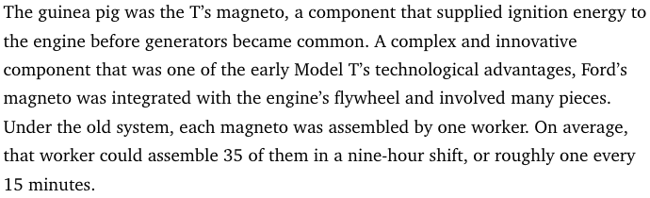

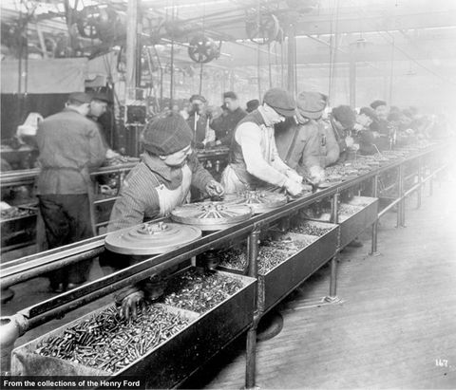
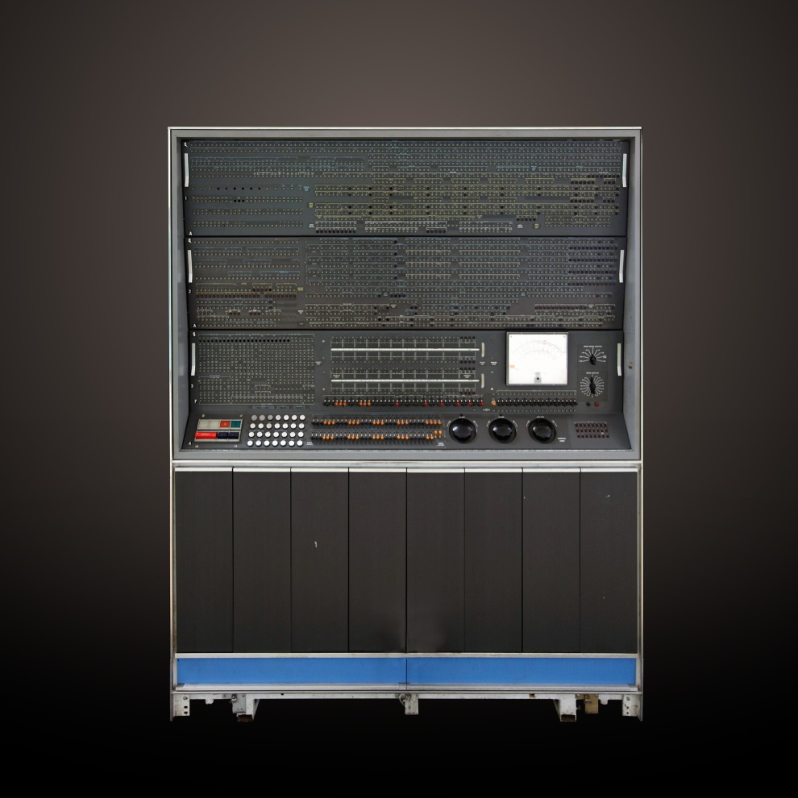
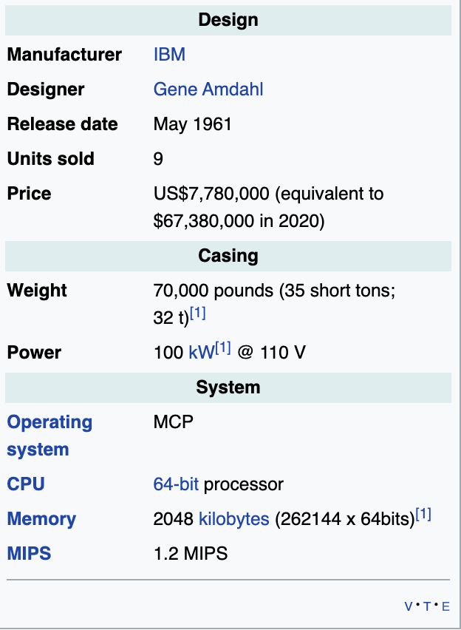

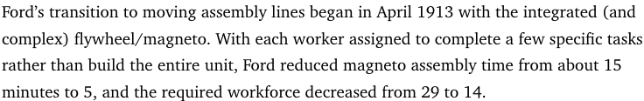
3. Concept of Pipelining
A Real-Life Modern Pipeline : Auto Assembly
Historical reference of Pipelining by Henry Ford is provided to appreciate the concept better
An Old Pipelined Computer : IBM Stretch
Executing the single instruction in multiple stages rather than executing all the stages of single Instruction in One Go.
Main Goal of Pipeline stage is to keep the pipeline full(steady-state) and make it run continuously
© Mirafra Software Technologies

Slide 21
For each Instruction if it is not a pipelined Design other Functional Blocks are sitting Idle.
So, each stage is Pipelined and Instruction throughput is increased greatly with pipelining
The main Disadvantage for a non-pipelined design is it needs more time to execute an instruction resulting in lower operating frequency
IF
ID
EX
MEM
WB
IF
ID
EX
MEM
WB
IF
ID
EX
MEM
WB
For a Non-Pipelined Design each instruction has to wait until all the Stages of Instruction Execution resulting in Longer execution times
IF
ID
EX
MEM
WB
IF
ID
EX
MEM
WB
IF
ID
EX
MEM
WB
For a Pipelined Processor Design each instruction gets executed parallel resulting less instruction execution times thereby increasing Instruction throughput.
Ideally speaking for every 200ns we will get an output for an instruction, unlike non-pipelined design which takes 1000ns for an instruction output
IF
ID
EX
MEM
WB
IF
ID
EX
MEM
WB
IF
ID
EX
MEM
WB
IF
ID
EX
MEM
WB
IF
ID
EX
MEM
WB
IF
ID
EX
MEM
WB
200
400
600
800
1000
1200
1400
1600
1800
2000
2200
2400
2600
2800
3000
3200
3400
3600
3800
4000

Slide 22
ID/EXE
EXE/MEM
Pipelined Processor
MEM/WB
IF/ID
Shift left by 1
Add
4
Add
ALUControl
RegWrite
MemWrite
MEMToReg
PCSrc
Registers
Data Memory
mux
PC
Read Register 1
Read Data 1
Address
Read Data
INSTRUCTION MEMORY
mux
0
address
Zero
Read Register 2
1
Instruction
Result
Write Register
ALUSrc
1
mux
0
Read Data 2
0
ALU
Write Data
Write Data
1
MemRead
Memory Stage
Instruction Fetch
Imm Gen
Execute
Write
Back
Instruction Decode

Slide 23
ID/EXE
EXE/MEM
LOAD INSTRUCTION
STAGE 1
MEM/WB
IF/ID
Shift left by 1
Add
4
Add
ALUControl
RegWrite
MemWrite
MEMToReg
PCSrc
Registers
Data Memory
mux
PC
Read Register 1
Read Data 1
Address
Read Data
INSTRUCTION MEMORY
mux
0
address
Zero
Read Register 2
1
Instruction
Result
Write Register
ALUSrc
1
mux
0
Read Data 2
0
ALU
Write Data
Write Data
1
MemRead
Memory Stage
Instruction Fetch
Imm Gen
Execute
Write
Back
Instruction Decode

Slide 24
ID/EXE
EXE/MEM
LOAD INSTRUCTION
STAGE 2
MEM/WB
IF/ID
Shift left by 1
Add
4
Add
ALUControl
RegWrite
MemWrite
MEMToReg
PCSrc
Registers
Data Memory
mux
PC
Read Register 1
Read Data 1
Address
Read Data
INSTRUCTION MEMORY
mux
0
address
Zero
Read Register 2
1
Instruction
Result
Write Register
ALUSrc
1
mux
0
Read Data 2
0
ALU
Write Data
Write Data
1
MemRead
Memory Stage
Instruction Fetch
Imm Gen
Execute
Write
Back
Instruction Decode

Slide 25
ID/EXE
EXE/MEM
LOAD INSTRUCTION
STAGE 3
MEM/WB
IF/ID
Shift left by 1
Add
4
Add
ALUControl
RegWrite
MemWrite
MEMToReg
PCSrc
Registers
Data Memory
mux
PC
Read Register 1
Read Data 1
Address
Read Data
INSTRUCTION MEMORY
mux
0
address
Zero
Read Register 2
1
Instruction
Result
Write Register
ALUSrc
1
mux
0
Read Data 2
0
ALU
Write Data
Write Data
1
MemRead
Memory Stage
Instruction Fetch
Imm Gen
Execute
Write
Back
Instruction Decode

Slide 26
ID/EXE
EXE/MEM
LOAD INSTRUCTION
STAGE 4
MEM/WB
IF/ID
Shift left by 1
Add
4
Add
ALUControl
RegWrite
MemWrite
MEMToReg
PCSrc
Registers
Data Memory
mux
PC
Read Register 1
Read Data 1
Address
Read Data
INSTRUCTION MEMORY
mux
0
address
Zero
Read Register 2
1
Instruction
Result
Write Register
ALUSrc
1
mux
0
Read Data 2
0
ALU
Write Data
Write Data
1
MemRead
Memory Stage
Instruction Fetch
Imm Gen
Execute
Write
Back
Instruction Decode

Slide 27
ID/EXE
EXE/MEM
LOAD INSTRUCTION
STAGE 5
MEM/WB
IF/ID
Shift left by 1
Add
4
Add
ALUControl
RegWrite
MemWrite
MEMToReg
PCSrc
Registers
Data Memory
mux
PC
Read Register 1
Read Data 1
Address
Read Data
INSTRUCTION MEMORY
mux
0
address
Zero
Read Register 2
1
Instruction
Result
Write Register
ALUSrc
1
mux
0
Read Data 2
0
ALU
Write Data
Write Data
1
MemRead
Memory Stage
Instruction Fetch
Imm Gen
Execute
Write
Back
Instruction Decode

Slide 28
ID/EXE
EXE/MEM
STORE INSTRUCTION
STAGE 1
MEM/WB
IF/ID
Shift left by 1
Add
4
Add
ALUControl
RegWrite
MemWrite
MEMToReg
PCSrc
Registers
Data Memory
mux
PC
Read Register 1
Read Data 1
Address
Read Data
INSTRUCTION MEMORY
mux
0
address
Zero
Read Register 2
1
Instruction
Result
Write Register
ALUSrc
1
mux
0
Read Data 2
0
ALU
Write Data
Write Data
1
MemRead
Memory Stage
Instruction Fetch
Imm Gen
Execute
Write
Back
Instruction Decode

Slide 29
ID/EXE
EXE/MEM
STORE INSTRUCTION
STAGE 2
MEM/WB
IF/ID
Shift left by 1
Add
4
Add
ALUControl
RegWrite
MemWrite
MEMToReg
PCSrc
Registers
Data Memory
mux
PC
Read Register 1
Read Data 1
Address
Read Data
INSTRUCTION MEMORY
mux
0
address
Zero
Read Register 2
1
Instruction
Result
Write Register
ALUSrc
1
mux
0
Read Data 2
0
ALU
Write Data
Write Data
1
MemRead
Memory Stage
Instruction Fetch
Imm Gen
Execute
Write
Back
Instruction Decode

Slide 30
ID/EXE
EXE/MEM
STORE INSTRUCTION
STAGE 3
MEM/WB
IF/ID
Shift left by 1
Add
4
Add
ALUControl
RegWrite
MemWrite
MEMToReg
PCSrc
Registers
Data Memory
mux
PC
Read Register 1
Read Data 1
Address
Read Data
INSTRUCTION MEMORY
mux
0
address
Zero
Read Register 2
1
Instruction
Result
Write Register
ALUSrc
1
mux
0
Read Data 2
0
ALU
Write Data
Write Data
1
MemRead
Memory Stage
Instruction Fetch
Imm Gen
Execute
Write
Back
Instruction Decode

Slide 31
ID/EXE
EXE/MEM
STORE INSTRUCTION
STAGE 4
MEM/WB
IF/ID
Shift left by 1
Add
4
Add
ALUControl
RegWrite
MemWrite
MEMToReg
PCSrc
Registers
Data Memory
mux
PC
Read Register 1
Read Data 1
Address
Read Data
INSTRUCTION MEMORY
mux
0
address
Zero
Read Register 2
1
Instruction
Result
Write Register
ALUSrc
1
mux
0
Read Data 2
0
ALU
Write Data
Write Data
1
MemRead
Memory Stage
Instruction Fetch
Imm Gen
Execute
Write
Back
Instruction Decode

Slide 32
ID/EXE
EXE/MEM
STORE INSTRUCTION
STAGE 5
MEM/WB
IF/ID
Shift left by 1
Add
4
Add
ALUControl
RegWrite
MemWrite
MEMToReg
PCSrc
Registers
Data Memory
mux
PC
Read Register 1
Read Data 1
Address
Read Data
INSTRUCTION MEMORY
mux
0
address
Zero
Read Register 2
1
Instruction
Result
Write Register
ALUSrc
1
mux
0
Read Data 2
0
ALU
Write Data
Write Data
Here we can have two types of implementations
1: When Stage is Idle let that stage be idle in that cycle : Simple Implementation
2: When a stage is idle and completed proceed to next instruction : Complex
1
MemRead
Memory Stage
Imm Gen
Execute
Write
Back
Instruction Fetch
Instruction Decode

Slide 33
Control Hazard
IF
ID
EX
MEM
WB
Consider the following Instructions:
beq x1, x2, loop → Instruction 1
addi x1, x1, 10 → Instruction 2
xor x7, x6, x5 → Instruction 3
and x5, x6, x5 → Instruction 3
Loop:or x6, x5, x4 → Instruction 4
IF
ID
EX
MEM
WB
IF
ID
EX
MEM
WB
IF
ID
EX
MEM
WB
IF
ID
EX
MEM
WB
IF
ID
EX
MEM
WB
IF
ID
EX
MEM
WB
IF
ID
EX
MEM
WB
Data Hazard
IF
ID
EX
MEM
WB
IF
ID
EX
MEM
WB
Consider the following Instructions:
addi x1, x2, 10
add x3, x1, x4
and x5, x1, x6
IF
ID
EX
MEM
WB
IF
ID
EX
MEM
WB
200
400
600
800
1000
1200
1400
1600
1800
2000
2200
2400
2600
2800
3000
3200
3400
3600
3800
4000

Slide 34
Consider the following Instructions:
beq x1, x2, loop → Instruction 1
addi x1, x1, 10 → Instruction 2
xor x7, x6, x5 → Instruction 3
and x5, x6, x5 → Instruction 4
Loop:or x6, x5, x4 → Instruction 5
IF/ID
ID/EXE
EXE/MEM
MEM/WB
Shift left by 1
Add
4
Add
ALUControl
RegWrite
MemWrite
MEMToReg
PCSrc
Registers
Data Memory
mux
PC
Read Register 1
Read Data 1
Address
Read Data
INSTRUCTION MEMORY
mux
0
address
Zero
Read Register 2
1
Instruction
Result
Write Register
ALUSrc
1
mux
0
Read Data 2
0
ALU
Write Data
Write Data
1
MemRead
Memory Stage
Instruction Fetch
Imm Gen
Execute
Write
Back
Instruction Decode

Slide 35
Consider the following Instructions:
beq x1, x2, loop → Instruction 1
addi x1, x1, 10 → Instruction 2
xor x7, x6, x5 → Instruction 3
and x5, x6, x5 → Instruction 4
Loop:or x6, x5, x4 → Instruction 5
IF/ID
ID/EXE
EXE/MEM
MEM/WB
Shift left by 1
Add
4
Add
ALUControl
RegWrite
MemWrite
MEMToReg
PCSrc
Registers
Data Memory
mux
PC
Read Register 1
Read Data 1
Address
Read Data
INSTRUCTION MEMORY
mux
0
address
Zero
Read Register 2
1
Instruction
Result
Write Register
ALUSrc
1
mux
0
Read Data 2
0
ALU
Write Data
Write Data
1
MemRead
Memory Stage
Instruction Fetch
Imm Gen
Execute
Write
Back
Instruction Decode

Slide 36
Consider the following Instructions:
beq x1, x2, loop → Instruction 1
addi x1, x1, 10 → Instruction 2
xor x7, x6, x5 → Instruction 3
and x5, x6, x5 → Instruction 4
Loop:or x6, x5, x4 → Instruction 5
IF/ID
ID/EXE
EXE/MEM
MEM/WB
Shift left by 1
Add
4
Add
ALUControl
RegWrite
MemWrite
MEMToReg
PCSrc
Registers
Data Memory
mux
PC
Read Register 1
Read Data 1
Address
Read Data
INSTRUCTION MEMORY
mux
0
address
Zero
Read Register 2
1
Instruction
Result
Write Register
ALUSrc
1
mux
0
Read Data 2
0
ALU
Write Data
Write Data
1
MemRead
Memory Stage
Instruction Fetch
Imm Gen
Execute
Write
Back
Instruction Decode

Slide 37
Consider the following Instructions:
beq x1, x2, loop → Instruction 1
addi x1, x1, 10 → Instruction 2
xor x7, x6, x5 → Instruction 3
and x5, x6, x5 → Instruction 4
Loop:or x6, x5, x4 → Instruction 5
IF/ID
ID/EXE
EXE/MEM
MEM/WB
Shift left by 1
Add
4
Add
ALUControl
RegWrite
MemWrite
MEMToReg
PCSrc
Registers
Data Memory
mux
PC
Read Register 1
Read Data 1
Address
Read Data
INSTRUCTION MEMORY
mux
0
address
Zero
Read Register 2
1
Instruction
Result
Write Register
ALUSrc
1
mux
0
Read Data 2
0
ALU
Write Data
Write Data
1
MemRead
Memory Stage
Instruction Fetch
Imm Gen
Execute
Write
Back
Instruction Decode

Slide 38
To be Continued …

