Slide 1

Only for you - relevant board game suggestions from BoardGameGeek.com
Sanni Isokirmo, Ahti Katiska, Miika Mäki

Slide 2


Slide 3
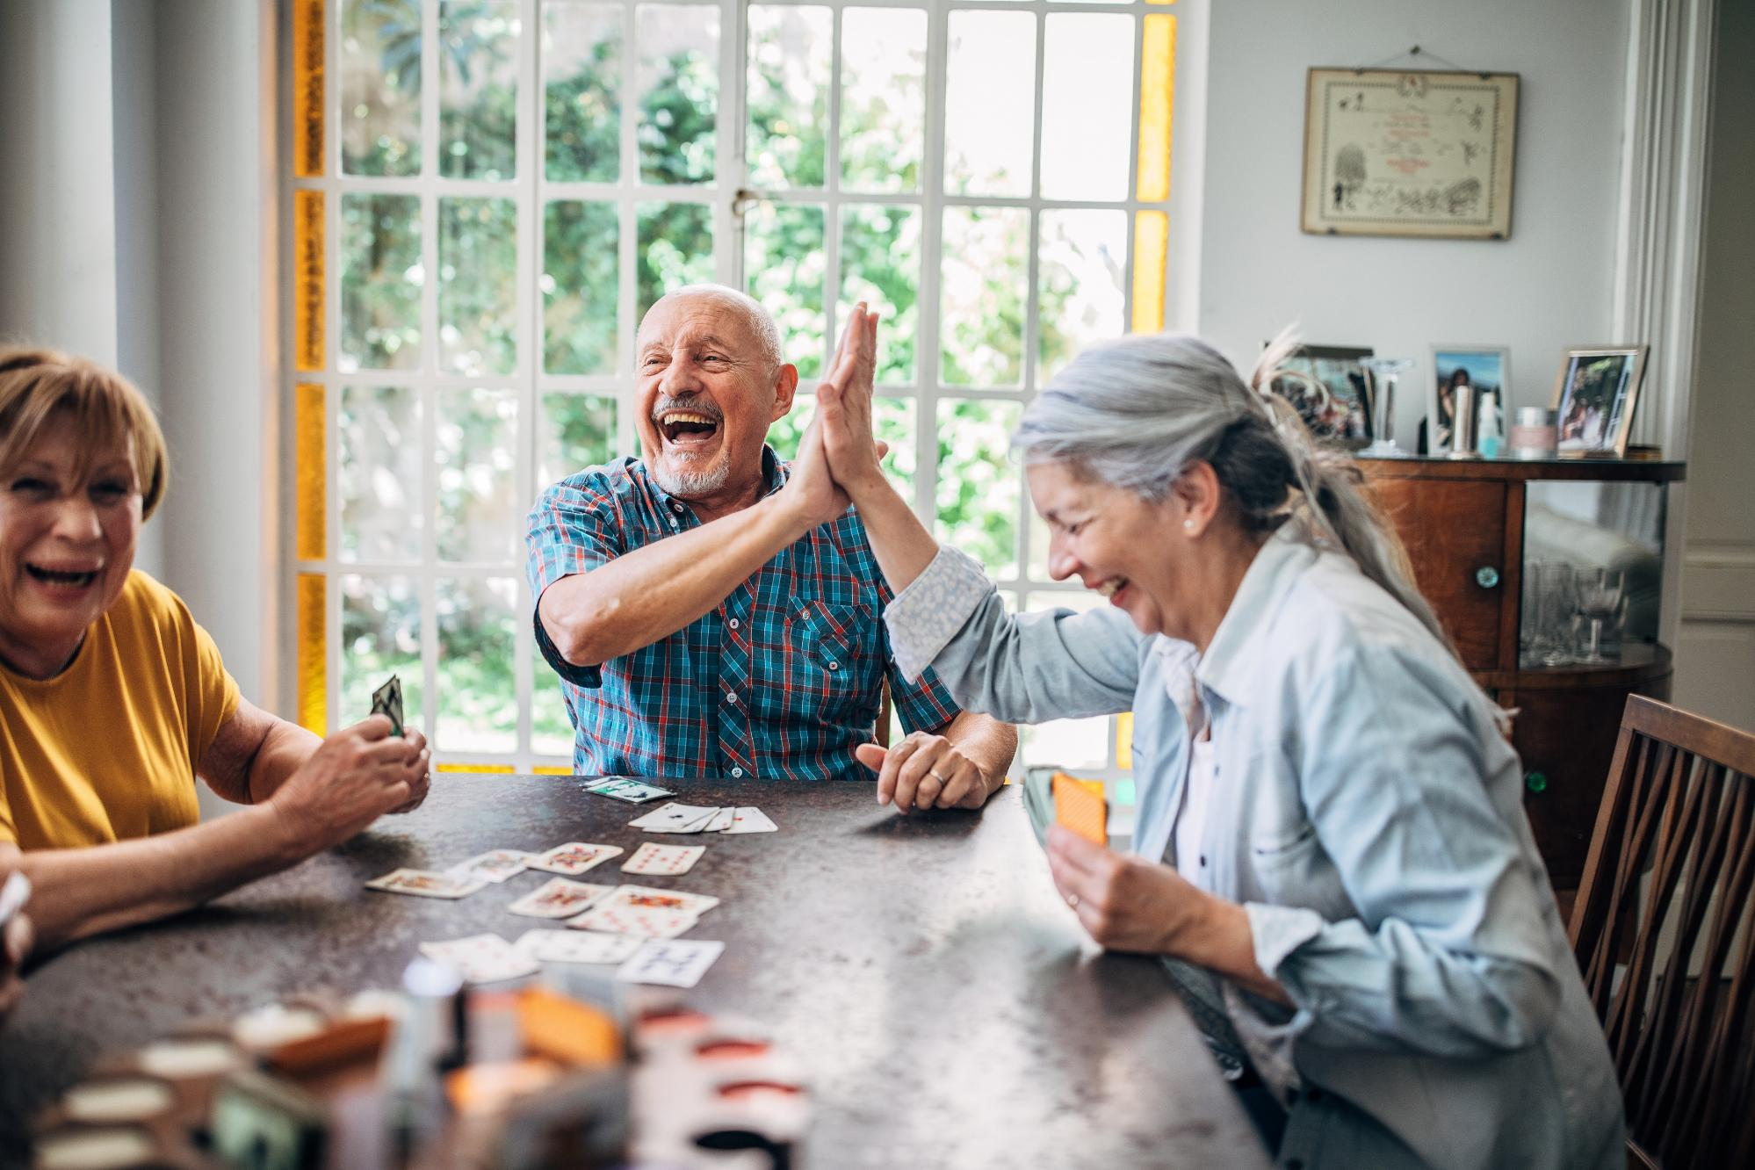

Slide 4


Slide 5


Slide 6


Slide 7

bit.ly/
board_game_geek

Slide 8
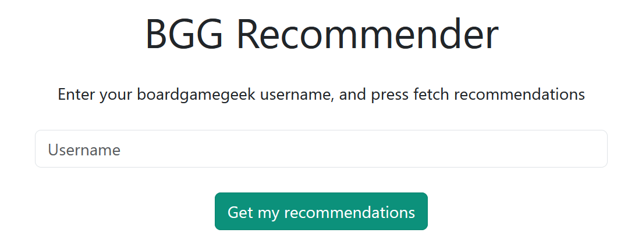


bit.ly/board_game_geek
AlexCast

Slide 9
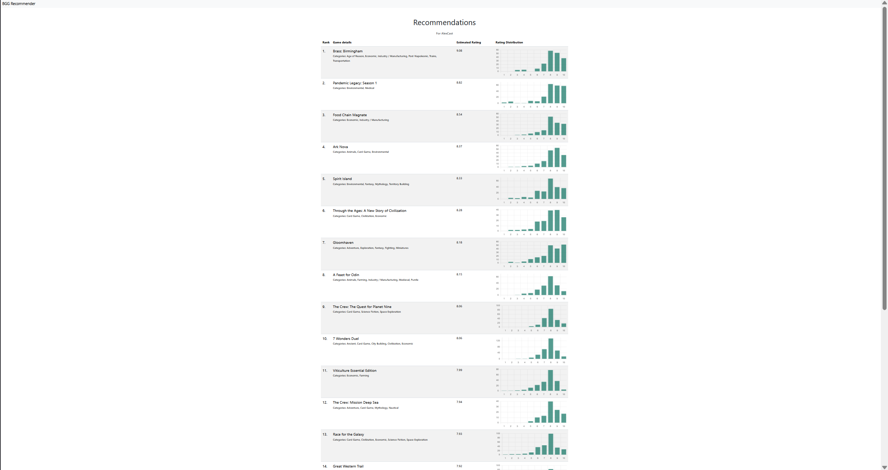
20
recommen-
dations

Slide 10
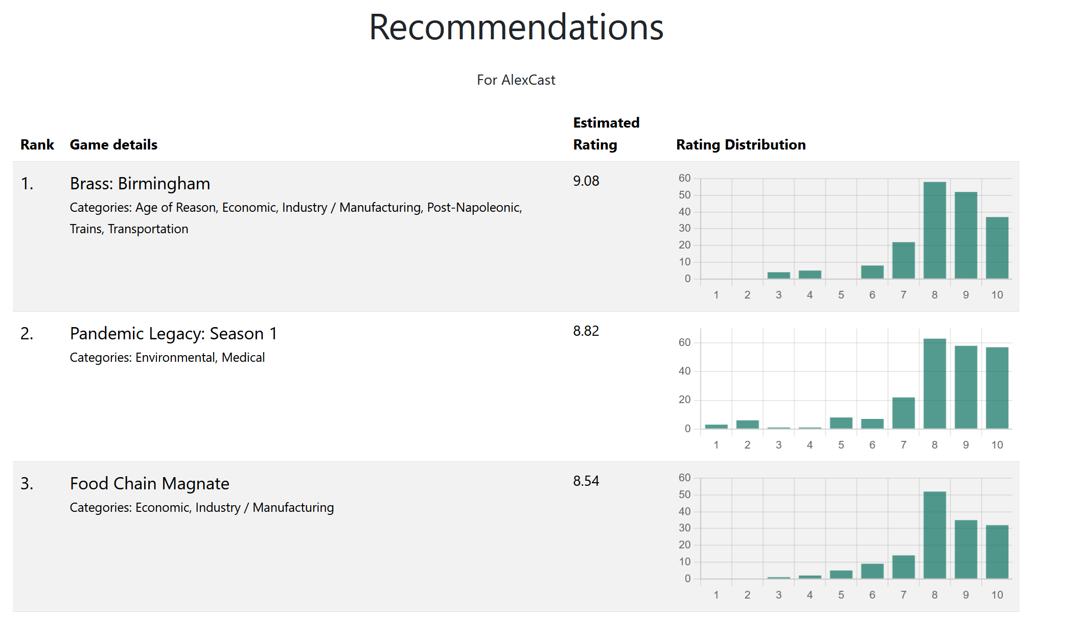



Slide 11




Slide 12
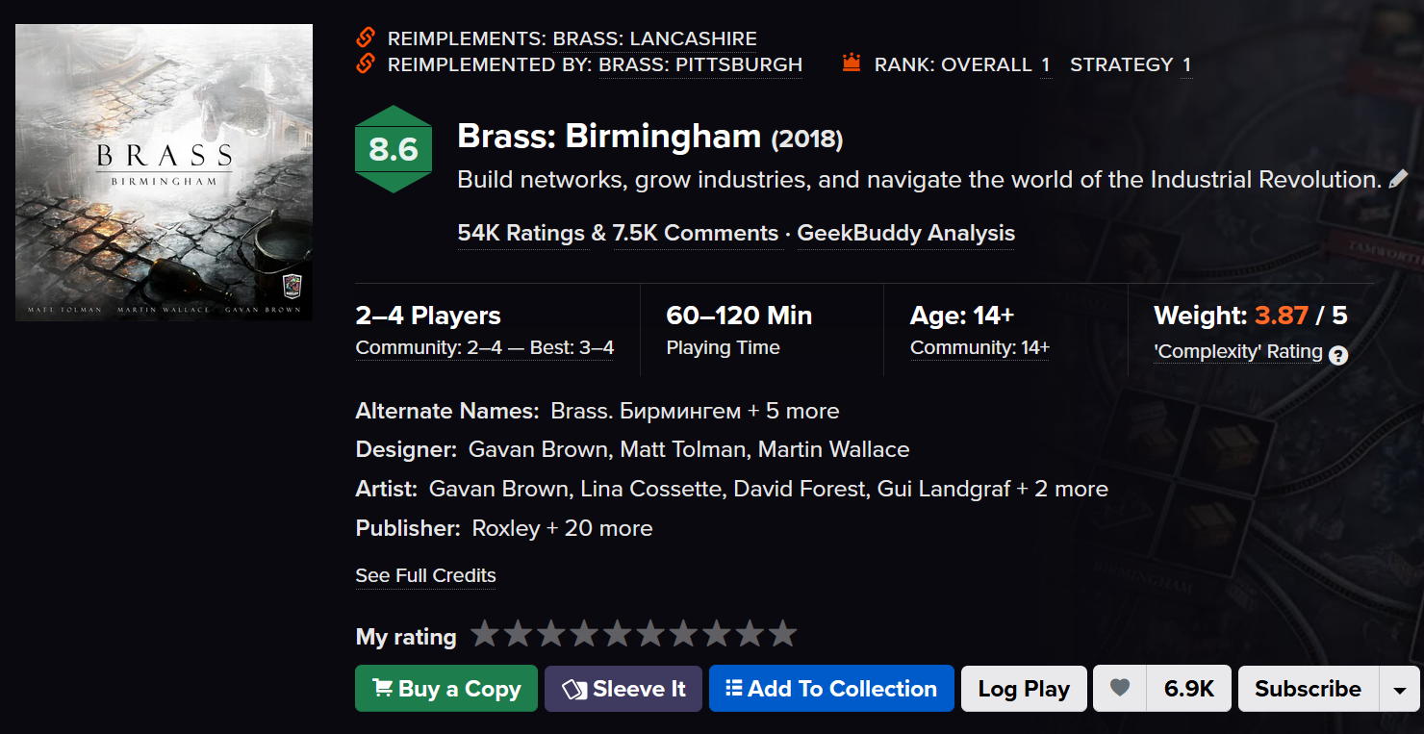

Slide 13

Notes:
Why this, you, know?

Slide 14

Game on! bit.ly/board_game_geek

