Slide 1

2026–2027 COHORT
SPLUNK
ORIENTATION
Zero to Hero
Saturday, October 31, 2026
8:00–10:00 AM Eastern
Notes:
Orientation: October 31, 2026. 8:00–10:00 AM Eastern from cohort announcement. Classes January 9–March 13, 2027, Saturdays at 8 AM Eastern. Source: user instructions and supplied orientation PDF.

Slide 2
Today’s orientation
The learning path
Complete Power User and Admin certification goals before formal classes.
Your personal lab
Purchase a server and prepare to build eight virtual machines in Proxmox VE.
The Saturday curriculum
Ten sessions from January 9 through March 13, 2027, starting at 8:00 AM Eastern.
Your next actions
Set your study plan, confirm hardware, and begin weekly instructor check-ins.
02

Slide 3
The program has two phases
NOW THROUGH DECEMBER 2026
JANUARY–MARCH 2027
Prepare for Power User first, then Enterprise Admin.
Build and operate your own distributed Splunk lab.
Use the exam blueprints, study resources, and short practice exercises.
Apply the concepts from certification study in weekly hands-on work.
Contact the instructor every week with questions and progress.
Finish with a working deployment, dashboards, and a troubleshooting demo.
03

Slide 4
Dates everyone needs
Milestone | Date | Expected result
Orientation | Oct 31, 2026 | Know the plan and requirements
Power User deadline | Nov 28, 2026 | Pass Splunk Core Certified Power User
Admin deadline | Dec 19, 2026 | Pass Splunk Enterprise Certified Admin
First official class | Jan 9, 2027 | Proxmox installation and VM setup
Final class / capstone | Mar 13, 2027 | Demonstrate the complete lab
All official classes: Saturdays at 8:00 AM Eastern.
04

Slide 5
Certification comes first
01 CORE CERTIFIED POWER USER
02 ENTERPRISE CERTIFIED ADMIN
Deadline: Saturday, November 28, 2026
Deadline: Saturday, December 19, 2026
No prerequisite certification. Focus on SPL, fields, knowledge objects, and data models.
Power User is the prerequisite. Focus on system administration and data administration.
Use official objectives to identify gaps and explain why each answer is correct.
Schedule early enough to leave room for a retake under current exam policies.
05

Slide 6
Weekly preparation and support
Every week through December
Reach out to the instructor with exam questions, difficult topics, and your progress.
Power User study period
From orientation through November 28: practice SPL and review the official blueprint.
Admin study period
After Power User through December 19: work through configuration and ingest scenarios.
Free T.O Analytics practice questions
Instructor reports a 100% first-attempt pass rate among more than 14 past users. Results vary.
Study hub: www.to-analytics.com
06

Slide 7
A server is required for every student
Required purchase
Every student must purchase a dedicated server for their personal virtualization lab.
Recommended option
Use the instructor’s Amazon link below. Verify the selected RAM and storage configuration.
Proposed lab target
x86-64 CPU with VT-x / AMD-V, 8+ cores, 64 GB RAM, 1 TB SSD/NVMe, wired Ethernet.
Before January 9
Have the server, a separate laptop, bootable USB media, and a working network ready.
Recommended server: https://a.co/d/0dqtgNco
07

Slide 8
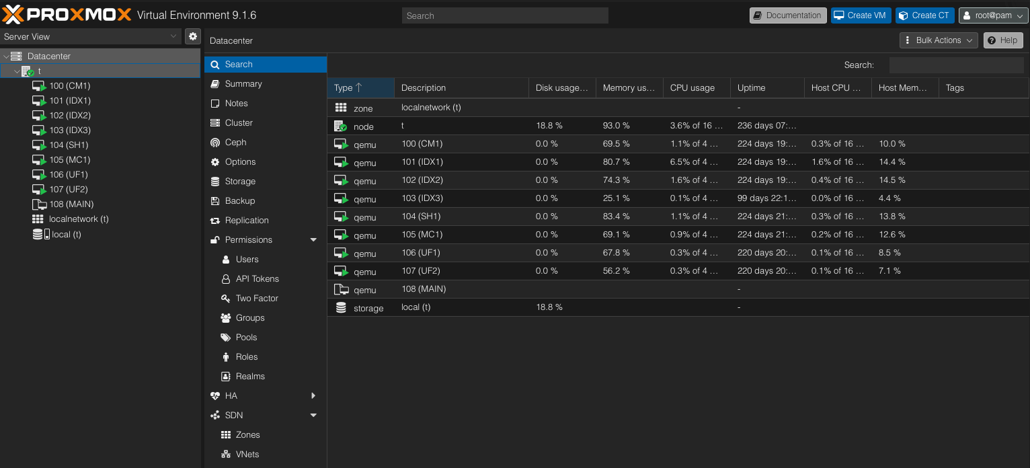
Your Proxmox lab will look like this
Eight Splunk VMs on one physical host. “MAIN” is optional.
08

Slide 9
Eight virtual machines, distinct roles
CM1
Cluster manager
UF1 + UF2
Collect logs
Data flow
IDX1 / IDX2 / IDX3
Store and replicate
Searches
SH1
Search and dashboards
MC1: deployment server, license manager, monitoring console
Lab cluster: replication factor 2, search factor 2. One host still means one physical failure domain.
09

Slide 10
A starting resource budget
VM role | Count | vCPU / VM | RAM / VM | Disk / VM
CM1 | 1 | 2 | 4 GB | 40 GB
IDX1–IDX3 | 3 | 4 | 8 GB | 120 GB
SH1 | 1 | 4 | 8 GB | 60 GB
MC1 (DS / LM / MC) | 1 | 2 | 6 GB | 60 GB
UF1–UF2 | 2 | 1 | 2 GB | 20 GB
Guest allocation | 8 | 22 total | 46 GB total | 560 GB total
64 GB host RAM leaves room for Proxmox and overhead. vCPU totals assume light lab use.
10

Slide 11
Licensing needs an early plan
The Enterprise trial lasts 60 days
The standard trial allows 500 MB/day. January 9–March 13 spans 63 days.
A license must cover the entire cluster lab
Arrange an authorized training or other eligible license before the lab begins.
Developer licenses have a specific purpose
The 10 GB/day developer program is for eligible app development and requires approval.
Splunk Free is not the cluster fallback
Its standalone scope does not replace the Enterprise features required by this curriculum.
Request Dev License - https://dev.splunk.com/developer-program/
11

Slide 12
Before the first official class
Accounts and access
Create your Splunk account. Confirm download access, course resources, and license eligibility.
Hardware and network
Confirm capacity, wired connectivity, virtualization support, and a private IP plan.
Safe installation preparation
Back up the server’s existing data. Proxmox installation can erase the selected disk.
Downloads and documentation
Prepare Proxmox media and an instructor-approved Linux ISO. Keep an IP and hostname inventory.
12

Slide 13
The ten-Saturday curriculum
Date | Session | Lab outcome
Jan 9 | Proxmox and virtual machines | Eight Linux VMs, networking, snapshot
Jan 16 | Distributed Splunk architecture | Installed roles and working cluster
Jan 23 | Forwarders and data onboarding | Validated os, network, gamelog inputs
Jan 30 | SPL and field knowledge | Reusable searches and extractions
Feb 6 | Dashboard Studio and reports | Three dashboards with drilldowns
13

Slide 14
The ten-Saturday curriculum, continued
Date | Session | Lab outcome
Feb 13 | Alerts, CIM and security use cases | Scheduled detections and CIM mapping
Feb 20 | Administration and automation | RBAC, configuration apps, REST exercise
Feb 27 | Health, performance and recovery | Failure drill and troubleshooting runbook
Mar 6 | Modern Splunk capabilities | SPL exercise and feature demonstrations
Mar 13 | Capstone demonstration | Working deployment and final handoff
14

Slide 15
January 9: Proxmox and Linux foundations
Build the virtualization host
Install Proxmox VE, configure storage and a network bridge, and confirm management access.
Create the eight Linux VMs
Use templates or clones, unique hostnames, private addresses, DNS/hosts resolution, and time sync.
Establish a safe baseline
Configure SSH access, updates, a dedicated Splunk service account, and a recovery snapshot.
Evidence to submit
VM inventory, IP map, successful SSH tests, and a documented restore procedure.
15

Slide 16
January 16: The Splunk architecture build
Install and assign roles
Install Enterprise on CM1, IDX1–IDX3, SH1 and MC1. Install Universal Forwarder on UF1 and UF2.
Configure the cluster
Set RF=2 and SF=2, connect SH1, and deploy os, network and gamelog as replicated indexes.
Connect management and forwarding
Configure MC1 licensing, deployment services and monitoring. Forward internal logs centrally.
Evidence to submit
Healthy cluster, searchable test events, forwarder connectivity, and Monitoring Console visibility.
16

Slide 17
January 23: Data onboarding that scales
Deploy inputs through apps
Use server classes and UF configuration apps. Understand where parsing and search-time settings belong.
Work with the lab data
Onboard Linux logs, web access logs, Cisco web/mail logs, and the game XML dataset.
Validate before production-style routing
Check event boundaries, timestamps, time zones, host, source and sourcetype in a test index first.
Evidence to submit
An input inventory and validation searches for os, network and gamelog. Add an HEC exercise.
17

Slide 18
January 30: SPL and knowledge objects
Search efficiently
Use search, where, eval, stats, eventstats, timechart and time functions with explicit time ranges.
Extract and enrich fields
Practice rex and spath, then create reusable extractions, lookups, aliases and calculated fields.
Reuse and correlate
Build macros, tags and event types. Compare stats-based correlation with transaction and join.
Evidence to submit
A tested search workbook with expected results, field definitions and correct object permissions.
18

Slide 19
February 6: Reports and Dashboard Studio
Build the required dashboards
Create OS, Network and Game Activity views based on the deployment lab reporting requirements.
Make the dashboard interactive
Use inputs, tokens, drilldowns, base/chain searches, and clear empty-result behavior.
Apply current Studio features
Explore treemap, table interactions and JSON inspection where the selected lab version supports them.
Evidence to submit
Three shared dashboards with tested panels and reusable report searches.
19

Slide 20
February 13: Alerts and security analytics
Turn a useful search into an alert
Set schedules, time windows, thresholds and throttling. Test actions using controlled sample events.
Map data to CIM
Validate field names and tags. Compare raw searches with data models and accelerated tstats.
Introduce detection engineering
Write a failed-login use case, explain false positives, and connect it to a relevant ATT&CK technique.
Evidence to submit
A tested alert, a CIM mapping checklist, and a short detection explanation.
20

Slide 21
February 20: Administration and automation
Manage access and ownership
Configure roles and index access. Test knowledge-object sharing and service-account ownership.
Control configuration changes
Understand precedence, local/default, app packaging, btool, server classes and cluster bundles.
Automate repeatable tasks
Use a read-only REST inventory exercise, simple scripts, and Git for configuration history.
Evidence to submit
A least-privilege role, versioned configuration app, inventory output, and rollback instructions.
21

Slide 22
February 27: Troubleshooting and recovery
Measure environment health
Use Monitoring Console, _internal and _audit to inspect ingest delays, queues and scheduled searches.
Improve performance
Review expensive SPL, job inspection, acceleration, retention, bucket sizing and storage pressure.
Test availability and recovery
Stop one indexer in a controlled exercise, verify searches, restore service and check cluster recovery.
Evidence to submit
A failure-drill report and a runbook covering diagnosis, recovery and verification.
22

Slide 23
March 6: Modern Splunk in practice
SPL2 alongside SPL
Explore datasets, modules and SQL-style syntax. Compare the result of a simple SPL2 search with SPL.
AI-assisted search
Review generated searches for correctness, permissions, time range and performance before running them.
Data pipelines and observability
Demonstrate Edge Processor concepts and OpenTelemetry logs, metrics and traces when access permits.
Evidence to submit
One SPL2 example plus a short explanation of Enterprise, Cloud, security and observability boundaries.
23

Slide 24
March 13: Capstone and final review
Demonstrate your deployment
Explain every VM role and show healthy replication, searchable data and monitoring.
Demonstrate the user experience
Present OS, Network and Game Activity dashboards plus a tested scheduled alert.
Resolve a troubleshooting scenario
Explain the symptom, gather evidence, apply a fix and verify the result.
Deliver your portfolio
Submit the architecture diagram, sanitized configuration apps, searches and operating runbook.
24

Slide 25
The capstone acceptance checklist
Deployment and availability
Eight roles are reachable. RF/SF are met. Search remains usable during a one-indexer failure drill.
Data quality and analytics
The three indexes have valid events. OS, Network and Game Activity dashboards answer the lab questions.
Operations and security
Monitoring works, a scheduled alert fires, permissions are tested, and secrets stay out of exports.
Repeatability and explanation
Another engineer can follow your inventory, configuration notes and recovery runbook.
27

Slide 26
Tuition and course expectations
$3,500
Every student purchases a server.
Course tuition
Attend Saturday sessions and complete weekly labs.
Bring questions and share progress during the certification phase.
Confirm exam fees and any other costs with the instructor.
Zelle
t.oanalyticsllc@gmail.com
28

Slide 27
Your next steps
This week
Set your Power User study schedule and contact the instructor with your first questions.
By November 28
Pass Power User, then complete Admin preparation for the December 19 deadline.
Before January 9
Purchase your server, verify capacity and connectivity, and confirm the lab licensing plan.
January 9 at 8:00 AM Eastern
Join ready to install Proxmox and build the virtual machines for your Splunk environment.
29

Slide 28
Resources and reference material
T.O Analytics study hub
Power User certification and blueprint
Enterprise Admin certification and blueprint
Splunk Enterprise release notes
What is new in Dashboard Studio
Proxmox VE requirements
30

