Slide 1
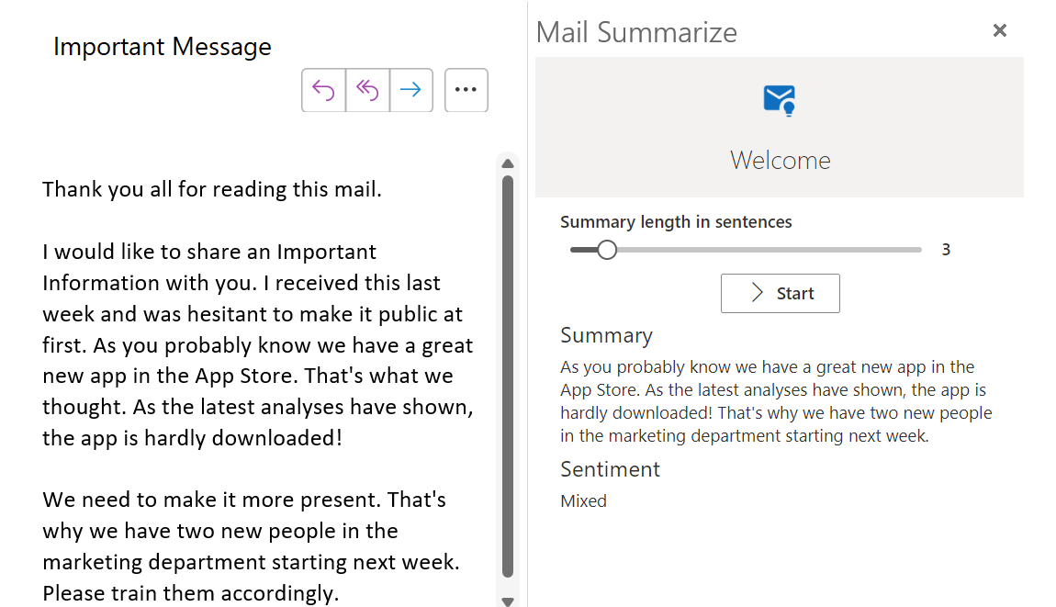
Summarize long mails

Slide 2
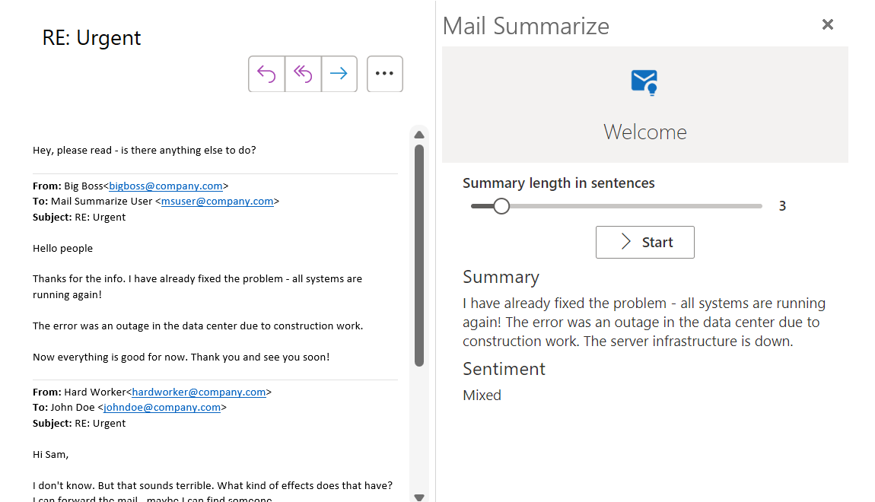
Summarize discussion mails

Slide 3
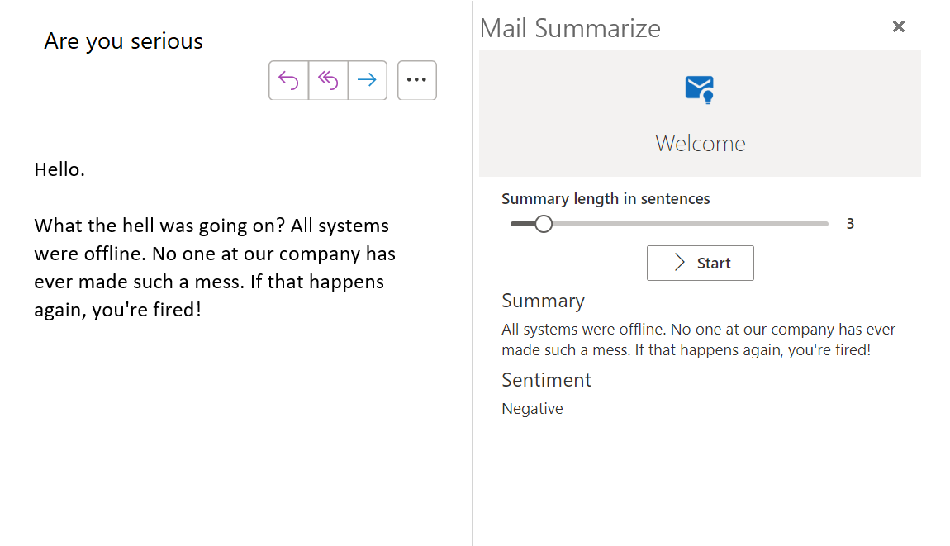
Recognize sentiment

