Slide 1

Introduction to Machine Learning in Python
G. Parkes, S. Senior, T. Rampat

Slide 2
Overview
An introduction to Machine Learning
Scikit-Learn
Practical 1 – Decision Trees/K-Means
More Theory
Practical 2 – TBD

Slide 3
Assumptions
Solid understanding of Python.
No/Little understanding of Machine Learning.
Exposure to Pandas and NumPy beneficial.
Knowledge of the Jupyter Notebook and a Python IDE like Spyder will be beneficial.

Slide 4
Machine Learning – What is it?
A subset of Computer Science and derived from Artificial Intelligence (AI)
At it’s heart a probability generator, with strong ties to statistics/mathematical optimisation.
Improving the probability score taken as ‘learning’. Uses this learnt data to ‘predict’ on new data.
Examples of use: Spam Filtering, Character Recognition, Computer Vision, Search Engines, Social Media

Slide 5
Machine Learning – What is it?
F(X) = y
where X is a matrix of input, independent variables, and y is a vector of output, dependent variables that classify X.
Sepal Length | Sepal Width | Petal Length | Petal Width | Species
5.1 | 3.5 | 1.4 | 0.2 | I. setosa
4.9 | 3.0 | 1.4 | 0.2 | I. setosa
4.7 | 3.2 | 1.3 | 0.2 | I. setosa
7.0 | 3.2 | 4.7 | 1.4 | I. versicolor
6.4 | 3.2 | 4.5 | 1.5 | I. versicolor
6.3 | 3.3 | 6.0 | 2.5 | I. virginica
Taken from Fisher's Iris data set

Slide 6
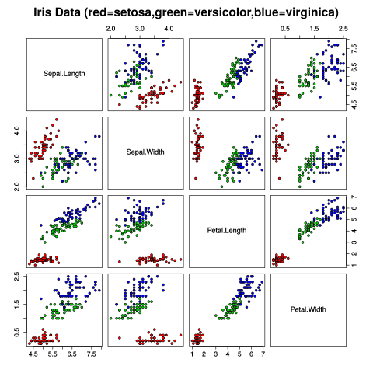
Iris Dataset
Each species is shaded a different colour
Clear distinct patterns emerge
ML trained to learn these patterns
Applies it to new information when available
By Nicoguaro - Own work, CC BY 4.0, https://commons.wikimedia.org/w/index.php?curid=46257808

Slide 7
Machine Learning – Going slightly deeper
Three broad categories:
Supervised Learning – Presented with example inputs and corresponding outputs, given by a ‘teacher’.
Unsupervised Learning/Data Mining – No labels given to inputs, computer infers features.
Reinforcement Learning – Interacts with a dynamic environment where it must perform a certain goal, feedback via rewards/punishments.

Slide 8
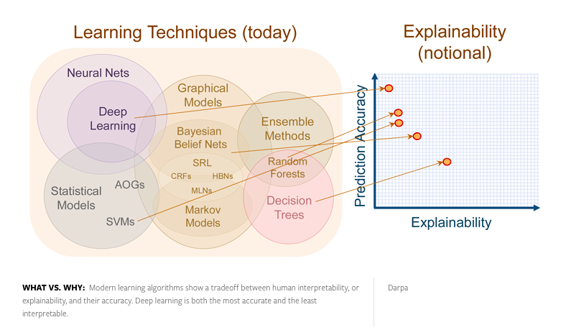
Understandability of Machine Learning
Taken from Nautil.us

Slide 9
Scikit-Learn
A package in Python programming language. Part of the Anaconda Distribution.
Built on NumPy, SciPy and MatPlotLib libraries.
Open source, commercially usable.
Simple to set up for most applications, very powerful functionality.
Highly accessible.

Slide 10
Scikit-Learn
Name of Method | Example use | Algorithm
Classification | Spam Detection, Image Recognition | SVM, random forest, nearest neighbours
Regression | Drug response, stock prices | SVR, Ridge regression, LASSO
Clustering | Customer segmentation, grouping experiment outcomes | K-Means, Spectral Clustering, mean-shift
Dimensionality Reduction | Visualization, increased efficiency | PCA, Feature Selection, non-negative matrix factorisation
Model Selection | Improved accuracy via parameter tuning | Grid search, cross validation, metrics
Preprocessing | Transforming data (i.e text) for use in ML algorithms | Feature Extraction
Taken from scikit-learn.org

Slide 11
Practical 1.1 – Decision Trees
Enter the folder ‘Practical-1-1-DT’
Open ‘apples.py’, run the example, and make changes to the features, labels, and trying your own pieces of fruit. Try and understand what is happening.
A ’tree.dot’ file will be created from running ’apples.py’. Use $ bash apples.sh $ to create a .png to visualise the decision tree.

Slide 12
Practical 1.2 – Classification & Iris Dataset
Enter the folder ‘Practical-1-1-DT’
Open ‘iris.py’, run the example, and make changes to the code, such as features, labels etc.
Complete Tasks 1 and 2 by implementing iris_dataset_2 and 3.
For a challenge, complete Task 3 by using another dataset.
Attempt all of the tasks before looking at the solutions-iris.py file.

Slide 13
Classification Summary

Slide 14
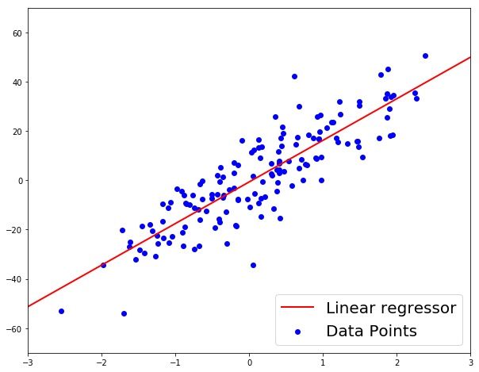
Regression
Regression is a measure of the relationship between some input values (features) and an output value (target).
Regression can be used for prediction of a target variable, the modeling of relationships, and the testing of hypotheses.
There are many different regression techniques.
Ski-Kit learn contains useful modules for regression.

Slide 15
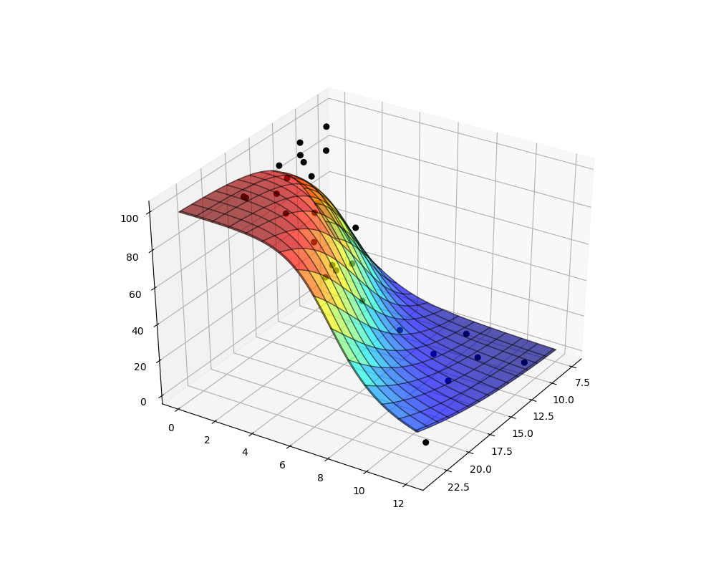
Regression
Regression becomes very useful when the dataset being dealt with is large or there are many features to it.
In a linear regression model, n variables satisfy a linear relationship,
y = β₀ + β₁x₁ + β₂x₂ + … + β_{n}x_{n} + ε_{i}
where the coefficients β are unknown and ε_{i} are random error terms.
By fitting a dataset, the β coefficients can be found and a model made.

Slide 16
Preprocessing
Preprocessing is the processing of data before modeling or analysis such that it is gotten into a ready state to be worked on.
An example of preprocessing was seen earlier in the first classification exercise, where the texture of the fruit was given as a string and had to be converted to a binary number.
Other preprocessing includes the splitting of data into training and testing sets and normalisation of the data.
More about preprocessing can be found on the scikit-learn website: http://scikit-learn.org/stable/modules/preprocessing.html#preprocessing

Slide 17
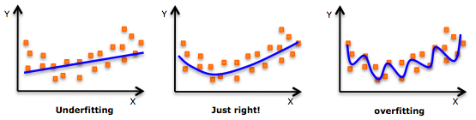
Underfiitting and Overfitting
If underfitted a model will not be good at making predictions.
If overfitted a model has been trained too much on one dataset and while it will good accuracy for that set, for other sets it will not have good accuracy.
One way to reduce overfitting is to only include features in a dataset that are believed to have a significant impact on the target.
https://stats.stackexchange.com/questions/192007/what-measures-you-look-at-the-determine-over-fitting-in-linear-regression/192021

Slide 18
Scikit-Learn and Regression
Scikit-learn makes linear regression very simple.
Import the linear_model module from sklearn, choose which linear model to use, fit the data to it, analyse and test the results.
In scikit-learn there are a number of regression techniques available, including linear, lasso, and ridge regression.
The linear regression techniques can be found under sklearn.linear_model
Scikit-learn comes with some built in dataset which can be found under sklearn.datasets

Slide 19
Regression and Decision Trees
When the target in a dataset is discrete the problem is one of classification.
When the target in a dataset is continuous then the problem is one of prediction.
It was seen how decision trees were used to classify the type of iris species.
Decision trees can be used continuous targets to predict values and the importance of each feature.

Slide 20
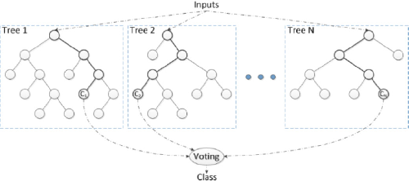
Extra Tree Regressor
To help improve accuracy for decision trees with regression and extra tree regressor can be used.
An extra tree regressor fits a number of randomised trees on different subsamples of the dataset and averages them to improve the accuracy and to control overfitting.
When an optimal selection of features is chosen the Extra Tree performs as well as the Random Forest, though in general is computationally faster.
https://wwrchgate.net/301243118_fig4_Figure-6-Random-Forest-Modelw.resea

Slide 21
Feature Importance and Metrics
Extra Trees are hard to visualise as there’s typically a large number of trees.
Instead, useful information such as feature importance can be extracted.
Feature importance gives a score to each feature that is a measure of how much they affect the target.
To gauge the accuracy metrics such as the R-squared value can be used.
Feature importance and the R-squared values are easy to extract in scikit-learn.

Slide 22
Regression Exercise
An example of linear regression analysis using scikit-learn and Python can be found in the “RegressionExercise” Jupyter Notebook, located in the “Exercises” directory.
Follow through the regression analysis in this Notebook and perform the same regression analysis for the “Saratoga Houses” dataset found in the “data” directory (Python code is already written to read this in).

Slide 23
Regression Summary
Regression can be used to find the relationship between a target variable and feature variables.
It can also be used to predict values of the target variable for given feature values.
Decision trees can be used to make a regression model.
Feature importances can be found for a given model.

Slide 24
Image Classifier With TensorFlow
Overview
Basic Introduction to Deep-learning
TensorFlow for Poets
Practical 1
Practical 2

Slide 25
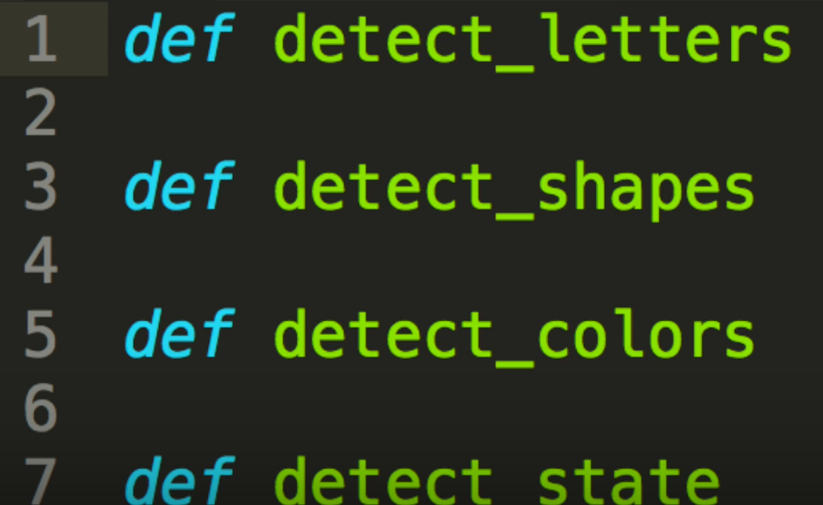
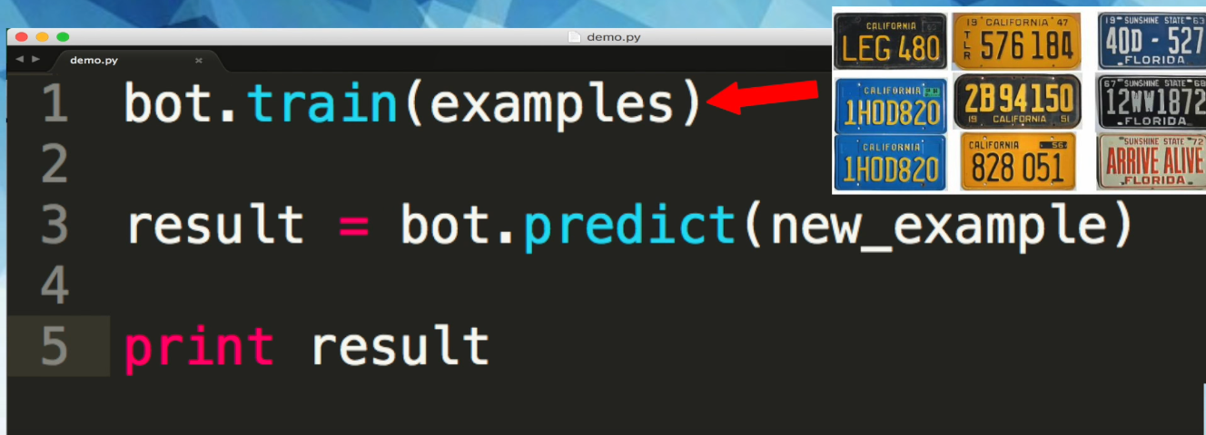

Deep-Learning
Hard Coding
Machine-Learning
Recap:
Supervised: Feedback every time- (Practical 1)
Unsupervised: No feedback, learns by itself
Reinforced learning: Feedback if positive(trial and error)- Practical 2
E.G License plate

Slide 26
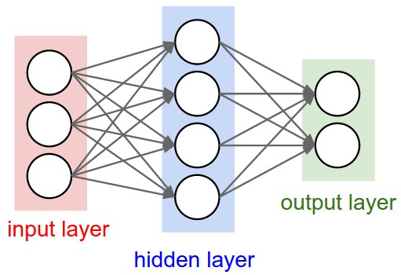
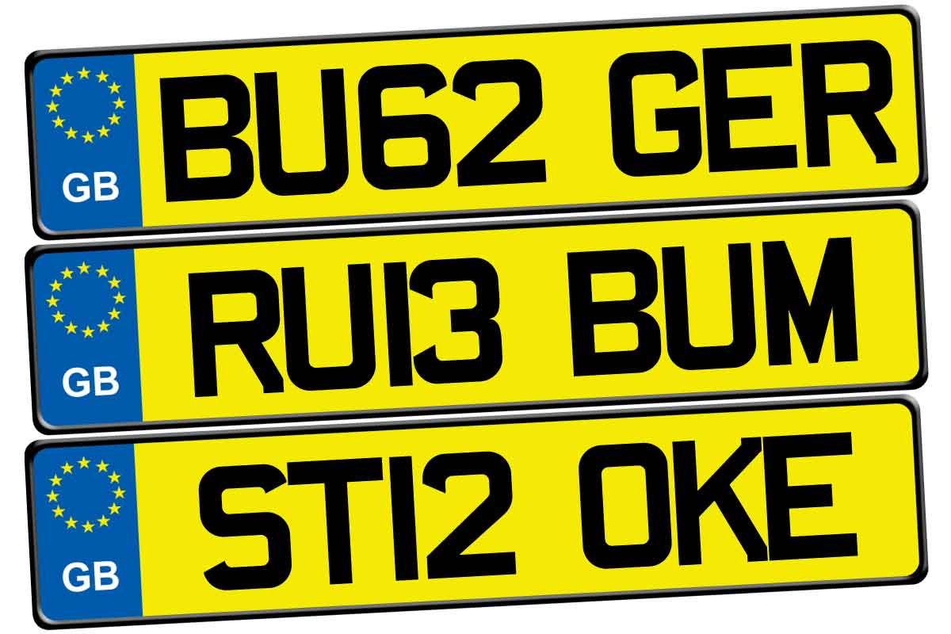

Neural Network
License plate UK
f(complex_0)
f(complex_1)
f(complex_2)
…
License plate FR
f(complex_3)
http://playground.tensorflow.org/

Slide 27


Slide 28

What is TensorFlow?
TensorFlow is a deep learning library recently open-sourced by Google.
But what does it actually do?
TensorFlow provides primitives for defining functions on tensors and automatically computing their derivatives.
http://playground.tensorflow.org/

Slide 29
Practical 1 - Supervised
https://codelabs.developers.google.com/codelabs/tensorflow-for-poets/?utm_campaign=chrome_series_machinelearning_063016&utm_source=gdev&utm_medium=yt-desc#0

Slide 30

Practical 2
What about a game using reinforcement learning?
Input Output
Maximise the score
Raw Pixel
https://github.com/HackerHouseYT/OpenAI-NEAT

Slide 31
Deep-Learning Summary

Slide 32
Summary
Machine learning is a wide ranging topic that focuses on learning from large datasets.
Data from discrete types of input can be classified using decision trees.
Regression can be used to find relationships in datasets and to make predictions.
TensorFlow can be used for image classification.
This work was supported by an EPSRC Doctoral Training Centre grant (EP/L015382/1)

Slide 33
Further Resources
The scikit-learn website: www.scikit-learn.org
The tensorflow website: www.tensorflow.org
A YouTube series on making a basic neural network: https://goo.gl/uvhELR

