Slide 1
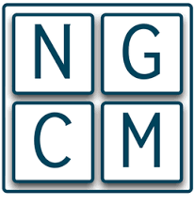
Introduction to Machine Learning in Python
G. Parkes, S. Senior, T. Rampat

Slide 2
Overview (Open for Suggestions)
An introduction to Machine Learning
Ski-kit Learn
TensorFlow for Poets
Hands-on with Installation
Summary

Slide 3
Assumptions
Moderate understanding of Python, including it’s more useful library packages.
No/Little understanding of Machine Learning.

Slide 4
Machine Learning – What is it?
A subset of Computer Science and derived from Artificial Intelligence (AI)
At it’s heart a probability generator, with strong ties to statistics/mathematical optimisation.
Improving the probability score taken as ‘learning’. Uses this learnt data to ‘predict’ on new data.
Examples of use: Spam Filtering, Character Recognition, Computer Vision, Search Engines, Social Media

Slide 5

Machine Learning – What is it?
$$f\left(X\right)=y$$
where X is a matrix of input, independent variables, and y is a vector of output, dependent variables that classify X.
Sepal Length | Sepal Width | Petal Length | Petal Width | Species
5.1 | 3.5 | 1.4 | 0.2 | I. setosa
4.9 | 3.0 | 1.4 | 0.2 | I. setosa
4.7 | 3.2 | 1.3 | 0.2 | I. setosa
7.0 | 3.2 | 4.7 | 1.4 | I. versicolor
6.4 | 3.2 | 4.5 | 1.5 | I. versicolor
6.3 | 3.3 | 6.0 | 2.5 | I. virginica
Taken from Fisher's Iris data set

Slide 6
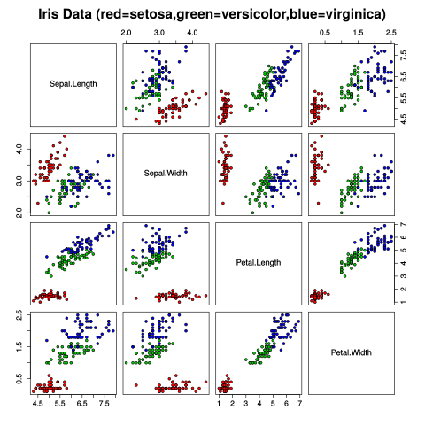
Iris Dataset
Each species is shaded in different colour
Clear distinct pattern emerges
ML trained to learn these patterns
Applies it to new information when available
By Nicoguaro - Own work, CC BY 4.0, https://commons.wikimedia.org/w/index.php?curid=46257808

Slide 7
Machine Learning – Going slightly deeper
Three broad categories:
Supervised Learning – Presented with example inputs and corresponding outputs, given by a ‘teacher’.
Unsupervised Learning/Data Mining – No labels given to inputs, computer infers features.
Reinforcement Learning – Interacts with a dynamic environment where it must perform a certain goal, feedback via rewards/punishments.

Slide 8
Ski-kit Learn
A package in Python programming language. Part of the Anaconda Distribution.
Built on NumPy, SciPy and Matplotlib libraries.
Open source, commercially usable.
Simple to set up for most applications, very powerful functionality.
Highly accessible.

Slide 9
Ski-kit Learn
Name of Method | Example use | Algorithm
Classification | Spam Detection, Image Recognition | SVM, random forest, nearest neighbours
Regression | Drug response, stock prices | SVR, Ridge regression, LASSO
Clustering | Customer segmentation, grouping experiment outcomes | K-Means, Spectral Clustering, mean-shift
Dimensionality Reduction | Visualization, increased efficiency | PCA, Feature Selection, non-negative matrix factorisation
Model Selection | Improved accuracy via parameter tuning | Grid search, cross validation, metrics
Preprocessing | Transforming data (i.e text) for use in ML algorithms | Feature Extraction
Taken from skikit-learn.org

Slide 10
Summary

