Slide 1

Introduction to Machine Learning in Python
G. Parkes, S. Senior, T. Rampat

Slide 2
Overview
An introduction to Machine Learning
Ski-kit Learn
Practical 1 – Decision Trees/K-Means
More Theory
Practical 2 – TBD

Slide 3
Assumptions
Solid understanding of Python.
No/Little understanding of Machine Learning.
Exposure to Pandas and NumPy beneficial.
Knowledge of a Python IDE like spyder will be beneficial.

Slide 4
Machine Learning – What is it?
A subset of Computer Science and derived from Artificial Intelligence (AI)
At it’s heart a probability generator, with strong ties to statistics/mathematical optimisation.
Improving the probability score taken as ‘learning’. Uses this learnt data to ‘predict’ on new data.
Examples of use: Spam Filtering, Character Recognition, Computer Vision, Search Engines, Social Media

Slide 5

Machine Learning – What is it?
$$f\left(X\right)=y$$
where X is a matrix of input, independent variables, and y is a vector of output, dependent variables that classify X.
Sepal Length | Sepal Width | Petal Length | Petal Width | Species
5.1 | 3.5 | 1.4 | 0.2 | I. setosa
4.9 | 3.0 | 1.4 | 0.2 | I. setosa
4.7 | 3.2 | 1.3 | 0.2 | I. setosa
7.0 | 3.2 | 4.7 | 1.4 | I. versicolor
6.4 | 3.2 | 4.5 | 1.5 | I. versicolor
6.3 | 3.3 | 6.0 | 2.5 | I. virginica
Taken from Fisher's Iris data set

Slide 6
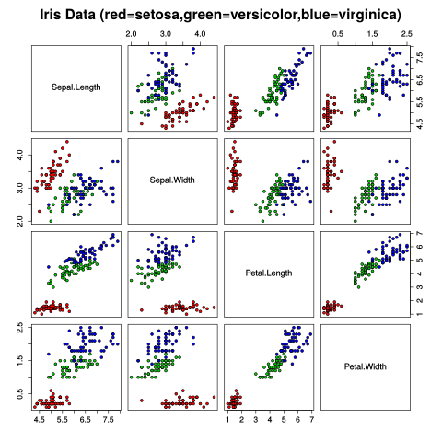
Iris Dataset
Each species is shaded in different colour
Clear distinct pattern emerges
ML trained to learn these patterns
Applies it to new information when available
By Nicoguaro - Own work, CC BY 4.0, https://commons.wikimedia.org/w/index.php?curid=46257808

Slide 7
Machine Learning – Going slightly deeper
Three broad categories:
Supervised Learning – Presented with example inputs and corresponding outputs, given by a ‘teacher’.
Unsupervised Learning/Data Mining – No labels given to inputs, computer infers features.
Reinforcement Learning – Interacts with a dynamic environment where it must perform a certain goal, feedback via rewards/punishments.

Slide 8
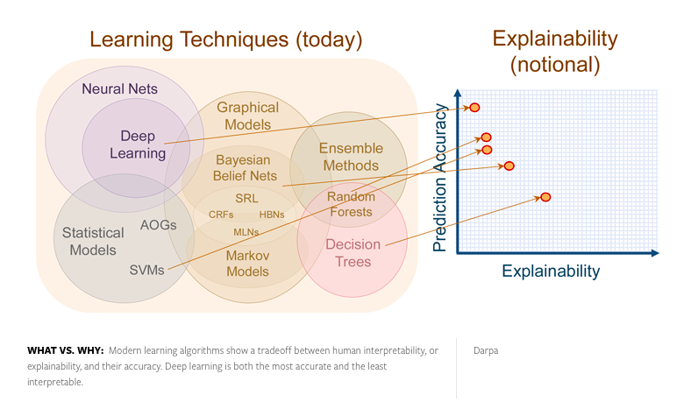
Understandability of Machine Learning
Taken from Nautil.us

Slide 9
Ski-kit Learn
A package in Python programming language. Part of the Anaconda Distribution.
Built on NumPy, SciPy and MatPlotLib libraries.
Open source, commercially usable.
Simple to set up for most applications, very powerful functionality.
Highly accessible.

Slide 10
Ski-kit Learn
Name of Method | Example use | Algorithm
Classification | Spam Detection, Image Recognition | SVM, random forest, nearest neighbours
Regression | Drug response, stock prices | SVR, Ridge regression, LASSO
Clustering | Customer segmentation, grouping experiment outcomes | K-Means, Spectral Clustering, mean-shift
Dimensionality Reduction | Visualization, increased efficiency | PCA, Feature Selection, non-negative matrix factorisation
Model Selection | Improved accuracy via parameter tuning | Grid search, cross validation, metrics
Preprocessing | Transforming data (i.e text) for use in ML algorithms | Feature Extraction
Taken from skikit-learn.org

Slide 11
Practical 1.1 – Decision Trees
Enter the folder ‘Practical-1-1-DT’
Open ‘apples.py’, run the example, and make changes to the features, labels, and trying your own pieces of fruit. Try and understand what is happening.
A ’tree.dot’ file will be created from running ’apples.py’. Use $ bash apples.sh $ to create a .png to visualise the decision tree.

Slide 12
Practical 1.2 – Classification & Iris Dataset
Enter the folder ‘Practical-1-1-DT’
Open ‘iris.py’, run the example, and make changes to the code, such as features, labels etc.
Complete Tasks 1 and 2 by implementing iris_dataset_2 and 3.
For a challenge, complete Task 3 by using another dataset.
Attempt all of the tasks before looking at the solutions-iris.py file.

Slide 13
Summary
This work was supported by an EPSRC Doctoral Training Centre grant (EP/L015382/1)

