Slide 1
Who Gets the Call?
Predicting 30-day hospital readmission for diabetic patients
ML for Social Good Ensemble Challenge · CIA 3 · Mission Health
MCA 521-4 Machine Learning · CHRIST (Deemed to be University)
Best model: Stacking · Test ROC-AUC 0.6574 · 2.44× lift at 10% capacity
Dataset: UCI Diabetes 130-US Hospitals (Strack et al., 2014) · CC BY 4.0

Slide 2
The problem
Mission Health · under-resourced clinics, fixed follow-up capacity
1 in 11
$15,000
$75
diabetic inpatients readmitted within 30 days
cost of one avoidable readmission
cost of one nurse follow-up call
The gap is not knowing that calls work. It is knowing who to call.
▪
Beneficiaries: diabetic inpatients (especially uninsured and high-utilising)
▪
Discharge nurses, who get a ranked worklist instead of an undifferentiated ward list
▪
Safety-net hospitals carrying fixed capacity and rising CMS penalties
▪
Prediction target: P(readmission < 30 days), evaluated at the moment of discharge
●
Impact metric: precision@10% and lift@10% — not accuracy, which is meaningless at a 9% base rate

Slide 3
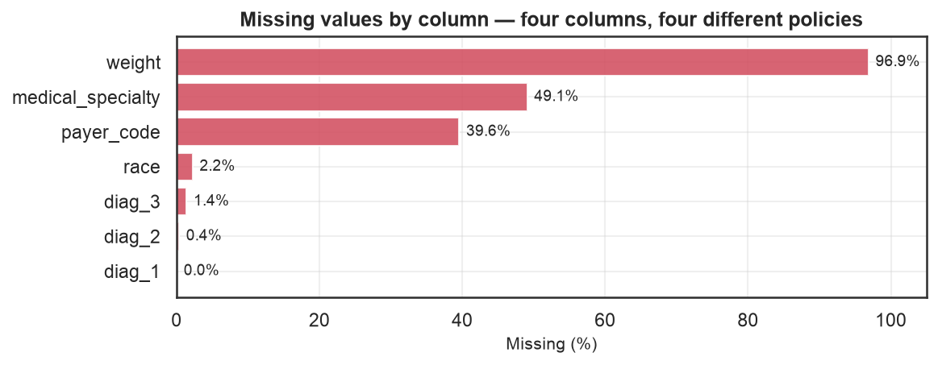
The data
101,766 encounters · 130 US hospitals · peer-reviewed at source
▪
UCI Diabetes 130-US Hospitals, 1999–2008
▪
Published with Strack et al. (2014), BioMed Research International
▪
CC BY 4.0 · de-identified under HIPAA Safe Harbor
▪
50 columns: demographics, utilisation, 23 drugs, ICD-9 diagnoses
▪
Chosen because it genuinely contains every wrangling problem the
▪
brief asks us to handle — not a pre-cleaned benchmark
Four columns, four different policies:
weight 96.9% → drop the value, keep 'was weighed' as a feature
medical_specialty 49.1% → explicit Unknown level
payer_code 39.6% → Unknown level; proxies for uninsured
race 2.2% → Unknown; never imputed, it is a protected attribute

Slide 4
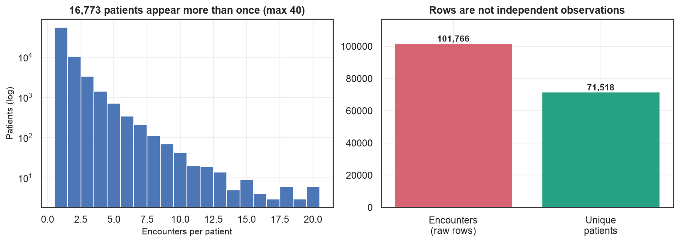
Cleaning was the hard part
Every dropped row is logged with a reason
▲
101,766 rows are only 71,518 patients — one appears 40 times
▪
Rows are not independent observations
▪
Kept each patient's first encounter (as Strack et al. did)
▪
Dropped 2,423 encounters ending in death or hospice —
▪
a patient who died cannot be readmitted
●
Positive rate fell 11.16% → 8.98% after de-duplication
That 2.2-point drop is the finding:
repeat encounters skew positive, so encounter-level
modelling quietly flatters itself.

Slide 5
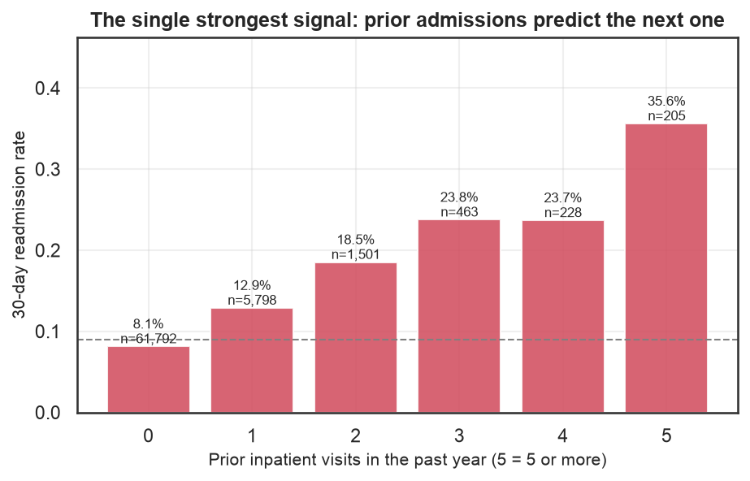
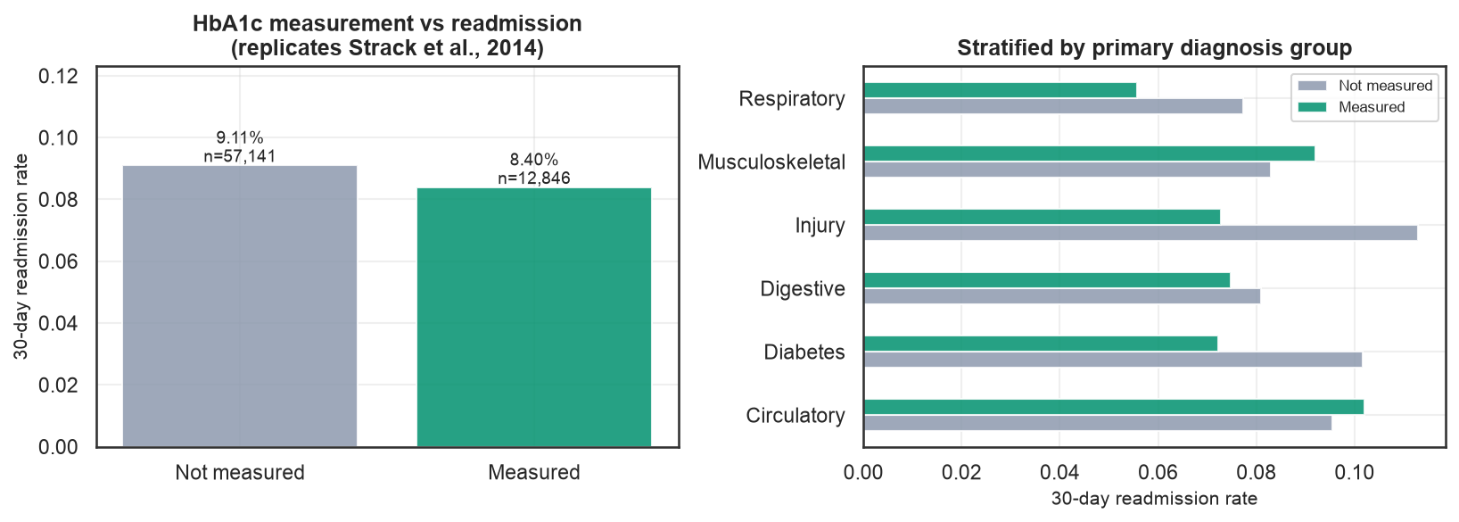
What the data says
Every claim is a plot, not an assertion
▪
Readmission rises monotonically with prior admissions: 8.1% → 29.3%
●
We reproduce the source paper's HbA1c finding (8.40% tested vs 9.11% not) — a credibility check on our cleaning
▪
HbA1c testing is one of the few actionable levers; age and race are not

Slide 6
Leakage-safe by construction
Asserted in code, not claimed in prose
▪
Stratified 60/20/20 split, seed 42
Split | Rows | Positive rate
Train | 41,991 | 8.98%
Validation | 13,998 | 8.98%
Test | 13,998 | 8.98%
▪
One row per patient ⇒ no patient can straddle a split
▪
Every transform lives inside an sklearn Pipeline,
▪
so CV refits it on each fold
▪
Test set untouched until the final comparison
▪
Class weights, not SMOTE: interpolating between one-hot
Imputer chosen by experiment
▪
medical categories invents patients who cannot exist
No numeric gaps remain after our policy, so we injected
MCAR missingness to answer a deployment question:
At 30% missing — KNN 0.6295
median 0.6130
MICE 0.5992
KNN degrades most gracefully.

Slide 7
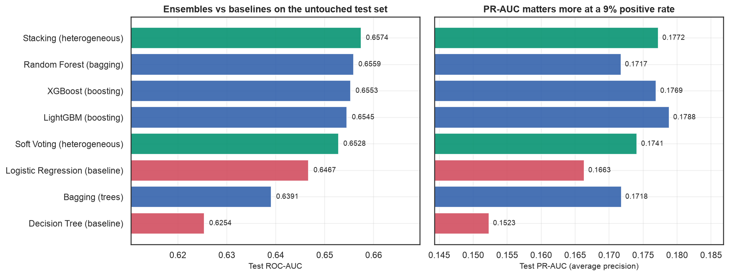
Baseline vs bagging vs boosting vs stacking
Eight models, one untouched test set
Stacking uses 5-fold internal CV so base learners only ever produce out-of-fold predictions — that is what stops the
meta-learner from rewarding whichever base model memorised hardest.

Slide 8
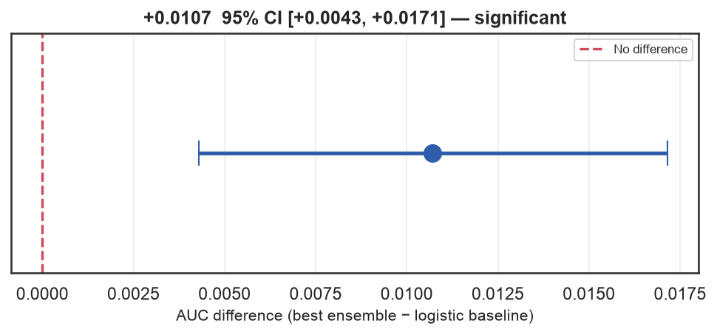
Does the ensemble beat the baseline?
Answered with a confidence interval, not a bigger number
0.6574
0.6467
+0.0107
Stacking — test ROC-AUC
Logistic baseline — test ROC-AUC
difference · 95% CI excludes zero
Yes — significantly, but modestly. Bootstrap 95% CI [+0.0043, +0.0171] over 2,000 resamples; McNemar agrees.
An AUC near 0.66 matches the published ceiling on this dataset. The limit is the data: housing, food security and
caregiver support drive readmission, and none of them are in a discharge record. Reporting 0.95 here would mean a leak.

Slide 9
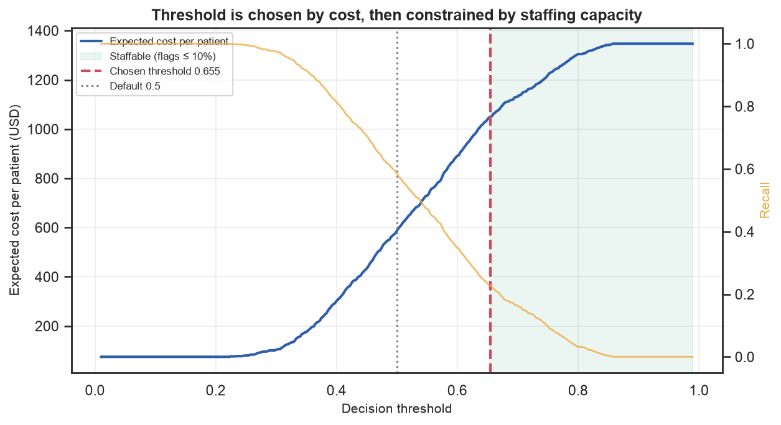
The threshold is a rationing decision
0.5 is a library default, not a clinical choice
▪
A missed readmission costs ~200× a phone call
▲
So unconstrained cost optimisation says: call everyone
▪
Correct for a clinic with unlimited nurses.
▪
Useless for a real one.
●
Capacity — not cost — is the binding constraint
●
Deployed threshold 0.655, flagging ~10%
At 10% capacity:
precision 21.9% vs 9.0% base rate
→ 2.44× more at-risk patients reached
with the same nurse hours.

Slide 10
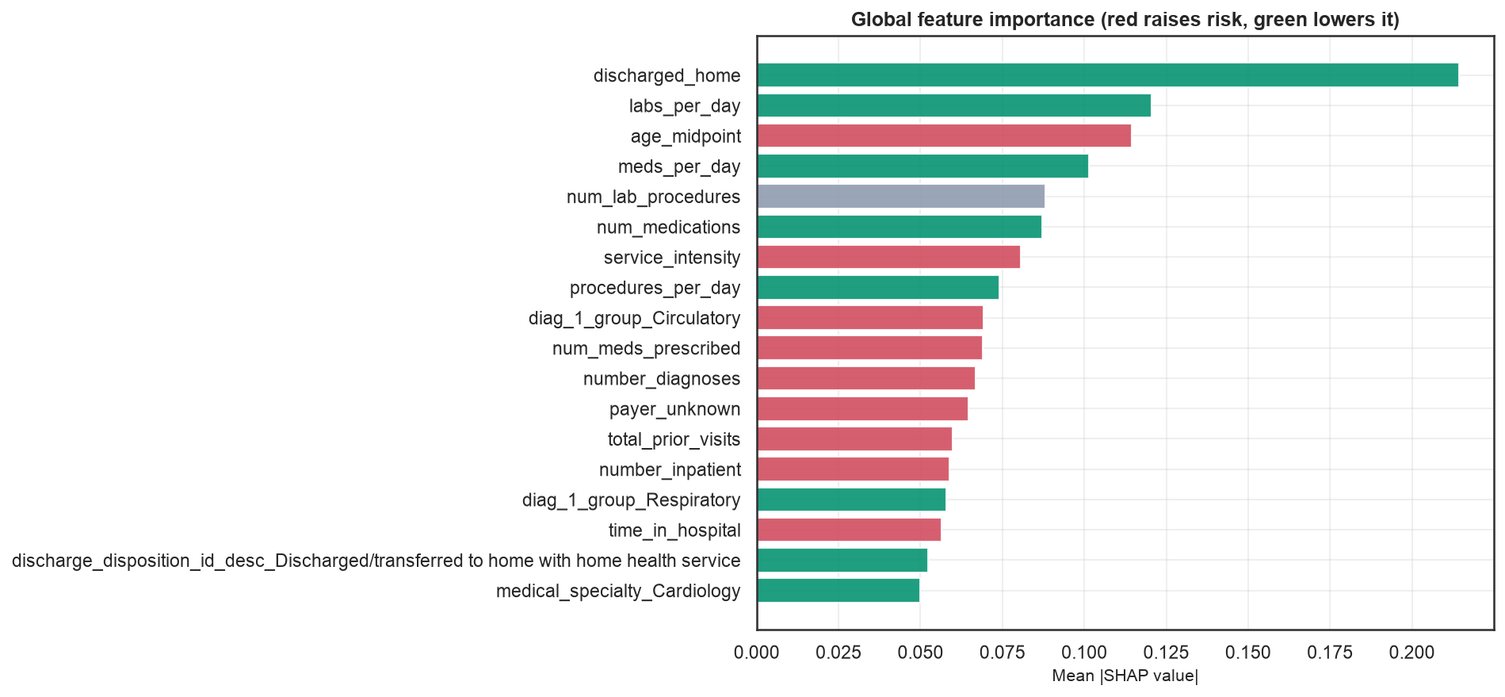
Why the model says what it says
SHAP, cross-checked against two other methods
▪
Prior inpatient visits dominate — matching the EDA
▪
gradient and mutual information, independently
▪
Directions match what we predicted before looking
▪
Cross-checked with permutation importance and LIME
▪
●
Actionable: HbA1c testing, medication reconciliation,
●
discharge destination
▪
Descriptive only: age, race, prior visit counts
A model whose top features were all descriptive would rank well and change nothing. Several of these are modifiable.

Slide 11
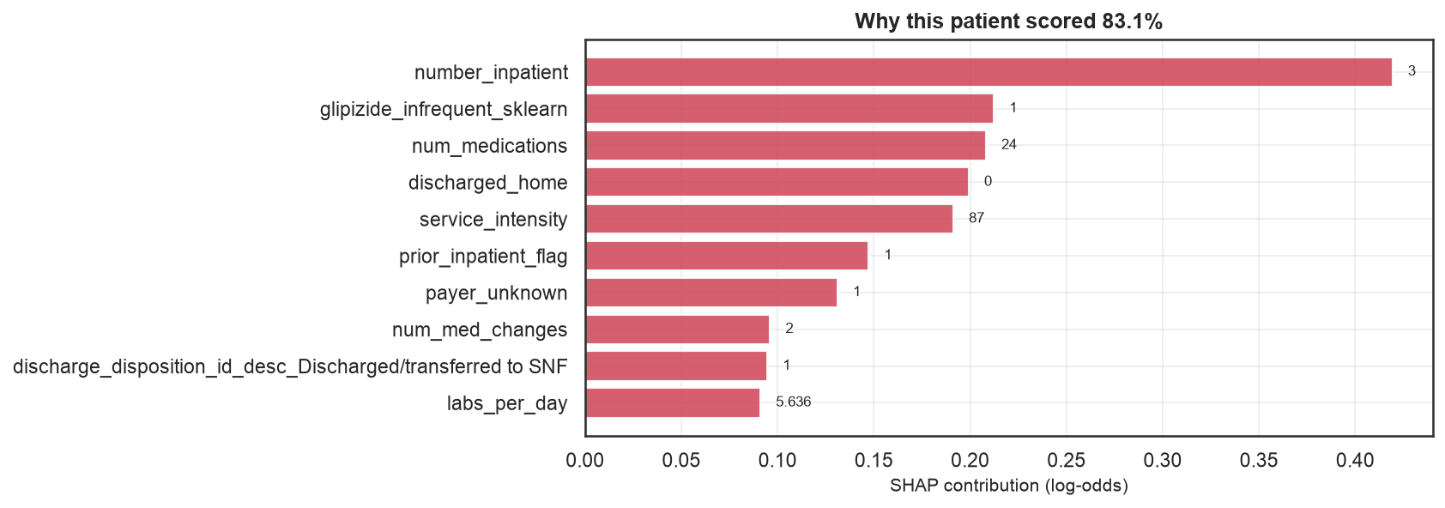
One patient, one explanation
The live demo, on a synthetic record
▪
78-year-old, three prior admissions
▪
HbA1c above 8, no payer code recorded
▪
Discharged to a skilled nursing facility
▪
▲
Flagged for a follow-up call
▪
Each contribution shown in log-odds —
▪
auditable, not decorative
Abstention band 0.40–0.60 routes
borderline cases to human review
instead of auto-deciding.

Slide 12
The fairness audit failed
And that is the most important slide here
Attribute | Disparate impact | Passes 4/5ths | AUC gap
race | 0.541 | NO | 0.101
gender | 0.945 | Yes | 0.015
age_band | 0.164 | NO | 0.183
payer_group | 0.265 | NO | 0.074
Equal need, unequal service
African American patients: 9.23% readmission rate
Caucasian patients: 9.07% readmission rate
Flagged for follow-up: 8.0% vs 10.2%
Recall: 19.9% vs 25.0%
▲
Not explained by differing risk — the underlying risk is the same
▲
Label bias runs deeper: only same-network readmissions are recorded, so mobile and uninsured patients are
▲
systematically labelled negative. No fairness metric above can see this — they all use the same biased labels
▪
Per-group thresholds would equalise recall, but conditioning a clinical cut-off on race is not a fix we would deploy
●
This result only appeared once the threshold was set honestly. At a threshold that flags everyone, everything passes.

Slide 13
What this model cannot do
Stated plainly, because the alternative is unsafe
▲
Near-random (AUC 0.566) on repeat high-utilisers vs 0.687 on first admissions — weakest where need is greatest
▲
Fails the four-fifths rule on race, payer and age → not deployment-ready
▲
Labels miss out-of-network readmissions, biased against the most vulnerable
▪
1999–2008 US data; not transferable to Indian clinics without prospective revalidation
▪
Triage aid only — never care denial, insurance pricing, discharge decisions, or staff evaluation
▪
Clinician override mandatory, and never logged against the clinician
●
Privacy: de-identified at source, no PII added, all demo records synthetic
The fairness audit was not a box to tick. It produced a result that blocks release — which is what an audit is for.

Slide 14
Same nurse hours.
2.4× more at-risk patients reached.
With an explanation attached to every flag,
and an explicit statement of who the model fails.
make setup && make data && make train && make app
Strack et al. (2014) · UCI ML Repository #296 · CC BY 4.0

