Slide 1
Finding claims that are actually overpaid
0–100
overpayment score
per claim
A claim-level overpayment score built on the ICD-10-CM guidelines, the MS-DRG grouper and FY 2026 IPPS pricing
Notes:
This deck explains, at a high level, how the guideline navigator scores claims for overpayment review. The tool reads the diagnosis and procedure codes on each claim, checks them against the FY 2025 ICD-10-CM Official Guidelines, groups the claim with the MS-DRG grouper, prices it at FY 2026 IPPS rates and returns one score from 0 to 100 per claim: the estimated chance that a review ends in an overpayment finding.

Slide 2
Most guideline errors don't move the money
17 of 59
findings on the 33 test claims lowered the payment when they were corrected
An error is an overpayment only if fixing it lowers the DRG payment
If another code carries the same CC/MCC level, the DRG stays the same and a review closes as no finding
So every finding is regrouped and repriced before it counts toward the score
Notes:
Guideline violations and overpayments are not the same thing. Across the 33 test claims the checks raised 59 findings, but only 17 lowered the payment when the correction was applied and the claim was regrouped and repriced. 36 left the DRG unchanged, usually because another code already carried the same CC or MCC level. An overpayment review built on those would close as no finding. That is why the score only counts findings whose correction lowers payment. The test claims are synthetic, built to exercise each rule, so the proportion on real claims will differ.

Slide 3
Six steps from codes to a score
1
2
3
4
5
6
Validate codes
Check guidelines
Group
Price
Test each finding
Score and explain
FY 2026 code set; retired and incomplete codes flagged
17 code checks and 12 validation targets, each tied to its rule
MS-DRG v43.1 (drgpy logic) assigns the billed DRG
FY 2026 IPPS operating and capital, transfers, outliers
Apply its correction, regroup, reprice: does payment drop?
Score, expected recovery, title, explanation, Excel export
Repeated for every finding: correct, regroup, reprice
Only findings that lower the payment add to the score. The rest are still reported, as coding-accuracy issues.
Notes:
Each claim passes through six steps. Codes are validated against the FY 2026 code set. The guideline checks look for code patterns the guidelines forbid or question, plus high-value diagnoses auditors routinely validate. The claim is grouped and priced as billed. Then, for every finding, the page applies the correction (resequence, combine, remove or downgrade a code), regroups and reprices the claim, and records whether the payment drops. Finally it combines the payment-lowering findings into the score and writes the explanation.

Slide 4
486 guideline rules, ranked into four tiers
Tier 1
Sepsis sequencing (I.C.1.d.3), septic shock, symptom codes as principal (II.A)
73 rules · top 15%
Tier 2
Sepsis with organ dysfunction, pressure ulcer stages (I.C.12.a)
122 rules · next 25%
Tier 3
Burn sequencing, admission from outpatient surgery (II.J)
146 rules · next 30%
Tier 4
Weeks of gestation, delivery outcome codes
145 rules · last 30%
Notes:
Every rule in the FY 2025 guidelines was scored on eight metrics: payment impact, audit risk, disease severity, precision (how checkable it is from codes alone), strength of the instruction, precedence in the guideline hierarchy, specificity and breadth. The weighted score ranks the rules into four tiers. The weights can be changed in the navigator, and the rule score feeds into the claim score: a finding backed by a stronger rule is more likely to be upheld.

Slide 5
Grouper and pricer match their references
MS-DRG grouper
FY 2026 IPPS pricer
26,468
$0.005
claims grouped exactly as drgpy v43.1 groups them
largest difference from an independent pricer over 8,310 cases
687 of 772 DRGs reached in testing
Uses diagnoses, procedures, sex and discharge status
About 0.06 ms per claim
Operating and capital: wage index, COLA, IME, DSH
Transfers per CMS SE1411; cost outliers
Table 5 weights with the 10% cap
Both run inside the HTML page: scoring a claim, including every regroup and reprice, takes about 0.2 ms.
Notes:
The grouper is the drgpy MS-DRG v43.1 logic translated to JavaScript. 26,468 claims were grouped by the page and by drgpy in Python with no differences. The pricer applies the FY 2026 IPPS payment steps: operating and capital payments, transfer per diem rules from CMS SE1411 and cost outliers. It was compared with a separately written Python pricer on 8,310 cases and with hand calculations. Present-on-admission indicators are not used yet, and add-on payments such as new technology are not priced.

Slide 6
The score: chance a review ends in recovery
1
Chance it is upheld
2
Does fixing it lower payment?
3
Combine into one score
Likely guideline error
55%
Yes
100%
Score = 100 × [1 − 0.98 × Π(1 − q)]
q = what each finding counts (steps 1–2)
Needs coding review
30%
No change, or raises payment
0%
High
40 and above
Clinical validation target
24%
Cannot be simulated
35%
Medium
25 to 39
Low
10 to 24
Data quality
10%
Outpatient claim
10%
Minimal
below 10
base rate × strength of the guideline rule
share of the chance that counts
selected at 30 or more (adjustable)
Expected recovery = Σ (chance × payment drop) · chance of no finding = 100 − score
Notes:
Step 1 estimates how likely each finding is to be upheld: a base rate by finding type, scaled by the strength of the guideline rule behind it. Step 2 keeps only the part that would recover money: 100 percent if the correction lowers payment, zero if it does not, 35 percent if the payment effect cannot be simulated from codes, and 10 percent for outpatient claims. Step 3 combines the findings with a 2 percent baseline into one score, and the expected recovery is each chance times its payment drop. The base rates are estimates until they are calibrated with real audit outcomes.

Slide 7
Worked example: one finding moves the money
Billed
If E43 is not supported
22
The claim (inpatient)
DRG 193
DRG 194
J18.9 Pneumonia (principal)
E43 Severe malnutrition · MCC
N17.9 Acute kidney failure · CC
I10 Hypertension
N18.30 CKD stage 3
E11.9 Diabetes, no complications
E11.22 Diabetes with CKD
$9,565
$5,864 (−$3,700)
Score · Low
Finding | Chance upheld | Payment change | Counts
Severe malnutrition (E43) | 21% | −$3,700 | 21%
Hypertension + CKD not combined | 46% | $0 | 0%
Diabetes coding contradiction | 45% | $0 | 0%
Acute kidney failure (N17.9) | 21% | $0 | 0%
Mostly unspecified codes | 9% | none | 0%
E43 is the only MCC, so DRG 193 depends on it.
Expected recovery $760 · maximum $3,700 · below the default threshold of 30. Action: clinical validation review of E43.
Notes:
This is the claim behind the Try an example button. As billed it groups to MS-DRG 193, simple pneumonia with MCC, priced at $9,564.57. Five findings fire. Two are real coding errors, the hypertension and CKD combination and the diabetes contradiction, but correcting them leaves the claim in DRG 193, so they add nothing to the score. Only severe malnutrition moves the money: if it is not supported and is downgraded to moderate malnutrition, the claim loses its only MCC and drops to DRG 194 at $5,864.34, a $3,700 difference. With a 21 percent chance of being upheld, the score is 22, Low, with an expected recovery of $760.

Slide 8
Test claims rank by money at risk
4 of 33
claims selected at the default threshold of 30
$21,661
expected recovery, of $75,159 if every finding were upheld
16
claims Minimal: clean, or errors with no payment effect
33 synthetic test claims, one per rule or pricing path
Notes:
On the 33 test claims, the highest scores go to coding errors that change the DRG and are visible in the codes, such as severe sepsis coded without its infection or hypertension and CKD coded separately. Single clinical validation targets, such as malnutrition or encephalopathy acting as the only MCC, land around 22 because those are upheld less often. Four claims cross the default threshold of 30. Claims with errors that do not change payment fall to Minimal. You can also rank by expected recovery in dollars instead of by score.

Slide 9
Every test suite passes
Suite | Scope | Result
Grouper vs drgpy | 26,468 claims · 687 DRGs | All match
Pricer vs independent pricer | 8,310 cases incl. transfers, outliers | ≤ $0.005
Pricer hand calculations | 3 worked payments | 3 of 3
Scenario outcomes | Findings, DRGs and payments | 33 of 33
Scoring math | Independent recomputation | 33 of 33
Titles and explanations | Amounts and DRGs quoted correctly | 33 of 33
Browser end-to-end | Upload, settings, Excel export | 12 of 12
10 issues found and fixed
Transfer status codes aligned to CMS SE1411
Retired code N18.3 caught by the FY 2026 code check
New joint check for MCCs that shadow each other
Underpayment and ungroupable claims now titled as such
Tests run the shipped HTML file’s own code against independent references.
Notes:
The tests load the shipped HTML file and run its own embedded code, then compare against independent references: drgpy in Python for grouping, a separately written Python pricer, hand-specified expected outcomes for 33 scenario claims and an independent recomputation of the scoring math. A browser test uploads the template, scores it and compares the Excel export with the Node results. Testing found ten issues, all fixed, including transfer status codes, the retired N18.3 code, and a missed overpayment where two MCCs shadowed each other.

Slide 10
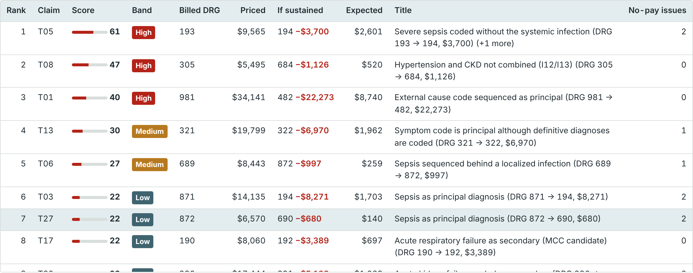
How to run it on your claims
1
Fill in the template
One row per claim; claim_id and diagnosis columns are required
2
Upload and confirm columns
The page finds the claims sheet and maps the columns
3
Set hospital factors
Ranked claims in the page: score, billed DRG and payment, DRG and payment if upheld, expected recovery, title
Wage index, COLA, IME, DSH and cost-to-charge ratio
4
Review and export
Files: guideline_navigator.html · Claims_Upload_Template.xlsx · How_The_Overpayment_Scorer_Works.docx · Test_Report.xlsx
Ranked claims with score cards; Excel adds six result sheets
Notes:
Open guideline_navigator.html in a browser; nothing is installed and claims stay on your machine. Fill in Claims_Upload_Template.xlsx with one row per claim, upload it in the Claims tab, confirm the column mapping, set the hospital factors used for pricing and run the scoring. The ranked list opens a score card for any claim, and the Excel download keeps your sheets and adds the scores, drivers, bands, a DRG summary, the method and the guideline catalog. The Word document explains the method in detail and the test report lists every test.

Slide 11
Next: calibrate with real audit results
1
Calibrate the chance upheld
2
Add present-on-admission flags
Load past audit outcomes and replace the estimated base rates with measured finding rates
Turns on hospital-acquired-condition logic in the grouper
3
Group by discharge date
4
Price the add-ons
drgpy covers MS-DRG v36 to v43.1; choose the version from each claim’s date
New technology, readmission, HAC and VBP adjustments; outpatient claims under OPPS
The score shows what is at stake and how likely a finding is. Validation targets still need the medical record.
Notes:
The most valuable next step is calibration: map past audit outcomes in the upload, and the page already reports outcome rates and AUC by band, so the estimated base rates can be replaced with measured ones. After that, adding present-on-admission flags, grouping each claim with the MS-DRG version in effect on its discharge date, and pricing add-on payments would make the payment estimates closer to what was actually paid.

