Slide 1

Offensive Tweet Prediction in R with Docker
Hands-on Workshop
07.06.19
Samuel Stelzer

Slide 2

Content
Preparations
Problem and approach
Modelling (code walk-through)
Deploy
Appendix: Troubleshooting

Slide 3

1. Preparations
Installing Tools and Libraries

Slide 4
Installing R and Docker
Download and install R: https://cran.r-project.org/bin/windows/base/
Download and install Rstudio: https://www.rstudio.com/products/rstudio/download/
Download Docker Desktop and register account: https://docs.docker.com/docker-for-windows/install/
Download data: https://github.com/uds-lsv/GermEval-2018-Data
Clone project: https://github.com/samuelstelzer/twitter_sentiment_analysis.git

Slide 5
Installing packages
#!/usr/bin/ Rscript
install.packages('caret')
install.packages('xgboost')
install.packages('dplyr')
install.packages('tidytext')
install.packages('data.table')
install.packages('stringr')

Slide 6
2. Problem and approach
Problem and process description

Slide 7
Problem description
A lot of toxic/offensive tweets can be found on Twitter
Based on labled data: Can we predict if a new tweet is offensive?
Approach: Supervised learning using text mining methodology

Slide 8
Machine Learning Process
deployment
data understanding
data cleaning
feature engineering
model training
evaluation
1 iteration

Slide 9
Machine Learning Data Pipeline
train
training
data
read data
clean data
create features
scale features
pre-processing
application
predict

Slide 10
3. Modelling (code walk-through)
Short description: what does the code do?

Slide 11
Load packages
#!/usr/bin/ Rscript
# I. load libraries and source functions
library('caret')
library('dplyr')
library('tidytext')
library('data.table')
library('stringr’)
source("./R/feature_creation.R")
[…]
attach packages to current workspace environment
load functions from file feature_creation.R (execute the code in that file)

Slide 12
Read data
# II. read data
# read tweet data
train_raw_df <- read.table(
"./data/germeval2018.training.txt",
header = FALSE, fill = TRUE, sep = "\t",
comment.char = "", quote = NULL,
stringsAsFactors = FALSE,
na.strings = "",
encoding = "UTF-8")
[…]
tab-separated file
Quotes can be used in Tweets
Usually ‚#‘ but this is actual a useful character in tweets
Be careful with „Umlauts“

Slide 13
Some data preparation
# III. preprocess text
# 1. rename columns
names(total_df) <- c("text", "sentiment", "offense_type")
# 2. factor variables
total_df$sentiment <- as.factor(total_df$sentiment)
total_df$offense_type <- as.factor(total_df$offense_type)
[…]
factor variables in R are „categorical“ variables

Slide 14
Train-test split
# 6. split into training and test data
set.seed(42)
train_index <- createDataPartition(
total_df$sentiment,
p=0.8,
list=FALSE)
train_df <- total_df[train_index,]
test_df <- total_df[-train_index,]
[…]
set random seed for reproduceability
80% training data
20% test data

Slide 15
tf-idf for the sentiments
„pipe“ operator
# IV. create sentiment tfidf dictionaries
sentiment_words <- train_df %>%
unnest_tokens(word, text) %>%
count(sentiment, word, sort = TRUE) %>%
bind_tf_idf(word, sentiment, n) %>%
mutate(tf_idf = ifelse(sentiment == "OTHER",
tf_idf,
tf_idf * -1)
) %>%
arrange(tf_idf)
tokenize
make count matrix
Make tf-idf matrix
Make tf-idf value negative for offensive words (stopwords have 0)
sort by tf-idf value

Slide 16
Feature creation I
data.table assignment by reference operator
number of characters
df[, chars := nchar(text)]
df[, words := str_count(text, pattern = "[^ ]+")]
df[, avg_chars_per_word := chars / words]
df[, text := gsub("@[a-zäöüß_0-9]+",
"@MENTION", text, ignore.case = TRUE)]
df[, mentions := str_count(text,
pattern = "@MENTION") / words]
df[, text := gsub("(^| )@MENTION", "", text)]
df[, linebreaks := str_count(text, pattern = " \\|LBR\\| ") / chars]
df[, text := gsub(" \\|LBR\\| ", " ", text, ignore.case = TRUE)]
number of words
„normalize“ and count mentions
count and remove linebreaks
most of the features are relative to the number of characters or words in the tweet

Slide 17
Feature creation II
Consecutive identical punctuation
„…“ „???“ „!!!“
df[, consecutive_punctuation := str_count(text,
pattern = "([[:punct:]])\\1") / chars]
[…]
df[, hashtags := str_count(text, pattern = "#") / words]
df[, all_caps_words := str_count(text,
pattern = "(?:^| )[A-ZÄÖÜ]{4,}") / words]
df[, ws_before_punctuation := str_count(text,
pattern = " [;,!\\.\\?] ?[[:alpha:][;,!\\.\\?]]+(?:$| )")]
df[, non_ascii := str_count(text, pattern = regex(
"(?![äöüß])[^[:ascii:]]", ignore.case = TRUE)) / words]
[…]
Number of hashtags used in the tweet
Non-ASCII characters (Emojis), exclude Umlauts

Slide 18
Feature creation III
tf-idf vectorization using the same matrix as we did during training
tf_idf_df <- create_tf_idf_df(df)
df <- max_positive_tfidf(tf_idf_df, df)
df <- min_positive_tfidf(tf_idf_df, df)
df <- avg_positive_tfidf(tf_idf_df, df)
df <- max_negative_tfidf(tf_idf_df, df)
df <- min_negative_tfidf(tf_idf_df, df)
df <- avg_negative_tfidf(tf_idf_df, df)
df <- avg_tfidf(tf_idf_df, df)
df <- negative_tfidf_count(tf_idf_df, df)
df <- positive_tfidf_count(tf_idf_df, df)
df <- negative_count(tf_idf_df, df)
df <- positive_count(tf_idf_df, df)
df <- neutral_count(tf_idf_df, df)
Feature: maximum positive sentiment in the tweet (single token)
analogous for minimum etc.
Using a dictionary of German word sentiments to count the fraction of negative words in the tweet

Slide 19
Feature creation IV
function definition accepting a data.frame object called df
create_tf_idf_df <- function(df) {
tf_idf_df <-
df %>%
unnest_tokens(word, text, drop = FALSE) %>%
merge(sentiment_words)
return(tf_idf_df)
}
tidytext function unnest_tokens on word level in tthe column text,
drop = FALSE prevents removing text to later join it
join the previously created sentiment words data
(tf-idf-vector on sentiment as document)

Slide 20
Feature creation V
if no words in the tweet are found in the tf-idf-matrix return 0
max_negative_tfidf <- function(tf_idf_df, df, default=0) {
if (nrow(tf_idf_df) == 0) {
result_df <- df[, max_negative_tfidf := default]
} else {
temp <-
tf_idf_df %>%
group_by(text) %>%
summarise(
max_negative_tfidf = max_(tf_idf[tf_idf < 0], na.rm = TRUE)
) %>%
as.data.table()
result_df <- df[temp, on="text"]
result_df[, max_negative_tfidf := max_negative_tfidf / words]
}
return(result_df)
}
Group by the text column (corresponds to a single tweet)
Take the maximum value of all vaues less than 0
Merge the result on the text column and divide by the number of words

Slide 21
Scaling data (0-mean, unit-std)
„train“ scaler on train using the caret method preProcess
# 2. scale and center training data
scaler <- preProcess(train, method = c("center", "scale"))
train <- predict(scaler, train)
test <- predict(scaler, test)
saveRDS(scaler, "./models/scaler.rds")
Apply scaling to train and test using the caret method predict
Save scaler to later use it for unseen tweets

Slide 22
Training XGBoost classifier I
5-fold cross-validation
print training progress
# 3. define train control and tune grid
train_control <- trainControl(method = "cv",
number = 5,
classProbs = TRUE,
verboseIter = TRUE)
tune_grid <- expand.grid(nrounds = c(30, 50, 75),
max_depth = c(4, 5, 7),
eta = c(0.08, 0.1, 0.12, 0.2),
gamma = c(0, 0.01, 0.05),
colsample_bytree = c(0.5, 0.75, 1),
min_child_weight = c(0, 0.3, 1),
subsample = c(0.7, 0.8, 0.9))
Create grid for grid search (try all parameter combinations and keep best)
→ Start with values around default and adjust each iteration

Slide 23
Training XGBoost classifier II
„train“ model using the caret method train
# 4. fit model
fit <- train(sentiment ~ .,
data = train,
method = "xgbTree",
trControl = train_control,
tuneGrid = tune_grid,
tuneLength = 10)
> Aggregating results Selecting tuning parameters
> Fitting nrounds = 50, max_depth = 4, eta = 0.09,
> gamma = 0.08, colsample_bytree = 0.8,
> min_child_weight = 0.85, subsample = 0.7 on full training set
Target variable is sentiment, rest are predictor variables
XGBoost classifier
Console output: best parameters from the tune grid for the final model

Slide 24
Evaluate classifier I
Apply the trained classifier (fit) to the test data using the caret method predict
# 5. testing
test_predict <- predict(fit, test)
# 6. print metrics
prec <- precision(test_predict, reference = test$sentiment)
rec <- recall(test_predict, reference = test$sentiment)
f1 <- F_meas(test_predict, reference = test$sentiment)
conf_matrix <- confusionMatrix(
test_predict, reference = test$sentiment)
[…]
saveRDS(fit, paste0("./models/model.rds"))
Calculate performance metrics for comparison between iterations

Slide 25
Evaluate classifier II
print performance metrics of the final classifier on the testset
print(paste("precision:", round(prec, digits = 3), […])
> [1] "precision: 0.821 | recall: 0.761 | F1: 0.79 | accuracy: 0.863"
print(conf_matrix)
> Confusion Matrix and Statistics
>
> Reference
> Prediction OFFENSE OTHER
> OFFENSE 440 96
> OTHER 138 1034
>
> Accuracy : 0.863
> 95% CI : (0.8458, 0.879)
> No Information Rate : 0.6616
> P-Value [Acc > NIR] : < 2.2e-16
Having a look at the confusion matrix
Actual confusion matrix
significant result
(P-Value < 0.05)

Slide 26
Evaluate classifier – feature importance
print „feature importance“ of the final model fit (caret function varImp)
print(varImp(fit))
> xgbTree variable importance
>
> only 20 most important variables shown (out of 24)
>
> Overall
> max_negative_tfidf 100.00000
> min_negative_tfidf 34.12760
> max_positive_tfidf 18.13497
> min_positive_tfidf 4.37938
> chars 1.00120
> positive_count 0.84348
> mentions 0.68921
> avg_chars_per_word 0.62555
> neutral_count 0.49604
> negative_count 0.45081
> linebreaks 0.27949
> punctuation_marks 0.25306
> words 0.22123
> avg_positive_tfidf 0.20314
variable name
importance score (normalized)
„how much does the accuracy improve on average for all trees in the XGBoost classifier?“

Slide 27
4.Deploy
How to deploy the trained model to predict new data

Slide 28
Deployment steps
Create script to classify unseen data
Define a Docker image
Built a Docker image
Run the docker (classify unseed data)

Slide 29
Create script to classify unseen data I
define location where the Rscript.exe is located in the Docker
#!/usr/bin/ Rscript
options(warn=-1)
suppressMessages(library(caret))
suppressMessages(library(dplyr))
suppressMessages(library(tidytext))
suppressMessages(library(data.table))
suppressMessages(library(stringr))
source("./R/feature_creation.R")
Suppress warnings and loading messages
Source functions for feature creation (including the loading of our sentiment dictionaries)

Slide 30
Create script to classify unseen data II
accept agrument from the command line call and store it in args
args <- commandArgs(trailingOnly=TRUE)
model <- readRDS("./models/model.rds")
scaler <- readRDS("./models/scaler.rds")
text <- args
df <- data.frame(text, stringsAsFactors = FALSE)
df <- create_features(df)
df <- predict(scaler, df)
df <- df[,2:ncol(df)]
result <- predict(model, df)
print(paste("Prediction for tweet:", text, " - ",
as.character(result)))
Load the models (scaler, XGBoost fit)
Make a data.frame and execute create_features
Classify tweet
Print result

Slide 31
Define a Docker image
Install R version 3.6.0
Copy files from the current location to /usr/local/src/ and set it as working directory
# get R
FROM r-base:3.6.0
# copy files
COPY . /usr/local/src/
WORKDIR /usr/local/src/
# install packages
RUN Rscript /usr/local/src/install_packages.R
# define entrypoint
ENTRYPOINT ["Rscript", "predict_tweet.R"]
Run install_packages.R
(to install the requirements)
Set entrypoint (this will be executed if the Docker image is called with the run command)

Slide 32
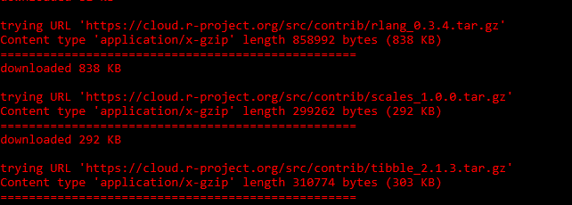
Run the docker (classify unseed data)
Run command line tool (as admin)
Navigate to the folder where the repository was cloned cd <path_to_git_repo>/twitter_sentiment_analysis _
Build the docker (will take several minutes, downloading R and packages) docker build -t predict . _
Build an image
Give it a name (tag)
Path to the Dockerfile
(current location)

Slide 33
Predict an unseen utterace
Run the Docker image docker run predict "der Dummschwätzer Herr #Dobrindt gehört nicht in die #Bundesregierung sondern ins Irrenhaus #CDU #CSU"
[1] "Prediction for tweet: "der Dummschwätzer Herr #Dobrindt gehört nicht in die #Bundesregierung sondern ins Irrenhaus #CDU #CSU" - OFFENSE" _
run the image called predict
new tweet as argument
Output of our classifier

Slide 34
5. Appendix: Troubleshooting
Norton Security / Docker Settings

Slide 35

Ausnahmeregel für Firewall hinzufügen
Mit user-Admin account anmelden
Norton Security öffnen
Einstellungen wählen
Firewall Einstellungen öffnen

Slide 36


Ausnahmeregel für Firewall hinzufügen
Zum Reiter Datenverkehrregel
Regel ‚Hinzufügen‘ klicken
Zulassen → Weiter
Verbindungen zu und von anderen Computern → Weiter

Slide 37
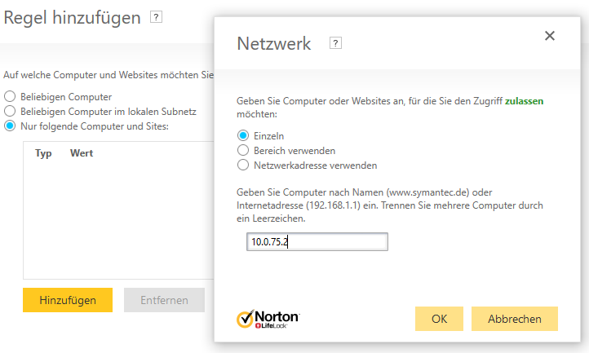
Ausnahmeregel für Firewall hinzufügen
Nur folgende Computer und Sites → Einzeln → 10.0.75.0 bis 10.0.75.2 → OK
→ Weiter → Weiter bis Dialogende

Slide 38

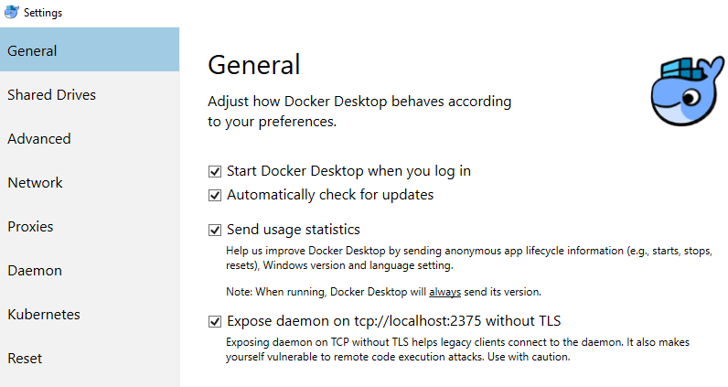
Docker Expose Daemon
Rechtklick auf Docker Desktop Icon
Settings wählen
Haken bei Expose daemon setzen

Slide 39
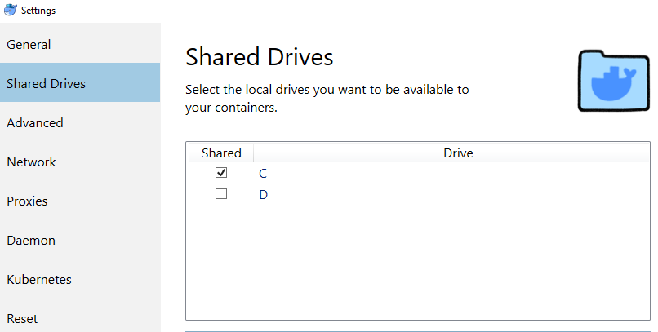
Docker Shared Drives
Rechtklick auf Docker Desktop Icon
Settings wählen
Haken bei C setzen

Slide 40
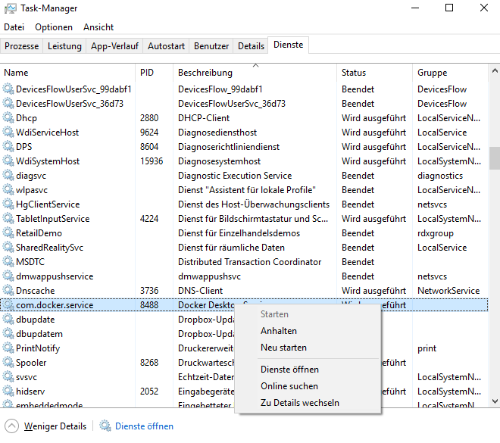
Docker Restart Service
Taskmanager als Admin ausführen
Im Reiter Dienste „Docker Desktop“
Rechstklick
Neu starten

